Slide 1
Using the Sound from a Tuning Fork to Demonstrate Heisenberg Uncertainty Principle
Phuc Tran
Brightpoint Community College

Slide 2
Heisenberg Uncertainty Principle
One cannot know precisely two complementary observables simultaneously.
$$∆a∆b≥\frac{h}{4π}$$

Slide 3
Complementary Observables
$$s\left(a\right)=\int{s\left(b\right)e^{−iab}db}$$
Time and angular frequency are complementary observables:
$$s\left(t\right)=\int{s\left(ω\right)e^{−iωt}dω}$$

Slide 4
Process
Record the sound of a 341.3-Hz tuning fork for 1.024s @ 1kHz: $\hat{s}(t)$
Multiply the signal with a window function of various sizes: $s\left(t\right)=W(t)\hat{s}(t)$
Rectangular window
Gaussian window
$$s\left(ω\right)=\frac{1}{T}\int{s\left(t\right)e^{iωt}dt}$$
Get the frequency spectrum of the resulting signal:

Slide 5
Discrete Fourier Transform
Signal duration: T = 1.024s
$$s\left(ω\right)=\frac{1}{T}\int{s\left(t\right)e^{iωt}dt}$$
$$t_{n}=\frac{nT}{1024} n=0, 1,2 …,1023$$
$$ω_{m}=2πf_{m}=\left(\frac{2π}{T}\right)m m=0, 1,2 …,512$$
$$s\left(f_{m}\right)=\frac{1}{1024}\sum_{n=0}^{1023}{s(t_{n})}e^{\frac{i\left(2π\right)nm}{1024}}$$

Slide 6
Tasks
Students don’t know about Fourier analysis, so will be provided with the software.
Software will take an input signal and multiply it with a window function then calculate
the spectrum of the signal.
Students’ tasks are to collect the sound from a tuning fork and to analyze its spectrum
for various window sizes.

Slide 7
Spectrum of 341.3-Hz Tuning Fork
341.3Hz corresponds to f_{m} with m = 349.5
m = 349

Slide 8
Square W =128
$$W\left(n\right)$$
$$\hat{s}\left(n\right)$$
FWHM = 9.5
$$s\left(n\right)$$
Δt = window size
Δf = FWHM

Slide 9
Square W = 64
FWHM = 19

Slide 10
Square W = 32
FWHM = 38

Slide 11
Square W = 16
FWHM = 71

Slide 12
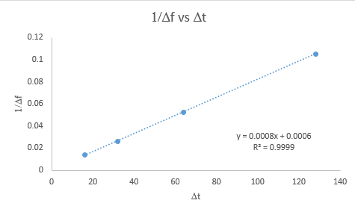
$$\frac{1}{∆f} vs ∆t$$

Slide 13
Gaussian Window
$$W\left(n\right)=\exp\left[−\frac{{\left(n−512\right)}^{2}}{w^{2}}\right]$$
$$n=0, 1, 2…1023$$

Slide 14
Gaussian W = 128
FWHM = 4.5

Slide 15
Gaussian W = 64
FWHM = 8.5

Slide 16
Gaussian W = 32
FWHM = 17

Slide 17
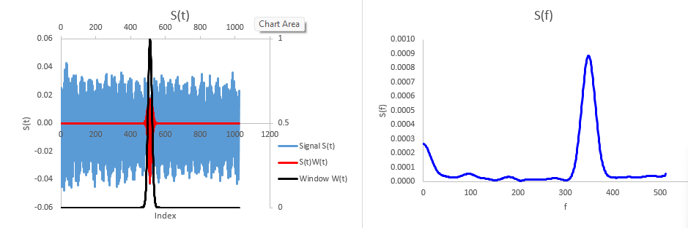
Gaussian W = 16
FWHM = 34

Slide 18
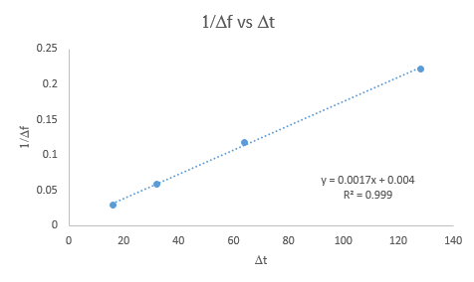
$$\frac{1}{∆f} vs ∆t$$

