Slide 1
Improving an Asynchronous Online Physics Course
Tim Jones, Craven Community College
October 19th, 2024
North Carolina and Chesapeake Joint AAPT Chapter Meeting at Jefferson National Labs

Slide 2
Agenda
Examples of Challenges
Organizational Rubric
Learning Management System ideas
Useful external tools and software
Combating cheating in online tests
Other ideas
Unimplemented ideas
Sources

Slide 3
Challenges
Implementing interactive activities (such as peer review) between students
Easy student input of math in a quickly gradable form
Overpriced lab kits
Forums which are either transactional, off topic, or unwieldy to grade
Students will be collaborating with each other and chatGPT, whether you want them to or not

Slide 4
Organizational rubric –(from Quality Matters)
Review standards from Quality Matters are available
NC community college faculty can get a faculty stipend for a program implementing the standards in an online course
Has some flexibility, but is still a rubric evaluating your course
Stopped having questions from students about how the course worked
Quality matters Review Standards
Course overview and introduction
Where to start, what are the requirements, introductions
Learning objectives
Assessment and measurement
Instructional Materials
Learning activities and learner interaction
Course technology
Learner support
Links to school’s technical support, accessibility and accommodation policies, academic support services, and other institutional resources
Accessibility and usability

Slide 5
Learning Management System (LMS) ideas
It is possible to add functionality to Moodle by searching through plugins (many are free):
https://moodle.org/plugins/
For example, the “formula” and “freehand (ETH)” plugins can be useful
Inserting a python shell into your LMS using trinket.io can be handy

Slide 6
External tools and software
Tracker: https://physlets.org/tracker/
Noragulfa tools (by Geoff Nunes):
Nplot: https://noragulfa.com/nPlot/
Sigmund video analysis: https://noragulfa.com/sigmund/
A free particle (by Michael Freeman): https://sites.google.com/view/afreeparticle/interactives
Perusall:
https://www.perusall.com/
Using OER books (except openstax) with Perusall is free

Slide 7
Combating cheating in online tests
Change multiple things at once
Require lockdown browser with webcam
Include short answer questions mixed with randomized numerical questions
Don’t allow students to browse through all questions, have them work on a randomized subset of the questions
Include similar questions (to others or past questions) with small changes
Grades on test questions went down by about 10 percentage points as a result

Slide 8
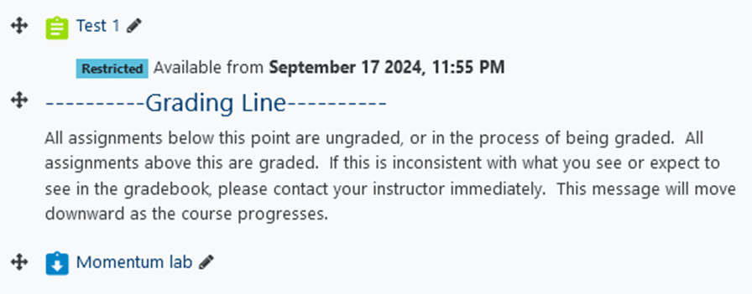
Other ideas
Ask more sketching-related questions to better evaluate root understanding
Grade by the argument of the question rather than the answer
Grading line:

Slide 9
Unimplemented ideas
Weighting questions in a test based on the number of students getting the question correct (more students getting correct the less it’s worth down to a minimum value)
Former colleague math teacher (Ben Doremus) did this, which removed the typical bimodal grade distribution
Worked well in conjunction with standards based grading
All grades were kept in an excel sheet
Gave concrete problem types for students to work on
Made grade report comments and parent conferences easy and objective
Asking questions which aren’t questions (context-dependent statements)
Using H5P
Branching scenario using video, powerpoint, images, or text. Branching controlled by multiple choice questions (similar to “interactive video vignettes” in Compadre)

Slide 10
Sources
Item | Source
Quality Matters higher education rubric | https://www.qualitymatters.org/sites/default/files/PDFs/StandardsfromtheQMHigherEducationRubric.pdf
Moodle formula plugin documentation | https://dynamiccourseware.org/course/index.php
Moodle freehand (ETH) plugin | https://moodle.org/plugins/qtype_drawing
Trinket | trinket.io
Tracker | https://physlets.org/tracker/
Noragulfa nplot | https://noragulfa.com/nPlot/
Noragulfa video analysis | https://noragulfa.com/sigmund/
A free particle (desmos simulations) | https://sites.google.com/view/afreeparticle/interactives
Perusall (commenting on texts) | https://www.perusall.com/
Learning to Think like a Physicist: A Review of Research-based Instructional Strategies (source talks about diagrams helping physics understanding) | American Journal of Physics 59, 891 (1991); doi: 10.1119/1.16667
Weighting questions by difficulty | Discussions with Ben Doremus in 2016
Asking questions which aren’t questions | From 2023 OPTYCs NFDS workshop sessions led by Dwain and Angela
H5P branching scenario | https://h5p.org/branching-scenario
Interactive Video Vignettes | https://www.compadre.org/ivv/

