Slide 1
QuarkNet
Particle Physics in the High School Classroom
Exploring the Data Activities Portfolio
Rebecca Jaronski
Lead Teacher, Virginia Tech QuarkNet Center
QuarkNet Neutrino Fellow
Physics and Astronomy Teacher, MCPS VA

Slide 2
QuarkNet: The Data Activities Portfolio (DAP)
accessible and free to use for ALL, not just teachers affiliated with QuarkNet
40+ lessons, with background info and student activity sheets!
QuarkNet website: www.quarknet.org and select “Data Activities Portfolio” from the menu at the top!
Bookmark it: https://quarknet.org/data-portfolio

Slide 3
Description of the DAP, from the DAP:
The Data Portfolio is a compendium of particle physics classroom activities organized by:
Data Strand
Level of student engagement (0 - 4)
Curriculum Topics
NGSS Standards
While each level can be explored individually, students who start in one level and progress to more complex levels experience increasingly engaging and challenging tasks.
Each Curriculum Topic provides connections between topics routinely covered in physics class and particle physics content and methods. Use the menus to find activities related to the content you are currently covering.
We are making Spanish Language versions of the activities. To find the activities with Spanish versions, use the Curriculum Topics menu, scroll to the bottom, select Spanish Language.

Slide 4
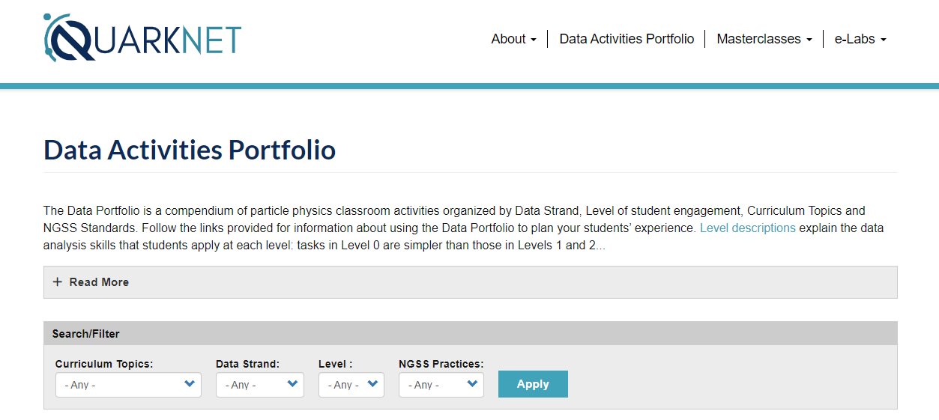

Slide 5
Search for Activities using this menu!

Slide 6
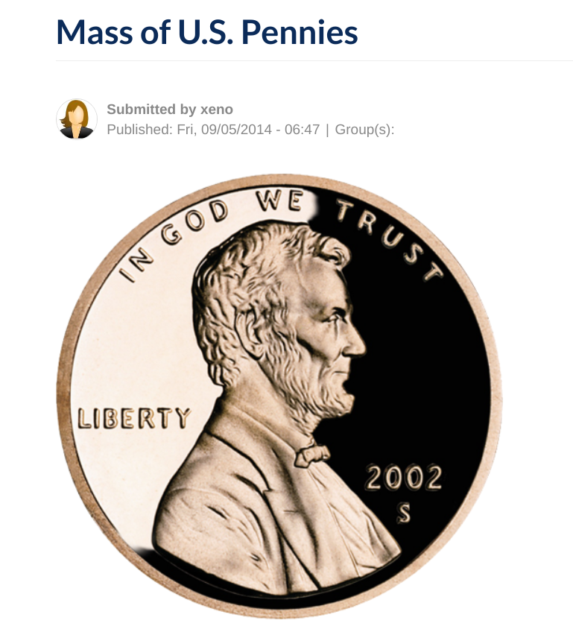
DAP Example: Mass of US Pennies
Click on any activity, and you will be linked with background material, teacher notes, student pages, and other useful resources that are largely ready-to-go!
Notes:
I choose this activity for my students as the materials are readily available: electronic scale, big jar of coins, and Google Sheets is all I need for the students to gain some amazing insight into data collection and analysis techniques.

Slide 7
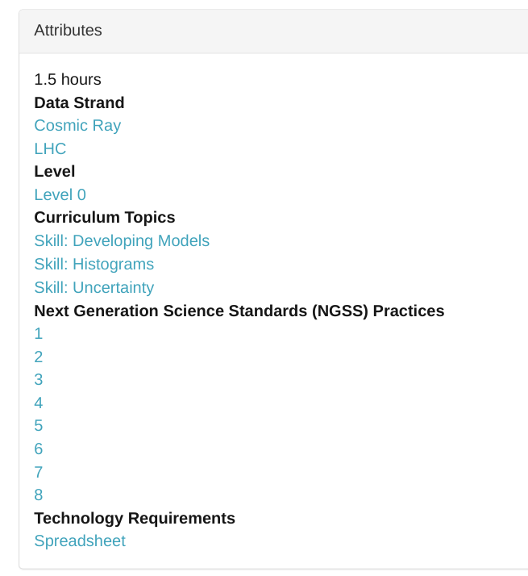
Mass of US Pennies
Search/Filter Categories that will return the Penny Mass Activity:

Slide 8
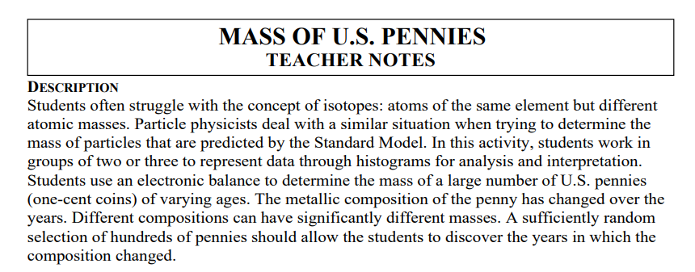
Penny Mass: Teacher Notes
Notes:
Teacher Notes slides: very quick summary (do NOT spend any time on these teacher notes slides!!), point out that ALL DAP activities have teacher notes, which help with understanding the science background, and preparing teachers for the expected student results and possible misconceptions. Of course, best practice is to try it for yourself first!

Slide 9
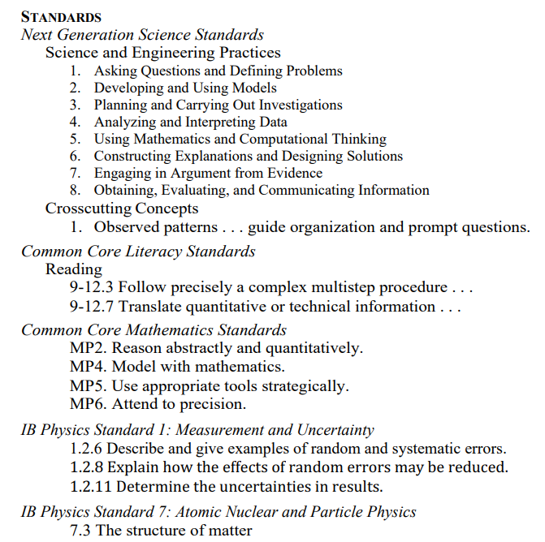
Pennies, continued
STANDARDS
(From the Teacher Notes)
-Useful if you need to add to your lesson plans, etc!

Slide 10
Pennies, continued (from the Teacher Notes)

Slide 11
Pennies, Background Material (from the Teacher Notes)

Slide 12
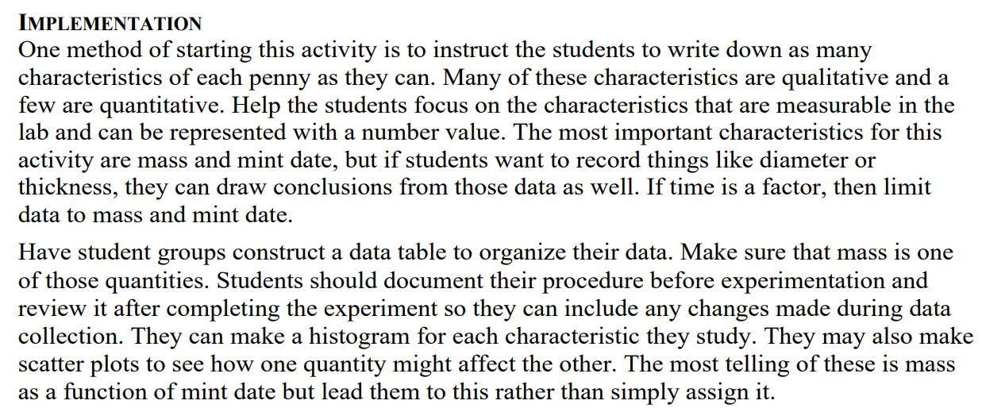
Pennies, Implementation (from the Teacher Notes)

Slide 13
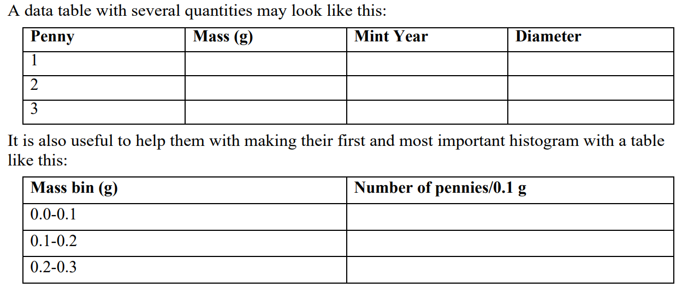
Pennies, Implementation (from Teacher Notes)

Slide 14
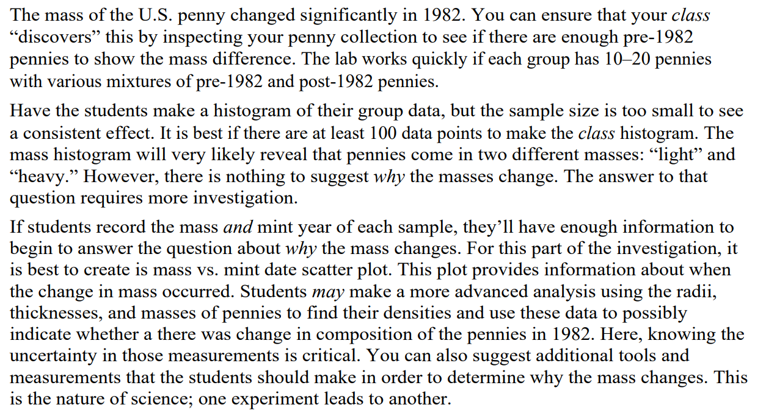
Pennies, Background/Results (from Teacher Notes)

Slide 15
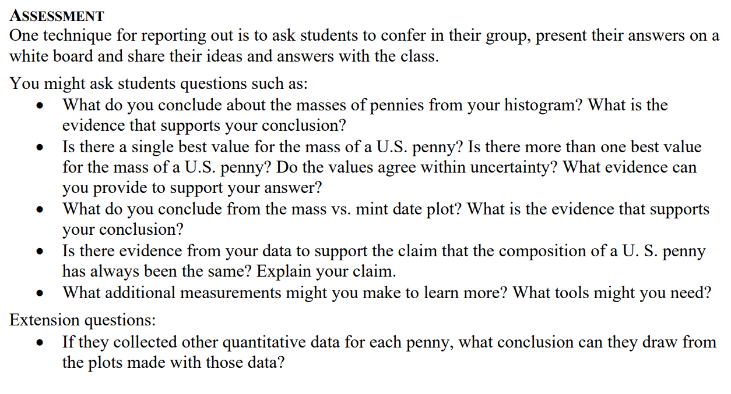
Pennies, Assessment (from Teacher Notes)

Slide 16
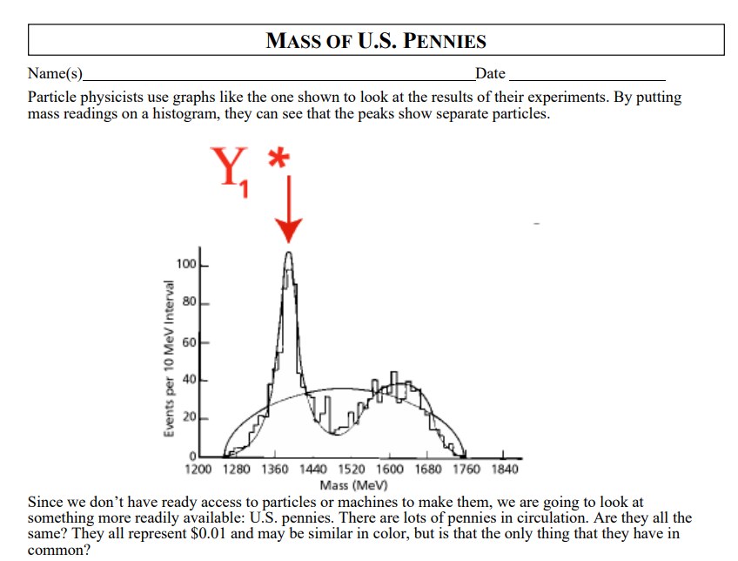
Pennies, Student Pages

Slide 17
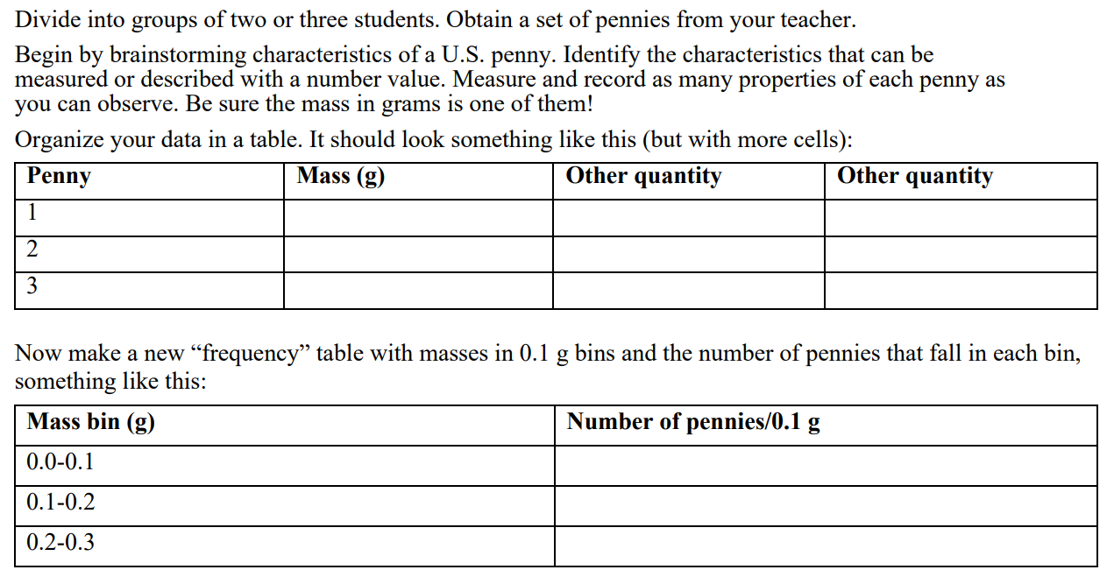
Pennies, Student Pages

Slide 18
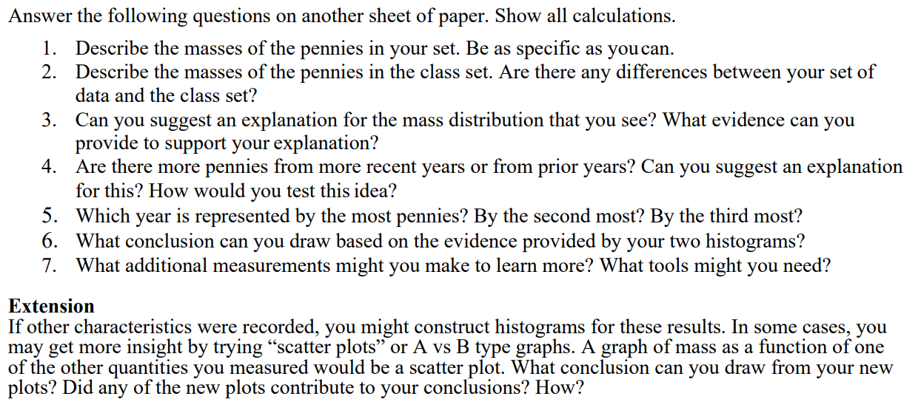
Pennies, Student Pages

Slide 19
Penny Mass: Implementation in MY Class
As you can see, this activity is essentially ready-to-go for some classes!
Format is very student inquiry-based
Some instructors may need to adjust the materials to suit their needs or their class
Student/Instructional Level
Differentiation
District Required Lesson Plan formats, etc
For my own classes, I have found that more explicit procedures are useful (introductory physics, algebra based, and I implement this activity early in the course)
All DAP activities can be modified and leveled up and down, rewritten for virtual instruction, and more- but it is so useful to have a place to start!

Slide 20
Penny Mass: Implementation in MY Class
I teach a short and ‘simple’ particle physics unit at the beginning of my course
This is the first lab, to introduce the data analysis concepts required for particle physics experiments
For my classroom, I have expanded the given materials into a more formal lab assignment, with an explicit procedure and conclusion questions that draw connections to real particle physics data
I also mixed a few nickels, dimes, quarters, and Canadian coinage into the sample to provide an extra challenge: ‘noise’

Slide 21
Penny Mass: Implementation in MY Class
Student Directions
Procedure:
Open your copy of the Google Sheet for taking your data.
Use the scale to find the mass, to the hundredth of a gram, of each coin.
Record in your data table: the mass, the year the coin was minted, and also the condition of the coin (this last is a more subjective measure, of course).
Use 1= Good, 2= Fair, 3= Poor for Coin Quality.
Once you have recorded the mass of at least 100 coins, you can begin data analysis!

Slide 22
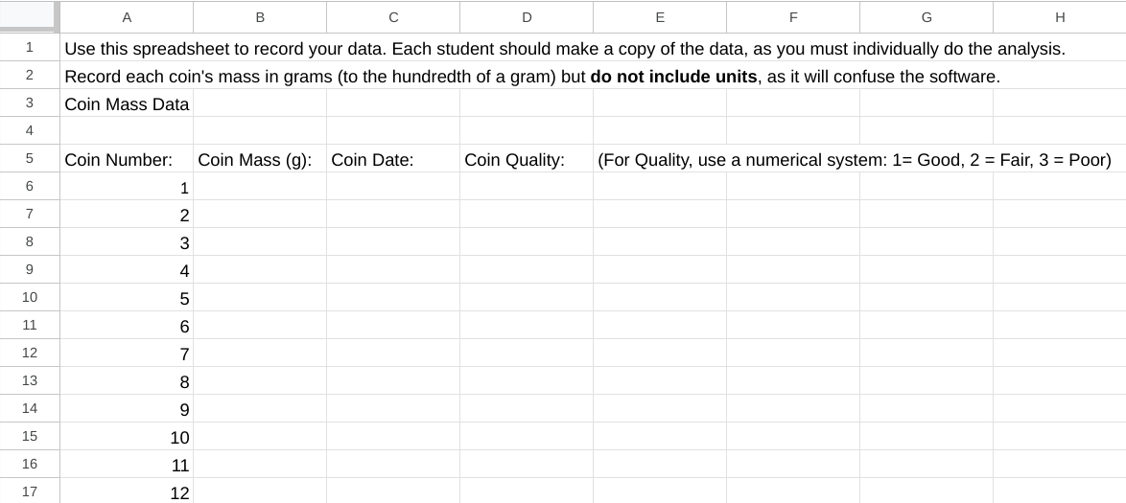
Example: Penny Mass Google Sheet

Slide 23
Penny Mass: Implementation in MY Class
In my class, the experimental procedure is more structured (I tell them WHAT data to take, HOW and WHERE to take it)
This allows me to better guide their analysis to ensure they can take-away the skills and understandings that will help them most in my class
Students make histograms and scatter plots of their data
For each, they must interpret their results
They also need to explain the uses of each type of plot!
Using Google Sheets to do this helps them to develop computer skills they will NEED!
They pool their results into a class data set
We make a class totals histogram so students can better visualize how more data leads to increased statistical significance

Slide 24
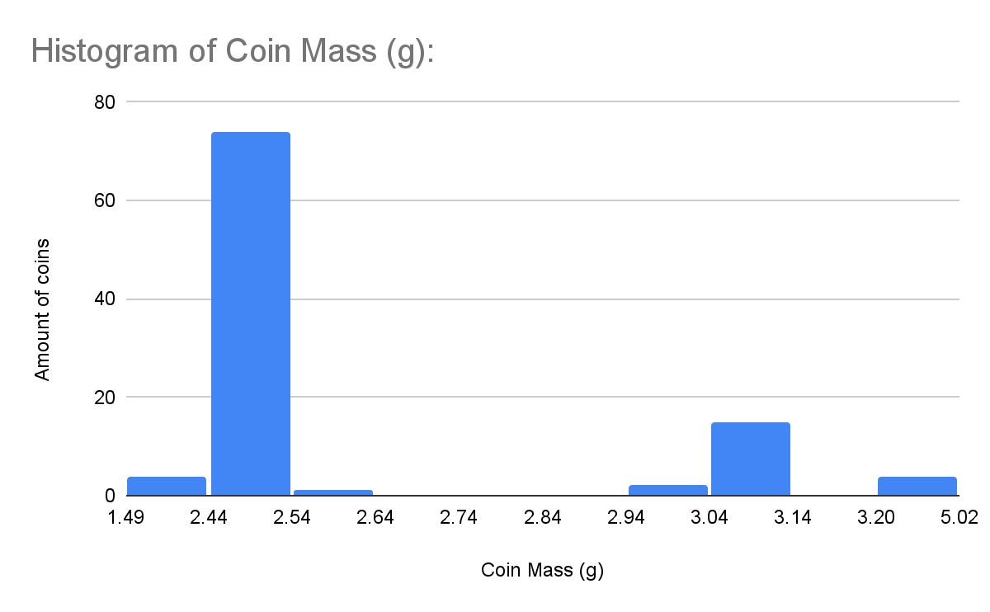
Sample Student Work: Histogram of Coin Mass

Slide 25
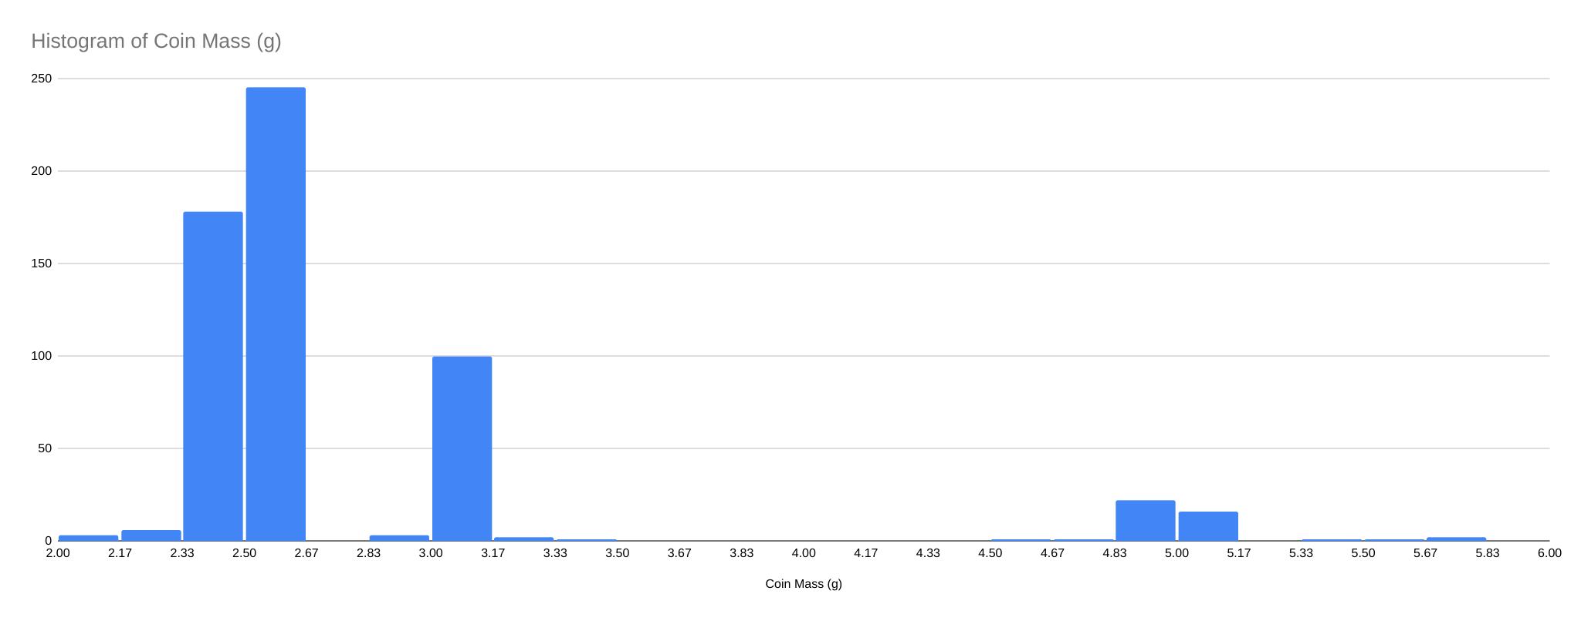
Class Histogram: Mass of US Pennies
Notes:
Students were asked to compare their histograms with the class histograms to better gain an understanding of statistical significance and ‘5 sigma’

Slide 26
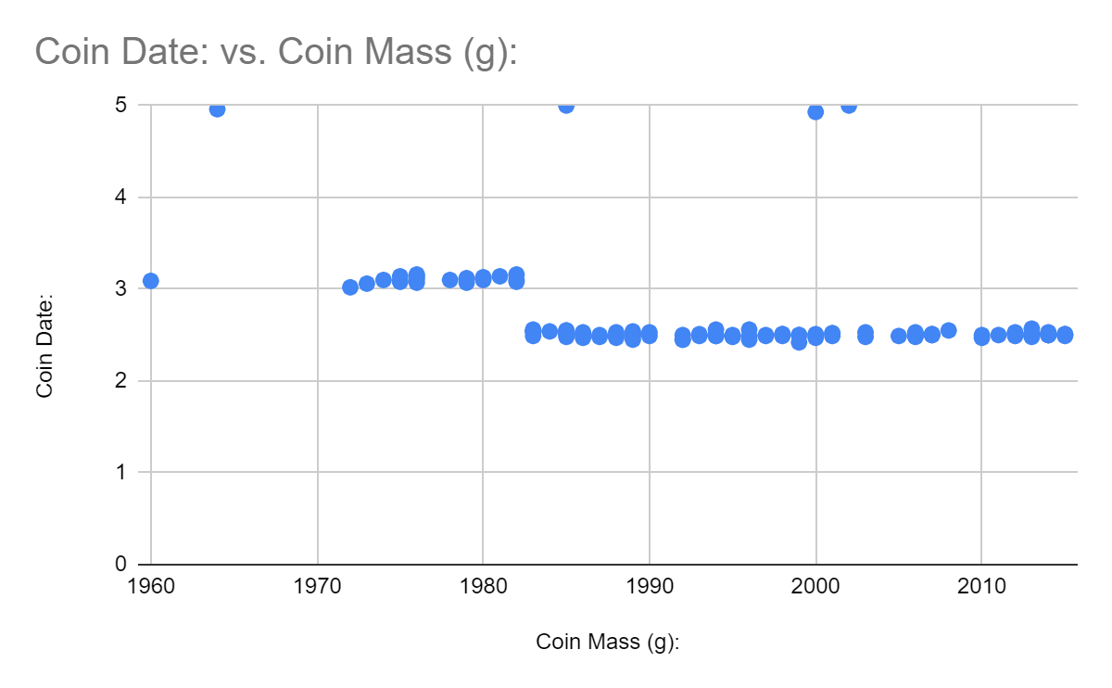
Sample Student Work: Mass of US Pennies
Notes:
Students can easily see that in the early 80s…the penny mass changed!

Slide 27
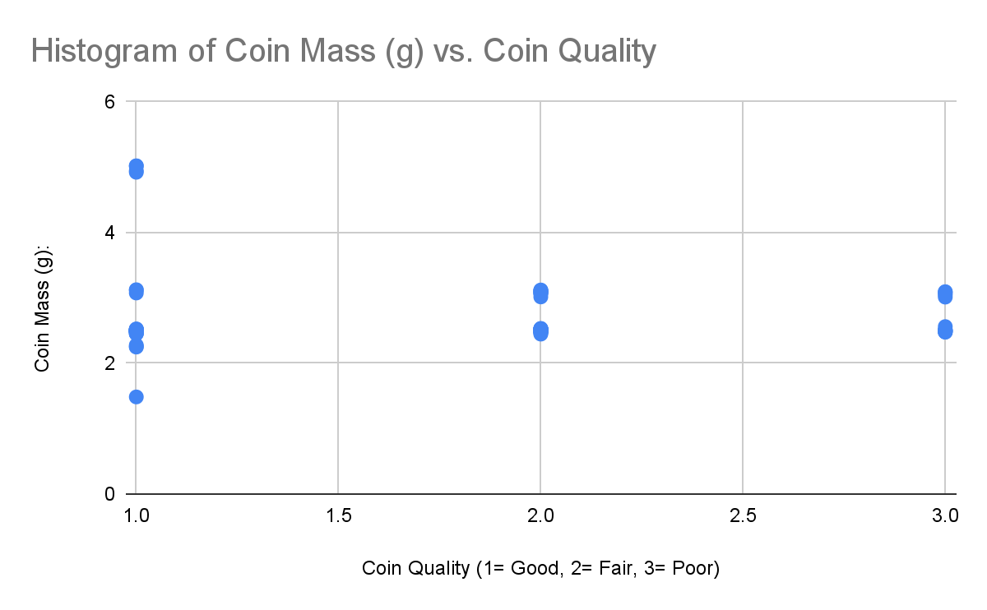
Sample Student Work: Mass of US Pennies
Notes:
Not every pair of measured quantities will have a correlation!

Slide 28
Penny Mass Histogram vs CMS Data Histogram
Image Credit: QuarkNet BAMC (Big Analysis of Muons) Lecture, Spring 2020.
Notes:
As an application/extension in the conclusion questions, students were asked to look at a histogram based on REAL data from CMS at CERN, and be able to read particle masses, identify noise/background, and more!

Slide 29
Sample Student Work: Penny Mass Conclusion

Slide 30
Implementing the Data Portfolio: 2 Common Methods
Dedicated Particle Physics Unit
Some QuarkNet teachers add Particle Physics at the end of the course if time allows
I choose to teach a short Particle Physics unit at the beginning of the year to make sure it happens!
I can then loop concepts back to Particle Physics while teaching Mechanics the rest of the year
‘Sprinkle’ Method
Traditional Introductory Physics covers Mechanics and E&M
Those concepts have many applications in Particle Physics!
Some QuarkNet teachers select Data Portfolio activities that relate to specific concepts and use them throughout the year
Notes:
I use the dedicated unit for my introductory Physics Classes, and sprinkle method for AP/DE physics!

Slide 31
Method 1: Dedicated Particle Physics Unit
Agenda:
Day 1: Particle Card Sort, Notes Part 1, and Particle Adventure Part 1
Day 2: Particle Adventure Part 2 and Particle Reactions (Notes and Problems)
Day 3: Notes Part 3 and Particle Adventure Part 3
Day 4: The Ghost Particle
Day 5: Penny Lab Part 1
Day 6: Penny Lab Part 2
Day 7: CRMD Lab Part 1
Day 8: CRMD Lab Part 2
Day 9: Review and Particle Physics Bingo!
Day 10: Test
Objectives:
Students will be able to.....
describe the Standard Model of Particle Physics
identify and classify fundamental particles according to the Standard Model
balance particle reactions
conduct a particle physics-type experiment
collect and analyze experimental particle data
Success Criteria:
In order to show mastery, students will...
define leptons, quarks, hadrons, bosons.
use conservation laws to determine allowed particle reactions
design an experiment to measure muon data
create histograms to analyze large data sets

Slide 32
Method 2: ‘Sprinkle’ the DAP into your curriculum
For this method, teach your course as usual, but if you are looking for new resources, labs, or extension assignments check out the DAP!
For Nature of Science
Multiple Activities use authentic data and focus on graphing skills, building models, experimental design, asking questions, and other basic science skills…..particle physics background is not required
For Kinematics
Several Activities use kinematics concepts such as relating speed, distance, and time
Conservation Laws
Conservation of energy and linear momentum are common themes in DAP activities
Electricity and Magnetism
Units: definition of the electronvolt
QED vs Field theory
charges of particles and charge conservation
Best Use of DAP: E&M applied in Accelerator and Detector science!

Slide 33
Sample Assignment: Mass of Z Boson
Data Portfolio Activity: Calculate the Z Mass
Assigned at the end of a unit on Momentum and Collisions
Involves concepts including graphical vector analysis (adding non-perpendicular vectors), conservation of energy and momentum, dimensional analysis, and more!

Slide 34
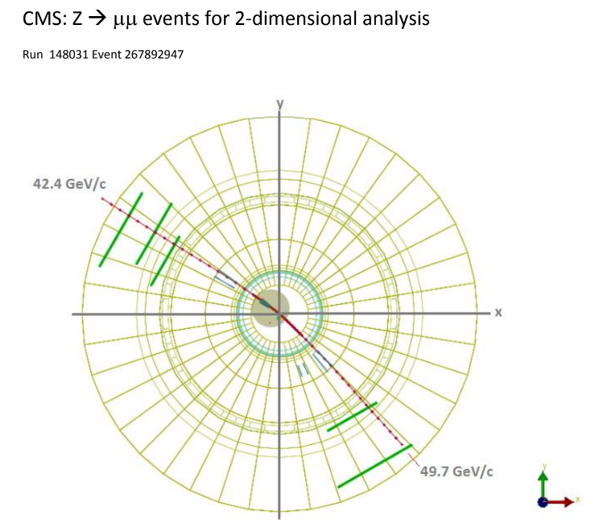
Sample Data: Mass of Z Boson

Slide 35
Samples of Student Work: Mass of a Z Boson

Slide 36
Sample assignment: Mapping the Poles
Need a lab to either introduce, or have students apply, the right hand rule?
Notes:
This is a great introductory activity for the magnetic field, Kids will be using magnets and compasses, applying the right hand rule, and figuring out how the beam at the LHC is directed and focused!

Slide 37
Sample DAP Assignment: Mapping the Poles

Slide 39
Mapping the Poles: Dipole Analysis Questions

Slide 43
Mapping the Poles, RHR Analysis and Application

Slide 47
Claim, Evidence, Reasoning: Mapping the Poles

Slide 48
Conclusion: Data Portfolio = Awesome!
Need a new lab? Find it here!
Scale it up and down! You could find inspiration from middle school to collegiate levels
Easy search filters!
More activities are always being added, as well as variations (virtual compatibility, spanish language, and more)
Wide application of concepts- and MINIMAL laboratory equipment needed-it’s cheap!
All activities in the Data Portfolio are inquiry based, involve Claim-Evidence-Reasoning process, and connect many concepts!
Try it out! See What YOU Find!

Slide 49
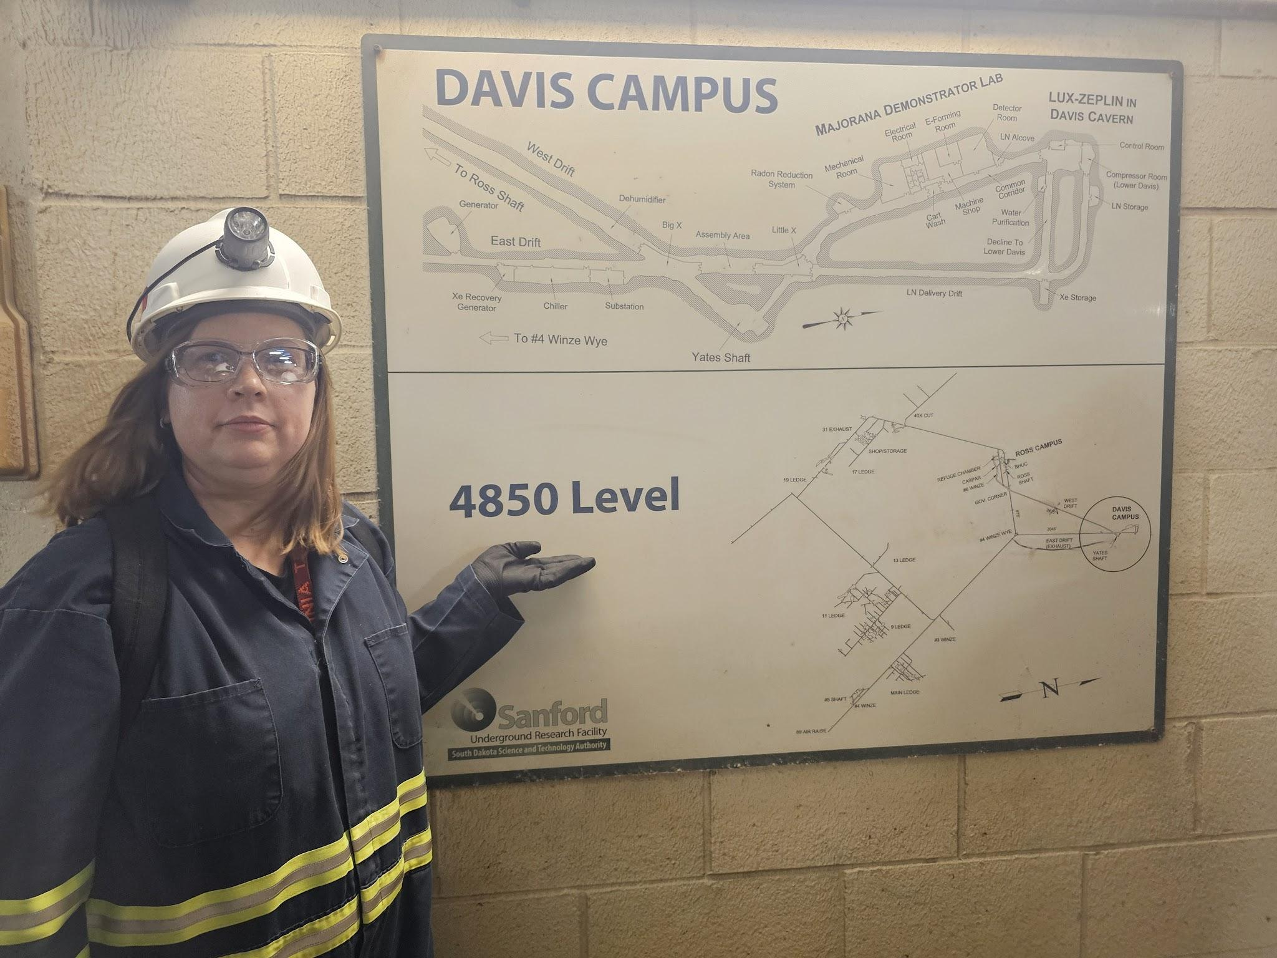
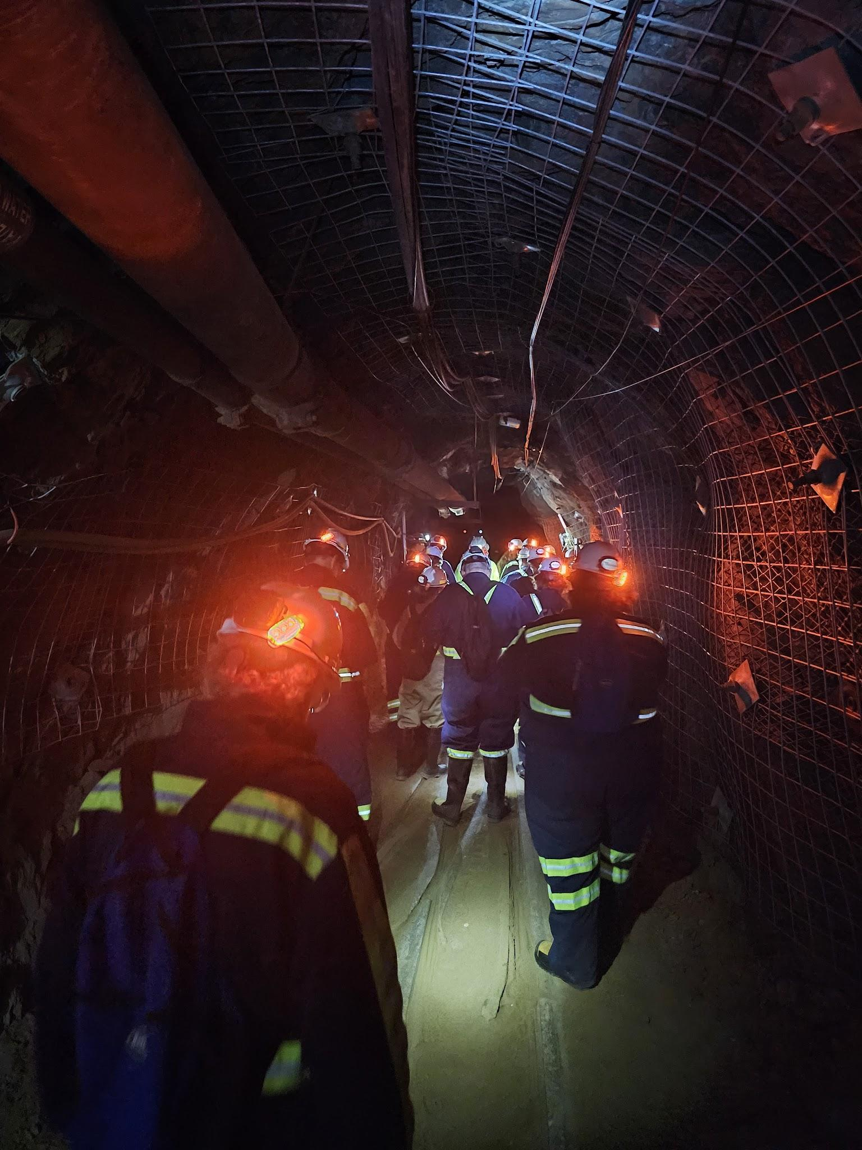
VT QuarkNet is looking for more teachers!
If you are a high school science teacher (or know one) from Virginia, West Virginia, North Carolina that is interested, please contact me:
rebeccajaronski@mcps.org
We offer workshops every summer (stipend and travel support included!)
We can also sponsor a trip to Fermilab’s Data Camp
Thank you very much!
ANY QUESTIONS?
Images taken during 2024 QuarkNet Lead Teacher Camp at SURF!

