Slide 1
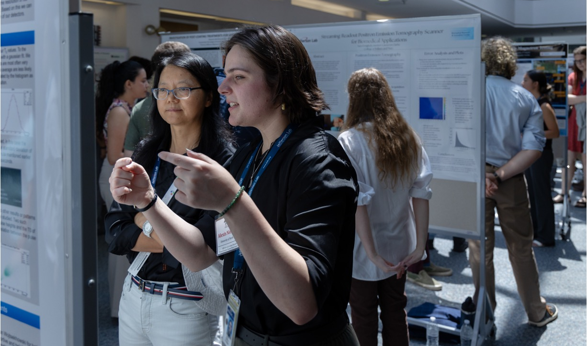
Workforce & Community Impact Through STEM Initiatives
Jalyn Dio, Science Education Administrator
Lisa Surles-Law, Science Education Manager

Slide 2
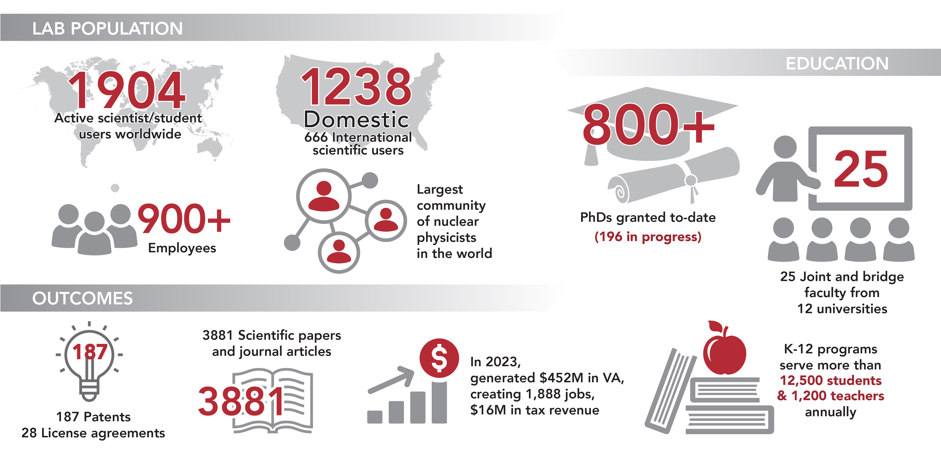
Jefferson Lab By The Numbers
2
Notes:
This infographic captures a number of Jefferson Lab's vital statistics and outcomes that demonstrate our impacts and outcomes, in science, technology and innovation, education, and the economy.

Slide 3
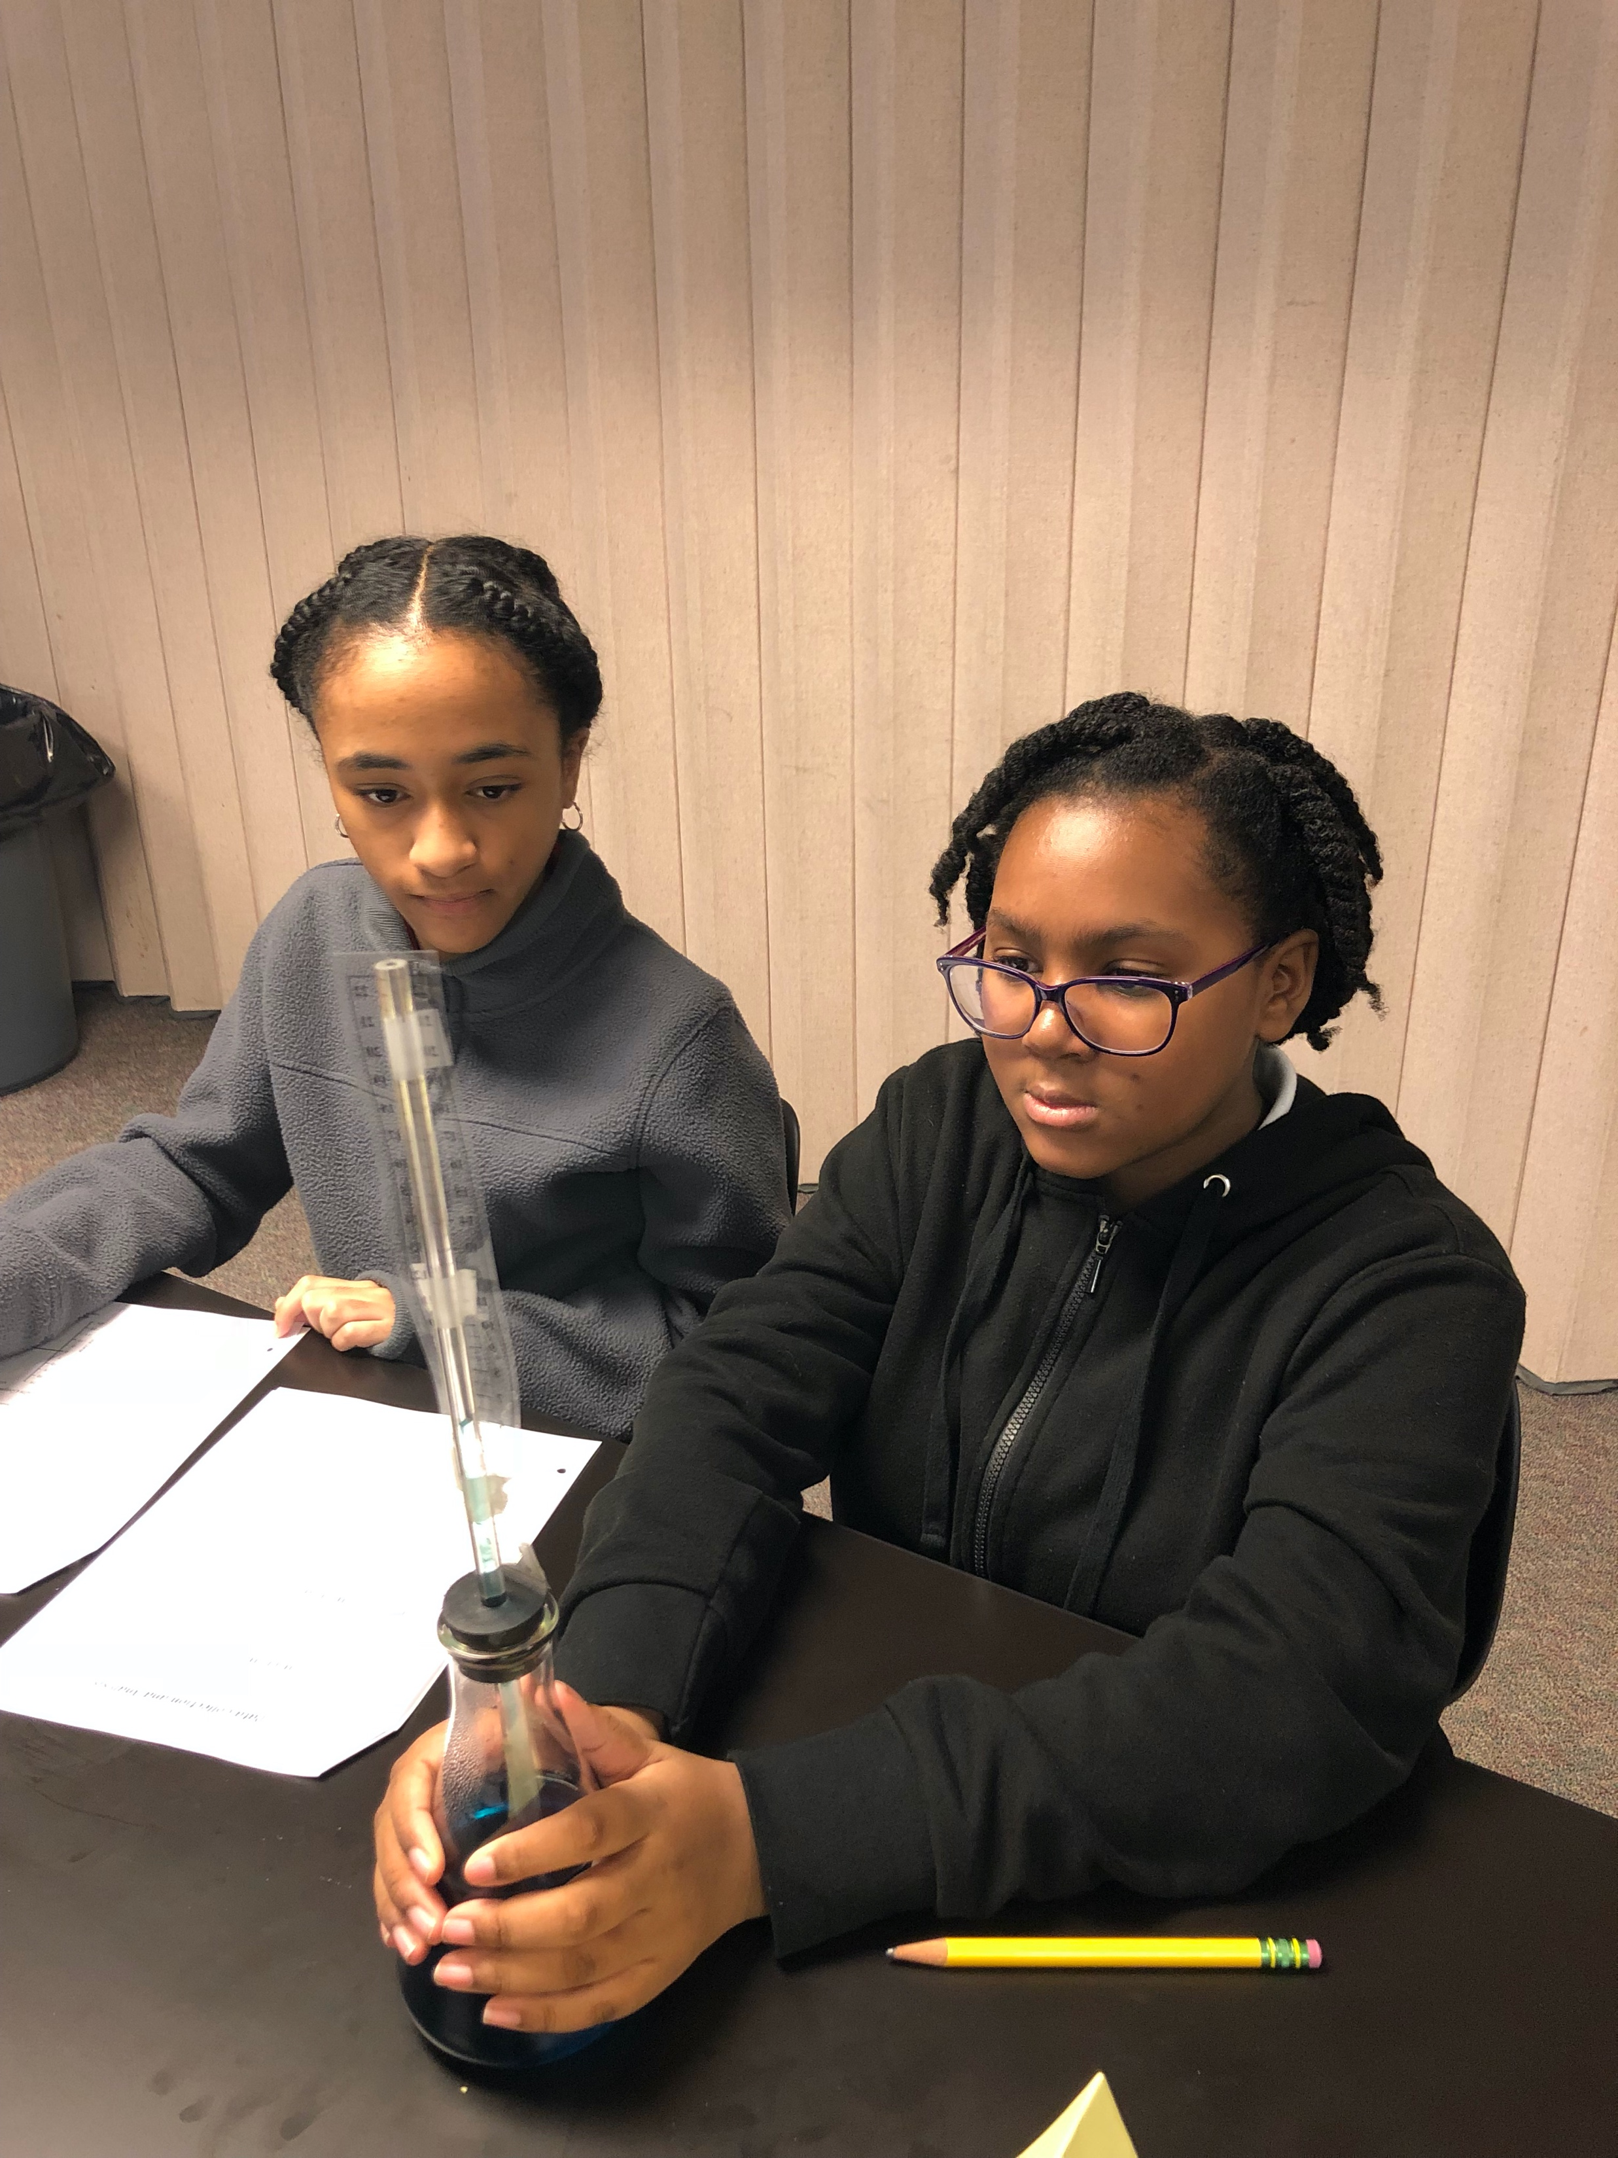
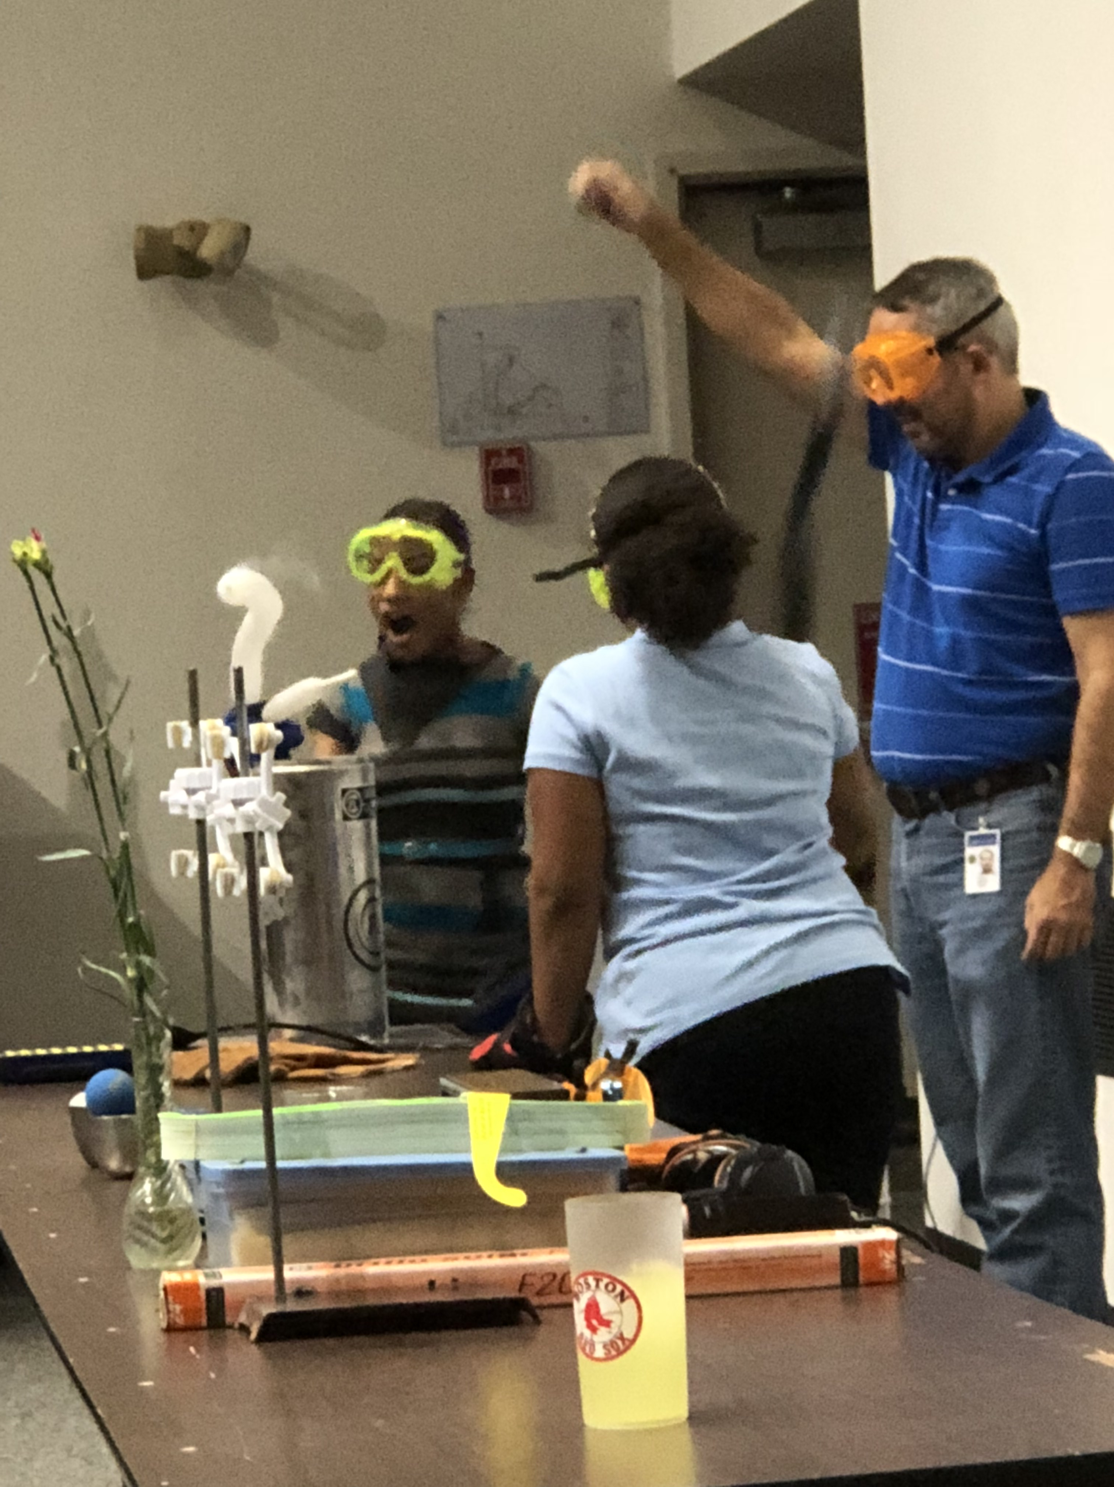
Science Education – Outreach Pathways
Develop local and state partnerships to advance STEM education
Improve the quality of K-12 instruction by enhancing teachers’ content knowledge
Immerse graduate, undergraduate, and high school students in a world-class facility research environment to prepare the nation’s next generation of leaders
Notes:
RB Our articulated goals that should be evident through our program portfolio
Vision Statement…
As a world-class research facility, Jefferson Lab is a valued partner to the local, regional, and national education community. Jefferson Lab's long-term commitment to science education continues to focus on increasing the number of teachers with a substantial background in math and science, strengthening the motivation and preparation of all students and addressing the serious underrepresentation of minorities and females in science, math, engineering and technology careers.

Slide 4
Science Education Pathways
As a world-class research facility, TJNAF is a valued partner to the local, regional, and national education community. Jefferson Lab's long-term commitment to science education continues to focus on:
increasing the number of teachers with a substantial background in math and science,
strengthening the motivation and preparation of all students,
addressing underrepresentation of minorities and females in STEM careers
STEM Educator Professional Development
JLab Science Activities for Teachers (JSAT)
Grades 5, 6, and 8
Region II Annual Teacher Night
Annually serves >940 teachers
K-12 Programming
Becoming Enthusiastic About Math and Science (BEAMS)
High School Summer Honors Program (HSSHP)
Summer Residential Governor’s School (SRGS) in Engineering
Mentorship Program
Annually serves >13,000 students
Undergraduate Programming
Science Undergraduate Laboratory Internship (SULI)
Research Experience for Undergraduates (REU)
Community College Internship (CCI)
Mexican Physical Society (MPS)
Undergraduate Physics Research (UPR) Program
Minority/Female Undergraduate Research Assistantships (M/FURA)
Supports >55 undergraduate students/year
Graduate Research
Office of Science Graduate Student Research (SCGSR) Program
Supports >100 graduate students/year

Slide 5
Science Education Pathways
K-12
Programming
Mentorships & Internships
STEM Educator
Professional
Development
Undergraduate Programming
Summer
Engagement
Notes:
LSL: Focusing on Lab wide programs – globally relate to all of the labs

Slide 6
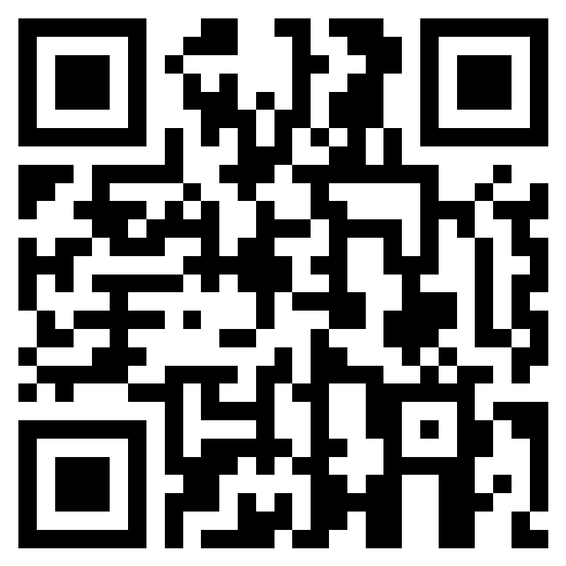
STEM Educator Professional Development
JSAT places JLab as the community leader in providing needed professional development for local teachers through SOL-based content and STEM applications during the school year.
JLab Science Activities for Teachers (JSAT)
Grades 5, 6, and 8
Region II Annual Teacher Night – Teachers from the JSAT (Jefferson Lab Science Activities for Teachers) program share science-themed classroom activities, focused on upper elementary and middle school students.
Professional development participants and attendees
Annually serves >940 teachers, impacting 28K+ students
APPLY HERE
https://education.jlab.org/jsat/
Notes:
LSL

Slide 7
JLab Science Activities for Teachers (JSAT)
Jefferson Lab Science Associates Teacher Development Initiative
5th, 6th & 8th grade cohorts
Meet twice monthly
Receive classroom equipment and supplies to conduct activities
48 teacher education recertification points
Participation stipend
APPLY HERE
https://education.jlab.org/jsat/

Slide 8
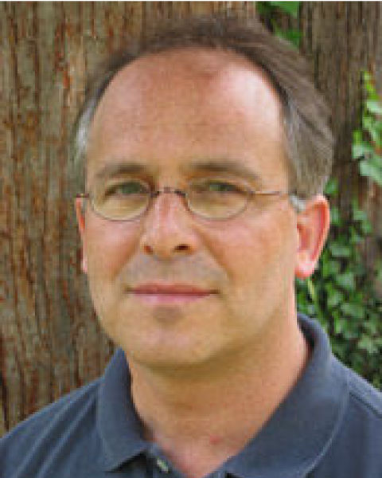
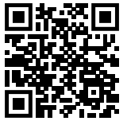
STEM Educator Professional Development
Visiting Faculty Program (VFP) is designed for full-time faculty members from institutions historically marginalized in STEM research.
Enhance research competitiveness
Innovative STEM learning that both professor and students can participate in a funded collaborative experience at a DOE lab
Offered over the summer for 10 weeks or during the fall or spring terms, with financial support for a teaching buyout
First participant, Summer 2024
APPLY HERE
https://science.osti.gov/wdts/vfp
Notes:
LSL

Slide 9
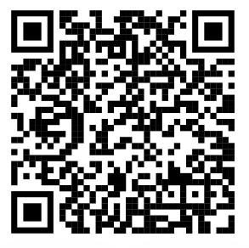
Region II Teacher Night
Teachers from the JSAT (Jefferson Lab Science Activities for Teachers) program share science-themed classroom activities, focused on upper elementary and middle school students.
REGISTER HERE:
~ April 3rd, 2025 ~
Notes:
LSL

Slide 10
Science Education Pathways
K-12
Programming
Mentorships & Internships
STEM Educator
Professional
Development
Undergraduate Programming
Summer
Engagement
Notes:
LSL

Slide 11
Elementary and Middle School Programming
Opportunities for students at surrounding schools to engage with JLab, the world of STEM and the career staff that supports it.
• School classroom activity visits
• Science Fair judges
• Career Fairs
• STEM Days
Annually serves >13,000 students
Notes:
LSL

Slide 12
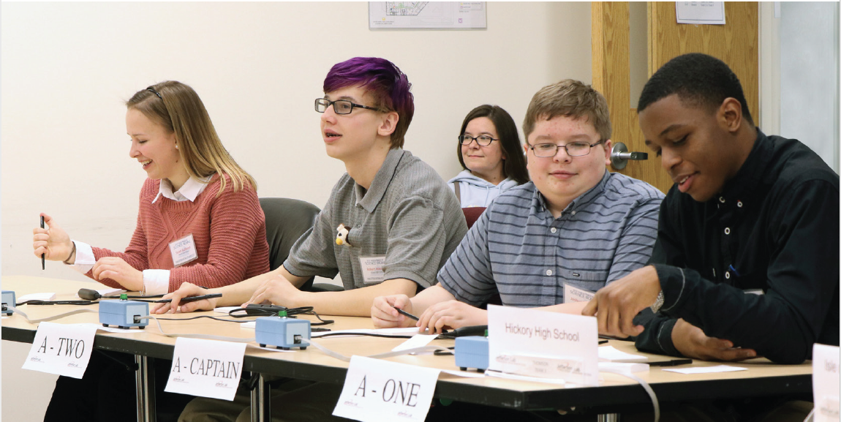
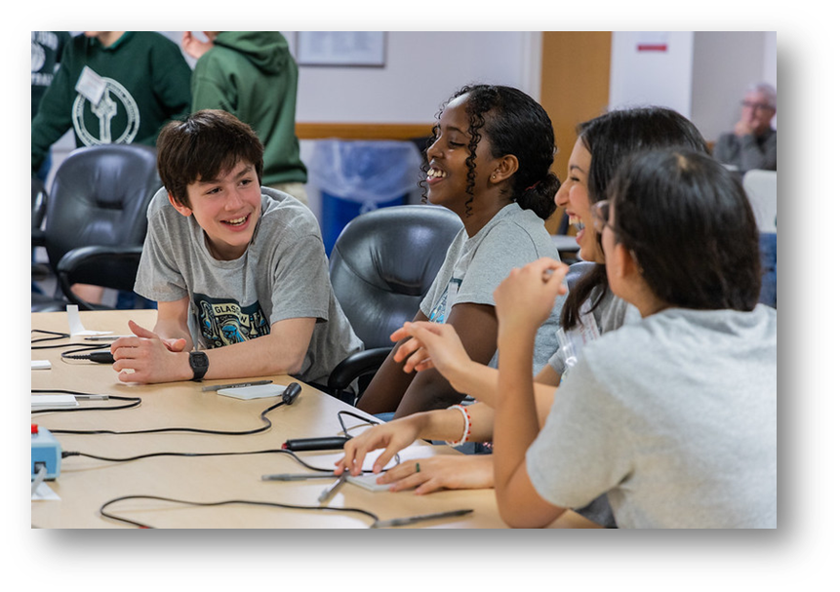
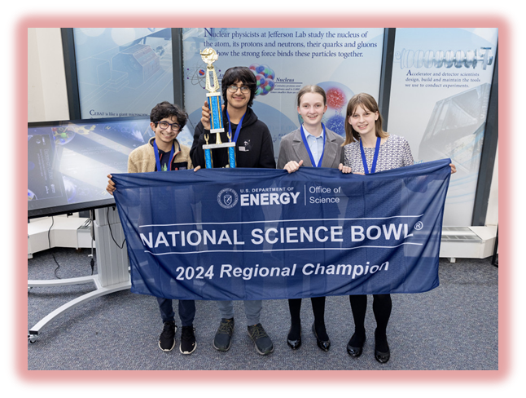
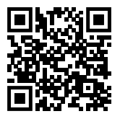
Middle and High School Virginia Regional Science Bowl
TJNAF is a regional host for the U.S. Department of Energy (DOE) National Science Bowl® middle and high school academic competition.
https://science.osti.gov/wdts/nsb
High School – February
Middle School – March
Registration begins Oct 1

Slide 13
Science Education Pathways
K-12
Programming
Mentorships & internships
STEM Educator
Professional
Development
Undergraduate Programming
Summer Engagement
Notes:
LSL

Slide 14
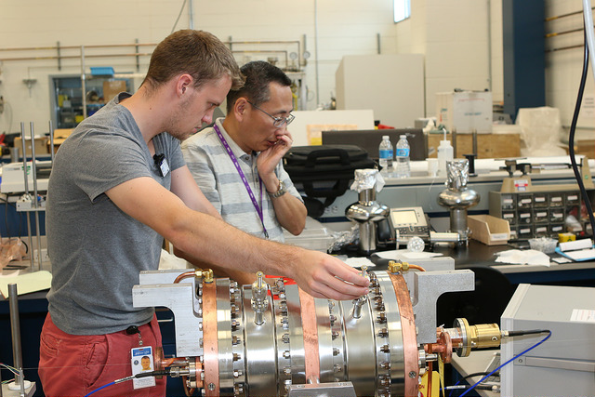
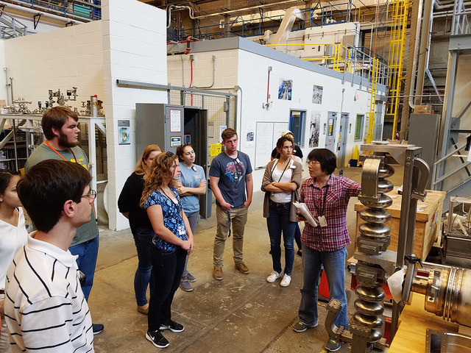
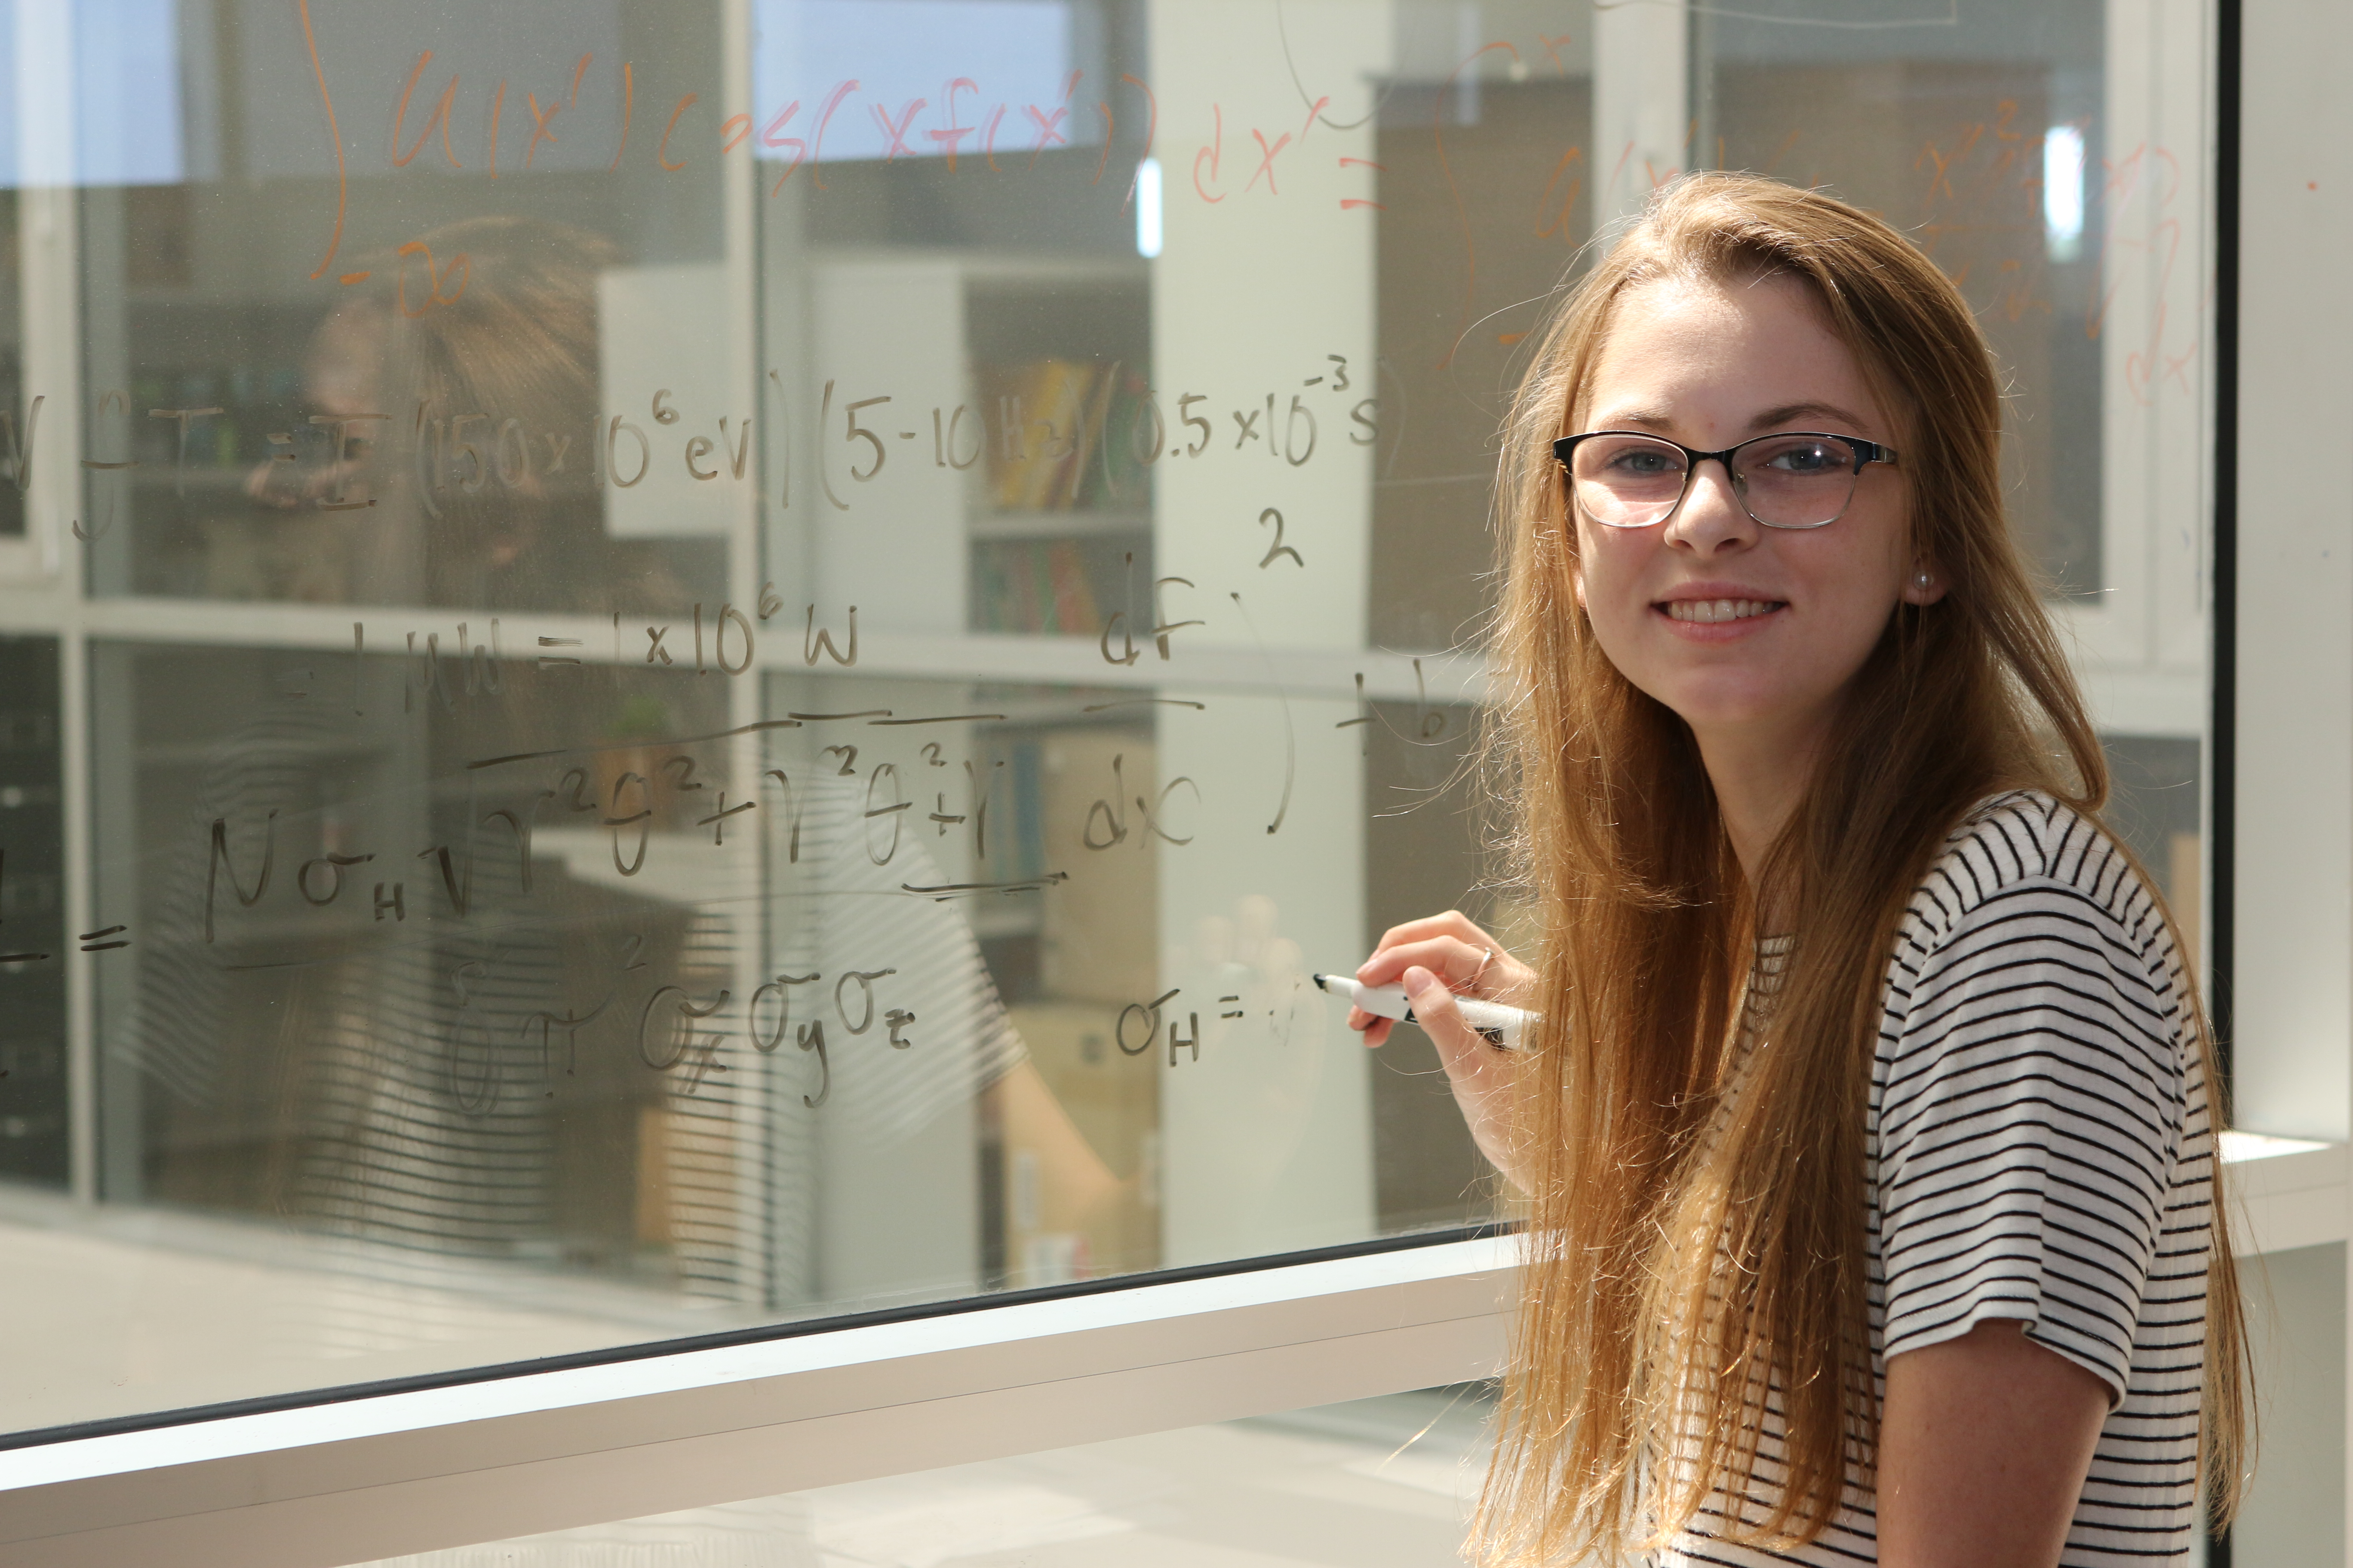
Undergraduate Programming
Science Undergraduate Laboratory Internship (SULI)
Community College Internship (CCI)
Undergraduate Physics Research (UPR) Program
Minority/Female Undergraduate Research Assistantships (M/FURA)
Supports ~50 undergraduate students annually
Notes:
LSL

Slide 15
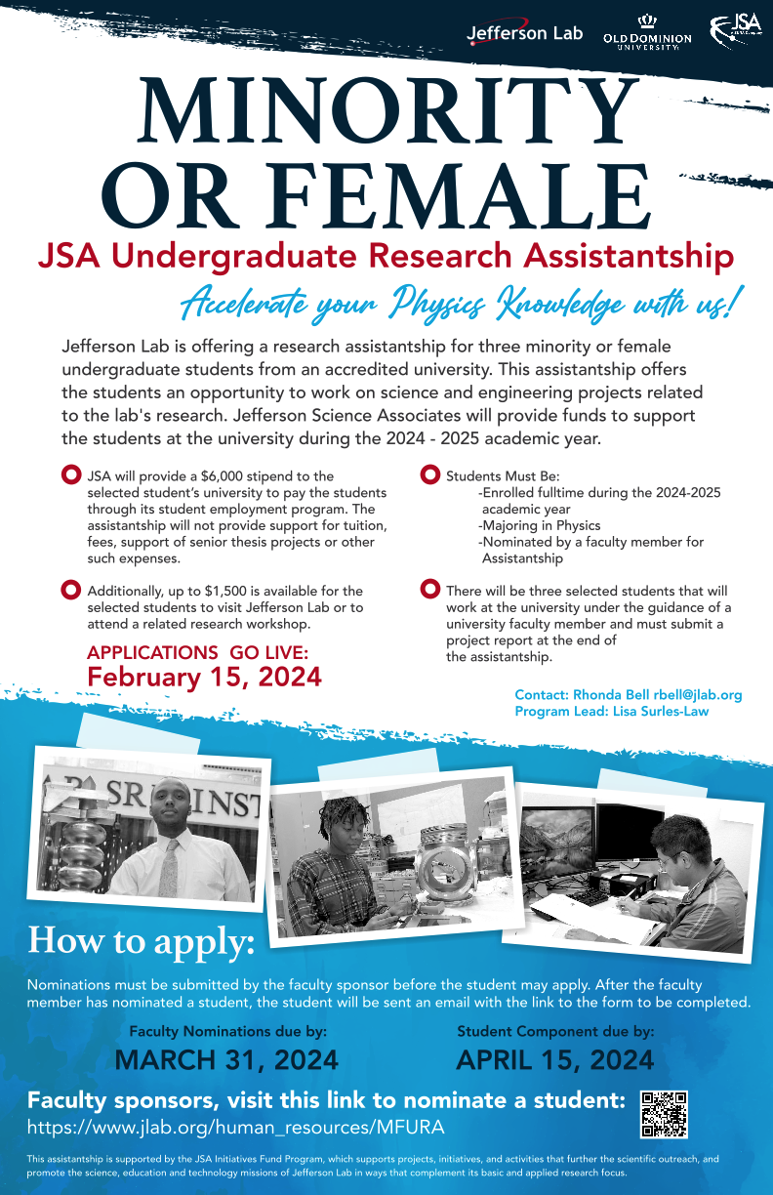
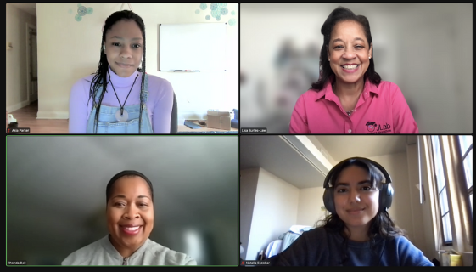
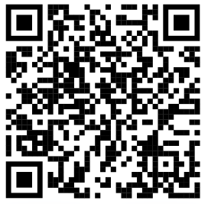
Minority/Female Undergraduate Research Assistantships (M/FURA)
Assistantships for minority or female students to work on projects, with their nominating professors, that are part of or directly related to the TJNAF’s research program.
https://www.jlab.org/human_resources/MFURA

Slide 16
Science Education Pathways
K-12
Programming
Mentorships & Internships
STEM Educator
Professional
Development
Undergraduate Programming
Summer Engagement
Notes:
LSL

Slide 17
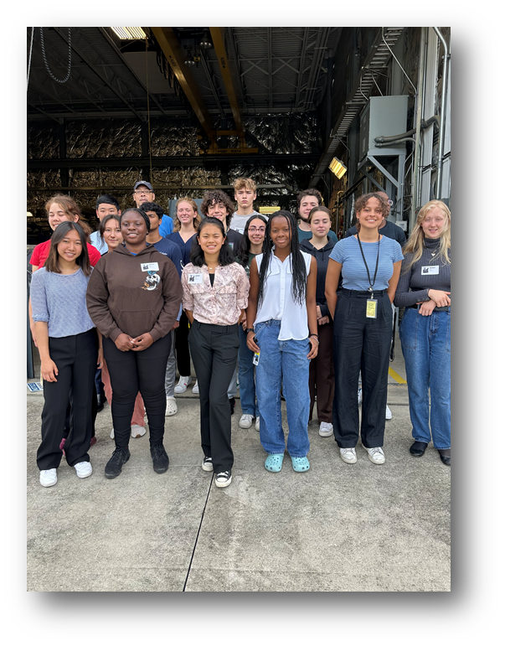
Mentorships and Internships
TJNAF staff and users encourage and prepare high school and undergraduate students to pursue advanced degrees in experimental/theoretical physics and accelerator science.
Programs by the numbers: 26 Science Undergraduate Laboratory Internship (SULI) students for FY24 10 NSF-Funded Research Experience for Undergraduates (REU) students via Old Dominion University for Summer 2024 2 Community College Internship (CCI) students for FY24 12 High School Summer Honors Program (HSSHP) students for Summer 2024 11 Summer Residential Governor’s School (SRGS) in Engineering students for Summer 2024 10 High School Mentorship students for FY24 3 MFURA Assistantship Positions 2 CNU Captains Program students
TJNAF supports ~55 undergraduate students and ~40 high school students annually.

Slide 18
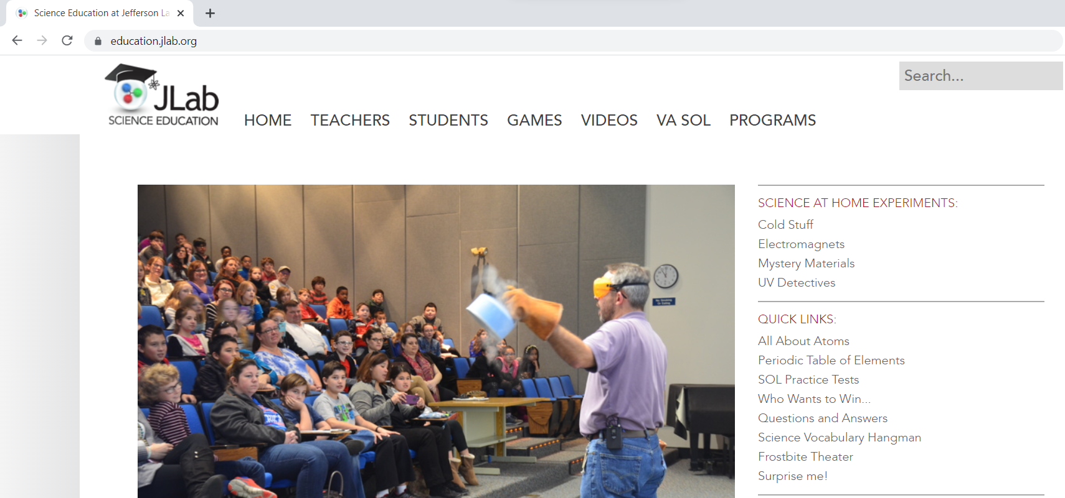
Science Education Website

Slide 19
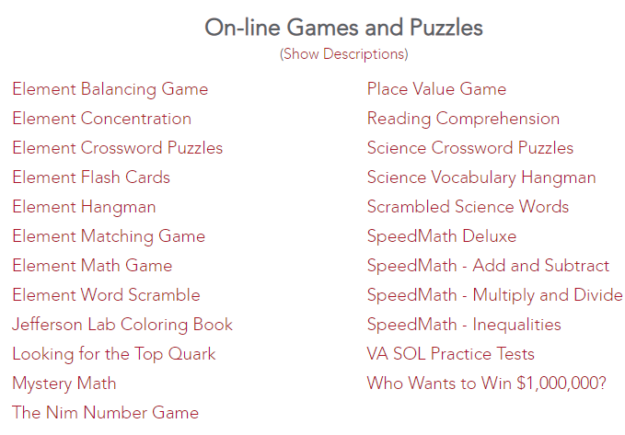
Science Education Website Resources
Educational resources for students and teachers: interactive periodic table of elements, engaging “Science at Home!” video series, Frostbite Theater video series, STEM virtual games, and SOL Review Practice Tests
Science at Home!
UV Detectives
Interactive Periodic Table of Elements
Fun with Static Electricity
https://education.jlab.org

Slide 20
Questions?
Jalyn Dio
Science Education Administrator
jdio@jlab.org
Lisa Surles-Law
Science Education Manager
surles@jlab.org

