Slide 1


Inclusive Data - JLab @22 GeV
Ioana Niculescu
James Madison university
Strong Interaction Physics at the Luminosity Frontier with 22 GeV Electrons at Jefferson Lab
arXiv:2306.09360
Symposium: Nucleon and nuclei structure from inclusive measurements
June 20 -21, 2023

Slide 2
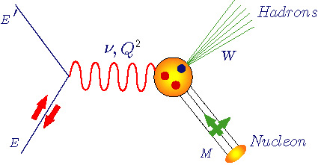
Inclusive Electron Scattering – Formalism
Q² : Four-momentum transfer
x : Bjorken variable (=Q²/2M ν)
ν : Energy transfer
M : Nucleon mass
W : Final state hadronic mass
Unpolarized structure functions F₁(x,Q²) and F₂(x,Q²), or
F_{T}(x,Q²) [=2xF₁(x,Q²)] and F_{L}(x,Q²), separated by measuring R = σ_{L}/σ_{T}

Slide 3
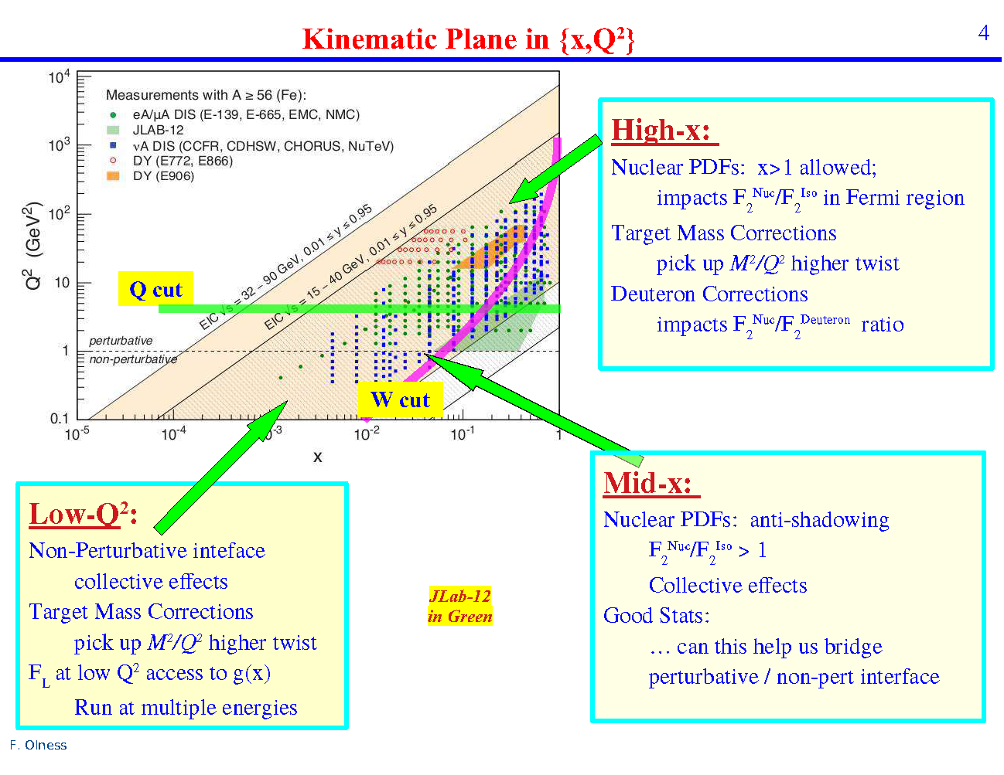
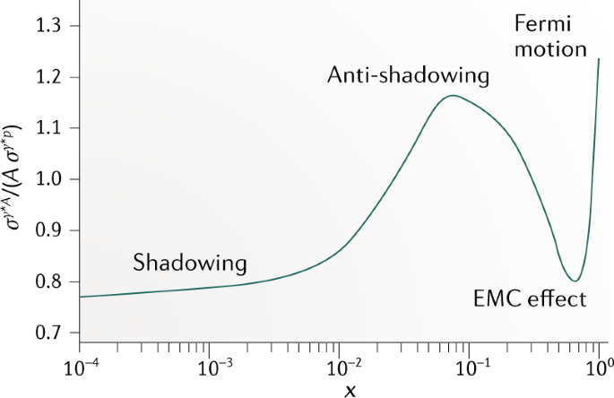
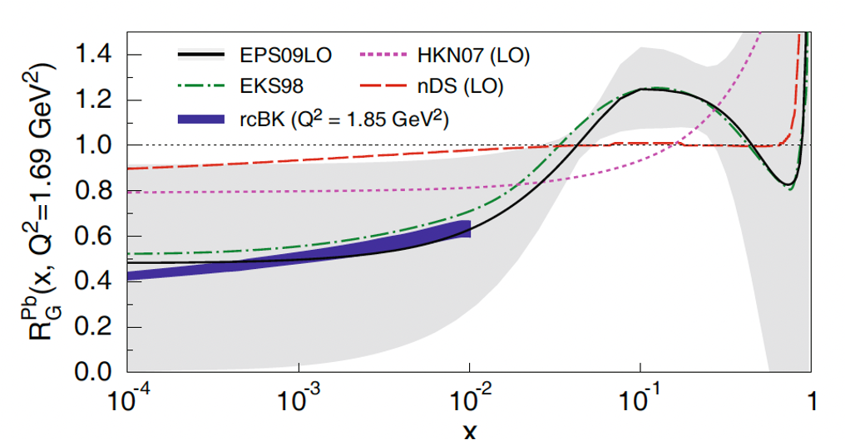
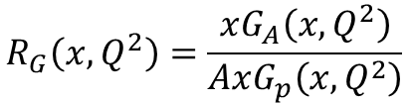
$$R_{G}\left(x,Q^{2}\right)=\frac{xG_{A}\left(x, Q^{2}\right)}{AxG_{p}\left(x,Q^{2}\right)}$$
F. Olness: Anti-Shadowing and Nuclear PDF Challenges
JLab High Energy Workshop Series 22-23 July 2022
A. Accardi et al: Electron Ion Collider: The Next QCD Frontier - Understanding the glue that binds us all
 | (arXiv:1212.1701)

Slide 4
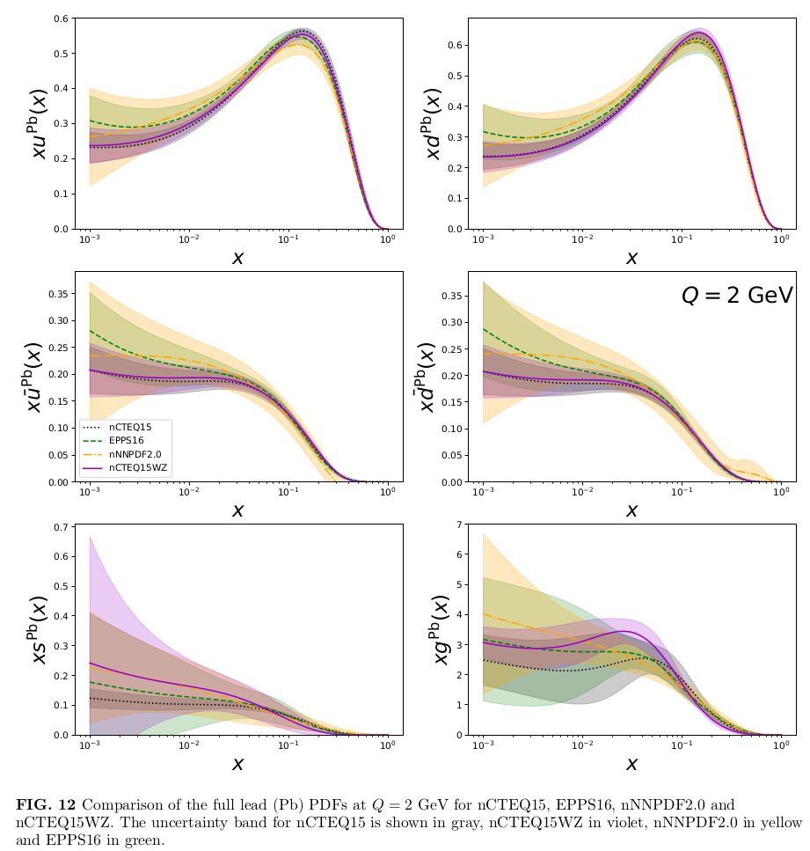
https://ncteq.hepforge.org/
Nuclear PDFs

Slide 5
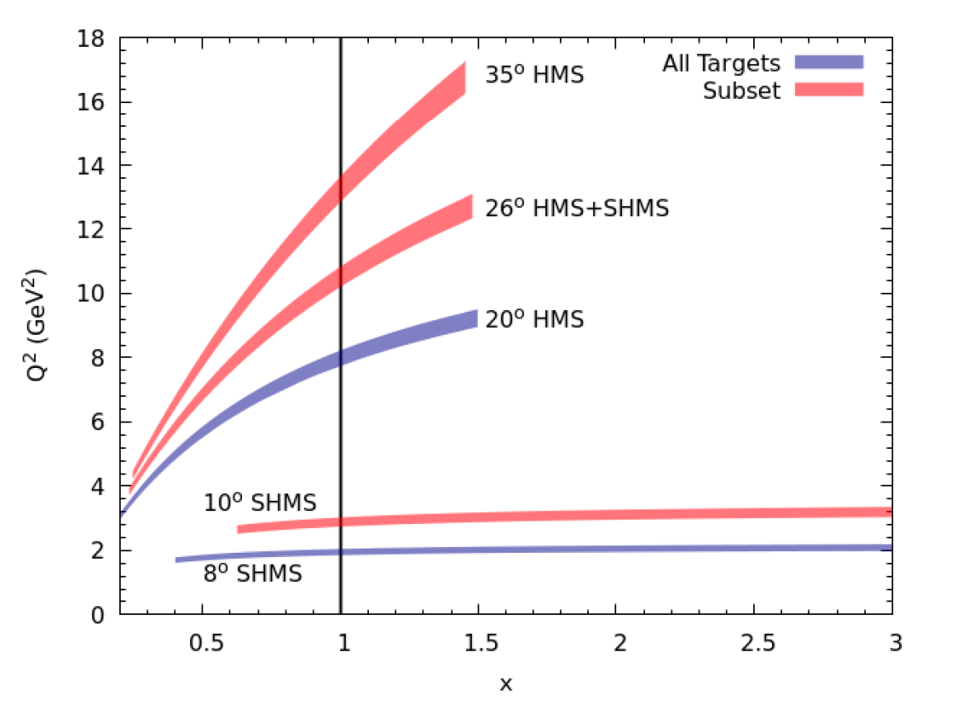
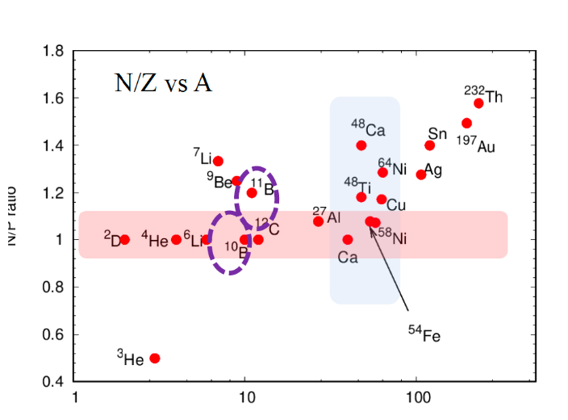
World Data: BCDMS, EMC, NMC, SLAC, FNAL, Hermes, JLab
He, Be, Li, C, N, Al, Ca, Fe, Cu, Kr, Ag, Sn, Xe, Au, Pb
Hall C Data at 12 GeV:
E12-06-105 and E12-10-008
nCTEQ15HIX — Extending nPDF Analyses into the High-x, Low-Q2 Region,
E.P. Segarra et al., Phys. Rev. D 103, 114015 (2021)

Slide 6
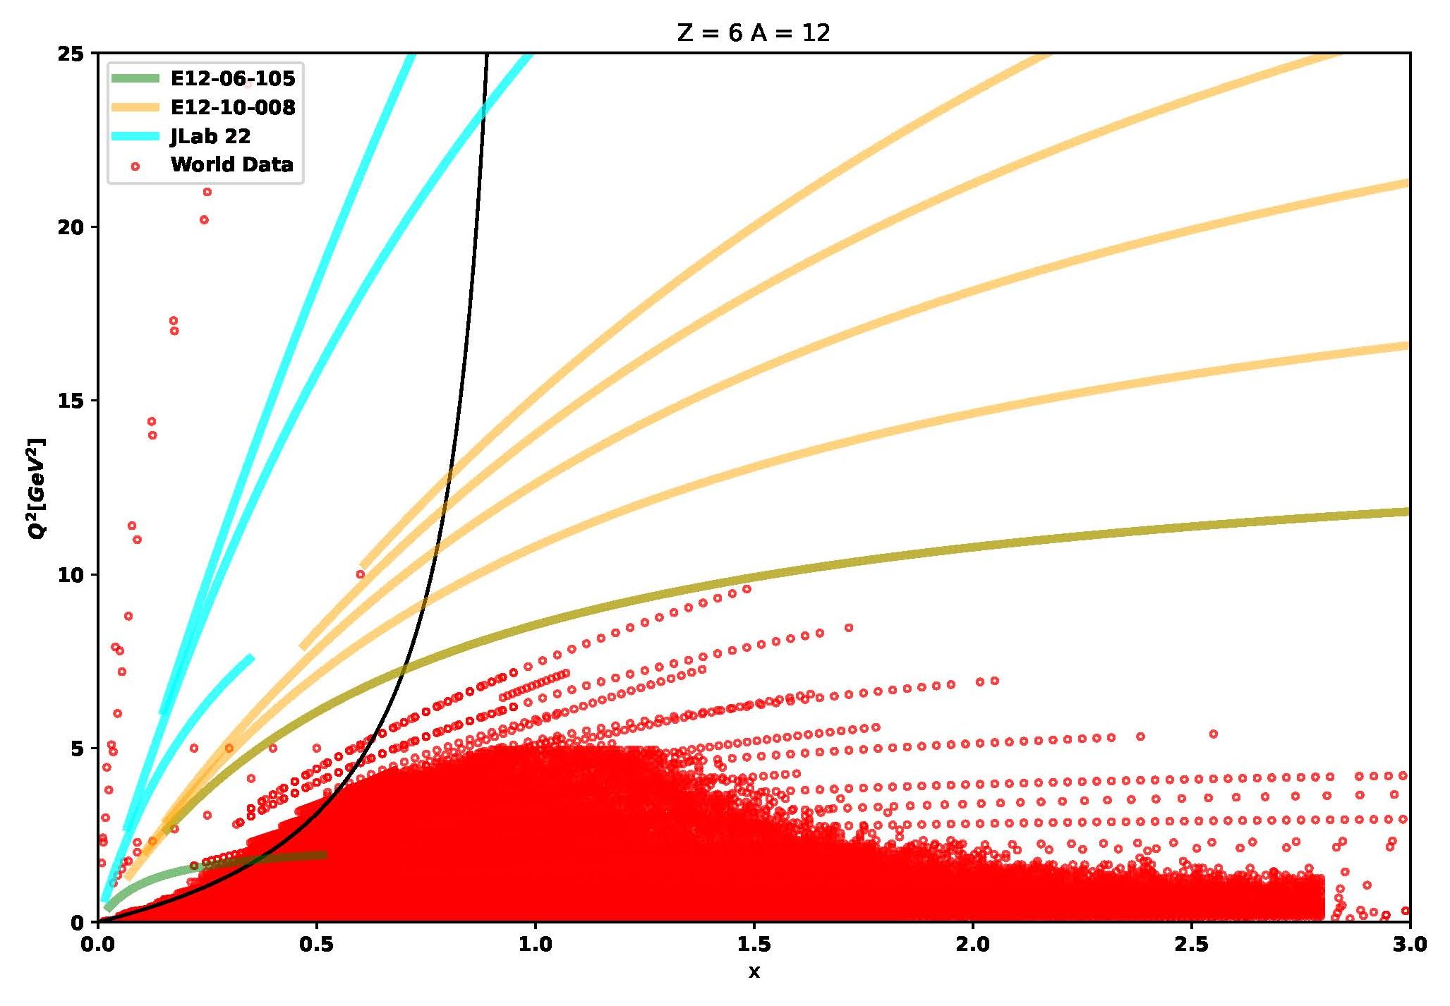
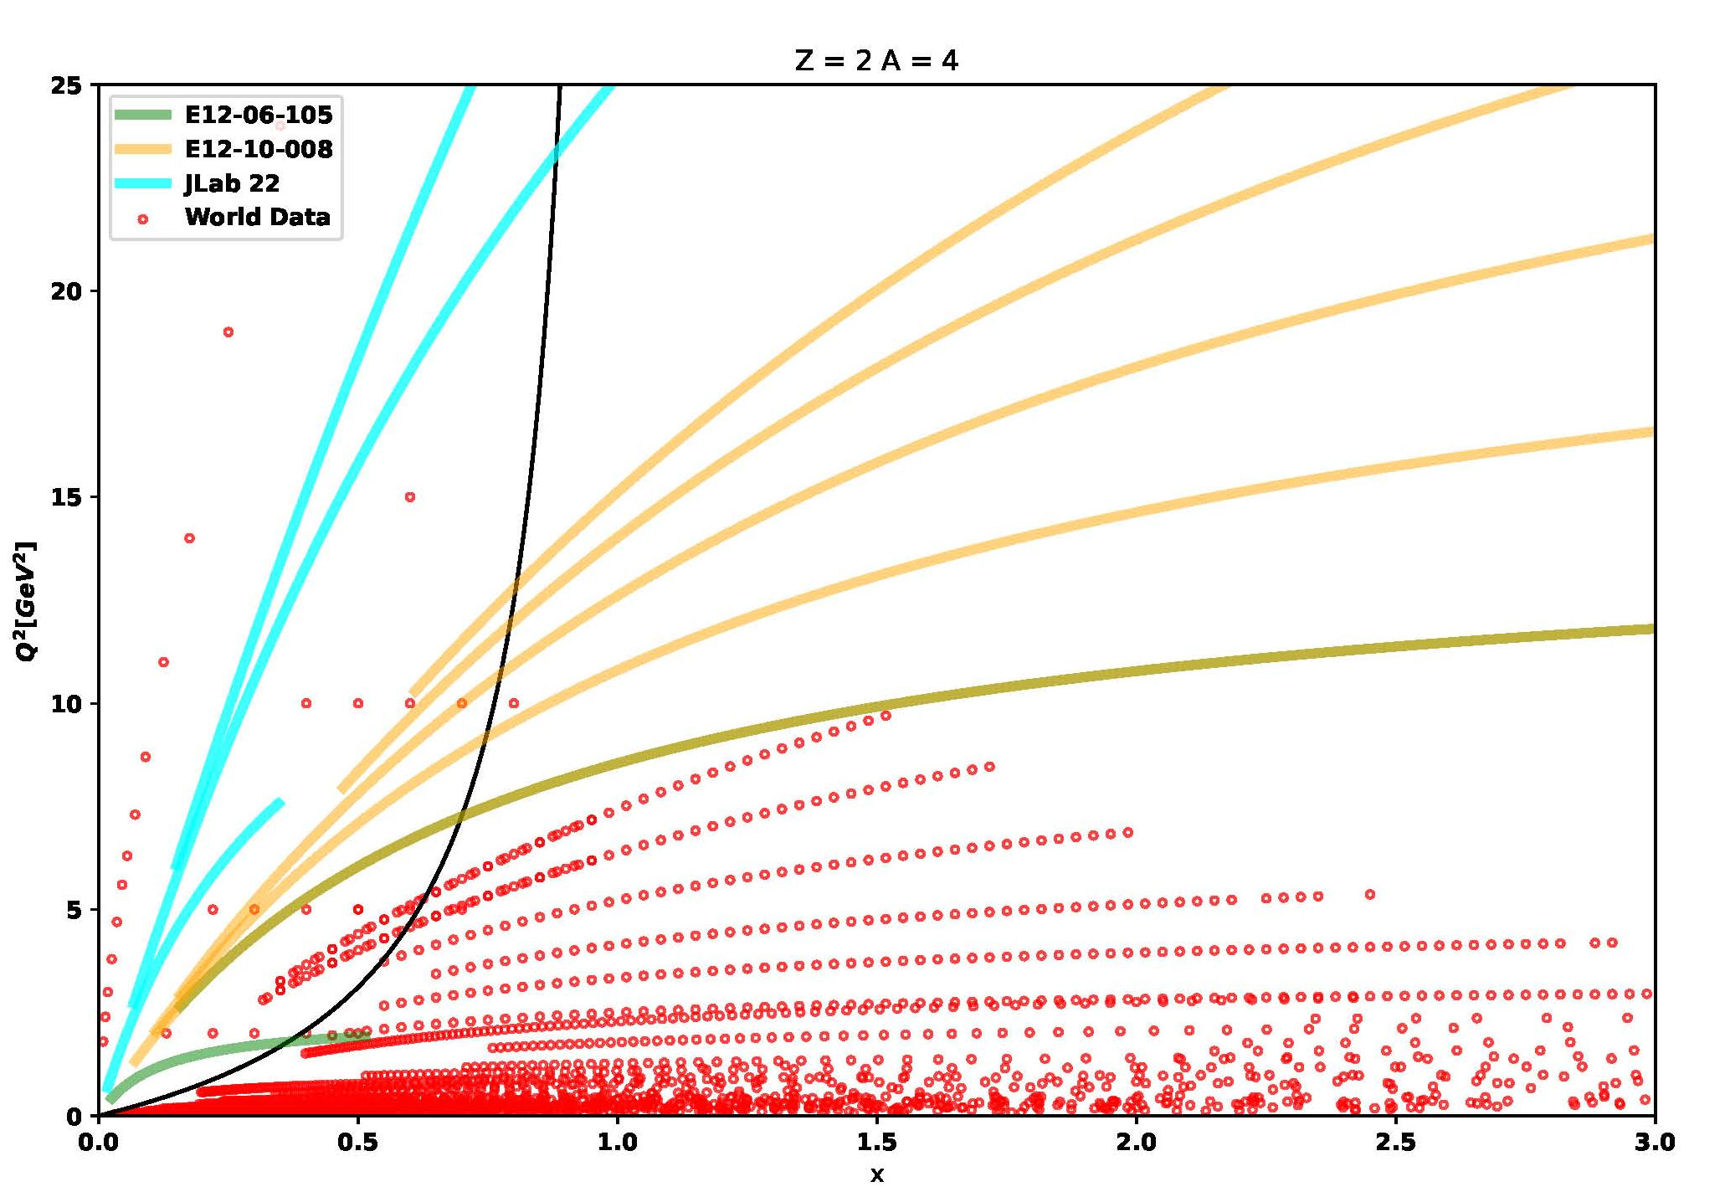



He-4, C-12
E_{Beam} = 22 GeV
SHMS at various angles
SHMS momenta = 0.5 - 11 GeV/c
$$θ=30°$$
$$θ=20°$$
$$θ=10°$$

Slide 7
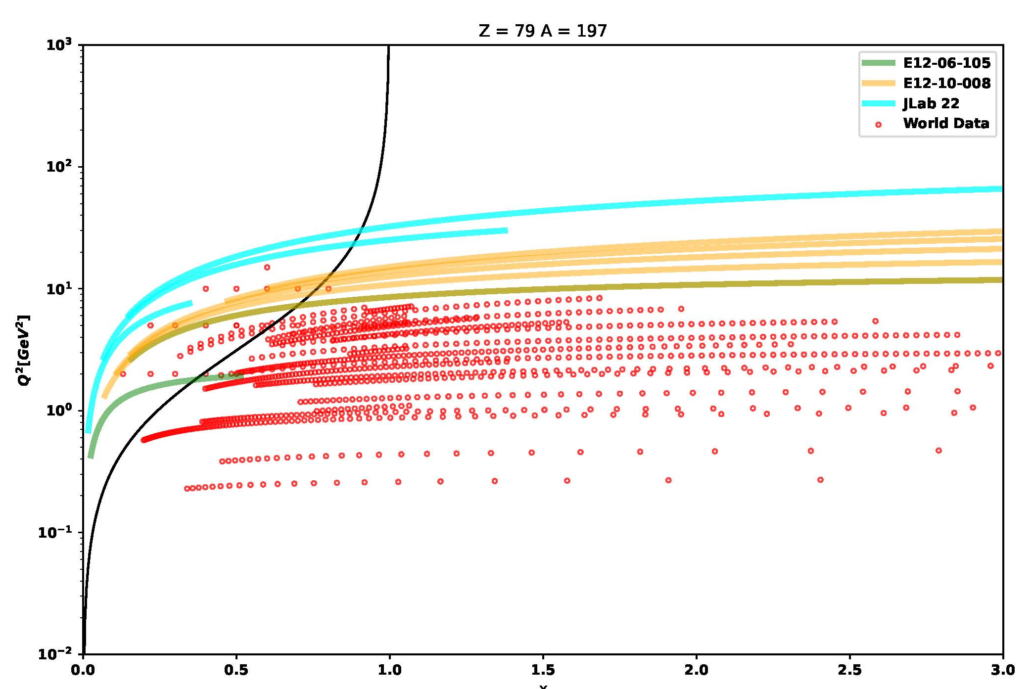
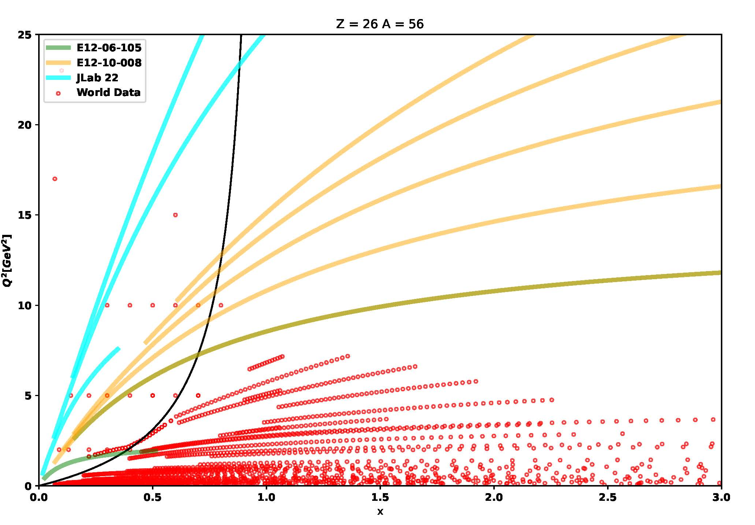
Fe-56 and Au-197
“Jlab 22 will provide definitive proof of three-nucleon short-range correlations by verifying the existence of the new nuclear scaling at x > 2 and Q²= 10 - 15 GeV² in inclusive e − A scattering” - arXiv:2306.09360

Slide 8
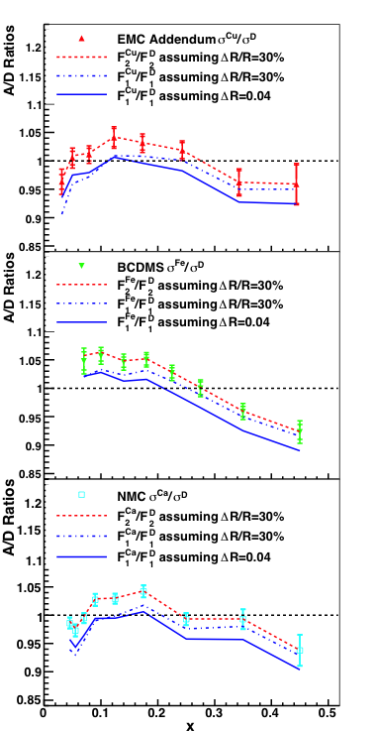

Nuclear Dependence of R
D. Gaskell
F₁ ratio purely transverse
Anti-shadowing disappears for F₁ ratio, remains for F₂
Anti-shadowing from longitudinal photons?
V. Guzey et al, PRC 86 045201 (2012)

Slide 9
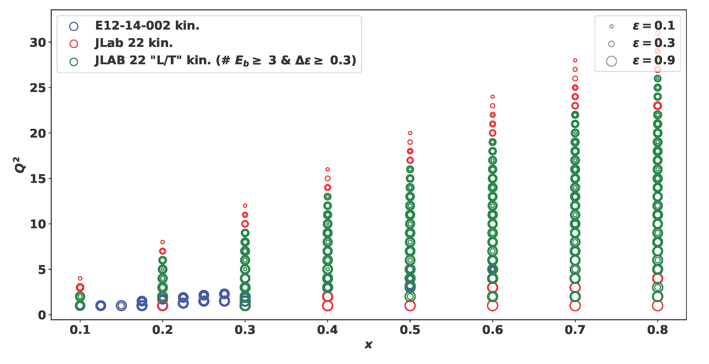
Kinematics coverage
Beam energy: 2.85---22.65 in 10 steps (so 2.2 GeV per turn, 1.1 GeV per LINAC)
Spectrometer limits:
HMS
p: 0.5—7 GeV
theta: 10.5—80 deg.
SHMS
p: 1—11 GeV
theta: 5.5—40 deg.

Slide 10
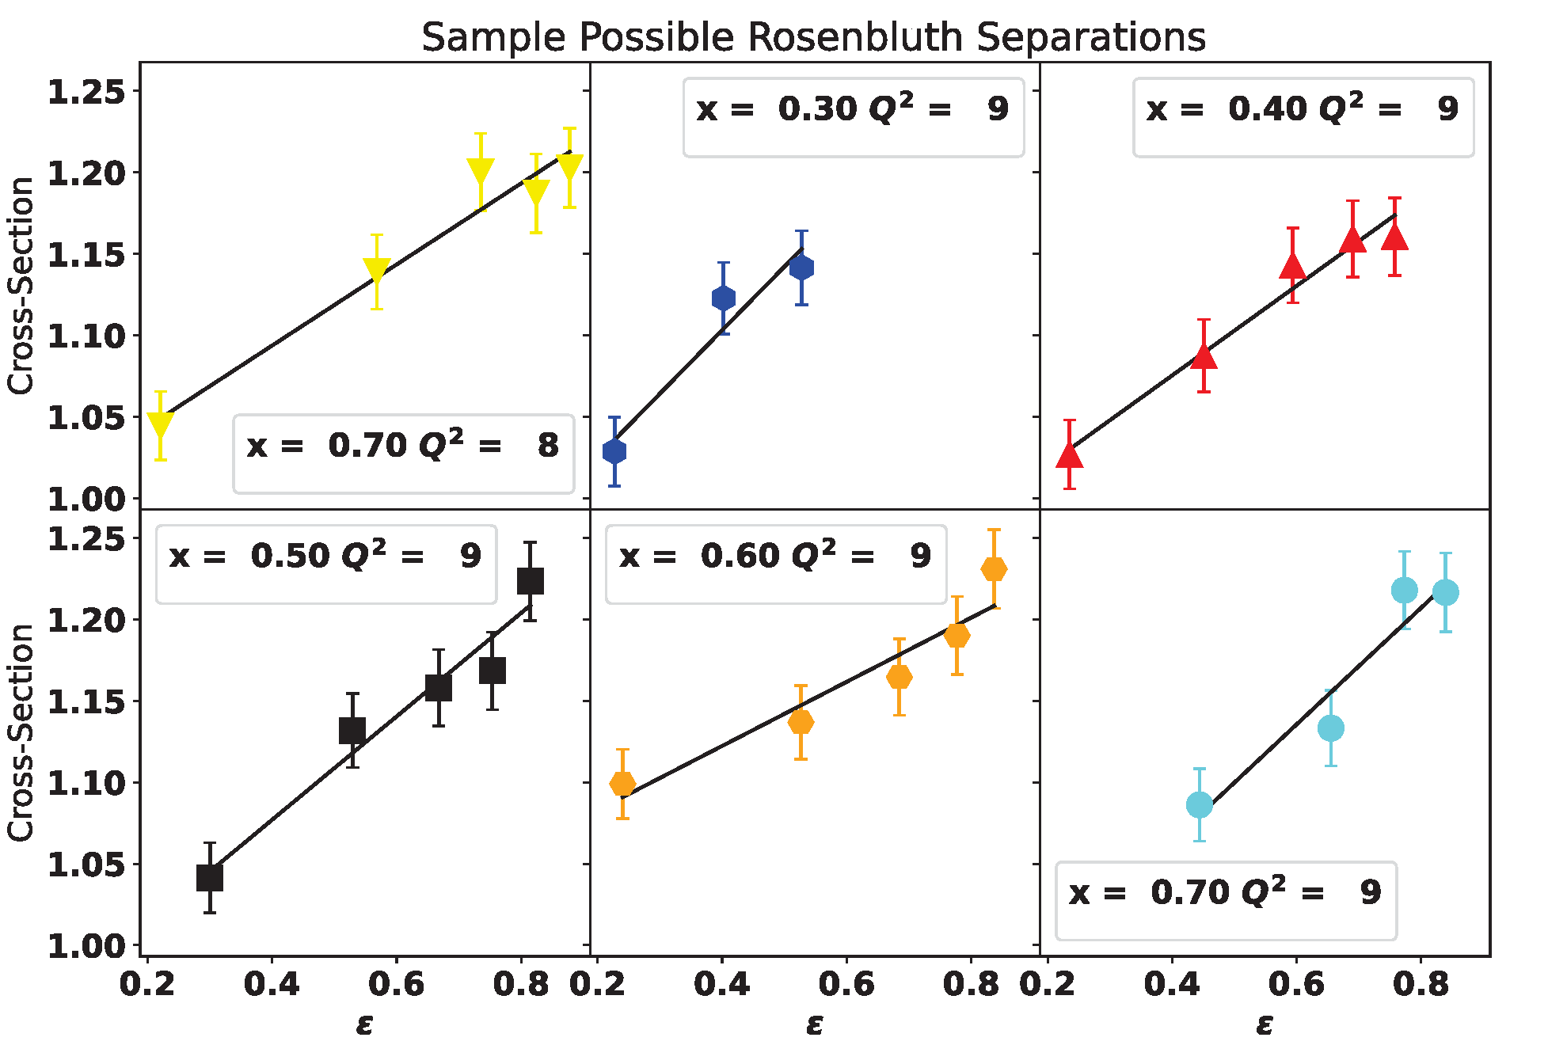
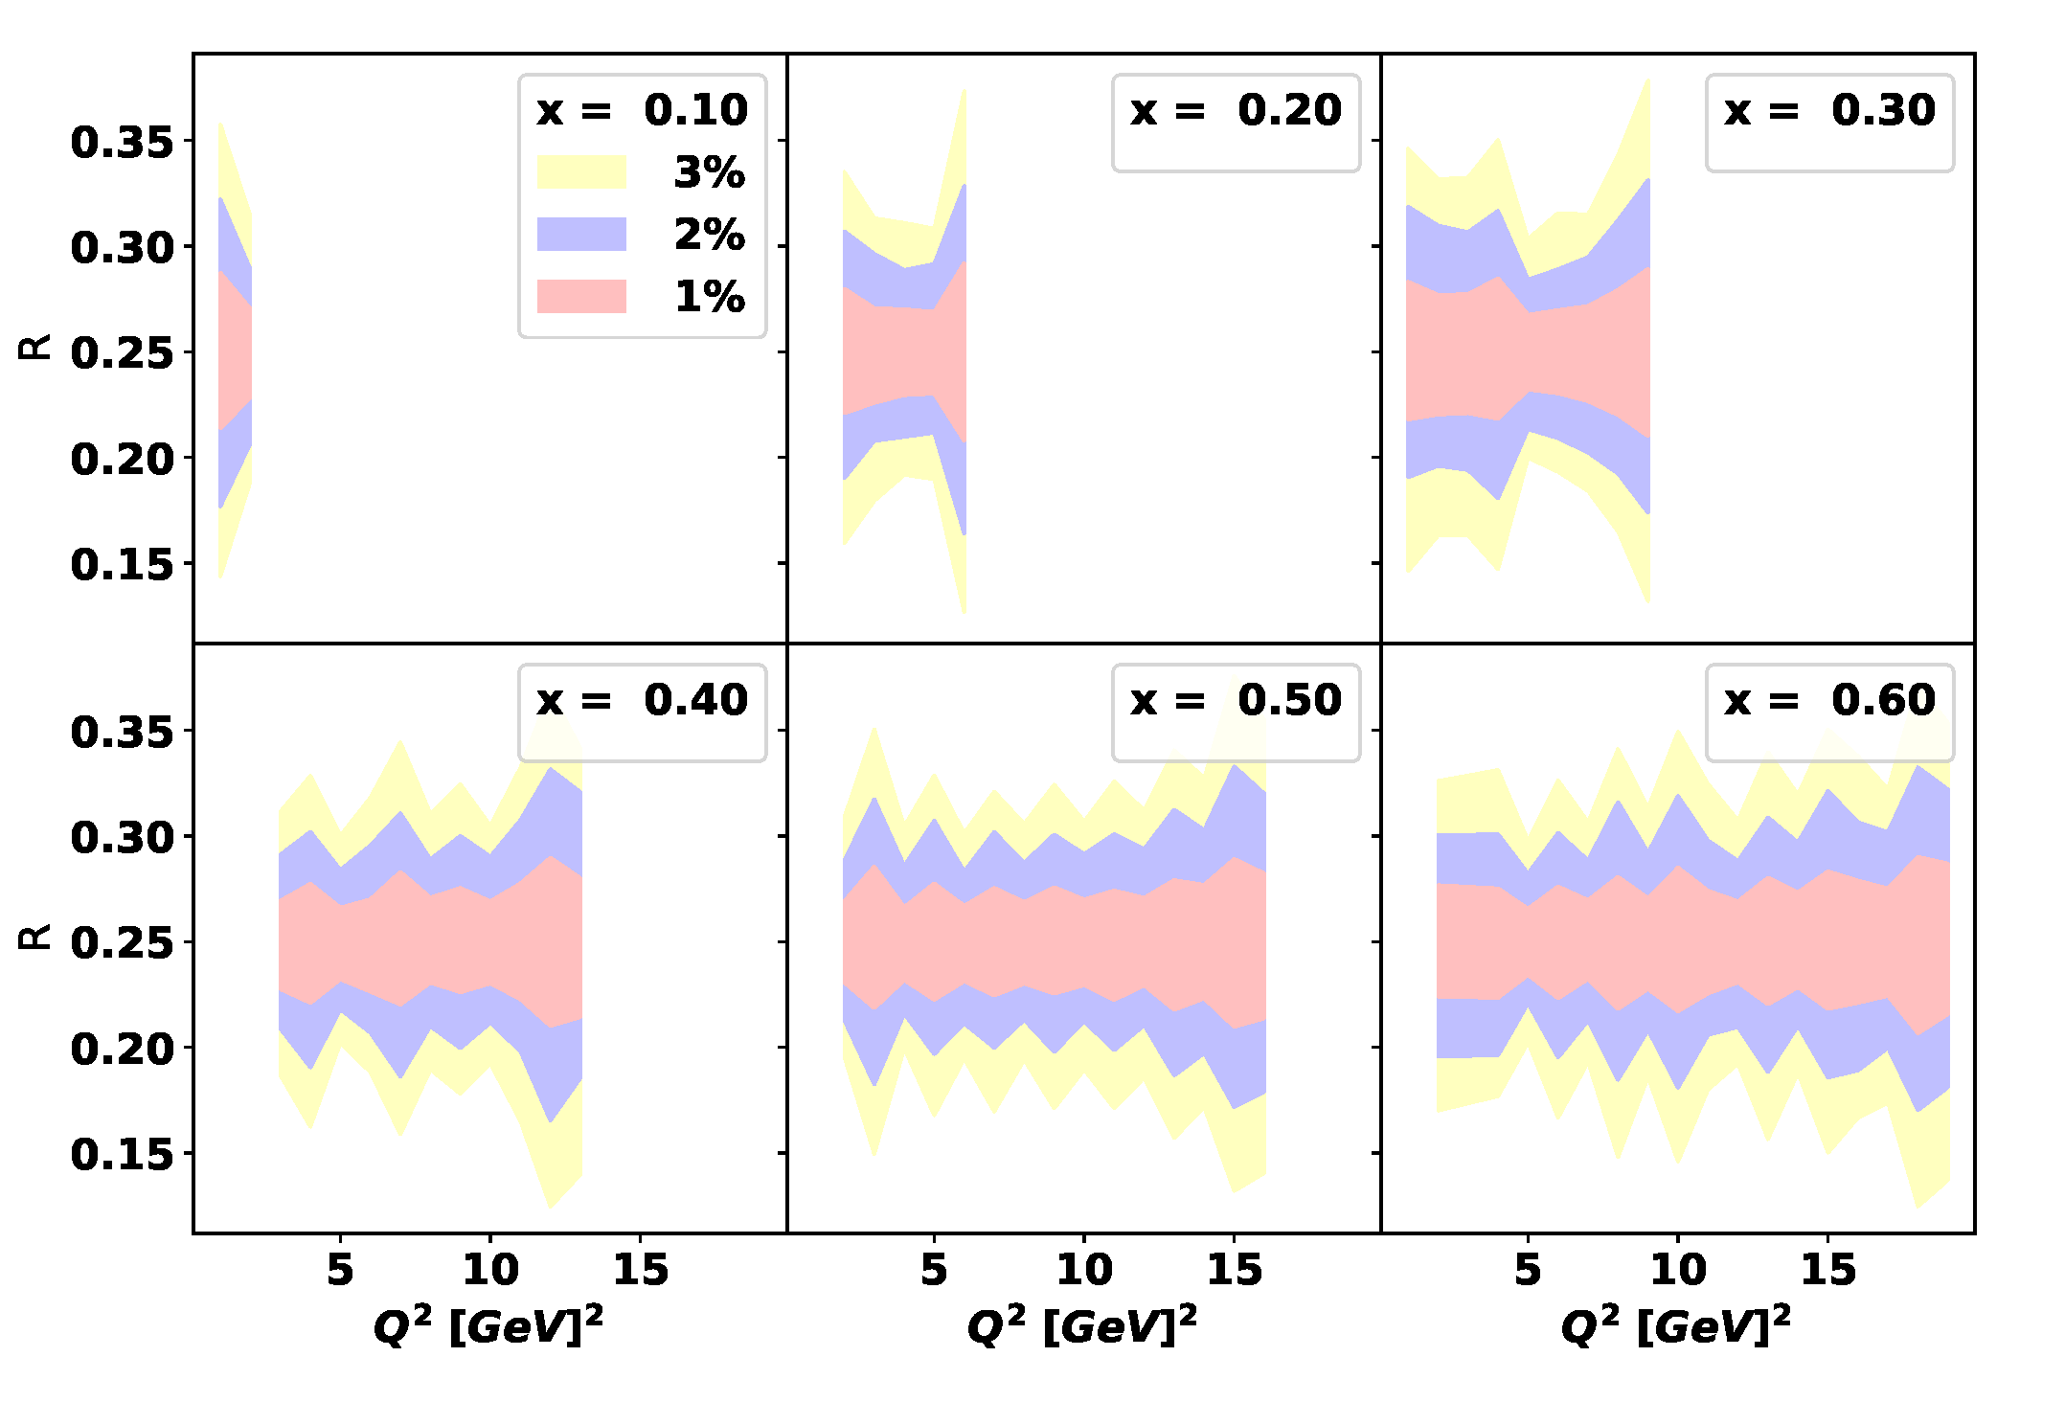
Extracting R: LT separation

Slide 11
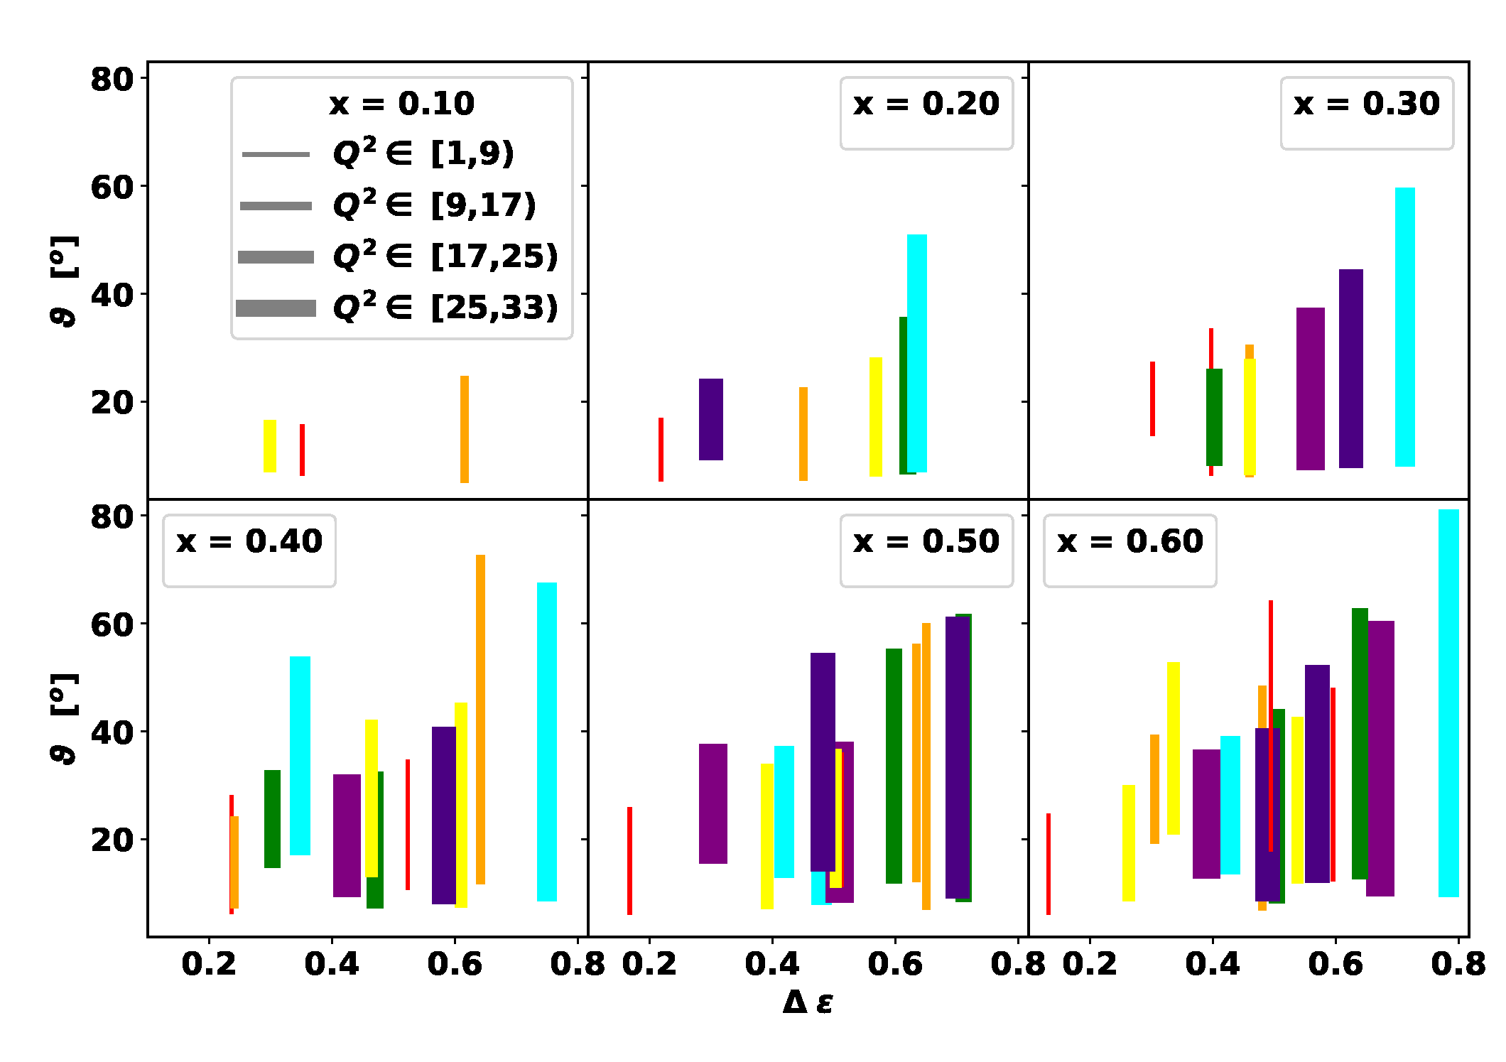
Bigger Δε: need backward angles

Slide 12
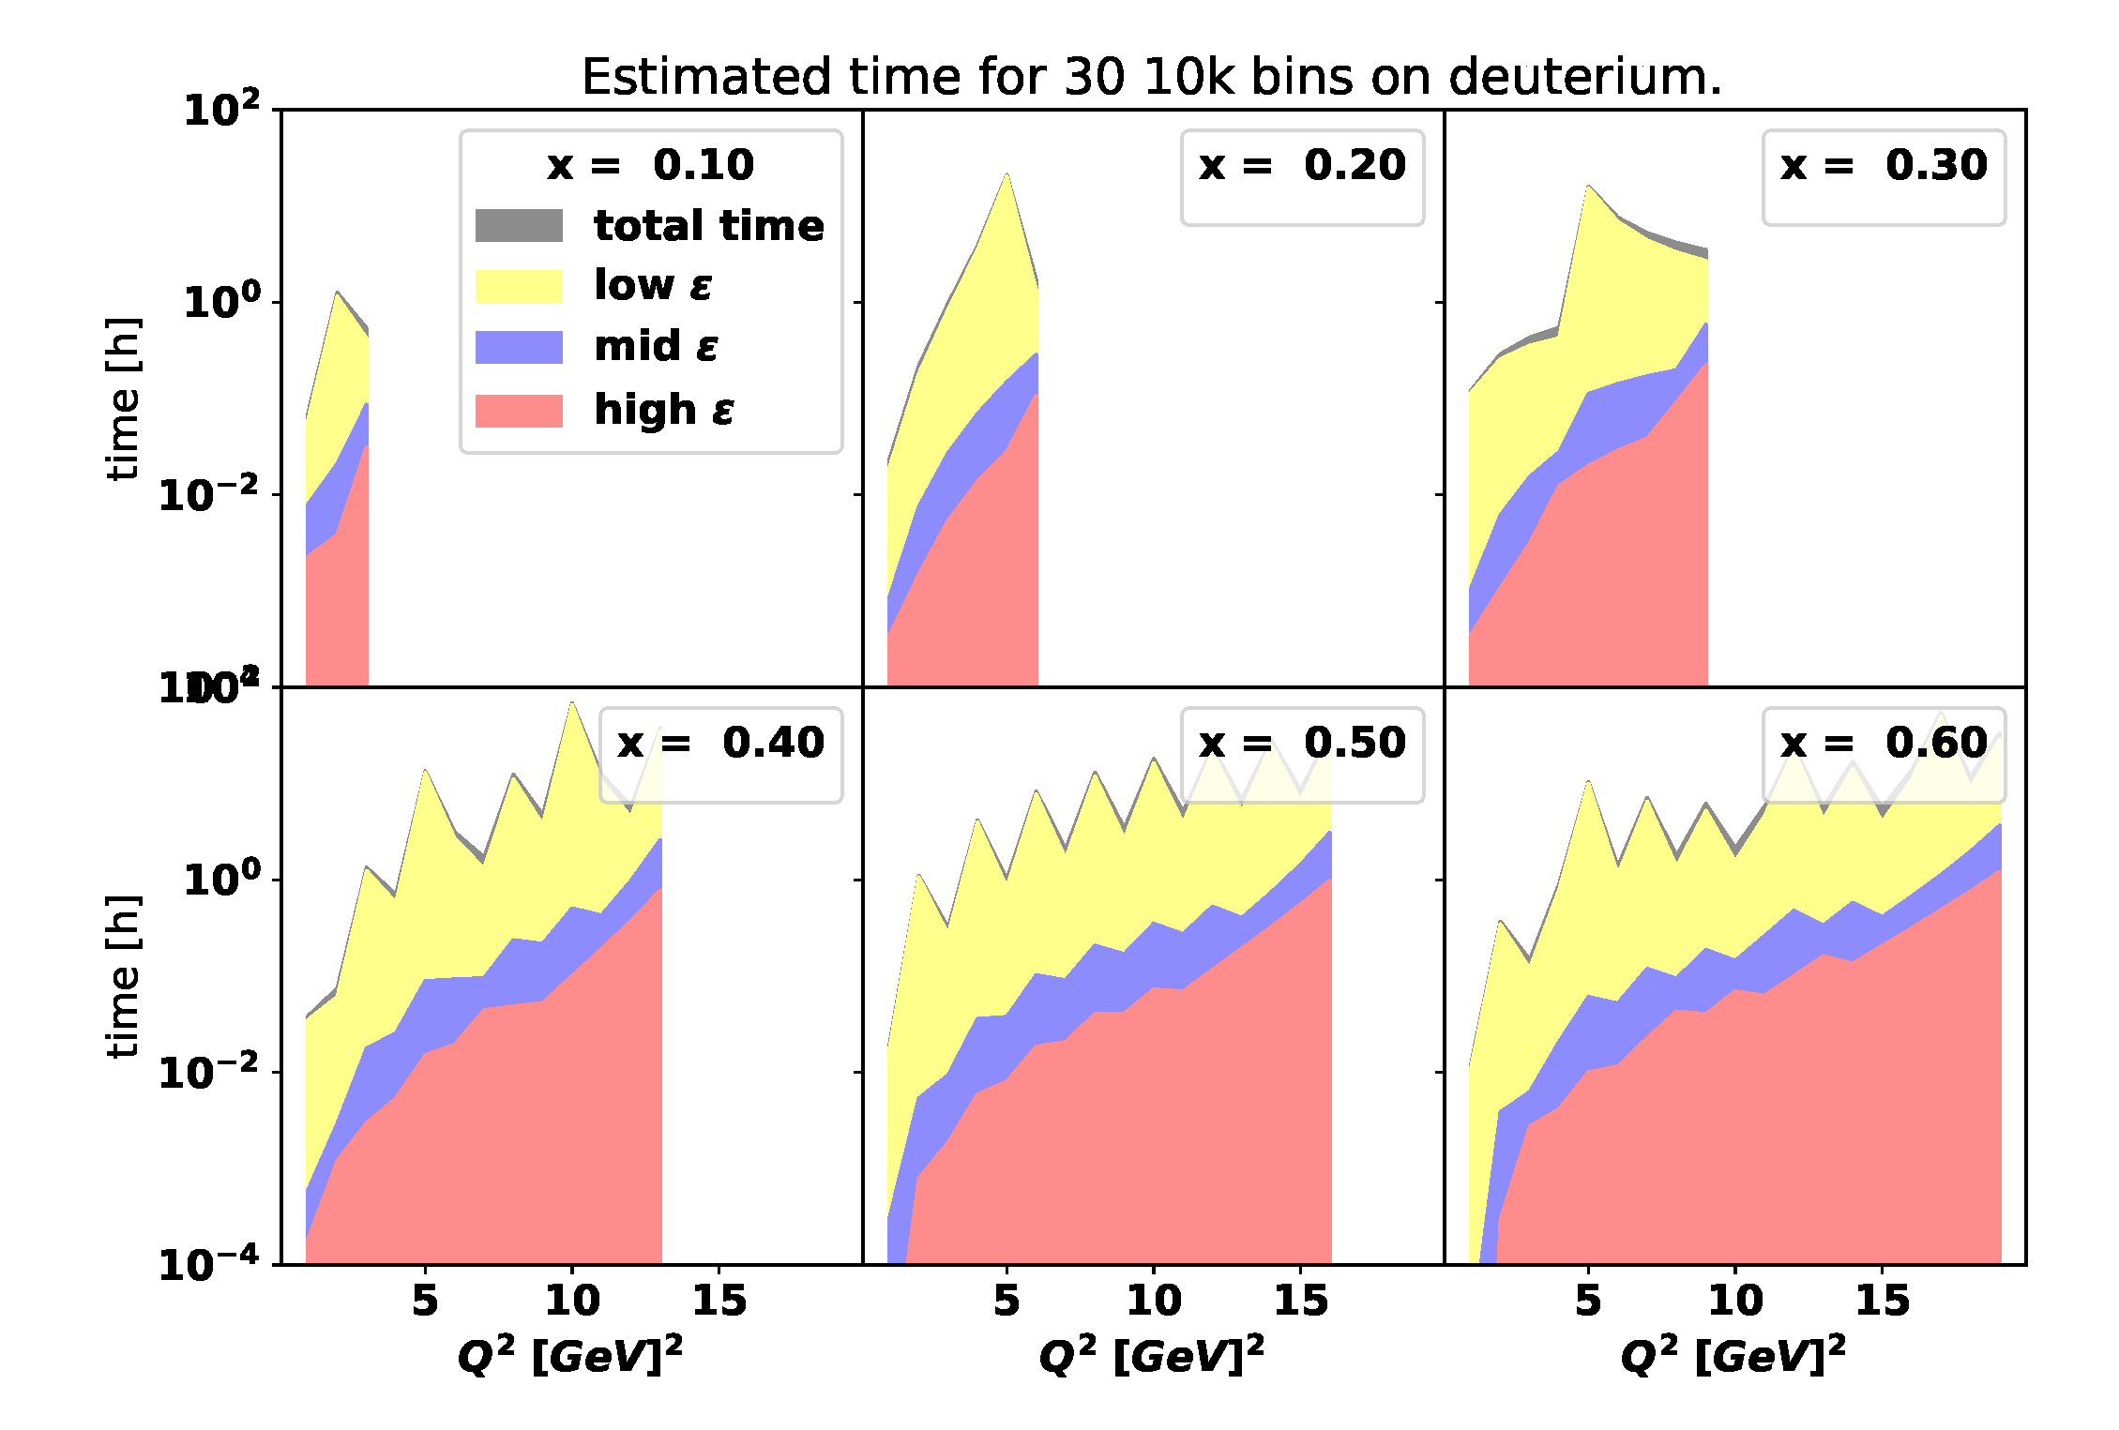
Rates
- F2ALLM for deuterium
- r1998
- solid angle: 4 msr
- p limits: -10--10%
- beam current: 10 uA
- tgt length: 4 cm

Slide 13
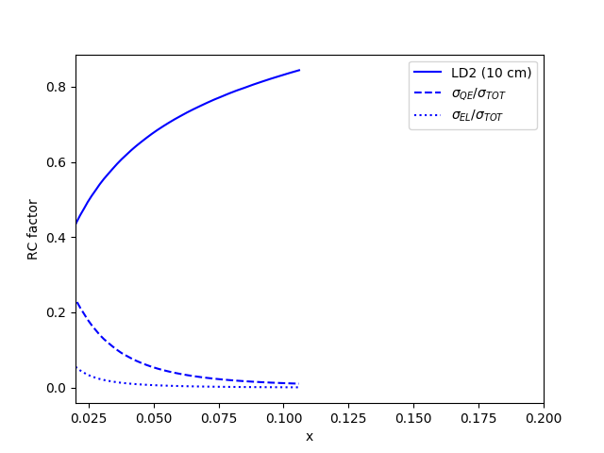
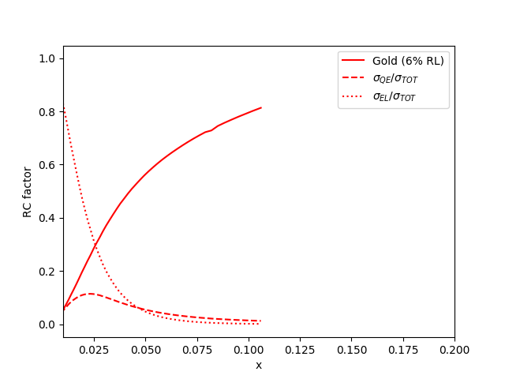
Challenges: Radiative Corrections
(calculations by D. Gaskell)
SHMS at 5.5 degrees
Total RC factor
Ratio of radiated QE/total cross sections
Ratio of radiated elastic/total cross sections

Slide 14
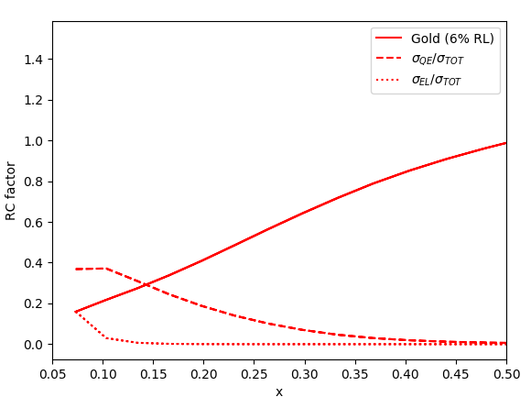
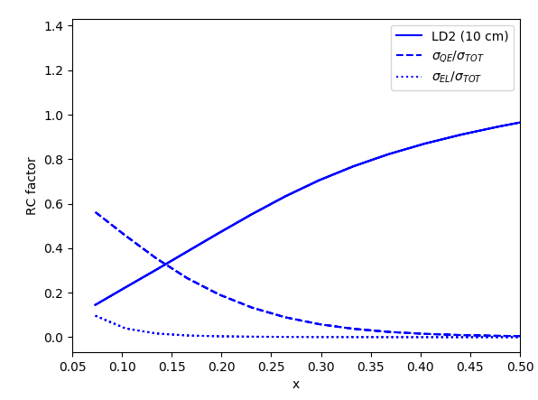
Radiative Corrections
SHMS at 30 degrees

Slide 15
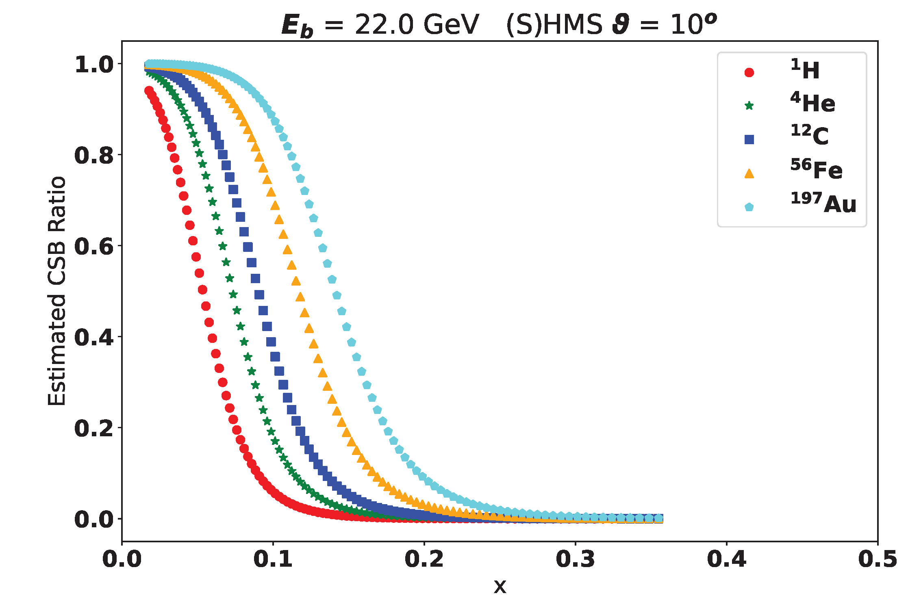
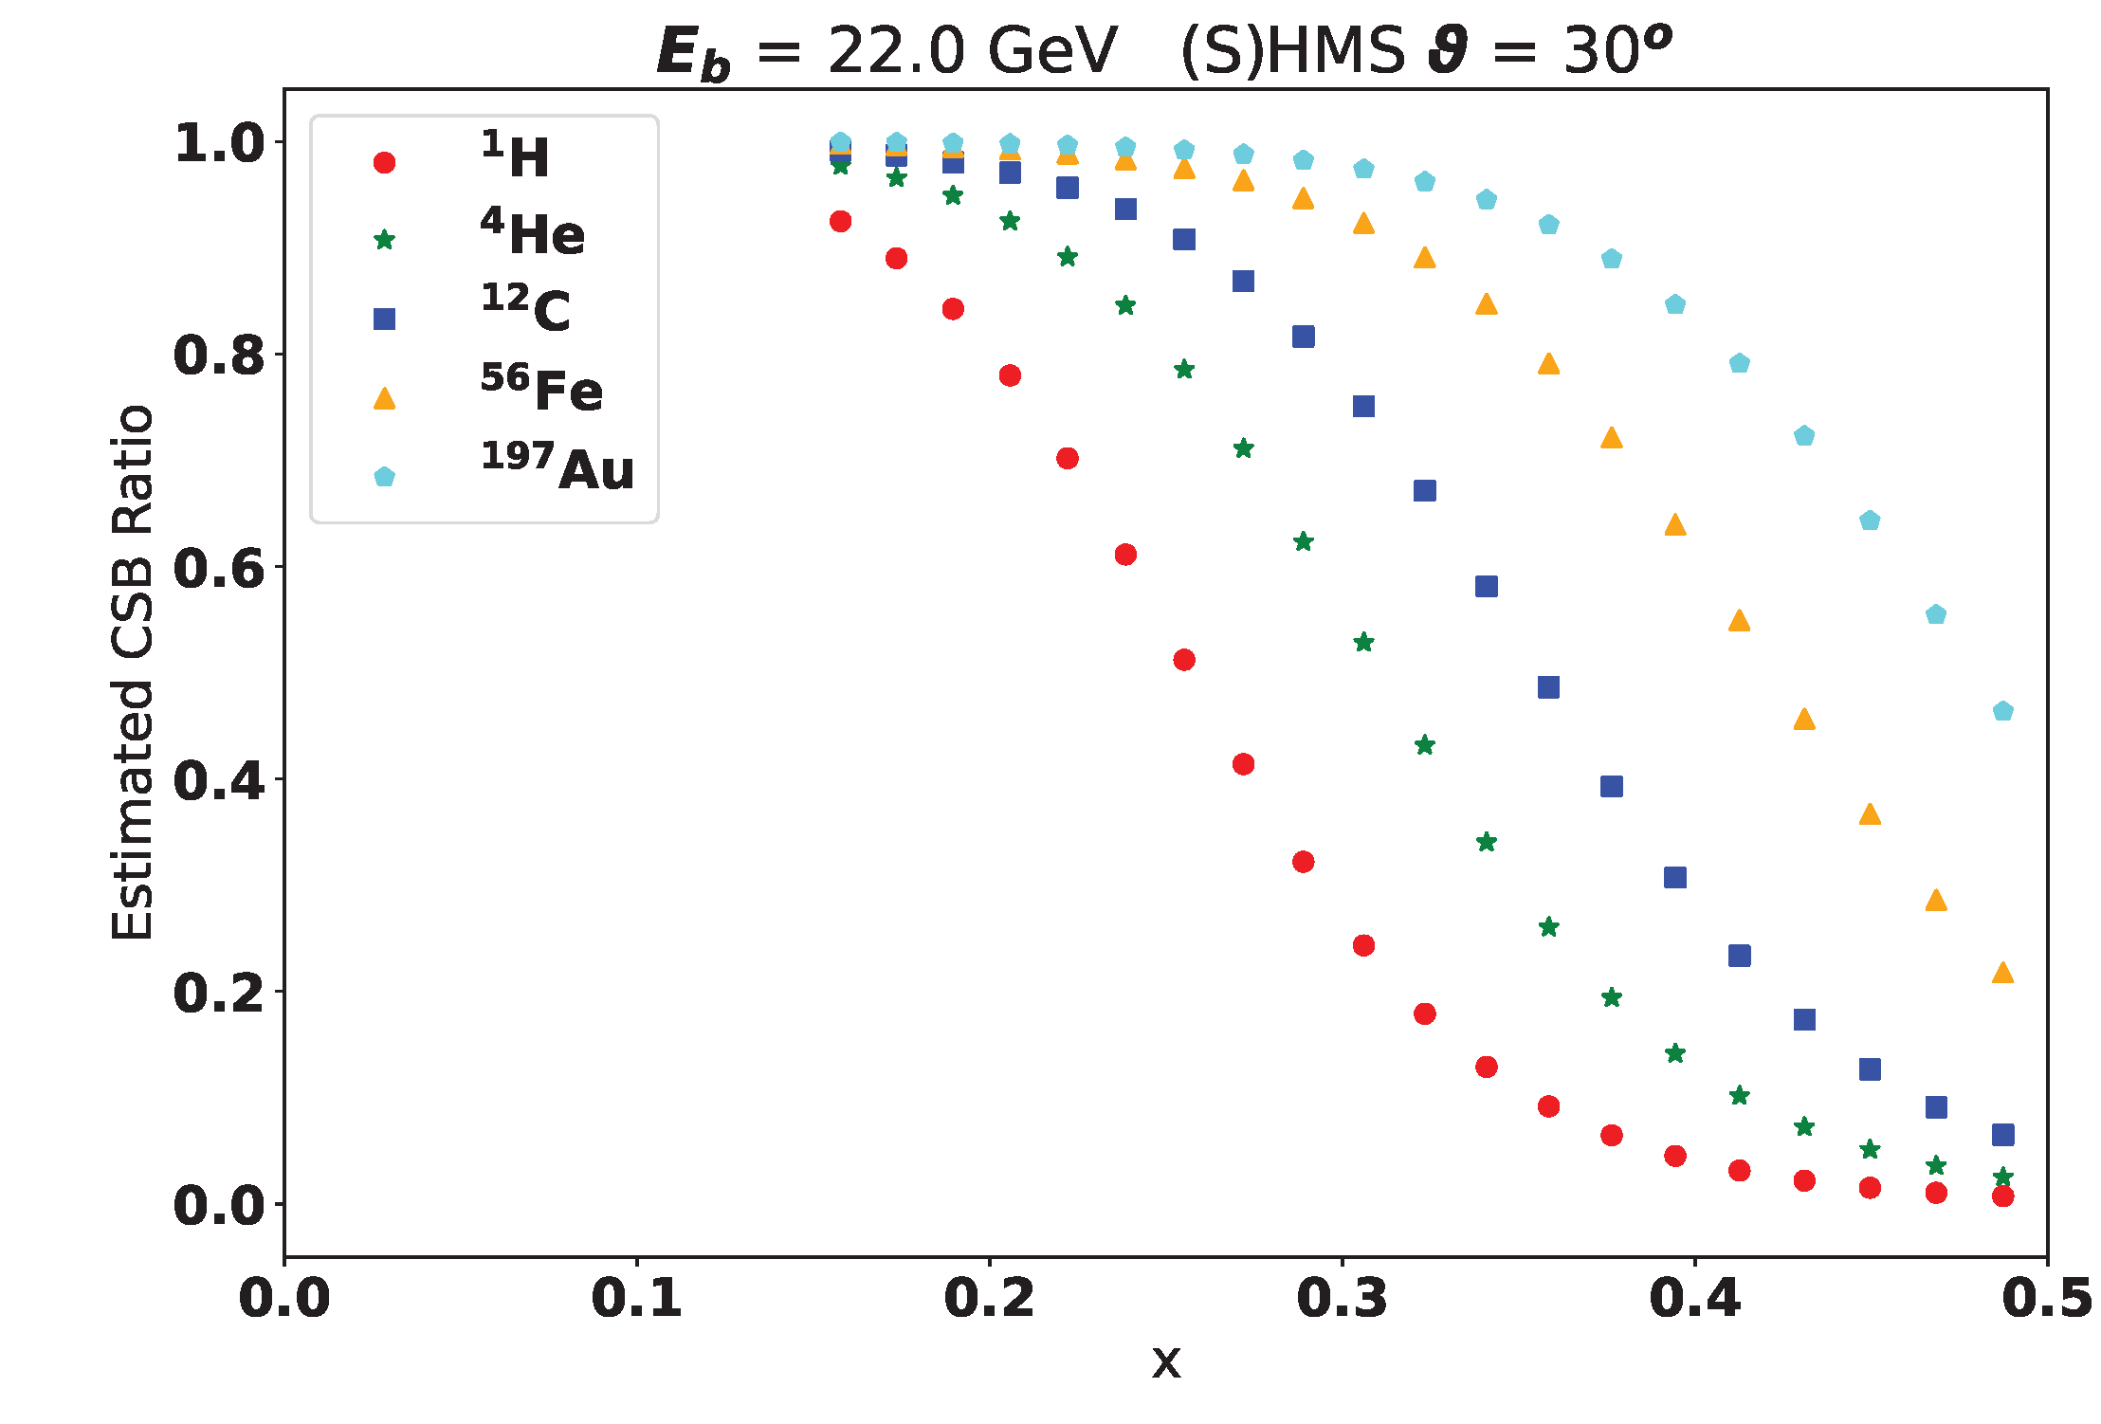
Challenges: Charge Symmetric Background
(calculations by G. Niculescu using P. Bosted code)

Slide 16
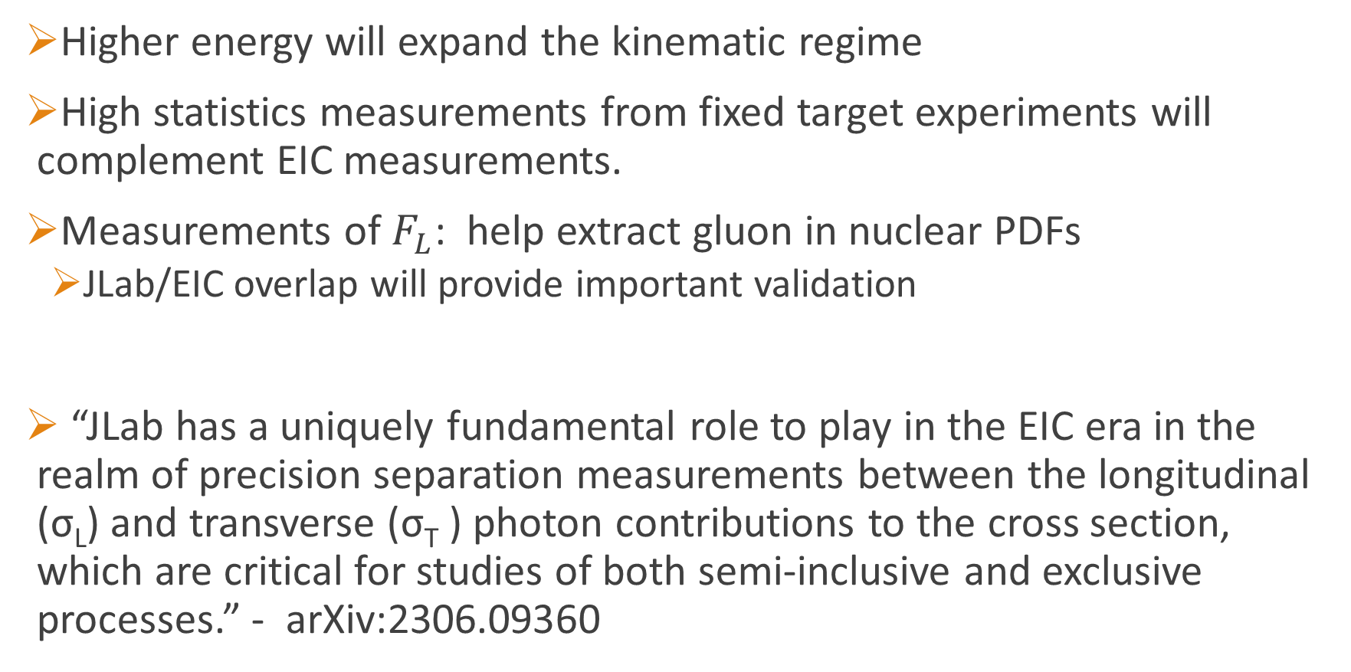
Outlook
Higher energy will expand the kinematic regime
High statistics measurements from fixed target experiments will complement EIC measurements.
Measurements of $F_{L}$: help extract gluon in nuclear PDFs
  JLab/EIC overlap will provide important validation
“JLab has a uniquely fundamental role to play in the EIC era in the realm of precision separation measurements between the longitudinal (σ_{L}) and transverse (σ_{T} ) photon contributions to the cross section, which are critical for studies of both semi-inclusive and exclusive processes.” - arXiv:2306.09360

Slide 17
Backup slides

Slide 18
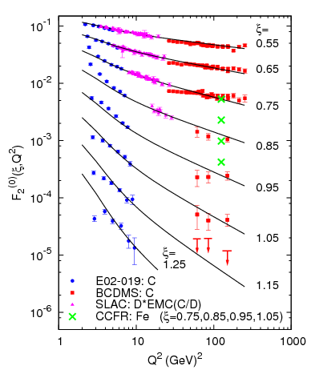
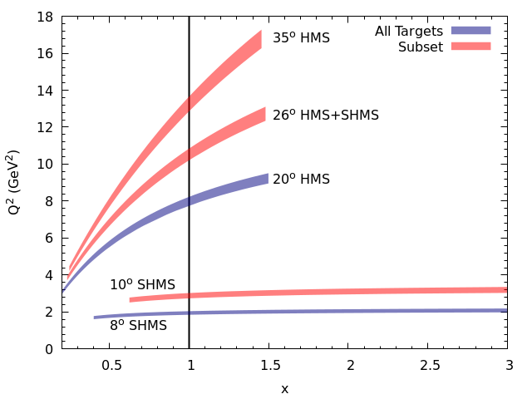
Super-fast quarks
6 GeV data at high x, Q² up to 10 GeV², shows QCD scaling-like behavior despite large resonance contributions (duality)
E12-06-105: inclusive scattering at x>1: SRCs and SFQs [J. Arrington, D. Day, N. Fomin]
Currently running in Hall C
SFQs: Inclusive scattering at x>1 to isolate SRCs
Push to larger Q² to study quark distributions
N. Fomin et al, PRL 105, 212502 (2010)
12 GeV measurement reaches Q²=15 GeV², with smaller resonance contributions
2N- and 3N-SRCs

Slide 19
Signatures of super-fast quarks
q_{D}(x)
two-nucleon only
two-nucleon only
5% 6 quark bag
5% 6 quark bag
Difference only ~1% piece of EMC effect?
6q bag is ‘shorthand’ for any model where nucleon overlap allows free sharing of quark momentum (e.g. hard gluon exchange)
Yields very large enhancement over simple convolution for x>1

Slide 20
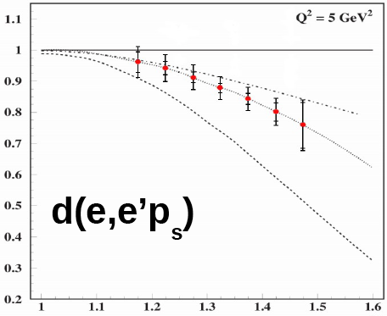
Signatures of super-fast quarks
From E12-11-10:
R ~ F₂^{tagged}/F₂^{untagged}
Convolution, hard gluon exchange, 6q bag – all yield enhancement
Misak Sargsian and Christian Weiss
Projected uncertainties
Resonance contamination will limit precision; need larger energy to cleanly isolate DIS.
But models predict large effects, from factor ~2 suppression to factor ~10+ enhancement.
Evaluation of models for inclusive F₂ in progress: Sargsian, Li, Arrington
Various models (PLC suppression, rescaling, off-shell) yield suppression in tagged scattering for large nucleon momenta, large x → F₂ suppressed for x>1

Slide 21
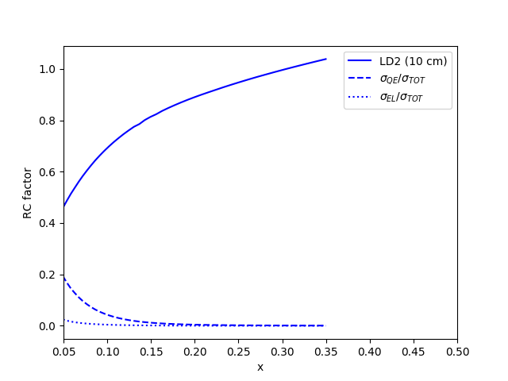
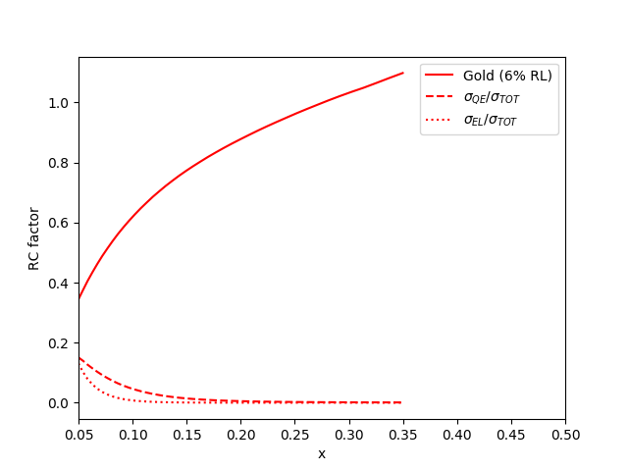
Radiative Corrections
SHMS at 10 degrees

