Slide 1
The TDIS Physics Program: Nuclear Physics with “effective” targets
Arun Tadepalli – Jefferson Lab
(ON BEHALF OF THE tdis COLLABORATION)

Slide 2
TAGGED DEEP INELASTIC SCATTERING EXPERIMENT (TDIS) physics program
Pion and kaon structure (focus of this talk)
F2n/F2p using spectator tagged approach ala BONUS
EMC effect in deuterium
Resonance region structure functions
GMn using a tagged proton
More!
2

Slide 3
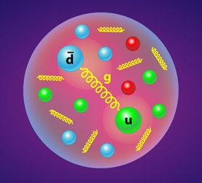
Why the pion?
Presumably the simplest quark anti-quark system (valence)
Explains the long-range nucleon-nucleon interaction
A QCD Nambu-Goldstone boson
Anti-quark flavor asymmetry in the nucleon interpretable in terms of a meson cloud => plays an important role in nucleon sea dynamics
https://physics.aps.org/articles/v11/s117
3

Slide 4
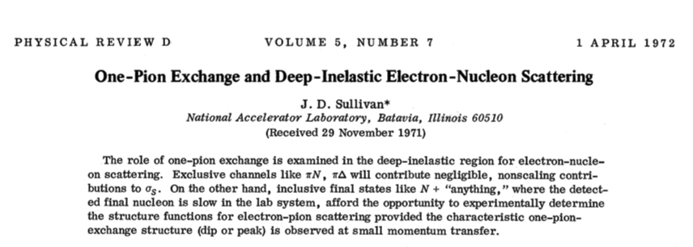
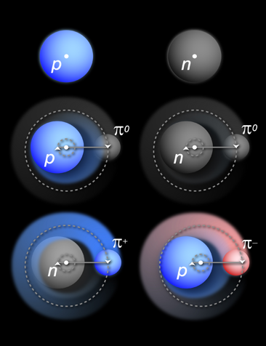
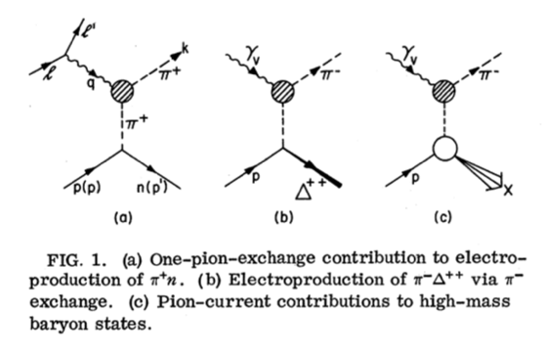
Accessing the pion content of the nucleon
Idea that the nucleon’s mesonic content can be accessed through electron nucleon DIS has a long history (~50 years!)
Credit: Joshua Rubin, Argonne National Laboratory
4

Slide 5
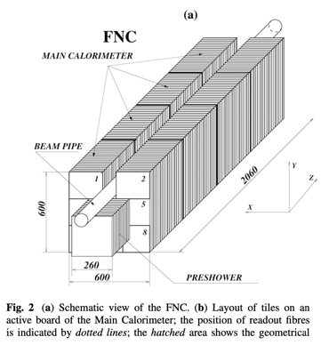
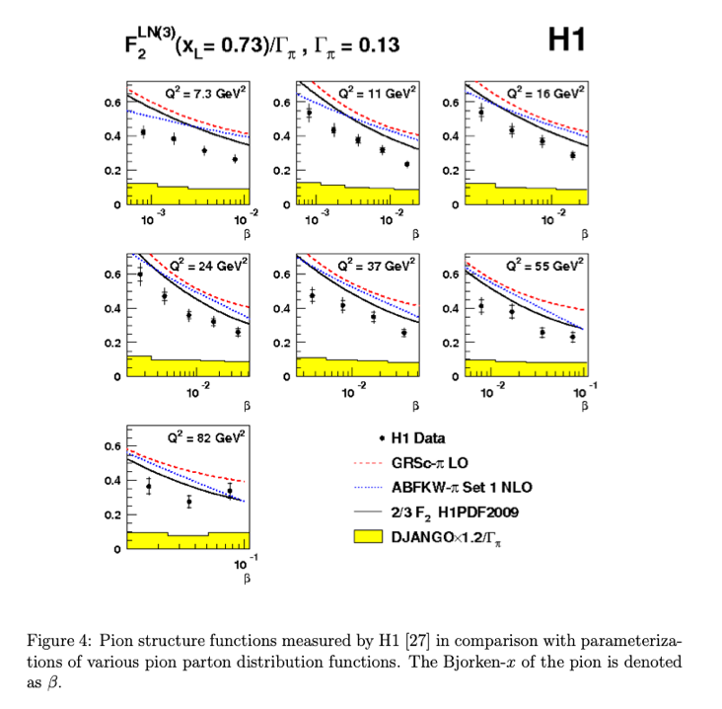
H1 at hera
H1 at HERA provided first data on extracted pion structure functions from leading neutron tagging with DIS events
1.5e⁻⁴ < x < 3.0e⁻², 6 < Q² < 100 GeV²
5

Slide 6
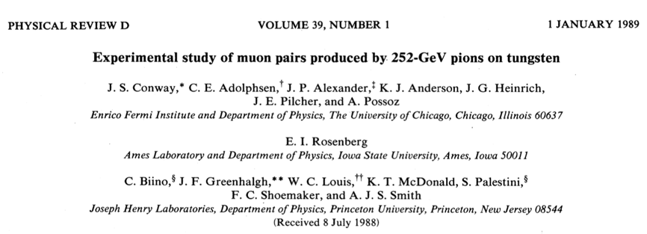
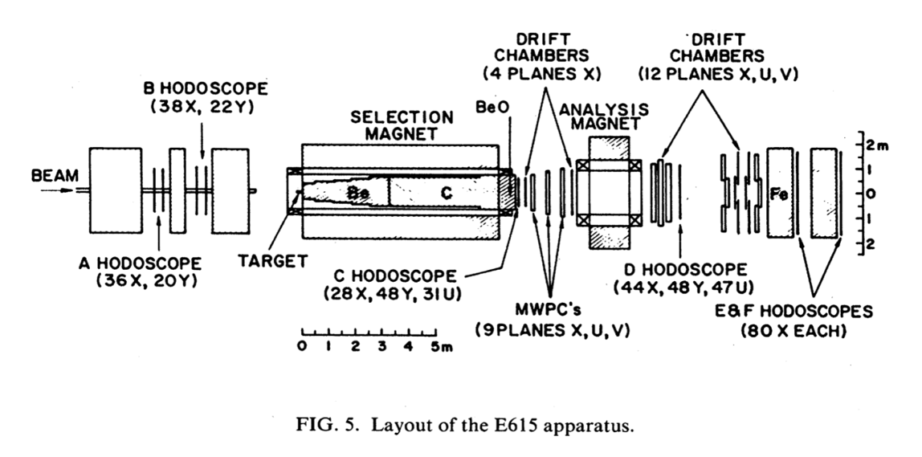
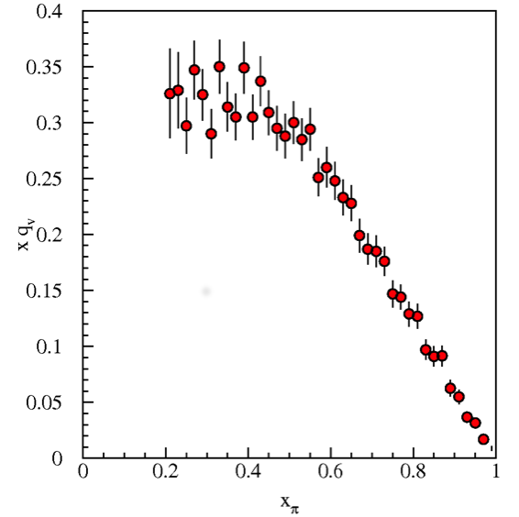
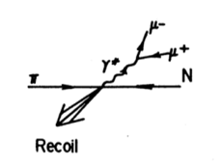
E615
Drell-Yan measurements conducted at Fermilab using pion on tungsten target in the intermediate and high x region
6

Slide 7
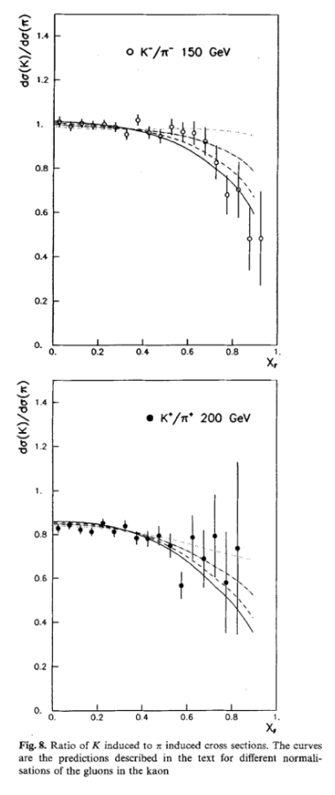
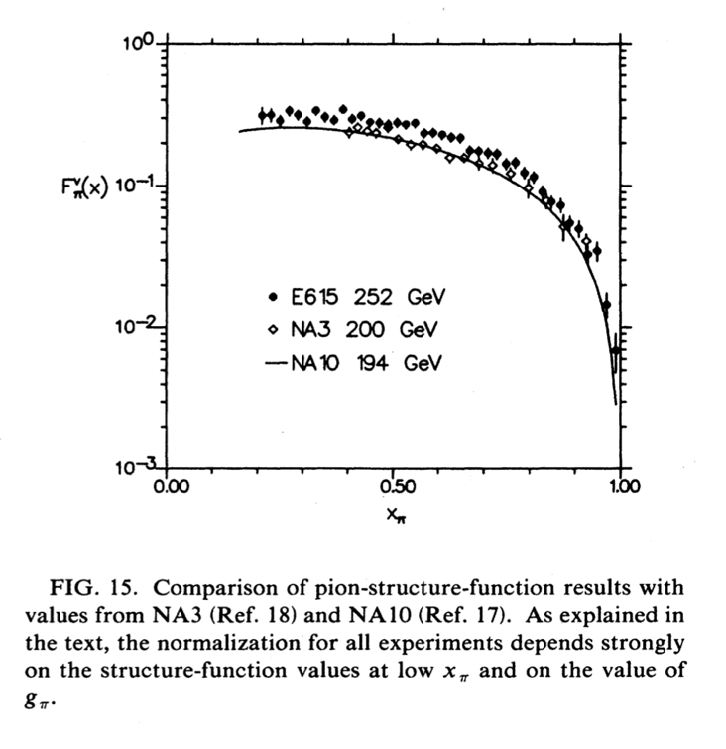
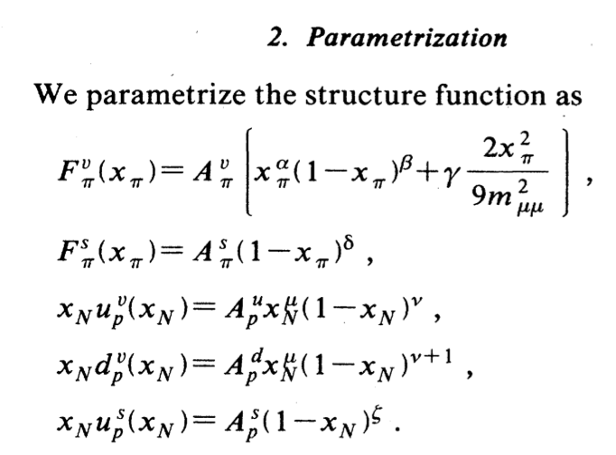
Na3 AND na10
NA3 and NA10 experiments conducted at CERN using 200 GeV and 194 GeV pion beams on proton target
Ratios of K⁺/π⁺ and K⁻/π⁻ were looked at to compare the behavior of valence quark distributions in these mesons
Studies have stressed that illustrating the similarity/difference between pion and protons SFs is critical to expose and explain EHM
7

Slide 8
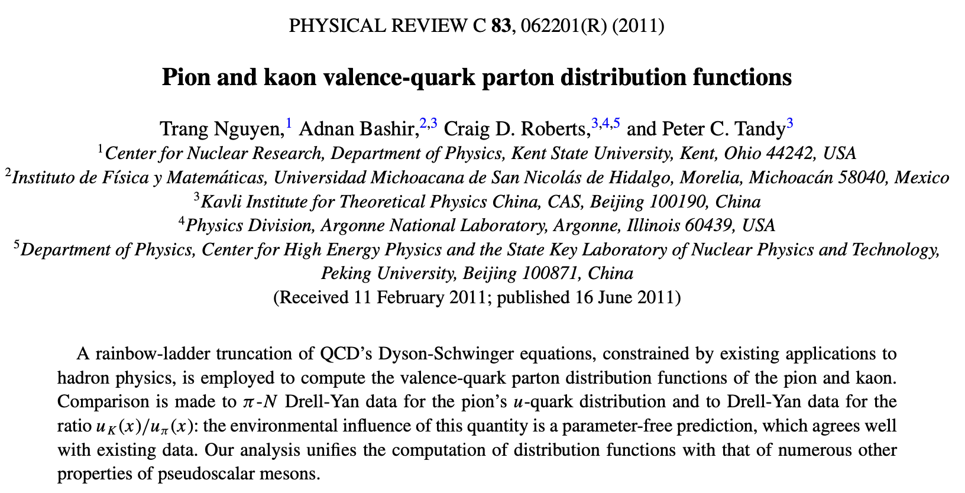
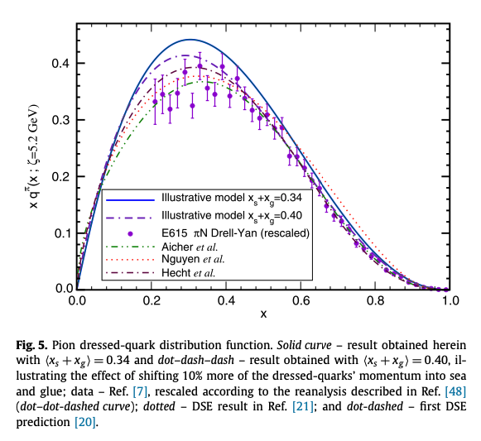
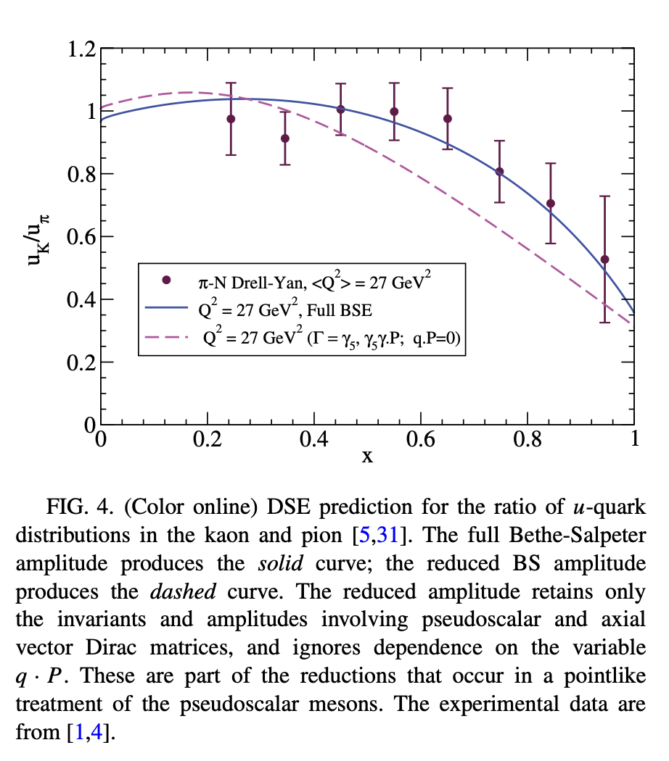
Recent re-analysis with gluon contribution showing better agreement with E615 data
Calculations of u quark distributions ratios in Kaon and Pion using Bethe Salpeter Equations (BSE)
8

Slide 9
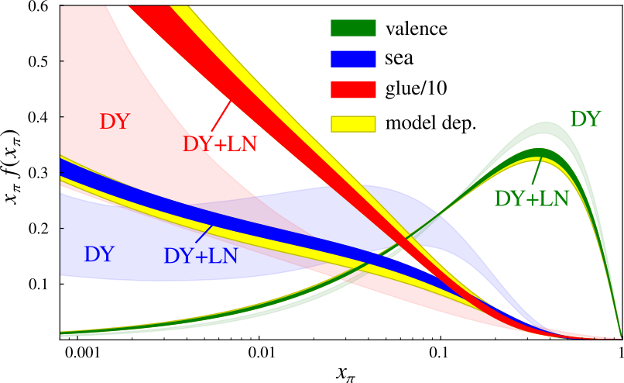
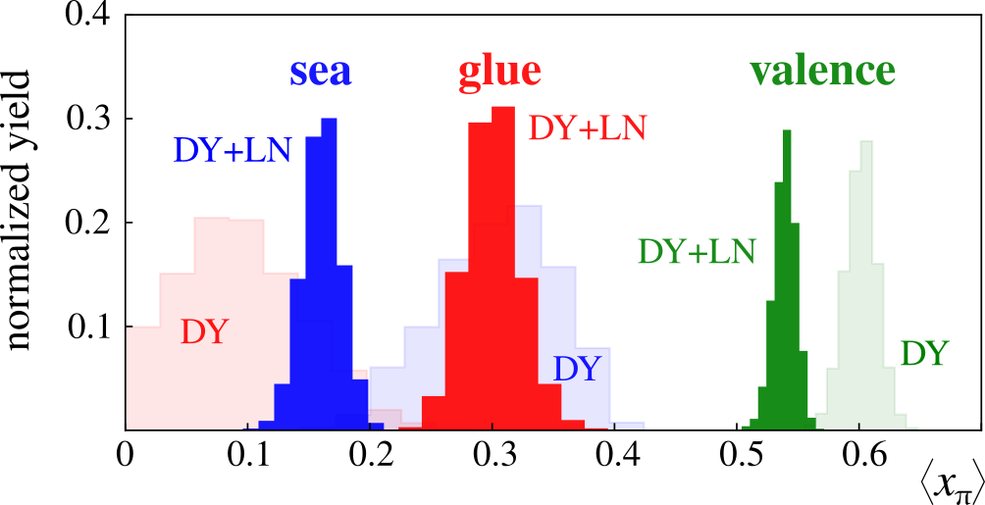
GLOBAL ANALYSIS OF PION PDFs
∼(1-x)
P. C. Barry, N. Sato, W. Melnitchouk, and Chueng-Ryong Ji (JAM Collaboration), Phys. Rev. Lett. 121, 152001 (2018)
pQCD: (1-x)²
pion momentum breakdown into fractions carried by valence quarks, sea quarks, and gluons
Non-overlapping uncertainties show some tensions between the LN inclusion with DY and only DY data.
9

Slide 10
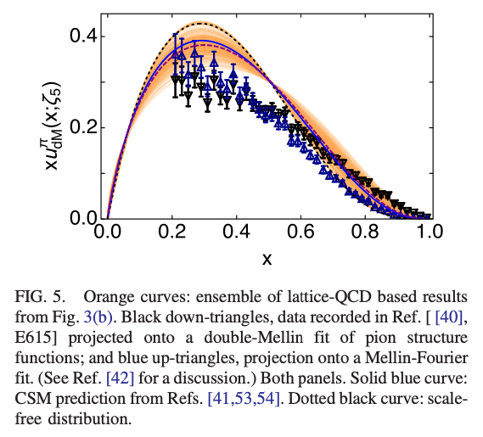
Recent theoretical work assuming threshold resummation
At some base q₀
NJL: xq(x)/ (1-x)^{β}, β = 1
pQCD: xq(x)/ (1-x)^{β}, β = 2
DSE: xq(x)/ (1-x)^{β}, β ≈ 1.9
Recent theoretical work assuming soft gluon resummation
10

Slide 11
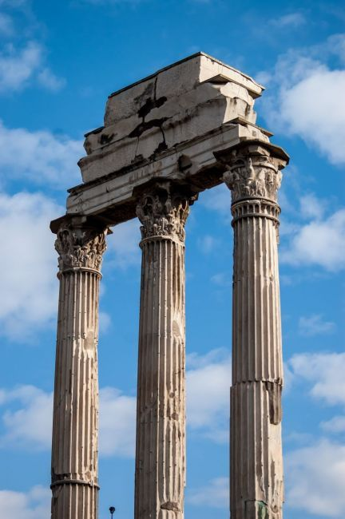
Complementarity of measurements
Scarcity of data on pion and kaon SF
Complementary processes access the “same” pion in different x and Q² regions with some overlap
Process independent PDF extraction could be established (Drell Yan vs Tagged DIS vs prompt photon)
TDIS could lead to a pioneering way to access exotic targets!
*Not to scale
Pion
EIC
TDIS – JLAB12
Q²
H1 LN
E615
EIC
TDIS
COMPASS++
X
Roman forum to the Maximus, Rome, Italy

Slide 12
Tdis EXPERIMENT (C12-15-006, C12-15-006a, C12-15-006B)
*ALL CONDITIONALLY APPROVED
C1 conditionally approved with A- rating in 2015
Luminosity of 2.9 x 10³⁶ /cm²s, current = 50 micro amps (needed for small cross sections)
Semi inclusive reactions with H(e, e’p)X and D(e, e’pp)X
8 < W² < 18 GeV²
1 < Q² < 3 GeV²
0.05 < x < 0.2
Low momentum recoil proton momenta detected by mTPC (large angular and kinematic acceptance for the recoil and recoil-spectator protons)
70 MeV/c < p < 400 MeV/c
30 < θ < 70 deg
Coincidence with deeply inelastically scattered e⁻ detected by Super Bigbite Spectrometer
Study of charged and neutral pions structure to check for validity of isospin symmetry
12

Slide 13
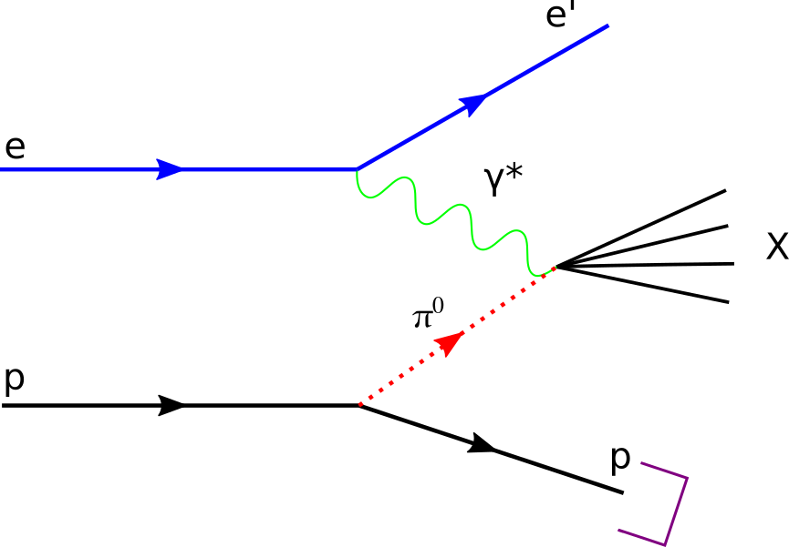
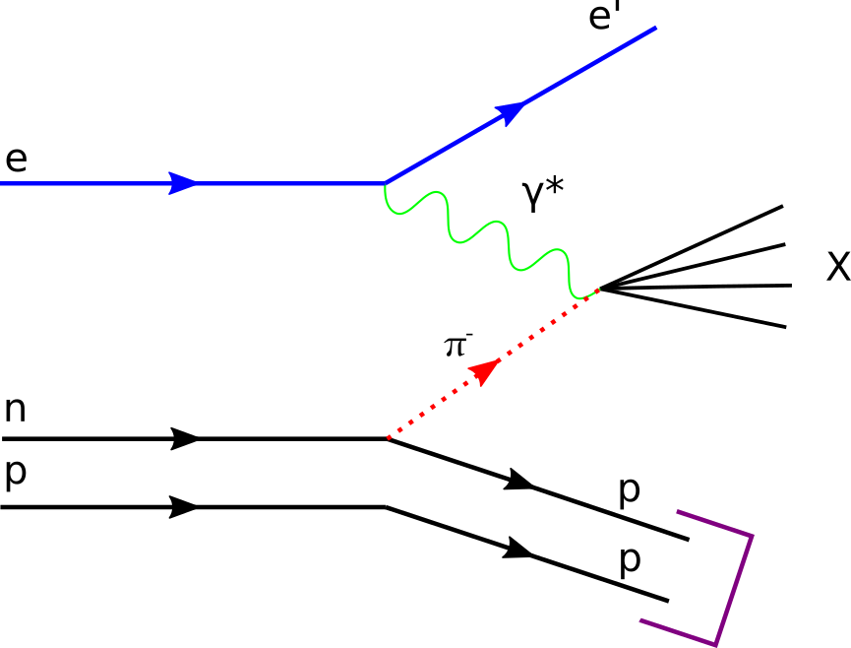
PION STRUCTURE FROM SULLIVAN PROCESS (TDIS)
Recoil proton
(backward going
slow proton) TAG
detecting two
protons with
common vertex
Spectator proton
Recoil proton
(backward going
slow proton) TAG
13

Slide 14
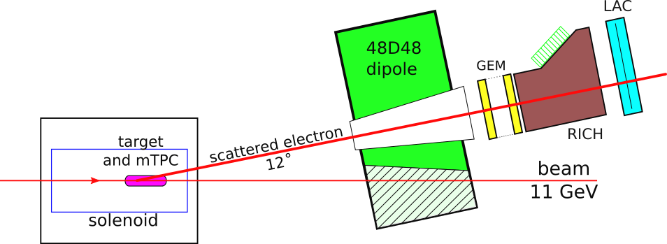
EXPERIMENTAL LAYOUT IN HALL C
14

Slide 15
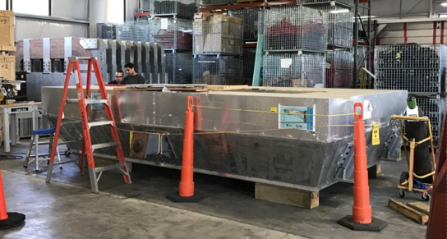
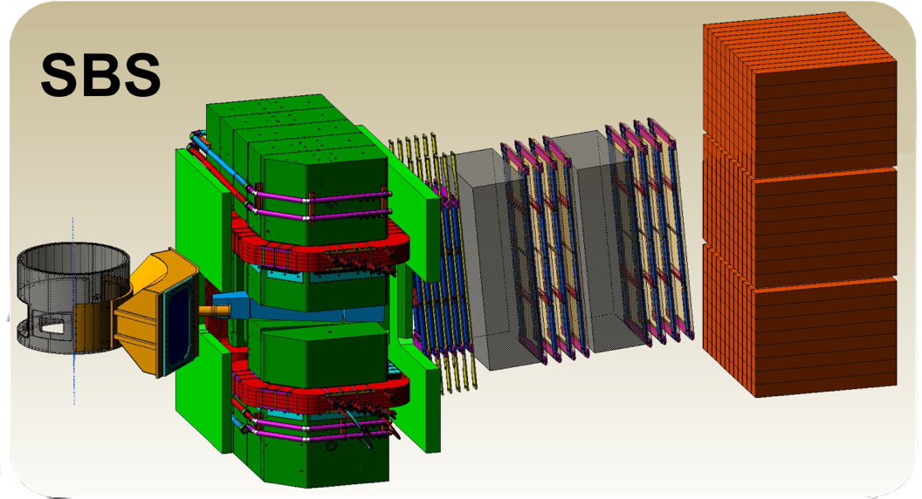
ELECTRON ARM
SBS configured for e⁻ detection; 12° scattering angle (large acceptance, ~50msr)
• 5 GEM tracker planes (70μm resolution)
• Threshold CO₂ Cherenkov detector (modified HERMES RICH)
• Large Angle Calorimeter - LAC (from Hall B CLAS)
• e⁻ PID and e⁻ trigger (L2) = Cherenkov + calorimeter (combined π rejection factor ~10⁴ )
LAC at ESB
15

Slide 16
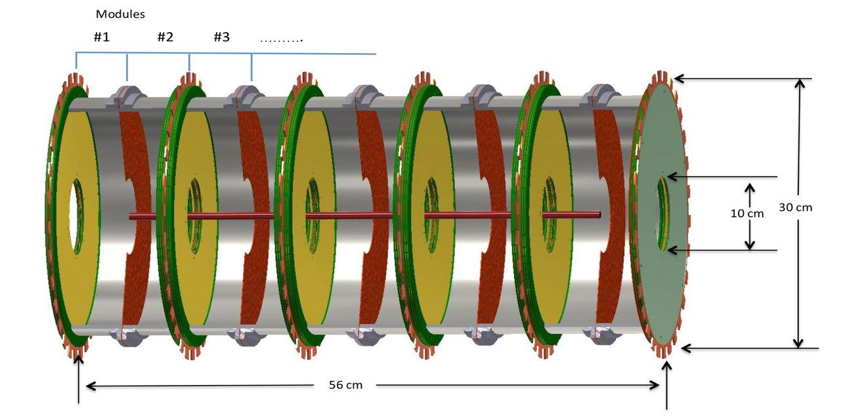
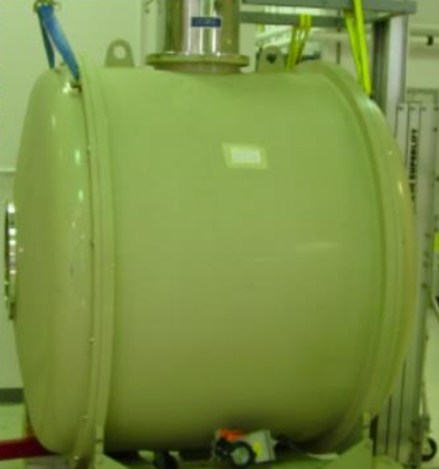
CONCEPTUAL DESIGN OF THE mTPC
Converged on a design since the original proposal: multi–Time Projection Chamber (mTPC)
Electric field is parallel to the solenoid magnetic field
mTPC embedded within a 5T solenoid
Prototype will be tested and mTPC design parameters will be finalized
16

Slide 17
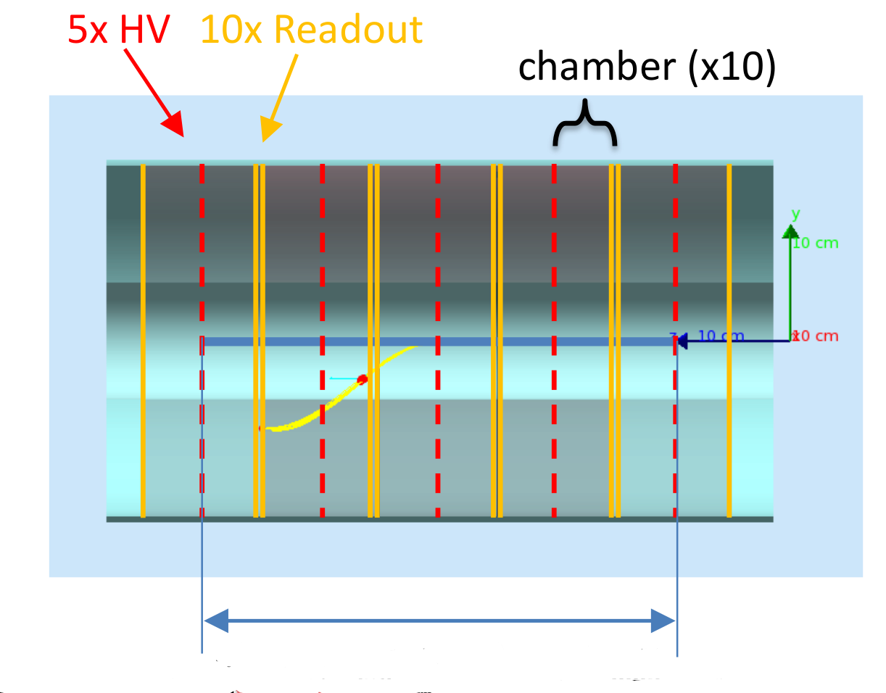
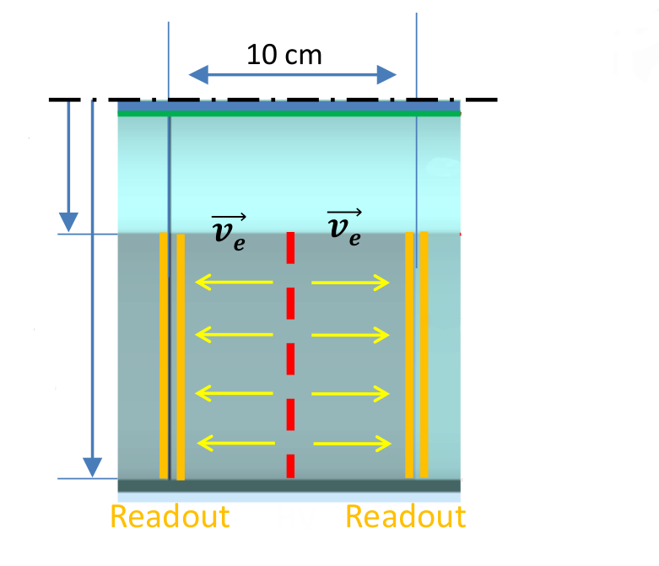
mTPC CELLS
A prototype cell is under construction
Target cell: Al straw
All volumes: He
(under study)
5 cm
Inner electrode:
15 cm
Each readout disc:
1 readout
2 GEM
Outer electrode:
Cathode
40 cm
17

Slide 18
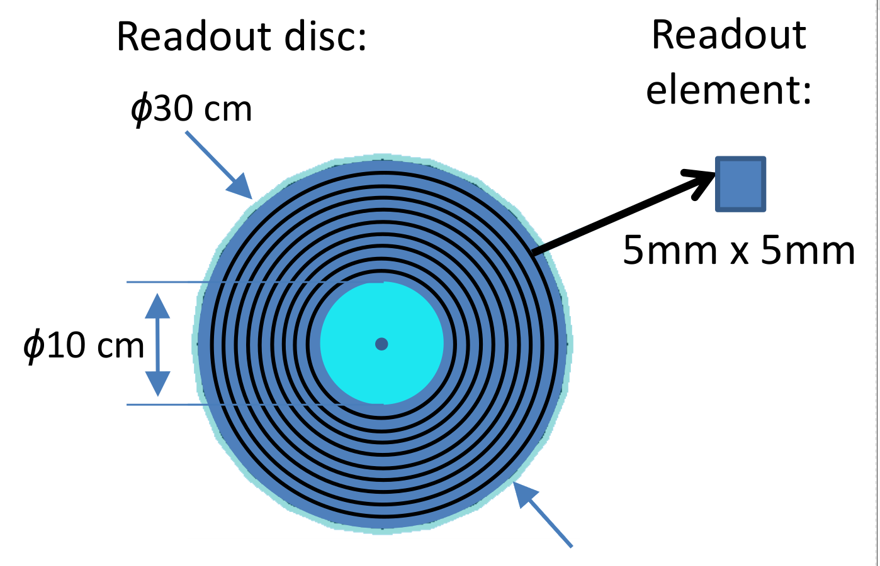
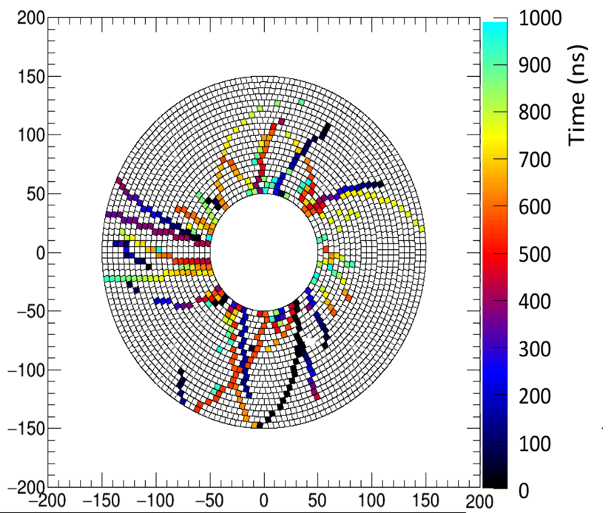
mTPC HITS ON A PAD GRID
Simulated hits superimposed on a grid of pads
M. Carmignotto, TDIS BiWeekly meeting.
February 28, 2019
Pad size and cell design still being optimized by the collaboration
18

Slide 19
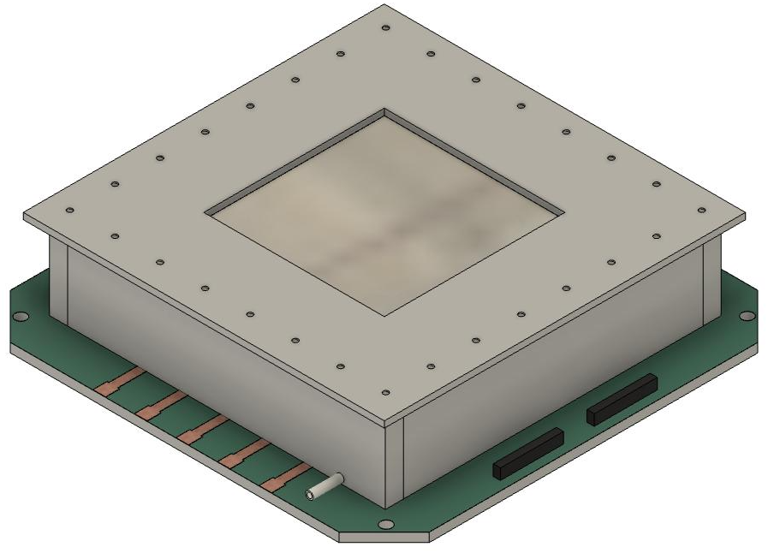
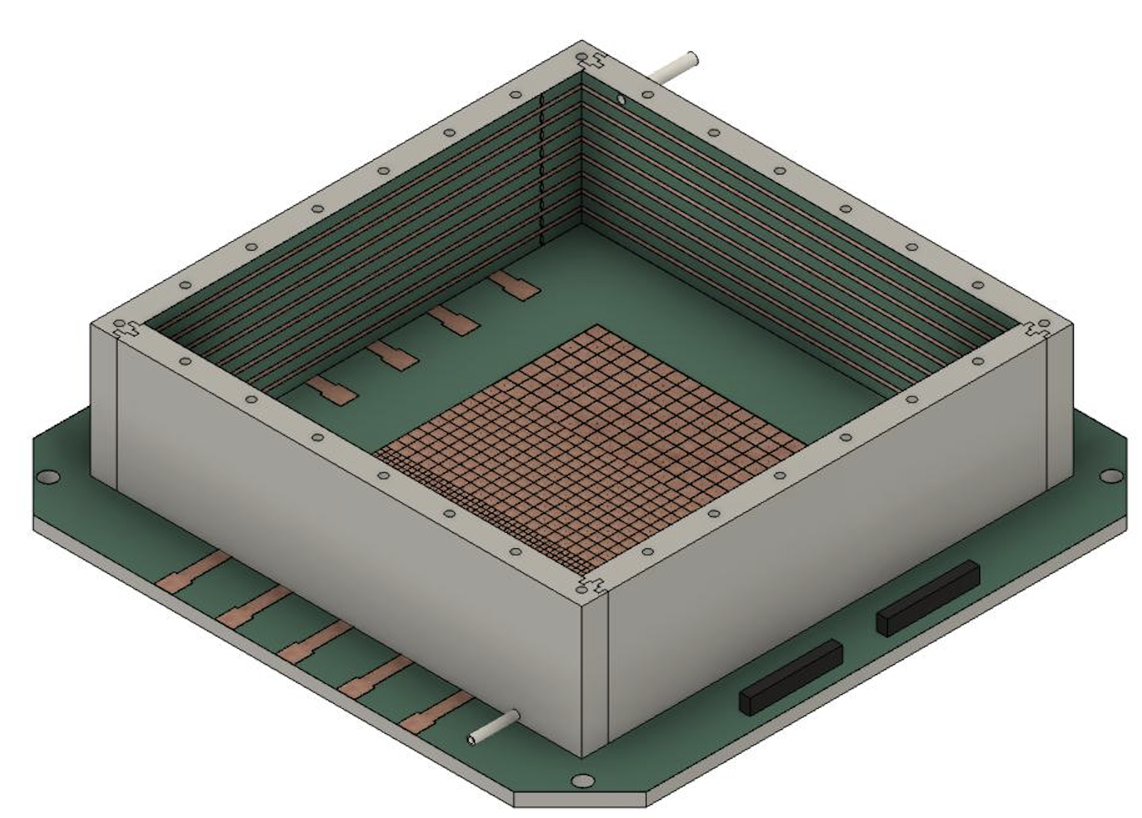
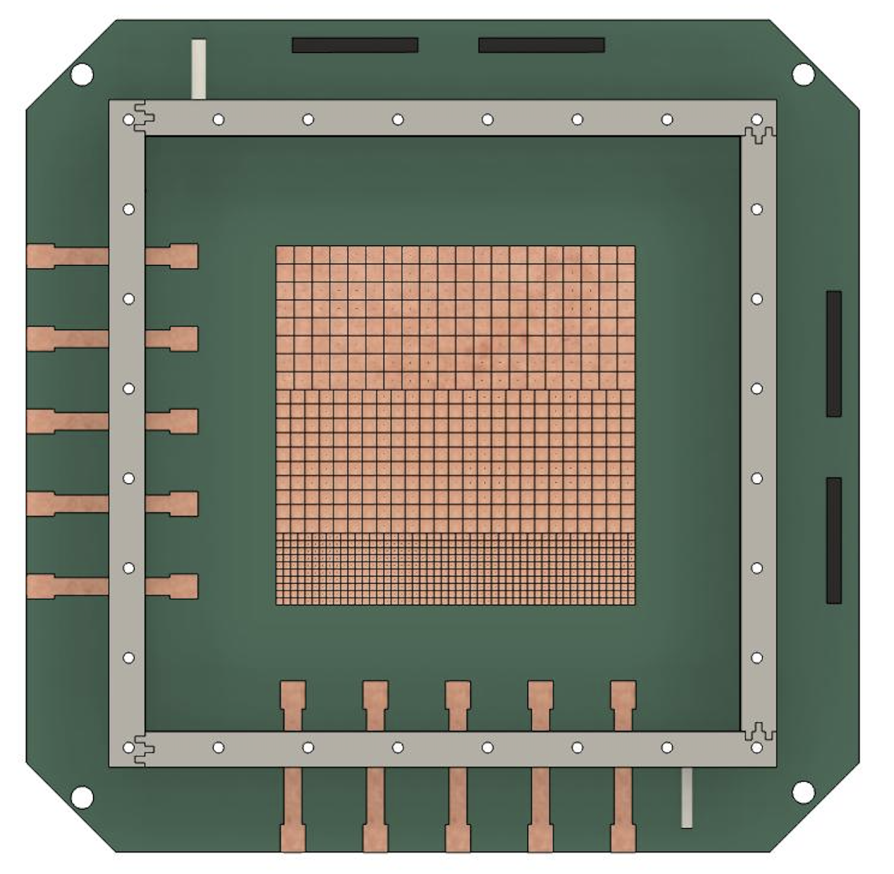
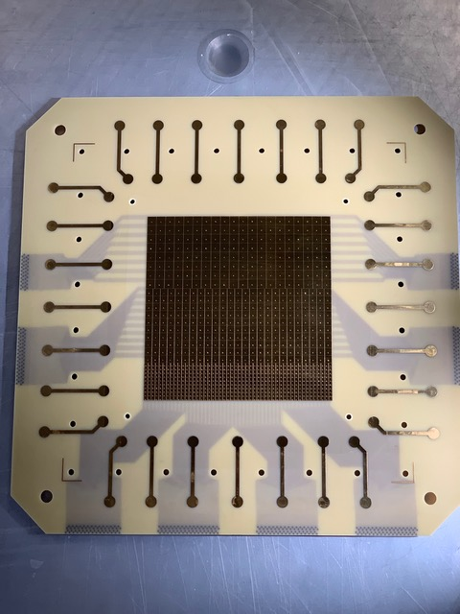
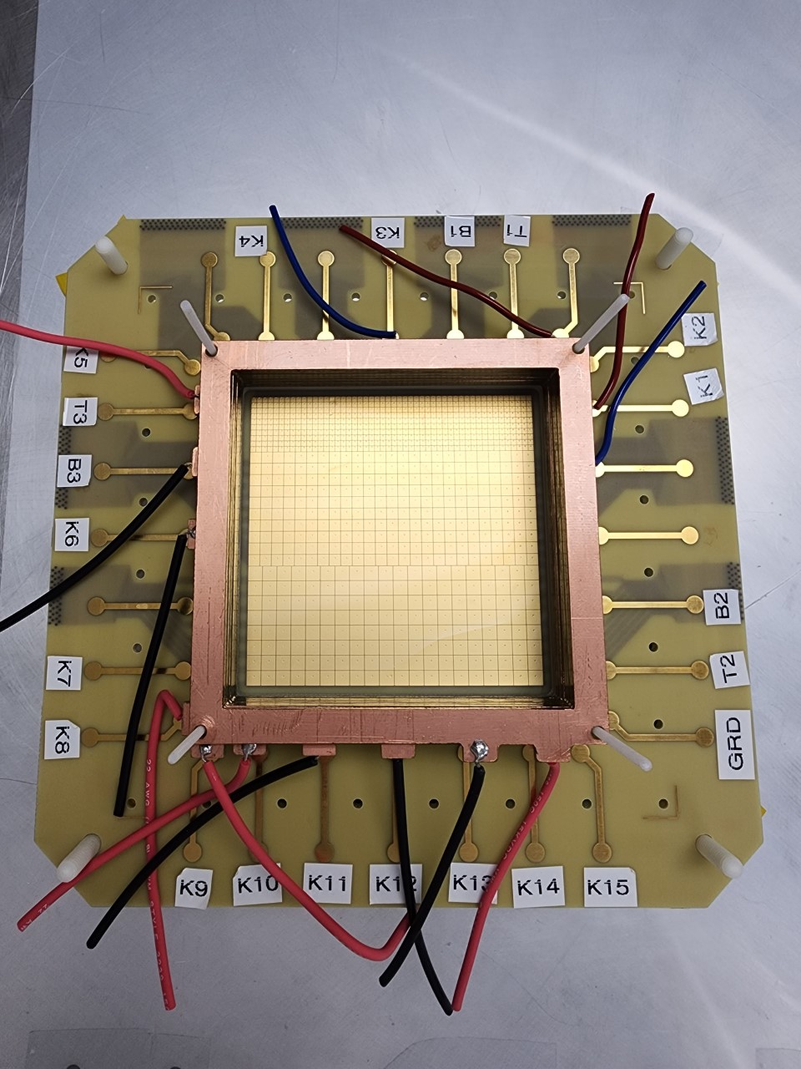
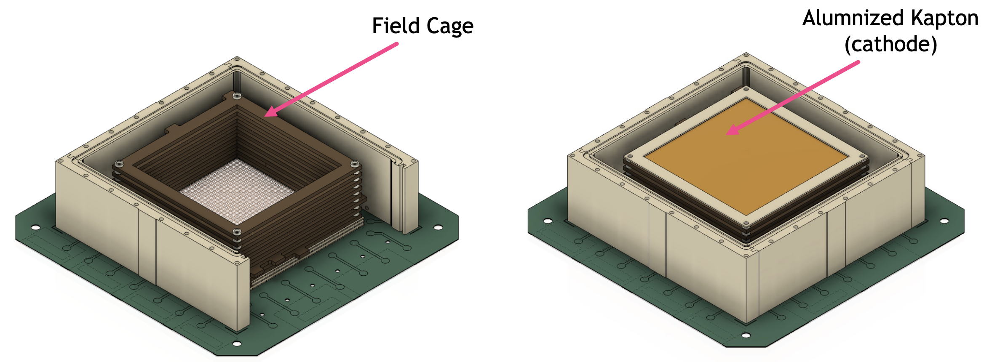
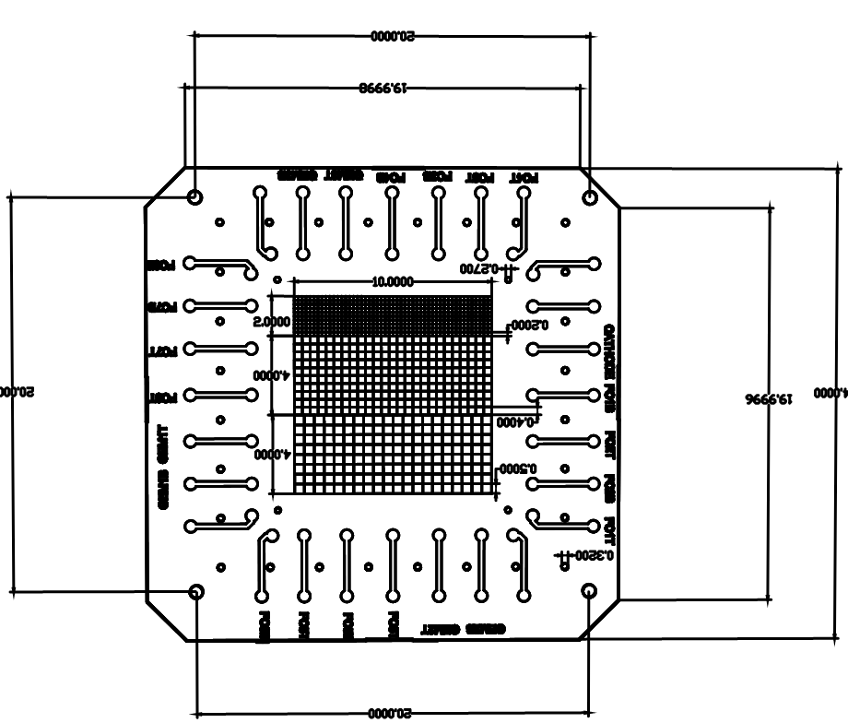
mTPC Prototyping
Slide credit: Rachel Montgomery
Thin aluminised kapton window
University of Virginia constructing 1st prototype mTPC chamber (N. Liyanage, H. Nguyen, S. Ali)
10 x 10 cm² square active area
Entrance window → cathode → 4.7cm drift in field cage → triple GEM (2mm between foils) → segmented anode (PCB) → Panasonic connectors
JLab/Mississippi State (E. Christy, C. Cuevas, A. Nadeshani) preparing HV divider
Expect start of tests ~ April
Aims: tune simulation and tracking, test design
Segmented Pads
GEM foils
Gas in
E-field set up by electrodes
10cm
ionisation
Charged particle
Not to scale
5cm
Gas out
HV strips
From S. Ali
Readout pads
Field set up by electrode strips
CAD model: S. Ali
Different sized pads
2mm, 4mm, 5mm pixels
19
Construction/image: Huang Nguyen

Slide 20
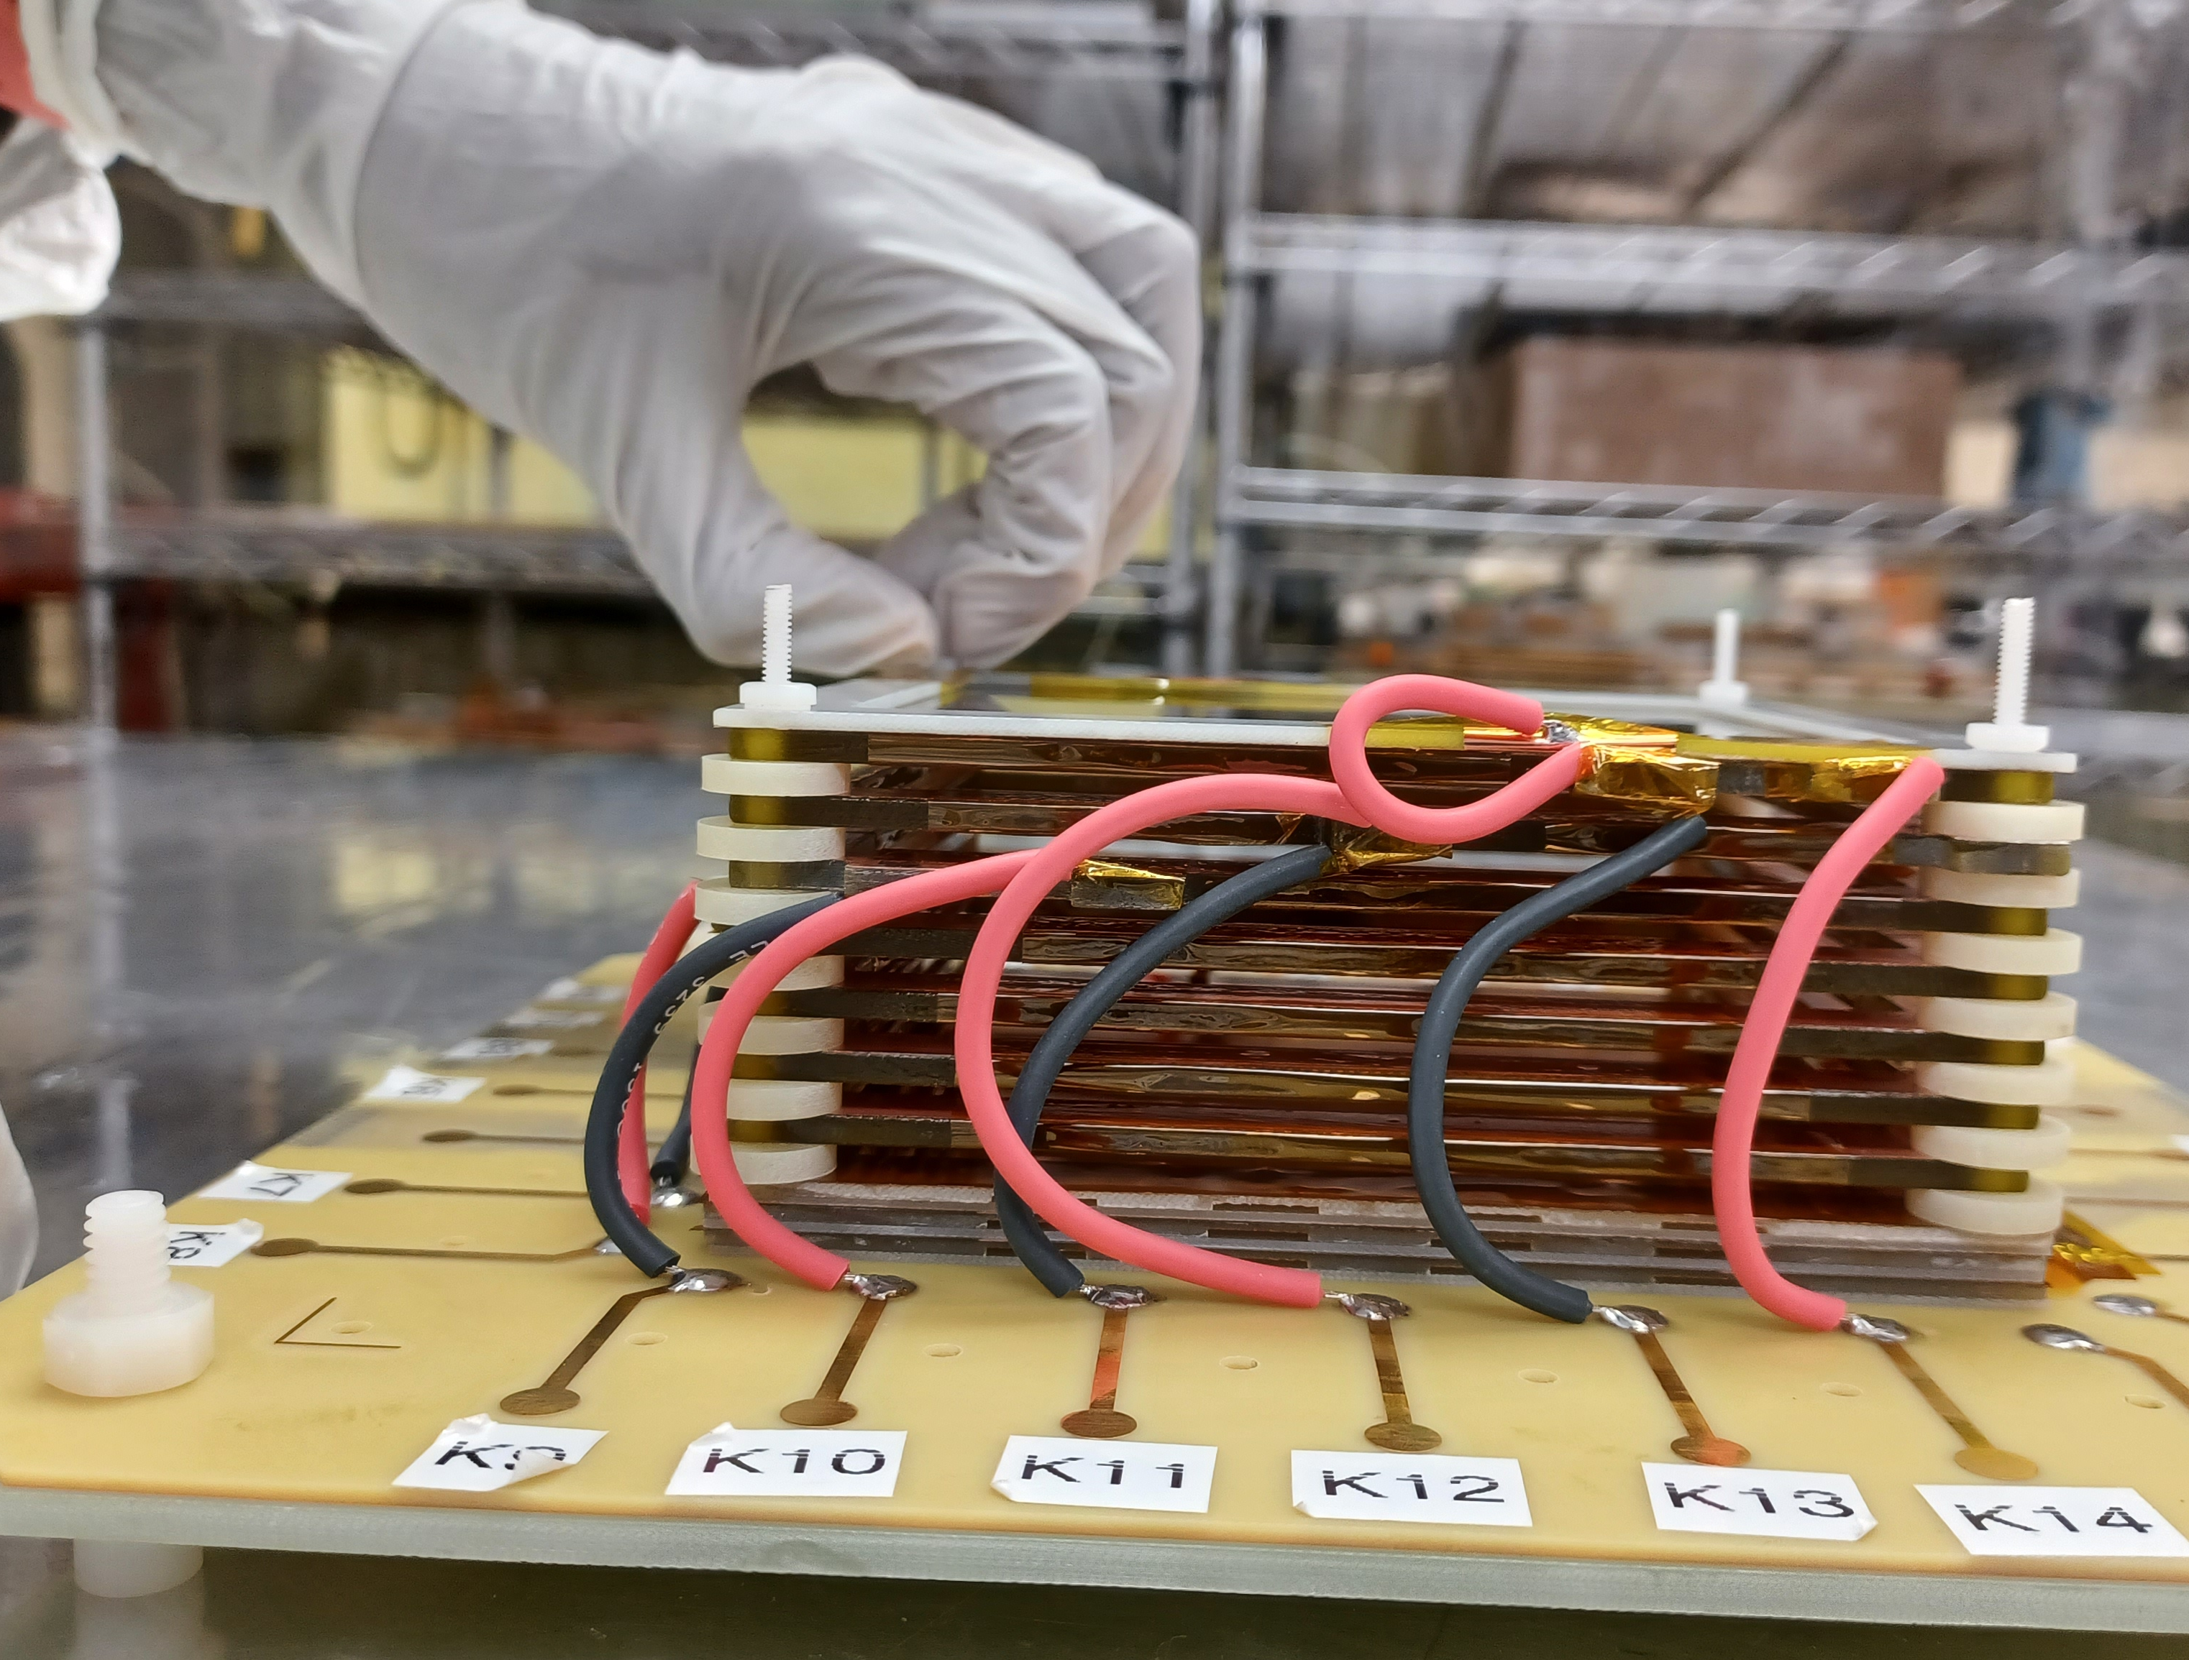
mTPC Prototyping
Slide credit: Rachel Montgomery
University of Virginia recently completed 1st prototype
(N. Liyanage, H. Nguyen, S. Ali)
10 x 10 cm² active area
Entrance window → cathode → 4.7cm drift in field cage → triple GEM foils (2mm between foils) → segmented anode PCB → Panasonic connectors/readout
JLab/MSU (E. Christy, C. Cuevas, A. Nadeeshani, D. Dutta) preparing HV divider and readout
Expect start of tests at JLab imminently
CAD model: S. Ali (UVa)
Field set up by electrode strips
Different sized readout pads
2mm, 4mm, 5mm pixels
HV strips
20
Construction images courtesy of Aruni Nadeeshani (MSU), Huang Nguyen (UVa)

Slide 21
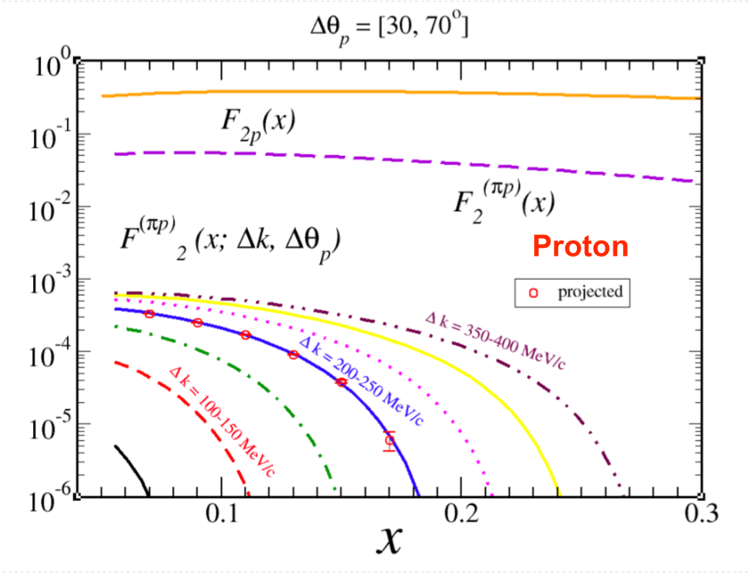
PHENOMENOLOGICAL CONTRIBUTIONS TO F_{2p}
Well measured F2p
Contribution to F2p from F2𝛑p
Colored lines are F2𝛑p contributions for different bins in proton momentum
21

Slide 22
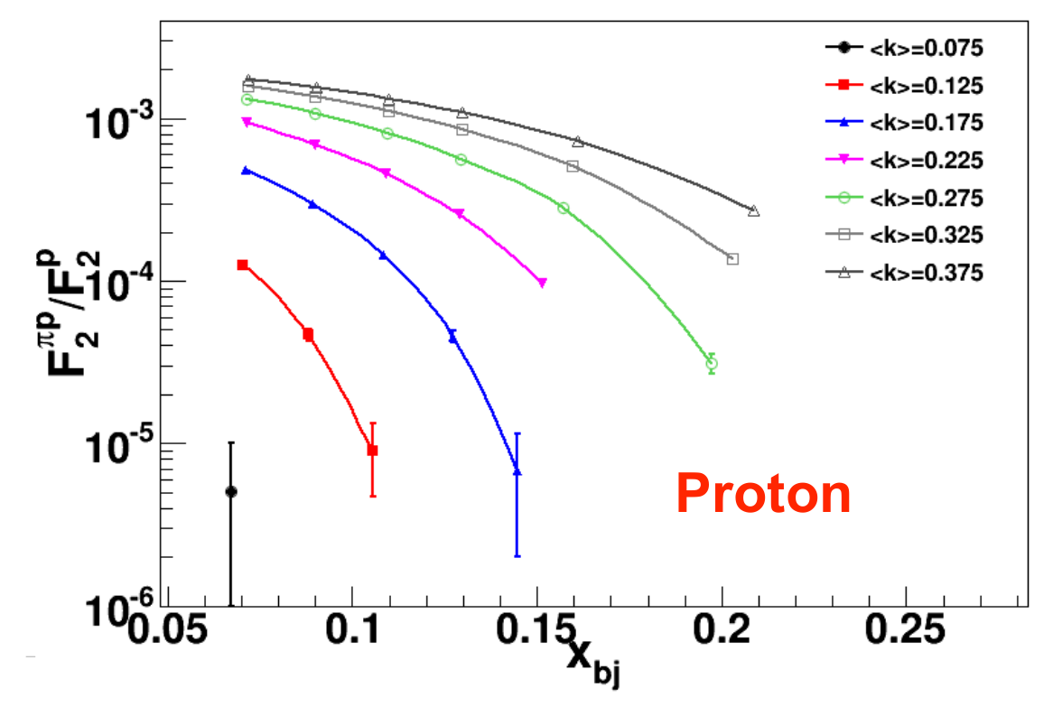
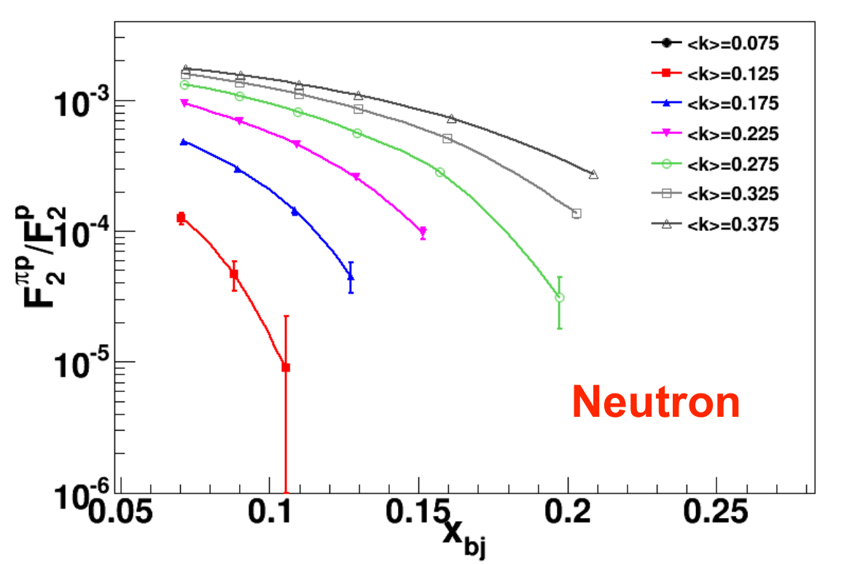
PROJECTED RESULTS IN BJORKEN-X
-At fixed x, highest x points are the lowest t values
22

Slide 23
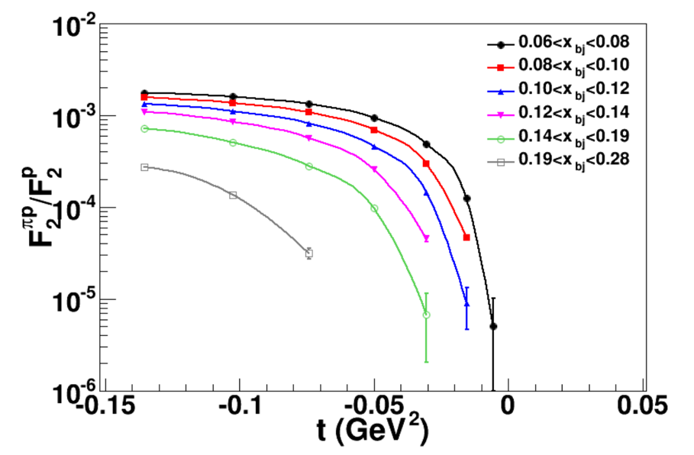
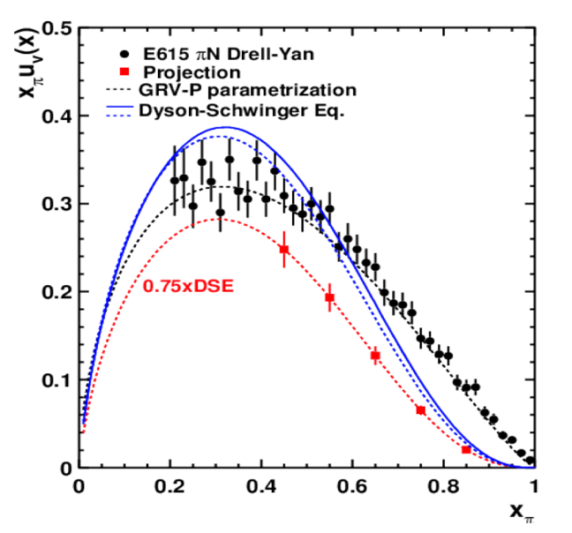
PROJECTED RESULTS IN t
Different colors are contributions for recoil momenta <k> bins (GeV/c)
Pion pole
Projected extracted pion structure function along curve with 0.75DSE
23

Slide 24
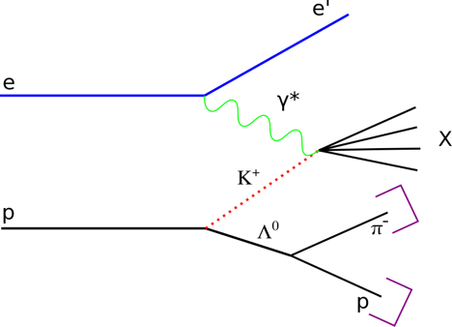
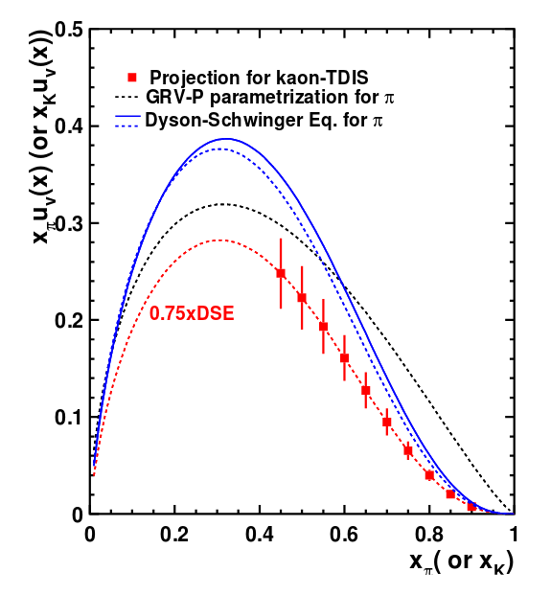
RUN GROUP PROPOSAL (C12-15-006A)
Conditionally approved kaon TDIS proposal
Proton is tagged with a pion generated by lambda decay
Kaon TDIS events are “background” measurement for pion TDIS (are they really?)
Fundamental kaon structure physics with no modification to the detectors!
24

Slide 25
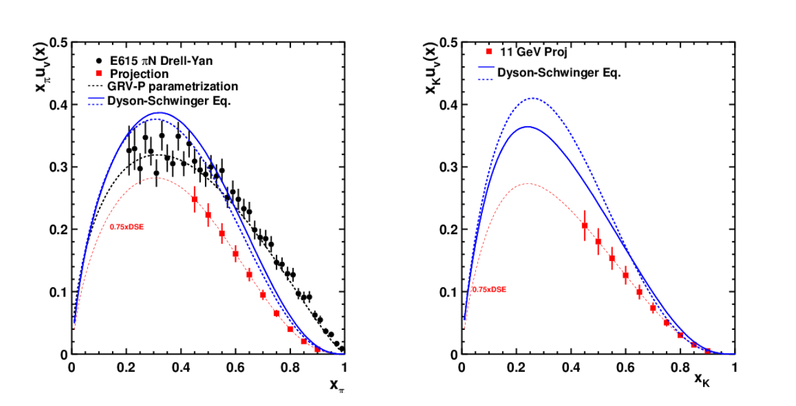
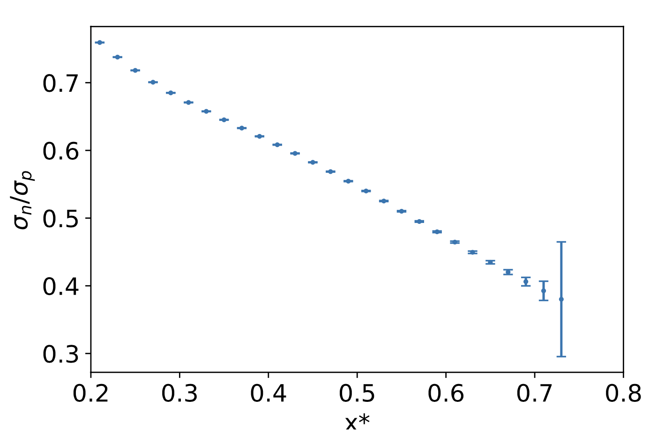
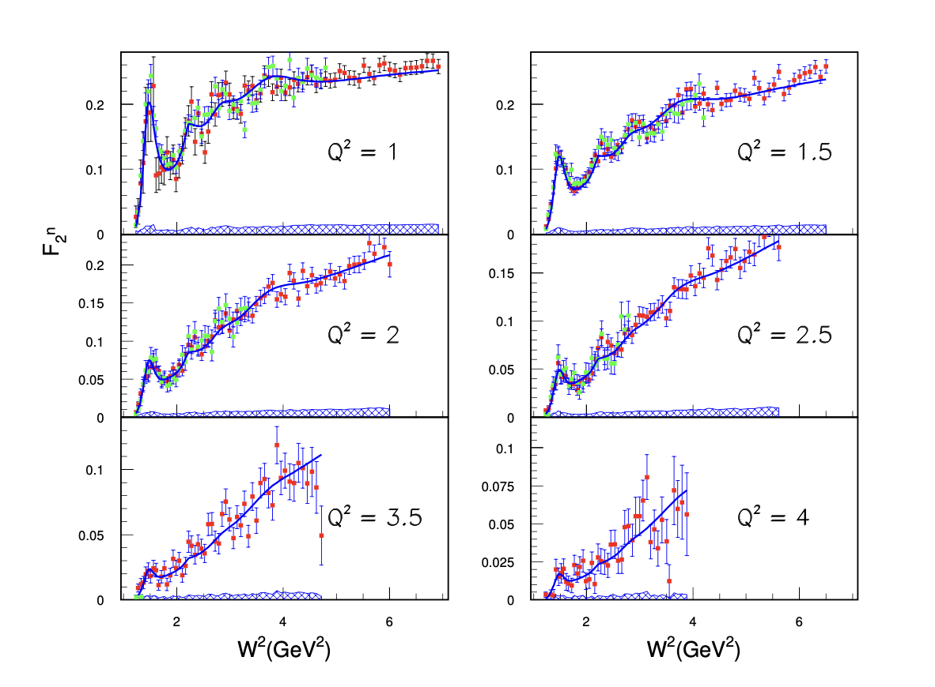
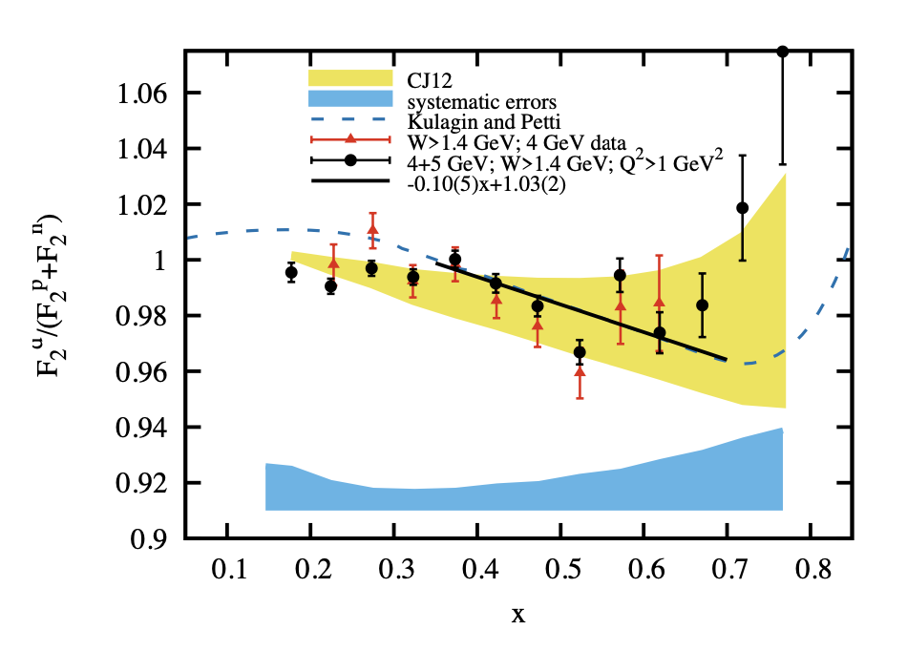
F2n/F2p ala Bonus
Resonance region structure
Pion and Kaon structure
Form factors with a tagged proton
EMC effect in deuterium
25

Slide 26
SUMMARY
Understanding meson structure functions is one of the central goals of nuclear physics.
With recent advances in theory, more precise data using complementary techniques is necessary and timely for a complete understanding of meson structure.
Tagged Deep Inelastic Scattering experiment (TDIS) takes advantage of the Sullivan process, uses a novel tagged DIS approach to probe pion and kaon structure in a high luminosity environment.
Two additional run group proposals were added to the main TDIS since its conditional proposal making it a very attractive and dynamic physics program.
TDIS experiment will defend jeopardy during the summer and its C1 conditional status later this fall.
26

Slide 27
arxiv:2303.02579v1
Eur. Phys. J. A (2019) 55: 190
Science at the luminosity frontier: 22GeV workshop
arxiv:1808.00848v6
EIC Yellow report
27
arxiv: 2103.05419v2

Slide 28
Thank you!
28

Slide 29
simulations
Simulations include G4SBS, the mTPC, including the straw target and the magnetic field in the mTPC area with a Tosca model of the magnetic field generated by the solenoid
The electron arm: composed of the SBS magnet (with a uniform magnetic field generated in the SBS magnet gap), and the detector package, itself composed of a stack of 5 GEM trackers, the SBS RICH detector (the former HERMES RICH detector) and a module of the Large Angle Calorimeter recovered from the CLAS6 spectrometer.
Figure shows a close-up view of the mTPC, and the trajectories for 100 MeV proton generated by G4SBS that were bent by the magnetic field of the solenoid.
29

Slide 30
CURRENT BACKGROUND ESTIMATES
Protons from Elastic: ~170MHz, QE: ~480 MHz (EPC code)
J. W. Lightbody, and J. S. O’Connell. Computers in Physics2, 57 (1988)
Protons from DIS: ~10.5 MHz on p and 8.9 MHz on n
FF DSS2007 and CTE6 PDFs
Pions from DIS: ~
Inelastic (p) π⁺ is 0.7 MHz and π⁻ is 0.5 MHz (Pythia6)
Inelastic (n) π⁺ is 0.43 MHz and π⁻ is 0.69 MHz (Pythia6)
Slide credit: Carlos Ayerbe Gayoso
30

Slide 31
Triggerless Readout at JLab
Slide credit: Rachel Montgomery
All pics:
E. Jastrzembski JLab
FEC, 5 Sampa chips (160ch)
Plan to read data continuously from ≥35k channels
Parallel data flow
Event synch with triggered detectors (SBS)
Prototyping at JLab (E. Jastrzembski, G. Heyes, et al.)
Using Oak Ridge SAMPA FEC for the ALICE TPC
SAMPA ASIC: pre-amp, ADC, zero-suppression… (M. Bregant, Sao Paolo)
Continuous sampling w/ high readout speed (~1TB/s post zero-supp for ~35k chan)
Awaiting delivery of chips; rad hard components under procurement
JLab Cosmic Test Stand
FEC coupled to GEM

Slide 32
Tools to probe pion structure
space
space
time
time
DEEP INELASTIC SCATTERING
Lepton scatters from hadron
Exchange of virtual photon
Excited states of the hadron (or more)
Doesn’t differentiate between quark and antiquark
DRELL YAN PROCESS
Quark from hadron annihilates with antiquark from another hadron
Virtual photon is created
Decays into a lepton + antilepton
Unique sensitivity to the anti-quark distributions
32

Slide 33
mTPC CELLS
Target cell: Al straw
5 cm
All volumes: He
(under study)
Inner electrode:
15 cm
Each readout disc:
1 readout
2 GEM
Outer electrode:
Cathode
40 cm
33

Slide 34
Projected results in Bjorken-x
-At fixed x, highest x points are the lowest t values
-Not expected to measure below 150 MeV/c due to
increased background constraints → larger
statistical uncertainties
34

Slide 35
Justification of the meson cloud
E866/NuSea Experiment
Symmetric (perturbative and non-perturbative) component cancels away in the difference
Remaining non perturbative asymmetric contribution interpreted in terms of a meson cloud due to virtual meson nucleon Fock state fluctuations
Credit: Joshua Rubin, Argonne National Laboratory
Peng et al. Phys. Rev. D 58 092004
35

Slide 36
Proton can be rewritten in terms of virtual meson nucleon fock fluctuations
NAIVE MESON CLOUD MODEL
36

Slide 37
Slide credit: Carlos Ayerbe Gayoso
37

Slide 38
Slide credit: Carlos Ayerbe Gayoso
38

Slide 39
SeaQuest results released!!
Experiment based at Fermilab
Uses 120 GeV proton beam on liquid hydrogen and deuterium targets to study Drell-Yan interactions and anti-quark flavor asymmetry in the nucleon
Meson cloud model by Alberg and Miller and Statistical parton distribution functions model from Bourrely and Soffer agree well with SeaQuest results

Slide 40
MODELS OF THE PION
Projection of experimental data onto x_{π} axis
Nambu and Jona-Lasinio Model:
R. Davidson, E. Arriola, PLB (1995)
J.T. Londergan et al. PLB (1994).
T. Shigetani et al. PLB (1993).
Dyson Schwinger Equation:
M. Hecht et al. PRD (2001).
L. Chang et al
Chiral Quark Model:
K. Suzuki, W. Weise, NPA (1998).
D. Arndt, M. Savage, nucl-th (2001).
Light-front constituent quark models:
Gerry Miller, et al. (too many to list).
Instanton Model:
A. Dorokhov, L. Tomio, PRD (2000).
QCD Sum Rule Calculations
A. Bakulev et al. PLB (2001).
Lattice Gauge
C. Best et al. PRD (1997).
and more
At some base q₀
NJL: xq(x)/ (1-x)^{β} β = 1
pQCD: xq(x)/ (1-x)^{β} β = 2
DSE: xq(x)/ (1-x)^{β} β ≈ 1.9
40
Slide credit: Paul Reimer

Slide 41
Caveat: x_{π} Resolution
J/ψ
x_{π} resolution
Best case, x_{π} and x_{N} contribute equally
(E866 experience Δx_{π} = 5 Δx_{N}) Δ x_{π}/x_{π}¼ 0.14)
x_{π} resolution not quoted in paper or thesis
41
Slide credit: Paul Reimer

Slide 42
pION STRUCTURE VIA Prompt photon production - WA70
42

Slide 43
pION STRUCTURE VIA Prompt photon production – NA24
43

