Slide 1

Center for Nuclear Femtography (CNF)
Overview and activities
Towards improved hadron-femtography hard exclusive-reactions-2023
Latifa Elouadrhiri
Acting Director
Newport News, Virginia
August 7, 2023

Slide 2
Mission
Supported by the Commonwealth of Virginia
Hosted at Jefferson Lab and supported SURA

Slide 3
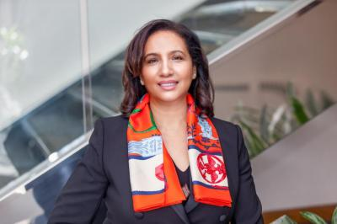
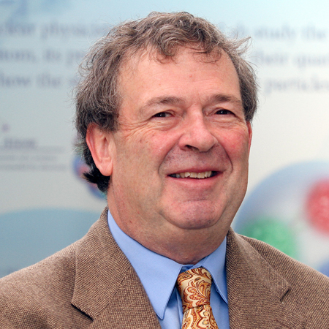
Organization
Acting Director: Latifa Elouadrhiri
Associate Director: David Richards
Senior Advisor: Xiangdong Ji
Fellows: Fellows from associated institutions
Postdocs: Gabriel Santiago, TBD
Graduate fellows: 6 for 2021-2022 and 5 for 2023 – 2024
CNF Website: https://www.femtocenter.org
  Seminars
  Series of Lectures
  Mini-workshops & Workshops
  Center research activities and publications

Slide 4
Participating Universities
University of Virginia
Old Dominion University
William and Mary
Christopher Newport University
Virginia Tech
Virginia Commonwealth University
Davidson College
Hampton University
George Washington University
University of Maryland
State University of New Mexico
Temple University
Jefferson Lab
University of Connecticut
MIT
Others to be invited

Slide 5
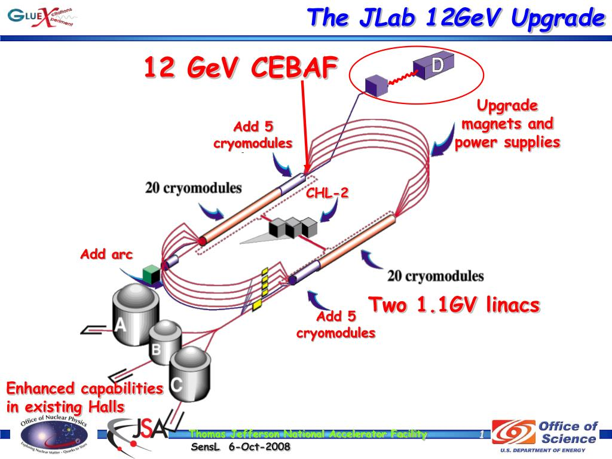
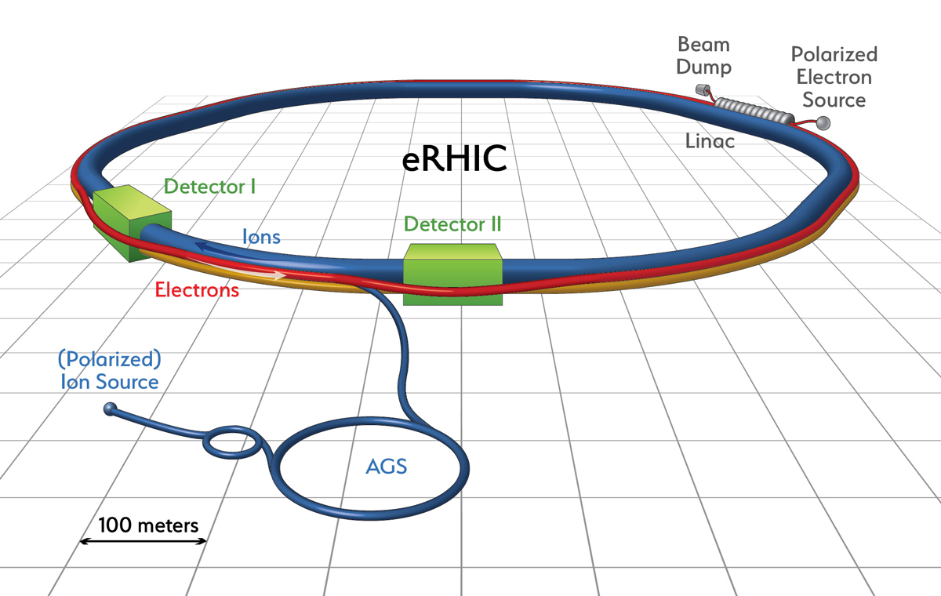
Research directions:
Exp. probes of nuclear femto-structure
JLab 6 & 12 GeV physics program
JLab 22 GeV
Electron-Ion Collider

Slide 6
CLAS12 in Hall B
Nuclear Inst. and Methods in Physics Research, A 959 (2020) 163419 + 17 articles on all subsystems.

Slide 7
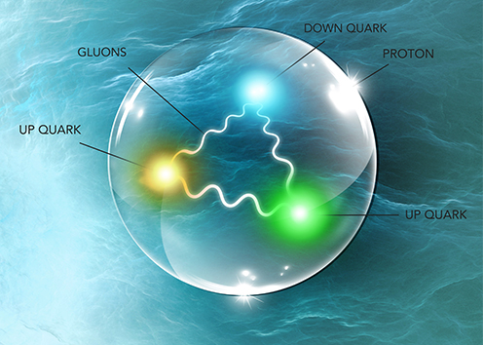
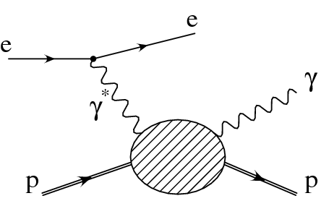
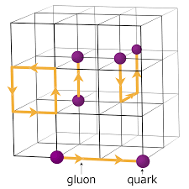
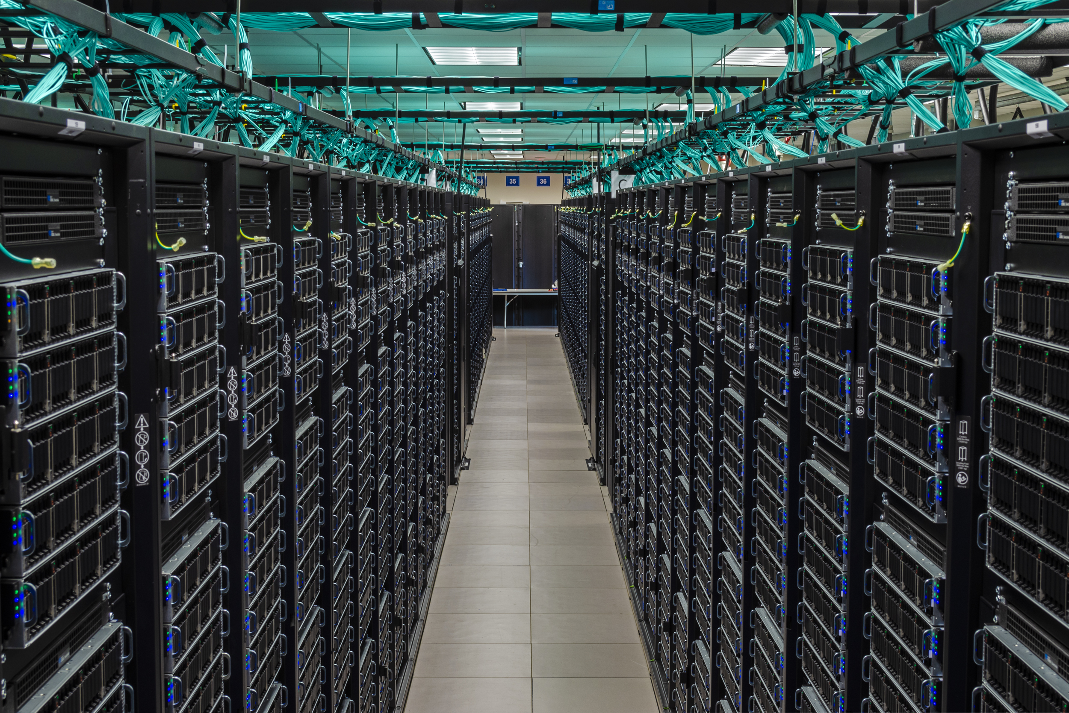
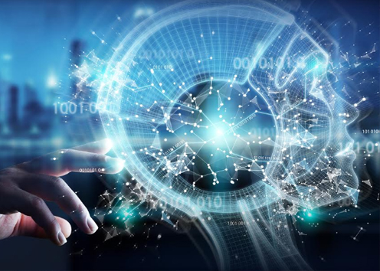
Research directions:
Imaging & Mechanical Structure of the Nucleon
Large-scale simulations of the proton structure:
Generalized Parton Distributions (GPDs) and Transverse Momentum Dependence (TMDs) probed through deep exclusive and semi-inclusive processes providing an important tool to visualize the nucleon.
QCD is the fundamental theory of strong interactions. It is a field theory that can be approximated on a four-dimensional Euclidean lattice, allowing researchers to use supercomputers to simulate this theory on lattice
Machine Learning/Artificial Intelligence in Femtography
Many intermediate steps in experiment and theory involve large amounts of data and computer simulations
Using ML/AI techniques and in collaboration with computer scientists and mathematicians, nuclear physicists will be able to obtain results in a timely and resource-saving manner.

Slide 8
CNF Workshops

Slide 9
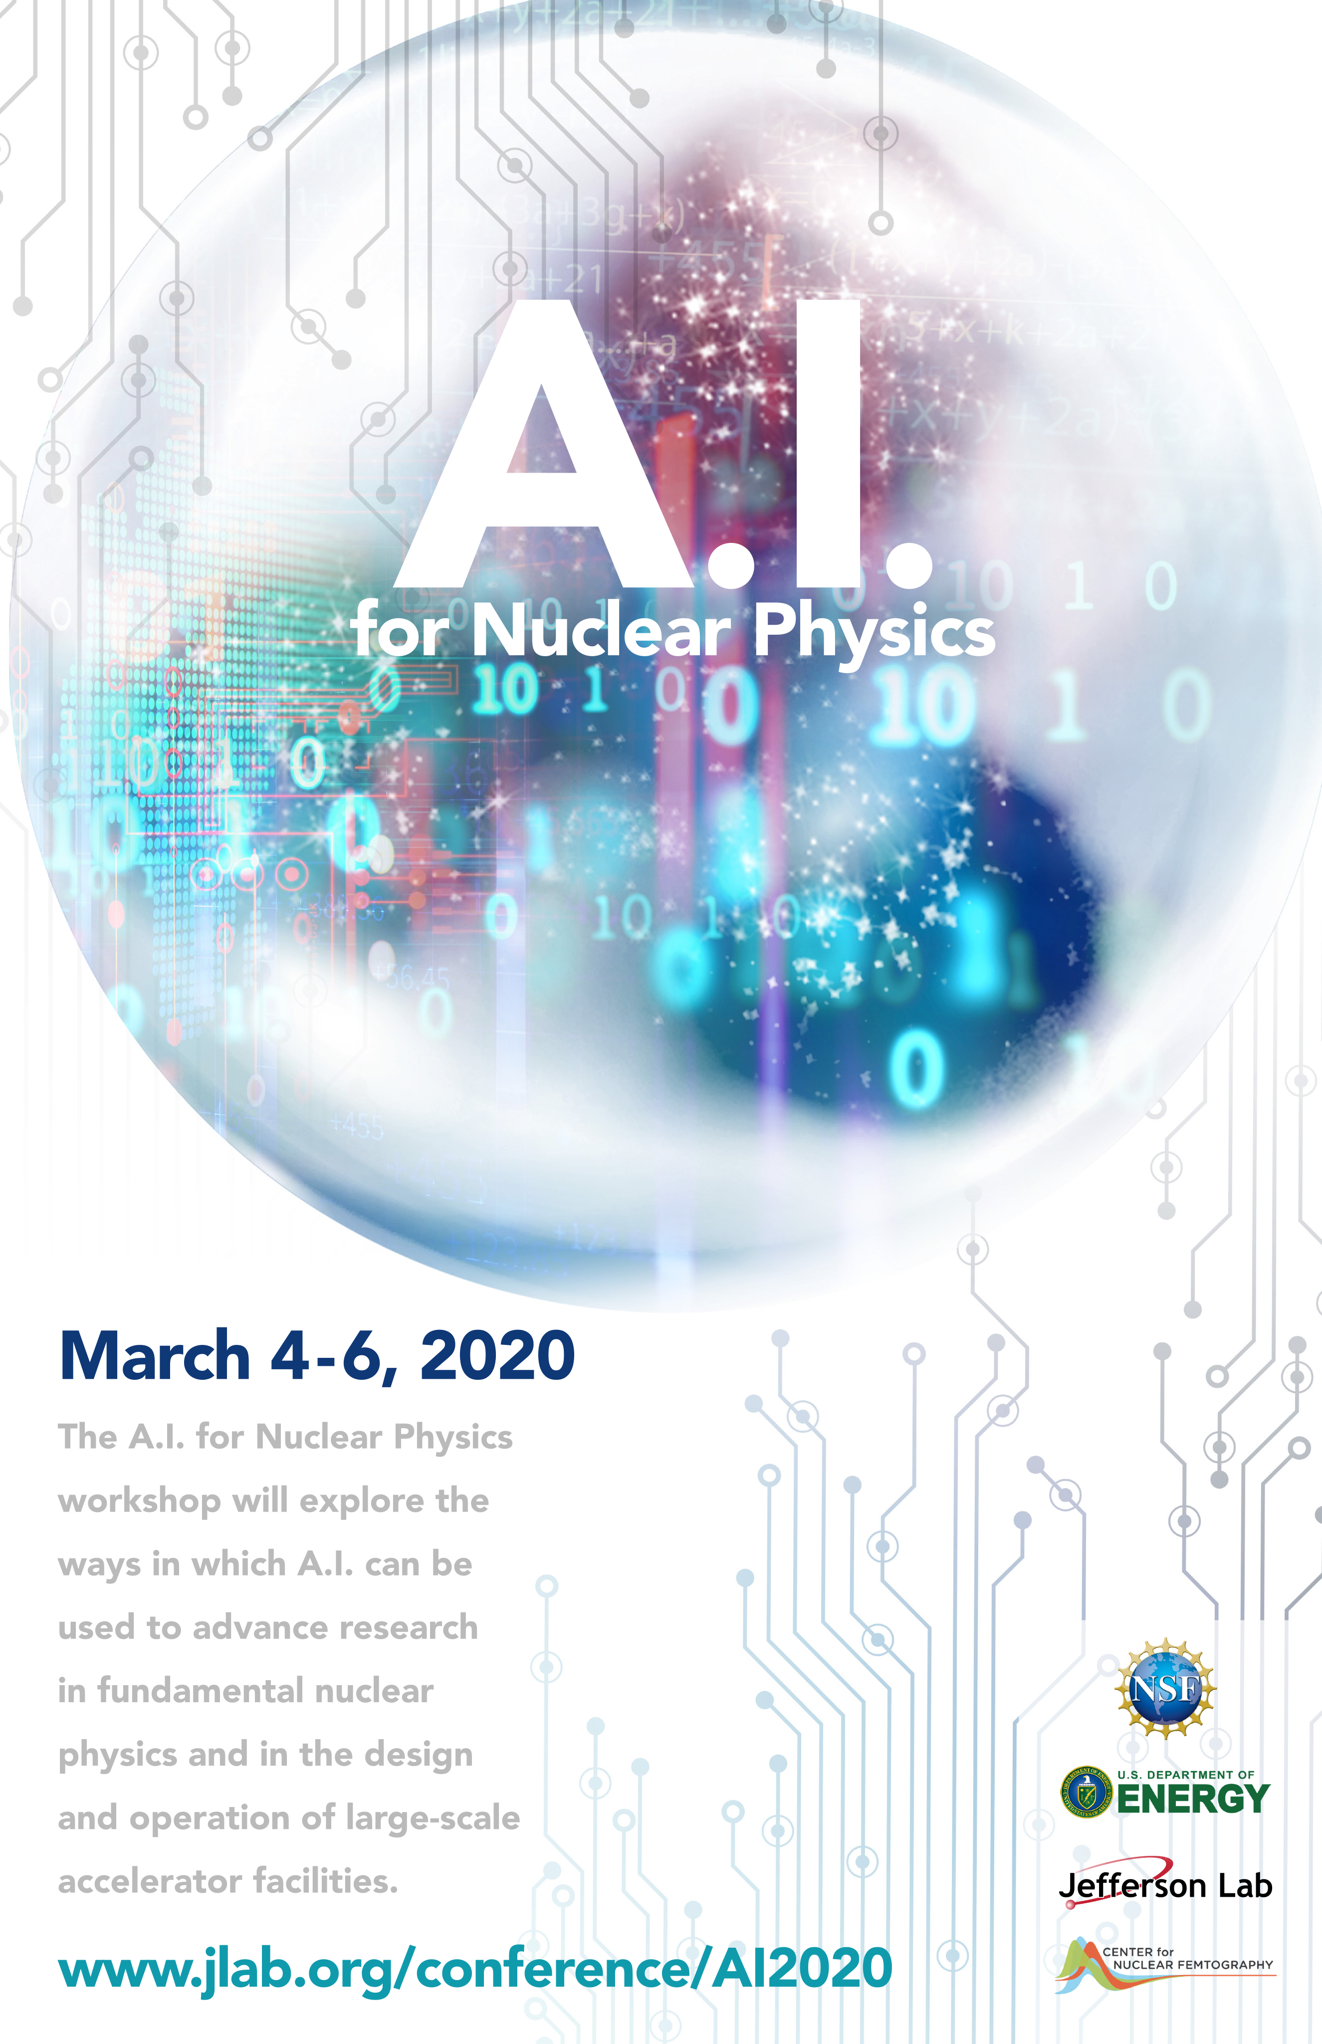
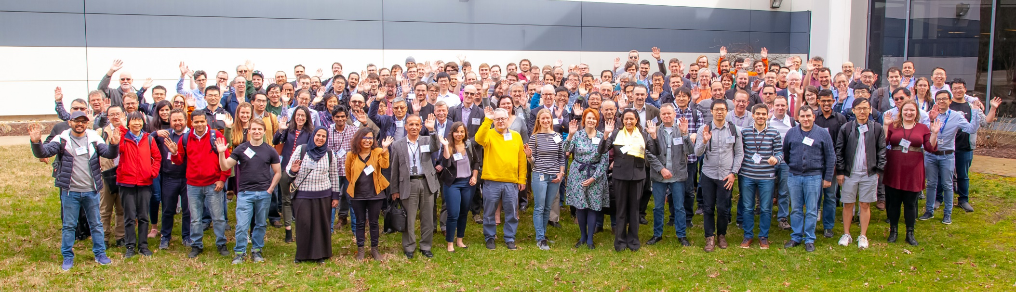
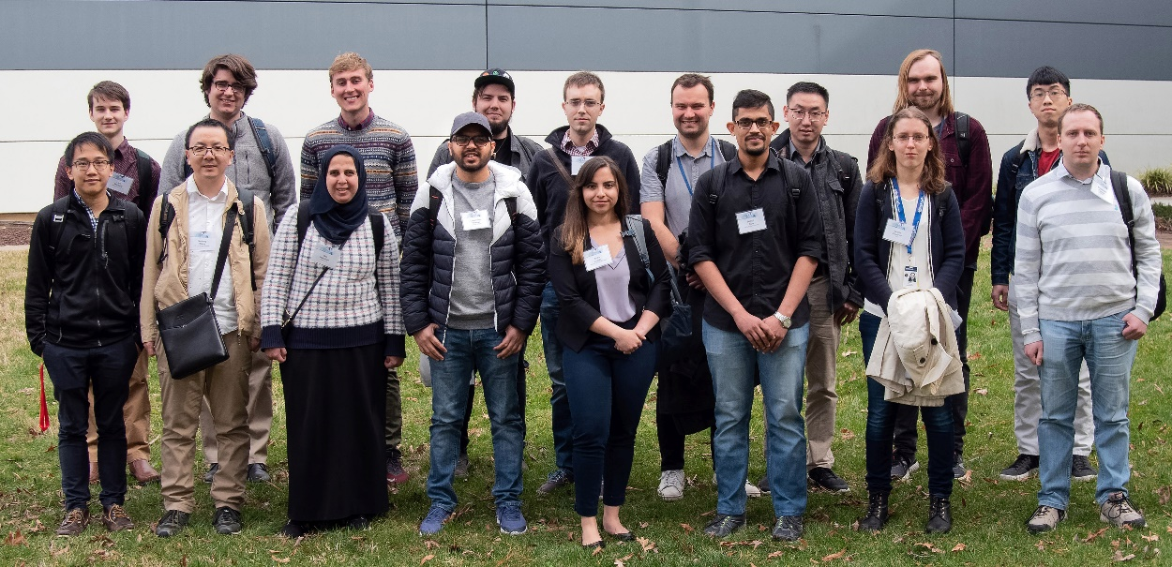
Above: 184 participants attended the March 3-6, 2020 AI Workshop for Nuclear Physics hosted Jefferson Lab and supported by NSF
Right: NSF funded travel grants for 18 students and early career professionals to attend the Workshop
Eur. Phys. J. A (2021) 57:100
Rev. Mod. Phys. 94, 031003 – Published 8 September 2022
Supported by CNF, ONP and NSF

Slide 10
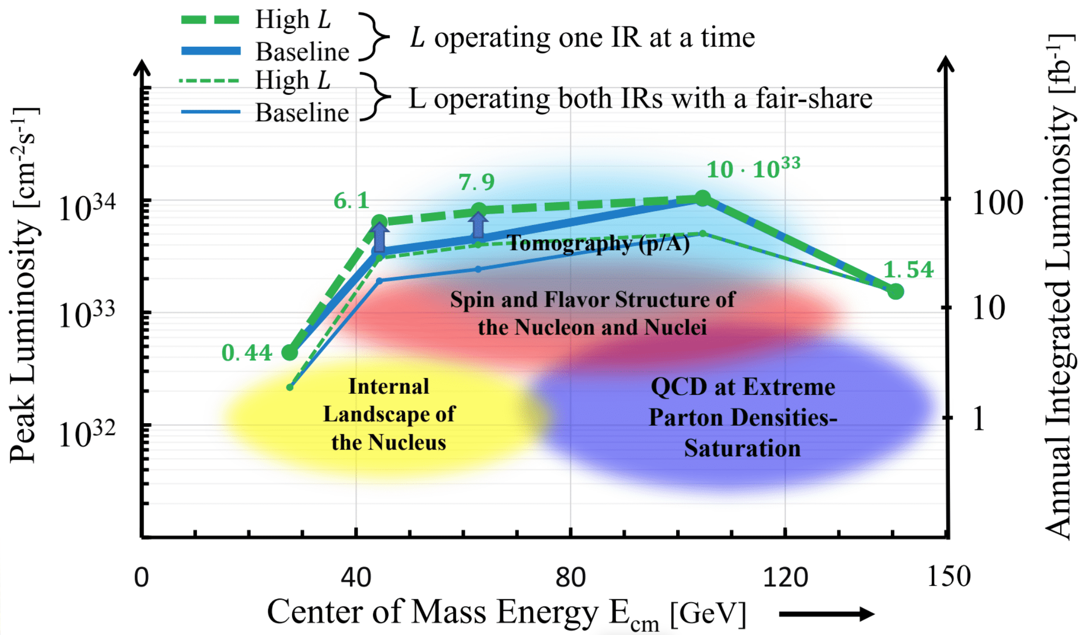
Precision Studies of QCD - PSQ@EIC
The challenge of precision QCD at the EIC
Stitching together a 5D image of the proton - exclusive & semi-inclusive processes (GPDs and TMDs)
Open problems in nuclear science – confinement, emergent hadron masses, force distribution on partons
Understanding the new particle zoo – exotic particles with heavy quarks
High luminosity operation at low CM energies
Detector collaborations
➔ Many programs require energies at the low end of the EIC range.
Preparatory WS: Talks
8 invited talks
8 contributions
Reg: 192
WS-1: Invited speakers
25 plenary talks
13 parallel talks
Reg: 417
WS-2: Invited speakers
30 plenary speakers
14 invited contributions
10 panelists
Reg: 198

Slide 11
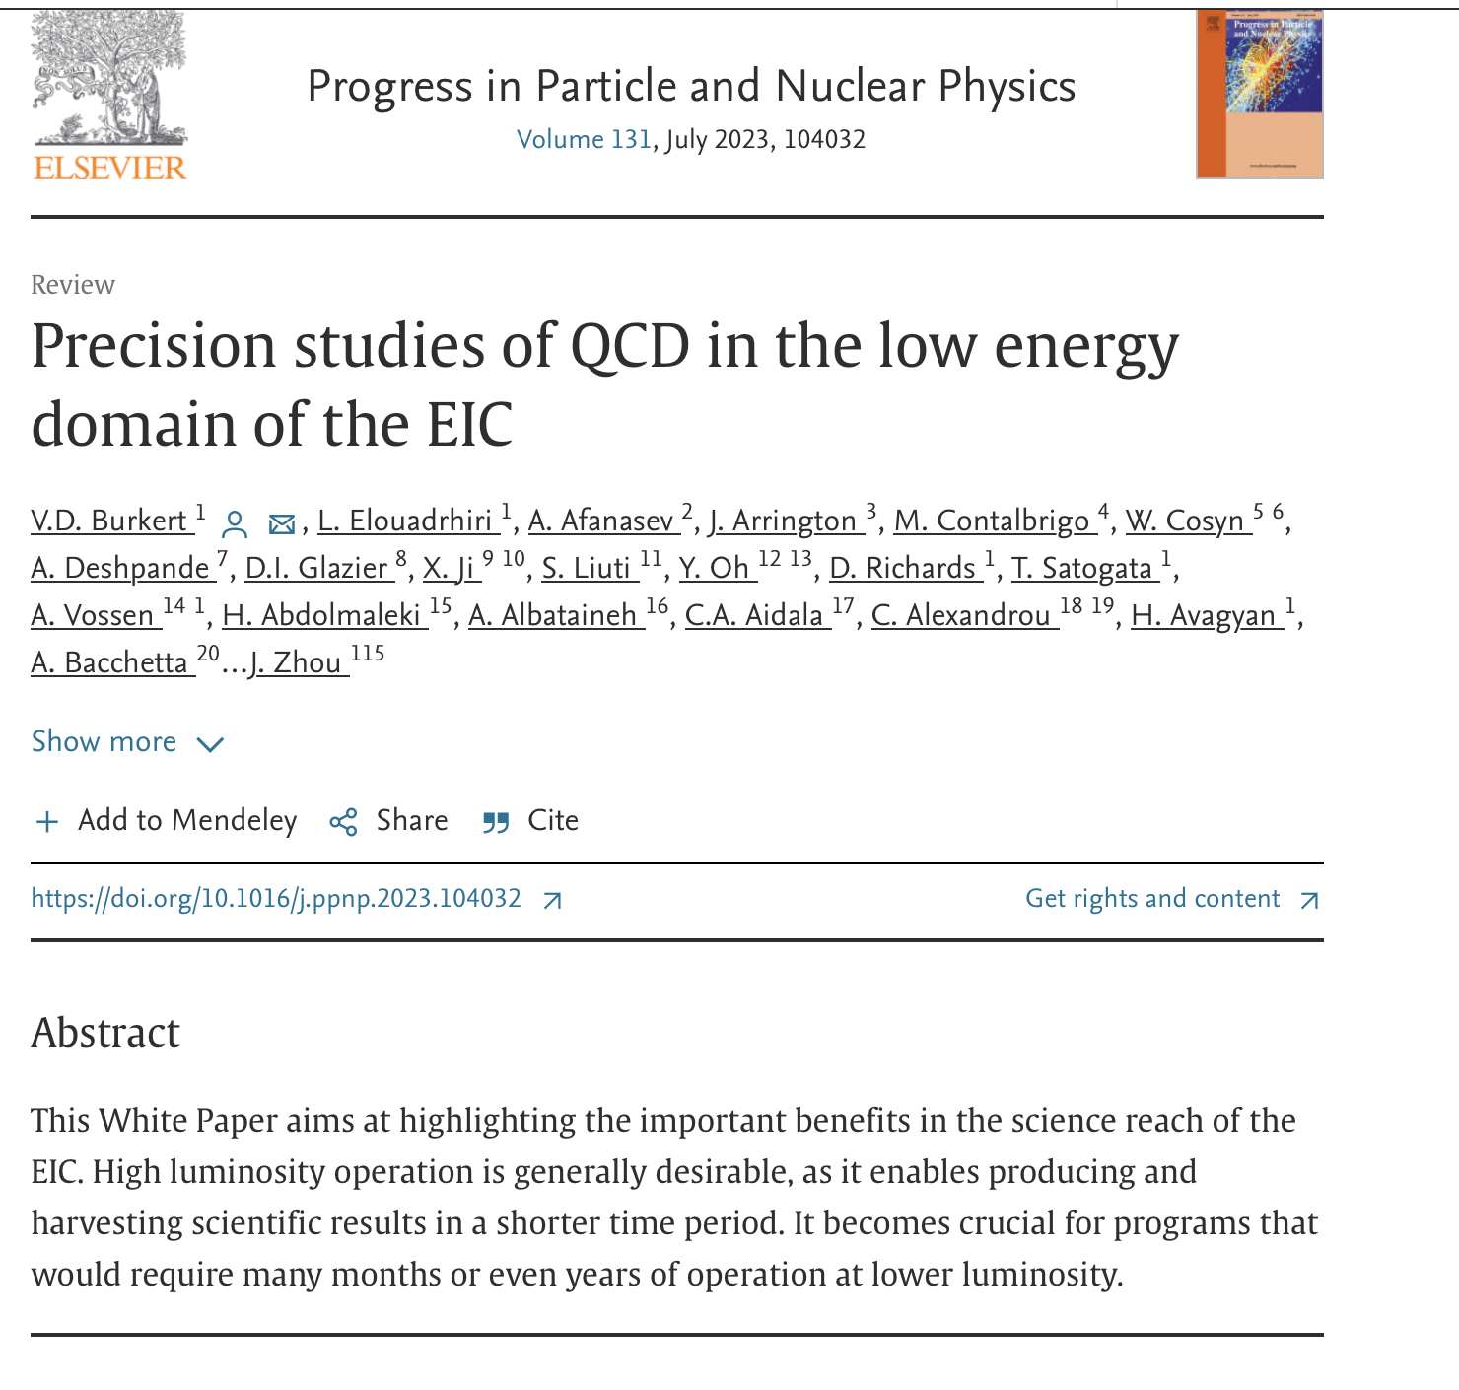
PSQ@EIC Series of Workshops
Preparatory
Coordination Meeting
For the Series of the 3 workshops
Workshop I (PSQ@EIC)
ANL/CFNS/CNF
Focus on
Science
Detector concept(s)
(virtual)
IR2@EIC Proposal
Submitted to CFNS
YR-Meeting
Presentation
Documentation
White Paper
Published/Summer 2023
Proposal Approved
July 19-23 2021
June 1, 2020
July 15, 2020
Nov. 2020
Dec. 2020
Mar 17-19 2021
Workshop II (PSQ@EIC)
APCTP/CFNS/CNF
Focus on
PSQ New Science
Detector proposals
International Engagement
Preparatory coordination meeting: https://indico.bnl.gov/event/9794/
1st PSQ@EIC - Science and Instrumentation of the 2nd IR for the EIC: https://indico.bnl.gov/event/10677/
2nd PSQ@EIC – Precision studies on QCD at the EIC https://indico.bnl.gov/event/11669/

Slide 12
Generalized Parton Distributions and Global Analysis
Jun 12 – 14, 2023
Jefferson Lab Center for Nuclear Femtography
The aim of this workshop was to bring together interdisciplinary experts to assess the current status of the 3D internal structure of the nucleon, and to identify the requirements and to develop a coherent approach to the extraction of the salient physics quantities. The workshop included plenary talks, with dedicated time for working group discussions.
https://indico.jlab.org/event/713/

Slide 13
Workshop Outcome
Task force on the short-term and long-term projects
  Data base for experimental data
  Benchmarking requirements
  Standards for data analysis
  Framework for Global analysis
  Common tools
Conveners of this group
Synergy between CNF, US and International groups working on GPD global analysis
Visitor program to CNF enables short- and long-term researchers across the disciplines of CNF to effectively impact the goals of the Center, that includes GPD global analysis
CNF - Biweekly seminars, platform for young and senior scientists to present their work (theory, experiment, phenomenology, and computing)

Slide 14



CLAS12
Experimental and Simulated Data
Glossary
Data processing services. Scaling up to Cn cores.
Data passage/link between services
Service control messages
Service configuration
Knowledge feedback
IO services
In memory data queue (ring-buffer)
Computing resource boundaries
Data-processing environment | CLARA DPE
CLARA Data Bus
CLARA DPE Farm Node_{N}
Cn
1
R
CLARA Data Bus
EBCMD
Table
1
Cn
CLAS12 Simulation and Reconstruction Multi-Node Application
CLARA DPE
MC
S₁
MC
S_{N}
EBCMD
Extraction
Service
1
Cn
EC
HT
TOF
TT
PID
DST
Cloud Computing Resources
EC
Event
Generator
HT
TOF
Cloud Node_{N}
CLAS12 Reconstruction Multi-Node Application
Assumptions
TT
STAT
EBCMD
Extraction
Service
CLARA Data Bus
Some other experiment
reconstruction program
σ_{R}
_{Calculation}
_{Service}
σ_{B}
_{Calculation}
_{Service}
SF
_{Calculation}
_{Service}
GPD-TMD
_{Calculation}
_{Service}
JLAB Computing Resources
Simulated data Reconstruction
PID
Model
Parameterization
W
Cn
1
CLARA DPE
CLARA DPE
Other Experiment and/or Research Facility Computing Resources
STAT
CLARA DPE
R
σ_{R}
_{Extraction}
_{Service}
σ_{B}
_{Extraction}
_{Service}
SF
_{Extraction}
_{Service}
GPD-TMD
_{Extraction}
_{Service}
W
W
EBCMD
W
W
EBCMD
Extraction
Service
CLARA DPE
Assumptions
CLARA DPE
Cooked,
DST
EBCMD
Table
EBCMD
Table
EBCMD
Table
EBCMD
Table
Reconstructed Data
CLARA Data Bus

Slide 15
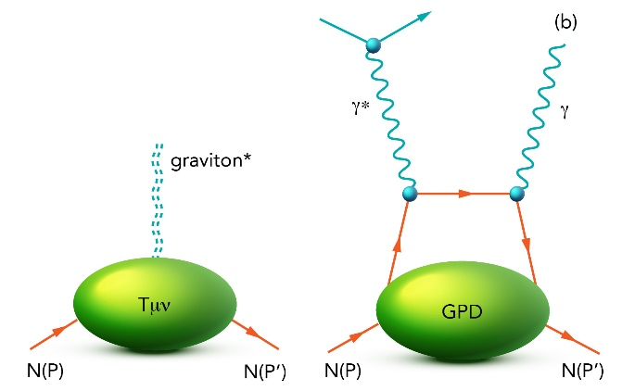
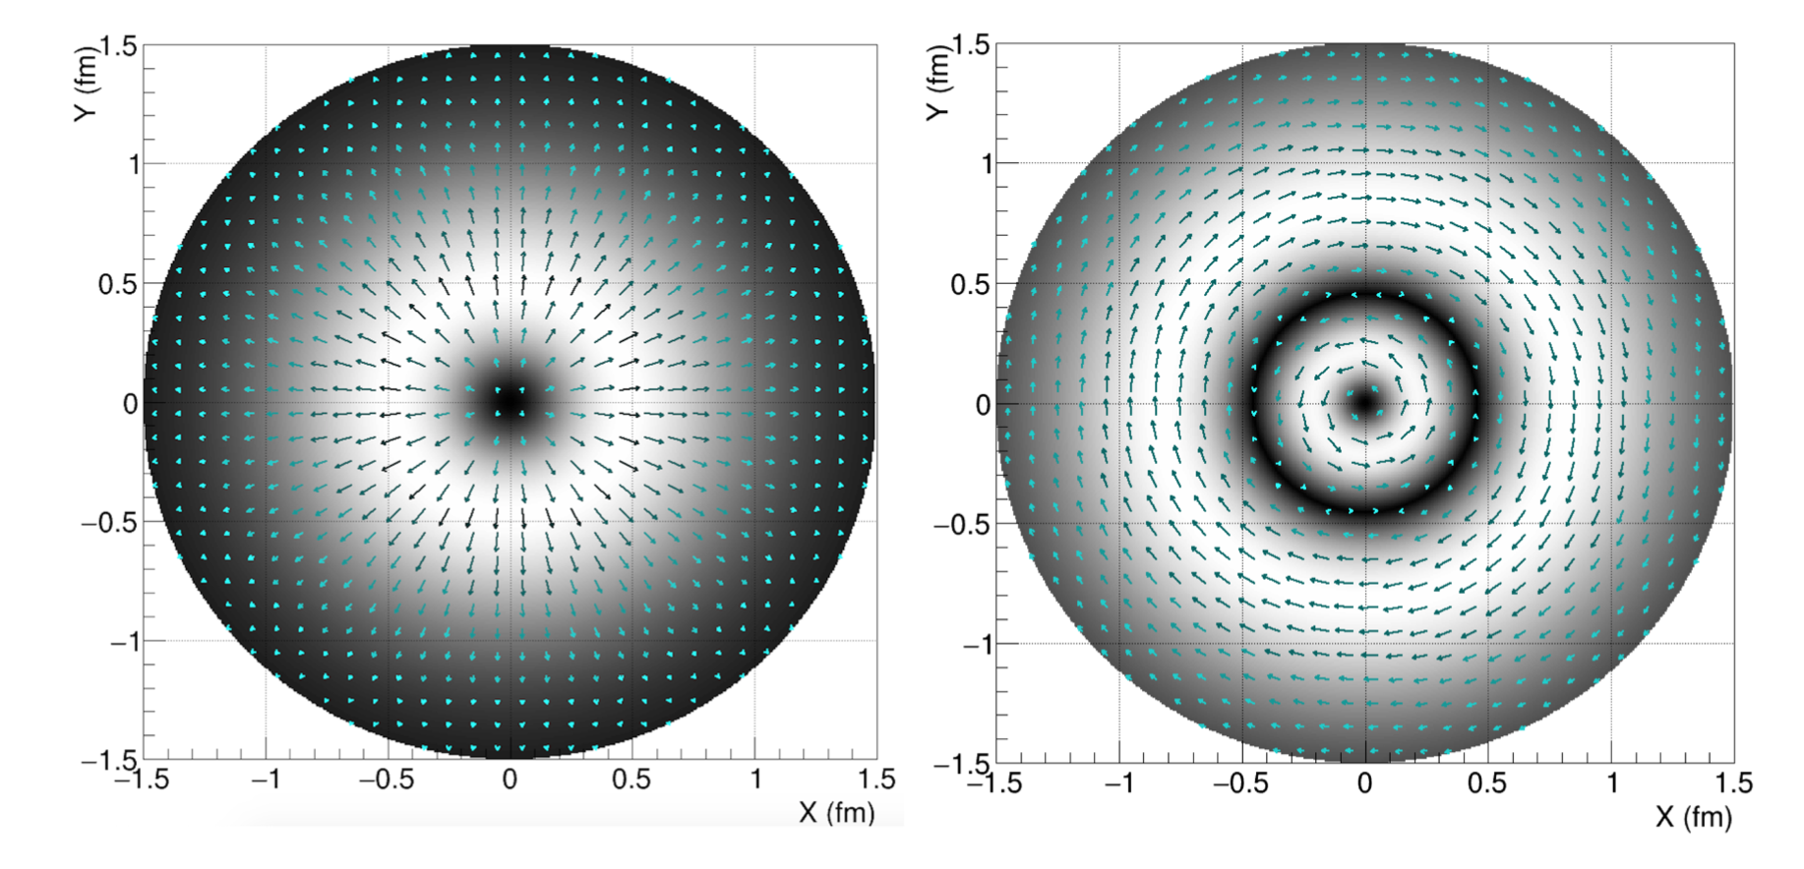

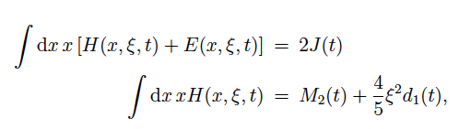
First determination of distribution of forces in the proton
Graviton coupling to the proton
Deeply Virtual Compton Scattering (DVCS)
Distribution of forces in the proton as function of the distance from the proton’s center - Left panel: normal forces - Right panel: tangential forces
Gravitational Form Factors of the Proton (accepted for publication in RMP)
V. D. Burkert, L. Elouadrhiri, F. X. Girod,1 C. Lorc ́e, P. Schweitzer, and P. E. Shanahan

Slide 16
Announcement and Upcoming Events
FY24 CNF Graduate Fellowship application due August 11, 2023
FY24/25 - Full time CNF post-doc to start in FY24
CNF- Radiative Corrections working group (led by Andrei Afanasev) will take place end of October 2023
Series of small and mini-workshops along the year
Nuclear femtography conference/workshop being planned early summer 2024
First CNF summer school – A dedicated school on nuclear femtography will be founded in FY24 targeted at graduate and young researchers. The school will comprise a core program together with a topical component (in discussion with the PI of GPD topical collaboration)

Slide 17
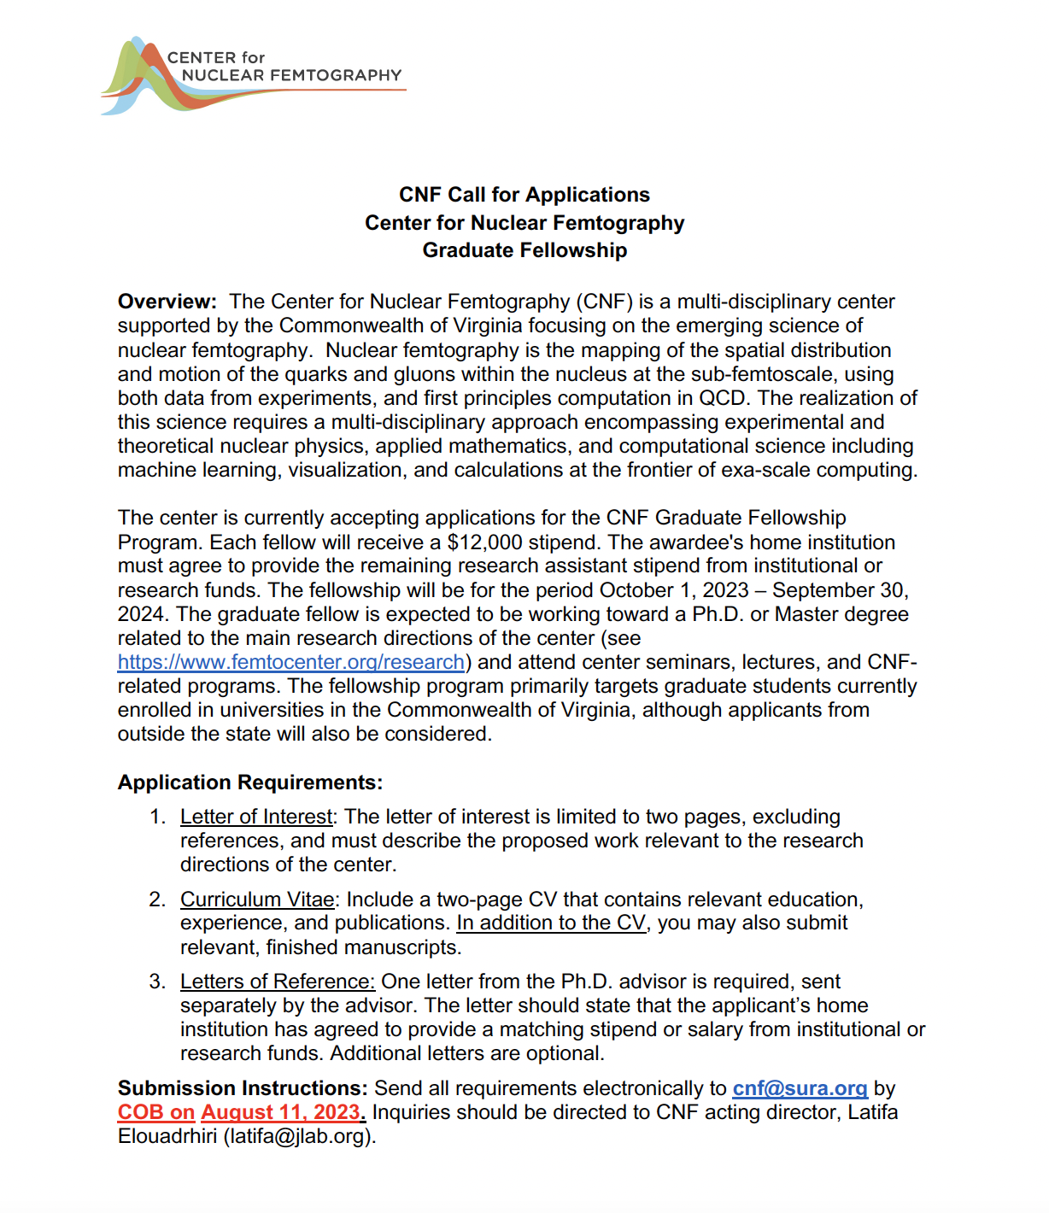

Slide 18
Path Forward
Aim for a coherent approach across the CNF activities, in particular through:
  Computationally efficient analysis/storage of experimental and MC data
  Impose constraints in global analysis guided by theory
  Advancing LQCD, e.g. through the efficient calculation
  The use of AI and other methods to tackle the inverse problem
  The use of experimental data and LQCD in a combined global analysis
  Visualization
  Training and professional mentoring
  Communication
Strengthen the relationships and activities with other National Labs, thematic collaborations and the international community through visitor program and dedicated interdisciplinary focused projects

