Slide 1
Double DVCS with CLAS12 in Hall-B
S. Stepanyan
Jefferson Lab
Towards improved hadron femtography with hard exclusive reactions 2023
Jefferson Lab, August 7 – 11
Notes:
----- Meeting Notes (9/27/11 07:19) ---
Many thanks to organizers for invitation to participate in the conference and give this talk on GPD program at JLAB.

Slide 2
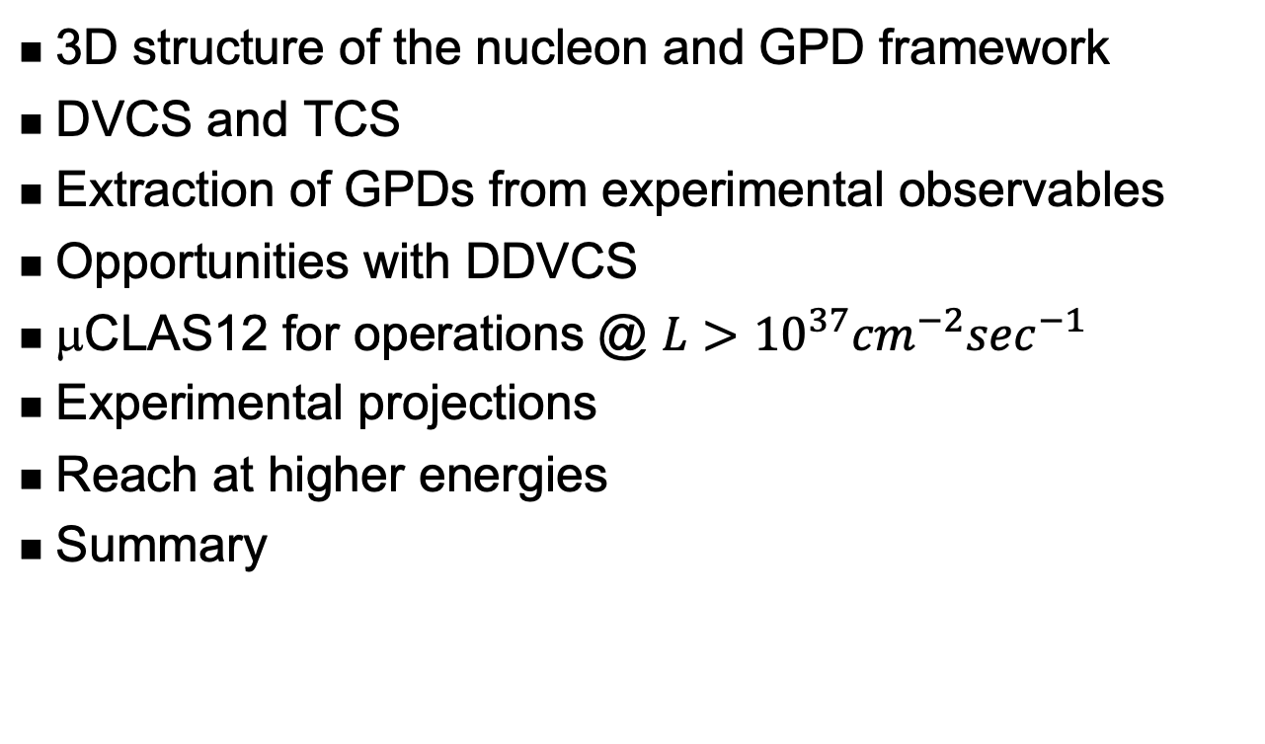
Outline
3D structure of the nucleon and GPD framework
DVCS and TCS
Extraction of GPDs from experimental observables
Opportunities with DDVCS
μCLAS12 for operations @ $L>{10}^{37}{cm}^{−2}\sec^{−1}$
Experimental projections
Reach at higher energies
Summary

Slide 3
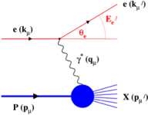
3-D Structure of the Nucleon
Elastic and deep inelastic scatterings give us two orthogonal projections.
DIS Parton Distribution Functions
Elastic Form Factors
No information about the underlying dynamics of the system
No information on the spatial location of the constituents
Advances in theory over the past 25 years – development of formalisms of Generalized Parton Distributions – laid the path towards 3-D imaging of the nucleon’s partonic structure and determination of nucleons’ fundamental properties using deep exclusive and semi-inclusive reactions become a reality.
Notes:
----- Meeting Notes (9/27/11 07:19) -----
we already heard about elastic form factors that characterize charge and magnetization distribution in hadrons
parton distribution functions that have been studied extensively in DIS reveal quark-gluon substructure of the nucleon
but these two are as 2-D projection of a complex, 3-D object
3-D imaging of the nucleon, that became now reality using formaism of generalized parton distributions and deeply exclusive reactions

Slide 4
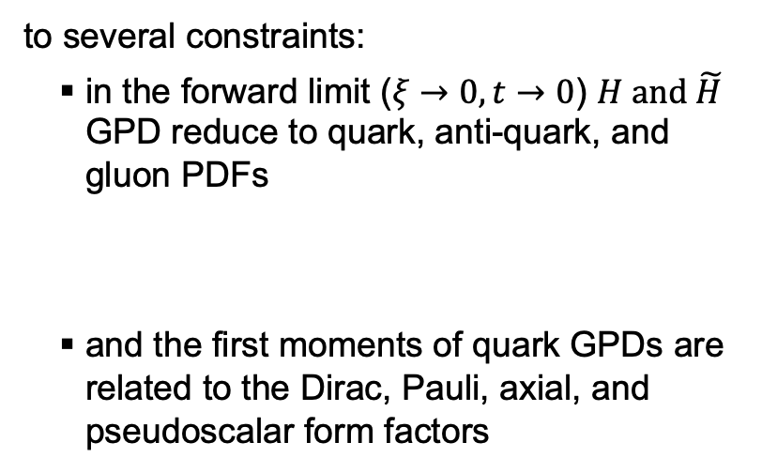
GPD framework
GPDs describe the correlation of quark/antiquark transverse spatial and longitudinal momentum, and the quark angular momentum distributions.
They exhibit several interesting properties, such as polynomiality and subject
to several constraints:
  in the forward limit ($ξ→0, t→0$) $H and \tilde{H}$ GPD reduce to quark, anti-quark, and gluon PDFs
  and the first moments of quark GPDs are related to the Dirac, Pauli, axial, and pseudoscalar form factors
At leading-twist, there are four chiral-even (parton helicity-conserving) GPDs:

Slide 5
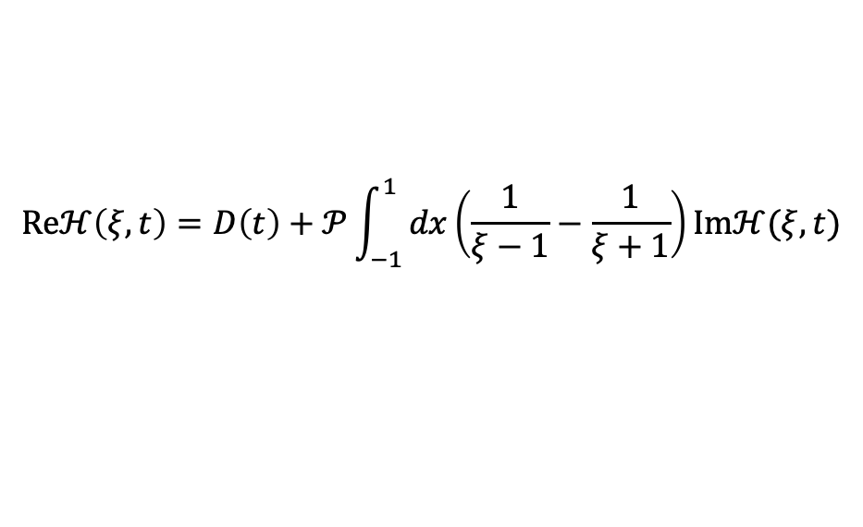
Nucleon EMT FF, GFF and GPDs
The QCD EMT of the nucleon:
The Mellin moments of GPDs linked to the EMT FF -
and the nucleon spin -
Ji, Phys. Rev. Lett 77 / Phys. Rev. D 55, 1997.
And the D-term characterizes the distribution of forces inside the nucleon and be inferred from GPD dispersion relation.
$$Reℋ\left(ξ,t\right)=D\left(t\right)+𝒫\int_{−1}^{1}{dx\left(\frac{1}{ξ−1}−\frac{1}{ξ+1}\right)}Imℋ(ξ,t)$$

Slide 6
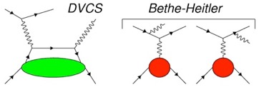
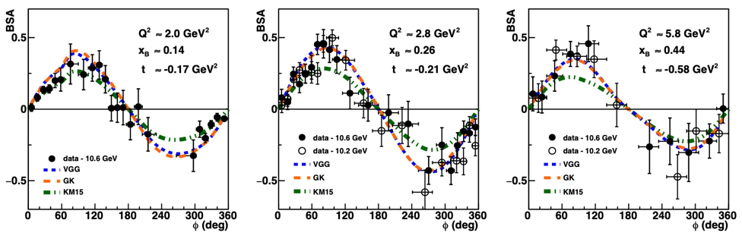
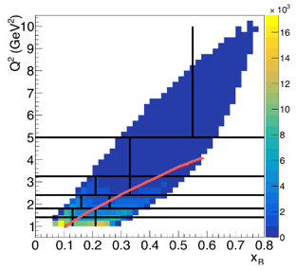






Accessing GPDs experimentally – DVCS
A large set of observables: beam helicity, longitudinal and transverse polarized target asymmetries, and cross sections.
Access various combinations of CFFs
+
$A_{LU}∝Imℋ(\tilde{ℋ}, ℰ)$
$A_{LL}∝Re\tilde{ℋ}(ℋ$)
$A_{UL}∝Im\tilde{ℋ}(ℋ$)
$A_{UT}∝Imℰ (ℋ$)
$$ep→e^{′}p^{′}γ=σ_{BH}{+σ}_{DVCS}{+σ}_{Int}$$
and a flavor decomposition, p/n
Comparisons with KM15 and VGG/GK models.
$$A_{LU}=\frac{a\sin{φ}}{1+c\cos{φ}+d\cos{2φ}}$$
G. Christiaens et al. (CLAS Collaboration) Phys. Rev. Lett. 130, 211902

Slide 7
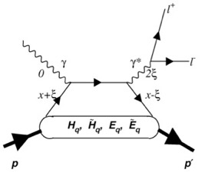
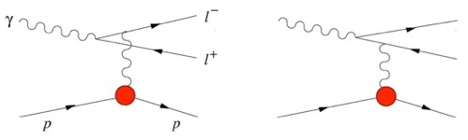
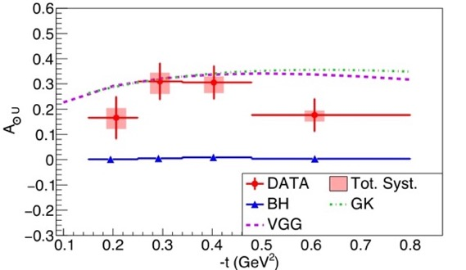
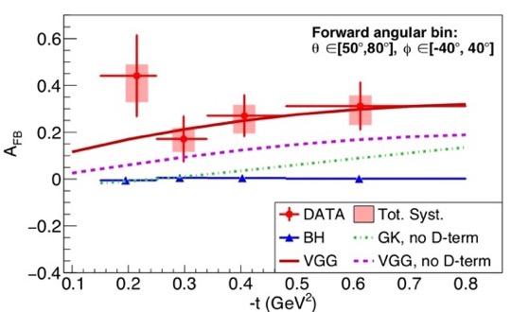
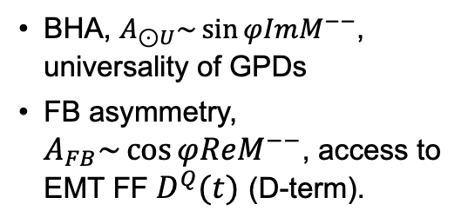
TCS with CLAS12
Bethe-Heitler (BH)
TCS
BHA, $A_{⊙U}\sim \sin{φImM^{−−}}$, universality of GPDs
FB asymmetry, $A_{FB}\sim \cos{φReM^{−−}}$, access to EMT FF $D^{Q}(t)$ (D-term).
+
P. Chatagnon, et al. (CLAS Collaboration),"Phys. Rev. Lett. 127, 262501 (2021).

Slide 8
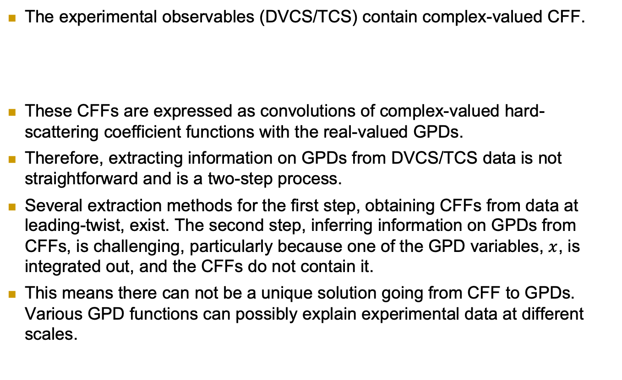
Extracting information on GPDs
The experimental observables (DVCS/TCS) contain complex-valued CFF.
These CFFs are expressed as convolutions of complex-valued hard-scattering coefficient functions with the real-valued GPDs.
Therefore, extracting information on GPDs from DVCS/TCS data is not straightforward and is a two-step process.
Several extraction methods for the first step, obtaining CFFs from data at leading-twist, exist. The second step, inferring information on GPDs from CFFs, is challenging, particularly because one of the GPD variables, $x$, is integrated out, and the CFFs do not contain it.
This means there can not be a unique solution going from CFF to GPDs. Various GPD functions can possibly explain experimental data at different scales.

Slide 9
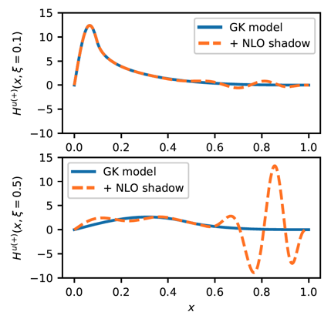
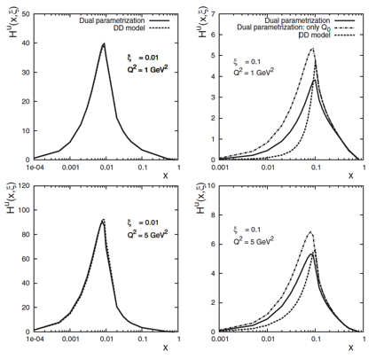
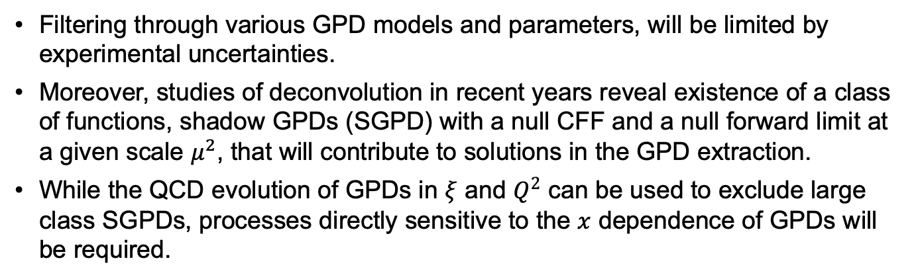
Models of GPDs and SGPDs
Filtering through various GPD models and parameters, will be limited by experimental uncertainties.
Moreover, studies of deconvolution in recent years reveal existence of a class of functions, shadow GPDs (SGPD) with a null CFF and a null forward limit at a given scale $μ^{2}$, that will contribute to solutions in the GPD extraction.
While the QCD evolution of GPDs in $ξ$ and $Q^{2}$ can be used to exclude large class SGPDs, processes directly sensitive to the $x$ dependence of GPDs will be required.
V. Bertone, H. Dutrieux, C. Mezrag, H. Moutarde, and P. Sznajder, Phys. Rev. D 103, 114019 (2021)
V. Guzey and T. Teckentrup, Phys. Rev. D 74, 054027 (2006)

Slide 10
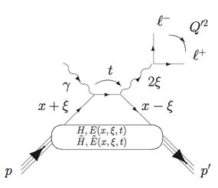
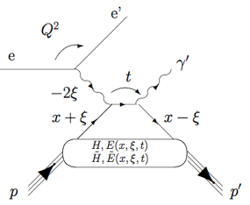
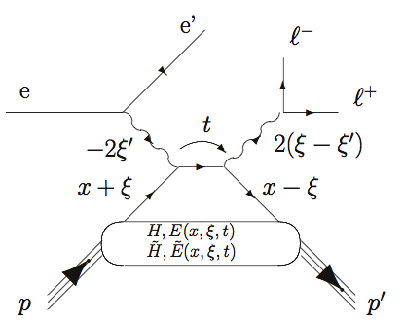

Closing the loop on virtual Compton scattering
First experimental measurement with CLAS12 PRL 127, 262501 (2021)
Started in 2001, PRL 87, 182002.
Now is the flagship physics program
TCS
Hard scale is defined by time-like photons
Hard scale is defined by space-like photon
DVCS
JLAB Flagship program – accessing GPDs through measurements of beam/target asymmetries and the cross sections of Compton processes (TCS and DVCS)
Access to the Re-part of the Compton amplitude
Jefferson Lab at the luminosity frontier is the only place in the world DDVCS can be measured!
μCLAS12 in Hall B and SoLID in Hall A are the two proposed facilities capable of carrying out such measurements.
DDVCS
Both space-like and time-like photons can set the hard scale
σ-DDVCS is three orders of magnitude smaller than σ-DVCS

Slide 11
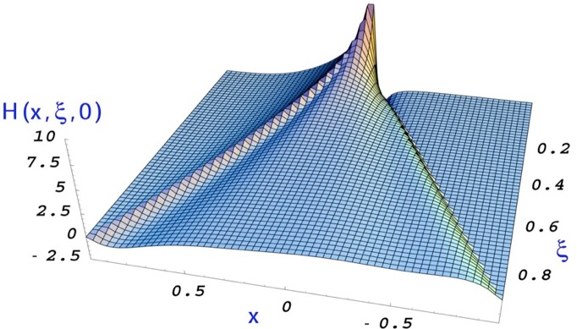
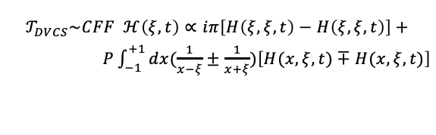
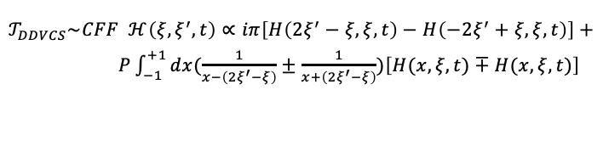
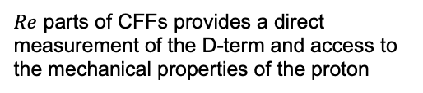


CFFs and GPDs in Virtual Compton Scattering
$$𝒯_{DVCS}\sim CFF ℋ\left(ξ, t\right)∝iπ\left[H\left(ξ,ξ,t\right)−H\left(ξ,ξ,t\right)\right]+$$
$P\int_{−1}^{+1}{dx(\frac{1}{x−ξ}±\frac{1}{x+ξ})\left[H(x,ξ,t)∓H(x,ξ,t)\right]}$
Q²<Q^{’2}
Q²>Q^{’2}
(the same for TCS)
x=-𝜉
x=𝜉
$$𝒯_{DDVCS}\sim CFF ℋ\left(ξ,ξ^{′},t\right)∝iπ\left[H\left(2ξ^{′}−ξ,ξ,t\right)−H\left(−2ξ^{′}+ξ,ξ,t\right)\right]+$$
$P\int_{−1}^{+1}{dx(\frac{1}{x−\left(2ξ^{′}−ξ\right)}±\frac{1}{x+\left(2ξ^{′}−ξ\right)})\left[H(x,ξ,t)∓H(x,ξ,t)\right]}$
Spin asymmetries (Im, $x=ξ$)
HERMES, CLAS, Hall A, JLAB12, COMPASS
Angular asymmetry in TCS (|Re|) JLAB12
Charge asymmetry in DVCS (|Re|) HERMES, COMPASS, JLAB12
DVCS Cross sections (|Re|²) H1, Hall A, JLAB12, COMPASS
DDVCS (Im, $x≠ξ$) – JLAB12 at L ≥ 10³⁷ cm⁻² sec⁻¹
$Re$ parts of CFFs provides a direct measurement of the D-term and access to the mechanical properties of the proton
Notes:
----- Meeting Notes (9/27/11 11:46) -----
so far the most promising way to access GPDs experimentally is through deeply virtual Compton scattering
DVCS is measured together with BH process, DVCS observables are spin and charge asymmetries and cross sections
----- Meeting Notes (9/27/11 12:09) -----
existing and a future programs will measure spin asymmetries and cross sections, there is one measurement on BCA (Hermes), important for direct access to the real part of CFF

Slide 12
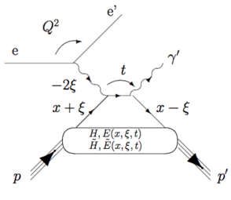
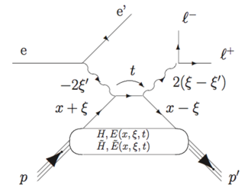
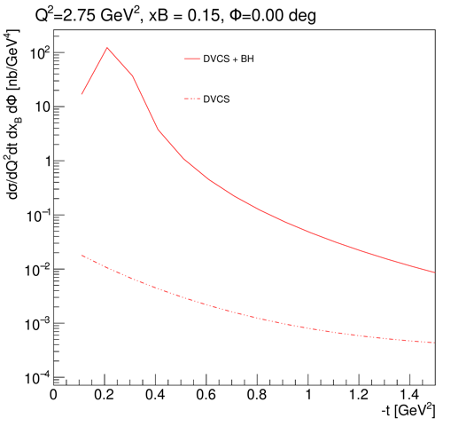
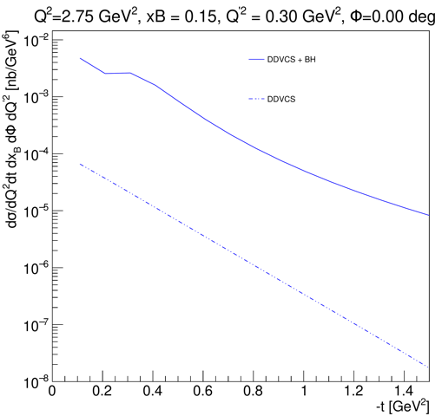



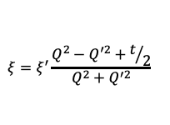
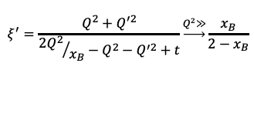

Cross section
DVCS & BH
DDVCS & BH
$$Q^{2}=−q^{2}={(e−e^{′})}^{2}$$
$$Q^{′2}≡M^{2}={(l^{+}−l^{−})}^{2}$$
$$x_{B}=\frac{Q^{2}}{2pq}$$
$$ξ^{′}=\frac{Q^{2}+Q^{′2}}{{{2Q}^{2}}/{x_{B}}−Q^{2}−Q^{′2}+t}\underset{→}{Q^{2}≫}\frac{x_{B}}{2−x_{B}}$$
$$t={(p−p^{′})}^{2}$$
$$ξ=ξ^{′}\frac{Q^{2}−Q^{′2}+t/2}{Q^{2}+Q^{′2}}$$
Cross sections from R. Paremuzyan, VGG code

Slide 13
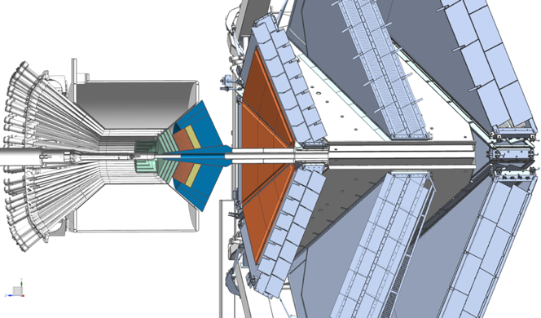
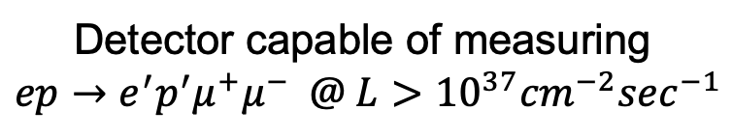
High luminosity CLAS12 for DDVCS
Two main challenges in DDVCS measurements:
Cross section is three orders of magnitude smaller than the DVCS cross section;
Ambiguities and anti-symmetrization issues with the decay leptons of the outgoing virtual photon and the incoming-scattered lepton.
Di-muon electroproduction using upgraded CLAS12 will overcome these challenges.
μCLAS12
A simple concept:
Remove HTCC and block the CLAS12 forward with a W-shield and PbWO₄ calorimeter to prevent flooding of DC by EM background;
Shield will work as pion filter, as most of charged pions will shower;
Remove CVT, instead use a high rate MPGDs for central and forward (in front of the calorimeter) tracking
Shield
Trackers
Calorimeter
Detector capable of measuring
$$ep→e^{′}p^{′}μ^{+}μ^{−} @ L>{10}^{37}{cm}^{−2}\sec^{−1}$$

Slide 14
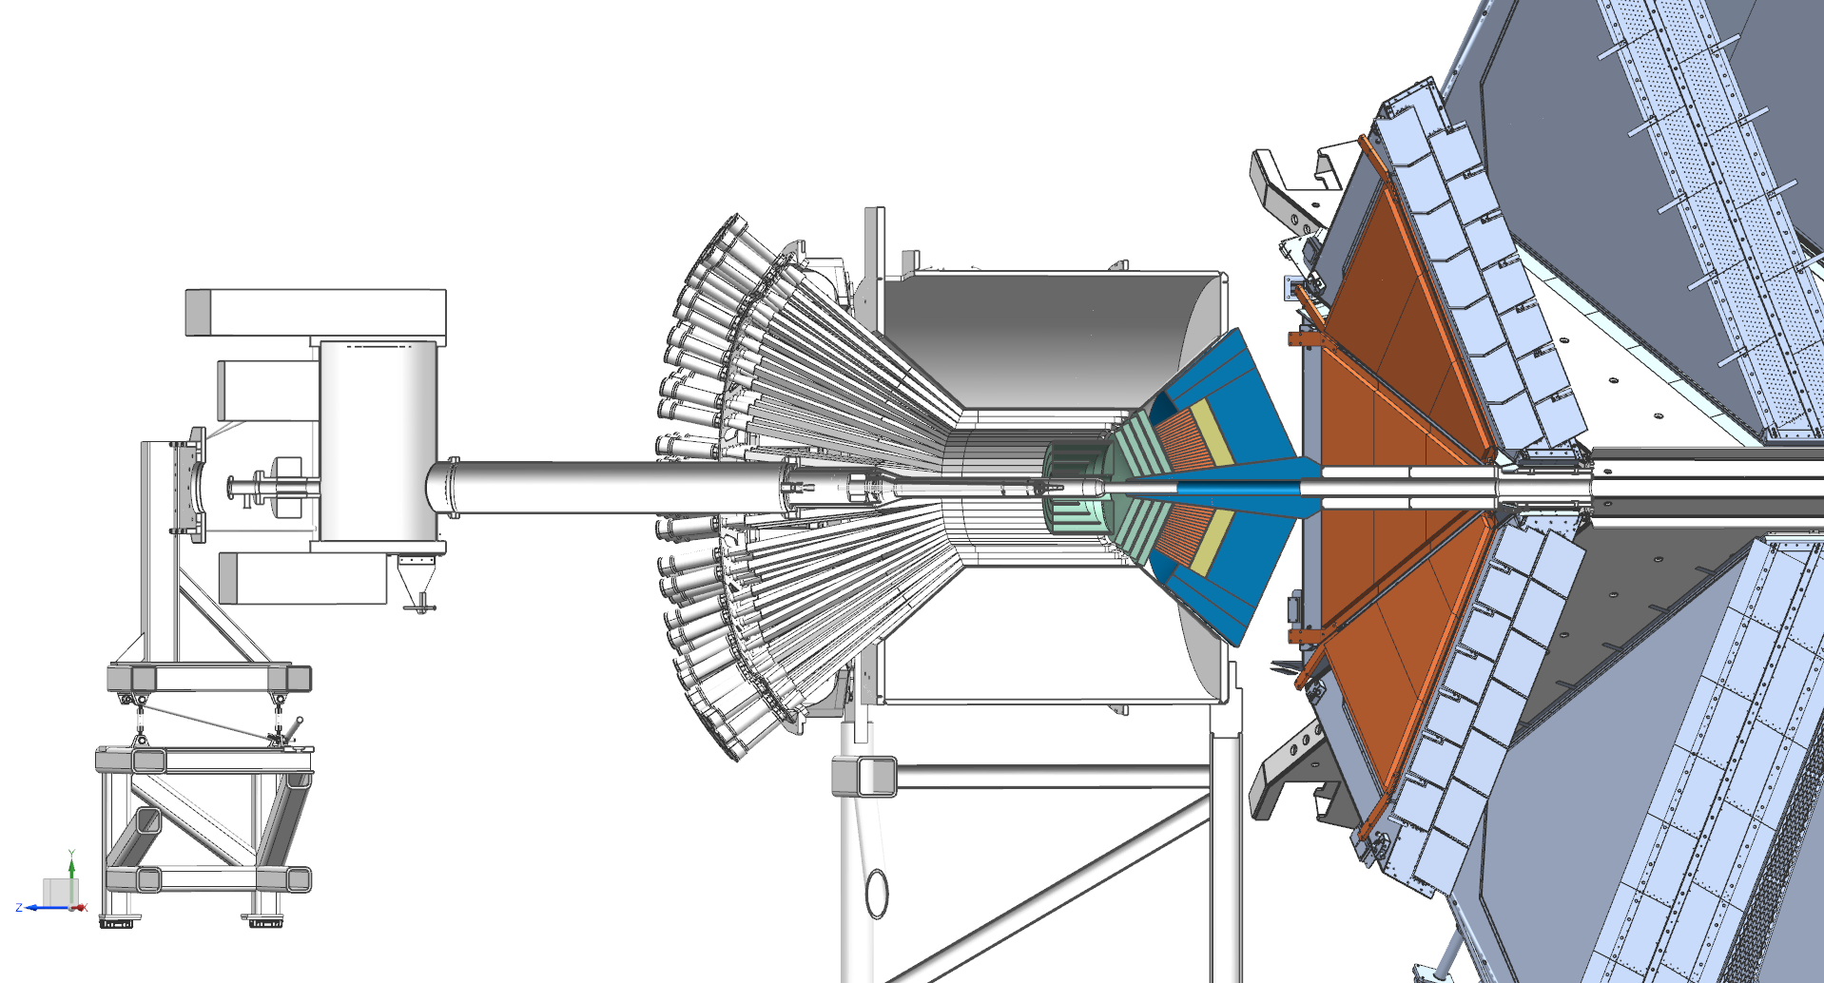
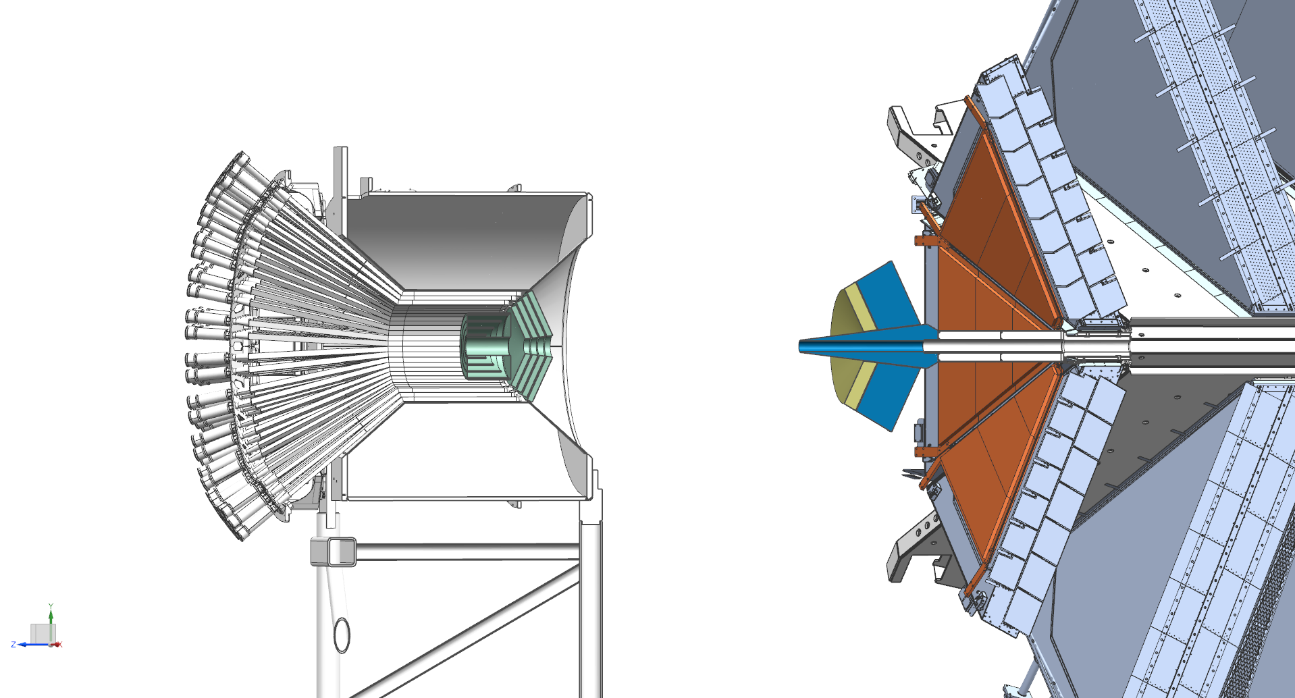
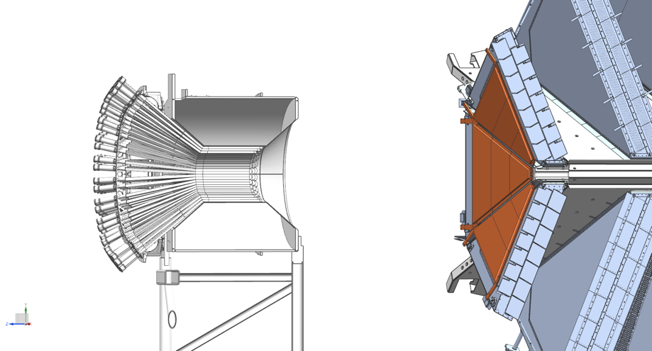
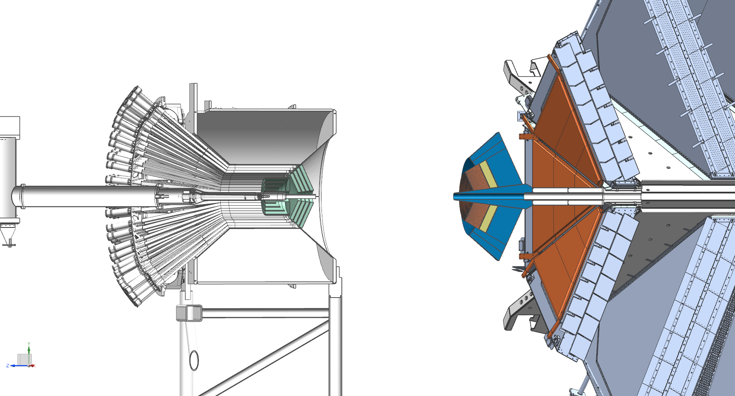
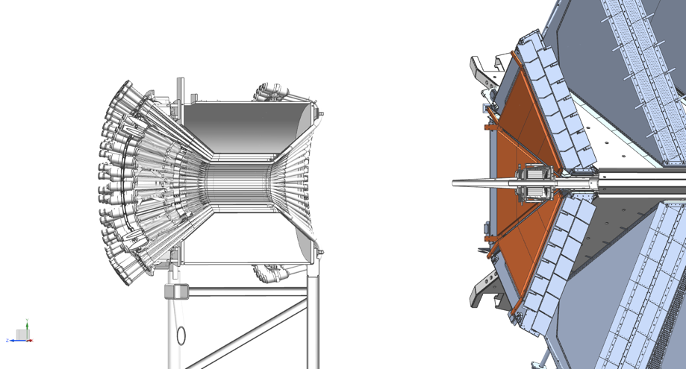
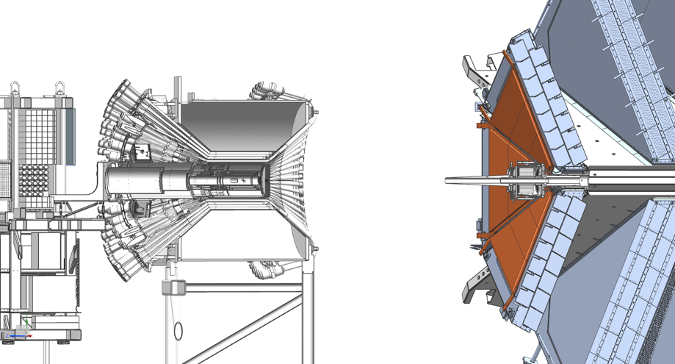
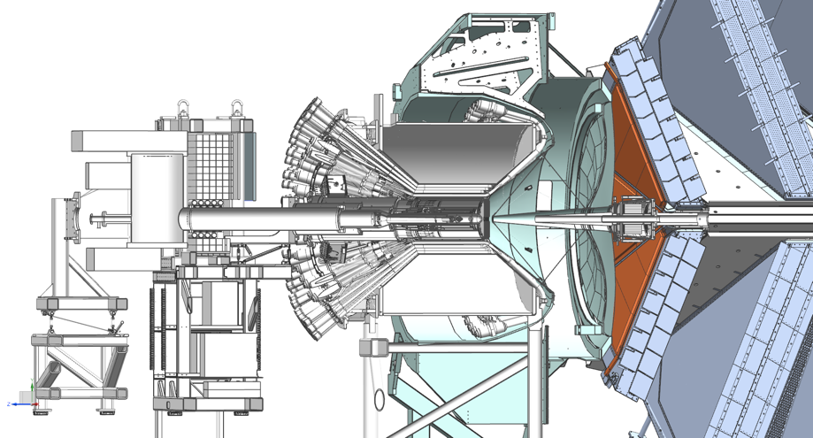
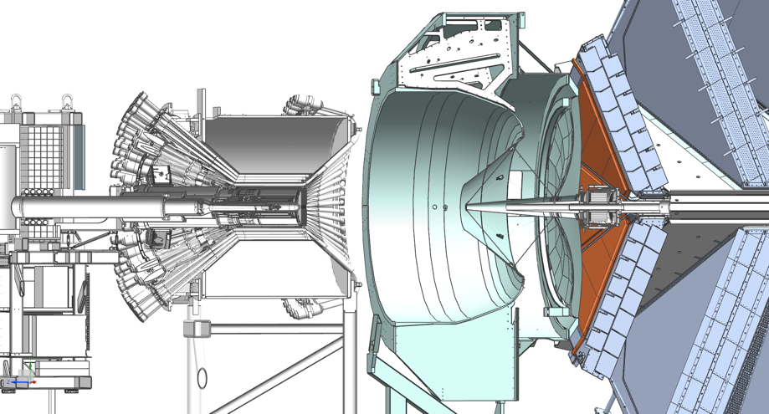
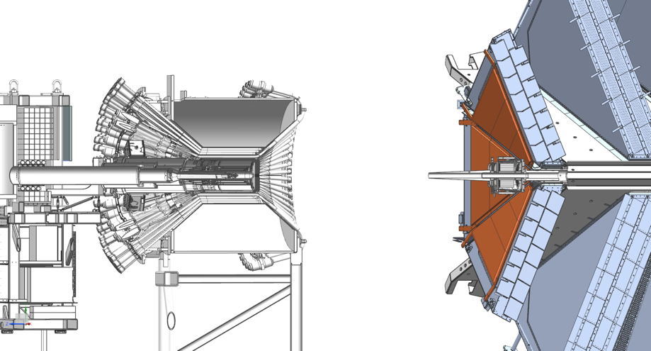
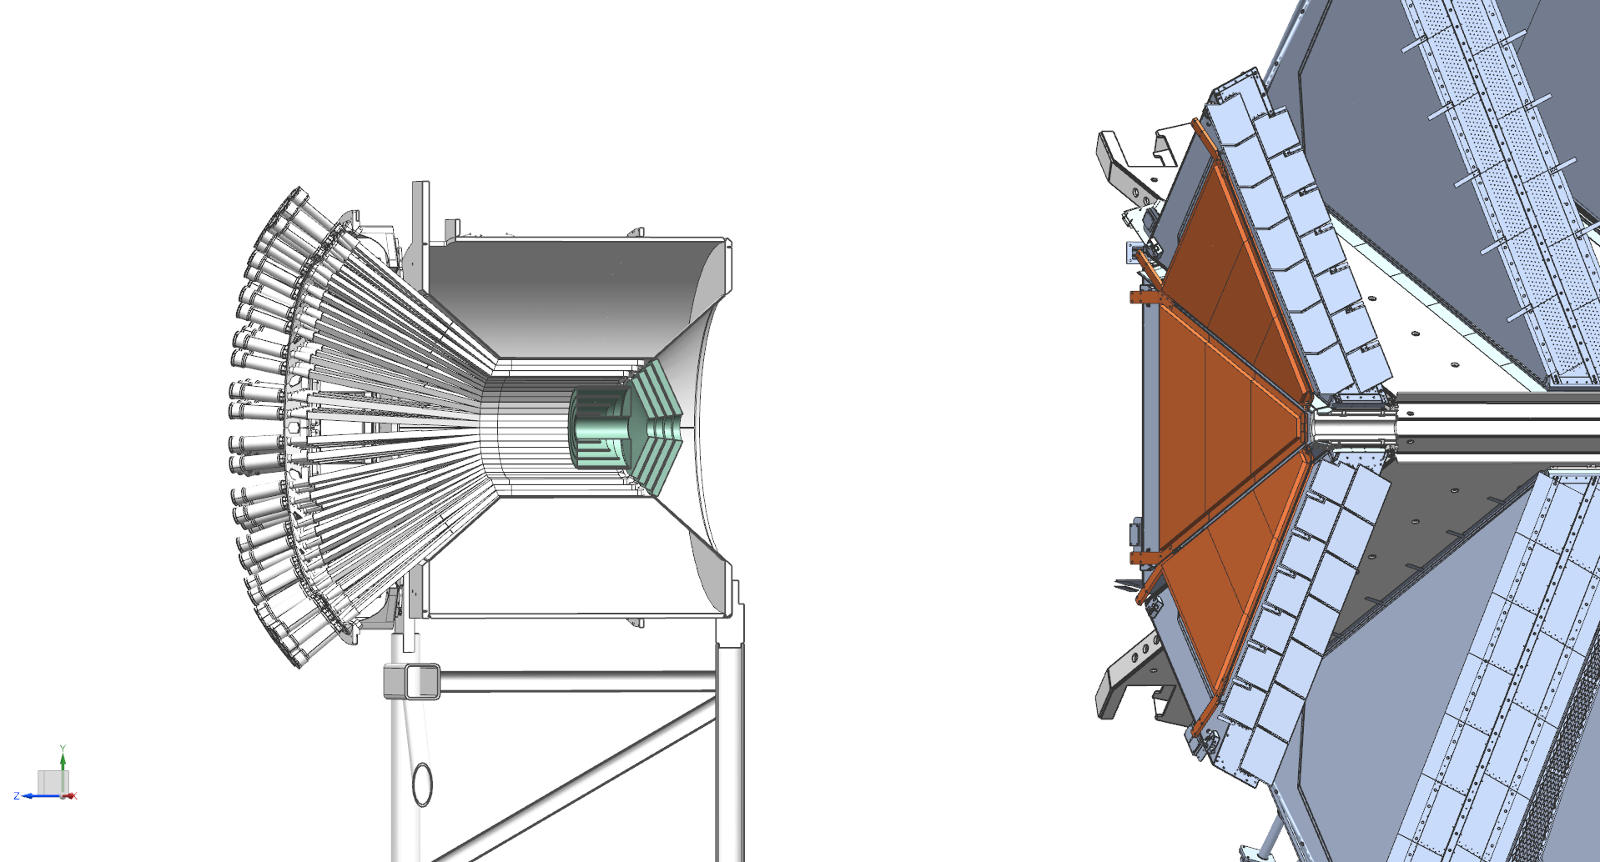
Convert CLAS12 FD into a μ-spectrometer
Starting from CLAS12 with μRWELL

Slide 15
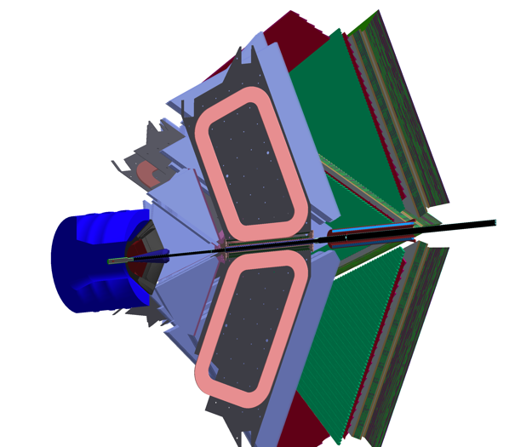
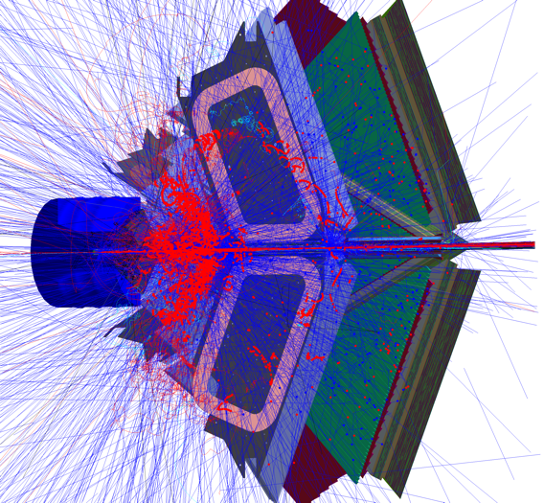
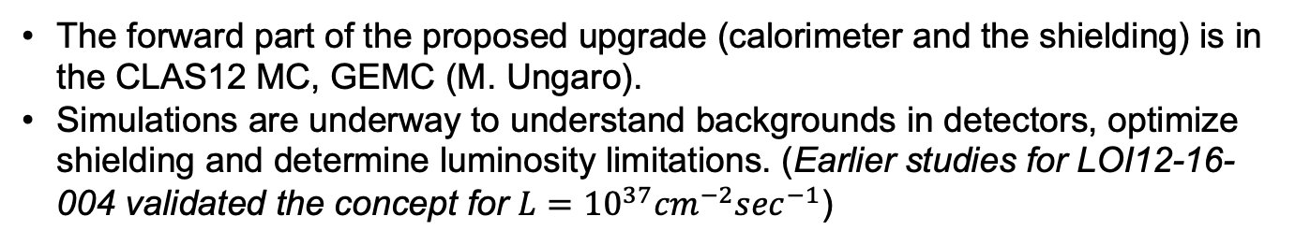
GEANT4 model
The forward part of the proposed upgrade (calorimeter and the shielding) is in the CLAS12 MC, GEMC (M. Ungaro).
Simulations are underway to understand backgrounds in detectors, optimize shielding and determine luminosity limitations. (Earlier studies for LOI12-16-004 validated the concept for $L={10}^{37}{cm}^{−2}\sec^{−1}$)
Shielding is the simple extension of the existing CLAS12 W-pipe.
ECal
FTOF
DC
Cylindrical recoil detector should be added
100k 11 GeV electrons in 250 ns

Slide 16
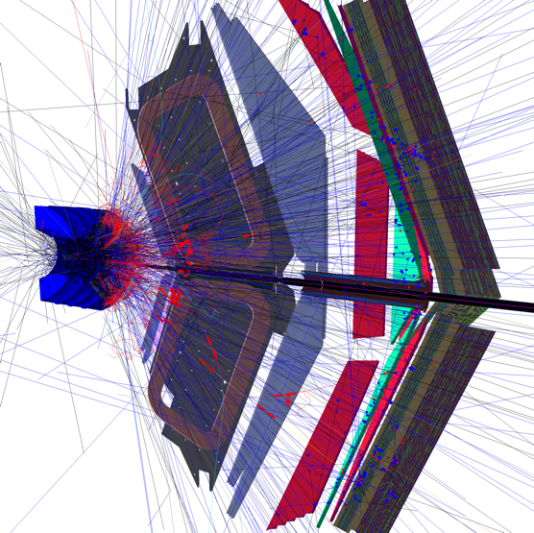
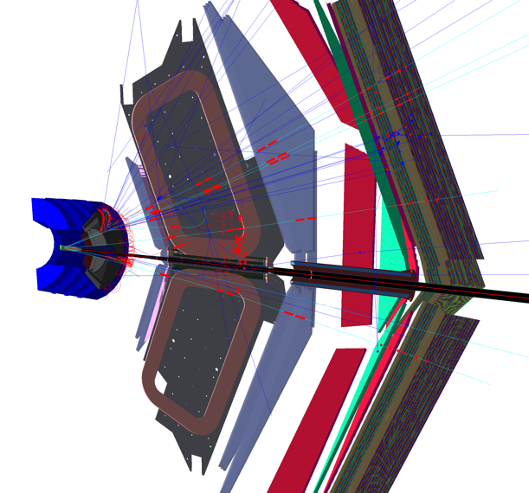



$μ/π$ – separation
6 GeV $π^{+}$
6 GeV $μ^{+}$
ECal
Most pions will shower in the calorimeter/shielding and will not reach drift chambers, much less the ECal.
Conversely, muons will lose some energy in the calorimeter/shielding but will reach drift chambers and Ecal. Ecal is where muons are IDed.

Slide 17
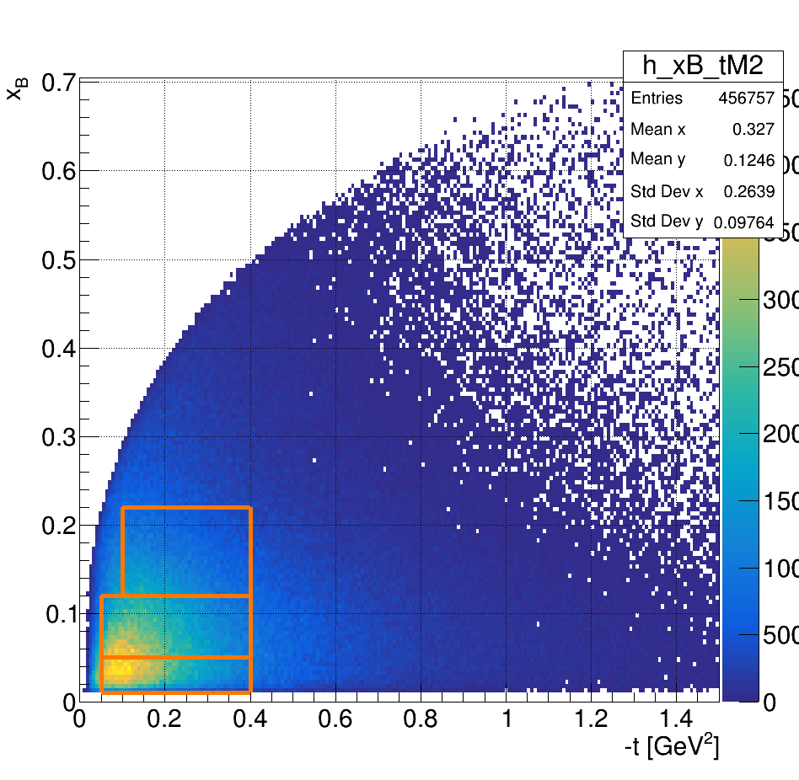
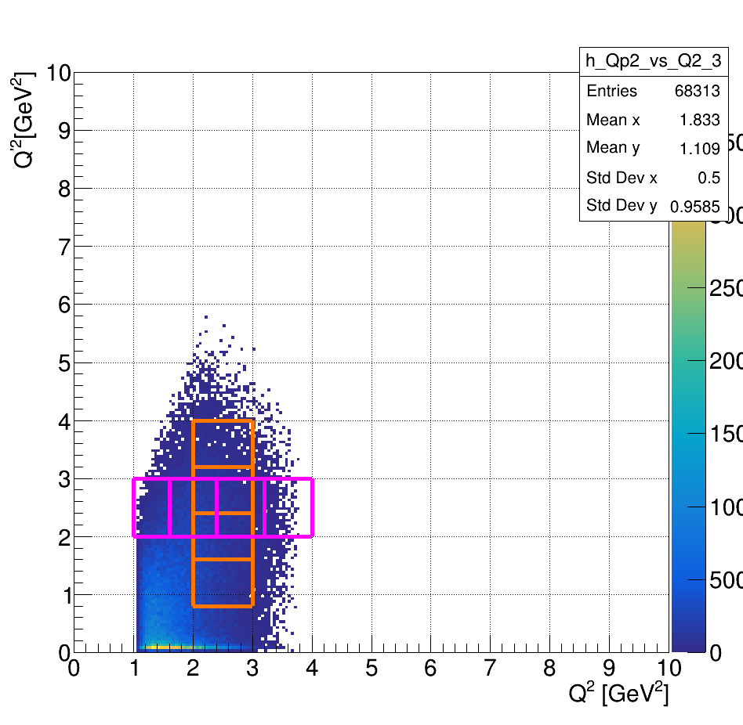
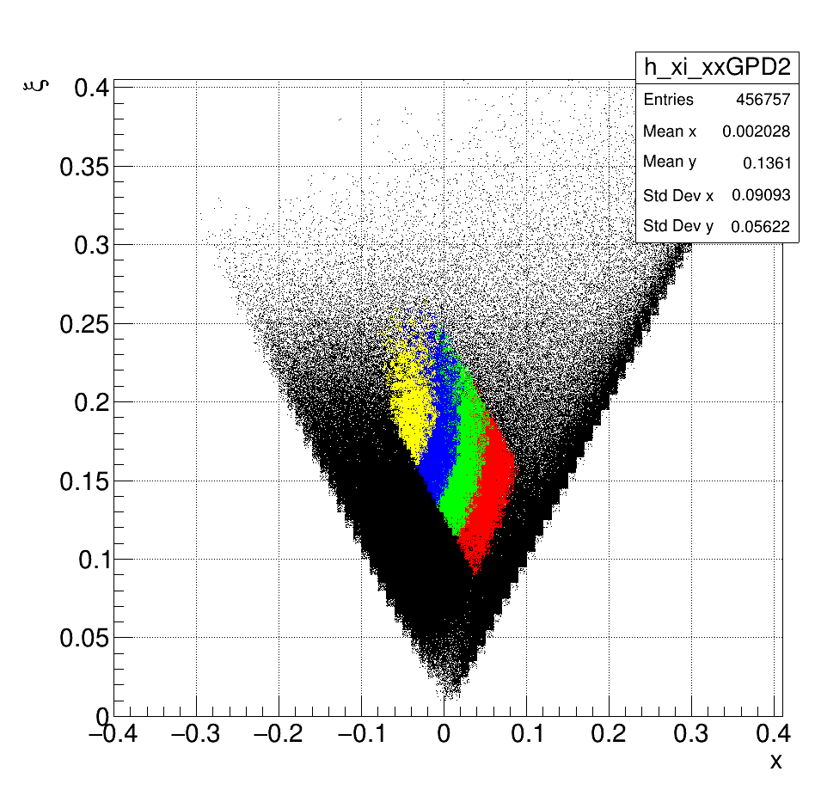
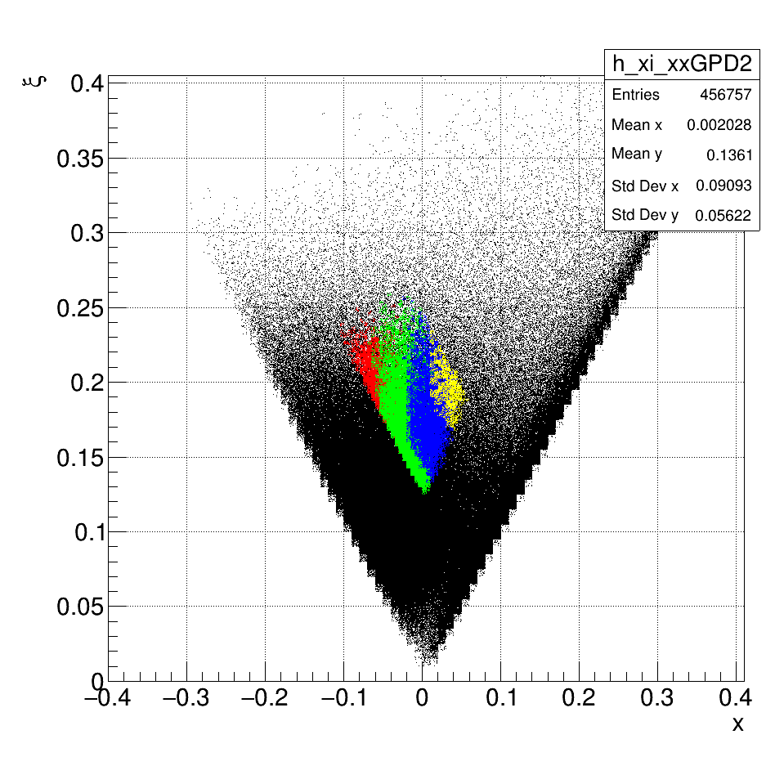






Kinematical coverage for DDVCS
R. Paremuzyan
GRAPE event generator, BH only.
Shown one t-bin, but measurements can be extended to $−t\sim 1$ GeV².
The whole region is measured simultaneously.
Bin1
Bin1
Bin3
Bin2
$$Q^{2}=−q^{2}={(e−e^{′})}^{2}$$
$$x_{B}=\frac{Q^{2}}{2pq}$$
Bin1 scan over Q'²
Bin1 scan over Q²
$$Q^{′2}≡M^{2}={(l^{+}−l^{−})}^{2}$$
$$ξ^{′}=\frac{Q^{2}+Q^{′2}}{{{2Q}^{2}}/{x_{B}}−Q^{2}−Q^{′2}+t}$$
$$ξ=ξ^{′}\frac{Q^{2}−Q^{′2}+t/2}{Q^{2}+Q^{′2}}$$

Slide 18




Final state particles
Electrons and muons are confined within the calorimeter and FD.
Recoil proton detection will be limited to $θ>{40}^{o}$, not crucial for DDVCS.
Electrons
Protons
𝝁⁻
𝝁+

Slide 19







Projections for BSA: Bin1
100 days @ ${10}^{37}{cm}^{−2}\sec^{−1}$
Space-like region, $Q^{2}>Q^{′2}$
BSA sign change
Time-like region, $Q^{2}<Q^{′2}$

Slide 20




How about 20+ GeV?
CLAS12 will perform with higher energy beams, providing a significant coverage at large Q².
Incremental improvements of the tracking detectors can help to retain momentum resolution for high momentum tracks.
Available PID will be sufficient for exclusive and for the most of semi-inclusive reactions.
$$μCLAS12, ep→e^{′}p^{′}μ^{+}μ^{−}$$
11 GeV
0.3 < Q'² < 0.6 GeV²
0.2 < x_{B} < 0.3
22 GeV

Slide 21

Summary
The description of the partonic structure of hadronic matter is a major thrust of the JLab 12 GeV.
The Compton scattering is the golden reaction for mapping GPDs, and a large set of data from DVCS and TCS measurements are already available for phenomenological analysis.
These data (DVCS & TCS) are crucially important yet limited for inferring information on GPDs from experimental observables, as one of the GPD variables (𝑥) is completely integrated out.
Double DVCS, on the other hand, allows mapping of GPDs in the $x$-space, and Jefferson lab, home to high luminosity experiments, is the only place DDVCS can be studied.
CLAS12 in Hall B, with modest upgrades, and SoLiD in Hall-A, can provide a wealth of data on DDVCS in a wide kinematic range.
Also, exciting opportunities for DDVCS exist with positron beams and high energy, >20 GeV, machine.

Slide 22




More kinematics to explore
Bin2
Bin3
Bin2 scan over Q'².
Bin3 scan over Q'².

Slide 23

CLAS12 ECal for muon ID

Slide 24




More with higher energy: XYZ spectroscopy
Several states in charmonium region have been discovered that do not fit into a simple $q\overline{q}$ model.
JLAB energy upgrade (20+ GeV) will open a phase space for photoproduction of some of these states.
𝝁CLAS12 at 10³⁷ cm⁻² sec⁻¹ will contribute in the studies of the lowest mass states.
An example, well know exotic 𝜒_{c1}(3872), aka X(3872), first discovered by Belle in 2003.
$$γp→χ_{c1}\left(3872\right)p^{′}$$
𝜒_{c1}(3872) decay modes:
$χ_{c1}→ω J/ψ$ BR= 4.3%
    $ω→γπ^{0}$ BR=8.28%
    $J/ψ→μ^{+}μ^{−}$ BR=6%
  $χ_{c1}→γγγμ^{+}μ^{−}$ BR≥ 2x10⁻⁴
$χ_{c1}→γ ψ(2S)$ BR= 4%
    $ψ(2S)→μ^{+}μ^{−}$ BR=0.8%
    $χ_{c1}→γμ^{+}μ^{−}$ BR≥ 2.3x10⁻⁴
The luminosity in the energy range: 13 GeV to 22 GeV is 100 nb⁻¹, even with modest efficiency of 2% one expects >50 detected 𝜒_{c1}(3872) per hour in each decay mode

Slide 25


Nucleon EMT FF, GFF and tomography
Link to the energy-momentum tensor
Decomposition of the nucleon spin
Nucleon tomography
Ji, Phys. Rev. Lett 77 / Phys. Rev. D 55, 1997.
$$Reℋ\left(ξ,t\right)=D\left(t\right)+𝒫\int_{−1}^{1}{dx\left(\frac{1}{ξ−1}−\frac{1}{ξ+1}\right)}Imℋ(ξ,t)$$
the D-term characterizes the distribution of forces inside the nucleon
Polyakov, Physics Letters B 555, 2003
M. Burkardt, Int.J.Mod.Phys.A18,2003

