Slide 1
Short History and a Non-Project Person’s View of the Project Status
Election-Ion Collider Overview
Douglas W. Higinbotham
7 August 2023

Slide 2
Fixed Target and Collider Electron Beam Scattering Facilities
CEBAF at Jefferson Lab
  Decade+ long physics program with 12GeV beams
    Lots of exciting new results and fantastic new experiments
    Outstanding new ideas still being developed.
    PAC51 was held last week of July
      Five Electron Experiments Fully Approved
      Five Positron Experiments Approved (C1)
  Very exciting ideas for increasing Jefferson Lab’s energy to 22GeV
EIC at Brookhaven
  Cutting edge electron-ion collider (amazing accelerator physics)
  World class physics program to start in the 2030’s
In general, the fixed target program’s focus is on the valence quark region (medium to high x_{B}) while with a collider one can easily access the sea quarks (low to medium x_{B}).

Slide 3
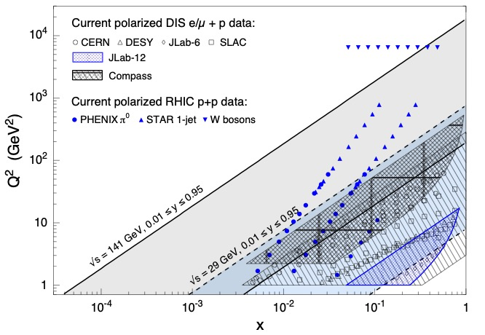
Kinematic Coverage Of The Electron Ion Collider
NOTE: Jefferson Lab is also very high luminosity >10³⁸ cm⁻²s⁻¹ while the proposed
EIC would be ~10³³ to 10³⁴ cm⁻²s⁻¹ so kinematic coverage alone isn’t the whole story.

Slide 4
Deep Inelastic Electron Scattering
Inclusive DIS
Semi-Inclusive DIS
Exclusive DIS
( low luminosity )
( medium luminosity )
( high luminosity )

Slide 5
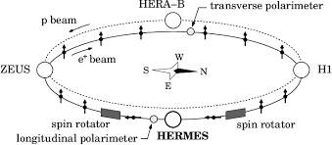
HERA
HERA (German: Hadron-Elektron-Ringanlage, English: Hadron-Electron Ring Accelerator) was a particle accelerator at DESY in Hamburg.
318 GeV center of mass energies: 27.5 GeV e, 920 GeV p
Electron-proton collider ran from 1992 – 2007
Electron polarization by Sokolov – Ternov effect.
Amazing machine and publications are still coming out from the data.
Luminosity (~10³¹ cm⁻²s⁻¹) and design choices limited the physics reach which now naturally lead to next generation machine: the EIC.

Slide 6
Key Science Questions For The EIC To Answer
How do the nucleonic properties such as mass and spin emerge from partons?
How are partons inside the nucleon distributed in both momentum and position space?
How do color-charged quarks and gluons, and jets, interact with a nuclear medium?
How does a dense nuclear environment affect the quarks and gluons, their correlations, and their interactions?
See National Academy of Science Report for details:
https://www.nap.edu/login.php?record_id=25171&page=https%3A%2F%2Fwww.nap.edu%2Fdownload%2F25171

Slide 7
October 2019 Review of Two Competing EIC Designs
For e-N collisions:
  Polarized beams: e, p, d/³He
  e beam 5-20 GeV
  Luminosity ~ 10³³⁻³⁴ cm⁻²sec⁻¹
  100-1000 times HERA
  20-140 GeV variable center of mass energy
For e-A collisions:
  Wide range in nuclei
  Luminosity per nucleon same as e-p
  Variable center of mass energy
Key Supporting Documents
  EIC White Paper
  National Academy of Science Report
JLEIC

Slide 8
Site Selection & Intellectual Ownership of the Physics
CD0 was approved 19 Dec. 2019 with an announcement from the DOE department of energy on 9 Jan. 2020 https://www.energy.gov/articles/us-department-energy-selects-brookhaven-national-laboratory-host-major-new-nuclear-physics
While JLab scientists were understandably disappointed, Tim Hallman (Associate Director of Science for Nuclear Physics) came here after site selection and encouraged the Jefferson Lab community to continue to develop their intellectual ownership of the physics.
This idea really resonated with many and a very positive BNL-JLab partnership started.
This commitment to the EIC was formalized with the BNL-JLAB Partnering Agreement, signed May 7, 2020.
This partnership has been flourishing ever since.

Slide 9

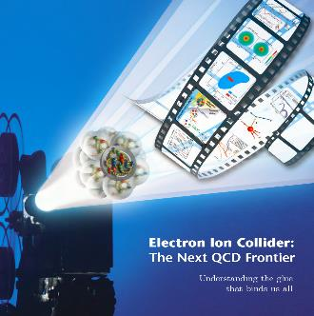
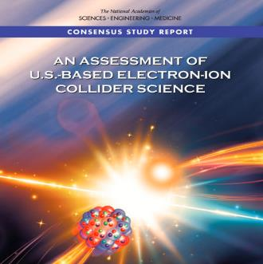
EIC Project Requirements
High Luminosity: L= 10³³ – 10³⁴cm⁻²sec⁻¹, 10 – 100 fb⁻¹/year
Highly Polarized Beams: 70%
Large Center of Mass Energy Range: E_{cm} = 20 – 140 GeV
Large Ion Species Range: protons – Uranium
Large Detector Acceptance and
Good Background Conditions
Accommodate a Second Interaction Region (IR)
Conceptual design scope and expected performance meets or exceed NSAC Long Range Plan (2015) and the EIC White Paper requirements endorsed by NAS (2018).

Slide 10
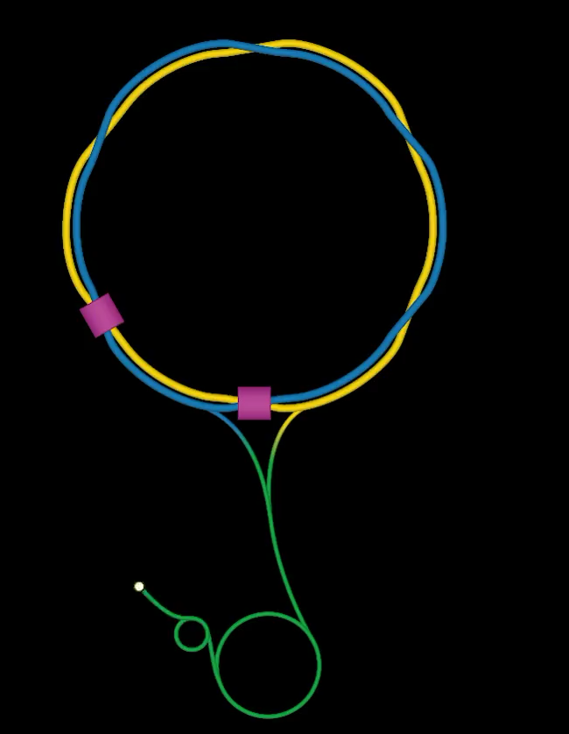
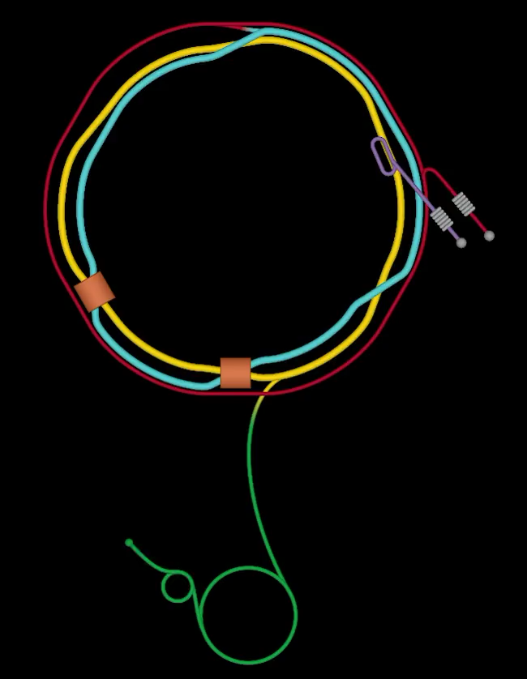
From RHIC to Electron Ion Collider @ BNL

Slide 11
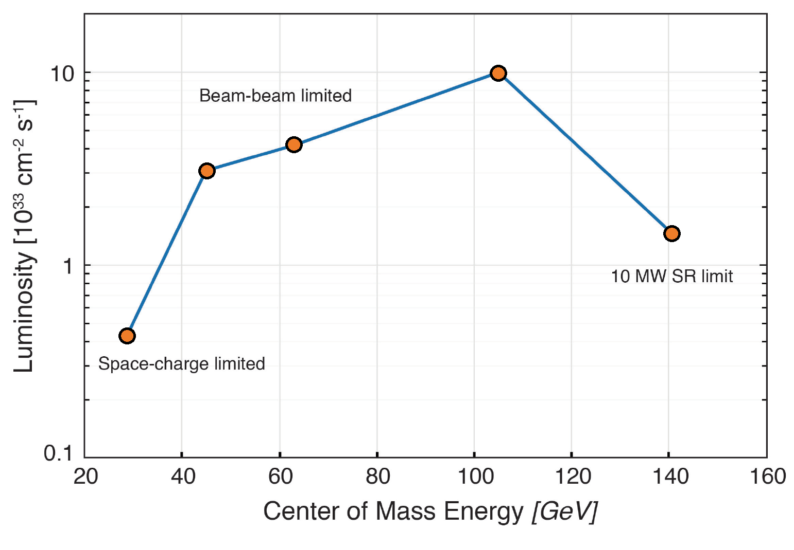
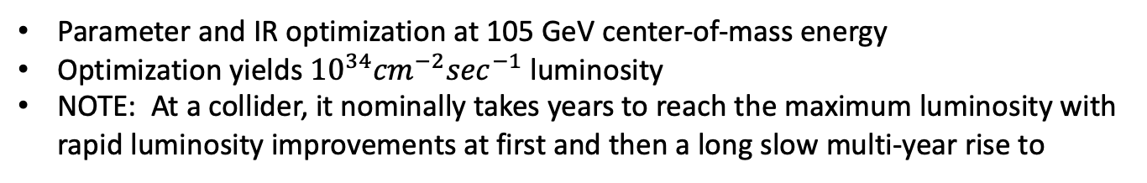
Luminosity vs Center of Mass Energy at the EIC
Parameter and IR optimization at 105 GeV center-of-mass energy
Optimization yields ${10}^{34}{cm}^{−2}\sec^{−1}$luminosity
NOTE: At a collider, it nominally takes years to reach the maximum luminosity with rapid luminosity improvements at first and then a long slow multi-year rise to

Slide 12
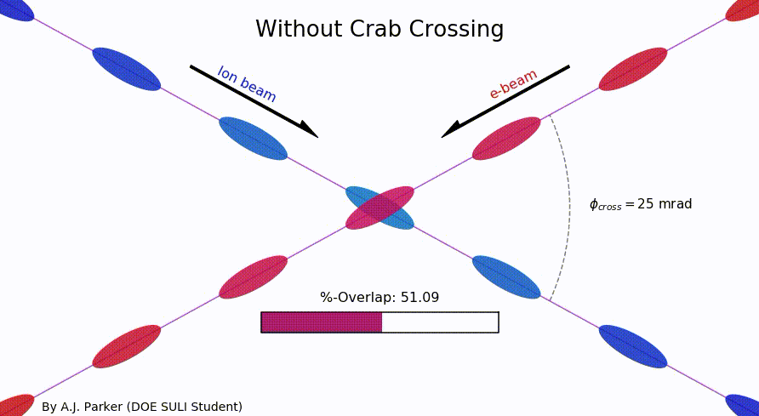
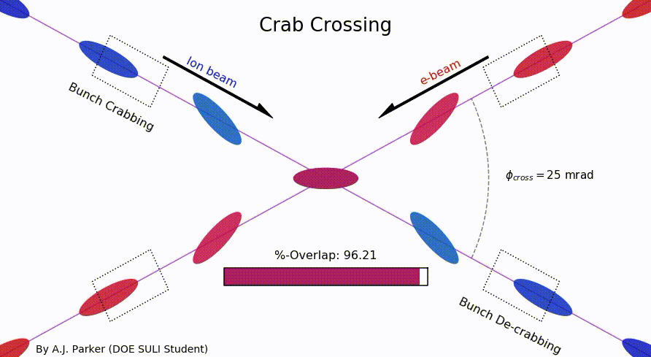
Crab Crossing Cavities Another Key To High EIC Luminosities
Animation made by DOE SULI summer student Asia Parker (Duquesne University) and source code posted online: https://github.com/sherwberry/SULI2020_CrabCrossingAnimation

Slide 13
EIC Yellow Report
Posted to the arXiv on 8 March 2021:
https://arxiv.org/abs/2103.05419
902 pages, 415 authors, and 151 institutions
LaTeX Source Code On The arXiv
Now also published in a refereed journal:
Nucl.Phys.A 1026 (2022) 122447
As of 7 August 2023 has 590 Inspire’s citations
The document is broken into three volumes:
Executive Summary
Physics
Detectors

Slide 14
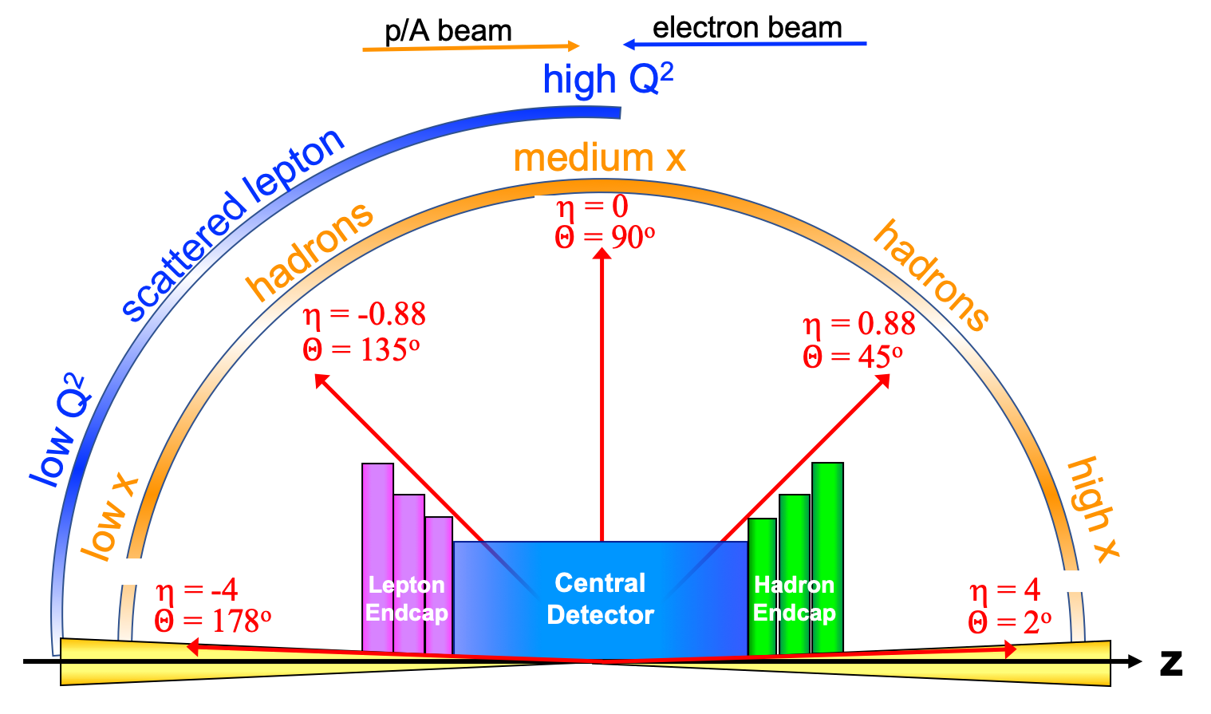
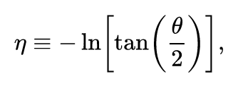
Detector polar angle / pseudo-rapidity coverage

Slide 15
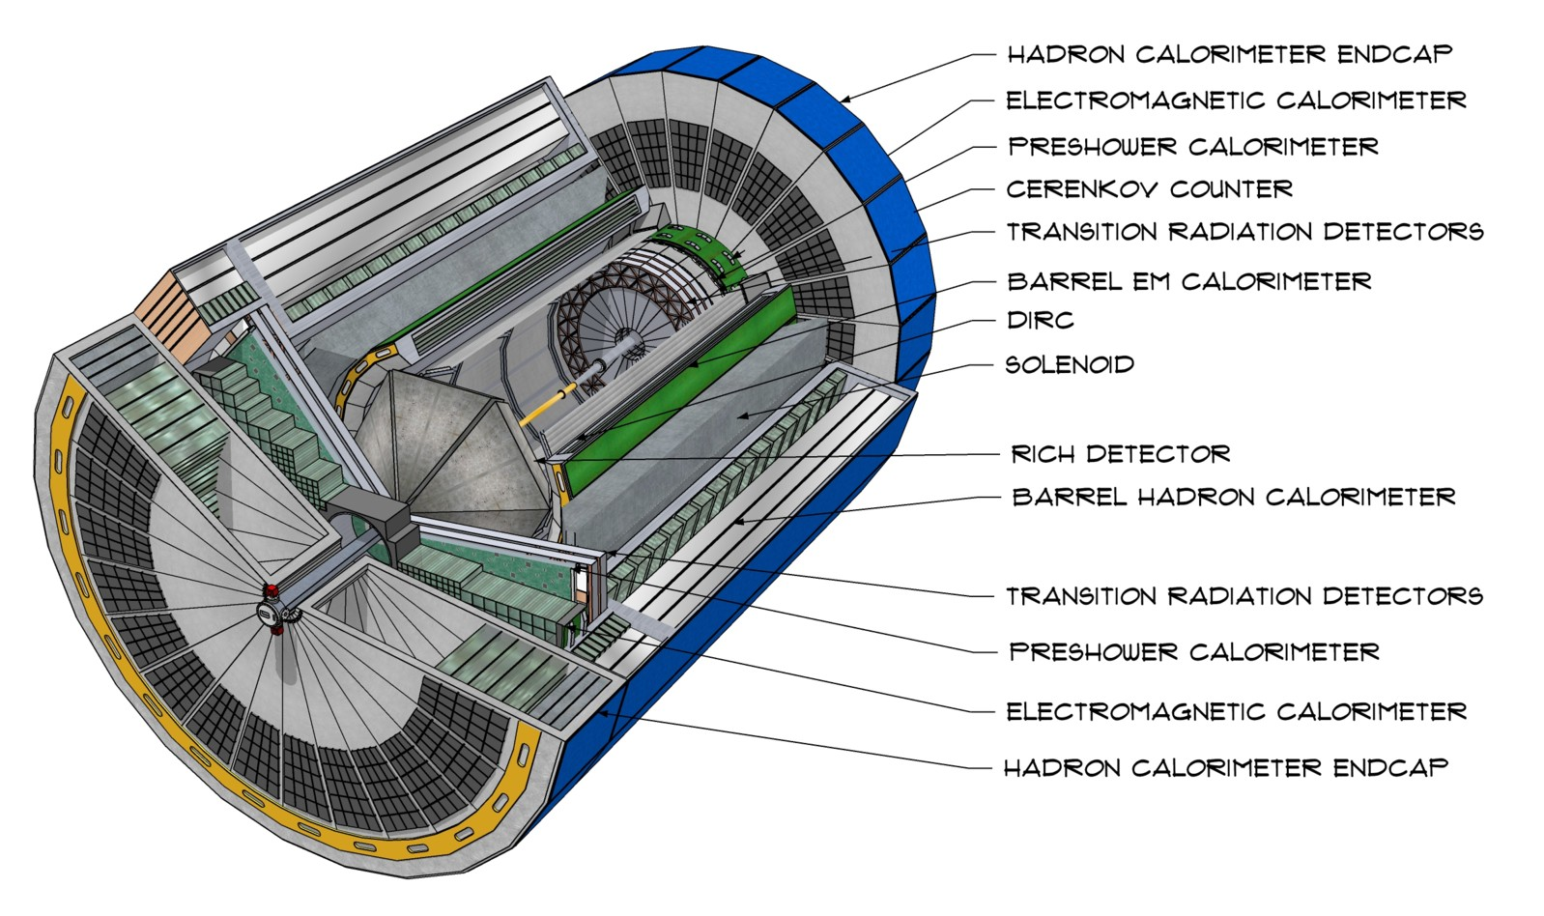
CAD Model of Generic EIC Detector
Alex’s talk will show the latest design which is different details but similar.

Slide 16
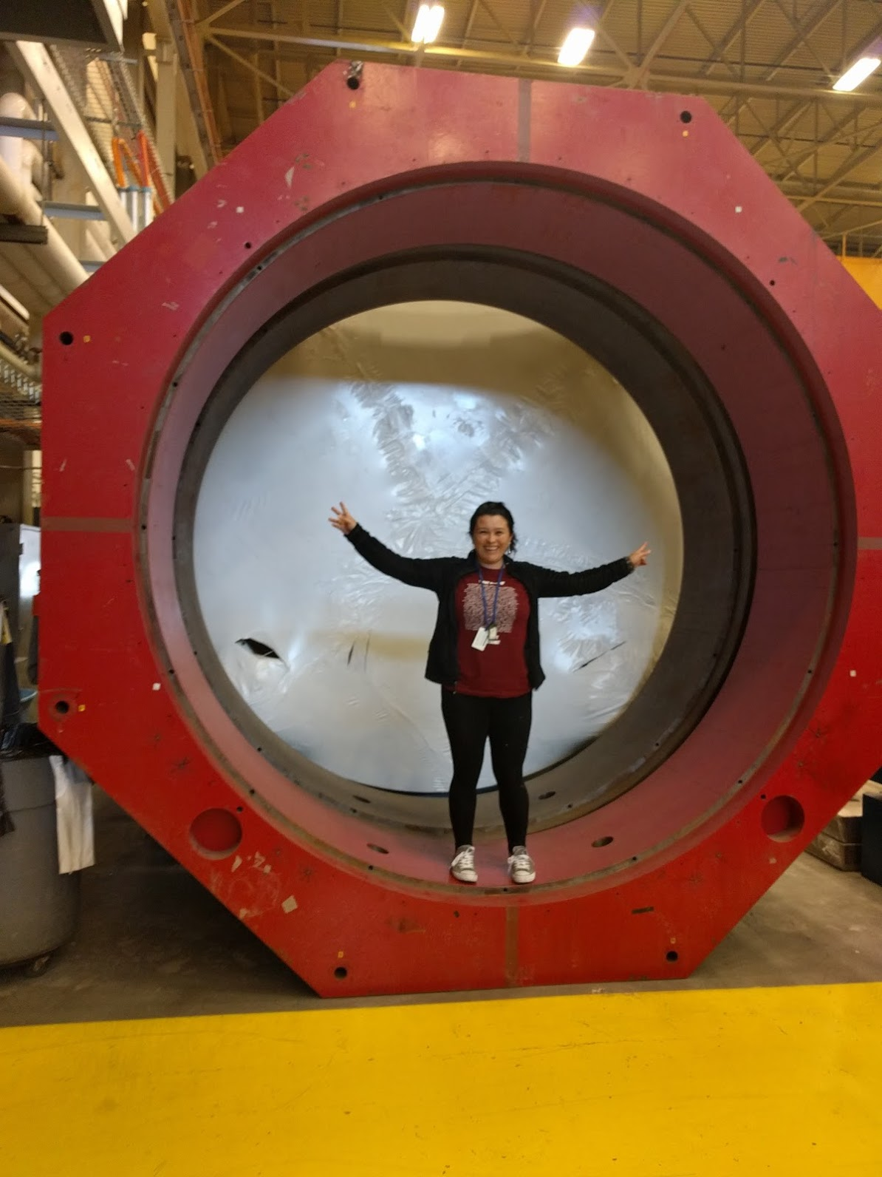
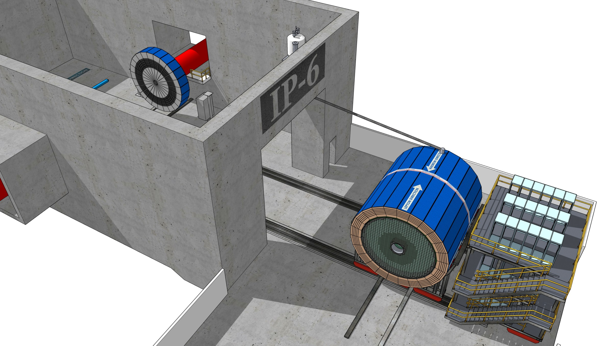
Size and Planned Location of the First EIC Detector
Image show how such a detector could be
moved out of IP-6 at the EIC.

Slide 17
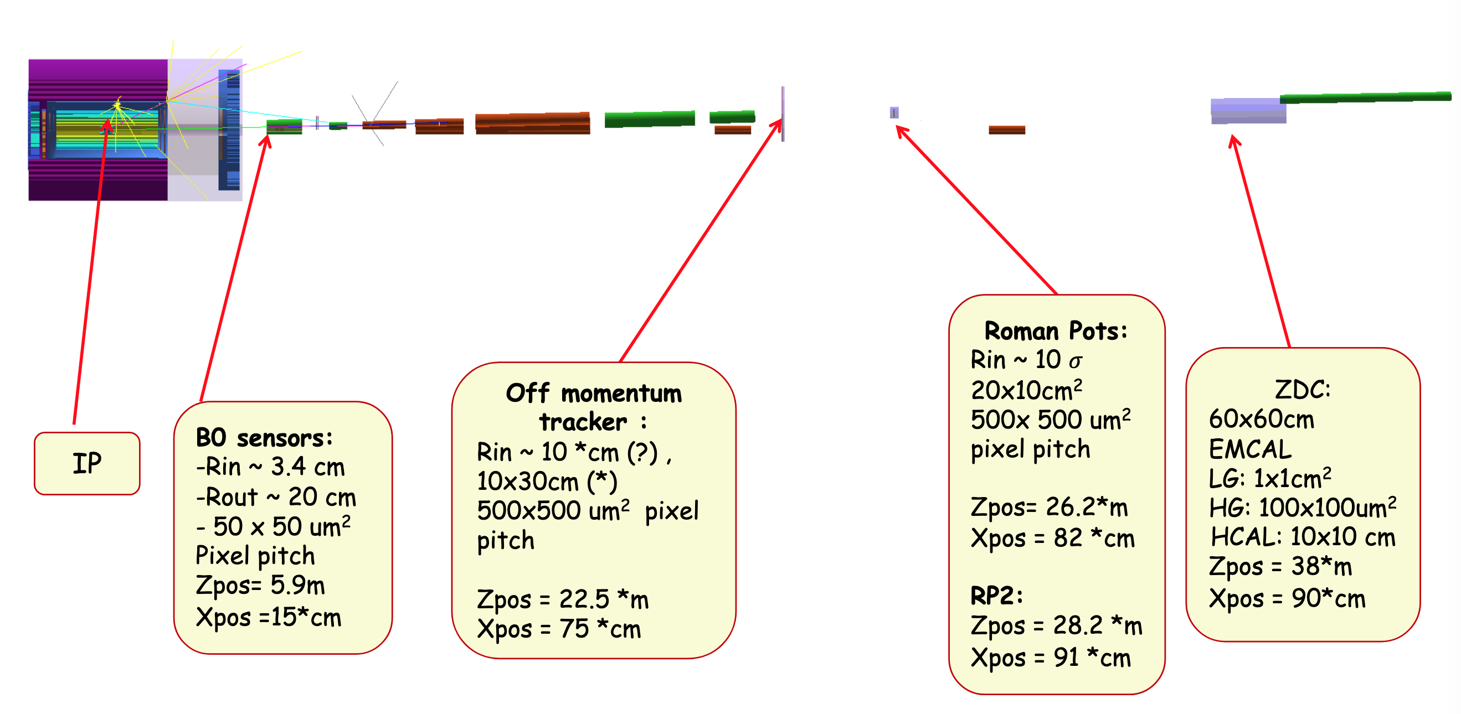
Far Forward Detection Systems ( my favorite part of the EIC)
Detectors located tens of meters from the main EIC detector and are small in size.

Slide 18
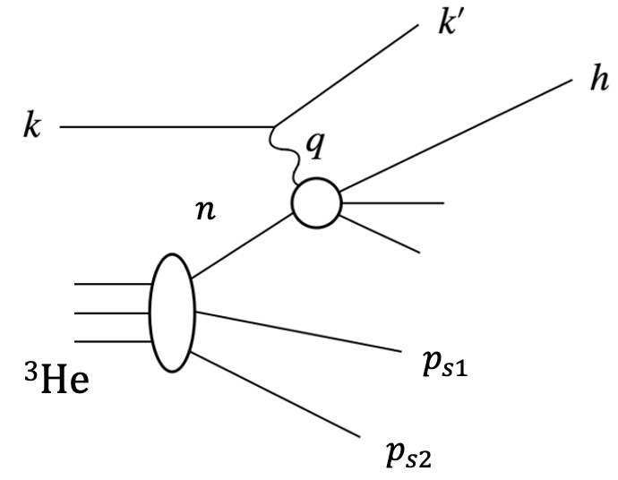
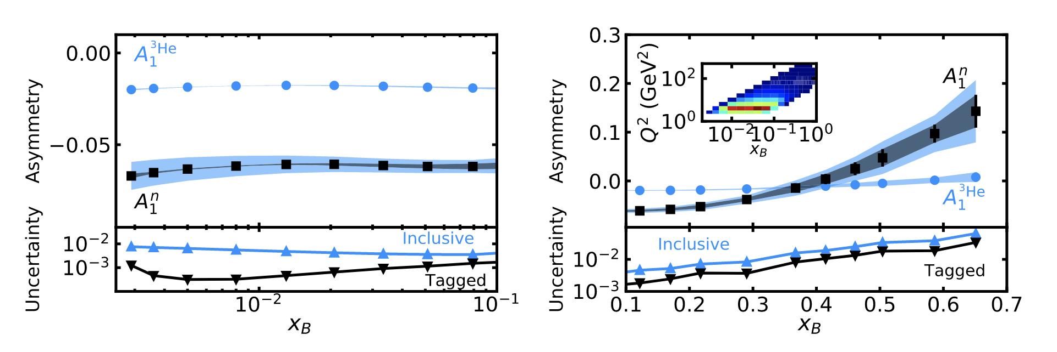
EIC ³He Physics with Tagging
Frišcic, D. Nguyen, J.R. Pybus, A. Jentsch, E.P. Segarra, M.D. Baker, O. Hen, D.W.H., R. Milner, A.S. Tadepalli, Z. Tu, J. Rittenhouse West, Phys. Lett. B (2021) 136726 https://doi.org/10.1016/j.physletb.2021.136726
Physics Goals:
Nucleon structure function F₂^{n}, F₂^{p} and study medium modifications
Neutron spin structure study on A₁^{n}, g₁^{n} for polarized PDFs
TMD measurements: Flavor and spin dependence of the Transverse Momentum Distribution.
DIS & SIDIS
Tagging

Slide 19
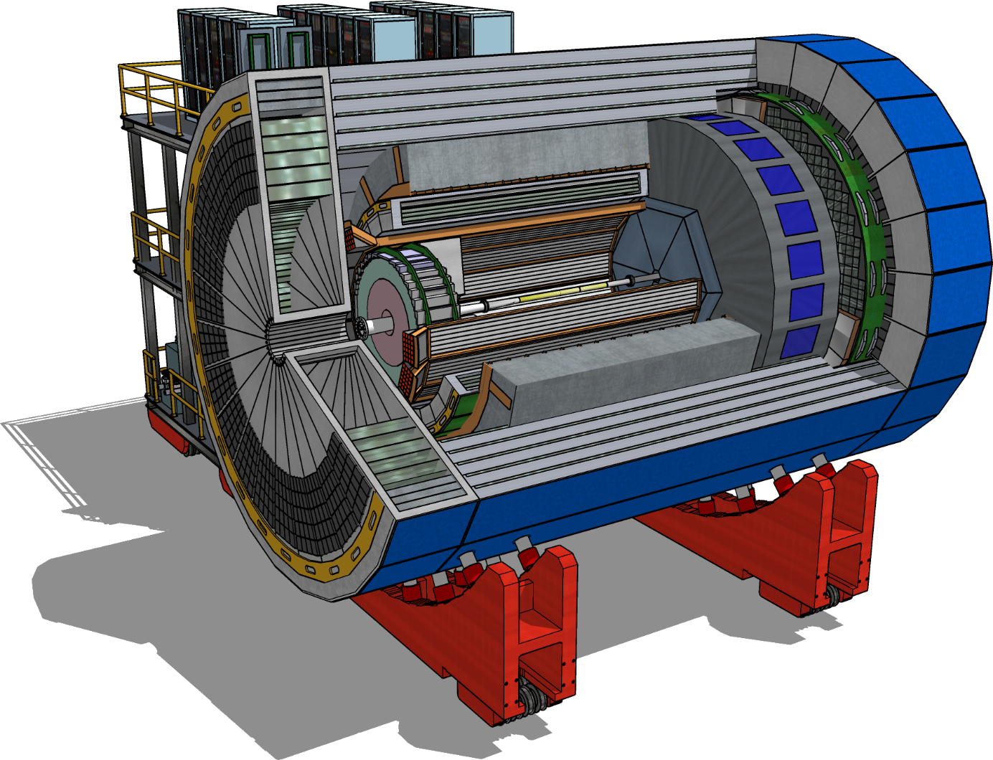
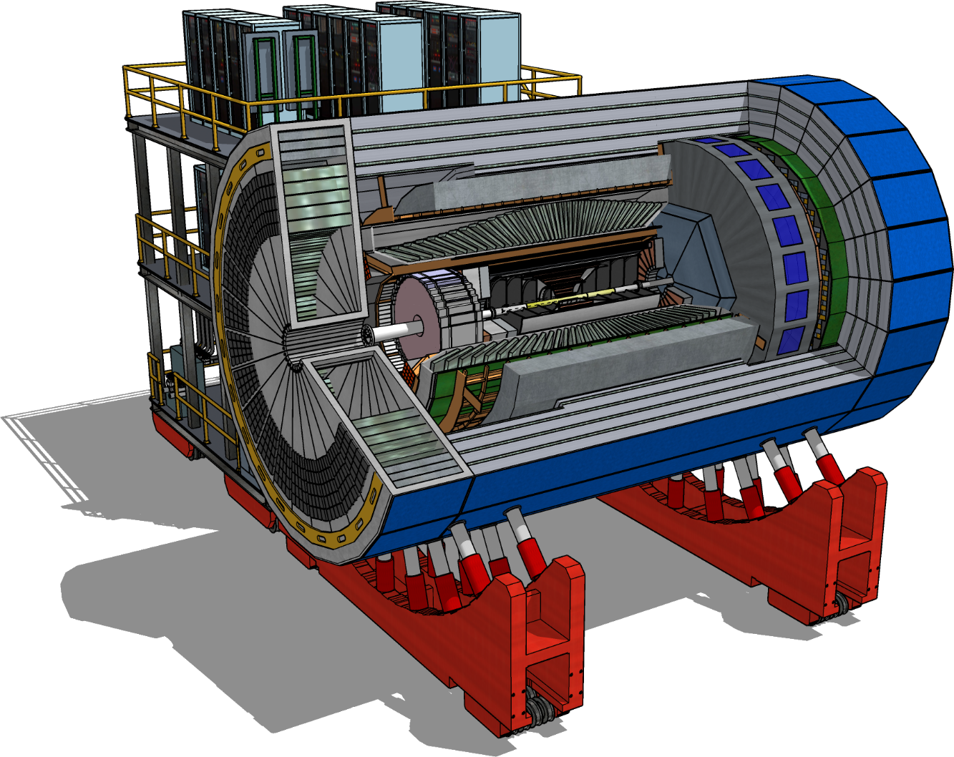
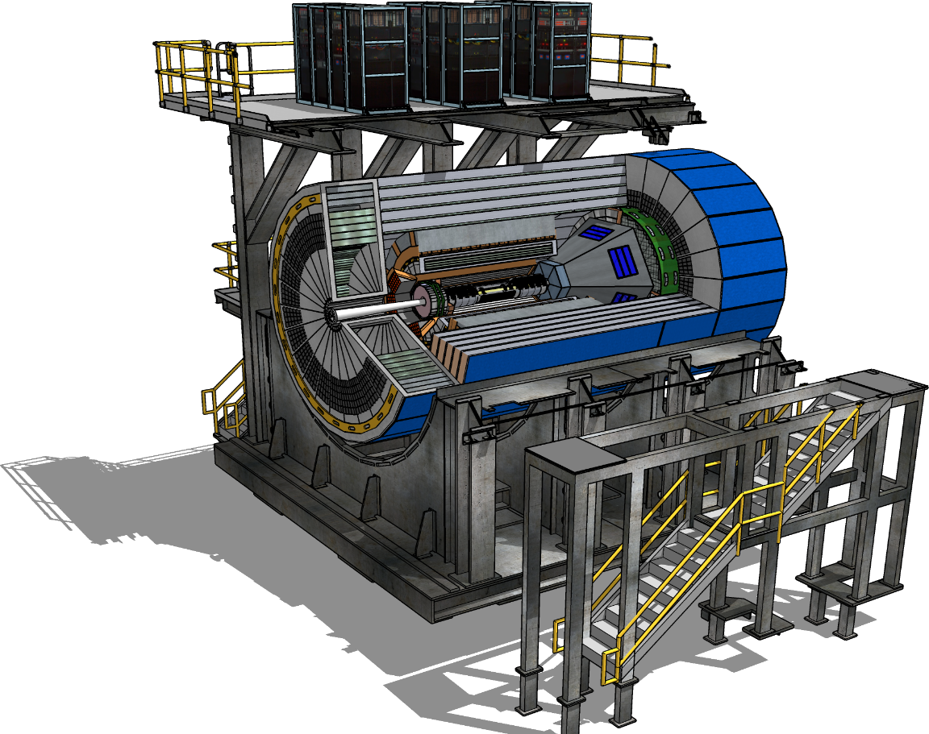
ATHENA, ECCE, and CORE Proto-Collaborations
https://www.bnl.gov/dpapanelmeeting/
CORE
COmpact detectoR for the EIC
ATHENA
A Totally Hermetic Electron-Nucleus Apparatus
ECCE
EIC Comprehensive Chromodynamics Experiment
21 March 2022 the ECCE concept was selected to be the baseline and now we are coming
back together to take those ideas (improve them) into what is presently called detector one.

Slide 20

Path to EIC Project Detector Collaboration
Silvia Dalla Torre, Or Hen, Tanja Horn, John Lejoie, Bernd Surrow
Consolidation of ATHENA and ECCE and formation of a new scientific collaboration for the first EIC detector
The ePIC Collaboration!
  Evolution of the ECCE reference design to a detector one technical design
  New Working Groups
    Taking advantage of the strength in both the ATHENA and ECCE collaborations
Many members of the CORE team are now focused on a 2nd detector for the EIC.
See talks from the EIC meeting 23-31 July 2023
  https://indico.cern.ch/event/1238718/

Slide 21
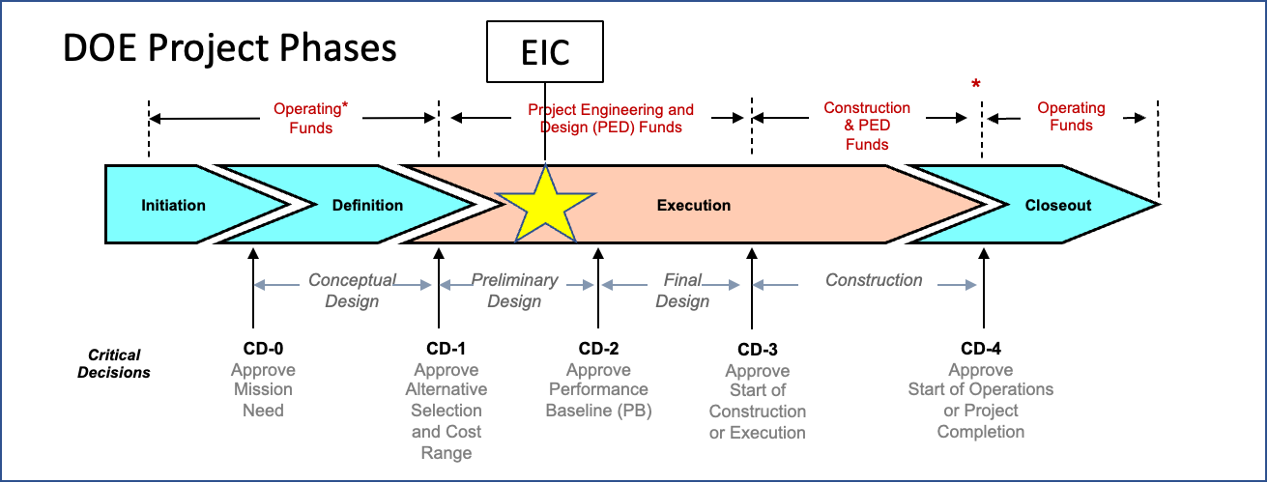
DOE Project Phases and EIC Milestones
CD-0, Mission Need Approved | December 2019
DOE Site Selection Announced | January 2020
CD-1, Alternative Selection and Cost Range, Approved | June 2021
CD-3A, Long Lead Procurement | January 2024
CD-2/3, Performance Baseline/Construction Start | April 2025
RHIC Shut Down | June 2025

Slide 22
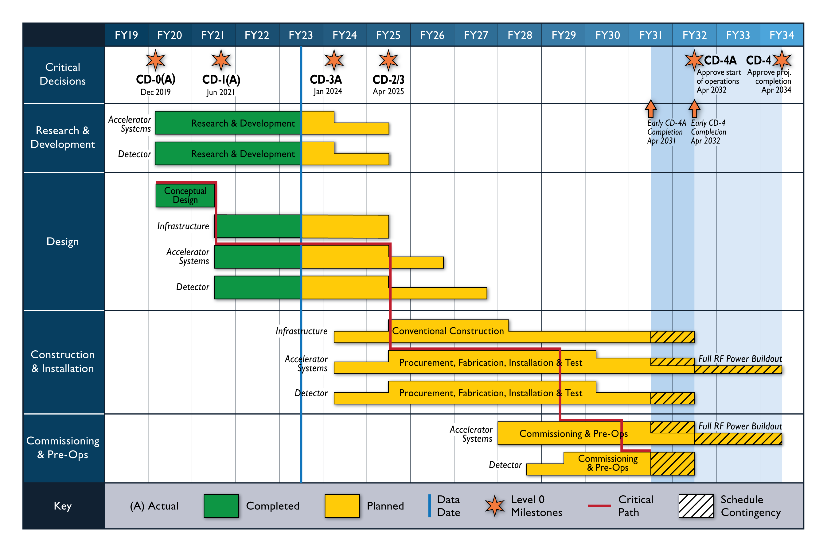
Reference Schedule (July 2023)

Slide 23
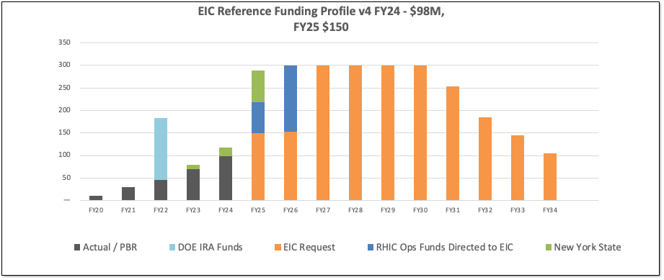
DOE Reference Funding Plan
23
DOE Inflation Reduction Act funding of $138M allocated in September 2022. Actual FY2023 funding is $70M. DOE request for FY2024 is $98M.
RHIC shut down planned for June 2025. Significant RHIC Operations funding will be redirected to EIC construction starting in FY2025 and reaching ~$150M/year in FY2026.
Current funding supports DOE CD-3A, Long Lead Procurement Approval, in January 2024. Long lead procurement mitigate risks: technical, supply chain, inflation, and schedule.
Sum of this funding profile is slightly under 3 billion dollars.

Slide 24
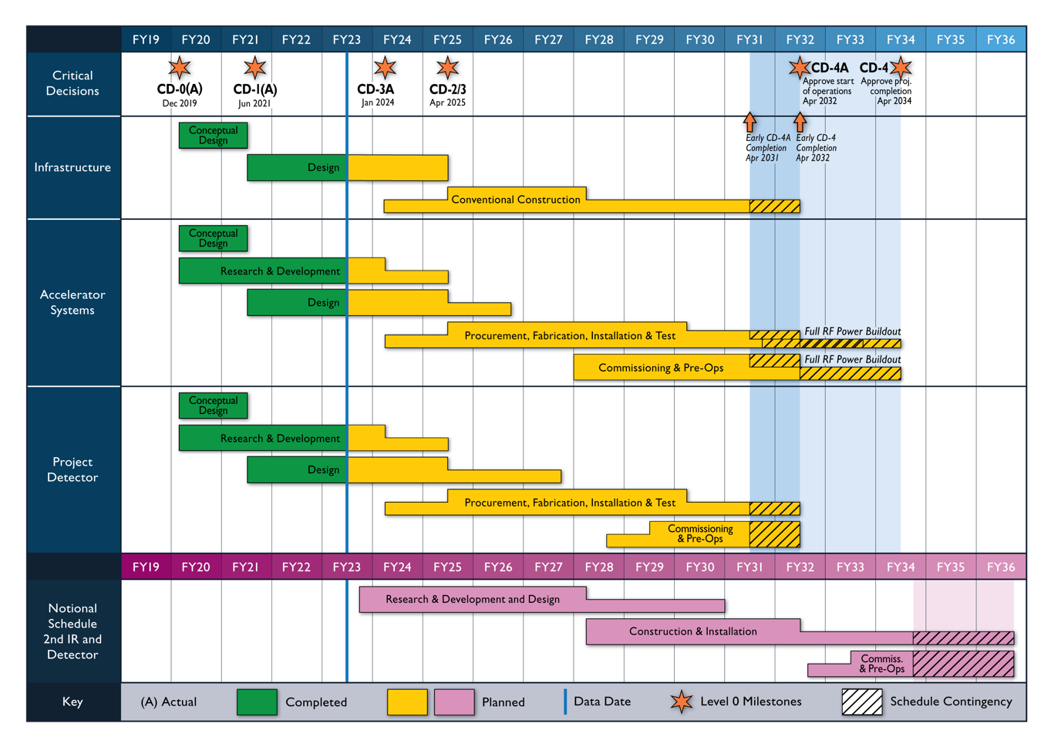
Notional Schedule for 2nd IR & Detector (July 2023)
24

Slide 25
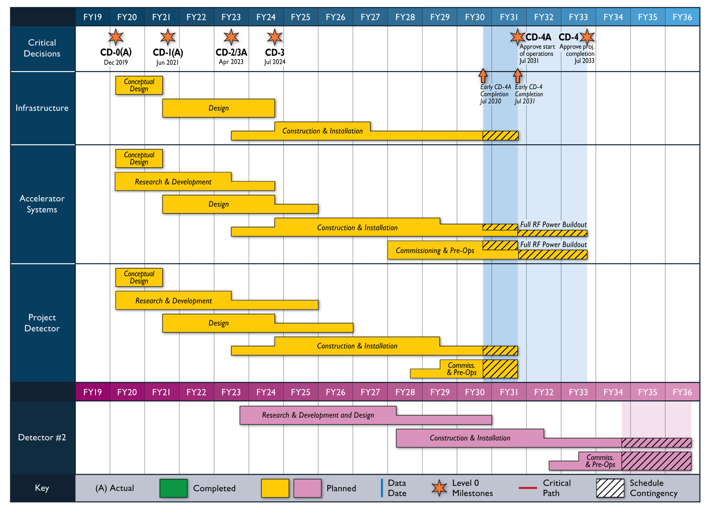
Reference Schedule (Oct. 2021)
Notional Schedule
2nd IR and
Schedule
Generic Detector R&D

Slide 26
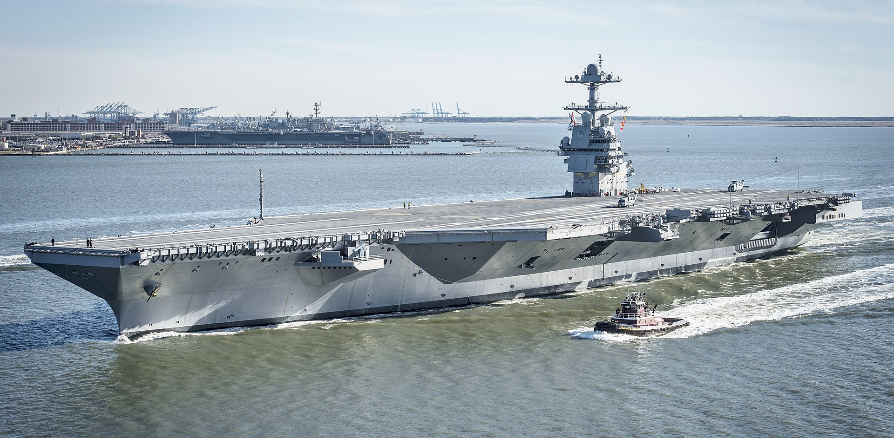
~10% Cost of A US Aircraft Carrier which are all built here in Newport News
Gerald R. Ford-class aircraft carrier
Nevertheless, 3 billion dollars is a very large amount for a DOE nuclear physics project and budgets in the US are annual so we can expect good years and bad years along the way.

Slide 27
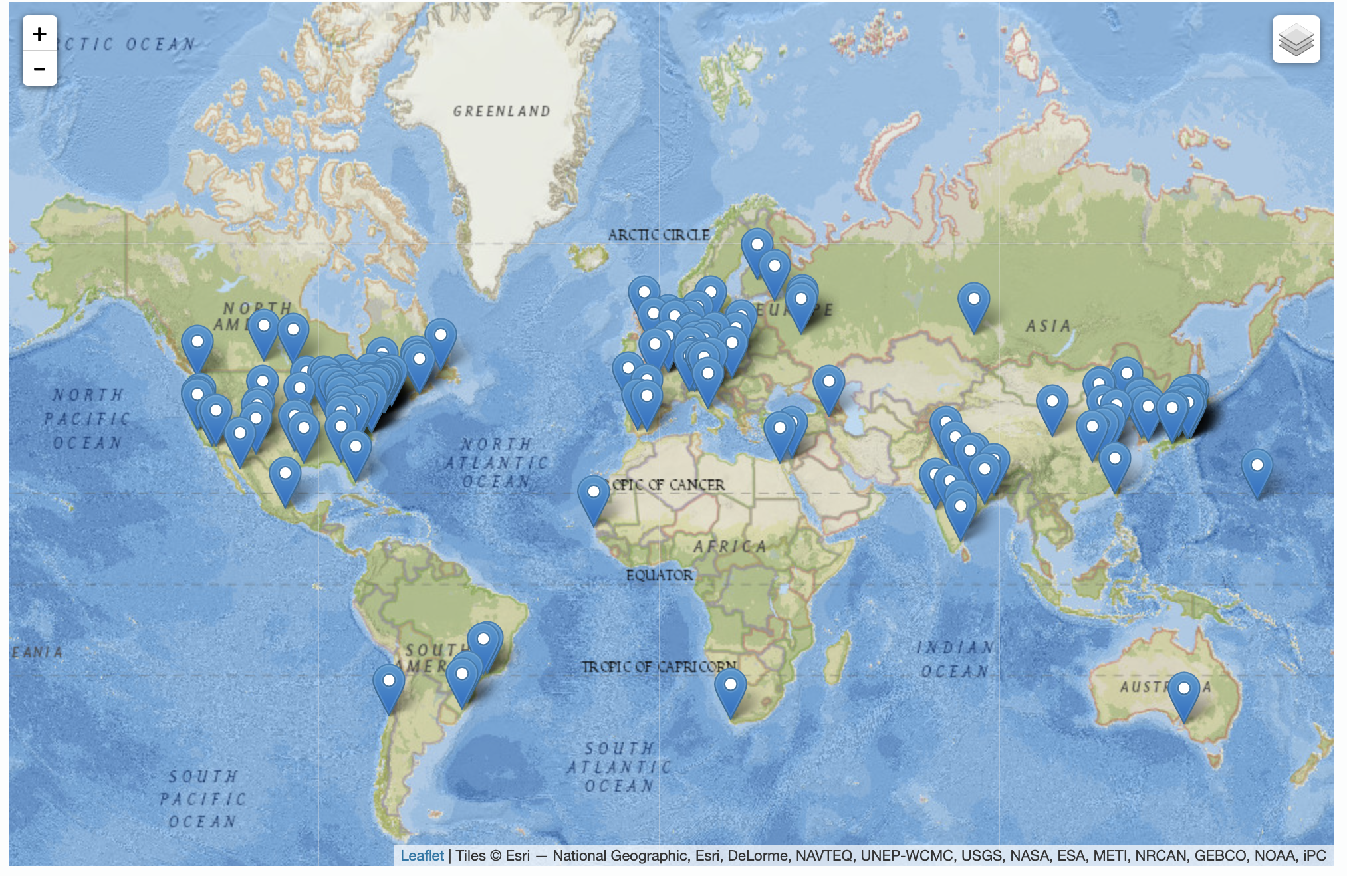
International Interest in EIC Science
The EIC User Group: EICUG.ORG, Formed 2016
7 August 2023:
1403 collaborators
279 institutions
37 countries
You are all welcome to join the EICUG by contacting your institutional representative: https://phonebook.sdcc.bnl.gov/eic/client/
( or email me and I will help you! )
Institutions

Slide 28

Summary
Due to a very strong overlap in the physics interests, the EIC project has turned into a very nice joint project with BNL and JLab. (note: in an ideal world this is how science should always be done!)
Just as the two labs were able to come together after site selection, the detector teams ECCE and ATHENA have nicely come together to form ePIC.
Many that were in the CORE team are now pushing for the second detector.
This machine will turn on for science in the 2030’s, so the young people in this room will be part of the scientific team running the experiments and analyzing the exclusive physics channels!
EIC

Slide 29
Detector Testing @ Jefferson Lab
Jefferson Lab users have a long history of its users setting up small parasitic detector tests in the experimental halls to ensure successful experiments.
With a focus on detectors for the EIC, the EIC center coordinates between outside groups and the experimental Halls to facilitate testing.
Presently Four Parasitic Testing Areas On Site
  High Luminosity Tests: Hall A and Hall C
  Low Luminosity Tests: Hall B and Hall D
Presently One Area For Dedicated Testing
  10 MeV Upgraded Injector Test Facility
Testing requires approval by hall leader and work coordinator as well as appropriate training and safety documentation
More details found at: https://www.eiccenter.org/detector-testing

Slide 30
Test Setup in Hall D
Photon beam
Electrons
Other halls are also used for parasitic detector testing (e.g. Hall C has been going SoLID tests).

