Slide 1
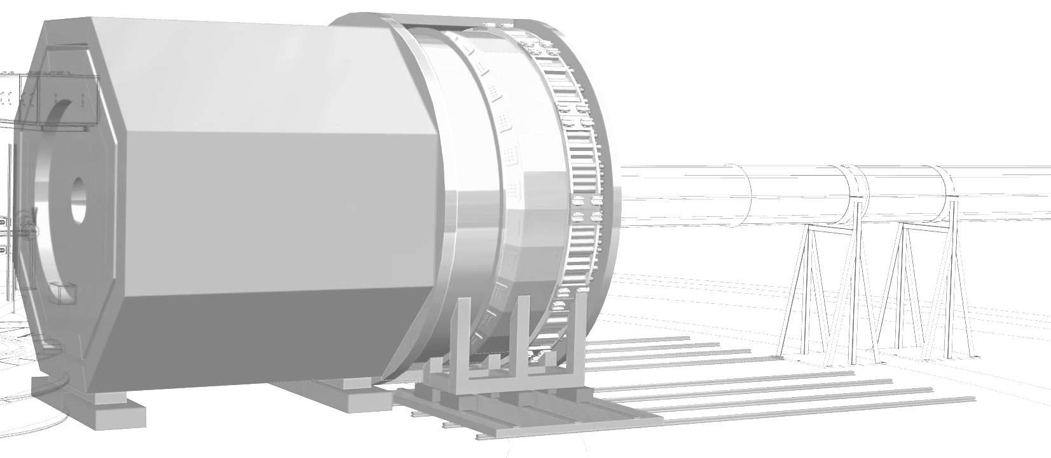

GPD Physics with SoLID
J. P. Chen, Jefferson Lab
For the SoLID Collaboration
Tomography_Workshop_2023
Jefferson Lab, August 7-11, 2023
Acknowledgement: Thanks to Z. Ye, Z. Zhao, A. Camsonne, M. Boer, G. Hubert, and many others for helping with slides and for their efforts in developing the SoLID GPD Program

Slide 2
Outline
Introduction/Overview of SoLID
SoLID GPD Program
i. DVMP on transversely polarized nucleon
ii. DVCS on transversely polarized nucleon
iii. TCS
iv. DDVCS
……
    DEMP
  DEMP
  D
  DE
3. Status and Outlook

Slide 3
1. Introduction/Overview of SoLID

Slide 4
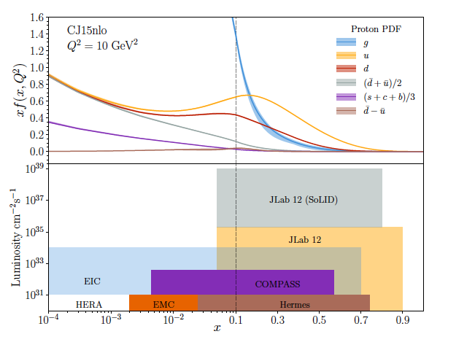
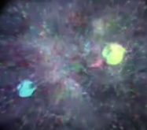
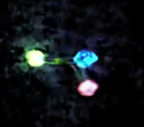
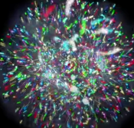
SoLID@JLab: QCD Intensity Frontier
Combining Hall A/C high luminosity, Hall B/D large acceptance → Dream Device
Nucleon spin/3-D structure, proton mass, beyond standard model experiments require
precision measurements of small cross sections and asymmetries,
combined with multiple particle detection
critical need for very high intensity
Probability Distribution
SoLID – extremely high intensity
  3D imaging of the nucleon
  Beyond Standard Model searches
  Exploration of gluonic-force
Probability Distribution
2020s-2030s
Luminosity (cm⁻²s⁻¹)
2010s-2020s
2030s-2040s
2000s-2010s
1980s-1990s
Fraction of nucleon momentum

Slide 5

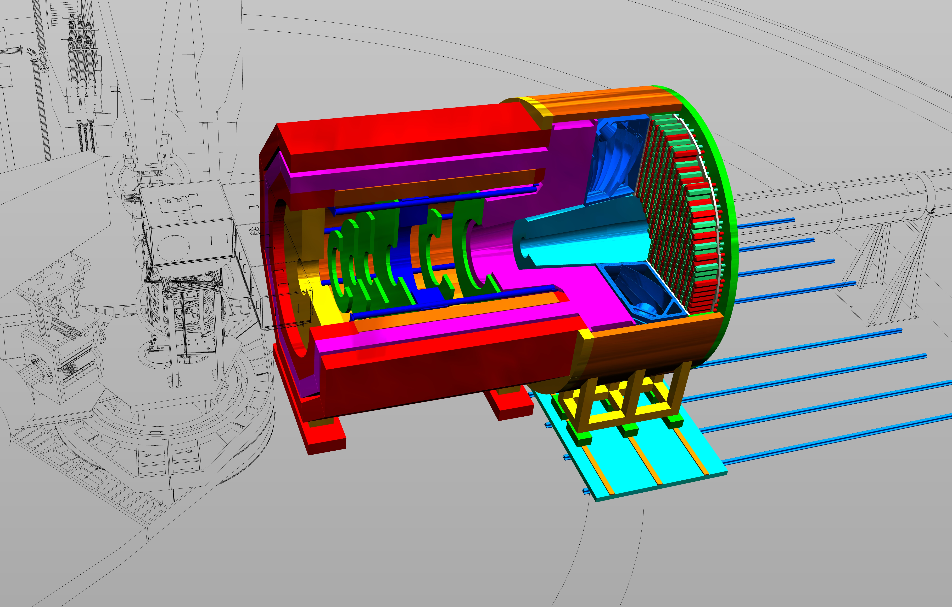
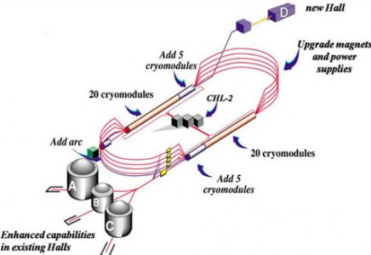
SoLID@JLab: QCD Intensity Frontier
SoLID will maximize the science return of the 12-GeV CEBAF upgrade by combining...
High Luminosity
10³⁷⁻³⁹ /cm²/s
[ >100x CLAS12 ][ >1000x EIC ]
Large Acceptance
Full azimuthal 𝜙 coverage
Research at SoLID will have the unique capability to explore the QCD landscape while complementing the research of other key facilities
Pushing the phase space in the search of new physics and of hadronic physics (PVDIS)
3D imaging of a relativistic strongly interacting confined system – TMDs/GPDs (nucleon spin)
Superior sensitivity to the differential electro- and photo-production cross section of J/𝜓 near threshold (gluon field and proton mass)
Synergizing with the pillars of EIC science (proton spin/3D and mass) through
high-luminosity valence quark tomography and precision J/𝜓 production near threshold
Notes:
5

Slide 6
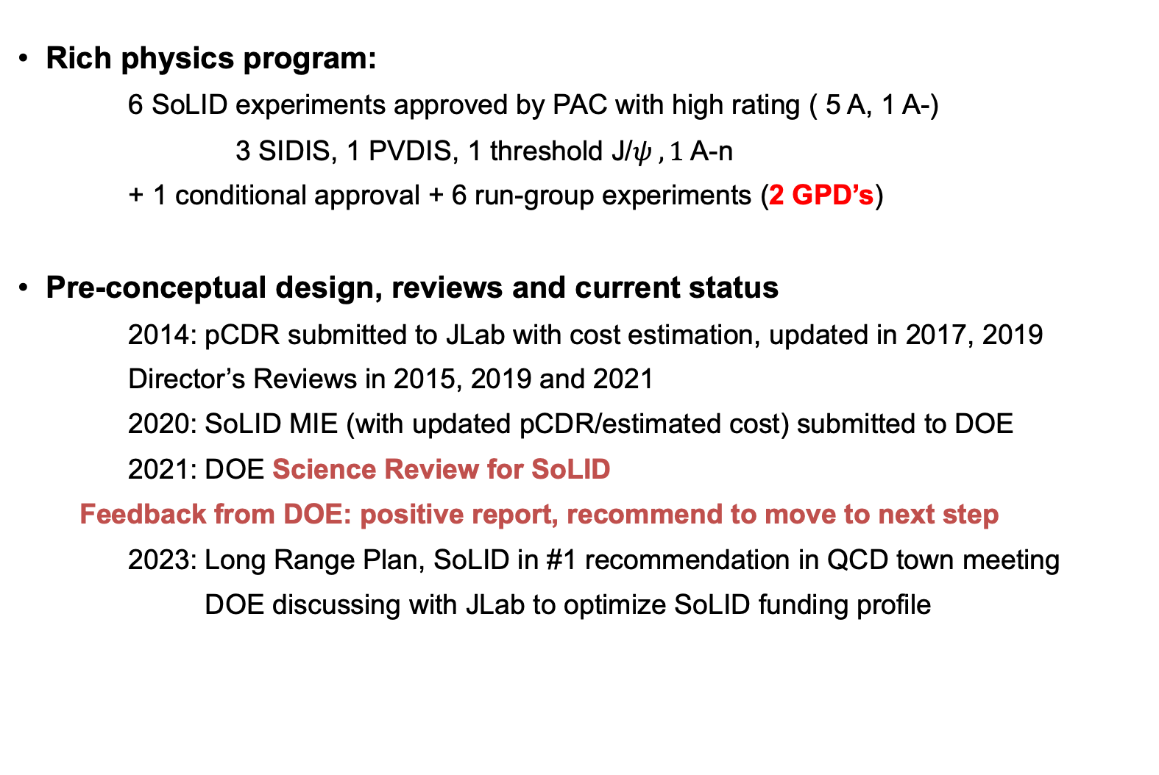
SoLID Physics and Project Development
Rich physics program:
6 SoLID experiments approved by PAC with high rating ( 5 A, 1 A-)
3 SIDIS, 1 PVDIS, 1 threshold J/$ψ , 1$A-n
+ 1 conditional approval + 6 run-group experiments (2 GPD’s)
Pre-conceptual design, reviews and current status
2014: pCDR submitted to JLab with cost estimation, updated in 2017, 2019
Director’s Reviews in 2015, 2019 and 2021
2020: SoLID MIE (with updated pCDR/estimated cost) submitted to DOE
2021: DOE Science Review for SoLID
Feedback from DOE: positive report, recommend to move to next step
2023: Long Range Plan, SoLID in #1 recommendation in QCD town meeting
DOE discussing with JLab to optimize SoLID funding profile

Slide 7
Approved SoLID Experiments
SIDIS-TMD:
SIDIS-He3-T (E12-10-006), J. P. Chen, H. Gao (contact), J.C. Peng, X. Qian; 90 days, A
SIDIS-He3-L (E12-11-107), J.P. Chen (contact), J. Huang, C. Peng, W.B. Yan; 35 days, A
SIDIS-P-T (E12-11-108), J.P. Chen, H. Gao(contact), X.M. Li, Z.E. Meziani, V. Khachatryan, 120, A
PVDIS (E12-10-007), P. Reimer, P. Souder (contact), X. Zheng, 120 days, A
J/ψ (E12-12-006), S. Joosten, Z.-E. Meziani (contact), X. Qian, N. Sparveris, Z. Zhao; 60,
BNSSA(A_n) (E12-22-004), W. Henry, M. Nycz (contact), Y. Tian, W. Xiong, X. Zheng; 38, A-
PVEMC (PR12-22-002), J. Arrington (contact), R. Beminiwattha, D. Gaskell, J. Mammei, P. Reimer; Conditional Approval
Details please see: https://solid.jlab.org/experiments.html.

Slide 8
Approved SoLID Run-Group Experiments
GPDs:
TCS (pol beam on unpol LH2), M. Beor, P. Nadel-Turonski, J. Zhang, Z. W. Zhao (contact)
DVMP (π- production on T-He3), G. Huber (contact), Z. Ahmed, Z. Ye
SIDIS-TMD:
SIDIS-dihadron (T-He3), J. P. Chen, A. Courtoy, H. Gao, Z. Xiao, J.Zhang (contact)
SIDIS-Kaon (T-He3), T. Liu, S. Park, Y. Wang, Z. Ye (contact), Z. Zhao
Spin:
A-y: (unpol beam on T-He3/T-P), T. Averett (contact), A. Camsonne, X. Jiang, N. Liyanage
g2n/d2n(pol beam on T-He3/L-He3), C. Peng, Y, Tian
LOI’s: DDVCS, Polarized PVDIS, C3 Coupling, Tensor Polarized Deuteron, …
Details please see: https://solid.jlab.org/experiments.html.

Slide 9
2. SoLID GPD Program

Slide 10
Overview of SoLID GPD Experiments
Advantages of SoLID: high luminosity and large acceptance
2π azimuthal angle acceptance
polarized p/n(³He) targets in both T/L
DVMP (exclusive π- production on transversely polarized neutron/³He)
Spokespersons: G. Huber (contact), Z. Ahmed, Z. Ye
Approved run-group with SIDIS transversely polarized neutron/³He
DVSC with transversely polarized nucleon targets
Zhihong Ye et al. Under study. Add recoil detector?
TCS (pol beam on unpol LH₂)
Spokespersons: M. Beor, P. Nadel-Turonski, J. Zhang, Z. W. Zhao (contact)
Approved run group with J/ψ threshold production on LH₂
LOI’s: DDVCS
Spokespersons: A. Camsonne (contact), M. Boer, E. Voutier, Z. Zhao,
(talk on Wednesday by Z. Zhao). Add muon detector
Backward DVCS: B. Li (talk on Wednesday)
…….

Slide 11
SoLID DVMP on Transversely Polarized n/³He
SoLID SIDIS and DVMP setup
  E12-10-006: Single Spin Asymmetries on Transversely polarized ³He @ 90 days, rating A
  E12-10-006B: Deep Virtual Exclusive π– from Transversely Polarized n
  E12-11-007: Single and Double Spin Asymmetries on longitudinally polarized ³He @ 35 days, rating A
  E12-11-108: Single Spin Asymmetries on Transversely Polarized Proton @120 days, rating A

Slide 12
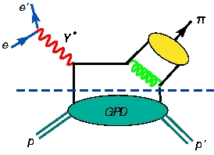
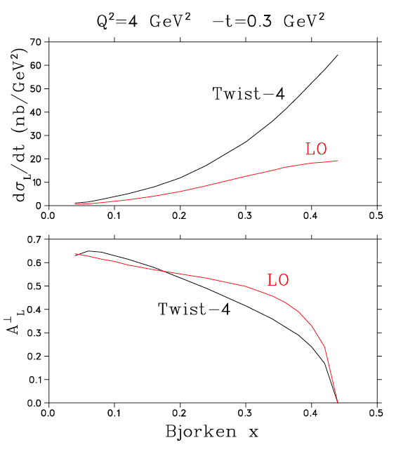
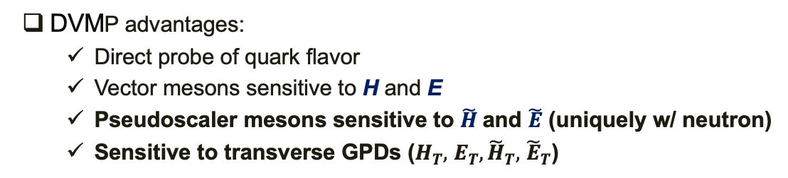
DVMP Cross Sections and Asymmetries
DVMP advantages:
  Direct probe of quark flavor
  Vector mesons sensitive to H and E
  Pseudoscaler mesons sensitive to $\tilde{H}$and $\tilde{E}$ (uniquely w/ neutron)
  Sensitive to transverse GPDs ($H_{T},$ $E_{T},{\tilde{H}}_{T},$ ${\tilde{E}}_{T}$)
Factorization
DVMP disadvantages:
  Usually requires Q² ~10 GeV² for factorization
  Higher twist contaminations
  Long. photons to link to GPD (LT separation)
DVMP w/ asymmetries:
  A_{L}┴ displays factorization even at only Q²~2-4 GeV²:
Belitsky & Műller PLB 513(2001)349, CIPANP 2003).

Slide 13
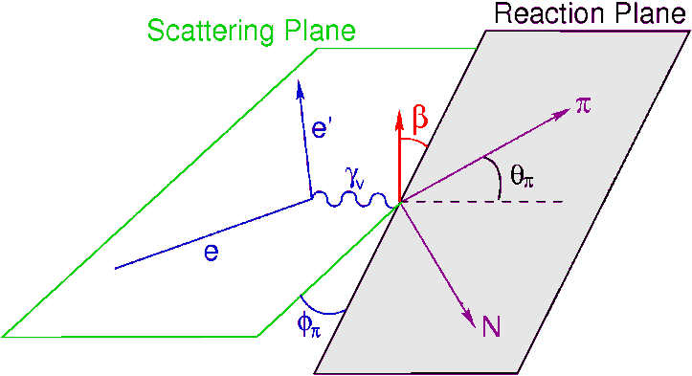
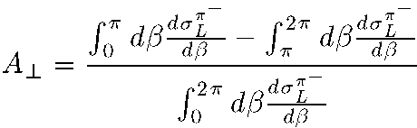
E12-10-006B: Deep Exclusive π– from Transversely Polarized n
Z. Ahmed, G. Huber, Z. Ye
~
Next Generation Study: Polarized GPD E
involves a helicity flip:
  Depends on the spin difference between initial and final quarks.
G_{P}(t) is highly uncertain because it is negligible at the momentum transfer of β-decay.
~
E not related to an already known parton distribution → essentially unknown.
Experimental information can provide new nucleon structure information unlikely to be available from any other source.
Fit sinβ=sin(φ–φ_{S}) dependence.
Need large acceptance
Garth Huber, U. of Regina

Slide 14
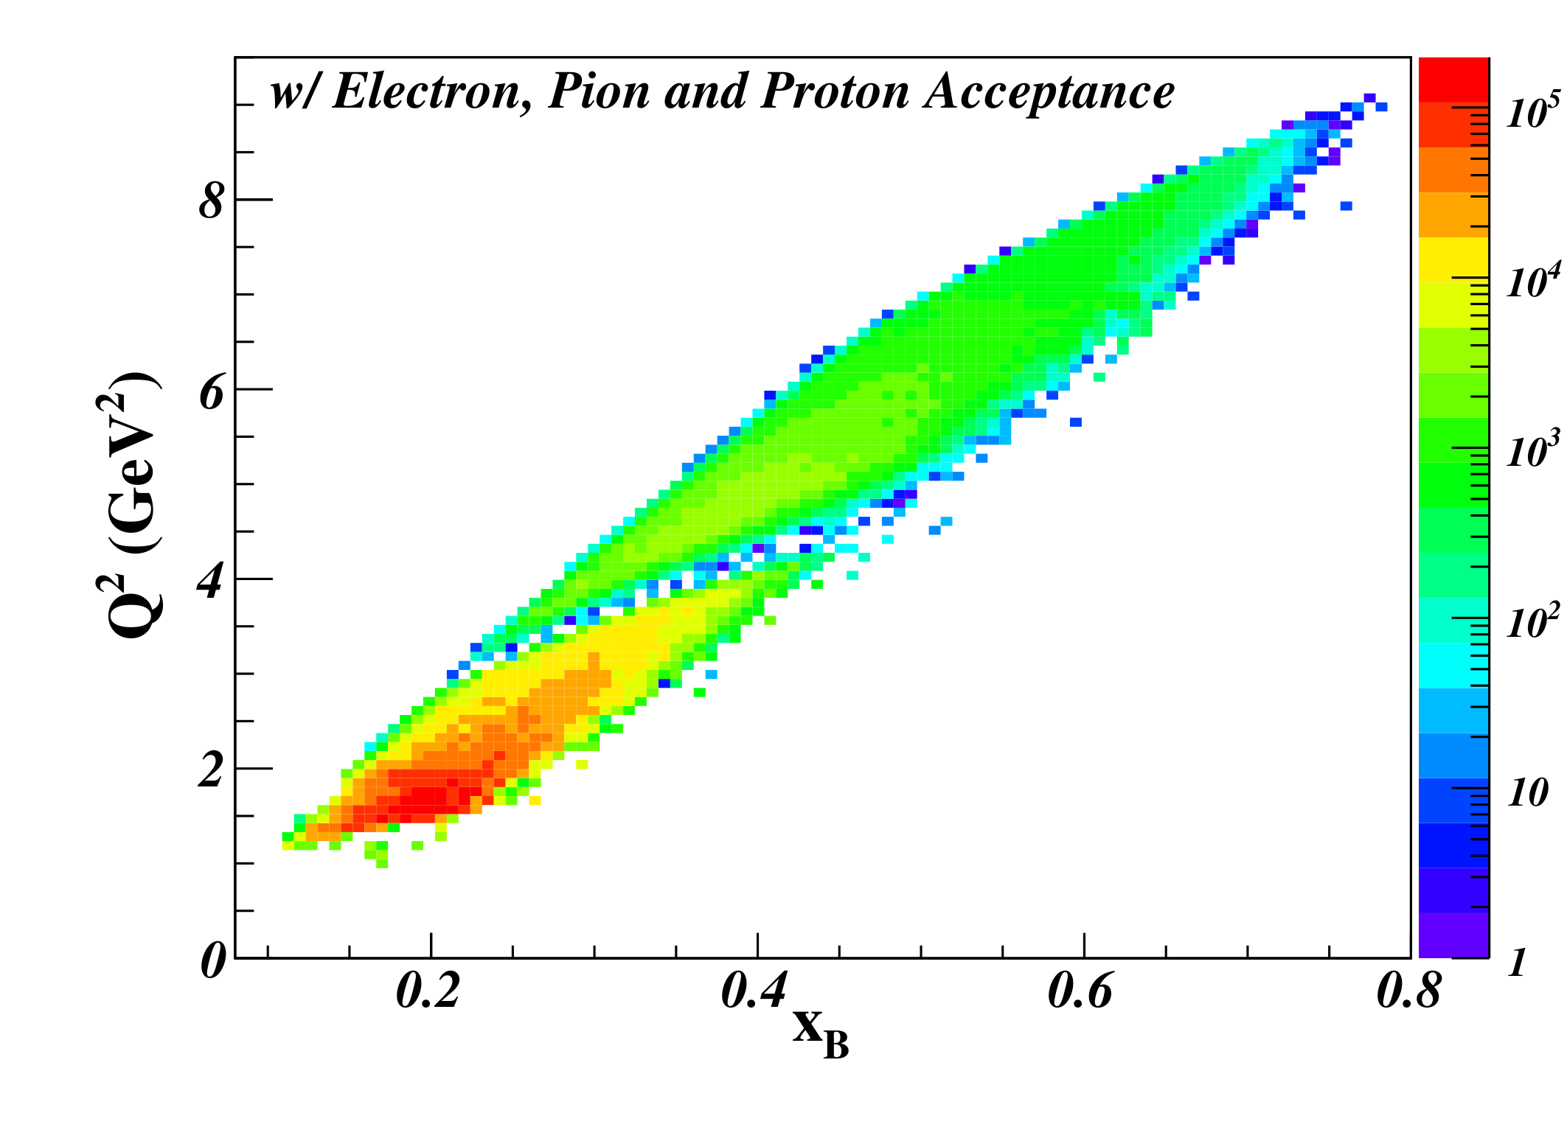
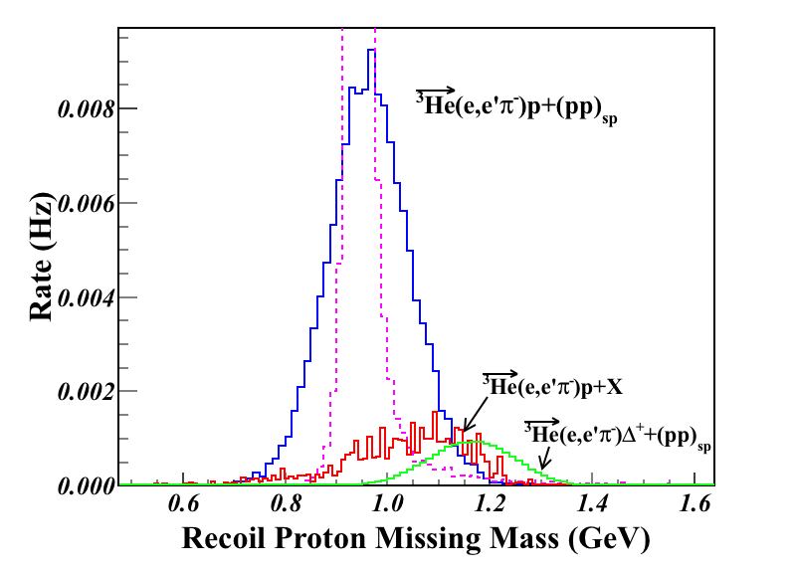
E12-10-006B: Deep Exclusive π– from Transversely Polarized n
Z. Ahmed, G. Huber, Z. Ye
Azimuthal modulations of Transverse Single Spin Asymmetry allow access to different GPDs:
  sin(β=φ-φ_{s}) moment sensitive to helicity-flip GPD
  sin(φ_{s}) moment sensitive to transversity GPDs
Need high luminosity
Q²>1 GeV² W>2 GeV | Q²>4 GeV² W>2 GeV
DEMP: n(e,e’π–p) Triple Coin (Hz)
4.95 | 0.40
SIDIS: n(e,e’π–)X Double Coin (Hz)
1425 | 35.8
with transversely polarized ³He
Large kinematic coverage and well controlled background
Garth Huber, U. of Regina

Slide 15
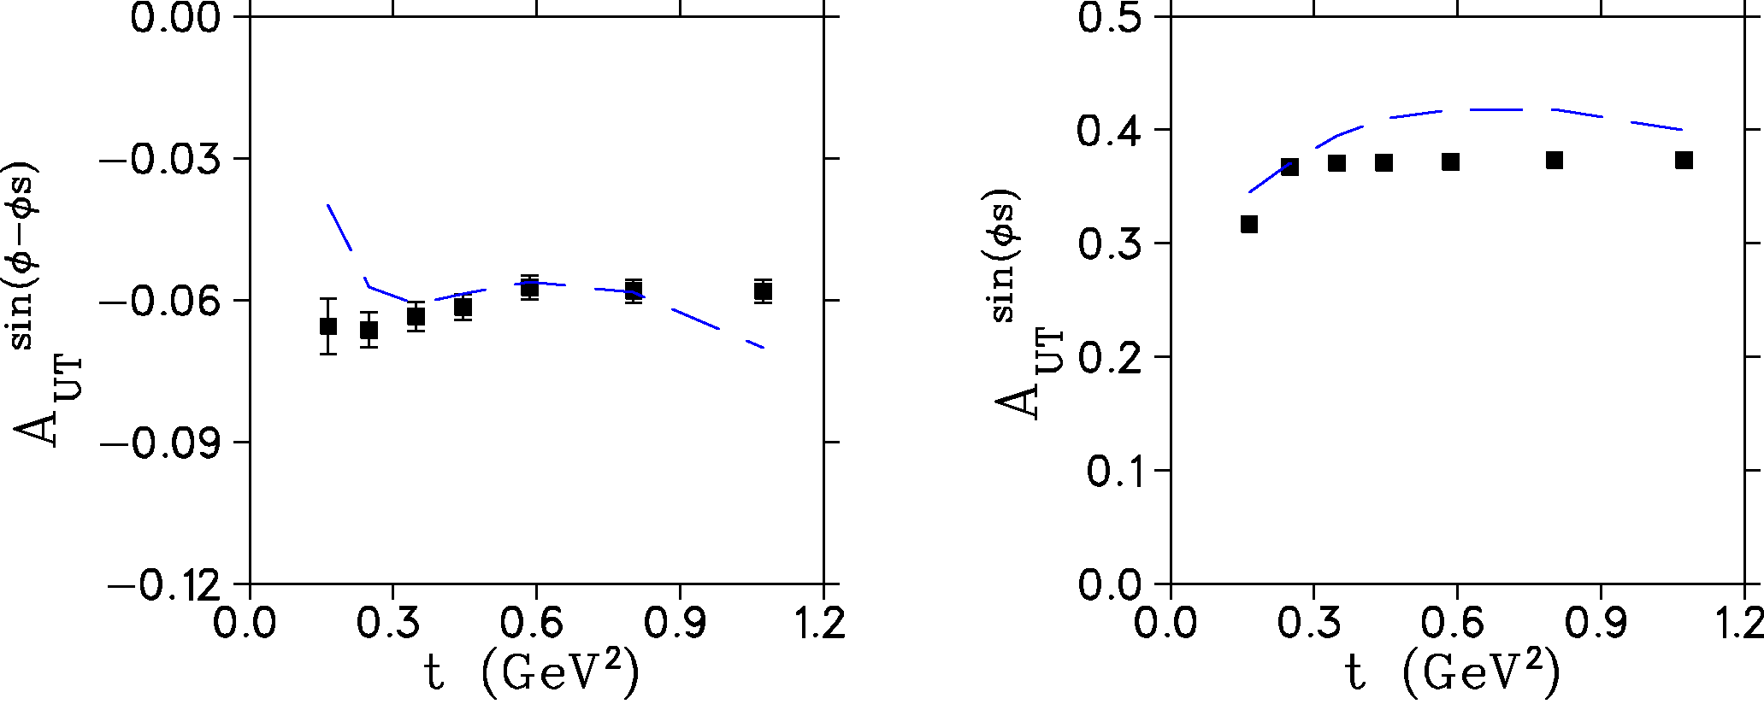
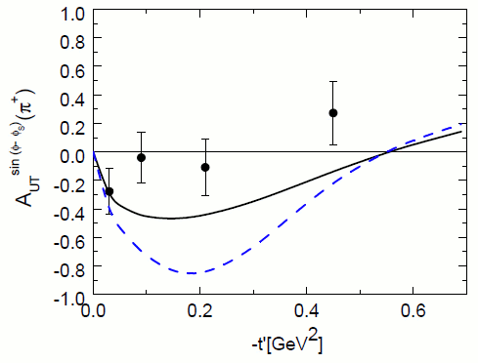
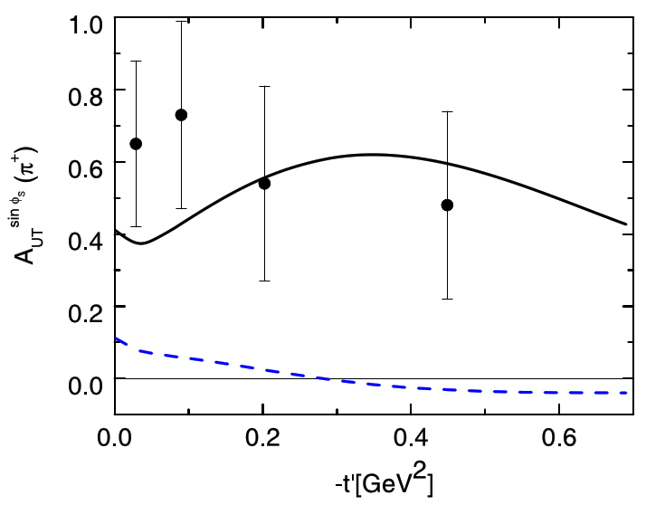
E12-10-006B: Deep Exclusive π– from Transversely Polarized n
Z. Ahmed, G. Huber, Z. Ye
SoLID Projected Uncertainties
Proton is tagged to isolate exclusive π– events
World Data: HERMES
Pioneering measurement [PLB 682(2010)345]
SoLID’s large acceptance and high luminosity well-suited to this measurement
Unique, cannot be done with precision anywhere else
Garth Huber, U. of Regina

Slide 16
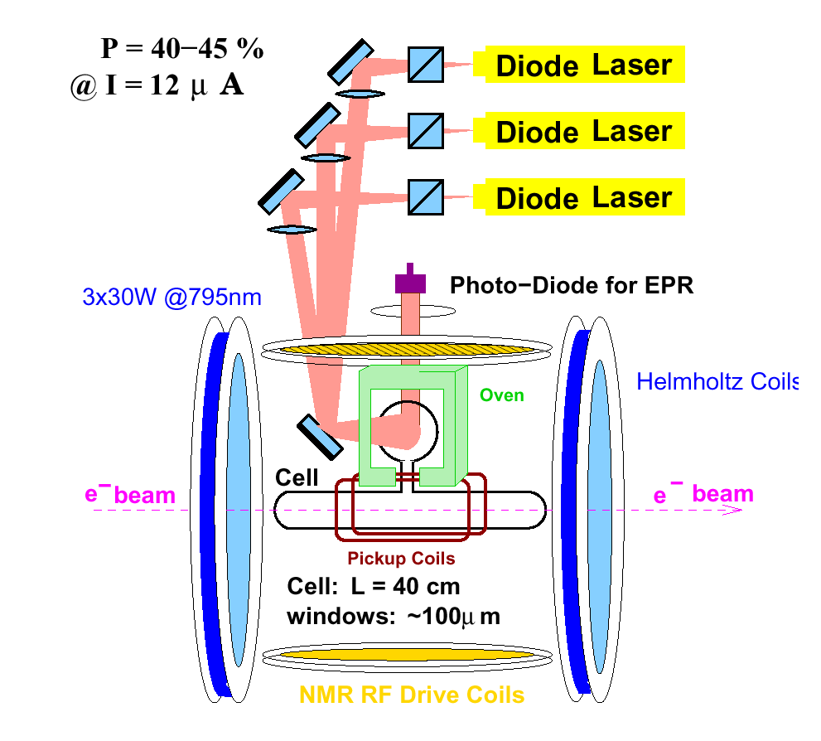
DVCS with polarized beam and (both T/L) polarized targets
No approved experiment yet, still under study
polarized ³He target
Both polarized proton and neutron targets are available
transversely polarized neutron is unique
May need a recoil detector?
Pol luminosity > 10³⁶/cm²/s
in-beam polarization ~ 60%
Zhihong Ye, Tsinghua U.

Slide 17
SoLID J/ψ and TCS Experiments
  E12-12-006: Near Threshold J/Psi production on LH2 target 60 days, rating A
  E12-12-006A: TCS with circular polarized beam and LH2 target

Slide 18
E12-12-006: Near Threshold J/ψ production on LH2 target
S. Joosten, Z.-E. Meziani, X. Qian, N. Spaveris and Z. W. Zhao
Most precise measurement near threshold

Slide 19
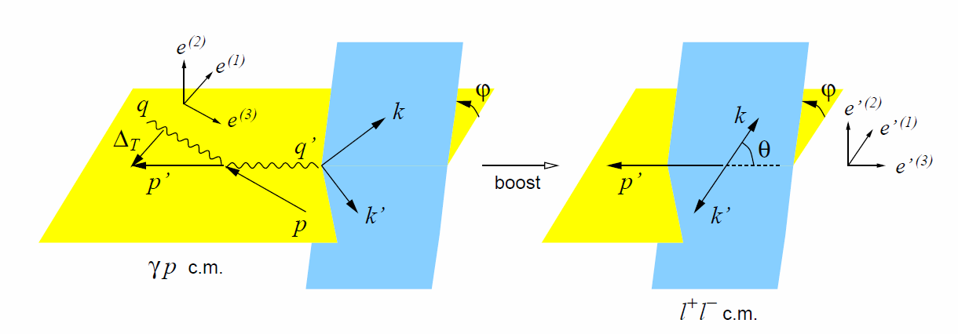
E12-12-006A: TCS with circular polarized beam and LH2 target
M. Boer, P. Nadel-Turonski, J. Zhang, Z. Zhao
sharing beam time with J/ψ run using same trigger on decay e⁻ e⁺ pair only
γ p → γ*(e⁻ e⁺) p′
Motivation
    Access the same GPDs like DVCS and test universality
    Access real and imaginary part of GPD H through CFF
    New observables for global GPD fits
Status
    exploration at CLAS 6GeV
    First CLAS12 result PRL, 127, 262501 (2021) nonzero beam polarized asymmetry A_{LU} and forward backward asymmetry A_{FB}
      Limited by low statistics
TCS
BH
Kinematics
CLAS12 result

Slide 20
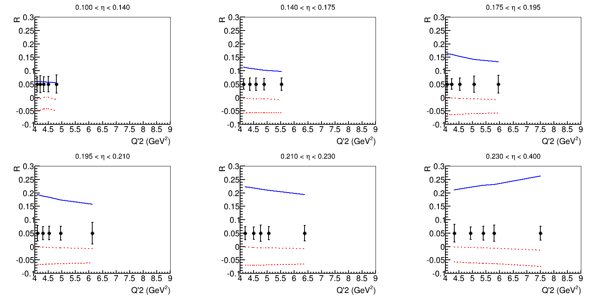
E12-12-006A: TCS with polarized beam and LH2 target
SoLID TCS will have at least 1 order larger statistics than CLAS12 and usher TCS study into precision era with multi-dimensional binning
    SoLID has 250 times more integrated luminosity than the CLAS12 TCS published result
    SoLID acceptance to TCS events is about ¼ of CLAS12. But with full azimuthal coverage, (ideal for the forward backward asymmetry)
    Cross section measurement (moment)
SoLID TCS help to study of NLO correction
SoLID TCS coverage

Slide 21
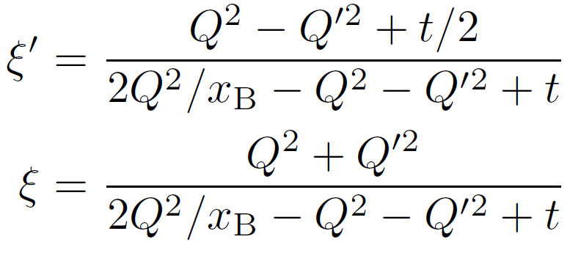
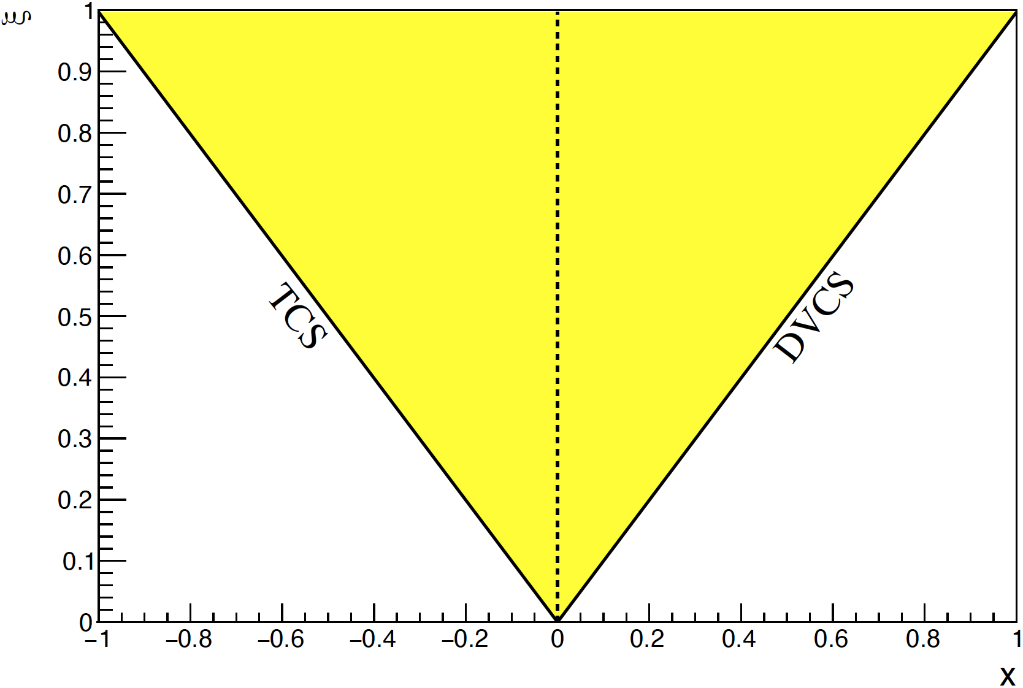
Double Deeply Virtual Compton Scattering with SoLID
DDVCS explores wide off-axis kinematic region of GPDs, beyond DVCS and TCS. The exclusive reaction has small crosssection and thus needs high luminosity and large acceptance.
The SoLID apparatus completed with muon detectors at forward angle, enables DDVCS measurements with both polarized electron and positron beams at 11GeV.
Lumi = 1e37/cm²/s
polar angle 8-15 deg
full azimuthal
Letter of Intent 2023
DDVCS
Marie Boer, Alexandre Camsonne, Eric Voutier, Zhiwen Zhao
S. Zhao et al. EPJ A 57 (2021) 240

Slide 22
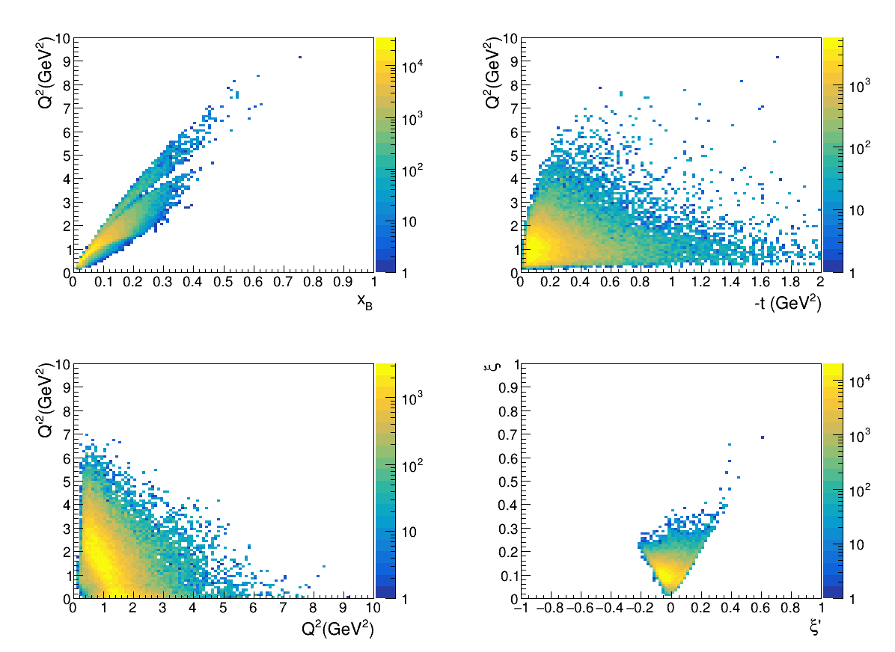
SoLID DDVCS with 11GeV polarized beam LH2 target
Kinematic coverage
Projection with 50 days
One bin as example,
out of 40 4D kinematic bins

Slide 23
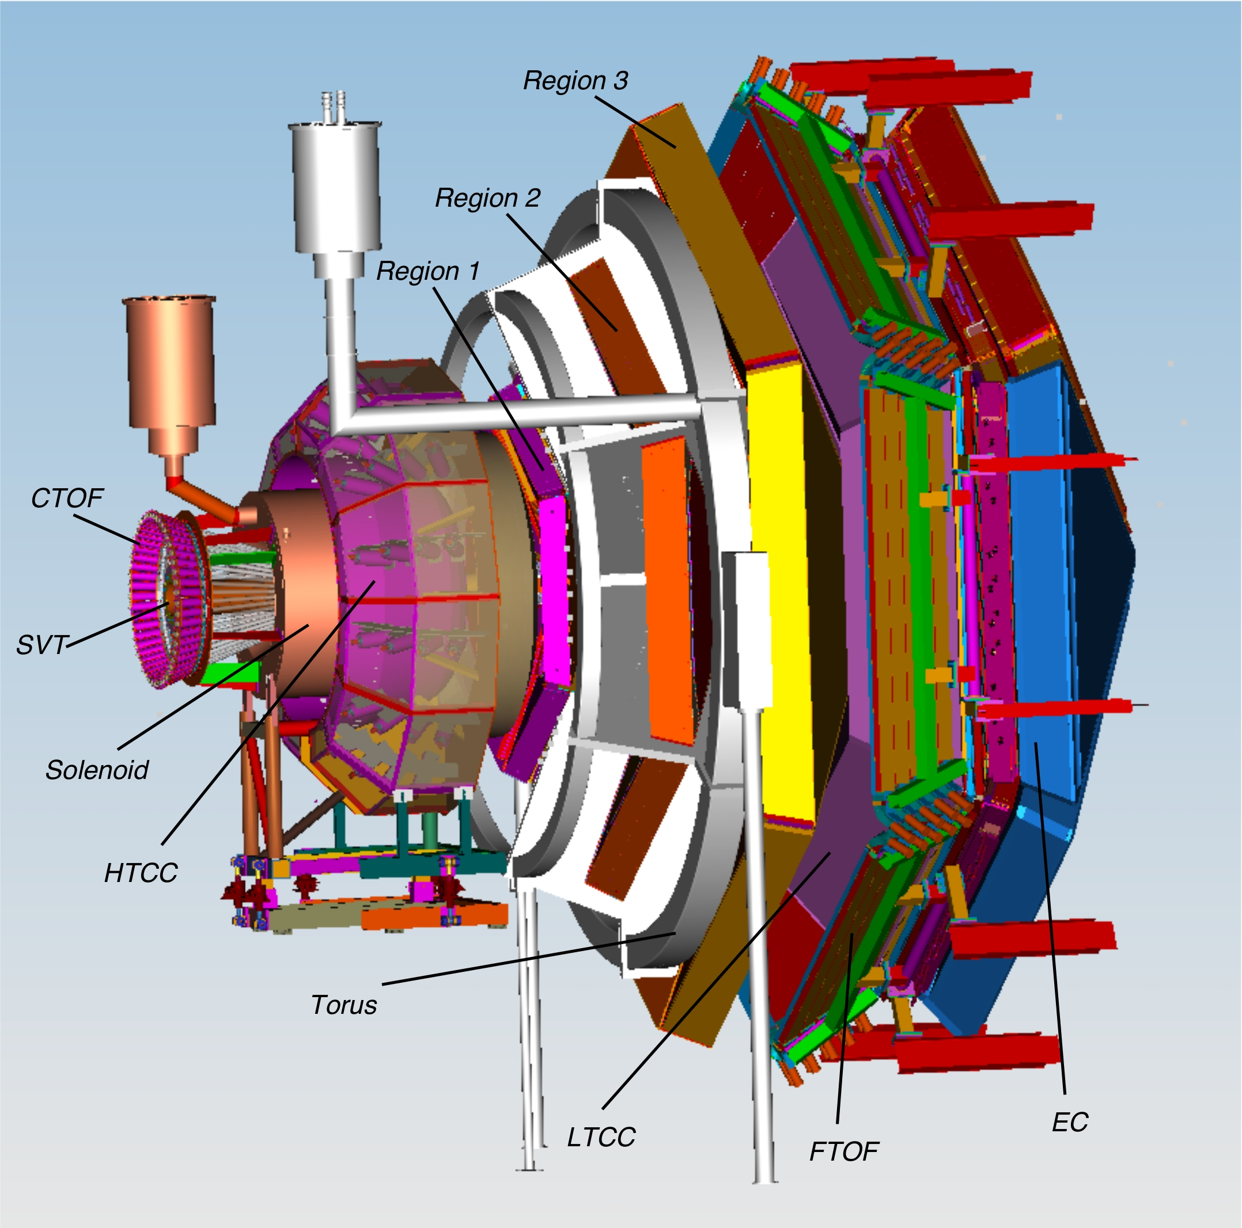
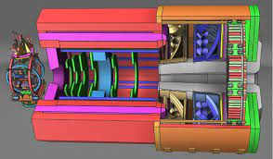
Tagging u-Channel DVCS with SoLID (B. Li)
Fast leading proton
Fast leading proton
e beam
e beam
𝛄, 𝛑⁰
𝛄, 𝛑⁰
Central-
backward Photon tag
Central-
backward Photon tag
If the CLAS 12 GeV backward tagging of DVCS is a reality, the same tagging system can be applied to the SoLID!

Slide 24
3. Status and Outlook

Slide 25
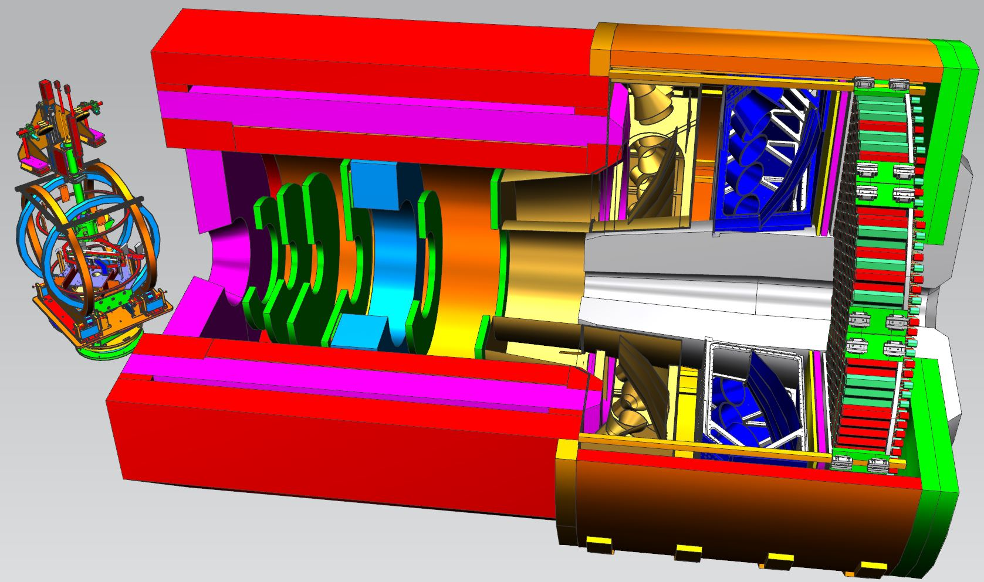
SoLID Apparatus
Requirements are Challenging
Polarized ³He (``neutron”) @ SoLID
High Luminosity (10³⁷-10³⁹)
High data rate
High background
Low systematics
High Radiation
Large scale
Modern Technologies
  GEM’s
  Shashlik ECal
  Pipeline DAQ
  Rapidly Advancing Computational Capabilities
High Performance Cherenkovs
Baffles

Slide 26

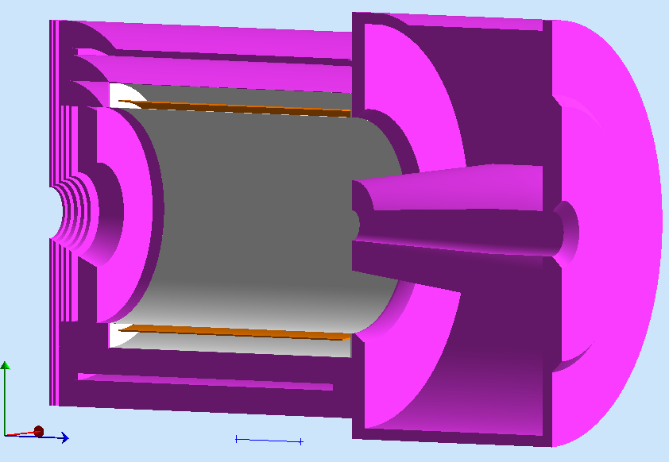
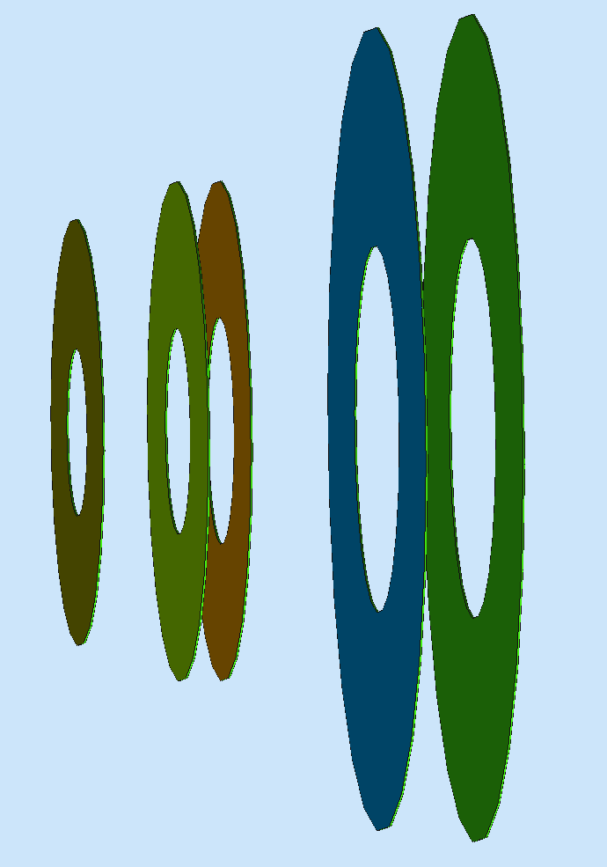
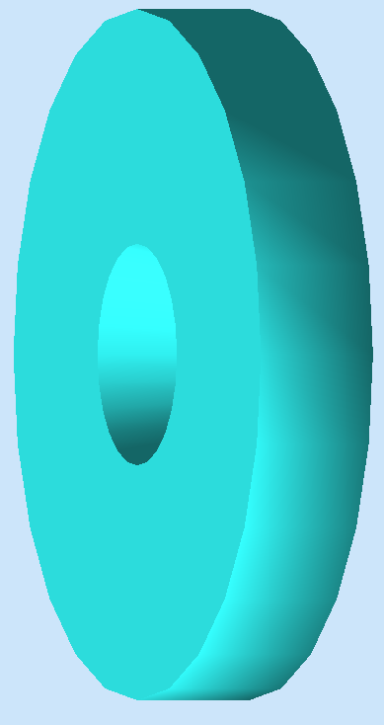
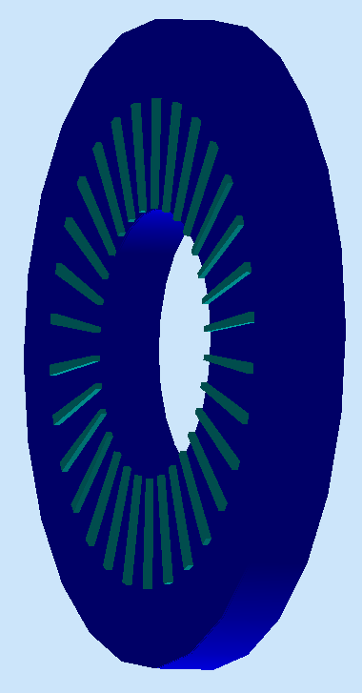
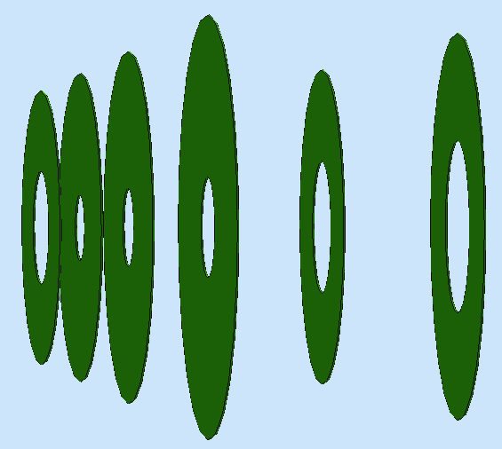
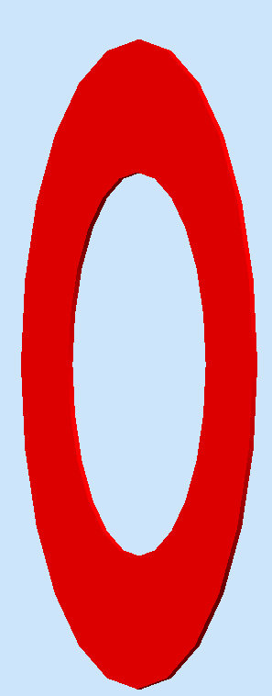
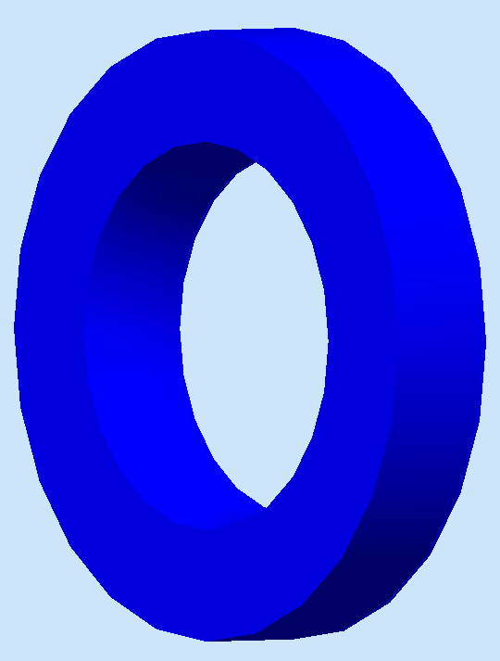
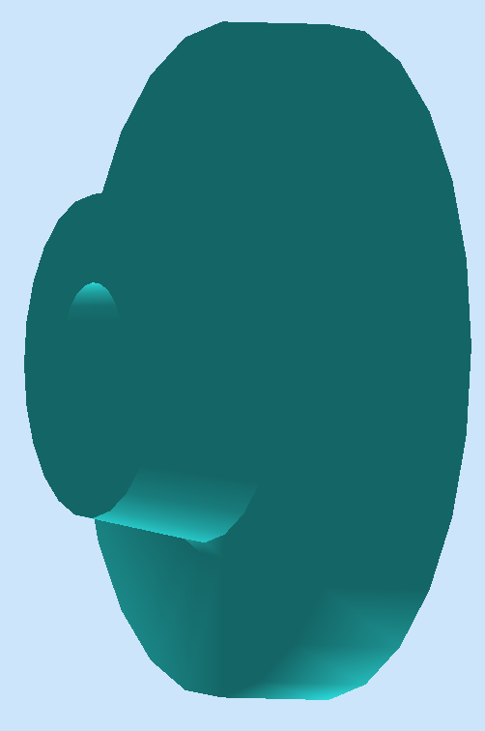
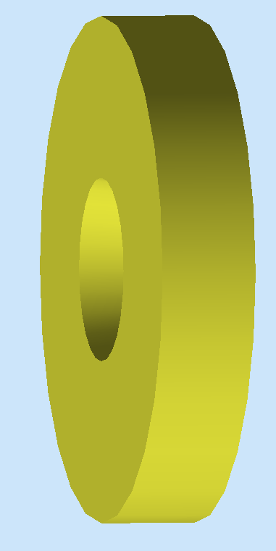

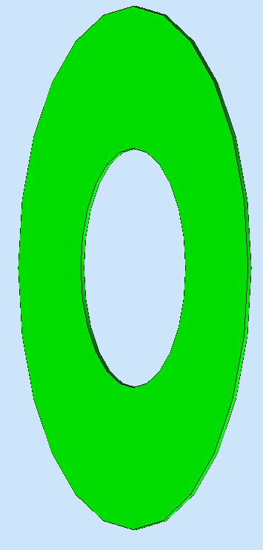
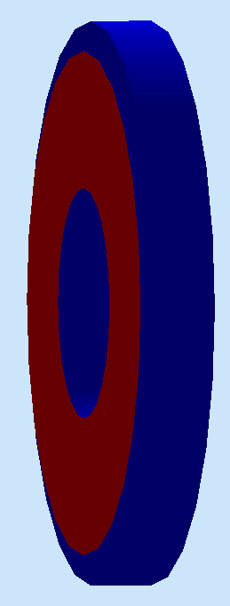
SoLID Detector Subsystems
Uses full capability of JLab electronics
PVDIS: Baffle 3xGEMS LGC 2xGEMs EC
SIDIS&J/y:
4xGEMs LASPD LAEC 2xGEMs LGC HGC FASPD (MRPC) FAEC
Pre-R&D items: LGC, HGC, GEM’s, DAQ/Electronics, Magnet

Slide 27
SoLID Equipment/Collaboration Development
Pre-R&D Activities: strong support from JLab, DOE and International
Goals: establish pre-conceptual design, verify pre-conceptual design, verify high luminosity capability
User groups/International:
GEM conceptual design and R&D: UVa, USTC, CIAE, Lanzhou, …
ECal: UVa, Shandong,Tsinghua, ANL, UIC
LGC: Temple, ANL, NMSU, SBU
HGC: Duke, Regina
MRPC: Tsinghua, UIC
DAQ: JLab, UMass, UVa, USTC, Tsinghua
Simulations/Software: Duke, ANL, Syracuse, SBU, Shandong, Tsinghua, UVa, JLab …
JLab: CLEO-II magnet arrived at JLab in 2016, first cold test complete
DAQ design/test: DAQ/Fast Electronics Group, Hall A/C
DOE funded Pre-R&D
Cherenkov/GEM and DAQ tests 2020-2022
ECal and DAQ (GEM readout) beam tests + Cherenkov Mirror test: 2023-2024
Formed Strong Collaboration > 270 Members from 70 Institution/13 countries

Slide 28
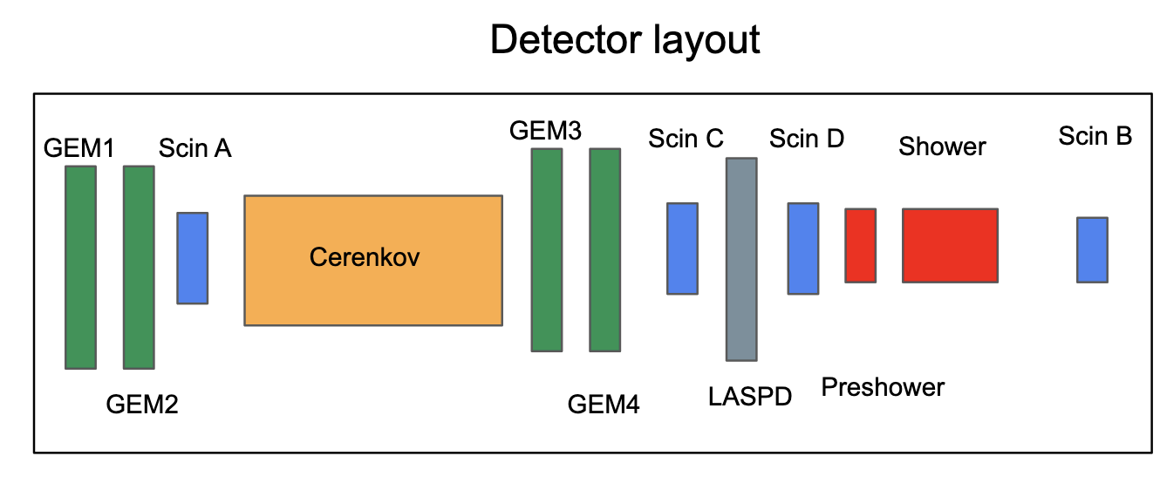
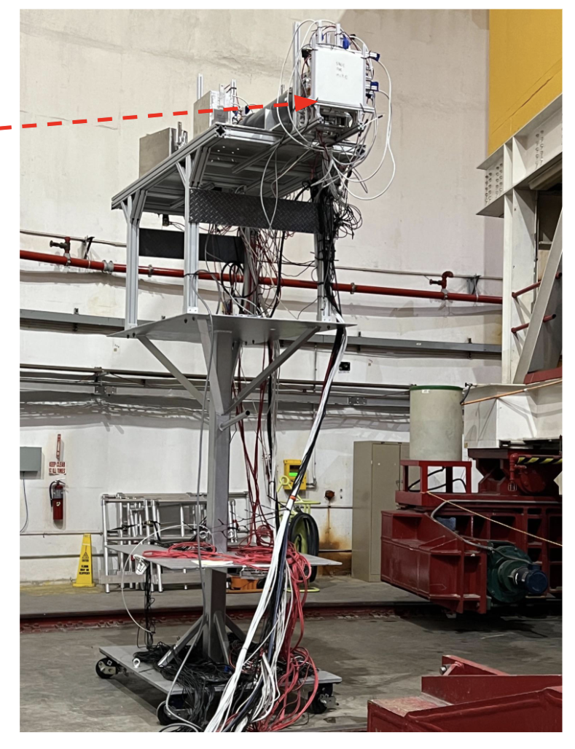
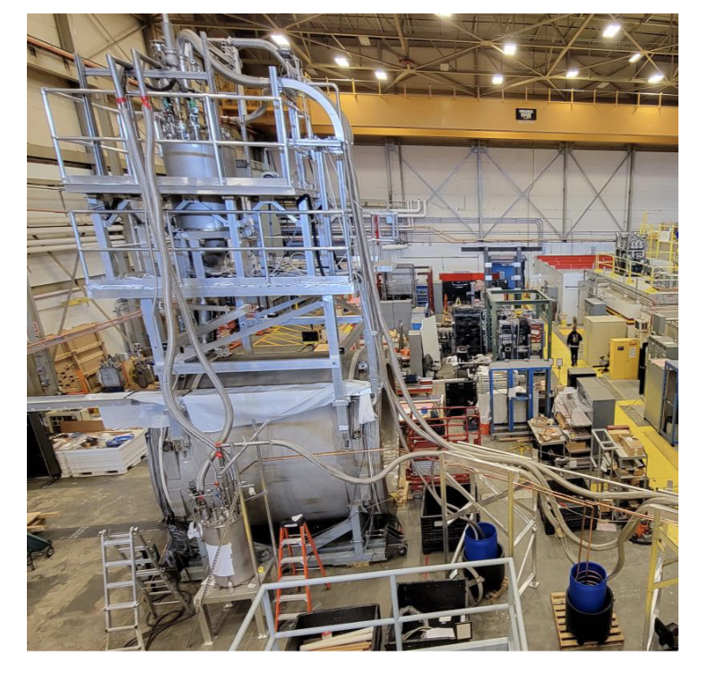
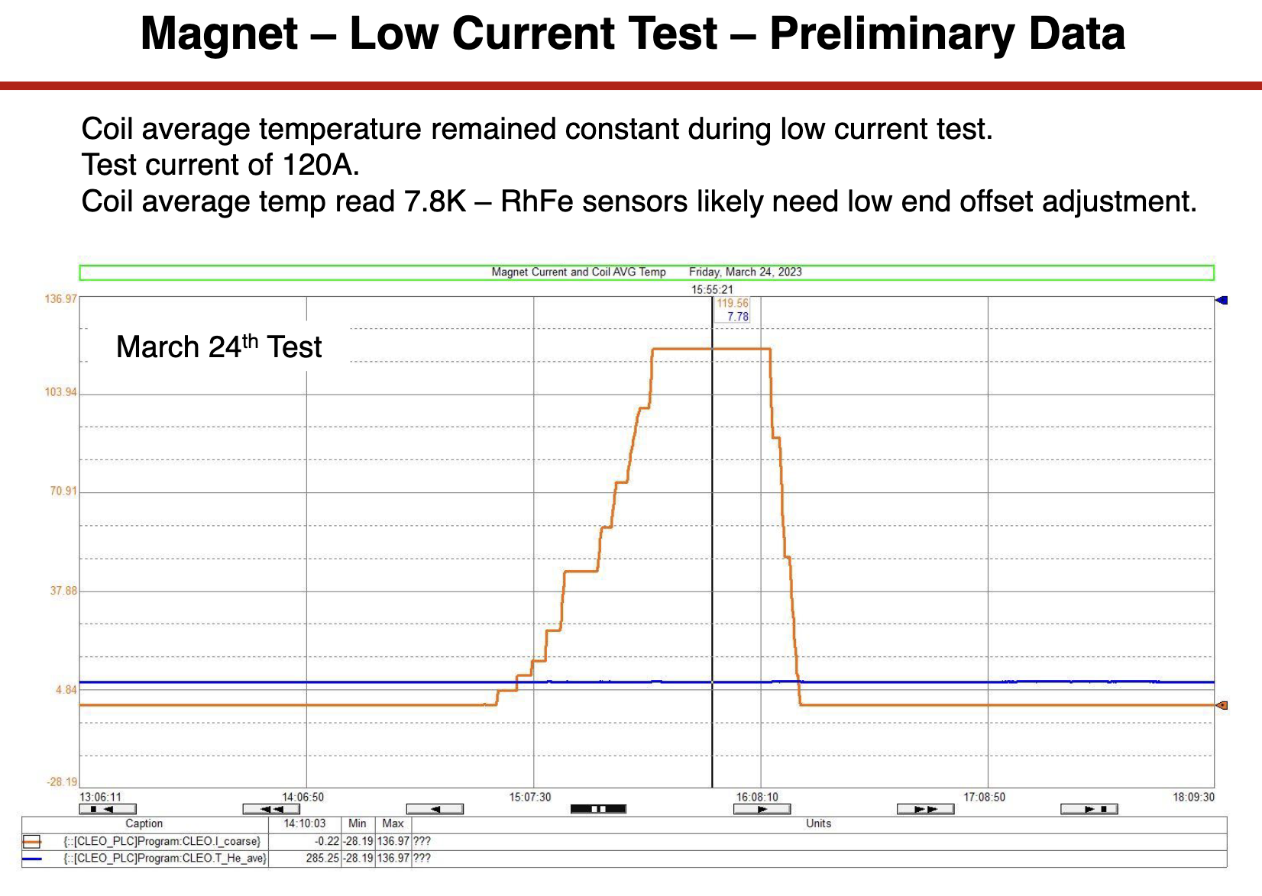
SoLID Pre-R&D Progress
Pre-R&D:
Completed 1st DOE funded pre-R&D (2020-2022): Cherekov/DAQ beam test.
DOE funded 2nd pre-R&D (2022-2023):
1. Detector Beam Test in Hall C
Focus on ECal, with GEMs/Cherenkov/ Scintillators
Completed data taking
2. DAQ GEM (VMM) readout test: bench test
CLEOII Magnet Cool/Low Current Test Completed

Slide 29
SoLID Recent Developments and Outlook
Recent discussions with DOE/NP
- SoLID is encouraged to make a strong case (“significant prominence”) in LRP
QCD town meeting: SoLID part of Recommendation #1
SoLID Whitepaper as input to the LRP
- R&D, synergy to EIC, to “preemptively reduce risk/cost for SoLID”
Submitted two AI/ML proposals: Tracking and PID
- Optimize cost/funding profile
Strong support from JLab: to help SoLID move forward
Schedule: ~2030 starting physics
5+ years of running experiments

Slide 30
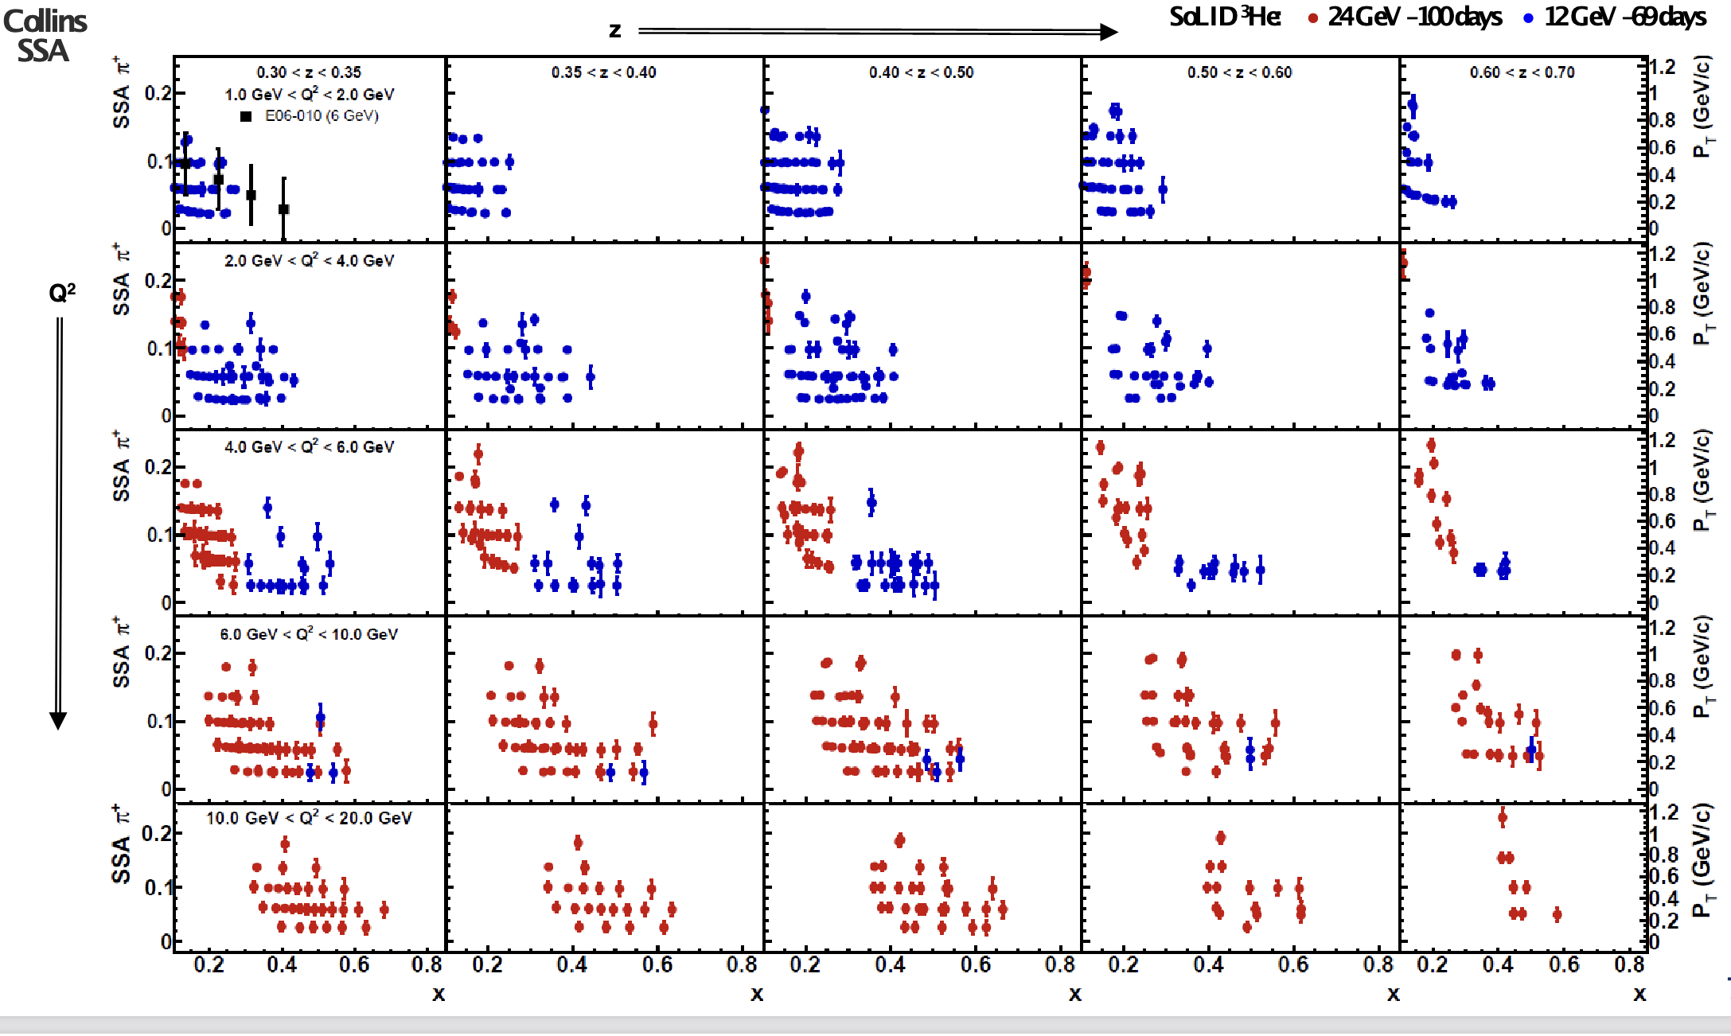

Great Potentials: SoLID with JLab20+
1) SIDIS: Collins Asymmetry: 20 GeV and 12GeV
Vlad Khachatrya
2) ψ’ : Complementary probe of the gluonic field (color dipole size)
Sylvester Joosten
SoLID SIMULATION (20 GeV)
ψ' Production
50 days at 10³⁷/cm²s
10
1
₁₀−1
photo production
J/ψ 2+3 gluon
ψ' 2+3 gluon
electroproduction
₁₀−2
14 16
10
12
18
8
E_{γ} (GeV)
3) PVDIS@JLab20+:
a) Standard Model test with deuterium, Alex Emmert/Xiaochao Zheng
b) Precision study of strange sea, Mark Dalton/Nobuo Sato
4) Electron weak coupling C₃ with e+ and e-
LOI by Xiaochao Zheng
5) DDVCS, Alexandre Camsonne, …
………..

Slide 31
Summary
SoLID: A large acceptance device which can handle very high luminosity to allow full exploitation of JLab 12 GeV potential
→ pushing the limit of the intensity frontier
SoLID has rich and vibrant science programs complementary and synergistic to the proposed EIC science program
3D structure (SIDIS/TMD and GPD), PVDIS and J/Psi production + more
Highlights on GPD program
  DEMP (approved)
  DVCS (under study)
  J/Psi near threshold (approved)
  TCS (approved)
  DDVCS (under study)
  ……
Great potentials for JLab22
Welcome new collaborators.
  https://solid.jlab.org/

