Slide 1
Modeling Meson Structure:
Form Factors to GPDs
Adnan Bashir
Institute of Physics and Mathematics
University of Michoacán, Morelia, Michoacán, Mexico
Visiting Scientist
Jefferson Laboratory, Newport News, Virginia, USA
August 7-11, 2023, Thomas Jefferson National Accelerator Facility

Slide 2
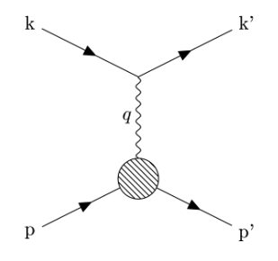
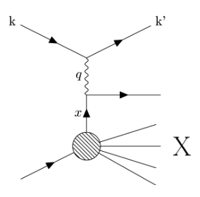
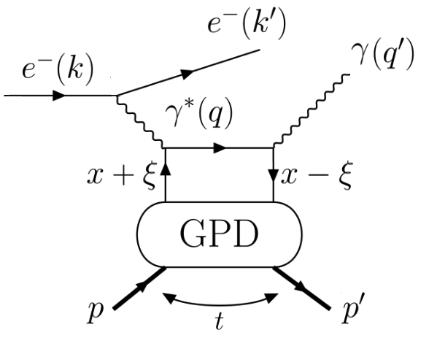
Generalized Parton Distributions (GPDs)
Hofstadter, et. al., Phys. Rev. 91, 422 (1953)
Hofstadter, Rev. Mod. Phys. 28, 214 (1956)
Feynman, Phys. Rev. Lett. 23, 1415 (1969)

Slide 3
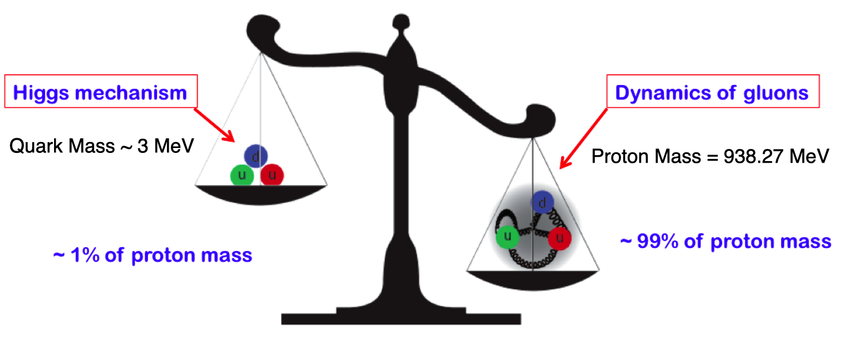
GPDs: Footprints of QCD
3D Structure of Hadrons: Global analysis of experimental
data, discrete lattice studies, effective field theories and
continuum Schwinger-Dyson equations.
QCD is characterized by two emergent phenomena:
confinement and emergent hadron mass (EHM).
Emergence of hadron masses
(EHM) from QCD dynamics
Formation of color-singlet bound states: “Hadrons”

Slide 4
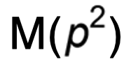
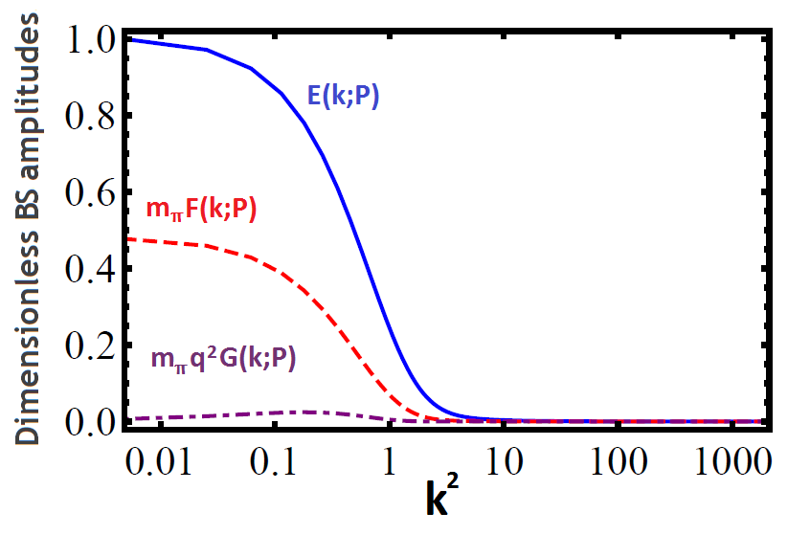
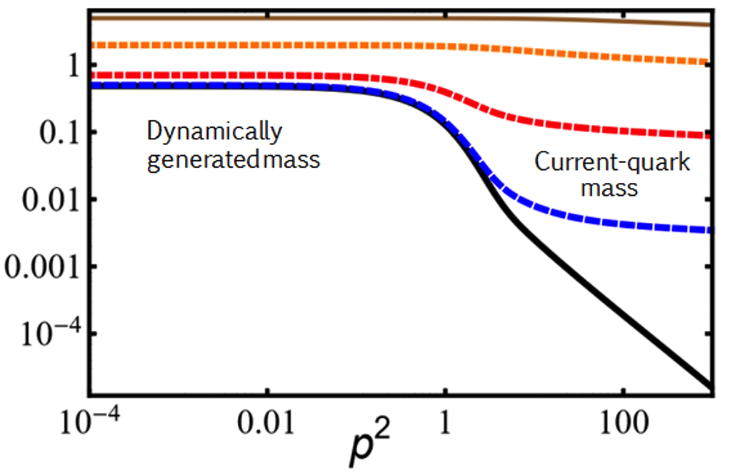
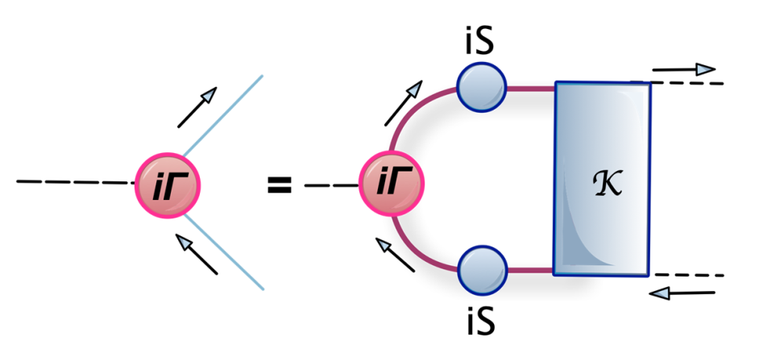
From QCD to the Form Factors and GPDs
Origins of confinement and dynamical chiral symmetry breaking (DCSB) can be traced back
to the Green functions of quarks and gluons.
These emergent phenomena of QCD, non-existent in perturbation theory are naturally linked to its non-abelian nature and infrared enhancement of the strong running coupling.
The effects of of the pattern of DCSB are traceable in the Q² evolution of the 𝜋 and K Bethe-Salpeter Amplitudes (BSAs) and form factors explored and planned in the JLab and the EIC.
PS-mesons have 4 BSAs
V-Mesons have 8 BSAs
Bethe-Salpeter Equation

Slide 5
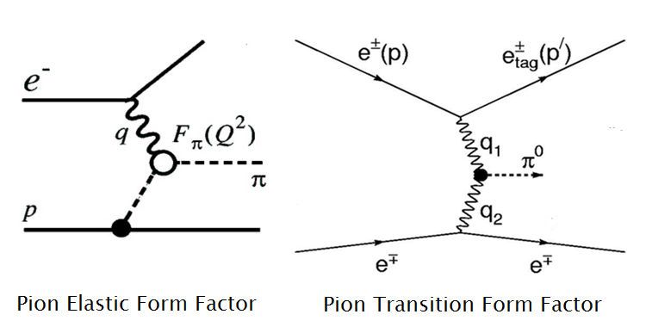
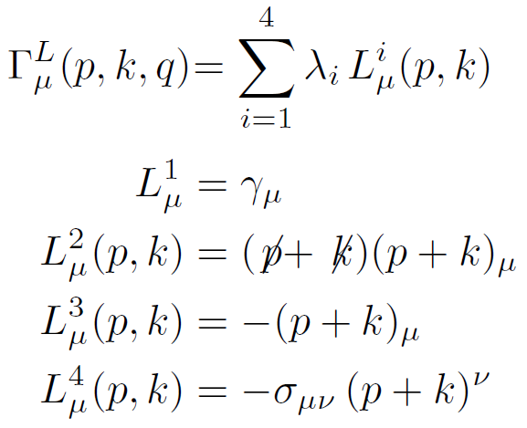
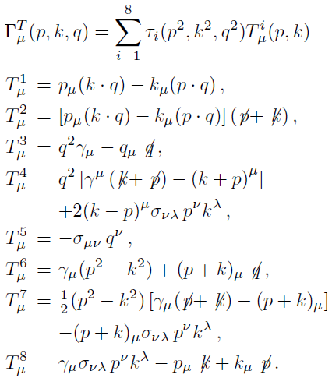
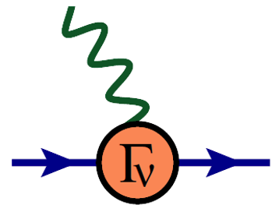
Mesons: Probing Quarks with Photons
In studying the elastic or transition form factors, it is the photon which probes the dressed quarks inside the bound states, highlighting the importance of the quark-photon vertex.
Gauge covariance (WTI,TTI, LKFT),
kinematic singularities, perturbation
theory, multiplicative renormalizability
AB, M.R. Pennington, Phys. Rev. D50 7679 (1994)
R. Bermudez et. al., Phys. Rev. C85, 045205 (2012)
V. Banda, AB, Phys. Rev. D107 073008 (2023)

Slide 6
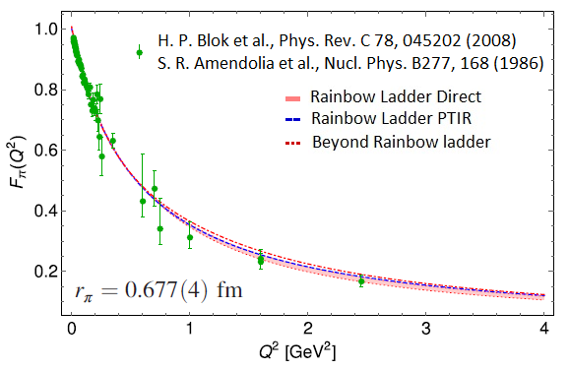
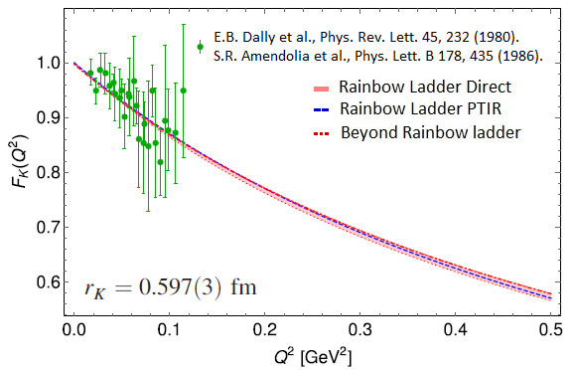
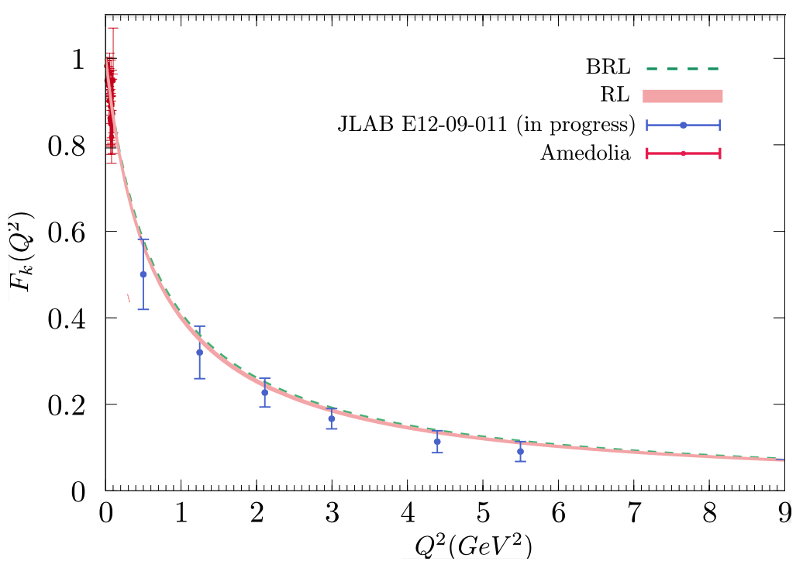
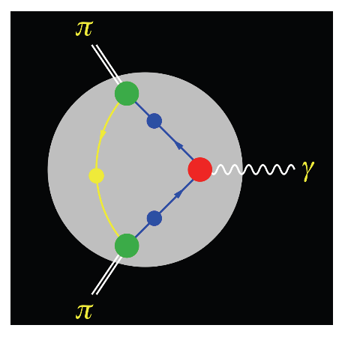
Meson Form Factors: Probing the Standard Model
A. Miramontes, AB, K. Raya, P. Roig,
Phys. Rev. D 105 (2022) 7, 074013
Radial excitations 𝜋¹, K¹:
Dispersive methods:
A. Miramontes, et. al. in preparation
Eichmann, et. al.
Phys.Rev.D 101 (2020) 5, 054015

Slide 7
Towards Algebraic Models
Sophisticated Truncations
Numerically Demanding
“QCD Predictions”
QCD Green Functions
Mesons – Static, FFs, PDAs, PDFs
Baryons – Static, FF
Schwinger-Dyson Equations
Most Observables
Mesons, Baryons
Moderate Simplicity
QCD-like Predictions
Contact Interaction
Algebraic Models
Simple Implementation
Insightful - Mindful
LFWFs, GPDs, TMDs,
PDFs, FFs

Slide 8
The Algebraic Model (AM)
The quark propagator:
For a quark in pseudo-scalar meson M, the leading twist (2-particle) light front wave function, ψ_{M} , can be obtained via the light front projection of the meson’s BSWF.
Bethe-Salpeter Amplitude:
The Algebraic Model:
L. Albino, M. Higuera, K. Raya, AB, Phys. Rev. D 106 (2022) 3, 034003

Slide 9
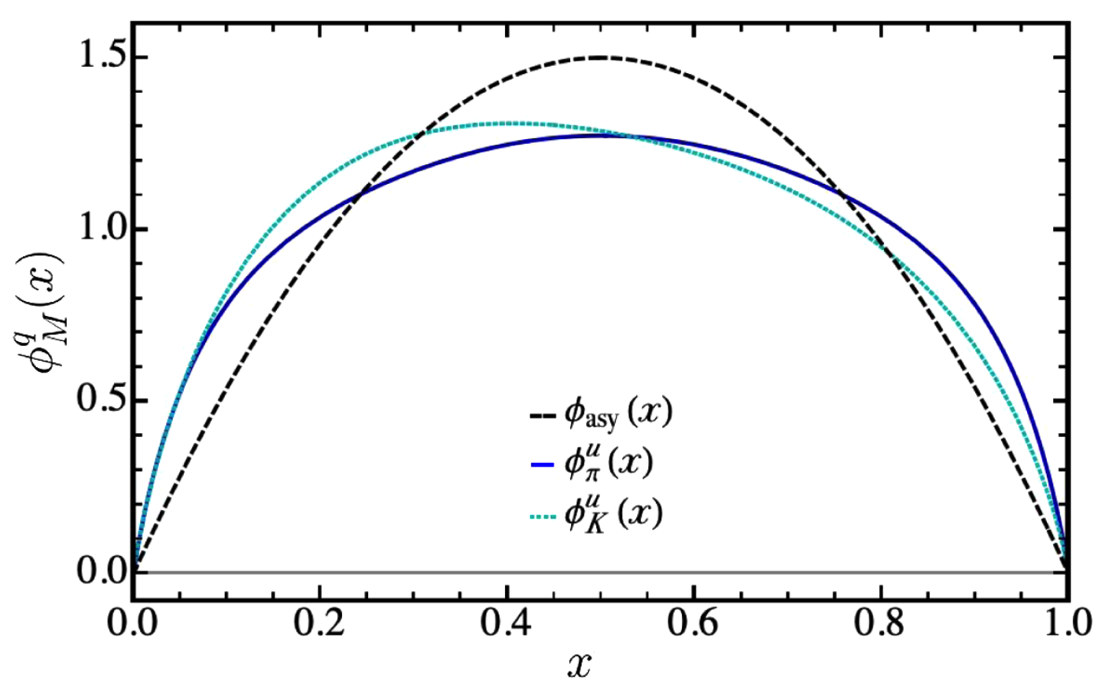
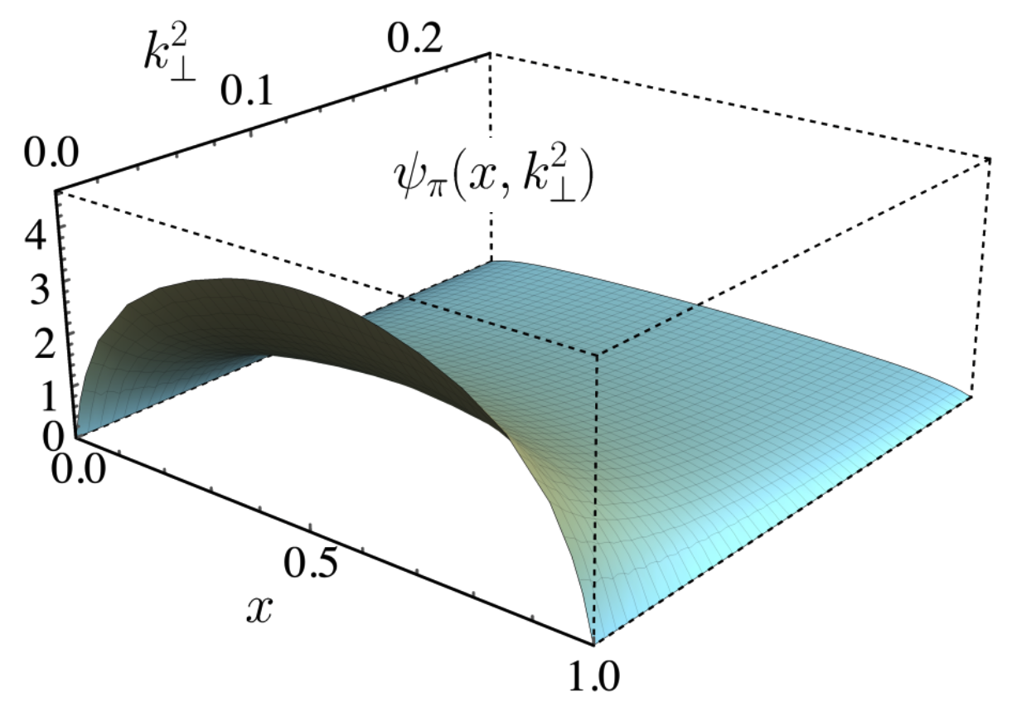
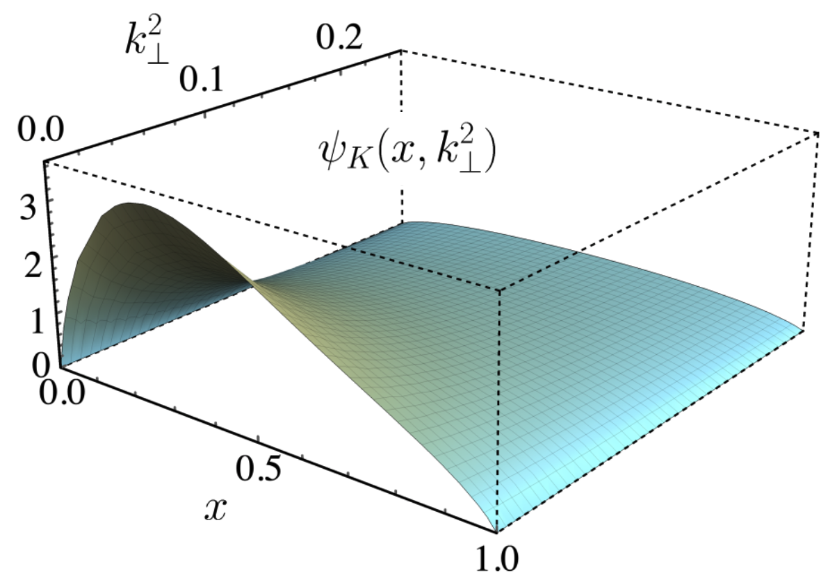
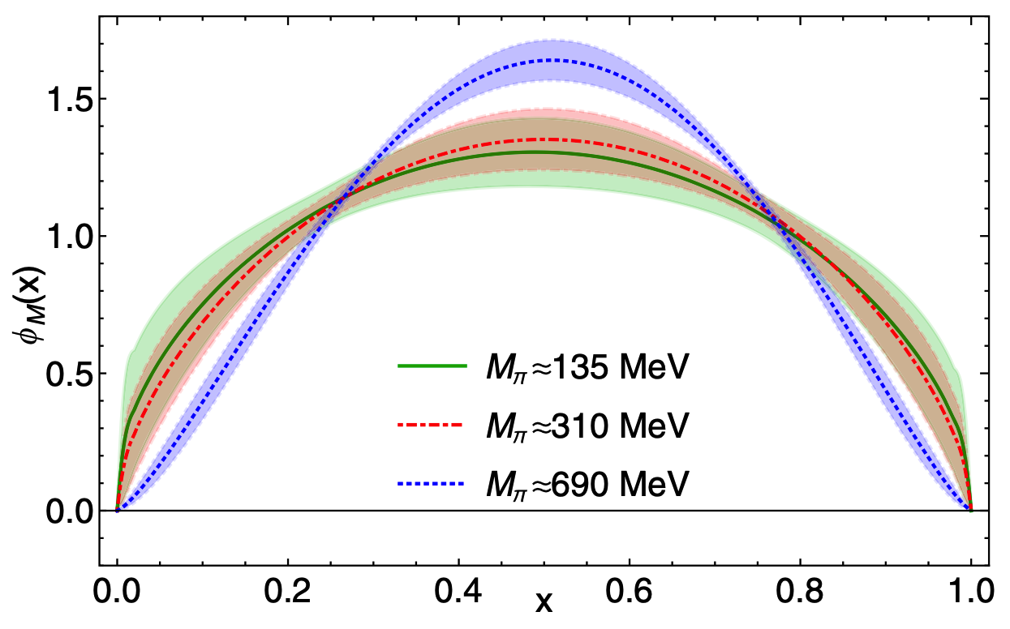
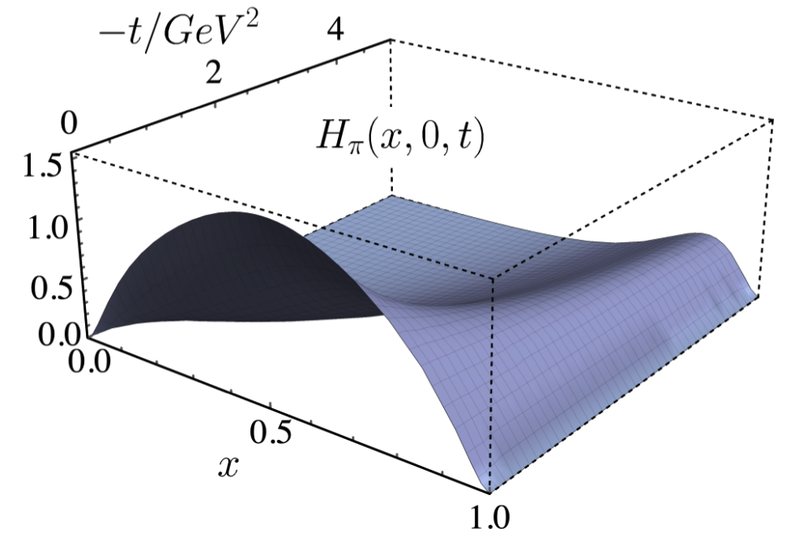
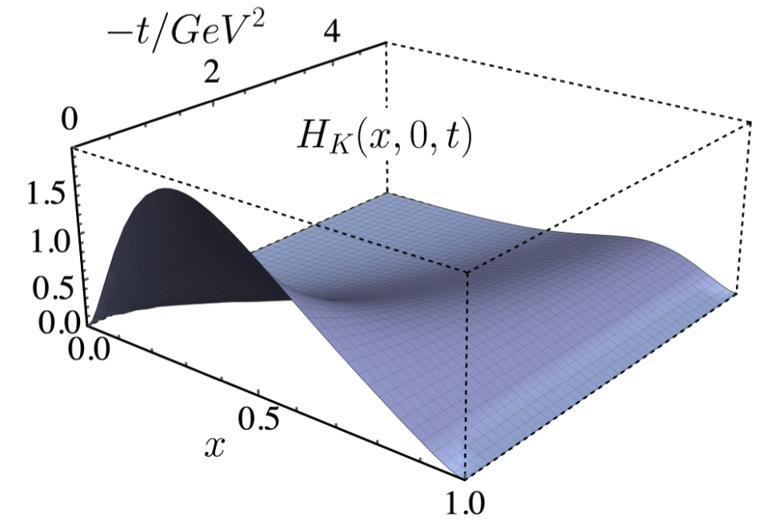
From the PDAs to the GPDs
PDA
Z.-F. Cui, et. al.,
Eur. Phys. J. C 80, 1064 (2020).
R. Zhang et. al.
PRD 2020
Overlap Rep. GPDs
M. Diehl, et. al., Nucl. Phys. B 596 (2001)
L. Albino, M. Higuera, K. Raya, AB, Phys. Rev. D 106 (2022) 3, 034003

Slide 10
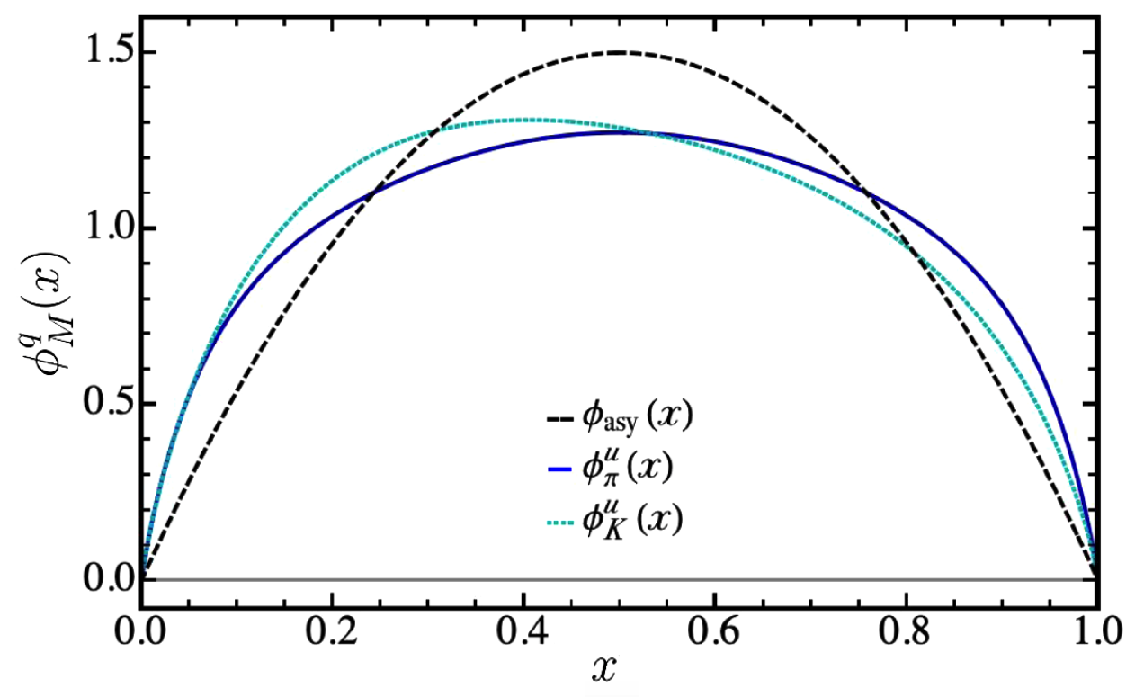
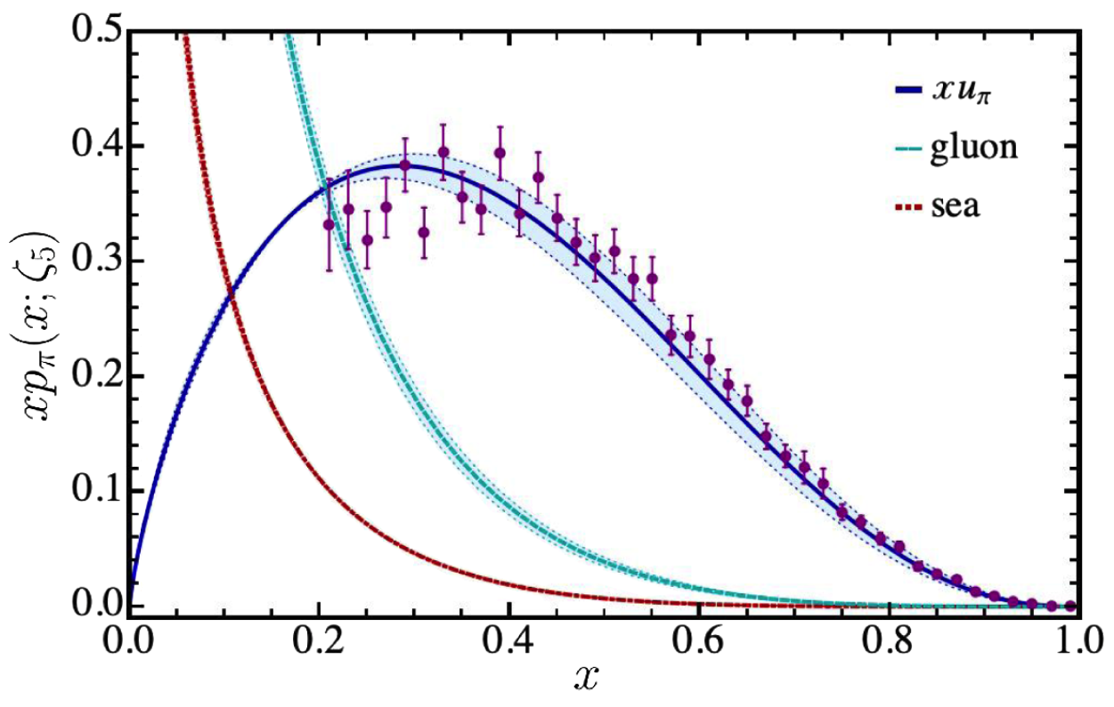
From the GPDs to the PDFs
DGLAP Evolution Equations
L. Albino, M. Higuera, K. Raya, AB
Phys. Rev. D 106 (2022) 3, 034003
Aicher et. al.
Phys. Rev. Lett. 105, 252003 (2010)

Slide 11
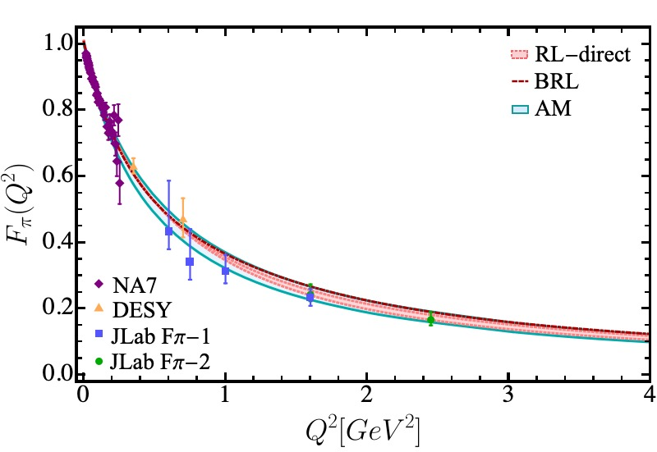
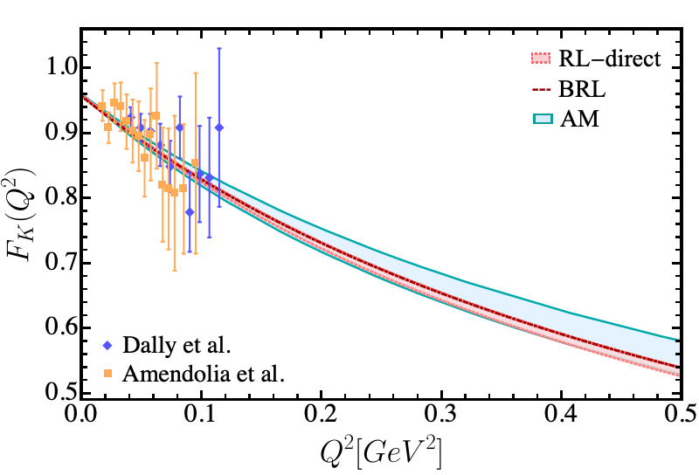
Completing the Cycle – Back to Form Factors
The electromagnetic form factors using our algebraic model can be obtained either through the knowledge of the GPDs or the direct evaluation of the triangle diagram.
Such an exercise provides stringent constraints on the efficacy of the algebraic model we have constructed by direct comparison with the refined calculation of these form factors.

Slide 12
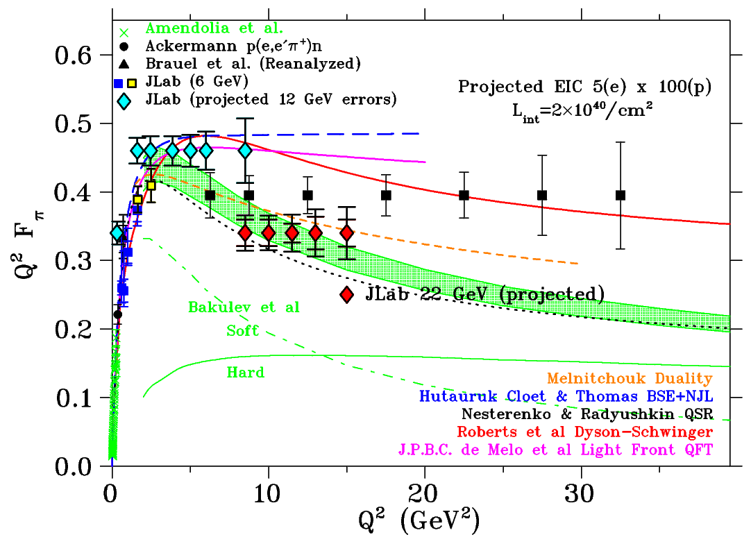
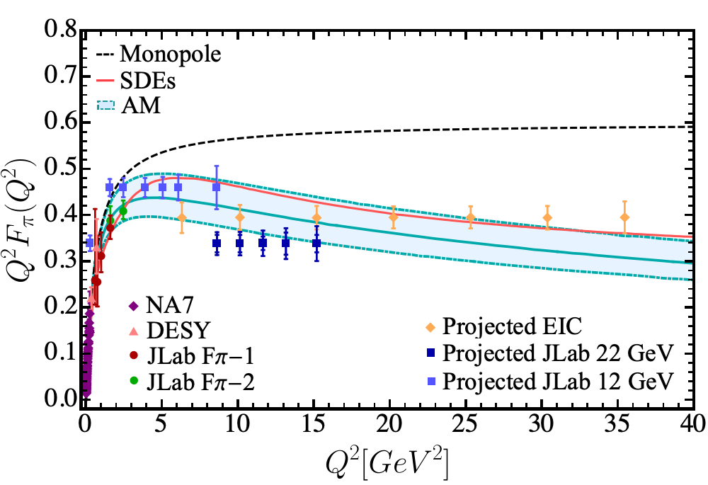
Completing the Cycle – Back to Form Factors
We can extend this analysis of the Algebraic Model to compute the pion electromagnetic form factors to larger Q² range: 0-40 GeV² which would likely cover the photon virtualities accessible to the JLab12, JLab22 and EIC programs:

Slide 13
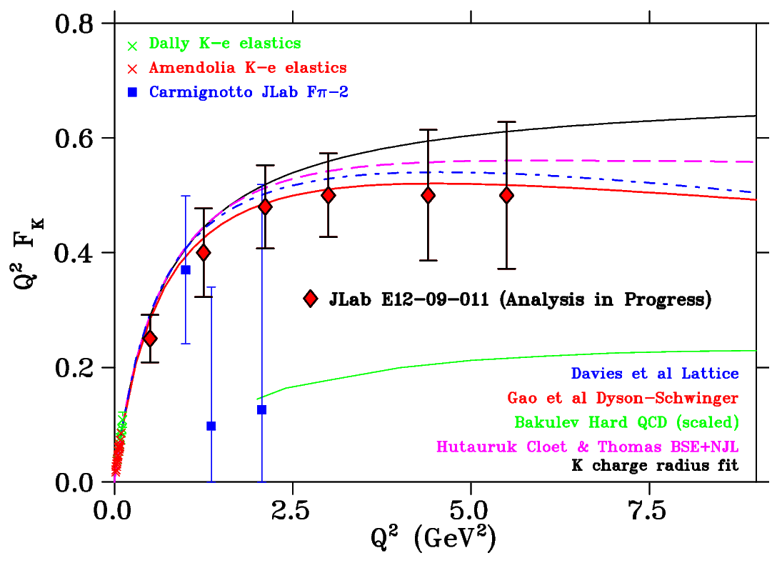
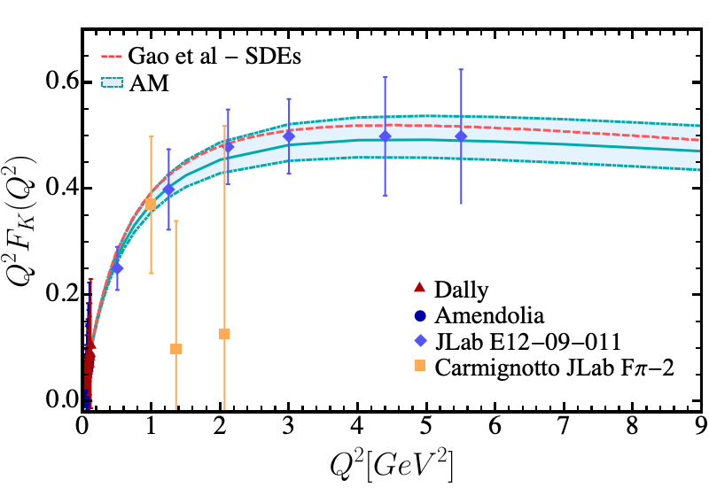
Completing the Cycle – Back to Form Factors
There is an analysis underway of the kaon electromagnetic form factor till 5.5 GeV² of the data obtained in JLab E12-09-011 experiment.
Courtesy Garth Huber
Algebraic Model results

Slide 14
Summary and Outlook
The interplay of QCD akin truncations of Schwinger-Dyson equations and algebraic model based upon these studies shed important light on the internal structure of pion and kaon.
QCD akin refined computation of pion and kaon electromagnetic form factors at low and intermediate virtualities of the probing photon in electroproduction processes:
A. Miramontes AB, K. Raya, P. Roig, Phys. Rev. D 105 (2022) 7, 074013
L. Chang, I.C. Cloët, C.D. Roberts, S.M. Schmidt, P.C. Tandy, Phys. Rev. Lett. 111 (2013) 14, 141802
Results for the pion electromagnetic form factor at large photon virtualities accessible to the potential 22GeV upgrade of the JLab and EIC are also available:
L. Chang, I.C. Cloët, C.D. Roberts, S.M. Schmidt, P.C. Tandy, Phys. Rev. Lett. 111 (2013) 14, 141802 J. Arrington, et al. (Feb 23, 2021, J.Phys. G 48 (2021) 7, 075106
More recently, pion and kaon form factors have been computed in the the time-like region
A.S. Miramontes, H. Sanchis Alepuz, R. Alkofer, Phys. Rev. D 103 (2021) 11, 116006
A.S. Miramontes, AB, Phys. Rev. D 107 (2023) 1, 014016

Slide 15
Summary and Outlook
Carefully constructed Algebraic Models can enable computation of the GPDs, PDFs and EFF
with relative ease while mimicking the reliability of QCD akin refined truncations of
Schwinger-Dyson equations.
L. Albino, M. Higuera, K. Raya, AB Phys. Rev. D 106 (2022) 3, 034003
Despite these encouraging results and synergy with experimental endeavors at JLab and EIC, further improvements and extensions in the continuum QCD approach are desirable.
More work into the theoretical foundations of the truncations involved at the level of the Green functions of the fundamental degrees of freedom, i.e., quarks, gluons, as well as quark-gluon and gluon-gluon interactions continues vigorously.
Schwinger-Dyson equations have also been of substantial success in the studies of baryons such as the transition form factors of nucleon to its excited states which is a hallmark of CLAS, CLAS12 and CLAS22 programs at JLab and hold the promise to offer a reliable tool for the future JLab and EIC era research into the heart of hadronic matter.
"Strong Interaction Physics at the Luminosity Frontier with 22 GeV Electrons at Jefferson Lab", A. Accardi, et. al., e-Print: 2306.09360 [nucl-ex]

Slide 16
Thank you for your attention

