Slide 1
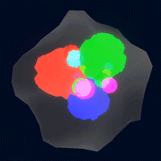
Study of the Correlated Spatial Structure of the Nucleon
Presenter: Zaki Panjsheeri*
Joshua Bautista*, Simonetta Liuti*, Brandon Kriesten**
*University of Virginia
**Argonne National Laboratory

Slide 2
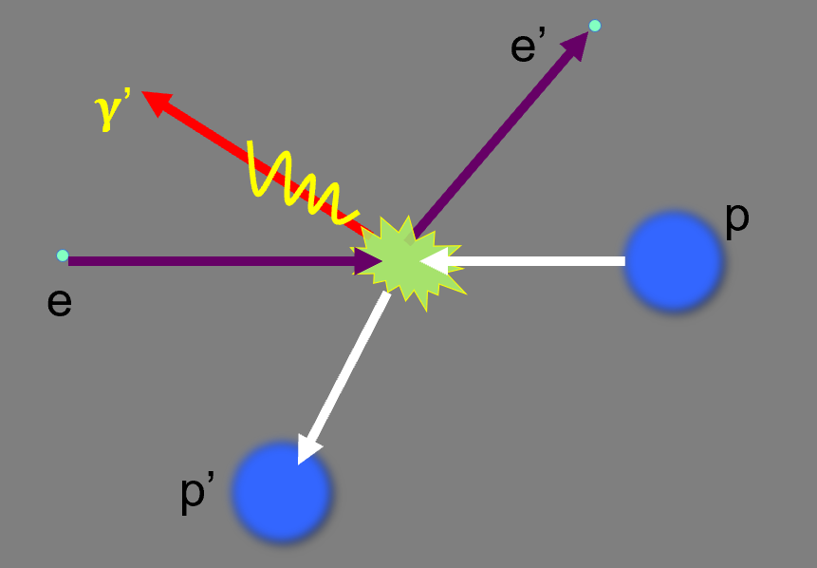
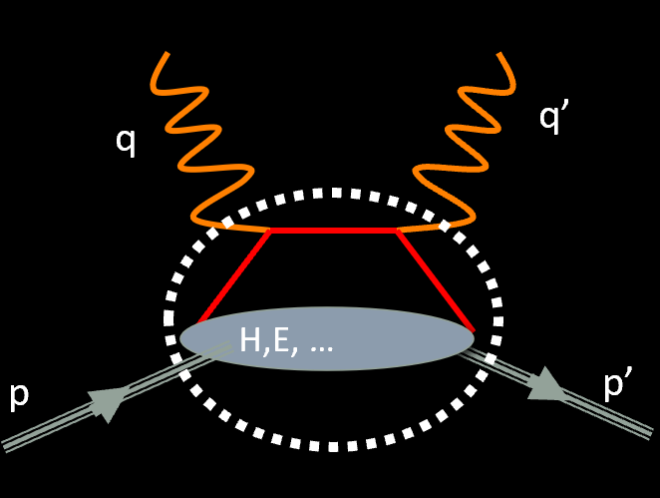
Generalized parton distributions (GPDs)
Nuclear femtography/hadron tomography has the GPDs at its disposal
The cross section of DVCS gives us the Compton Form Factors, from which we can extract GPDs – a task for which ML is well-suited
See S. Liuti’s Wednesday talk!
Simonetta Liuti, “Hadron Ion Tea (HIT@LBL) seminar” (2021).

Slide 3
3D Coordinate Space Representation
The GPDs, through Fourier transform, give us spatial information on the charge, matter, and radial distributions of the quarks and gluons inside the nucleon
The Fourier transform of GPD H^{q} gives the one-body parton density distribution in b_{T}
Definition of the GPD
Fourier transform of the GPD

Slide 4
Unpolarized parton correlation function; trivial gauge link
Having projected out the ”good components,” introducing a complete set of states, and applying translational invariance
Having replaced the sum over final states X with an integral over the four momentum, k_{X}, of the final state
Vertex function

Slide 5
Fourier transforming the vertex functions,
We obtain a one-body parton density distribution in the transverse plane, or the impact parameter dependent distribution (IPPDF)

Slide 6
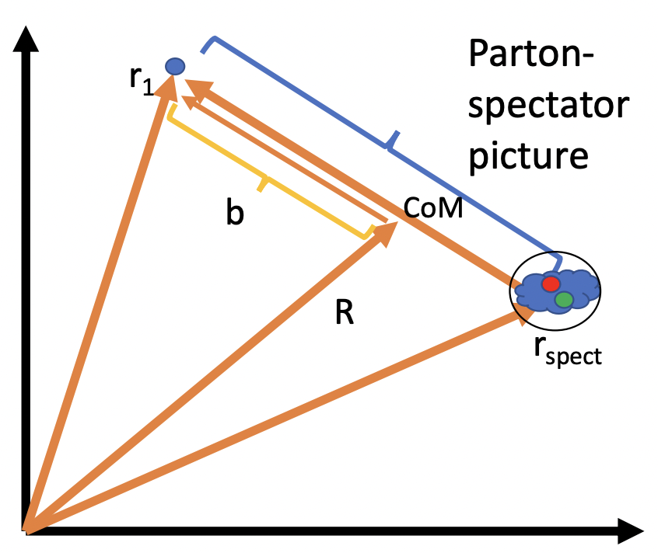
What do we see about the proton so far?
Proton
Parton

Slide 7
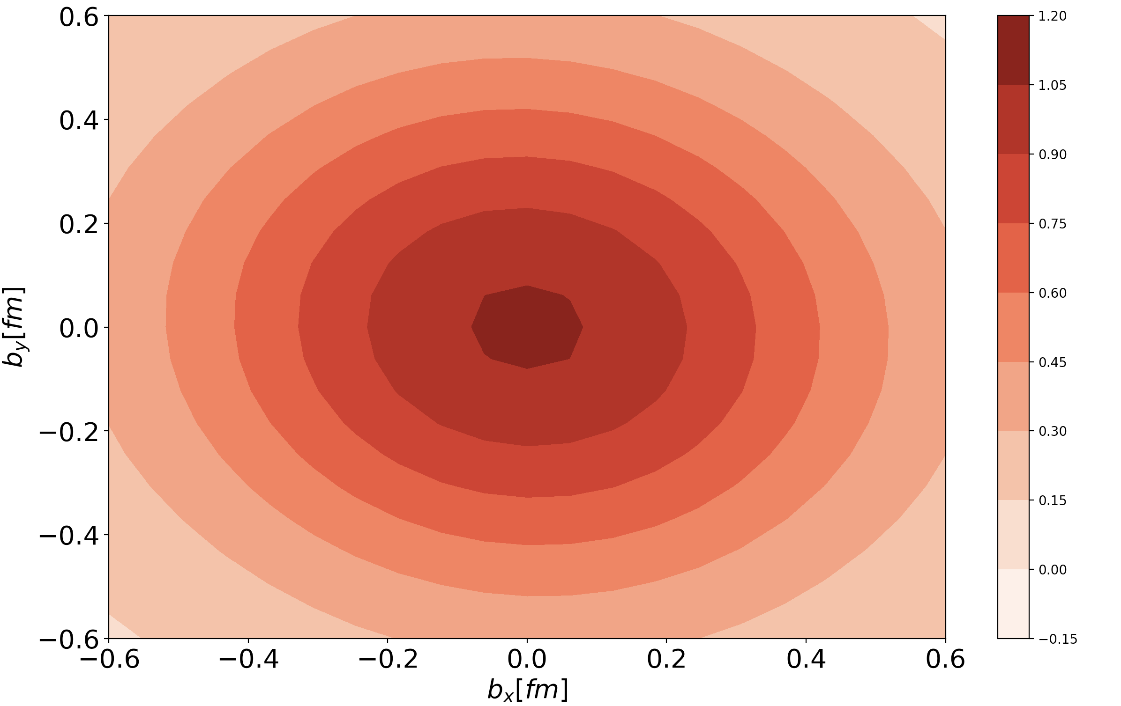
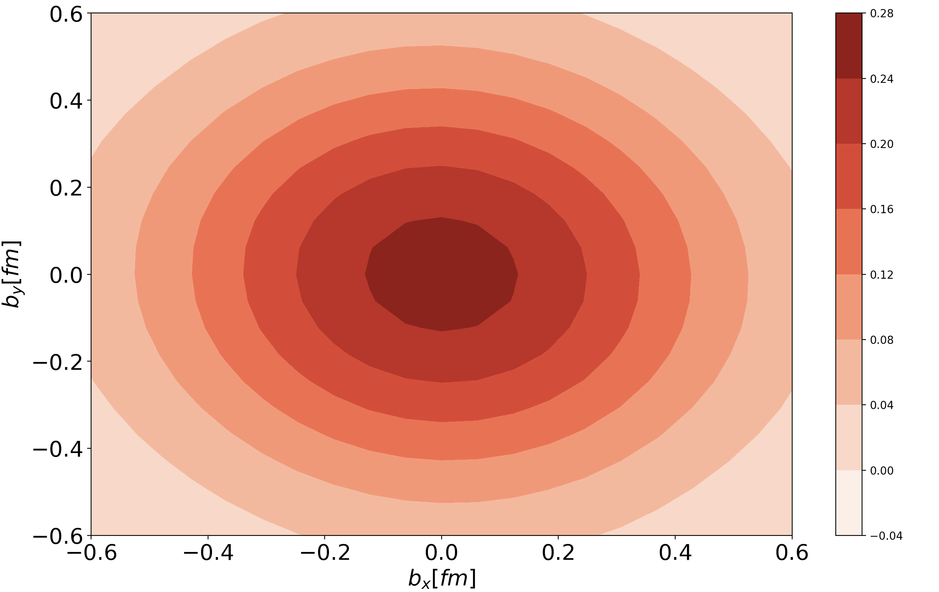
Hu distribution
$$Q^{2}=5 {GeV}^{2}$$
$$X = 0.001$$
The Fourier transform of the GPD Hu for fixed Q² at different values of X.
We obtain these distributions by evolving and Fourier transform our parametrization, fitted to data, within the spectator model.
$$Q^{2}=5 {GeV}^{2}$$
$$X = 0.1$$
B. Kriesten. P. Velie, E. Yeats, F. Y. Lopez, & S. Liuti, Phys.Rev.D 105 (2022) 5, 056022

Slide 8
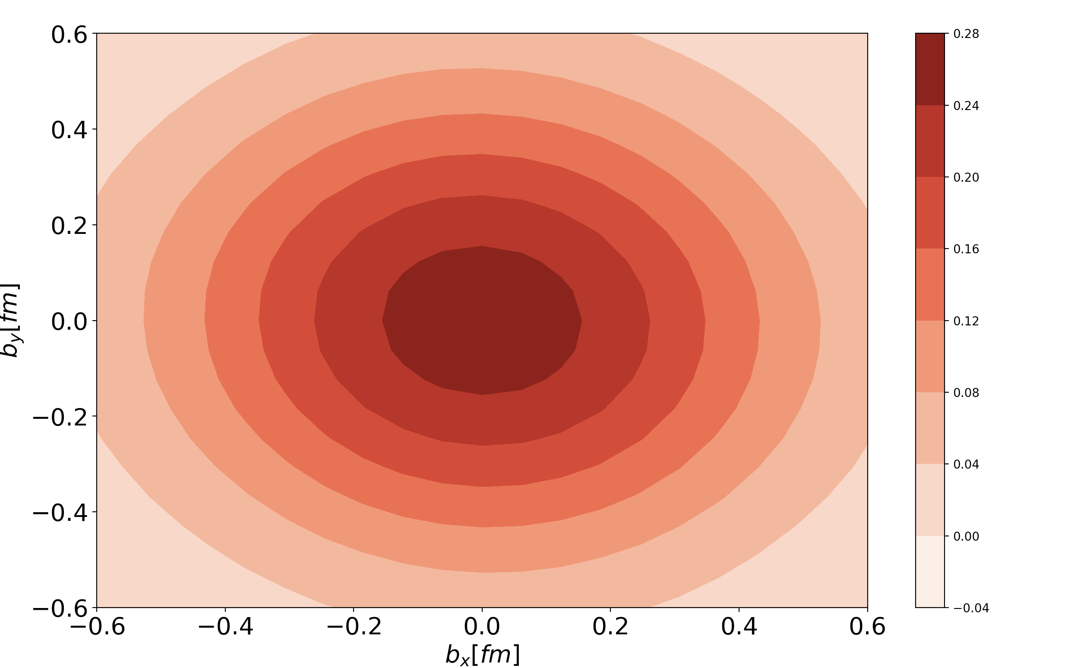
Hu distribution
$$Q^{2}=5 {GeV}^{2}$$
$$X = 0.1$$
The Fourier transform of the GPD Hu for different values of Q^{2.}
We obtain these distributions by evolving and Fourier transform our parametrization, fitted to data, within the spectator model.
$$Q^{2}=15 {GeV}^{2}$$
$$X = 0.1$$
B. Kriesten. P. Velie, E. Yeats, F. Y. Lopez, & S. Liuti, Phys.Rev.D 105 (2022) 5, 056022

Slide 9
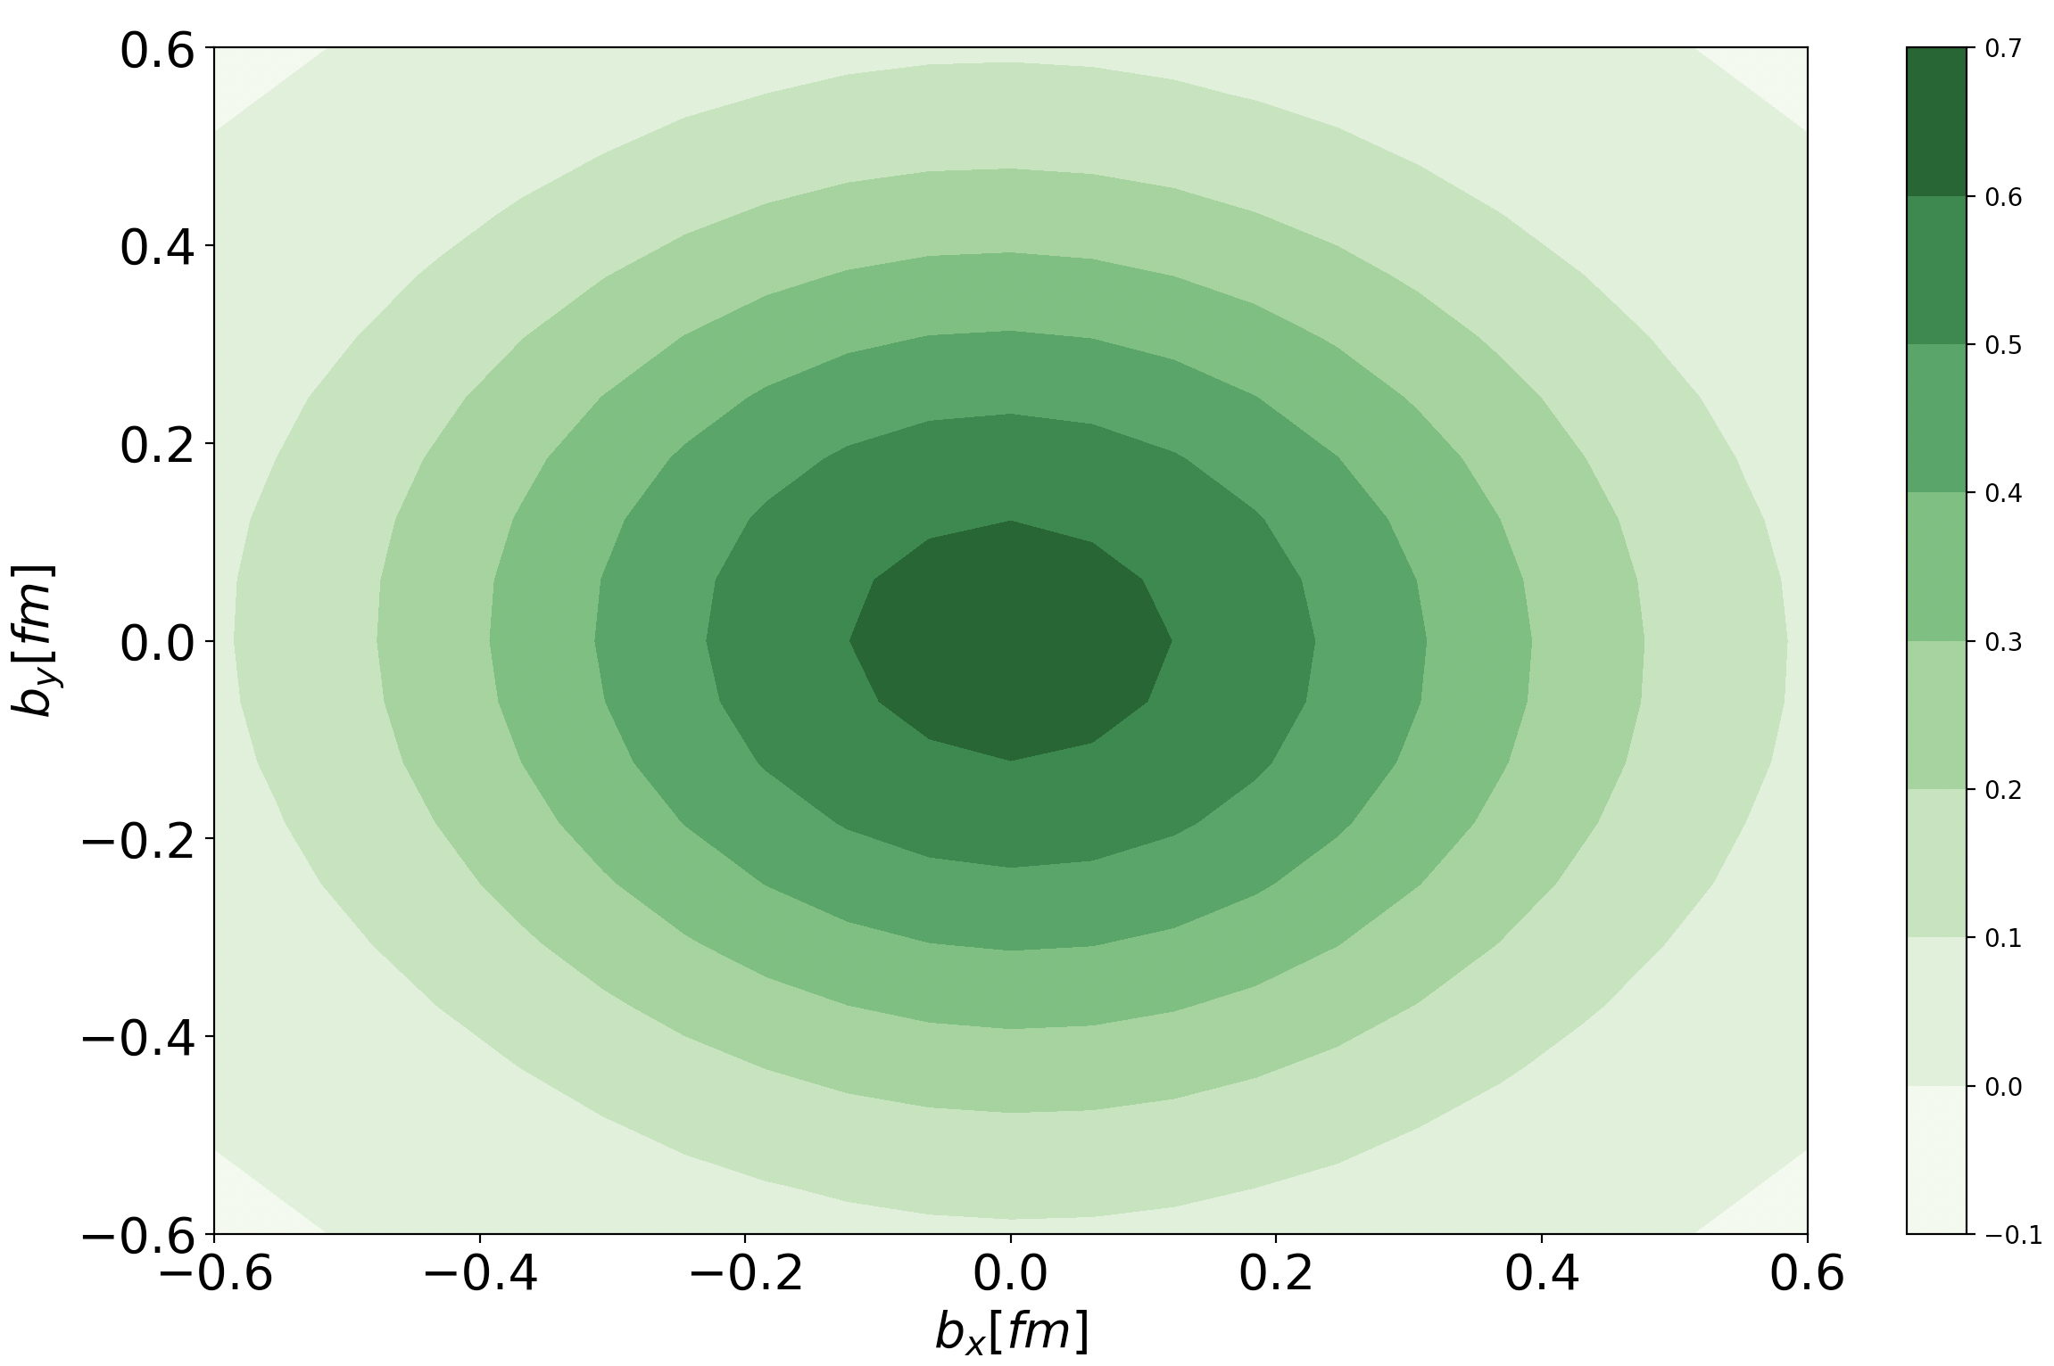
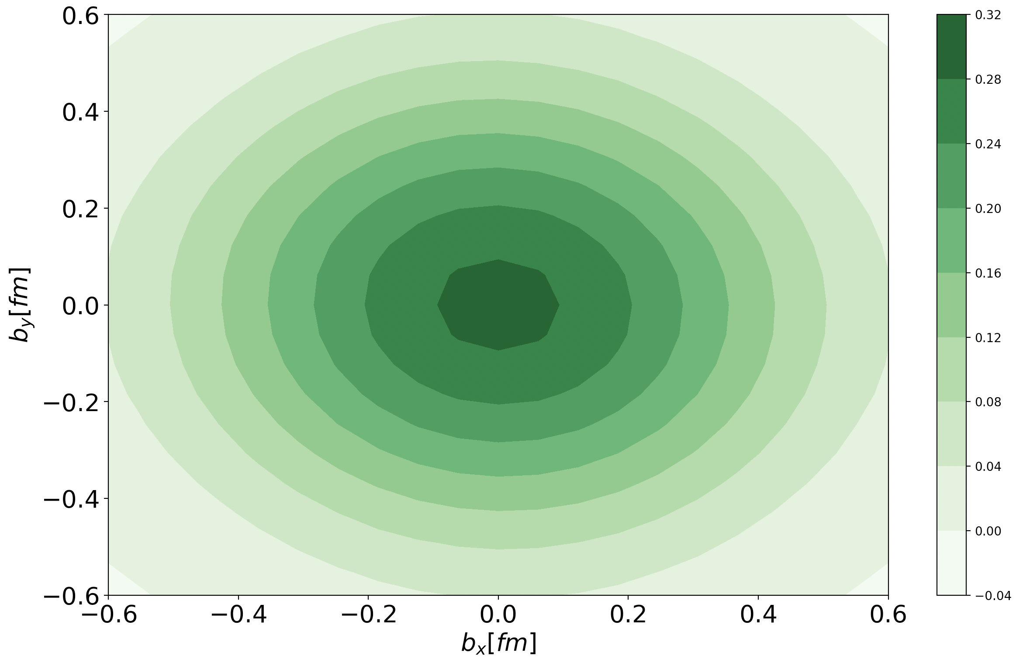
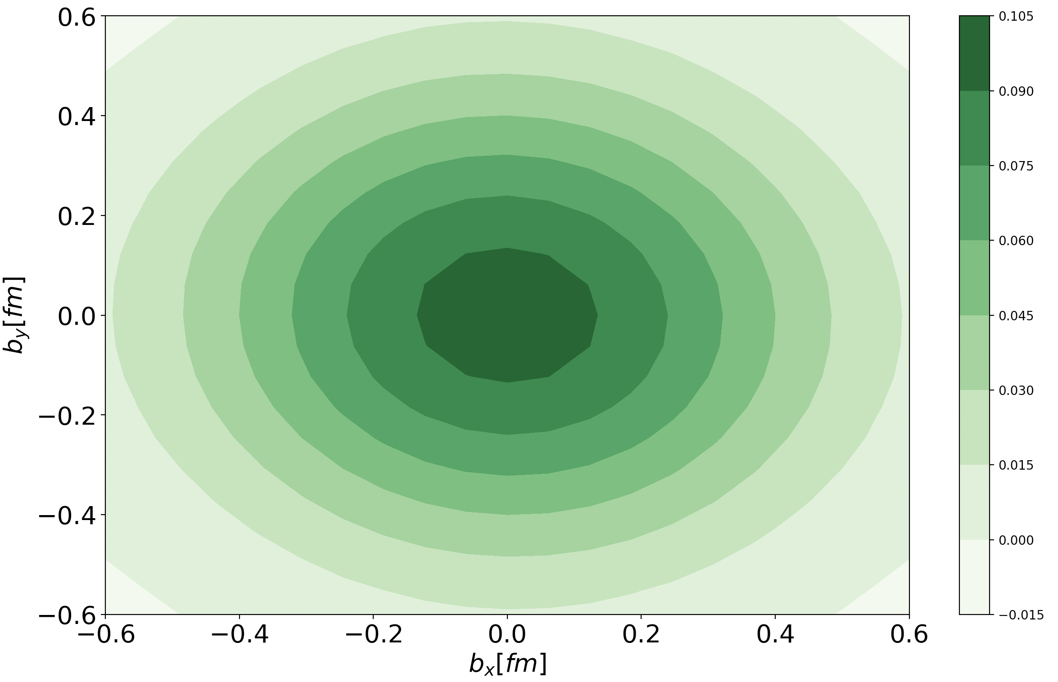
Gluon distribution
$$Q^{2}=5 {GeV}^{2}$$
$$Q^{2}=5 {GeV}^{2}$$
$$X = 0.0001$$
$$X = 0.001$$
Here, we show Hg, which corresponds to the gluon momentum distribution
Varying low X values at fixed Q²
$$Q^{2}=5 {GeV}^{2}$$
$$Q^{2}=5 {GeV}^{2}$$
$$X = 0.01$$
$$X = 0.1$$

Slide 10
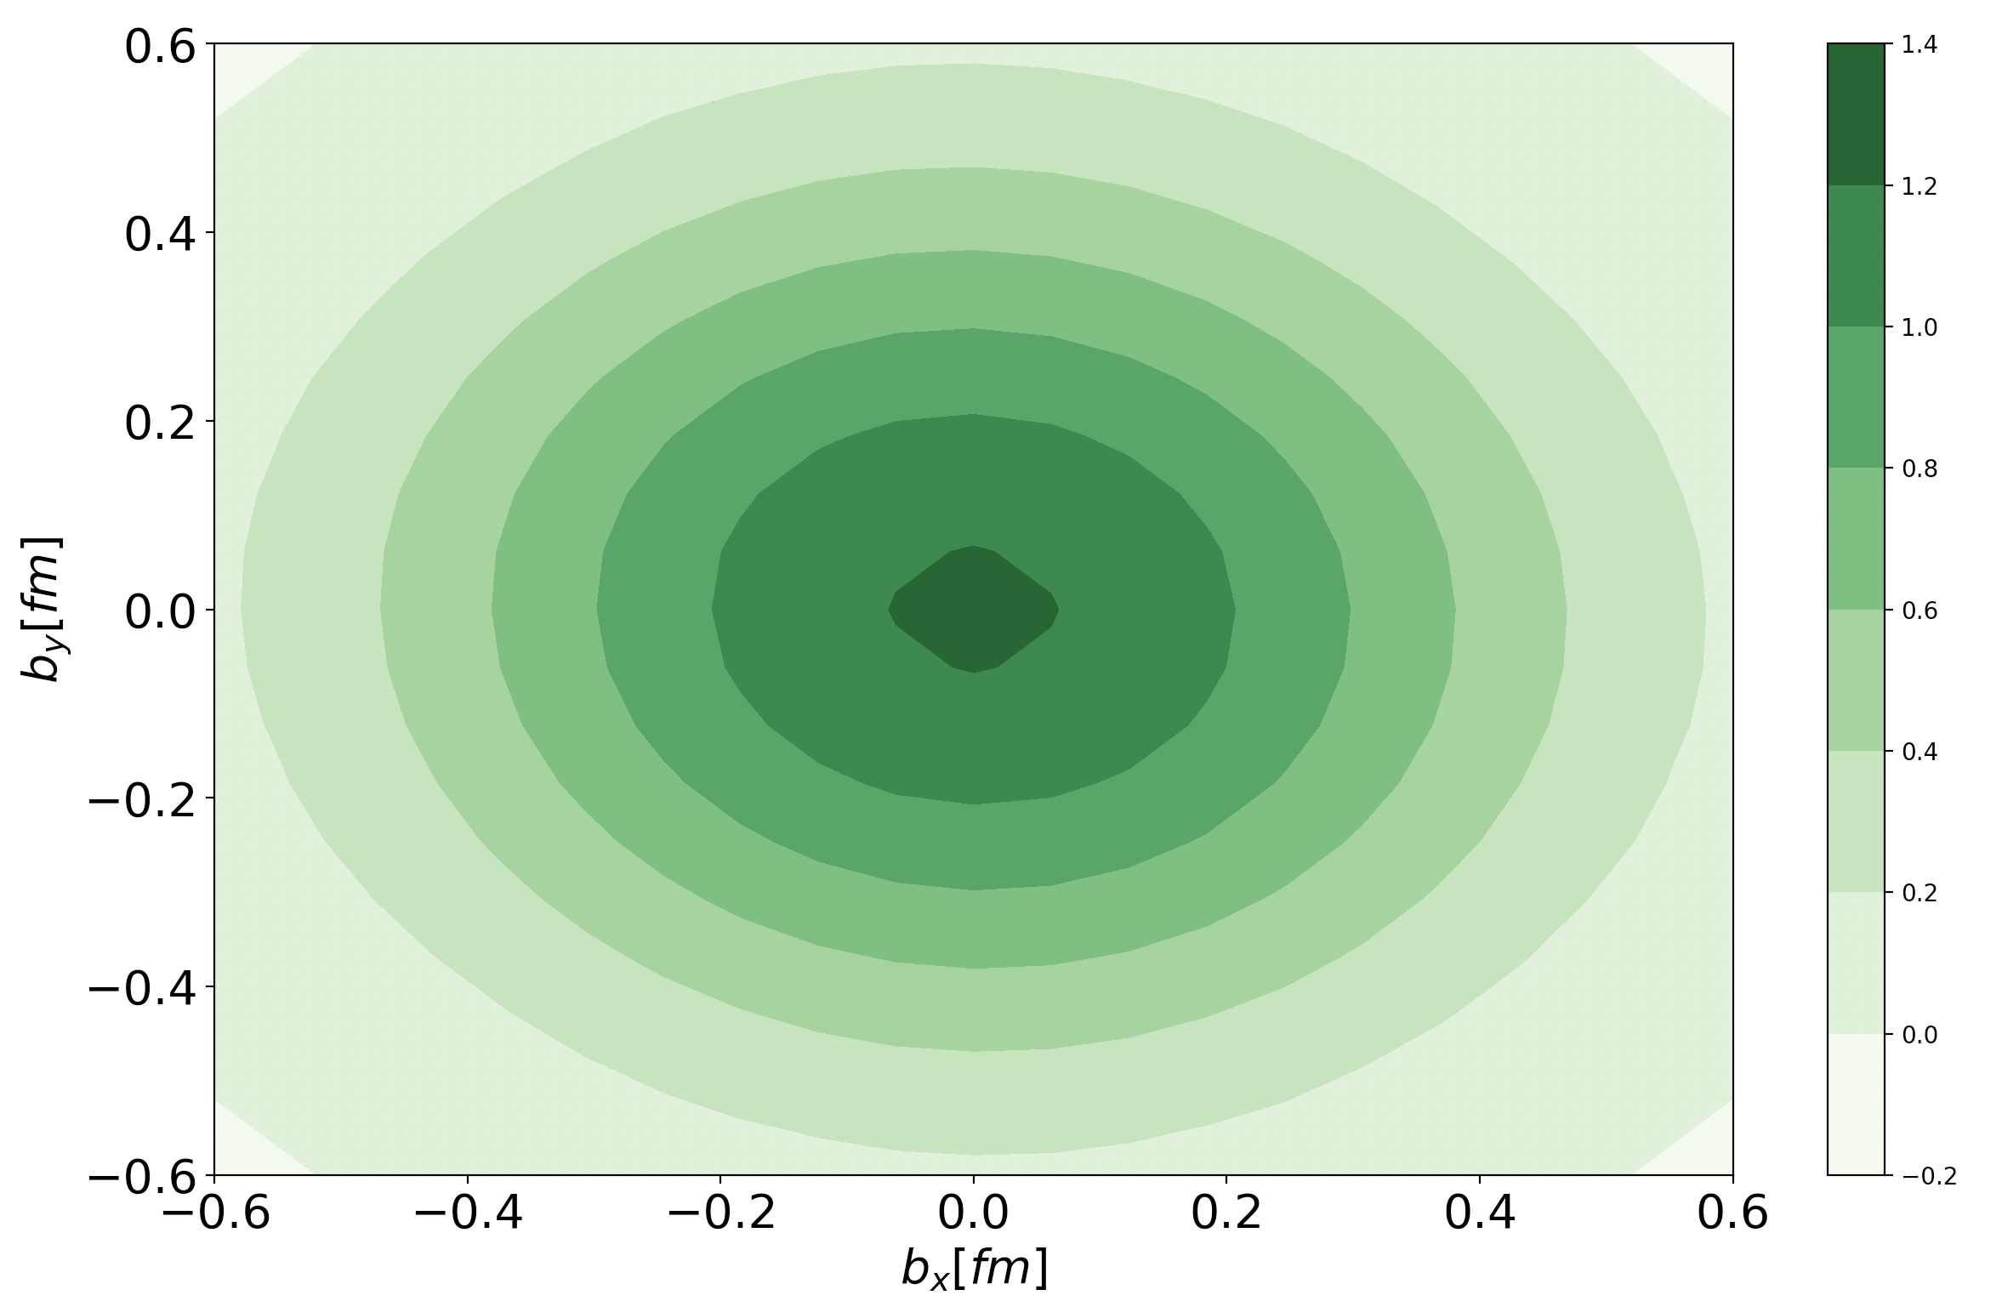
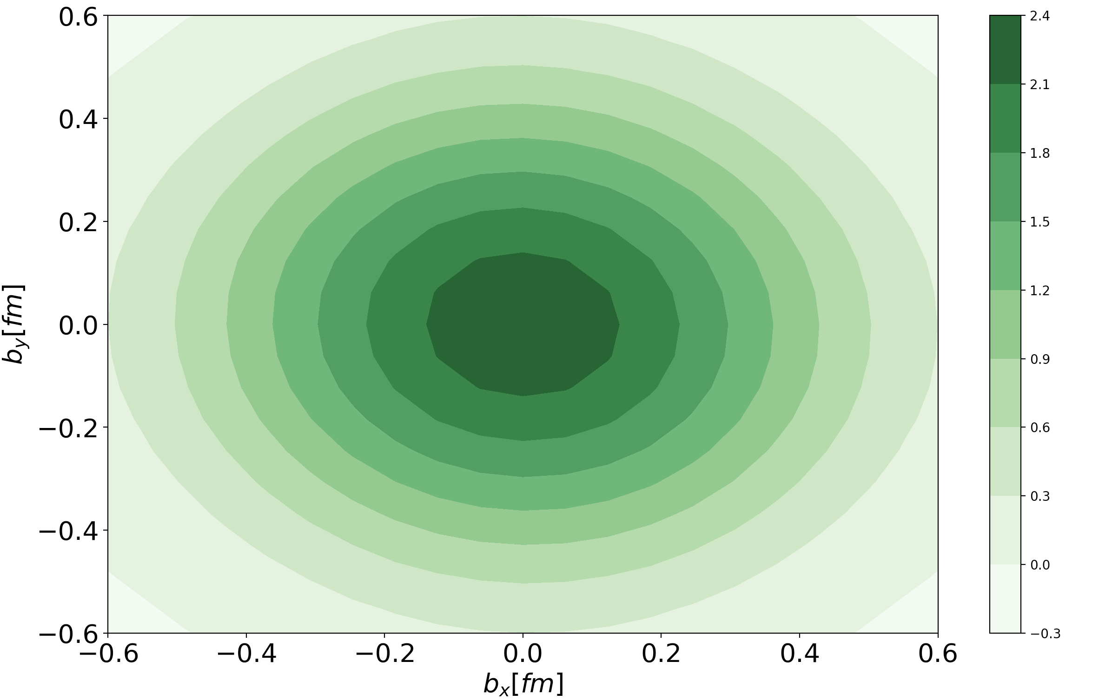
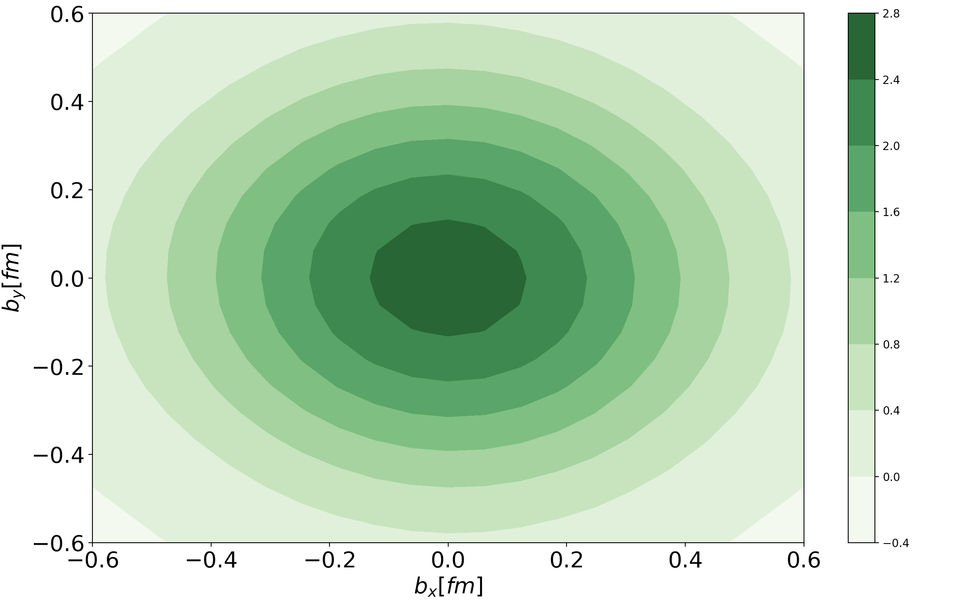
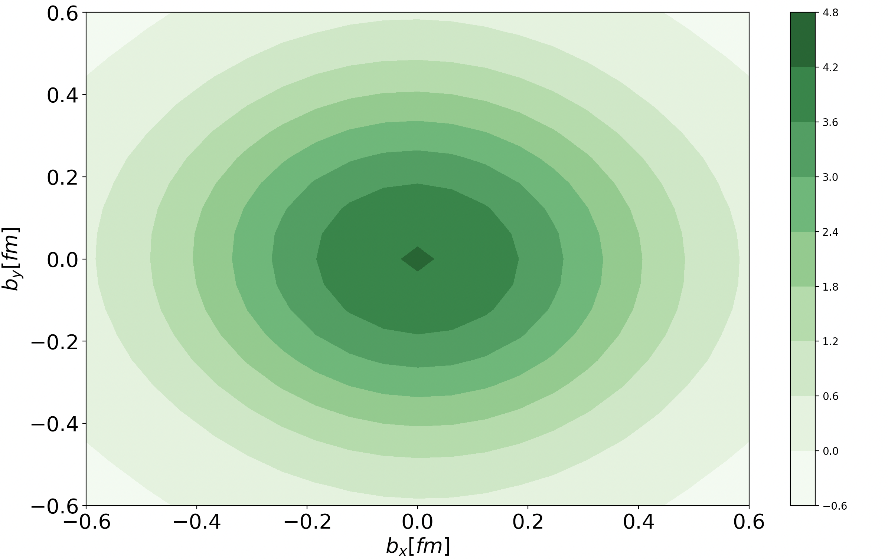
Gluon distribution
$$Q^{2}=5 {GeV}^{2}$$
$$Q^{2}=15 {GeV}^{2}$$
$$X = 0.0001$$
$$X = 0.0001$$
Here, we show Hg, which corresponds to the gluon momentum distribution.
Varying values of Q²
$$Q^{2}=20 {GeV}^{2}$$
$$Q^{2}=100 {GeV}^{2}$$
$$X = 0.0001$$
$$X = 0.0001$$

Slide 11
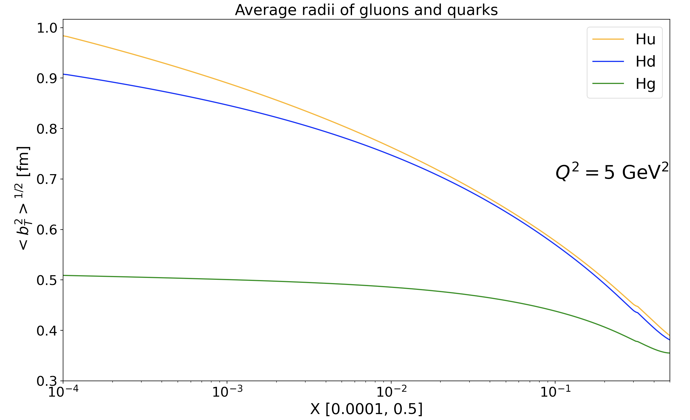
Average radii
Expectation value of the transverse impact parameter distance

Slide 12
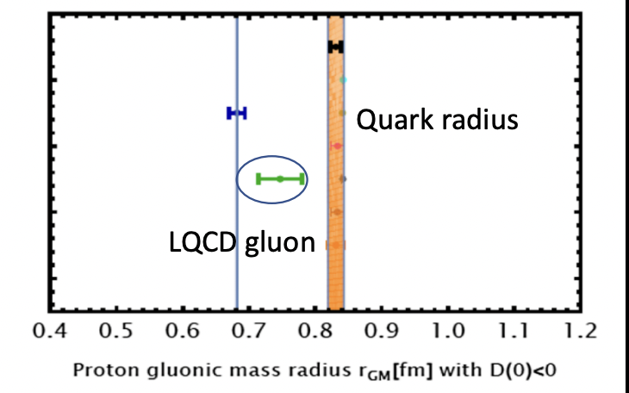
Average radii
Expectation value of the transverse impact parameter distance
Compare to lattice and AdS/CFT results.
Mamo and I. Zaeed PRD106, 086004 (2022)
LQCD: Shanahan and Detmold Phys. Rev. Lett. 122, 072003 (2019)

Slide 13
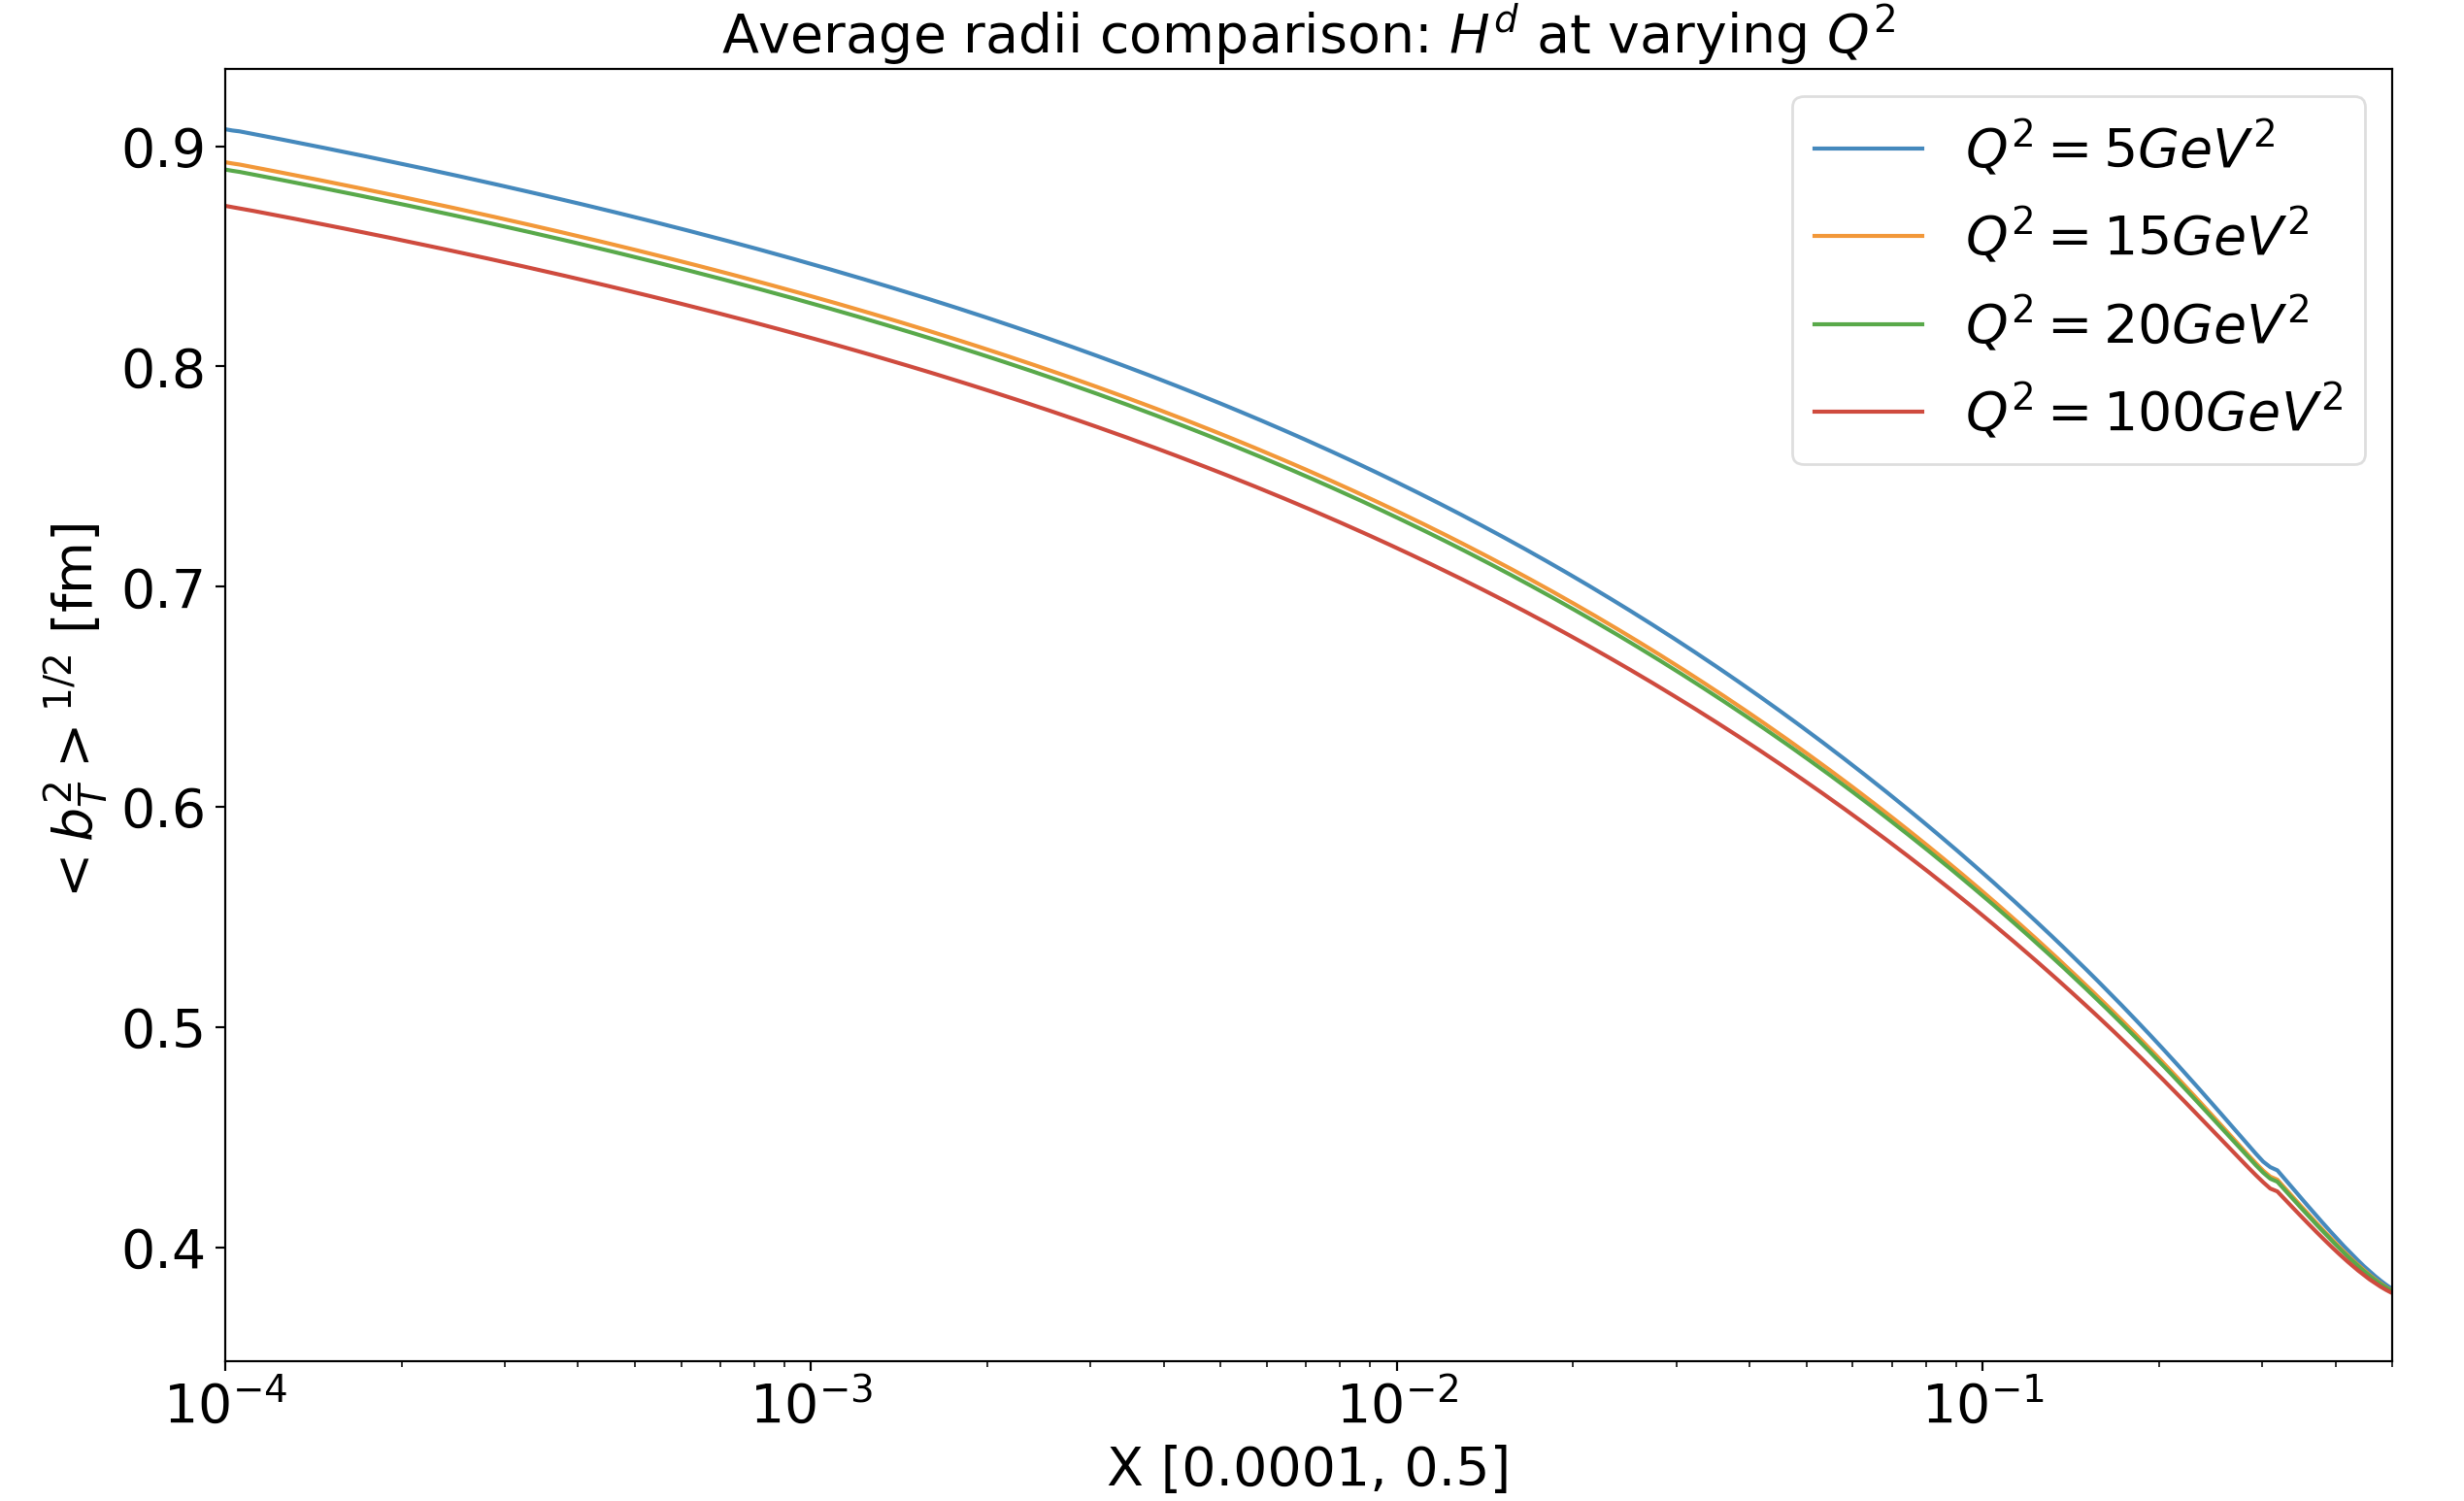
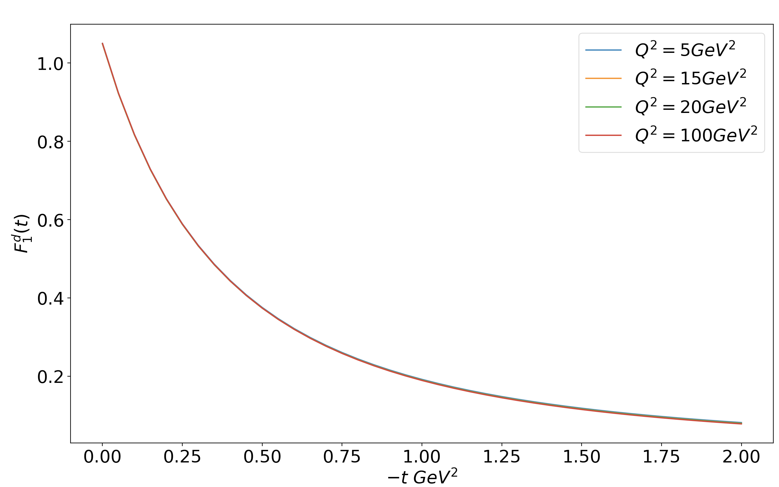
What about Q² evolution?
We do not expect a dependence on scale for the total average radii corresponding to the valence quarks since the form factors are scale-independent.

Slide 14
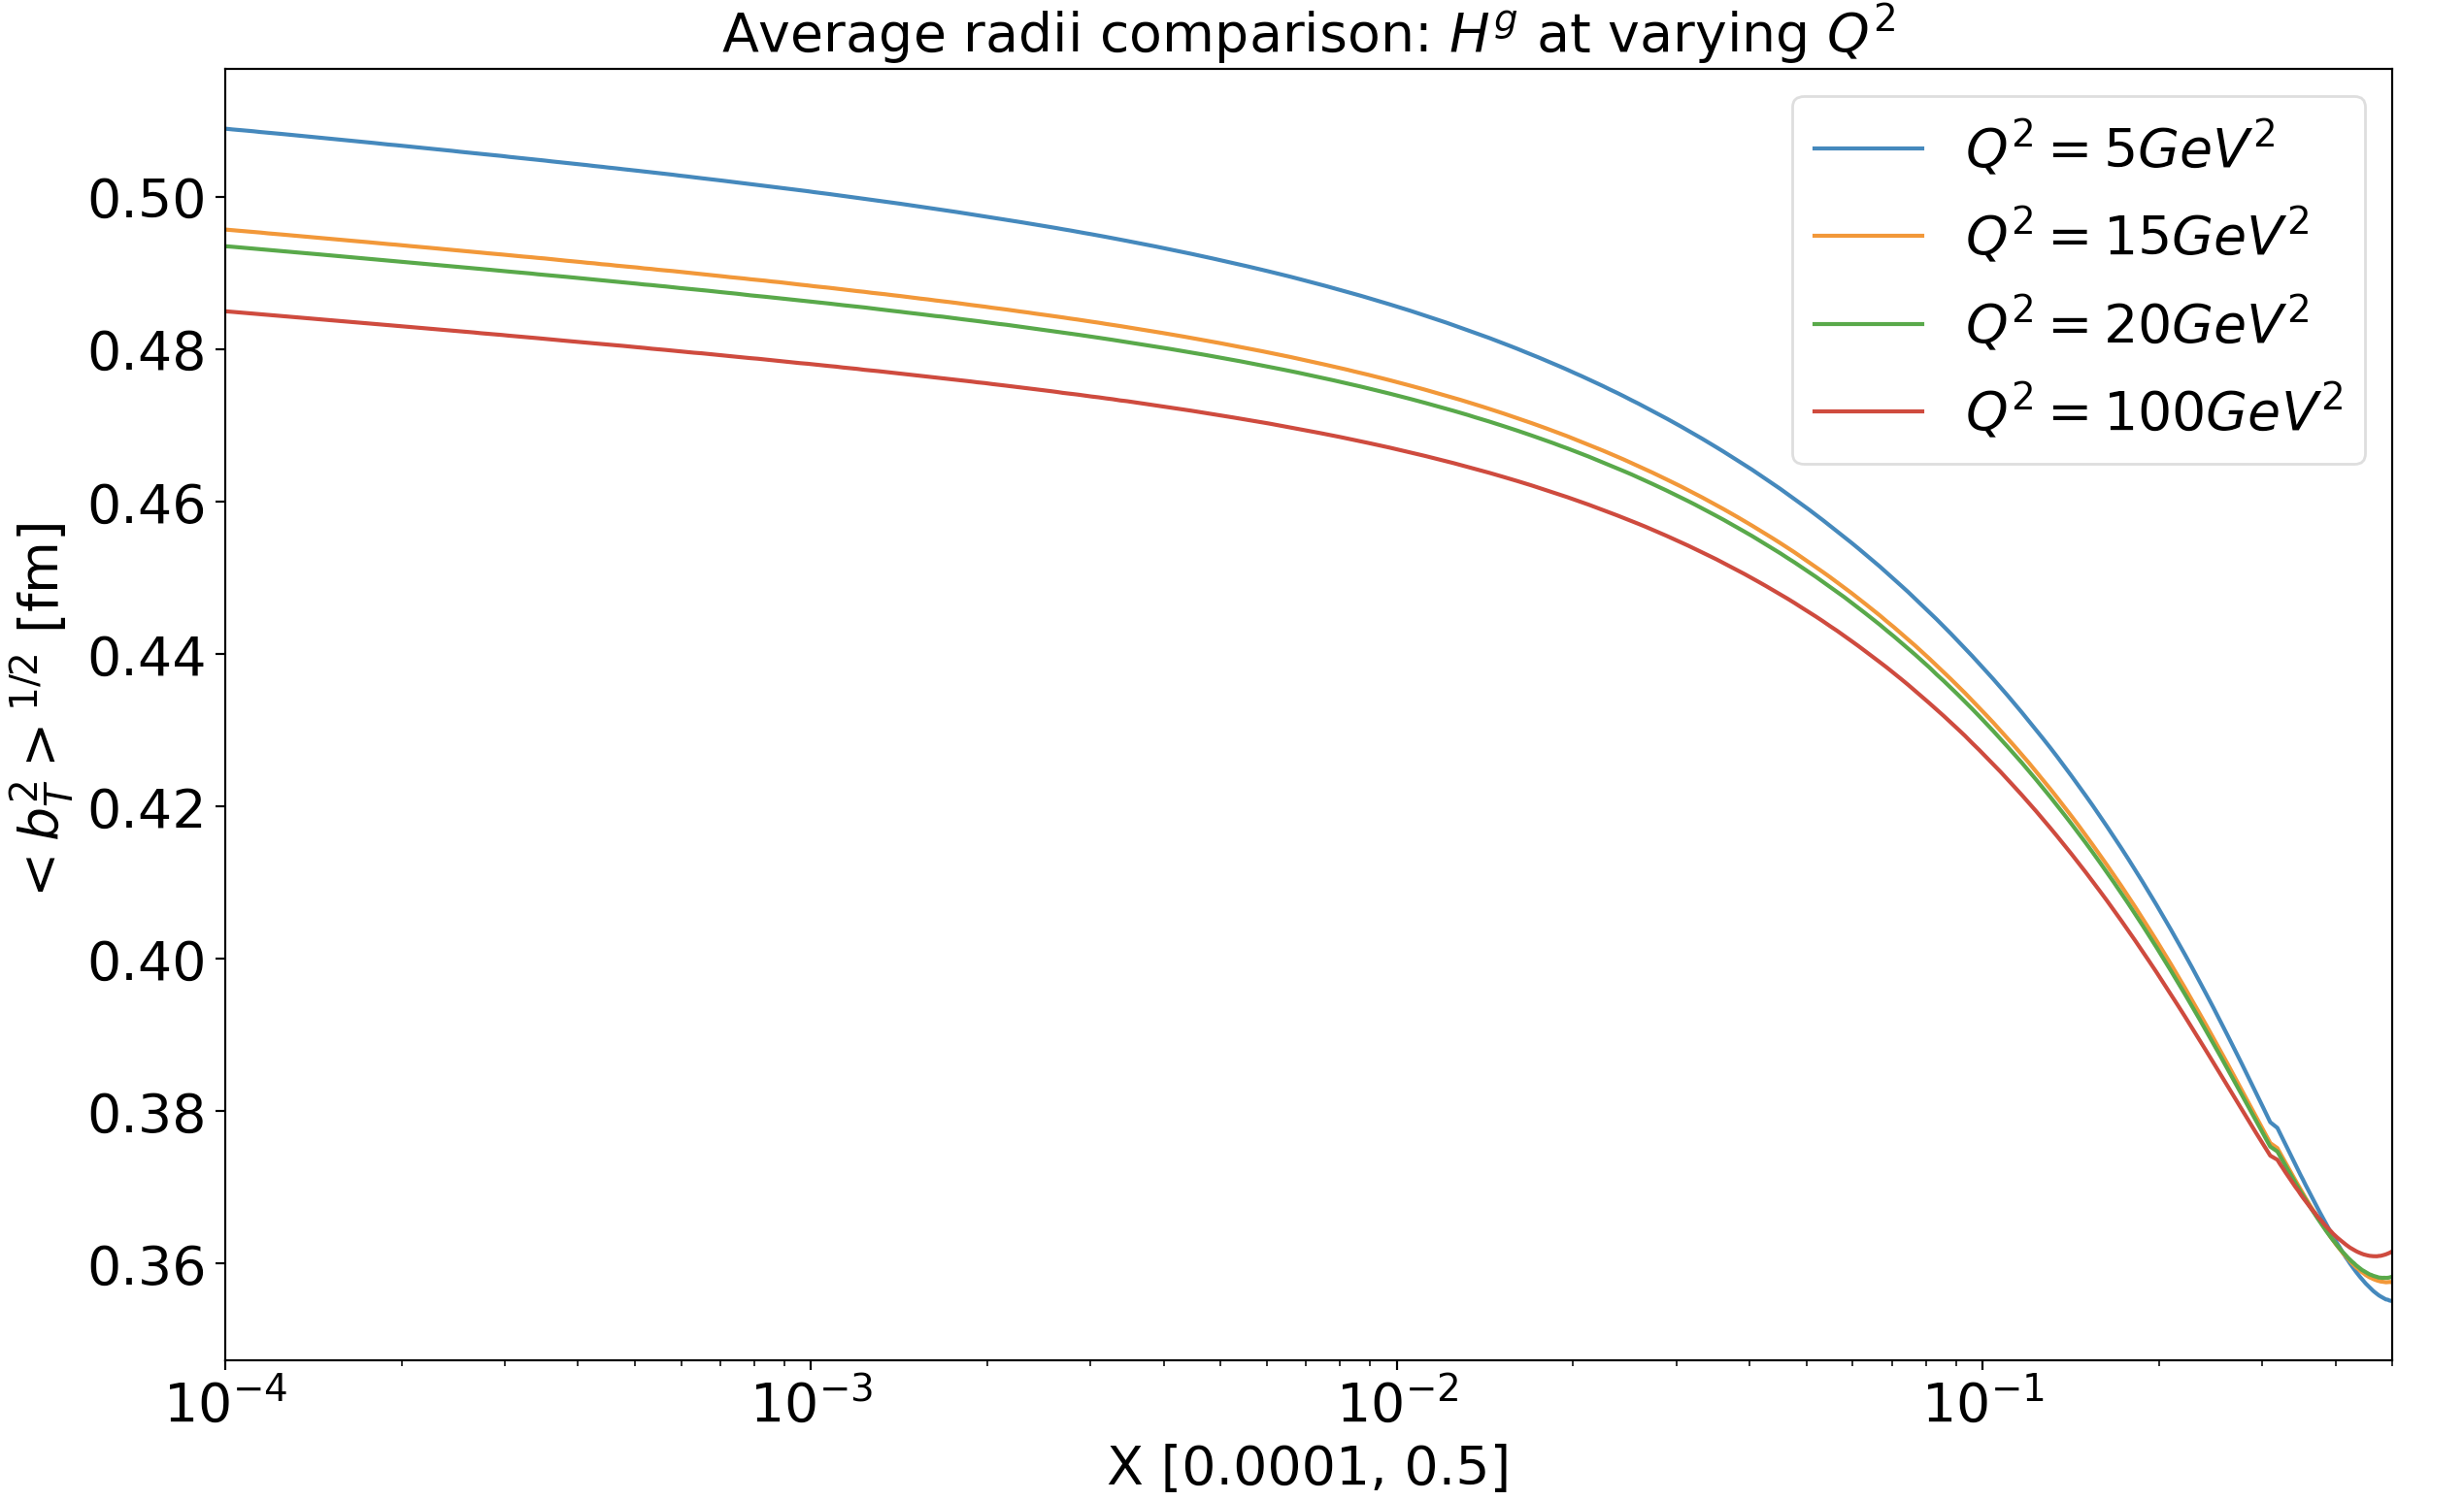
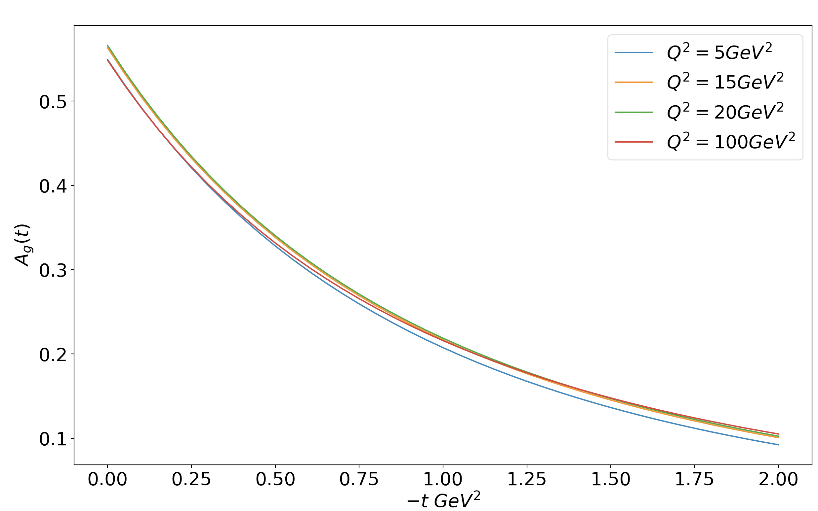
What about Q² evolution?
However, for the gluon, we expect some dependence on the scale since the gluon distribution integrates to scale-dependent form factors

Slide 15
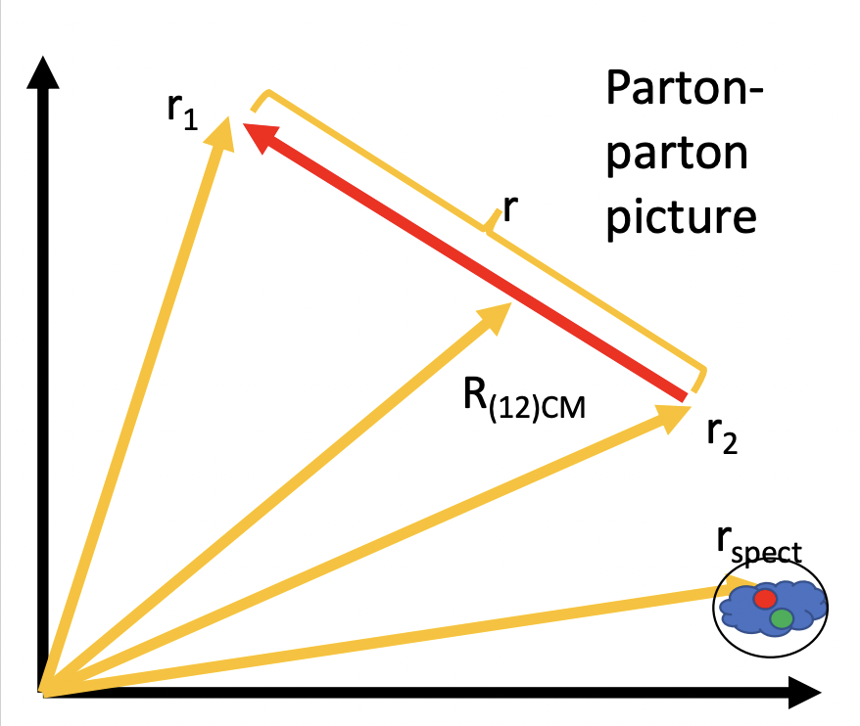
Towards improved hadron tomography
Proton
Parton
Parton

Slide 16
Work in progress: Double parton distributions (DPDs)
The correlation function defined for parton type i,j = q, g
Quark double parton distribution is related to the two-parton correlation function through Fourier transform

Slide 17
Work in progress: Double parton distributions (DPDs)
Reducing to the simpler case of longitudinal fractional momenta x = x₁ = x₂
Relevant to multi-parton final state processes

Slide 18
Two-body densities
General two-body density
In the two-body density framework, the Fourier transform of the GPDs act as densities that allow us to define useful quantities
Assuming independent particle motion
Average relative distance

Slide 19
Two-body densities
General two-body density
In the two-body density framework, the Fourier transform of the GPDs act as densities that allow us to define useful quantities
Assuming independent particle motion
Overlap between two partons
Geometric overlap of two circles, where R₁, R₂ are the average radii of the partons q₁, q₂

Slide 20
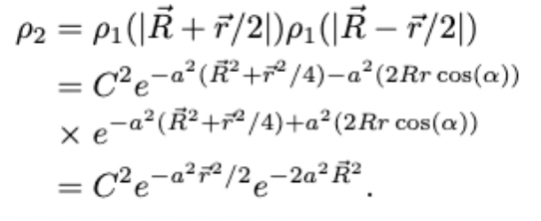
Two-body densities – Examples
Suppose we fit the density distribution, which is obtained through the GPDs, to a Gaussian:
Taking two partons, say two gluon distributions, at the same X, we obtain the following two-body density:
We obtain a simple relation for the average relative distance in such a scenario:

Slide 21
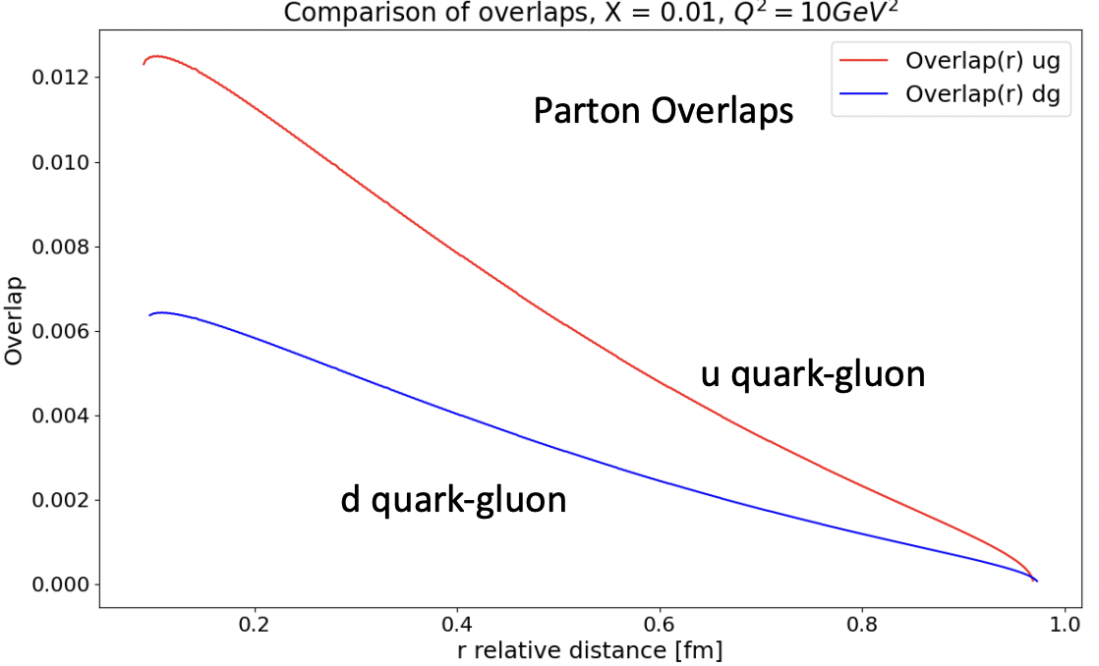
Two-body densities – Examples
Here, we fit the u, d and g distributions to Gaussians at some X and Q² to obtain overlaps between u and g and d and g.
*Numerical results here are preliminary

Slide 22
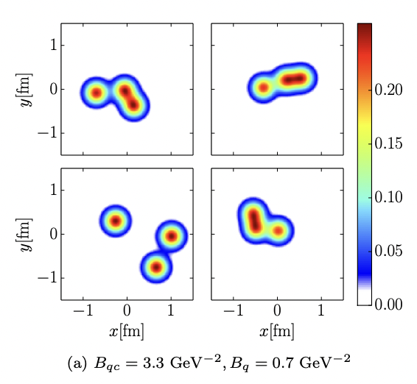
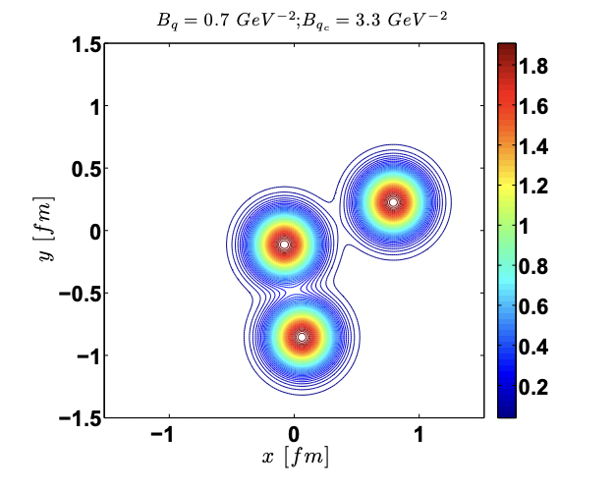
u
g
Heikki Mäntysaari and Björn Schenke
Phys. Rev. D 94, 034042
<b_{T}²>^{1/2}= 1 fm
r = 0.3 fm
<b_{T}²>^{1/2}= 0.5 fm
Traini, M.C., Blaizot, JP. Eur. Phys. J. C 79, 327 (2019)
Overlap = 0.010 fm²
X = 0.01, Q² = 10 GeV²

Slide 23
Conclusion
The one-body density picture provides incredible insight into partonic structure
Moving from a one-body density picture to a two-body density picture can greatly improve our understanding of the proton’s internal structure
DPDs act as the connection of the two-body densities to observables, much like how GPDs act as the connection of the one-body densities to observables
Differently from the hotspot formalism (Mantysaari and Schenke), we use GPDs to describe the relative motion of quarks and gluons

