Slide 1

Origin of mass and Spin
I. Zahed
JLAB 23’

Slide 2
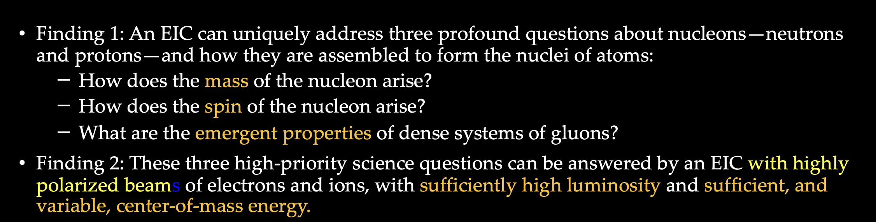
US National Academy of Science 18’

Slide 3
Outline
Vacuum
Mass
Spin
Mass FFs
Summary

Slide 4
Vacuum

Slide 5
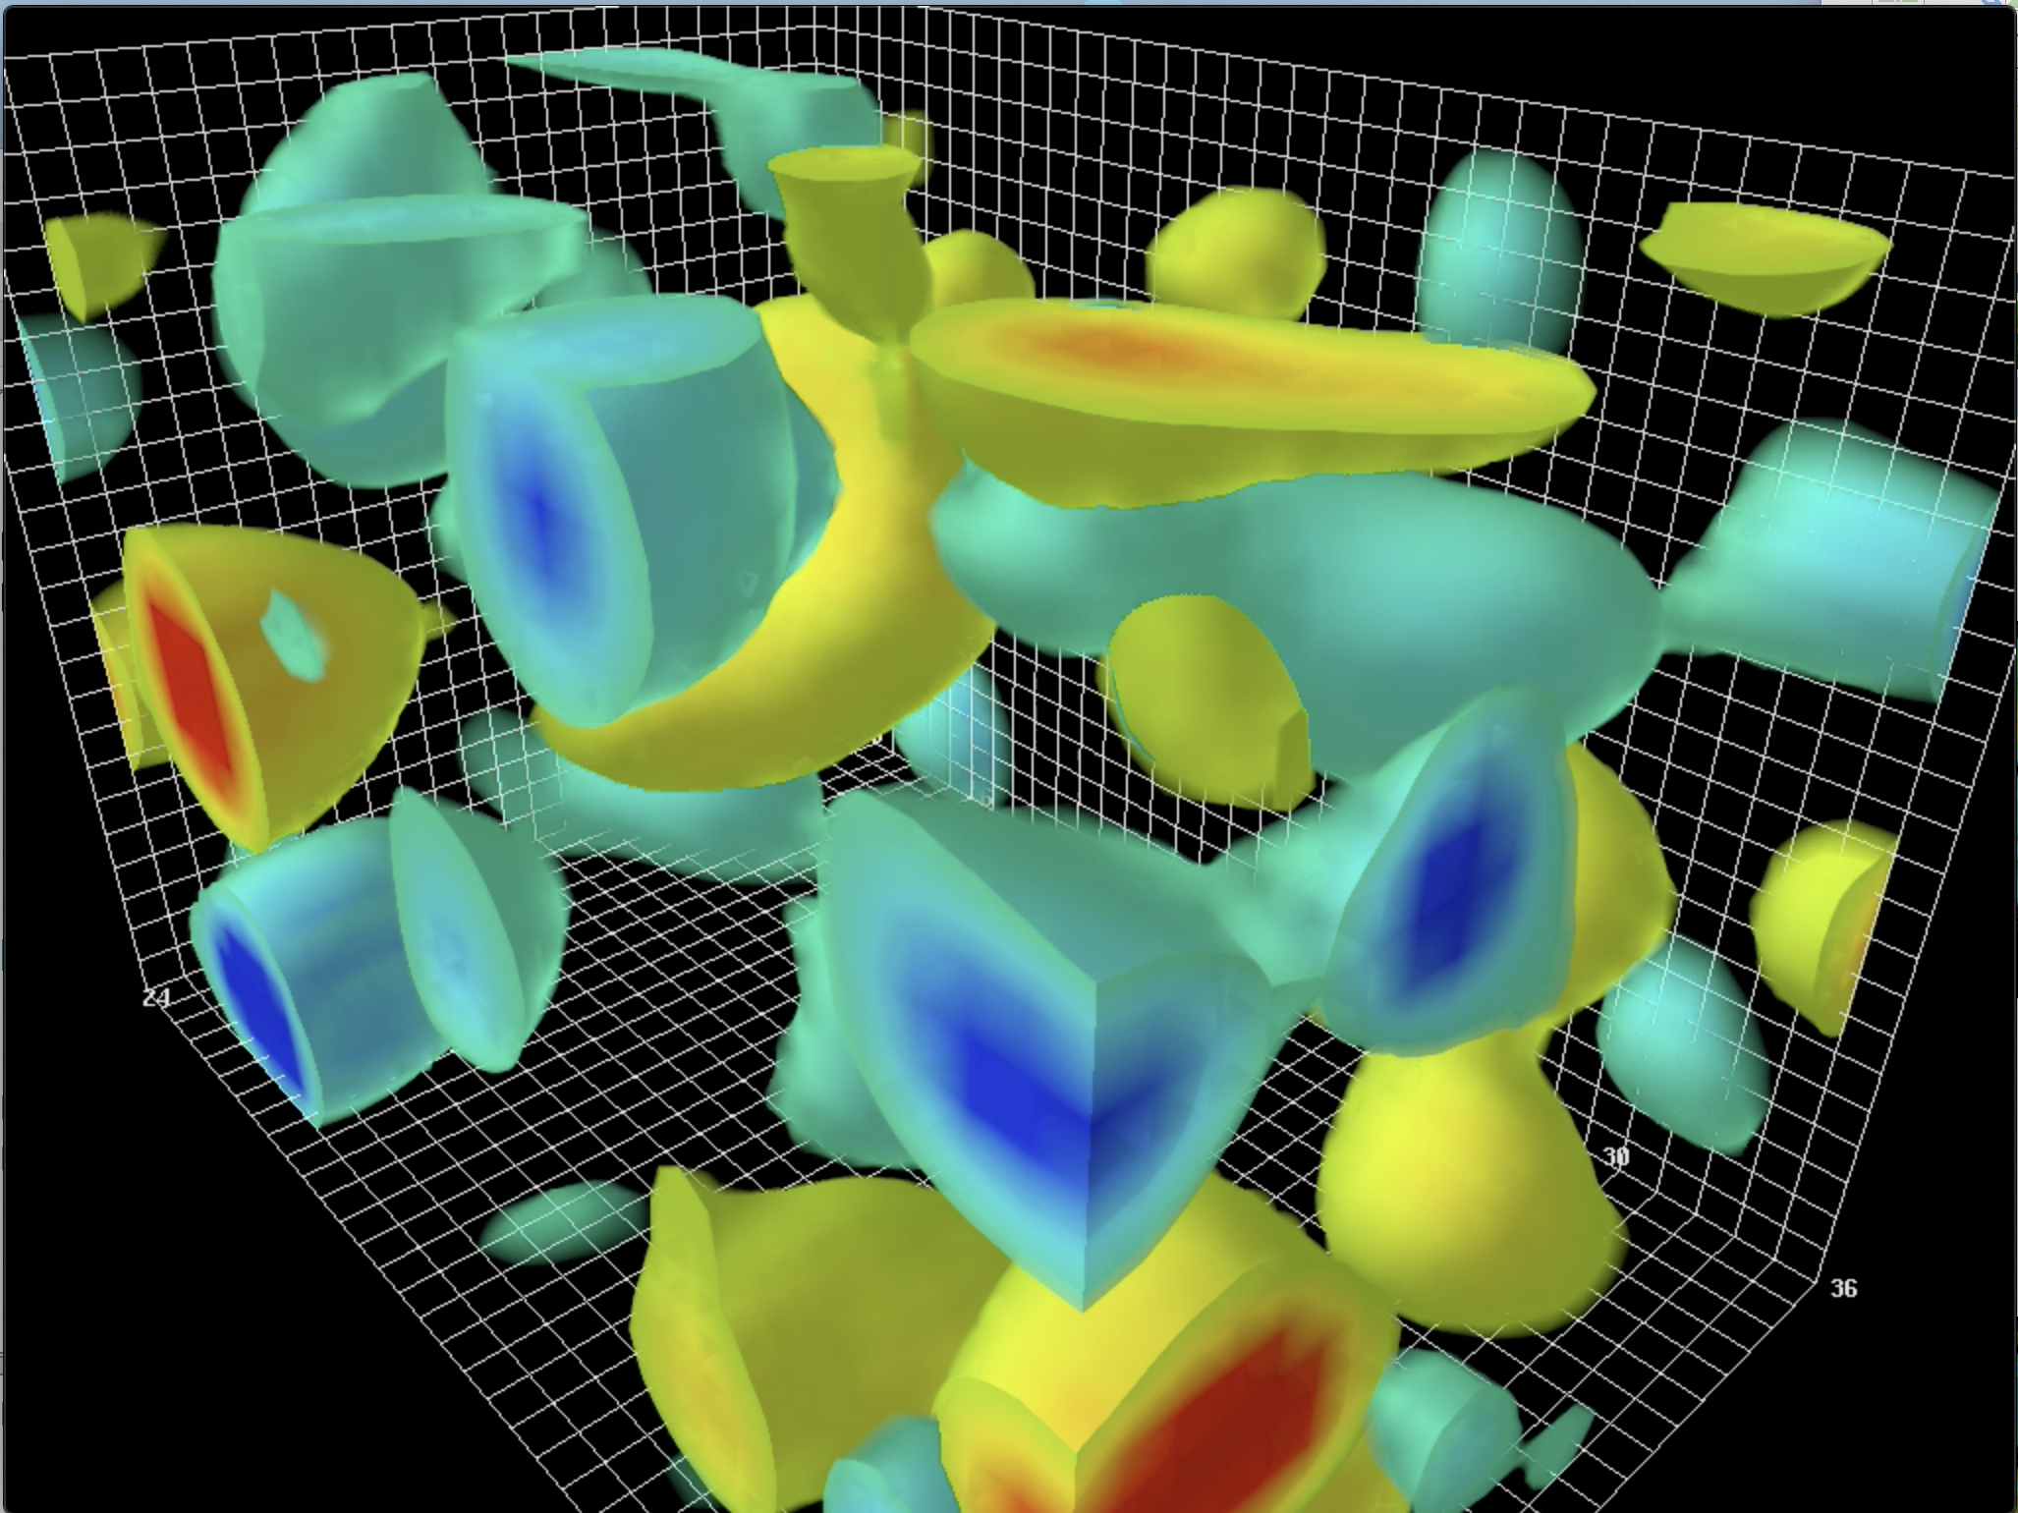
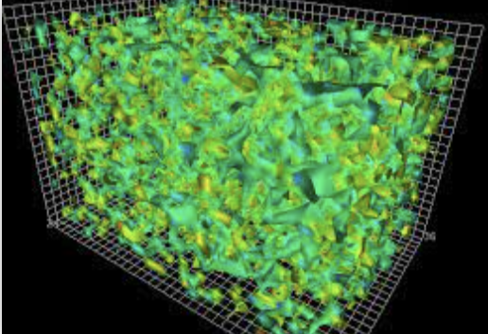
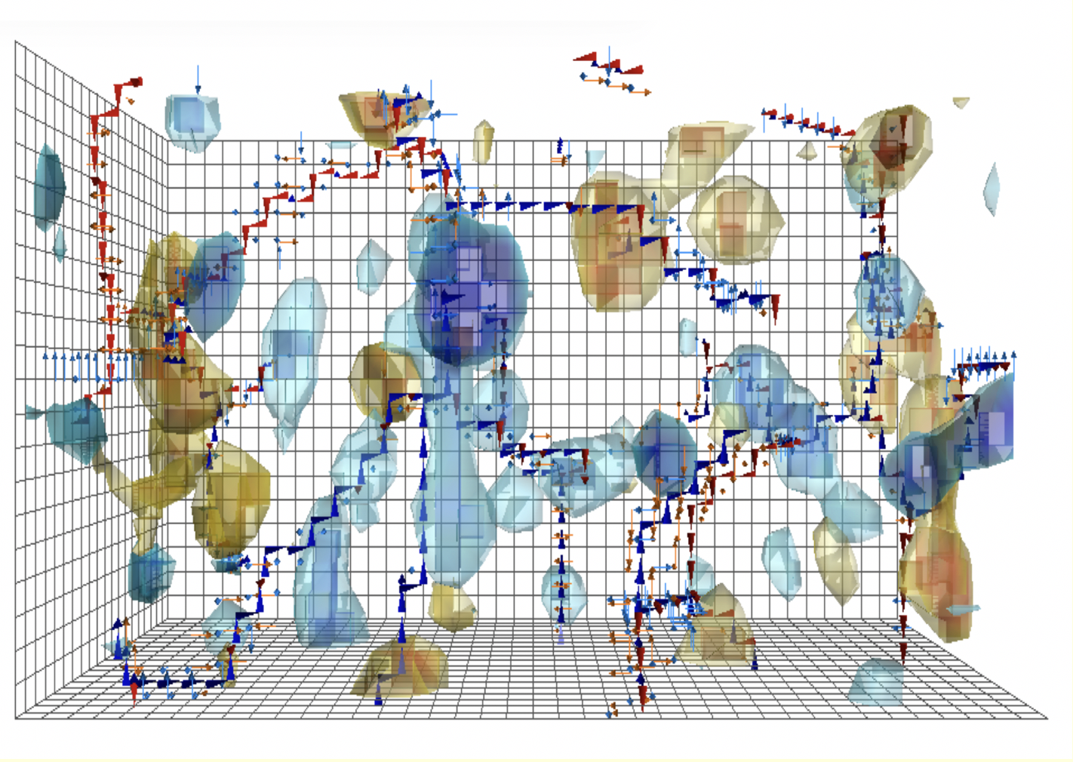
YM vacuum topologically active:
primordial glue!

Slide 6
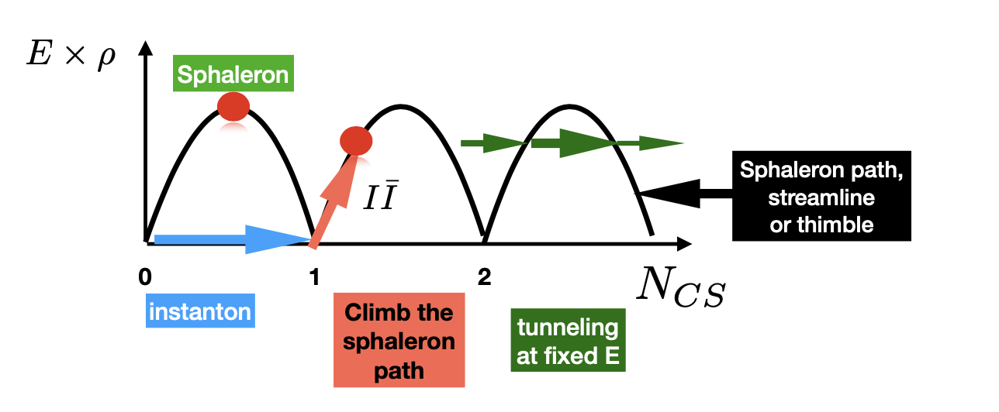
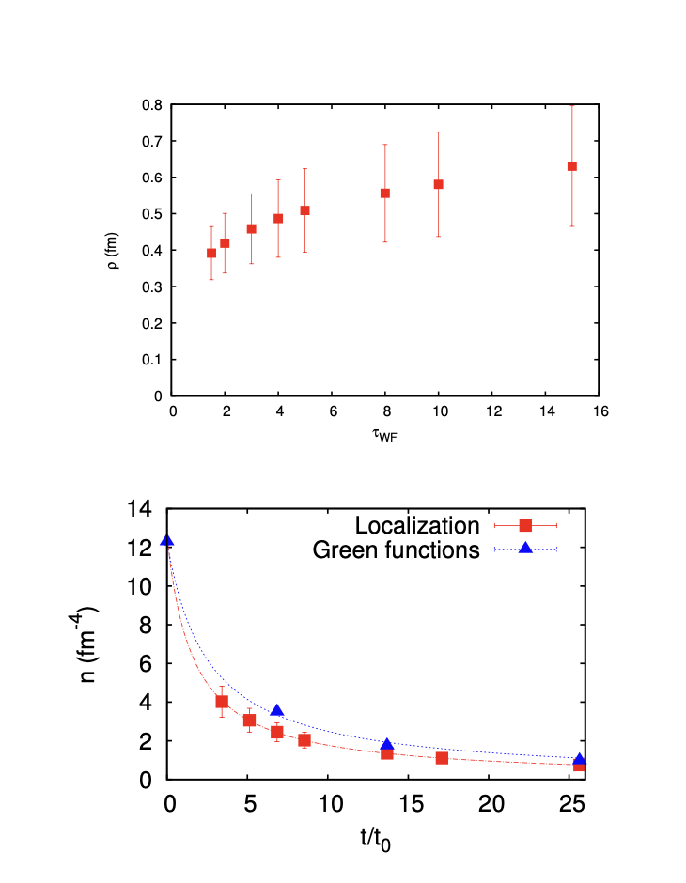
Topological landscape
Shuryak-Zahed 21’
Cooling
Athenodrou et al. 18’
ILM
MOL
Shuryak-Zahed 21’

Slide 7
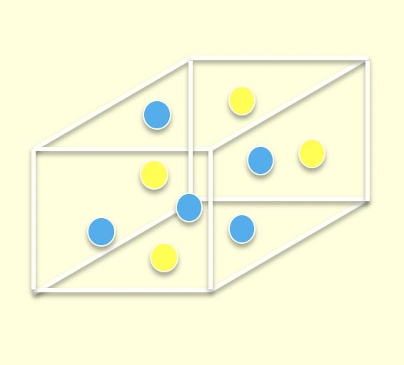
ILM

Slide 8
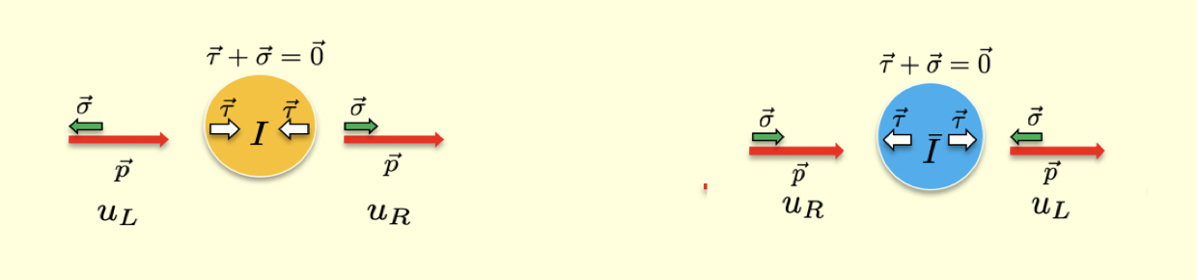
Topological origin of mass

Slide 9
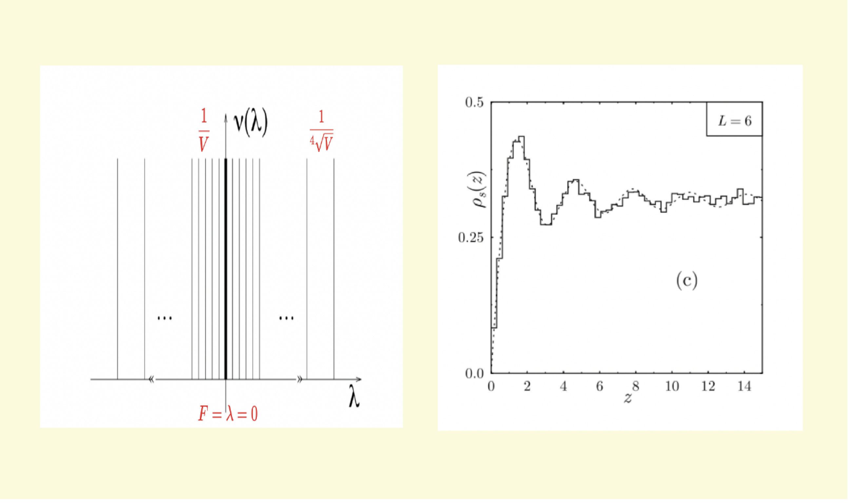
Lattice evidence for this mechanism

Slide 10
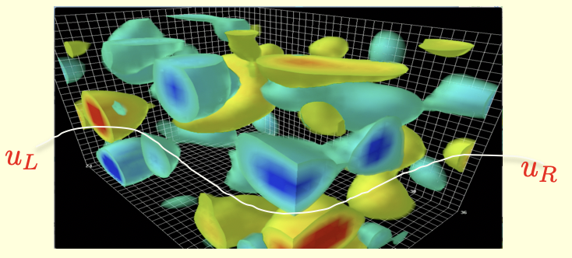
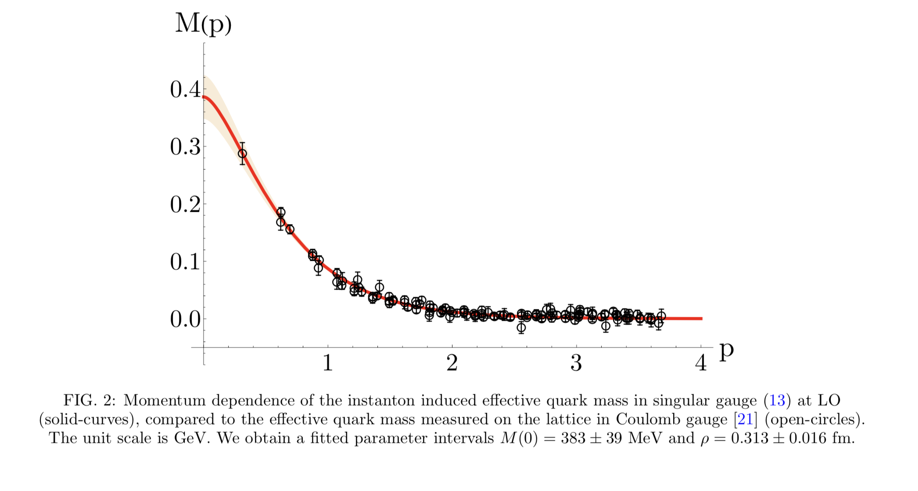
Topologically induced quark-mass in metallic regime

Slide 11
Mass

Slide 12
Mass from EMT
Rank-2-Symmetric

Slide 13
Ji mass sum rule in ILM
Scale anomaly is not a sum rule!

Slide 14
FF from ILM compressibility

Slide 15
Ji Mass Sum Rule

Slide 16
Spin

Slide 17
Ji spin sum rule in ILM

Slide 18
Intrinsic spin and U(1) axial anomaly

Slide 19
from ILM

Slide 20
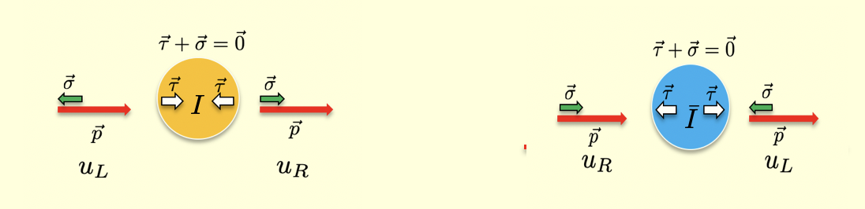
Nucleon intrinsic quark spin

Slide 21
Ji Spin sum rule

Slide 22
Mass FFs

Slide 23
Mass and Spin and FFs

Slide 24
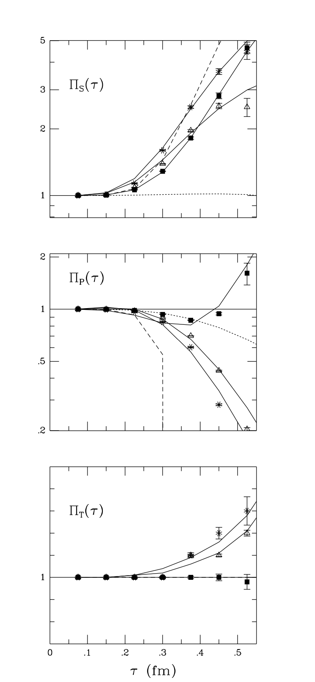
Glueballs: S,P,T
FF
FF
Schafer-Shuryak 95’

Slide 25
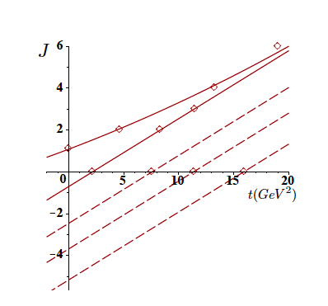
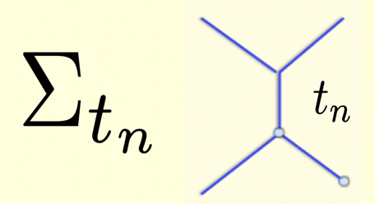
Glueball Regge and Resonance Dual Model

Slide 26
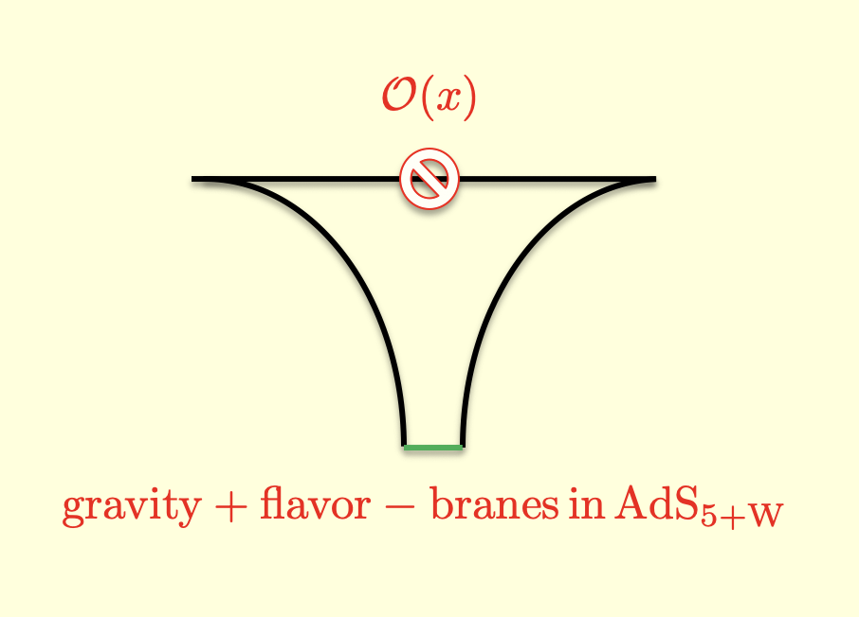
Holography as a string/Field theory!

Slide 27
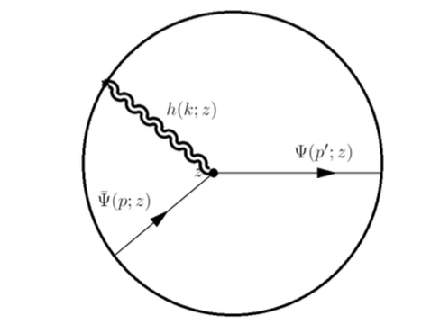
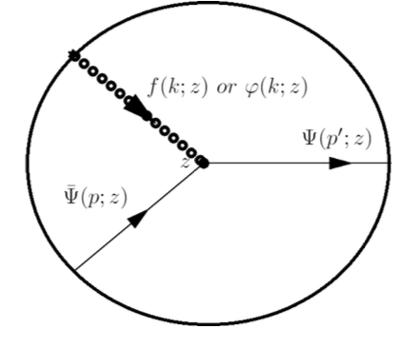
Gravitational FF in Holography
Spin-2 :
Spin-0 :

Slide 28
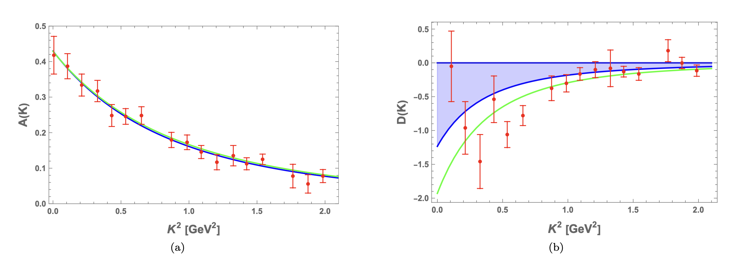
Gravitational FF : holography vs lattice

Slide 29
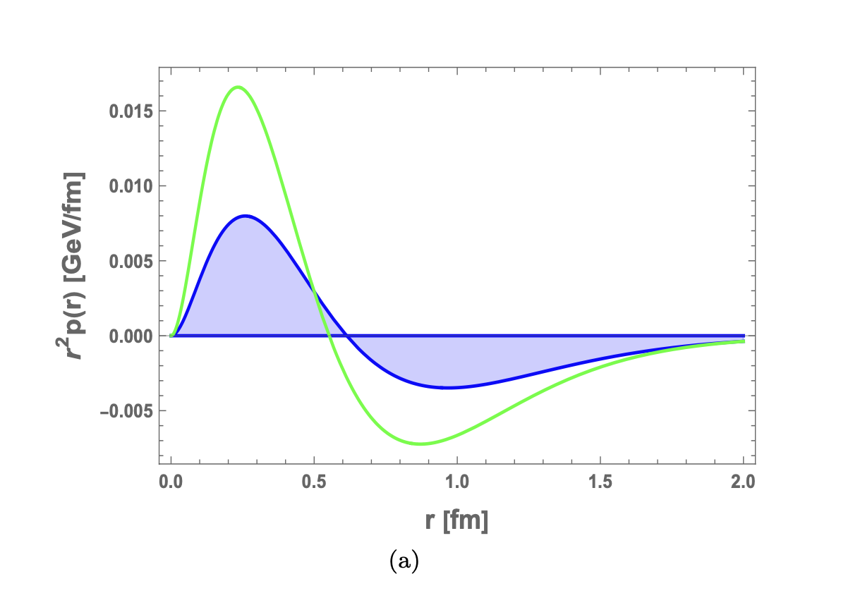
Genealogy of D=4C-term and Pressure
Negative!
Tripole!

Slide 30
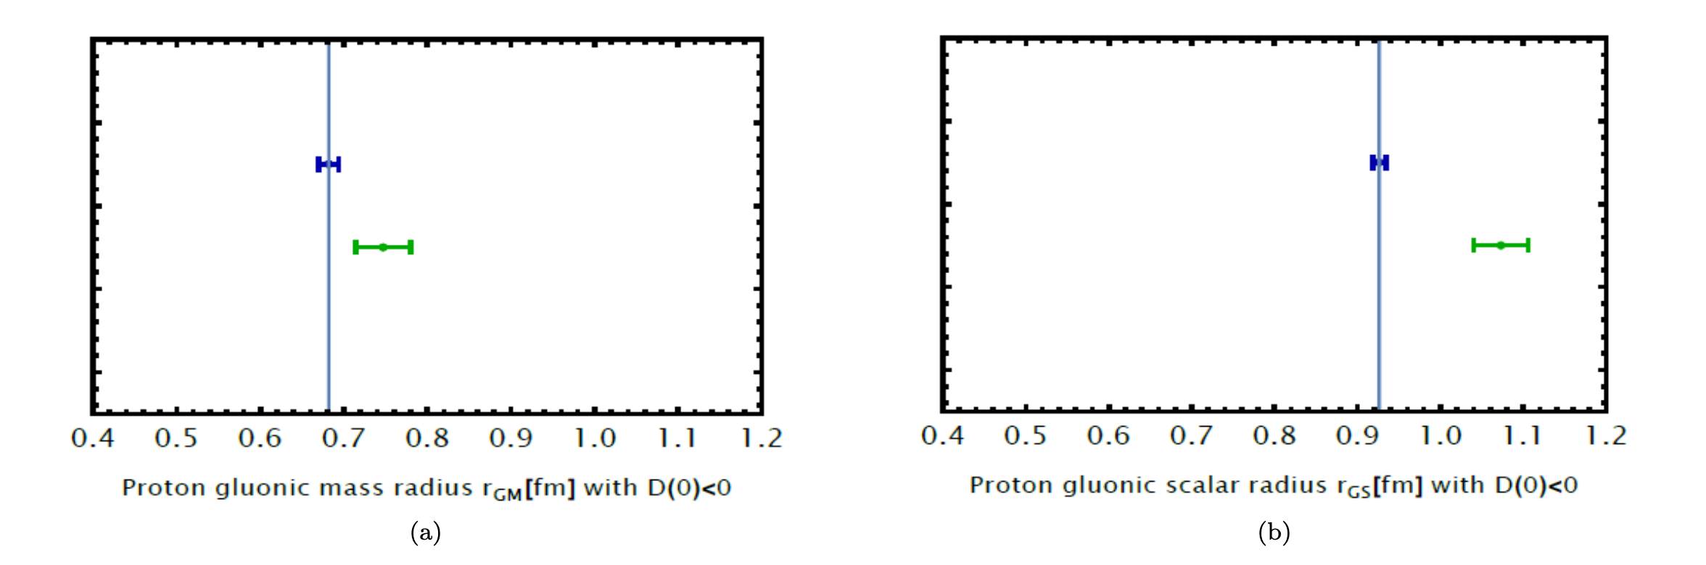
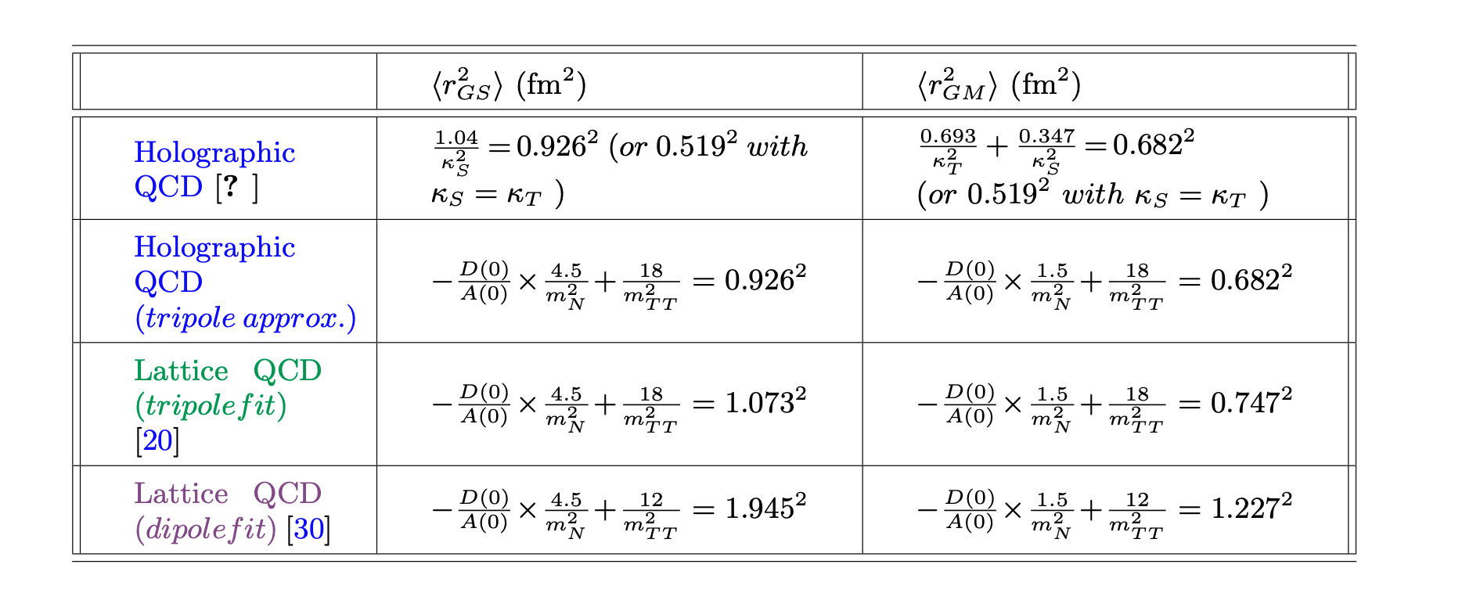
Gravitational radii

Slide 31
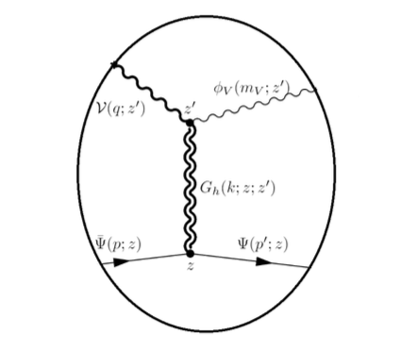
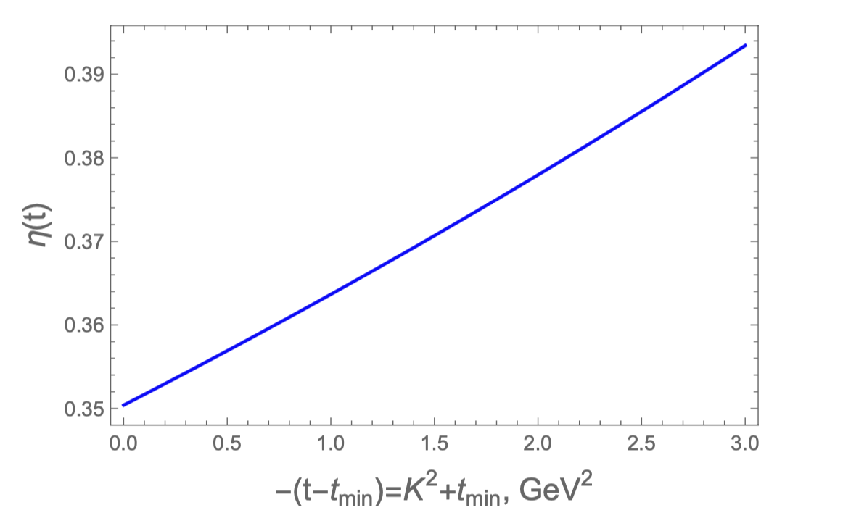
A and D accessible to

Slide 32
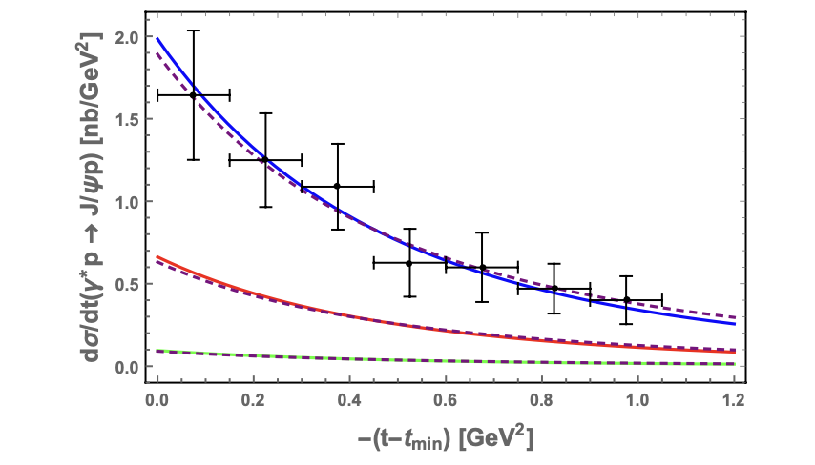
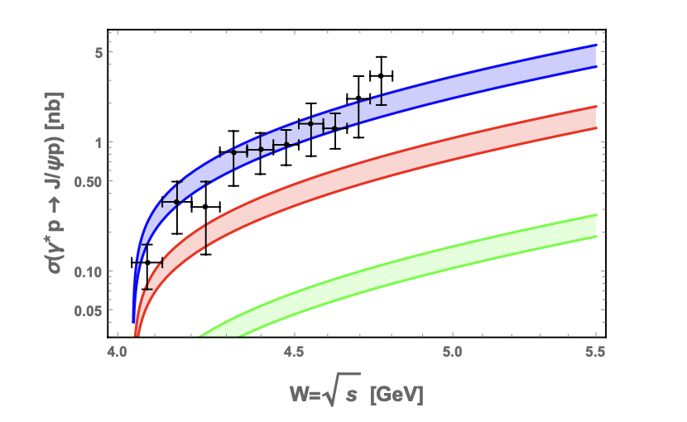
A Measured by GlueX!

Slide 33
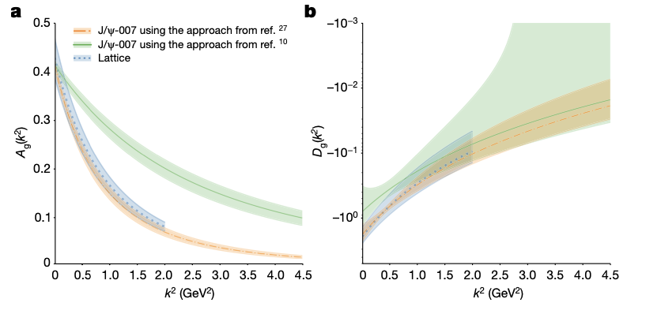
A,D Measured by J/Psi-007!
J/Psi-007 23’

Slide 34
Summary
Vacuum : topologically active
Spin : topo-susceptibility
Mass : topo-compressibility
Mass FF : accessible a JLab

