Slide 1

Generalized Parton Distributions through Universal Moment Parameterization (GUMP): Towards global analysis at non zero skewness
M Gabriel Santiago
With Yuxun Guo, Xiangdong Ji, Kyle Shiells and Jinghong Yang
JHEP 05 (2023) 150,
arXiv:2302.07279

Slide 2
Outline
GPD Review
GUMP Program
  Conformal moment parameterization
First Step Towards Global Analysis: u and d quarks
  Simplified GPD moment ansatz
  Experimental and lattice input
Non-zero Skewness Global Fit
GPD Extraction
  Ambiguity in the ERBL/DA-like region
  D-terms vs DA-like terms
Moving Forward
Conclusions

Slide 3

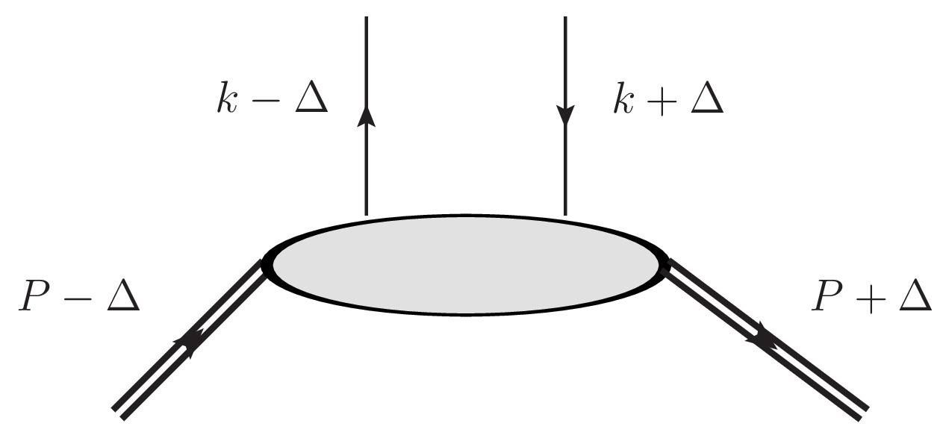
GPDs
GPDs generalize the well known PDFs to encode full 3 dimensional information on the quarks and gluons within hadrons

Slide 4
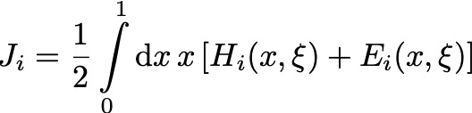
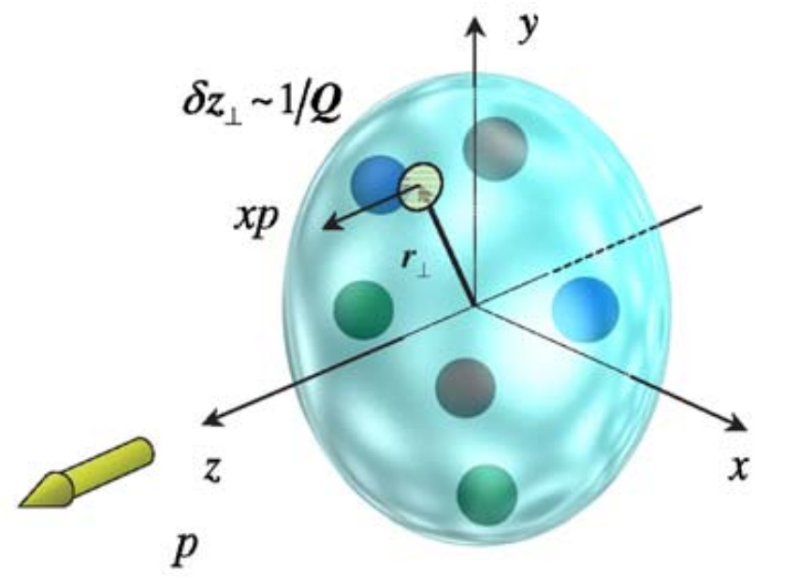

GPDs
Polarization of the hadron and its parton constituents connects GPDs to the distribution of angular momentum within hadrons (X. Ji 1997)
  Ji sum rule
Related via a Fourier transform to the impact parameter distribution of partons (M. Burkardt 2003)
Related to bulk properties of hadron states encoded in form factors

Slide 5
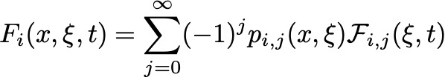
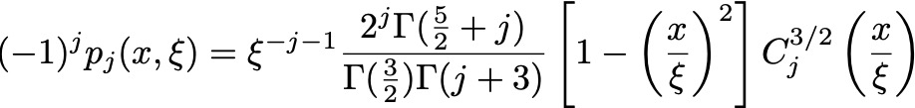
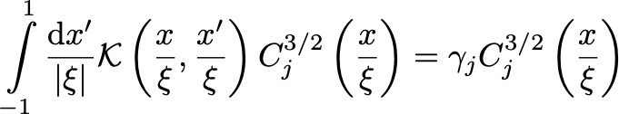
GUMP program: Moment Parameterization
Parameterize GPDs by directly parameterizing their conformal moments
Expansion based on eigenfunctions of evolution – Gegenbauer polynomials
(D. Mueller and A. Schafer 2006)
conformal wave function
GPD evolution kernel

Slide 6
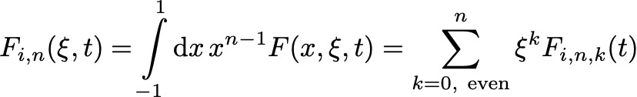
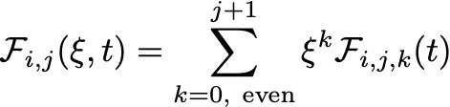
GUMP program: Moment Parameterization
Conformal moment parameterization has nice features for fitting GPDs
  Simple evolution implementation – conformal moments are multiplicatively renormalized at LO
    Follows from using eigenfunctions of evolution kernel
  Polynomiality condition (X. Ji 1998) automatically enforced on conformal moments

Slide 7


First Step Toward Global GPD Analysis
Apply in GUMP program for global analysis of u and d quark GPDs at non-zero skewness with LO scale evolution
Parameterize each GPD moment with five parameters
Take each moment to be a power series in skewness – polynomiality condition
$$β\left(t\right)=e^{−b\left|t\right|}$$
Euler Beta Function
Regge trajectory

Slide 8
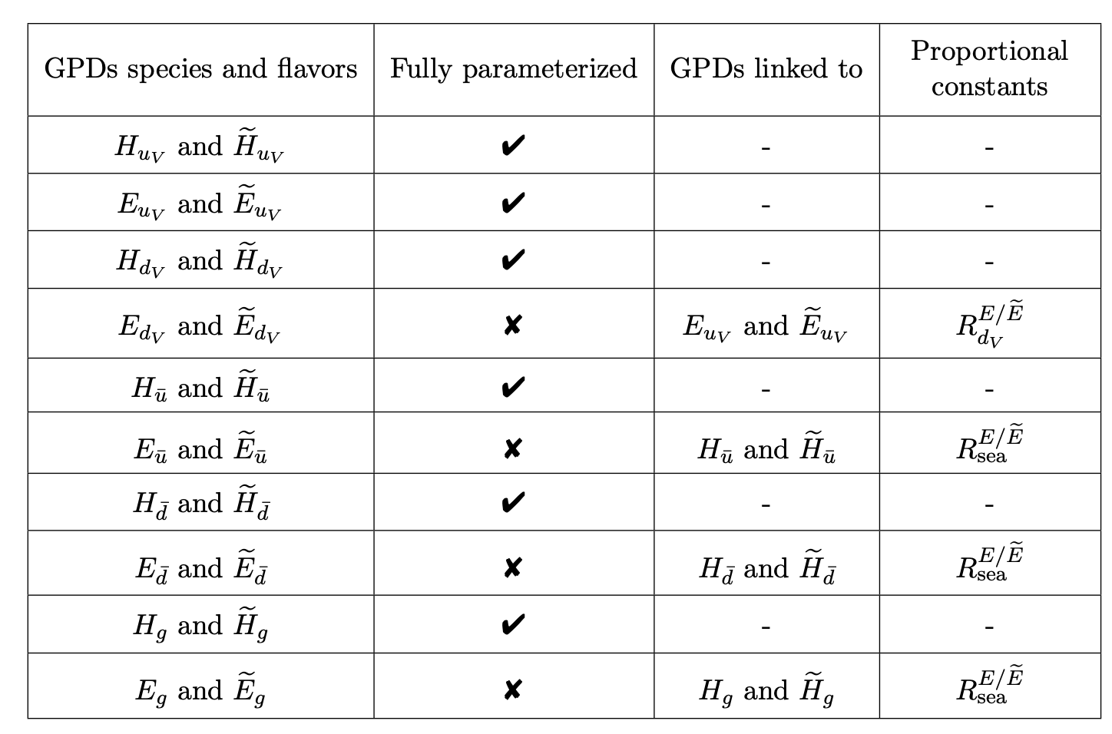
First Step Toward Global GPD Analysis
The number of parameters needed for modelling all the species of GPD grows very quickly
We impose extra constraints for simplicity

Slide 9

Non-zero Skewness Global Fit
Even with constraints, lots of parameters!
  Very high dimensional space to navigate for best fit
  Very computationally demanding to do error propagation
We employ a sequential fit, starting with forward (PDF, t-dependent PDF) constraints for each GPD species then apply the off-forward constraints from DVCS data

Slide 10
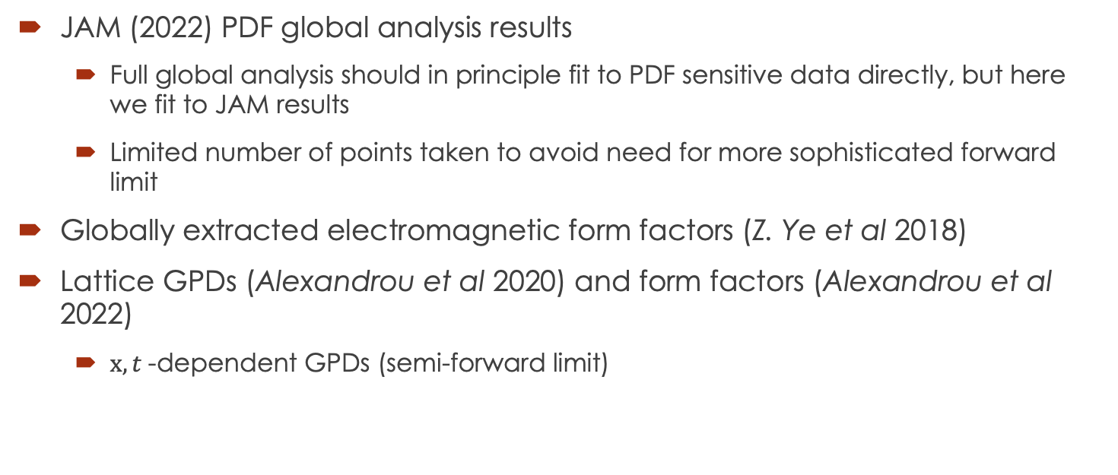
Semi-Forward Inputs
JAM (2022) PDF global analysis results
  Full global analysis should in principle fit to PDF sensitive data directly, but here we fit to JAM results
  Limited number of points taken to avoid need for more sophisticated forward limit
Globally extracted electromagnetic form factors (Z. Ye et al 2018)
Lattice GPDs (Alexandrou et al 2020) and form factors (Alexandrou et al 2022)
  $x,t$-dependent GPDs (semi-forward limit)

Slide 11
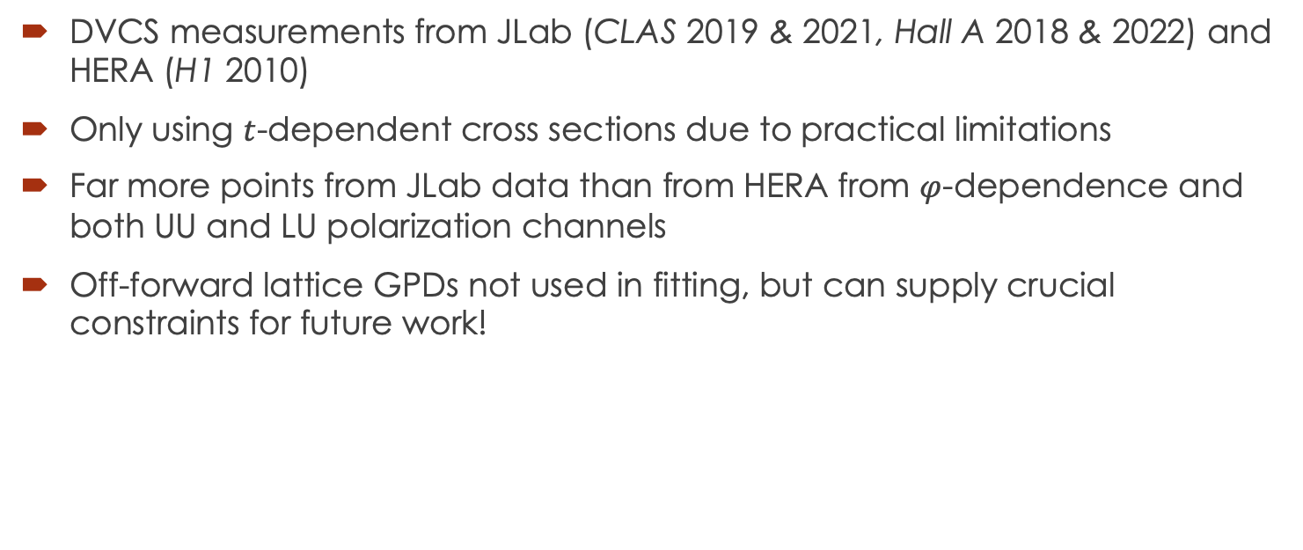
Off-Forward Inputs
DVCS measurements from JLab (CLAS 2019 & 2021, Hall A 2018 & 2022) and HERA (H1 2010)
Only using $t$-dependent cross sections due to practical limitations
Far more points from JLab data than from HERA from $φ$-dependence and both UU and LU polarization channels
Off-forward lattice GPDs not used in fitting, but can supply crucial constraints for future work!

Slide 12
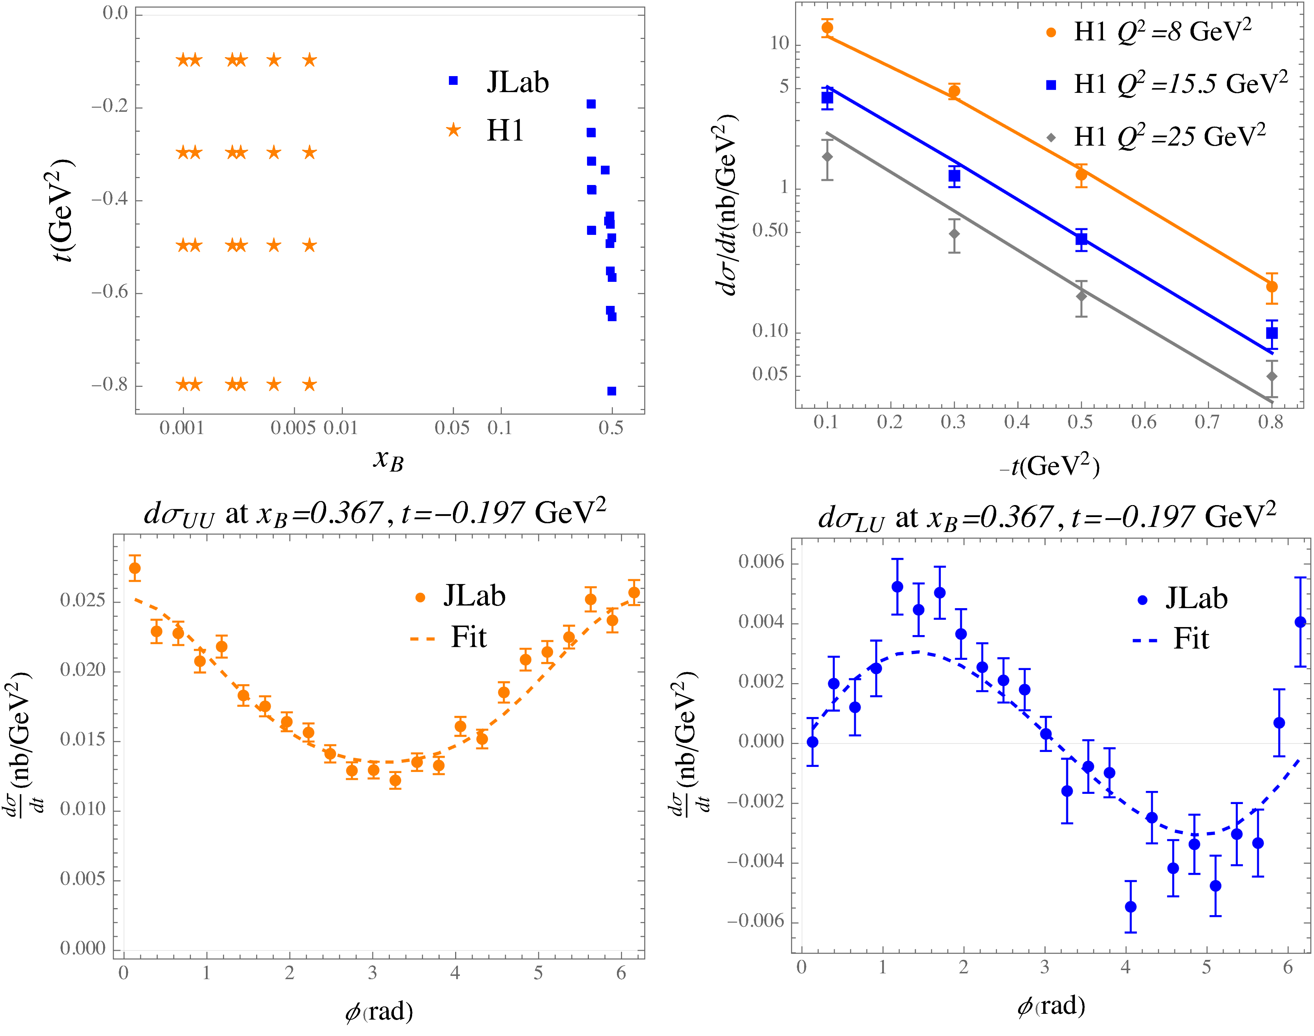
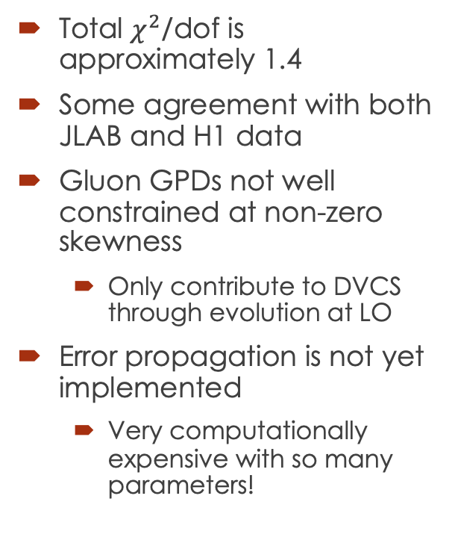
Non-zero Skewness Global Fit
Total $χ^{2}$/dof is approximately 1.4
Some agreement with both JLAB and H1 data
Gluon GPDs not well constrained at non-zero skewness
  Only contribute to DVCS through evolution at LO
Error propagation is not yet implemented
  Very computationally expensive with so many parameters!

Slide 13
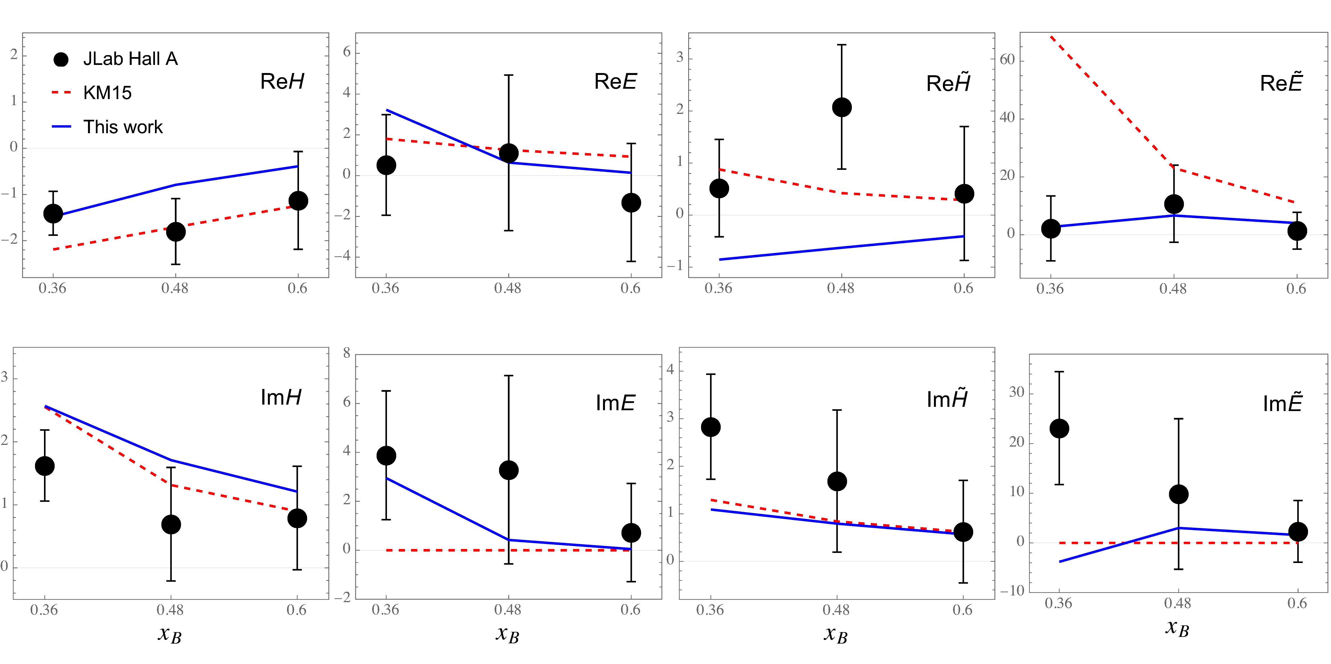
Non-zero Skewness Global Fit
CFFs from fit are mostly consistent with local extraction from JLAB Hall A data as well as KM15 extractions
Some inconsistencies can be expected from degeneracies in CFF contribution to cross sections – need more polarization configurations!

Slide 14
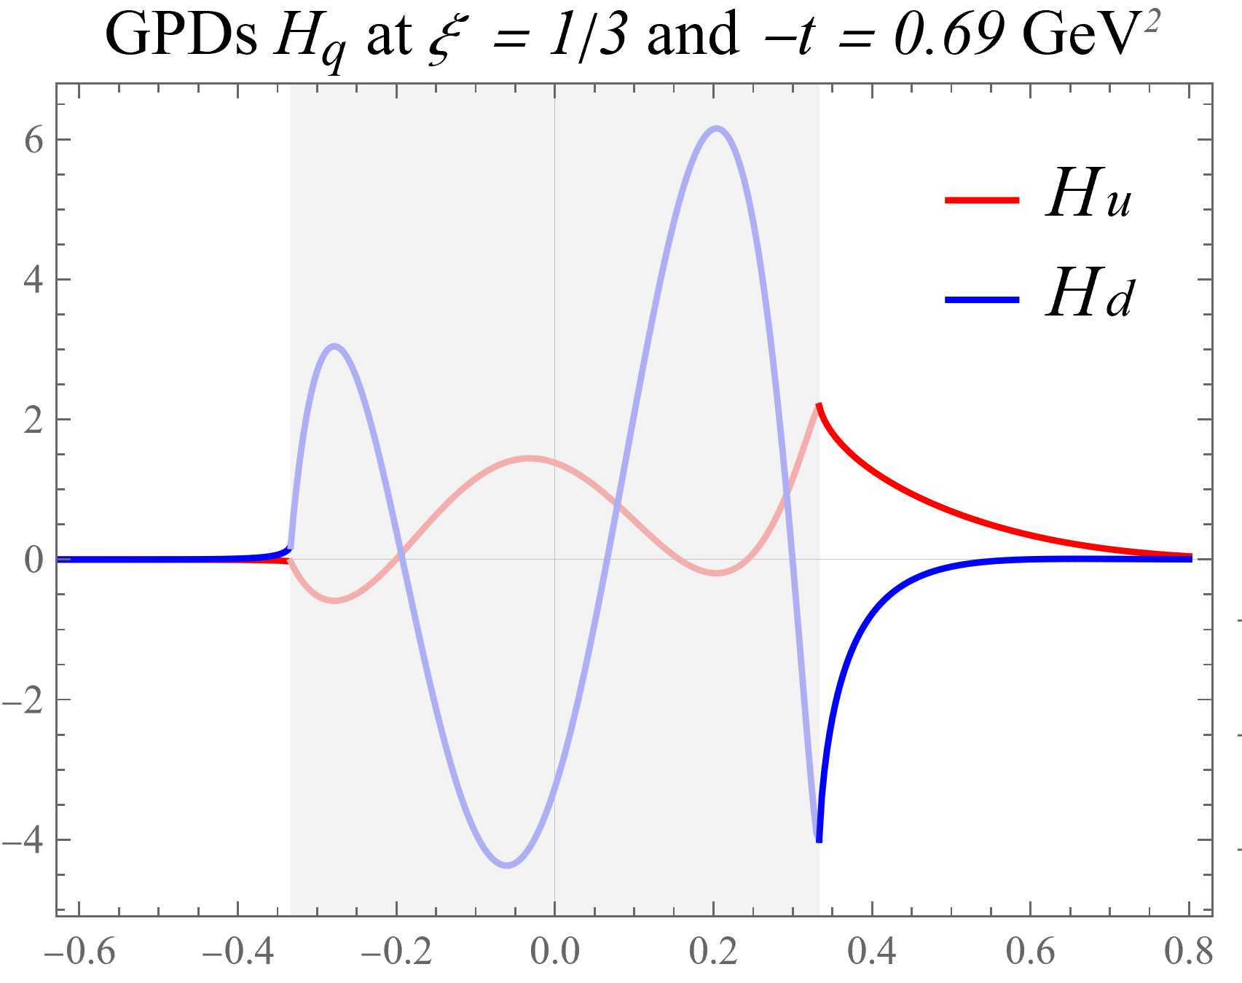

Extracted GPDs
GPDs are mostly constrained on the $ξ=x$ line and in the DGLAP region $|ξ|<|x|$
ERBL region shows large oscillations which are characteristic of the Gegenbauer polynomials used in the moment expansion

Slide 15




Ambiguity in ERBL Region
We can add terms in the moment expansion which only contribute to the ERBL region
This suggests an interpretation of the GPDs in terms of quark and antiquark pieces as well as a ERBL region distribution amplitude (DA) piece
quark
antiquark
DA

Slide 16
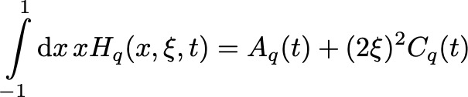
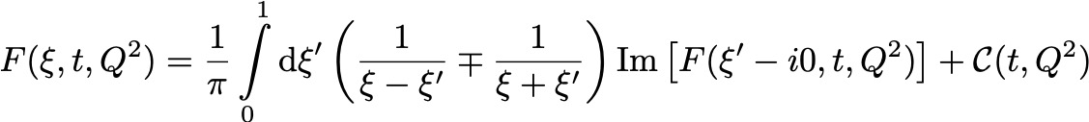
Connection to D-term
These DA terms don’t have a large affect on CFFs, but they do contain information related to the various D-terms in QCD, ex.
  Gravitational form factor C/D
  Dispersion relation subtraction term
By constraining the DA terms with further experimental data and lattice calculations, we can access the mechanical properties of hadrons contained in these D-terms!

Slide 17
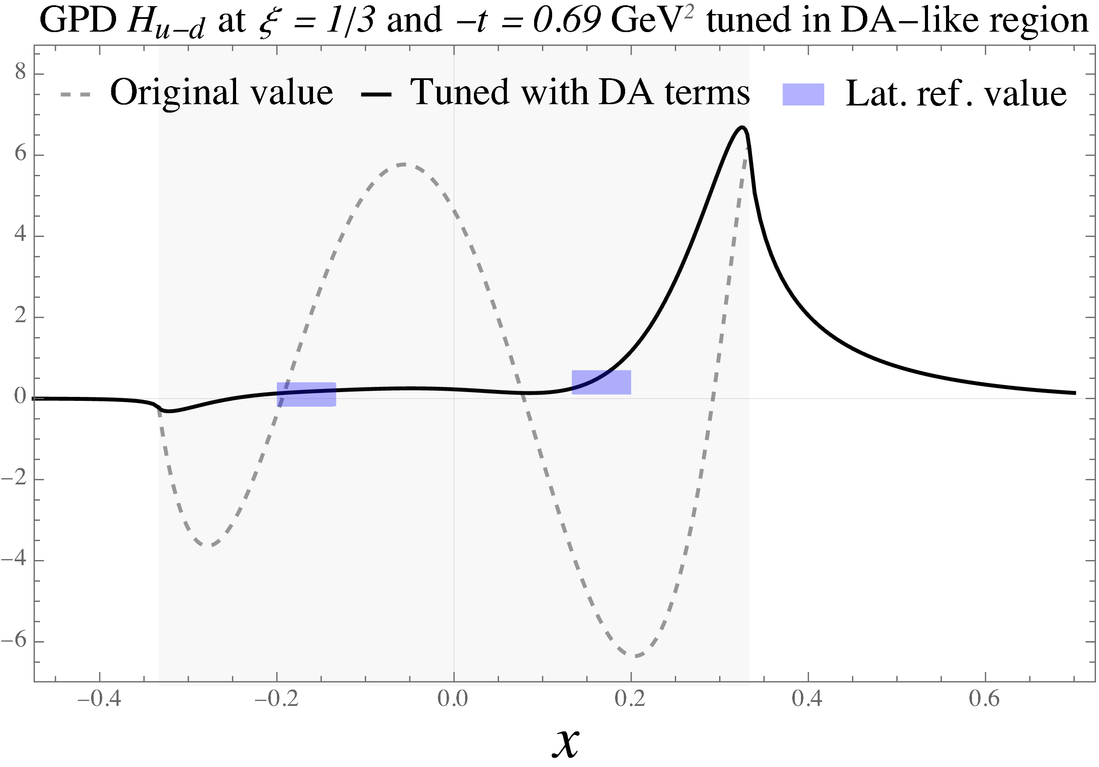
Constraining DA Terms
Adding in lattice GPD calculations can give us constrains directly in the ERBL region
Adding just a few terms to the moment expansion can remove the unphysical oscillations

Slide 18
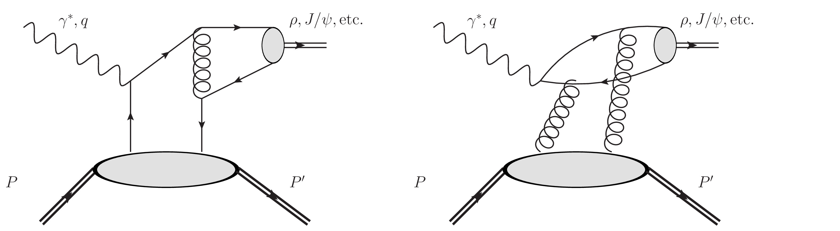
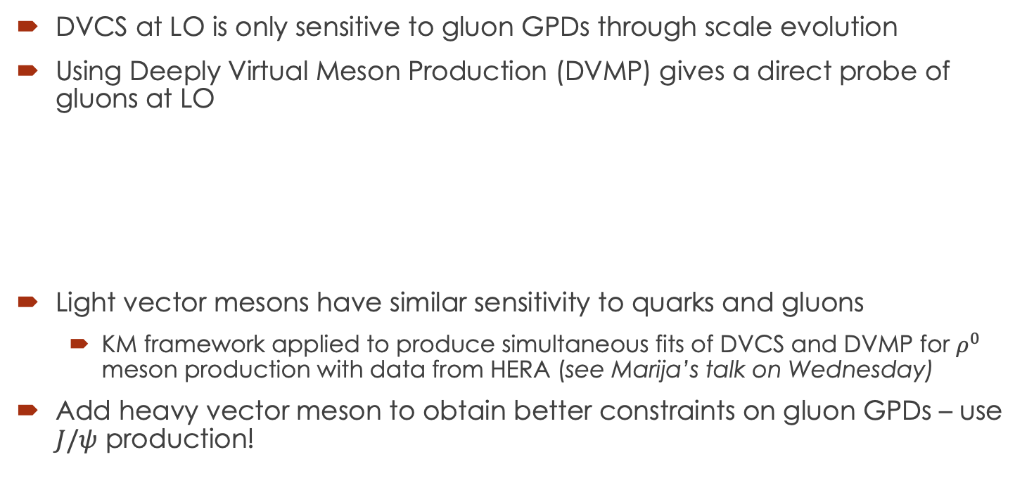
Moving Forward: Adding in Gluons!
DVCS at LO is only sensitive to gluon GPDs through scale evolution
Using Deeply Virtual Meson Production (DVMP) gives a direct probe of gluons at LO
Light vector mesons have similar sensitivity to quarks and gluons
  KM framework applied to produce simultaneous fits of DVCS and DVMP for $ρ^{0}$ meson production with data from HERA (see Marija’s talk on Wednesday)
Add heavy vector meson to obtain better constraints on gluon GPDs – use $J/ψ$ production!

Slide 19
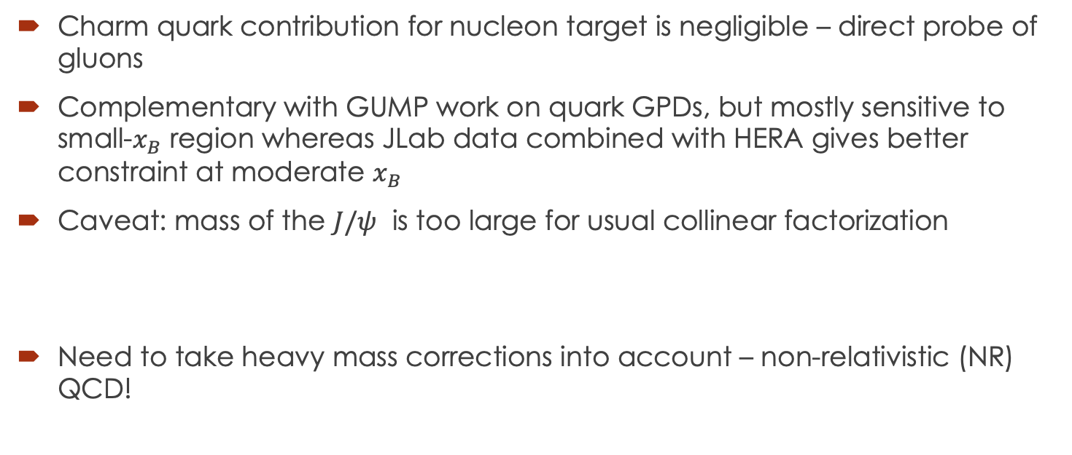

Deeply Virtual $J/ψ$ Production
Charm quark contribution for nucleon target is negligible – direct probe of gluons
Complementary with GUMP work on quark GPDs, but mostly sensitive to small-$x_{B}$ region whereas JLab data combined with HERA gives better constraint at moderate $x_{B}$
Caveat: mass of the $J/ψ$ is too large for usual collinear factorization
Need to take heavy mass corrections into account – non-relativistic (NR) QCD!

Slide 20

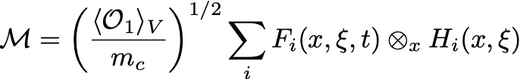
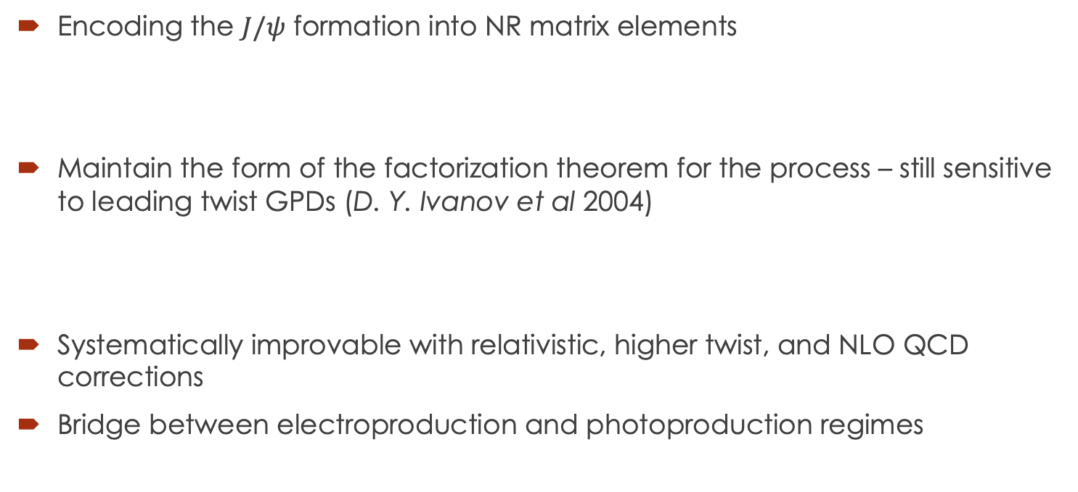
Non-relativistic model approach
Encoding the $J/ψ$ formation into NR matrix elements
Maintain the form of the factorization theorem for the process – still sensitive to leading twist GPDs (D. Y. Ivanov et al 2004)
Systematically improvable with relativistic, higher twist, and NLO QCD corrections
Bridge between electroproduction and photoproduction regimes

Slide 21
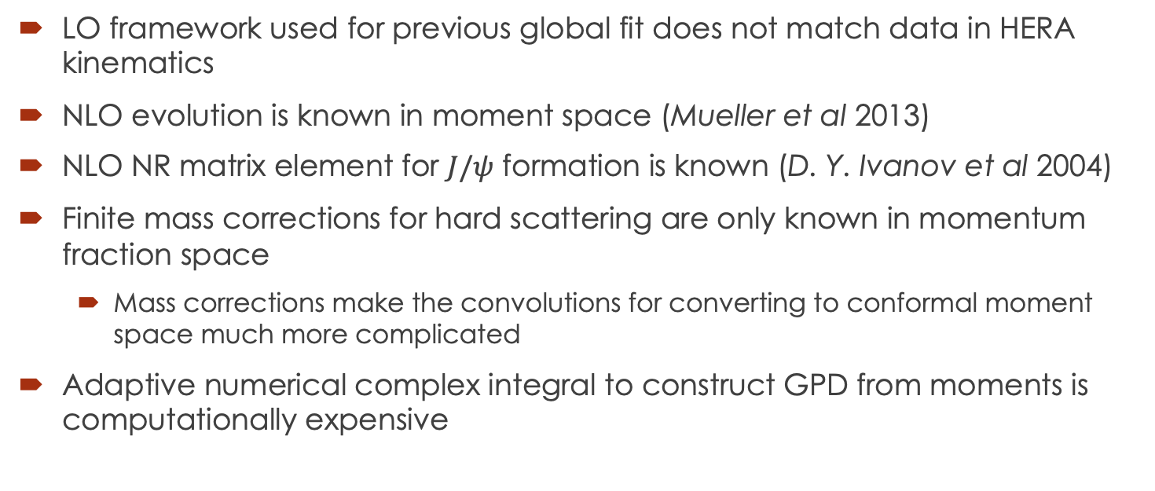

Implementing NR $J/ψ$ Production in GUMP
LO framework used for previous global fit does not match data in HERA kinematics
NLO evolution is known in moment space (Mueller et al 2013)
NLO NR matrix element for $J/ψ$ formation is known (D. Y. Ivanov et al 2004)
Finite mass corrections for hard scattering are only known in momentum fraction space
  Mass corrections make the convolutions for converting to conformal moment space much more complicated
Adaptive numerical complex integral to construct GPD from moments is computationally expensive

Slide 22
Implementing NR $J/ψ$ Production in GUMP
Implemented NLO evolution
  Corrections are large enough to fix scaling problems from LO!
Switching over to a fixed order integral evaluation allows significant reduction in computation time with < 1% extra numerical error
  Terms in the integral can now be memorized and only calculated a few times (as in Gepard)
Conversion of NLO finite mass hard scattering terms to moment space is on going

Slide 23
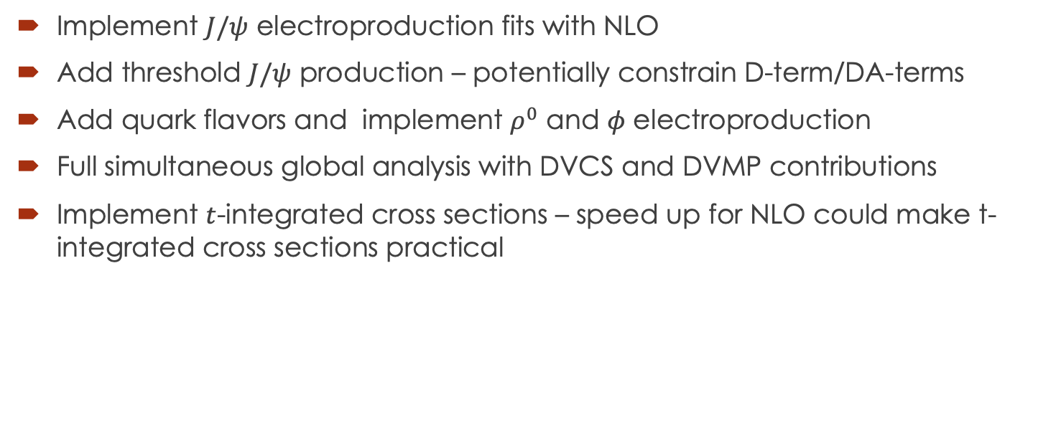
Future Improvements/Additions
Implement $J/ψ$ electroproduction fits with NLO
Add threshold $J/ψ$ production – potentially constrain D-term/DA-terms
Add quark flavors and implement $ρ^{0}$ and $φ$ electroproduction
Full simultaneous global analysis with DVCS and DVMP contributions
Implement $t$-integrated cross sections – speed up for NLO could make t-integrated cross sections practical

Slide 24
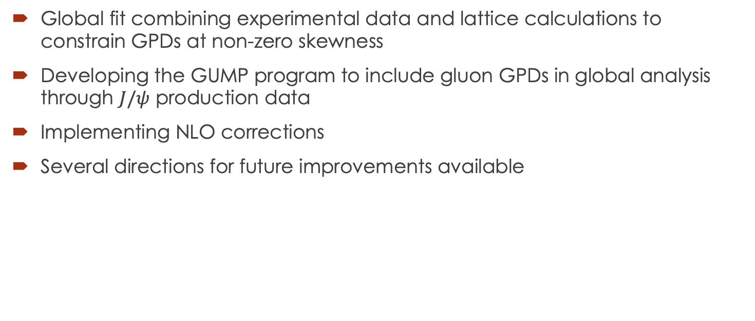
Conclusions
Global fit combining experimental data and lattice calculations to constrain GPDs at non-zero skewness
Developing the GUMP program to include gluon GPDs in global analysis through $J/ψ$ production data
Implementing NLO corrections
Several directions for future improvements available

Slide 25
Backup Slides

Slide 26
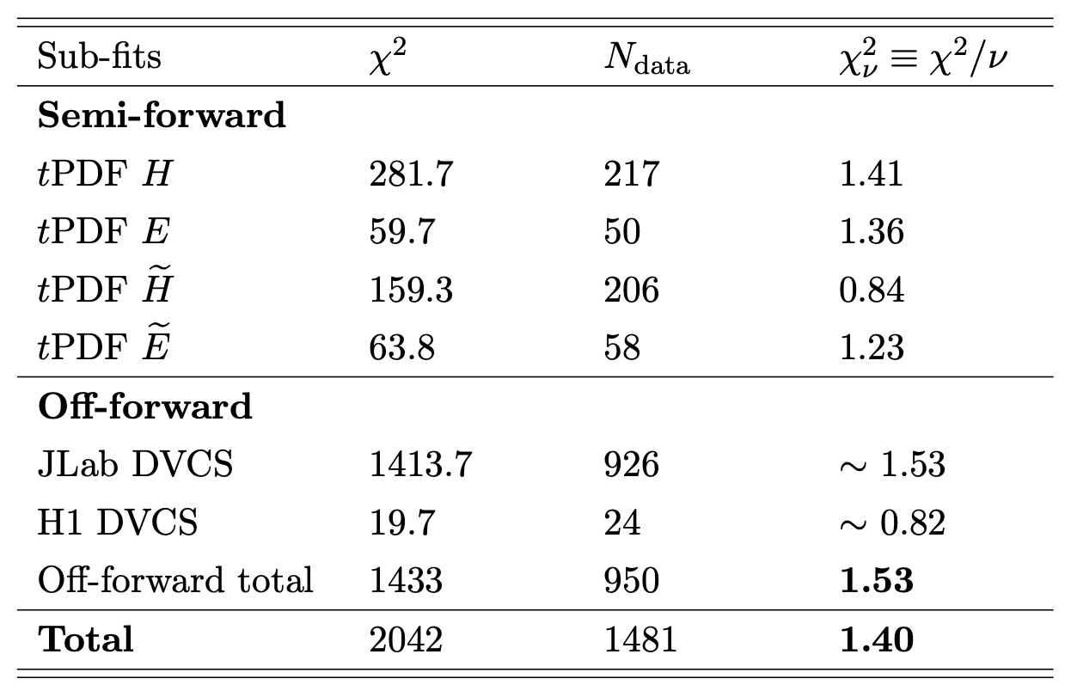

Best Fit $χ^{2}$ Breakdown

Slide 27
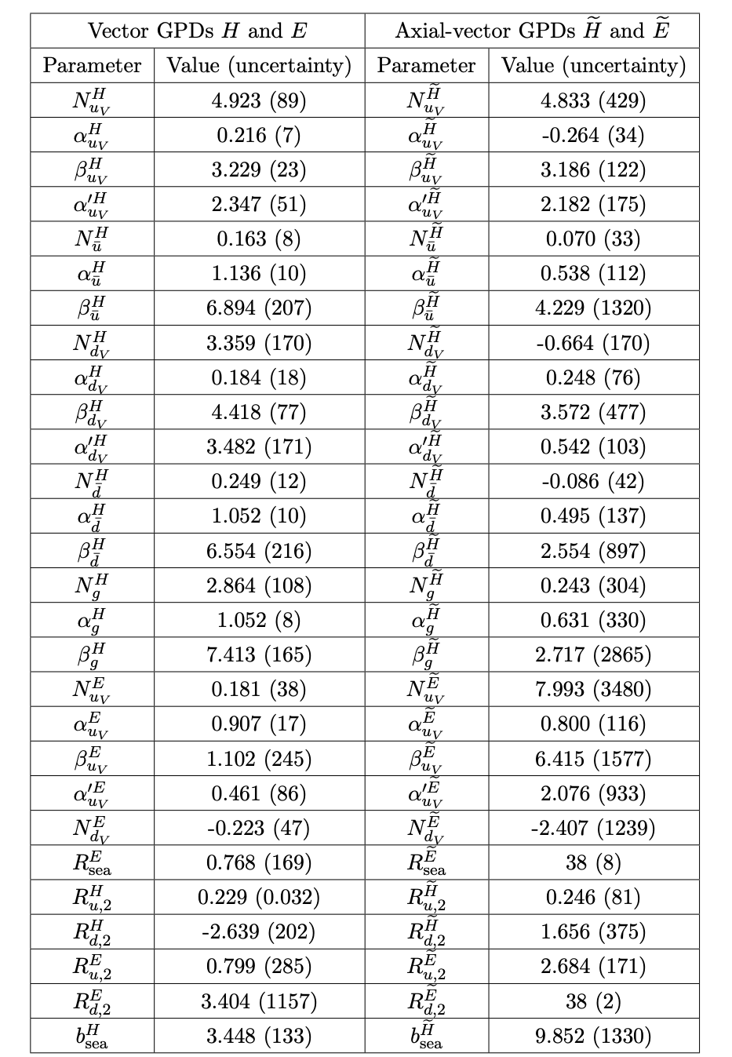
Best Fit Parameters

