Slide 1
Towards improved hadron femtography with hard exclusive reactions 2023
Alexandre Camsonne
Jefferson Laboratory Hall A

Slide 2
Modern hadronic structure
Hadronic structure through Deep Inelastic Scattering (1950s) : nucleons made of quarks and gluons
Spin crisis : spin of nucleon not simply spin of valence quarks
Nucleon is a dynamic system, raises many questions
Mass repartition
Motion of quarks and gluons inside nucleons : quark orbital momentum

Slide 3
New formalism and measurements
GPDs : exclusive reactions ( DVCS, DVMP )
Generalization of concept of parton distributions and form factor
TMDs : semi-inclusive reactions
Transvere Momentum Distributions in Nucleon
J/ψ at threshold gives access to gluons
Form factors and DIS measurements also contributes to GPDs ( limit cases )

Slide 4
Workshop goal
Discussion about how to access GPDs
Which processes in addition to DVCS can contribute the most to the GPDs extraction
Future measurements and upgrade
EIC, positron, 22 GeV

Slide 5
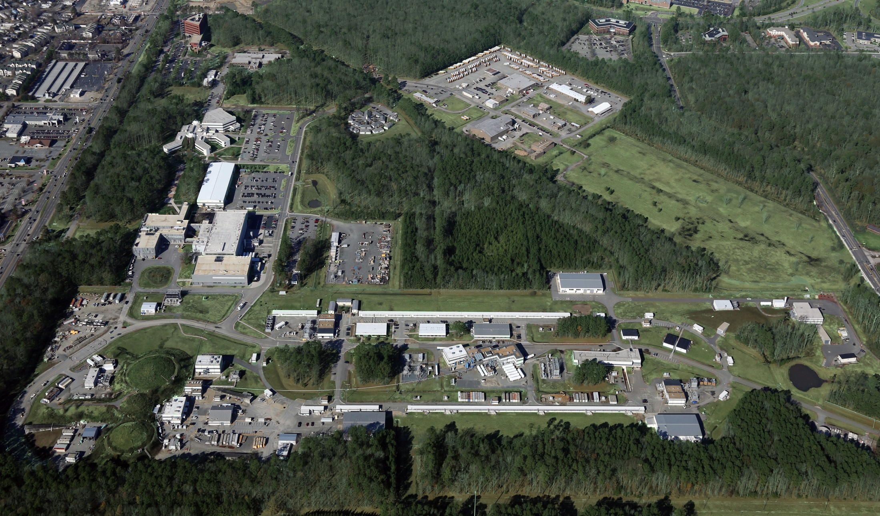
Overview of Jefferson Lab
Created to build and operate the Continuous Electron Beam Accelerator Facility (CEBAF), world-unique user facility for Nuclear Physics
Jefferson Lab Stats: Located in Newport News, Virginia 169 acre site In operation since 1995 ~700 employees 1,694 Active Users (FY21) 1/3 of Users are from non-US Institutions, from 37 countries >650 PhDs granted to-date On average 30% of US PhDs in nuclear physics FY2016 Costs: $184.1M (~2/3 operations, ~1/3 new construction)
Hall D
Hall A
Hall B
Hall C
~0.5 kilometer
What is the role of gluonic excitations in the spectroscopy of light mesons? Can these excitations elucidate the origin of confinement?
Can we reveal a novel landscape of nucleon and nuclear substructure through measurements of new multidimensional distribution functions?
Can we discover evidence for new physics beyond the Standard Model?
5

Slide 6
CEBAF at Jefferson Lab
INJECTOR
LINAC
RECIRCULATION ARCS
D
1
2
3
A
3
2
B
C
CEBAF Upgrade completed in September 2017
CW electron beam
E_{max} = 12 GeV
I_{max} = 90 μA
Pol_{max} = 90%
Nuclear experiments at ultra-high luminosities, up to 10³⁹ electrons-nucleons /cm²/ s
World-record polarized electron beams
Highest intensity tagged photon beam at 9 GeV
Ability to deliver a range of beam energies and currents to multiple experimental halls simultaneously
Unprecedented stability and control of beam properties under helicity reversal
CEBAF World-leading Capabilities
Commissioning:
April 2014: hall A
October 2014: hall D
February/March 2017: halls C & B

Slide 7
Jefferson Lab’s Science and Technology Vision
Experimental Nuclear Physics at CEBAF
Electron-Ion Collider
Technology Development
Advanced Computing
CEBAF operation at > 30 weeks/yr supporting 1,700 annual users
Nuclear Physics research
MOLLER Project
SoLID Proposal
Future upgrade opportunities
EIC Project Partnership with BNL
Engagement/leadership in EIC scientific program
Accelerator component production for DOE/SC projects
R&D in superconducting accelerators, detectors, isotopes
Vision for world-leading computational program
Growth in data science, artificial intelligence, quantum computing research
Exploring potential in close coordination with Office of Science
Nuclear Physics spans the whole program at Jefferson Lab

Slide 8
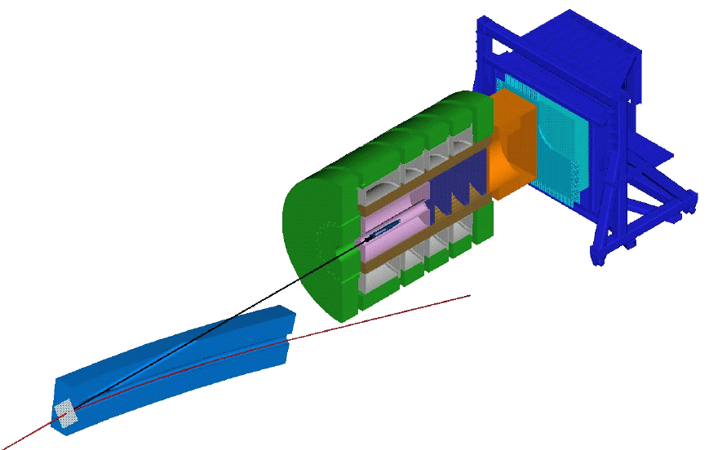
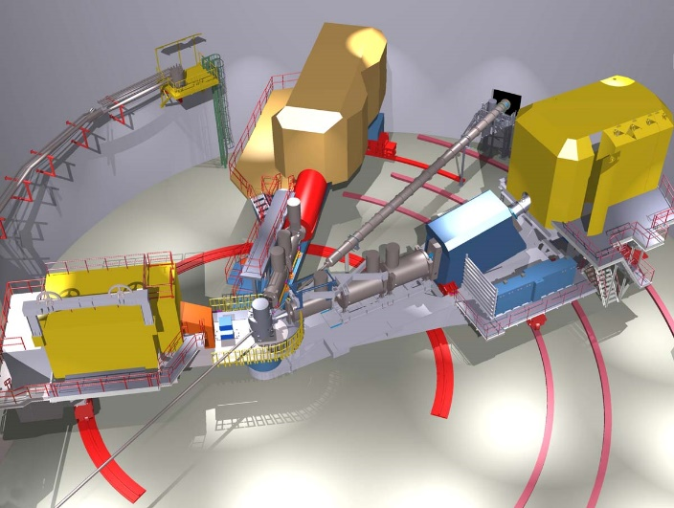
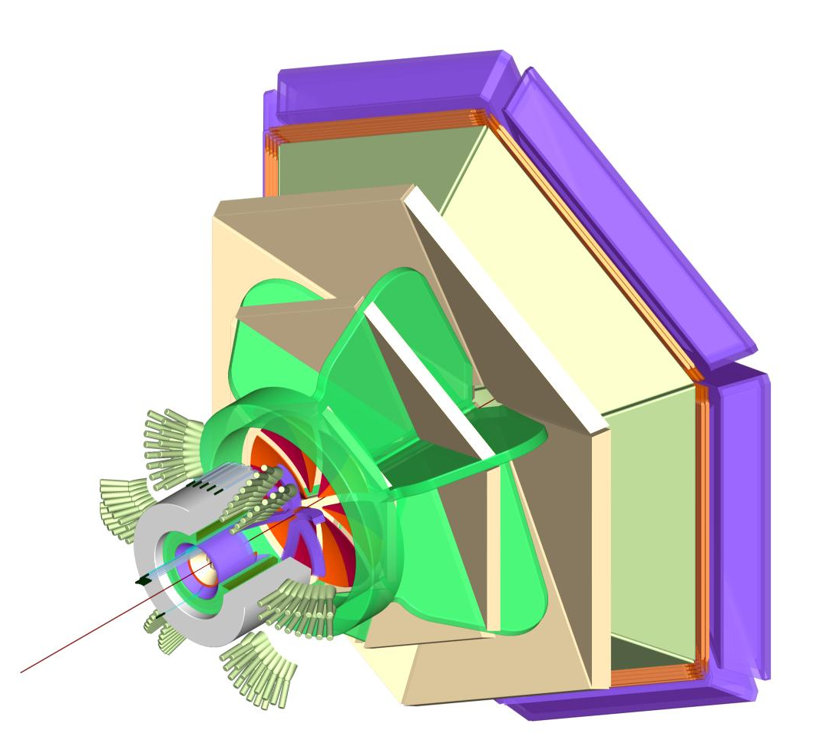
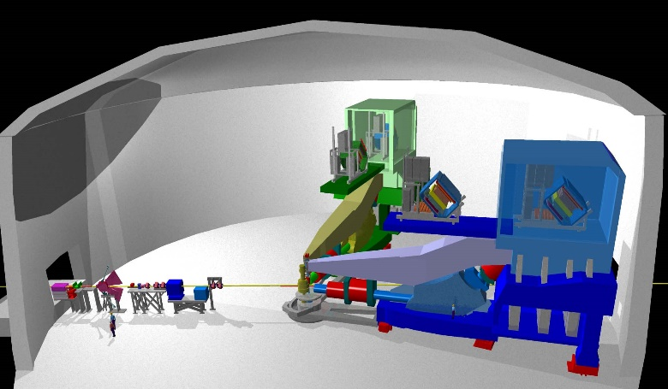
JLab 12GeV experimental halls
D
C
9 GeV tagged polarized photons and a 4π hermetic detector
Super High Momentum Spectrometer (SHMS) at high luminosity and forward angles
B
A
Retain HRS Pair for continuation of research in which resolution comparable to nuclear level spacing is essential. Use Hall to stage “one-of-a-kind” specialized experiments requiring unique apparatus.
CLAS upgraded to higher (10³⁵ cm⁻²s⁻¹) luminosity and coverage

Slide 9
Sessions
Experimental facilities and new experiments
Theory / phenomenology
Compton-like reactions
Meson structure
Hard exclusive meson production
Transition GPDs
Theoretical activities and centers / new theory idea and future facilities
Polarized targets and new observables

Slide 10
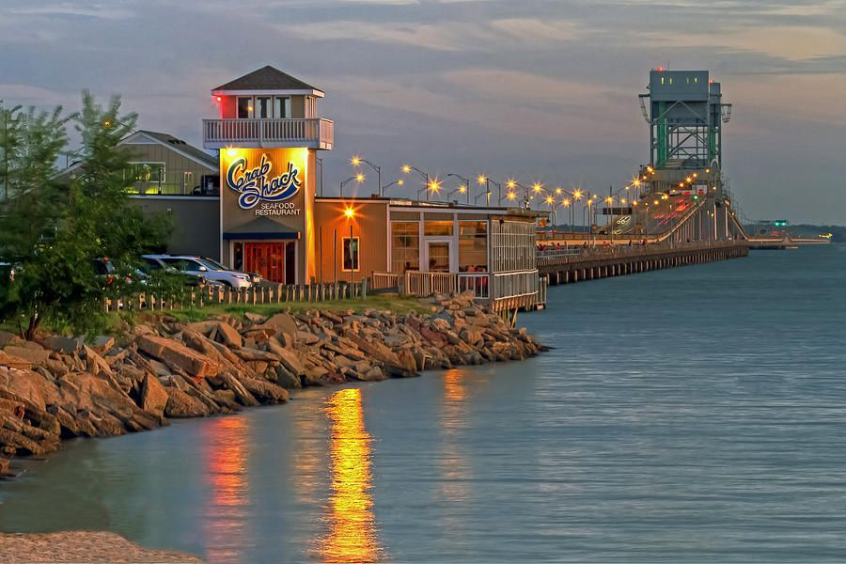
Please fill the google form for dinner at Crab Shack Wednesday
https://docs.google.com/forms/d/e/1FAIpQLScMcw9JPBPerLEXYXx-MvyjFvHvUoBCpXLrKnizQNtmLf9f-Q/viewform?usp=sf_link
(if you did,
you are fine)
Contact us if you have extra guests

Slide 11
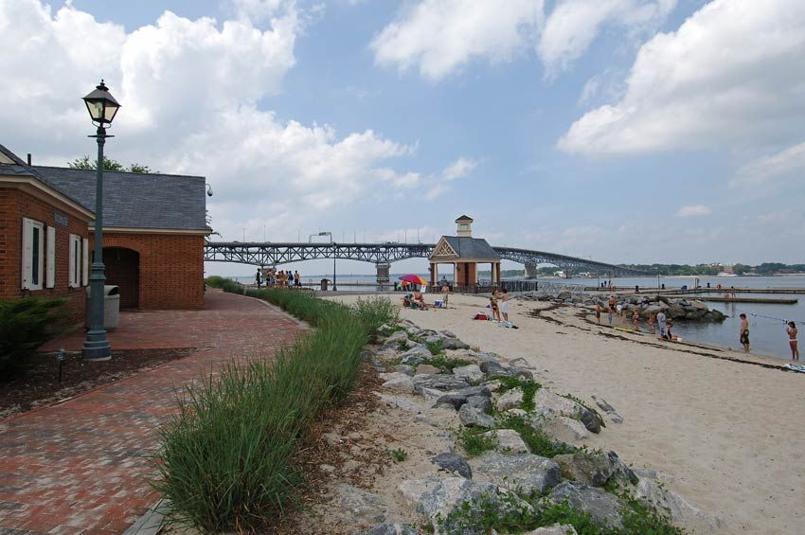
Fill the form also for Wednesday social (4 PM - evening)
https://docs.google.com/forms/d/e/1FAIpQLScpdBoLnpiomIs69f1S_UAlCQK9wu0fyzsyRQqYaKvdnqZp8w/viewform?usp=sf_link
- museum (4-5 PM)
- trail along the beach
or trail in the park
(time TBD)
- beach (anytime)
- picnic (after 7 PM)
- other: let us know

Slide 12
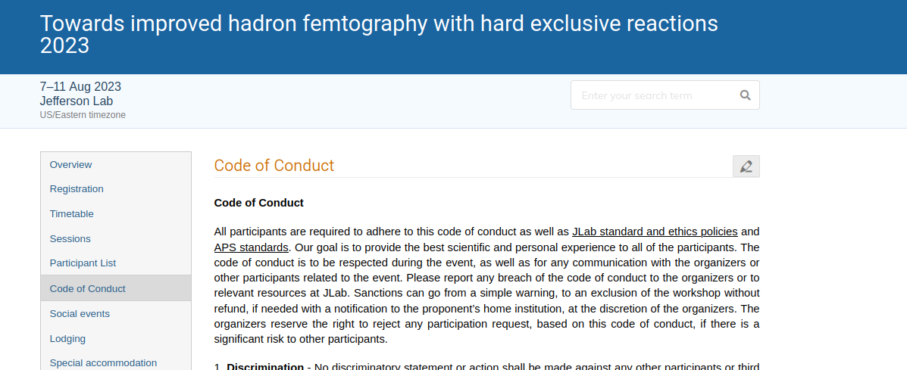
Code of conduct
https://indico.phys.vt.edu/event/58/page/46-code-of-conduct
- Not to annoy anyone, but to protect us and ensure that we all get a good experience out of this event
- If you are here: you read and all agreed to follow it

Slide 13
Please register if you aren’t yet!
https://indico.phys.vt.edu/event/58/registrations/28/
Networking session tonight at Residence facility

