Slide 1
Tautochrone and Brachistochrone
Tatsu Takeuchi
Virginia Tech
March 16, 2024 @ Chesapeake Section of the AAPT
spring 2024 Meeting @ Delaware state University

Slide 2
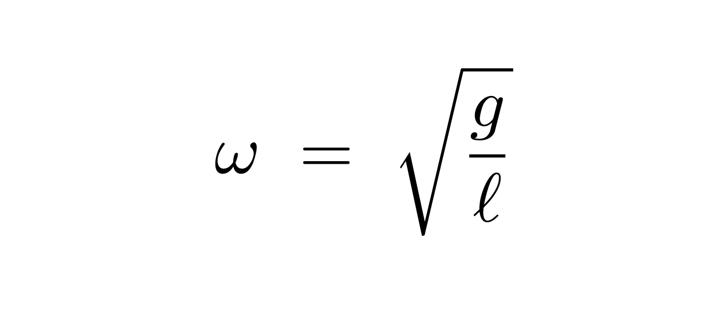
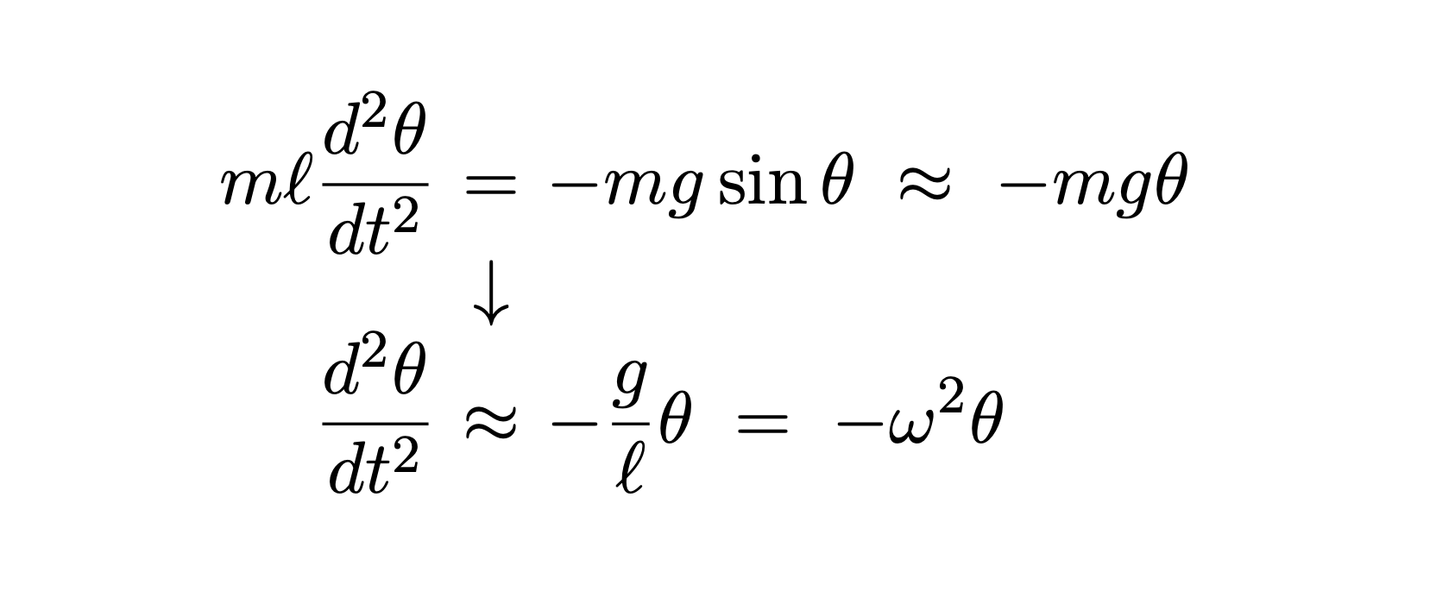
Angular frequency of a simple pendulum:
In our intro physics courses, we tell our students that a simple pendulum undergoes simple harmonic oscillation with angular frequency
But this is only true in the small angle approximation:
In reality, the frequency will depend on the amplitude
→ Cannot be used for time keeping!

Slide 3
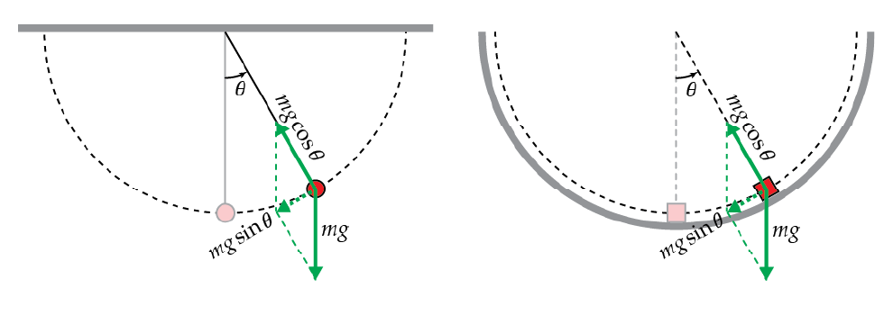
The tautochrone problem:
The motion of the pendulum bob is the same as that of the mass that slides frictionlessly along a semi-circular track
Can the mass be made to undergo simple harmonic oscillation by an appropriate choice of track shape?

Slide 4
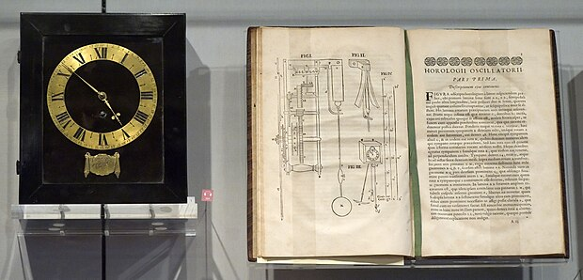
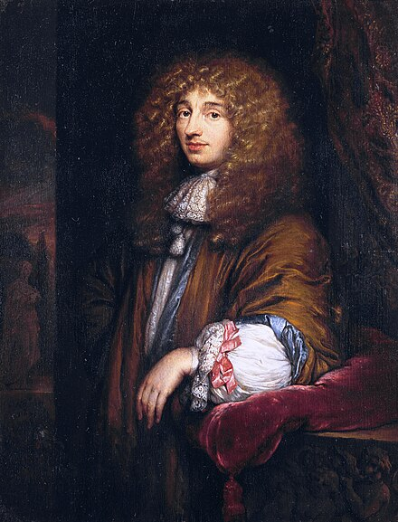
Solution Found by Christiaan Huygens (1629-1695)
Solution found by Huygens in 1659
Published in his book Horologium Oscillatorium (The Pendulum Clock) in 1673

Slide 5
Cycloid

Slide 6
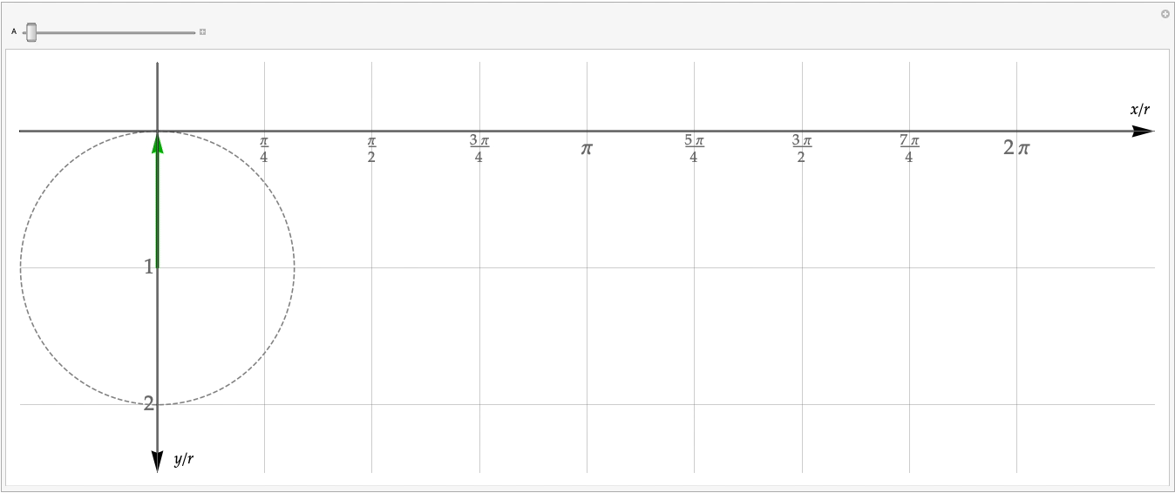
Cycloid

Slide 7
Can a pendulum bob be made to follow a cycloid?

Slide 8
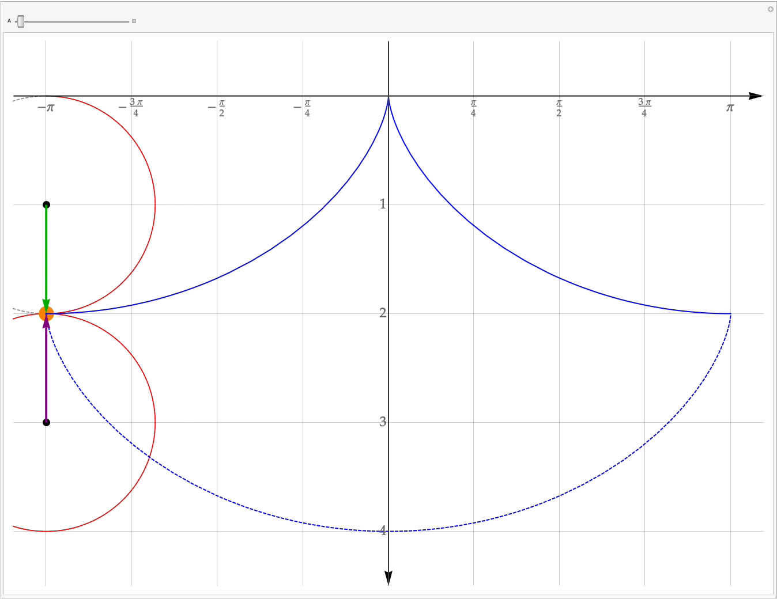
Can a pendulum bob be made to follow a cycloid?

Slide 9
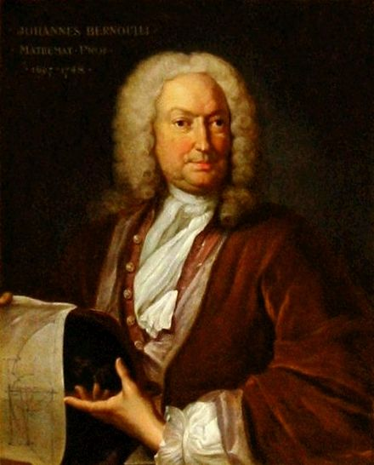
The Brachistochrone problem:
An object slides from point A to point B along a frictionless track. (A is located higher than B.)
What should the shape of the track be to make the time it takes for the object to slide from A to B the shortest?
Posed by Johann Bernoulli (1667-1748) in 1696.

Slide 10
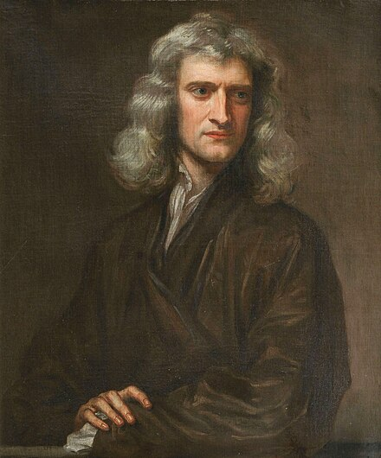
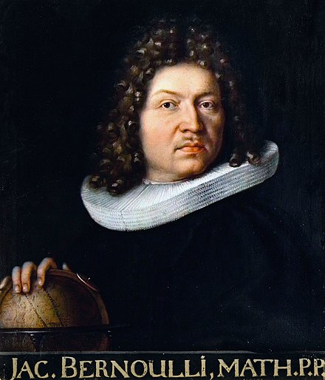
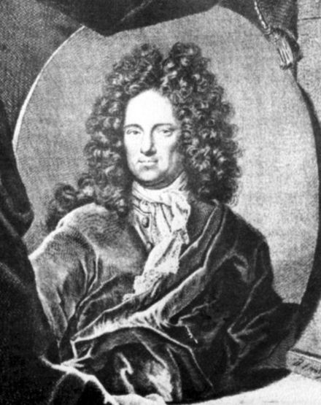
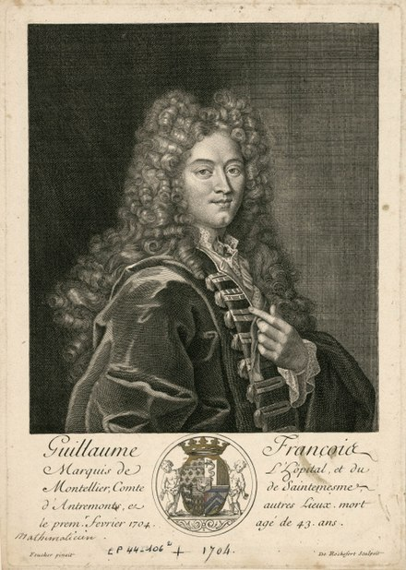
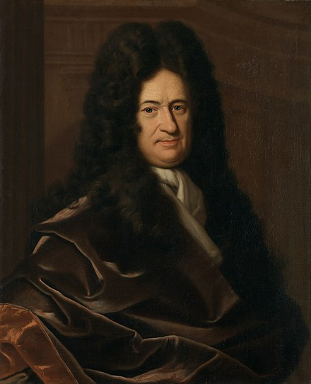
Solution Found by:
Sir Isaac Newton (1642-1727)
Jakob Bernoulli (1655-1705, Johann's brother)
Gottfried Wilhelm Leibniz (1646-1716)
Ehrenfried Walther von Tschirnhaus (1651-1708)
Guillaume de l’Hôpital (1661-1704)

Slide 11
Cycloid
Object starts sliding at the origin

Slide 12
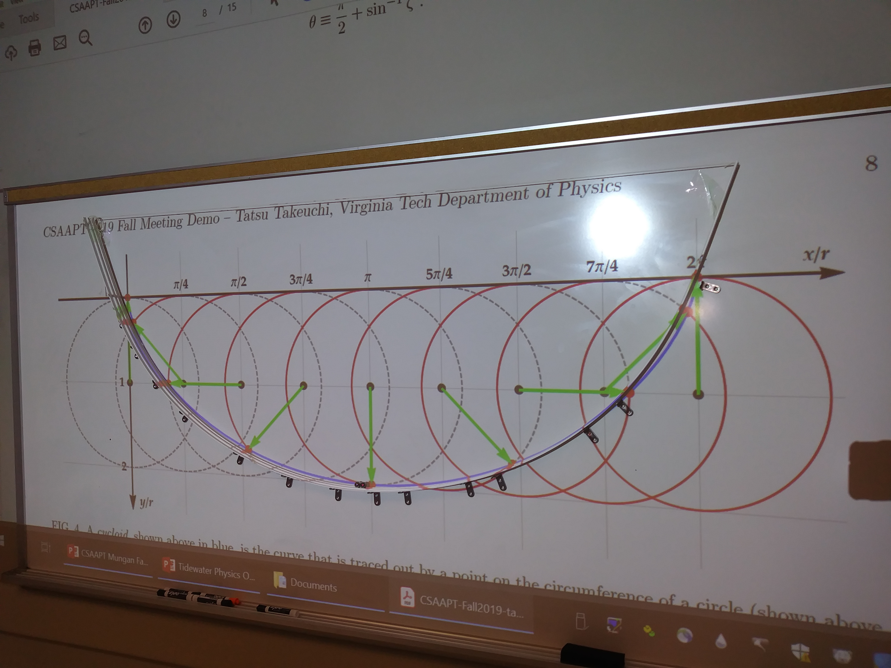
DEMO (Graph is projected onto the whiteboard)

Slide 13
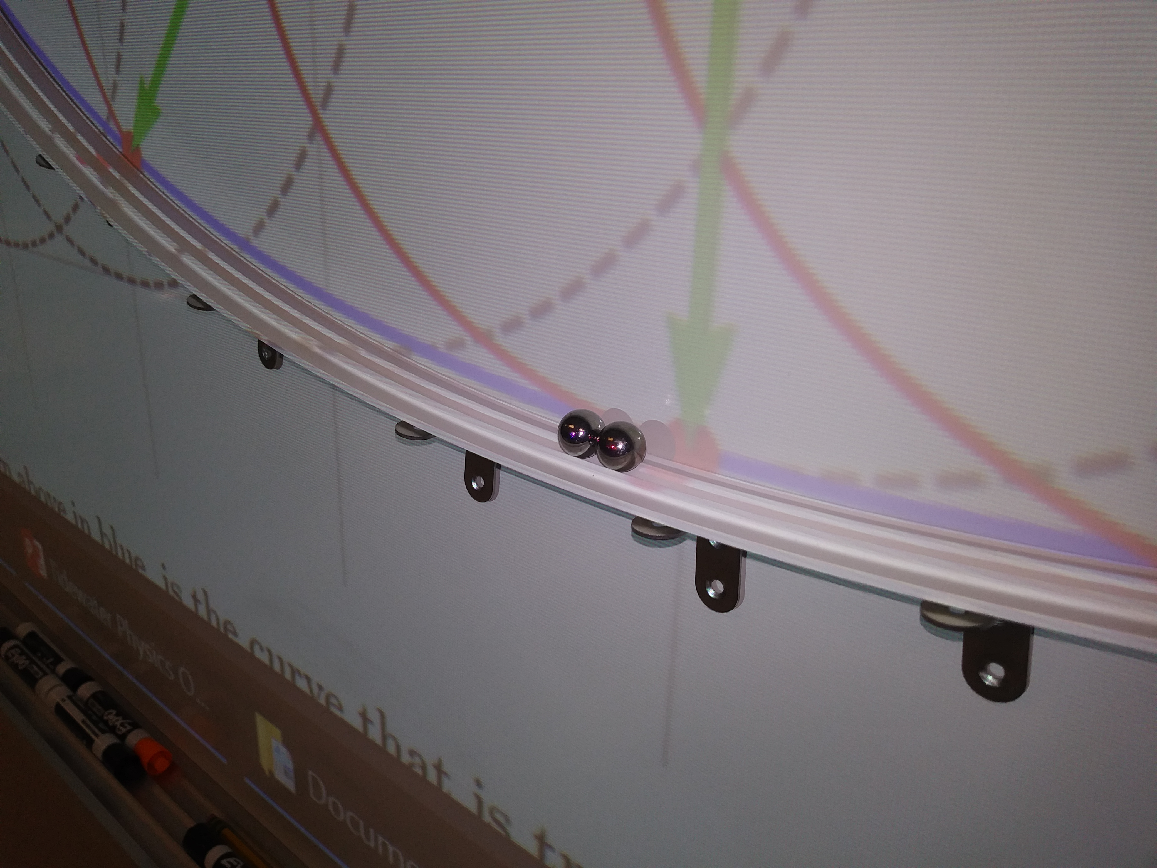
DEMO: Close-up

Slide 14
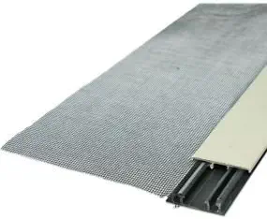
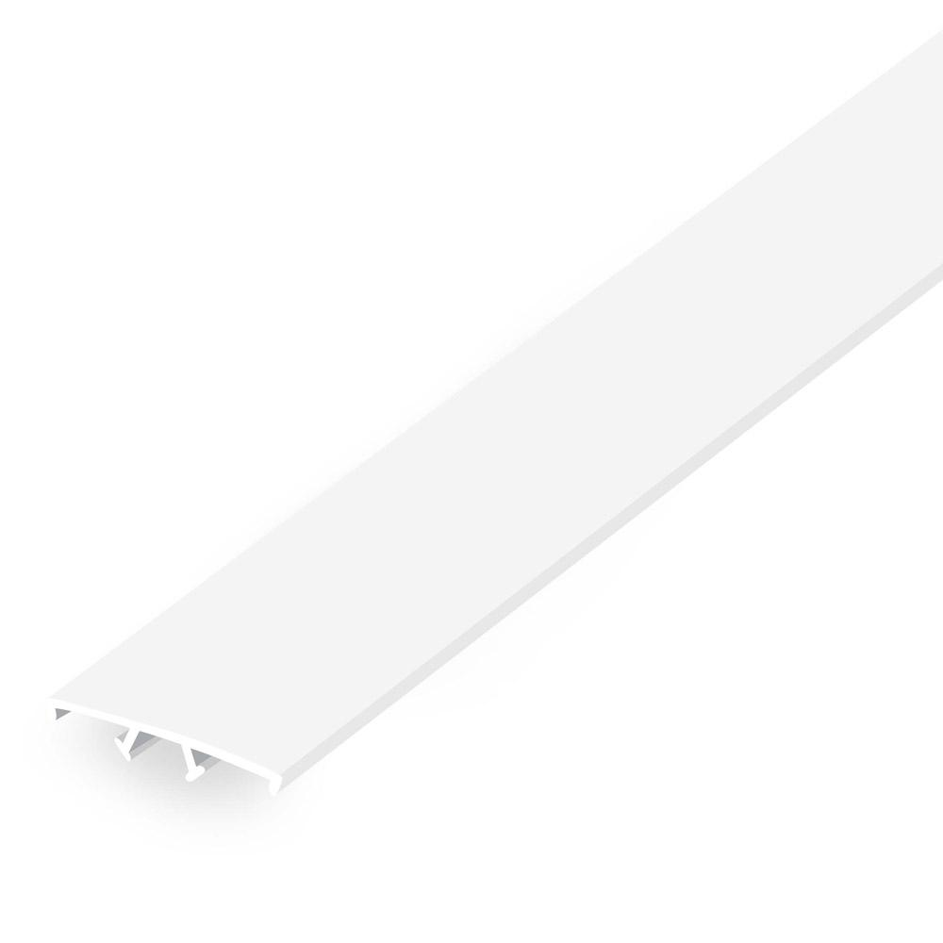
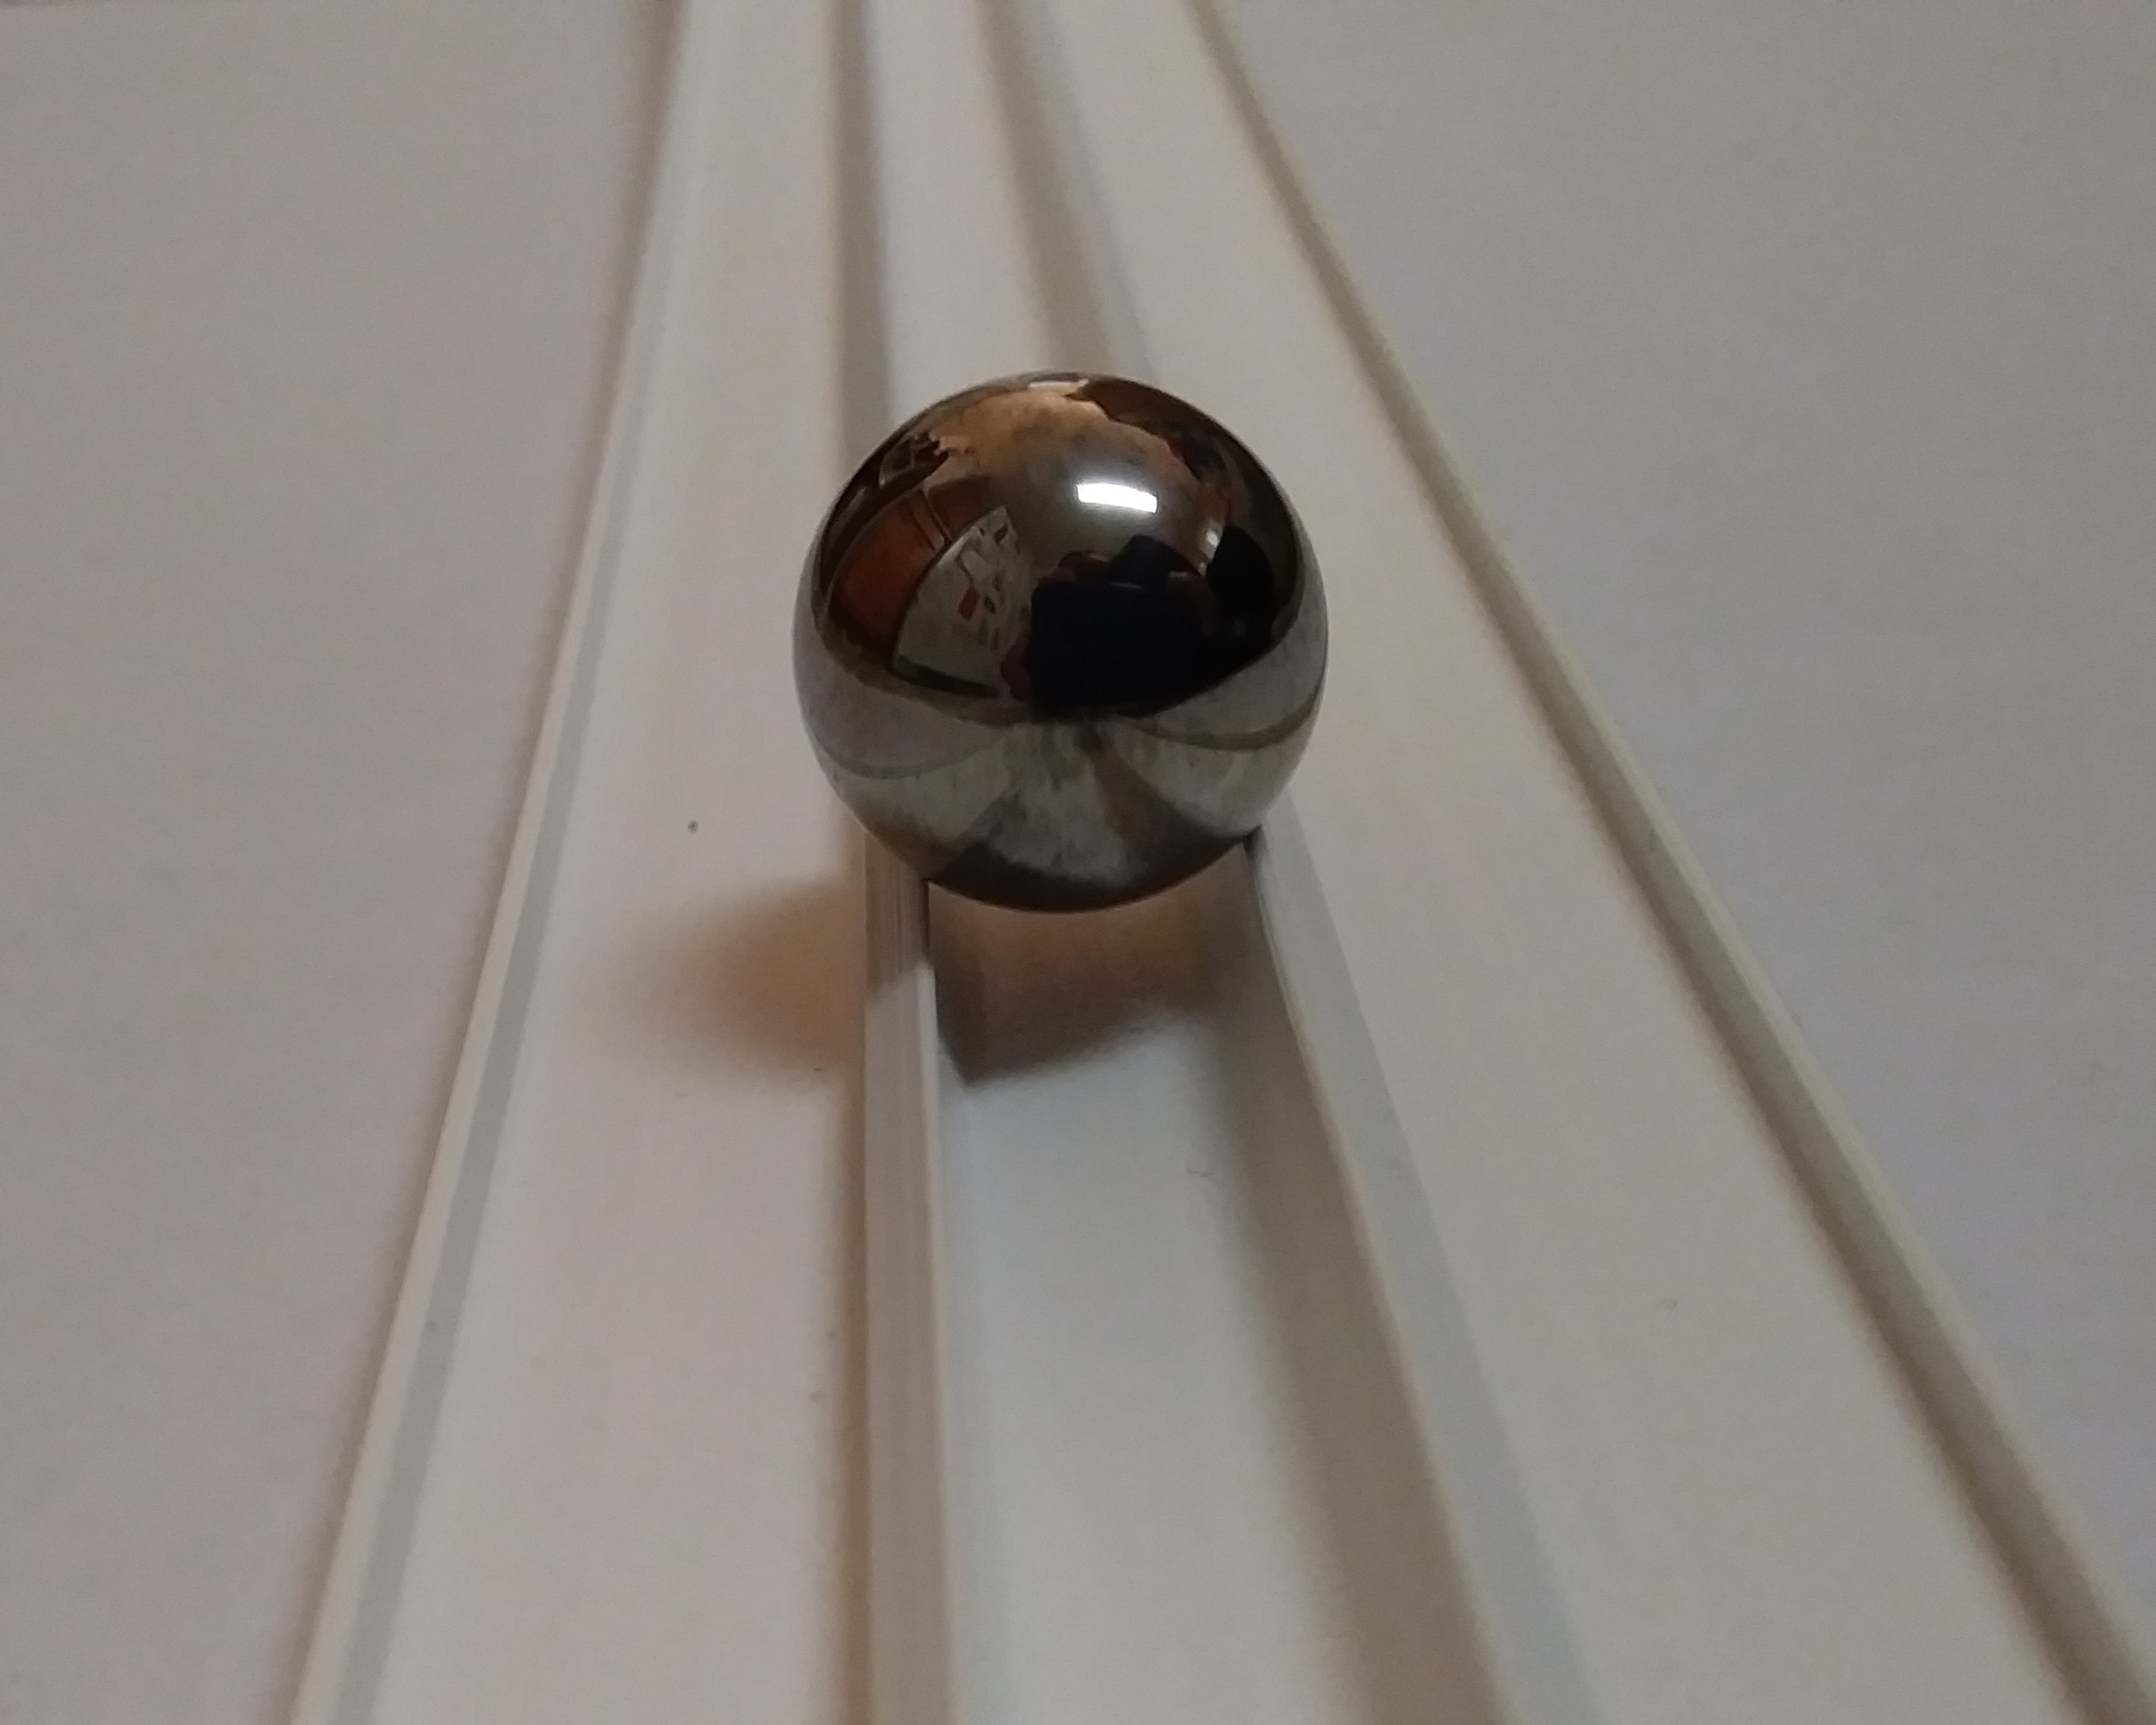
Materials:
The track:
Screen Tight® 1-1/2 inch Porch Screening System Cap (1.5 in. × 8 ft.)
$4.38 @ Home Depot, $4.48 @ Lowes
5/8 inch diameter steal ball bearings: $20.00/100 on Amazon (20¢ each)
5/8 inch diameter marbles: $6.00/60 on Amazon (10¢ each)

Slide 15
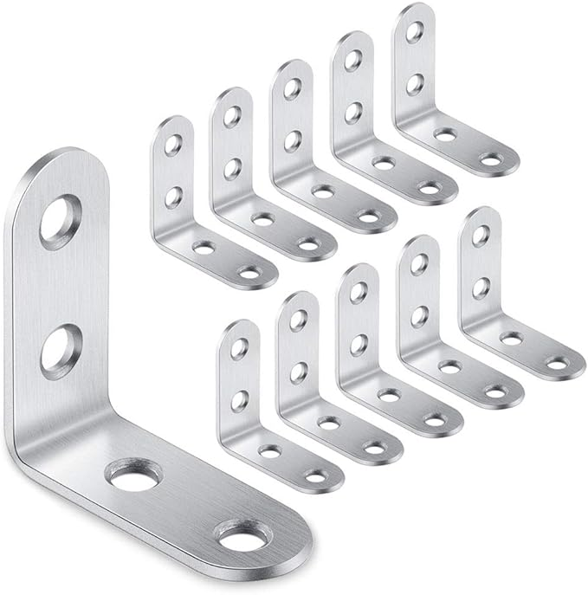

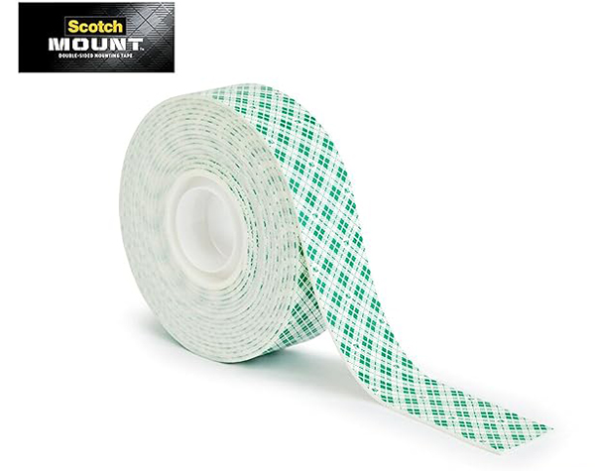
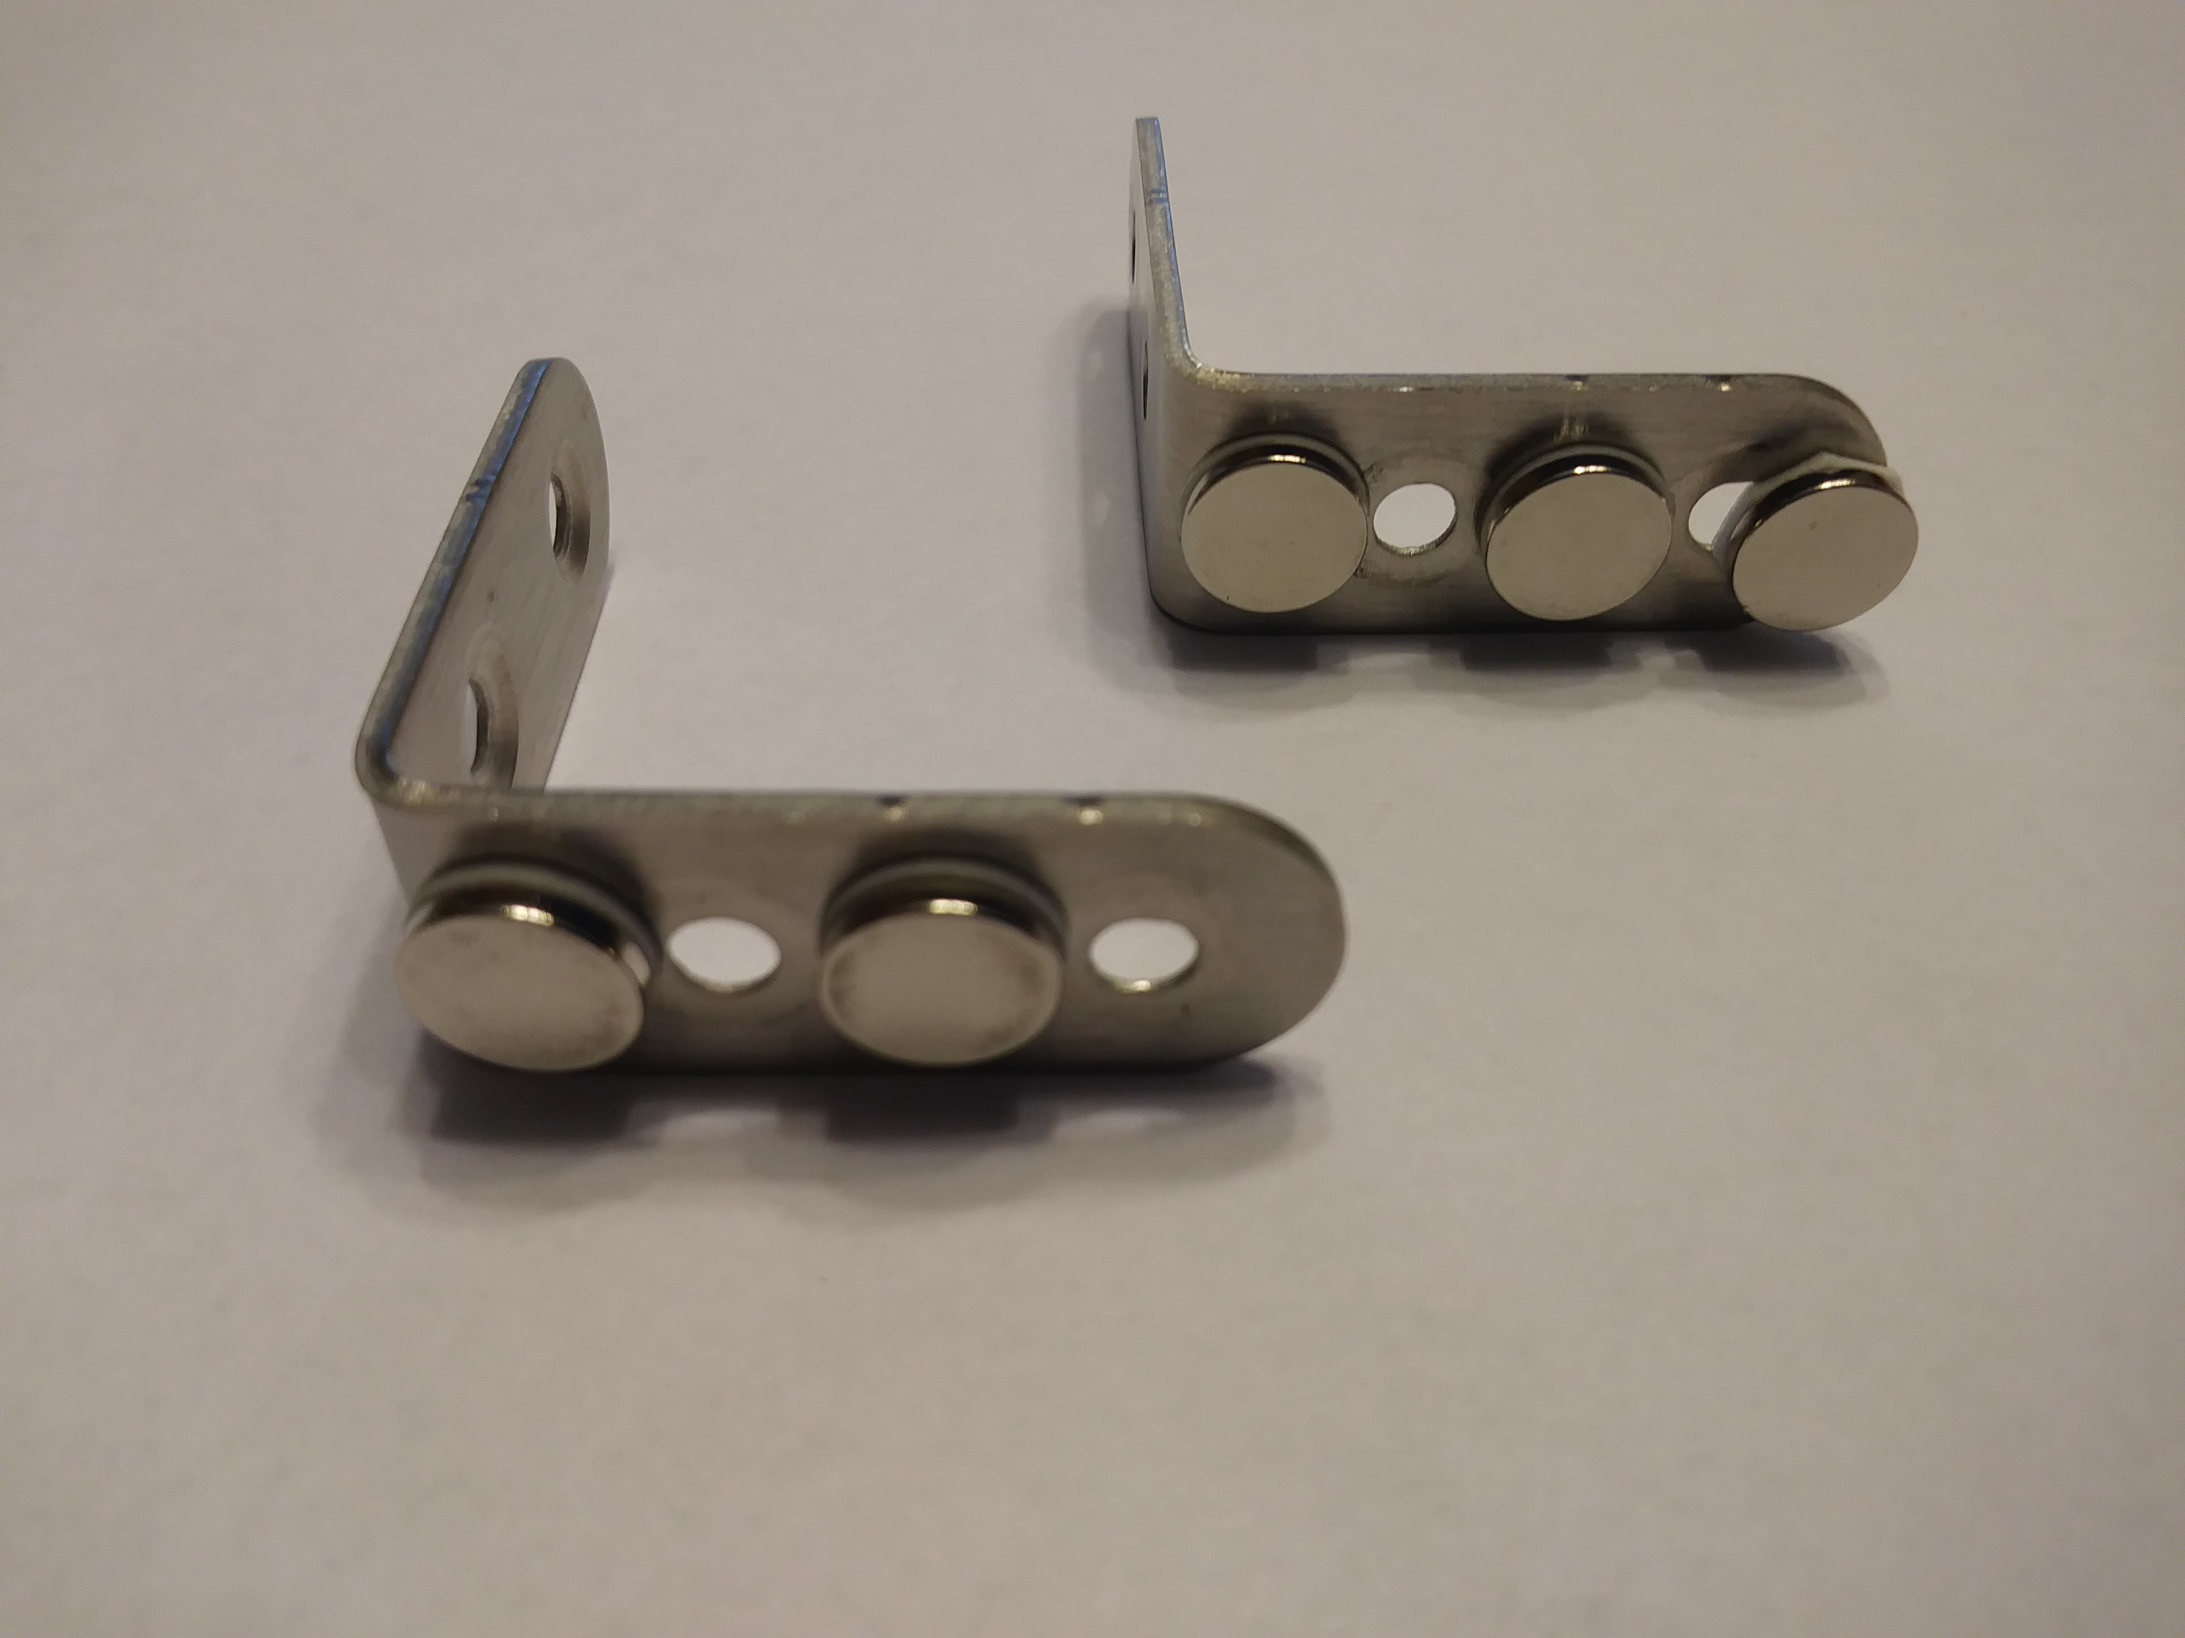
Materials:
The support:
(for magnetic blackboards and whiteboards)
  40mm × 40mm L-shaped corner braces
  $15.00/50 on Amazon (30¢ each)
  Button magnets (may have adhesive backing)
  $7.00/90 on Amazon (8¢ each)
  Double sided foam tape
  $5.00/10 ft. on Amazon

Slide 16
OTher:
Straight Track – To race against the brachistochrone
  Track: Screen Tight® 1-1/2 inch Porch Screening System Cap (1.5 in. × 8 ft.)
  1 in x 2 in x 8 ft piece of wood
  $3.00 at Home Depot or Lowes
  Attach track to wood.

