Slide 1
What is happening In science Education/Physics in Delaware?
Delaware Department of Education
Presentation by: Tonyea Mead, Science Education Association, K-12

Slide 2
The Next Generation Science Standards came out in 2013
Delaware was the 4th state to adopt the NGSS (Next Generation Science Standards) www.nextgenscience.org
Delaware’s NGSS standards were clustered by grade level for K-5, but needed to be grouped by grade level for 6th-12th grade. DOE formed a group of teachers, curriculum directors, national science experts, higher Ed, and business partners to determine where each standard should be placed. Science / Next Generation Science Standards (doe.k12.de.us)
DOE recommends that all curricular resources by HQIM (High Quality Instructional Materials through Ed Reports. Explore Reports (edreports.org)

Slide 3
Most district Curricular Resources
Elementary: Amplify Science Amplify Science | Elementary & Middle School Curriculum | Amplify
Middle School: OpenSciEd www.openscied.org
6th grade: 6th Grade Science Thermal Energy - MS-PS1-4. MS-PS3-3, MS-PS3-4, MS-PS3-5, MS-PS4-2, MS-ETS1-4 (openscied.org)
8th grade: 8th Grade Physical Science - MS-PS2-1, MS-PS2-2, MS-PS3-1, MS-LS1-8, MS-ETS1-2, MS-ETS1-3 (openscied.org)
High School: OpenSciED: http://www.openscied.org/
Physics: Instructional Materials - OpenSciEd

Slide 4
All Curriculum Must
Be aligned to Standards
Start with a Phenomenon
Have a storyline that ties back to the unit Phenomenon
Three dimensional assessments-tests practices, core ideas and crosscutting concepts.

Slide 5
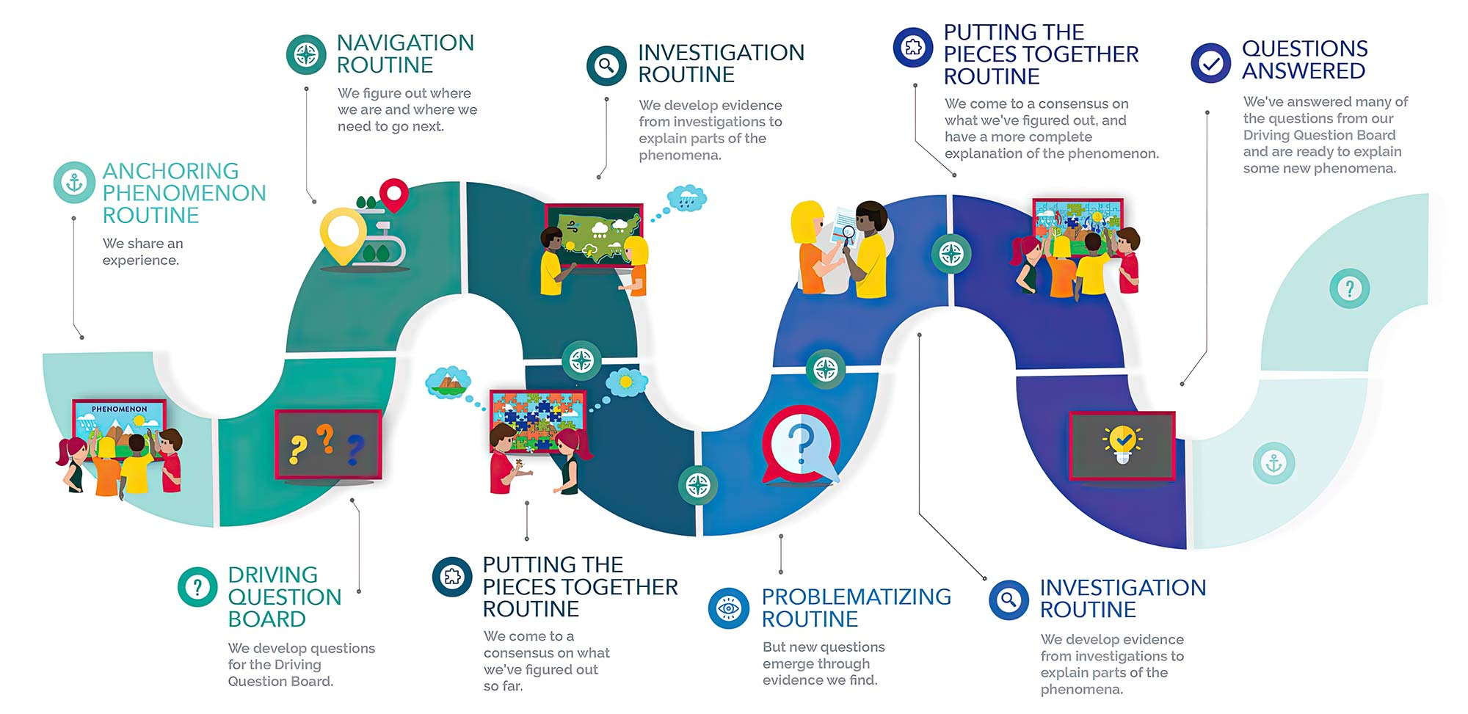

Slide 6
Shared 9th grade Forces and Interaction/Energy Transfer and Conservation End of Unit Assessment
Please email me if you are interested in having a copy of the assessment-student and teacher version

Slide 7
Concerns in Delaware
No pipeline-students are not going into the field of education, let alone secondary sciences.
Elementary science is not a priority. The focus is state testing of reading and mathematics. Students might get 20 minutes of science in a week. That is the national average too!
Science is being cut and middle and high school with block scheduling. For one graduate credit, students are supposed to have 135 hours. Most students are receiving half those hours.
Some Success-
DOE has changed the physics Praxis pass grade from 144 to 140 to match surrounding states.
There is now an education pathway for students in high school.

Slide 8
How do you evaluate a science teacher in the Classroom
Classroom Walkthrough Tool
ttps://www.doe.k12.de.us/cms/lib/DE01922744/Centricity/Domain/391/CSSS%20Observation%20tool_1%20w_Links_June.pdf

Slide 9
Thank you!
tonyea.mead@doe.k12.de.us

