Slide 1
Navigating Challenges and Alternatives in Physics Education: An Engineer’s Perspective
Mr. Andres Y. Akamine Washington County Public School District
Physics & Science Teacher Boyd J. Michael, III Technical High School

Slide 2
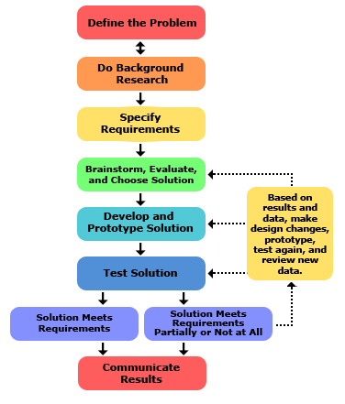
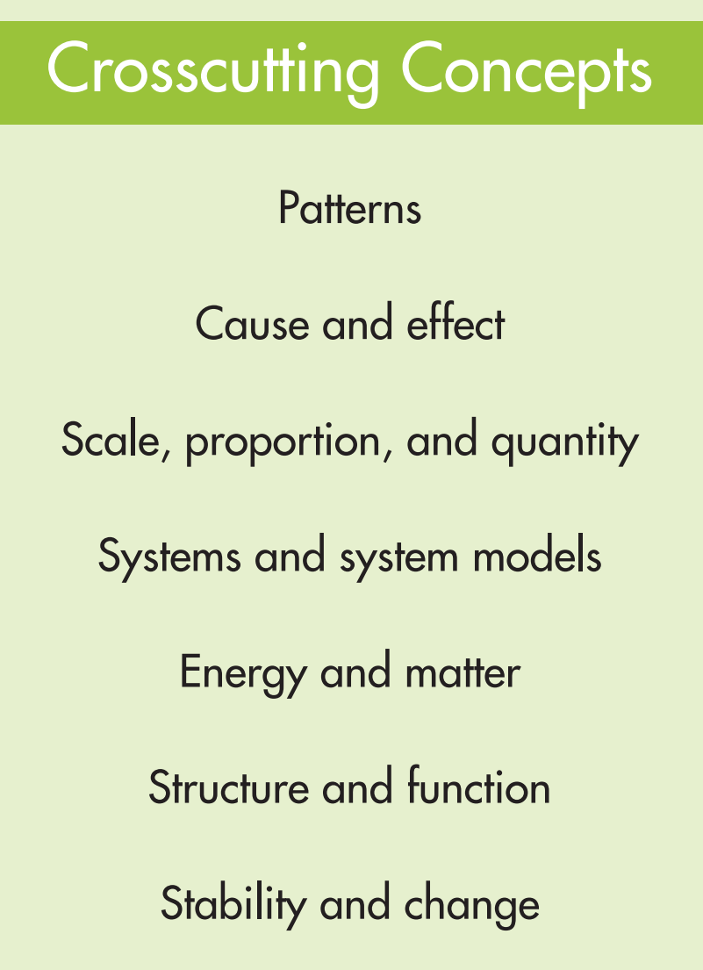
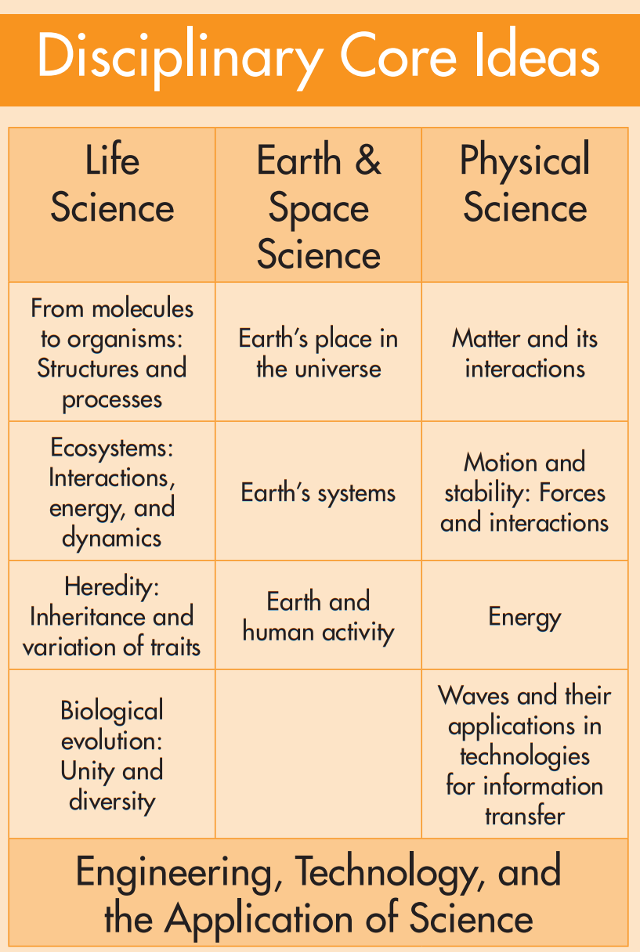
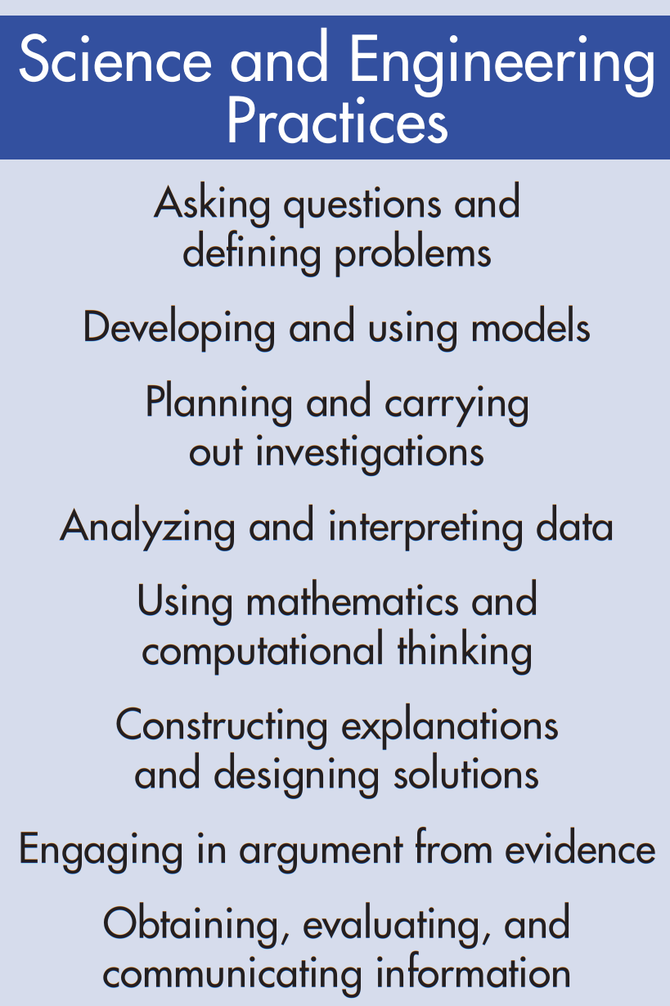
What does it look like to ACT and THINK in a Science class?

Slide 3
Creating a model of a student in school
Vision:
Building a community that inspires curiosity, creativity, and achievement
Mission:
Prepare students with the knowledge and skills necessary to be employable and to further their education
Beliefs:
Adults should model and promote life-long learning
Self-discipline is critical to learning
Assessments are necessary to improve student achievement
Parents, guardians, and family members are encouraged to collaborate with teachers and school administrators to support student’s education

Slide 4
Student self-regulation is key to their learning process
Self-regulation habits supercede academic content in priority
Teacher Led Activity - 5 weeks long
Self Paced Activity - 5 weeks long
Total Time on Task | Number of Students
30-40min | 37
20-30min | 15
10-20min | 5
0-10min | 3
Total Time on Task | Number of Students
30-40min | 5
20-30min | 15
10-20min | 20
0-10min | 20
Plan
Evaluate
Implement

Slide 5
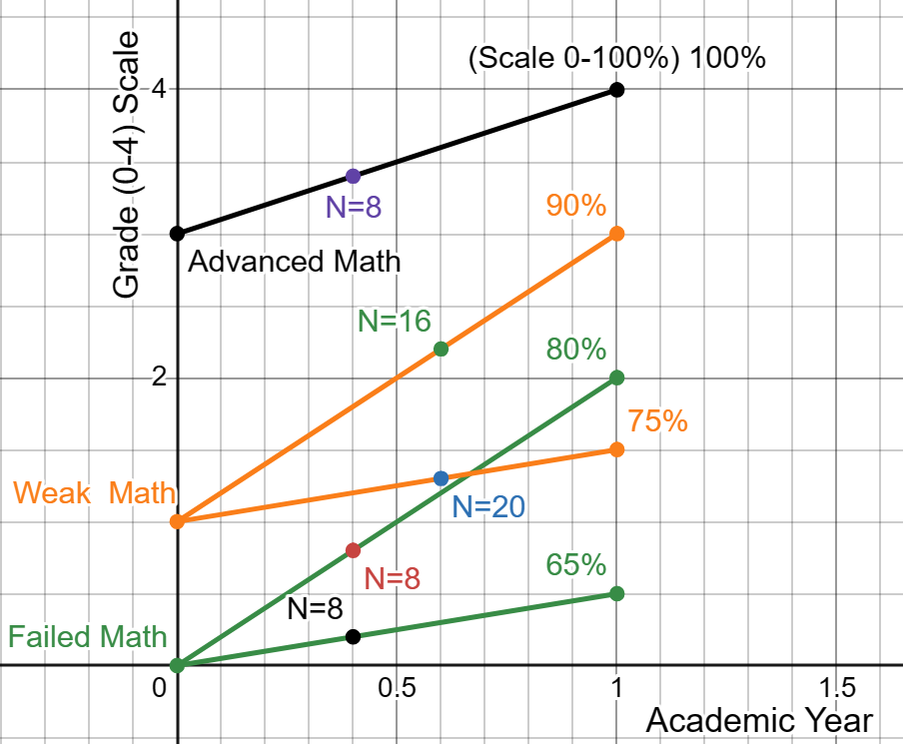
Challenging mathematical skills heterogeneity
Plan
Evaluate
Implement
Physics and Math have an extremely high correlation
Teaching Physics requires math instruction
Physics supports both English and Math students’ education
Math is the foundation for logical thinking
Teach English, Math and Physics

Slide 6
Teachers set the pace of the implementation cycle
Plan
Evaluate
Implement
Use a strong well-developed curriculum
Model and discipline self-regulation habits
Encourage them to
DO Science
Assessments
Daily feedback (grades)

Slide 7
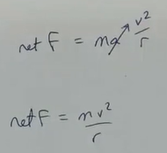
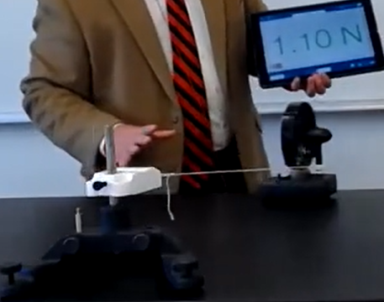
Uniform Circular Motion: A curriculum for your student
Plan
Evaluate
Implement
Giancoli Textbook
Etkina Textbook & Active Learning Guide
AP Classroom Videos & Workbook
Workbook
Explain: $\frac{mv^{2}}{r}>μ_{s}∙F_{n}$

Slide 8
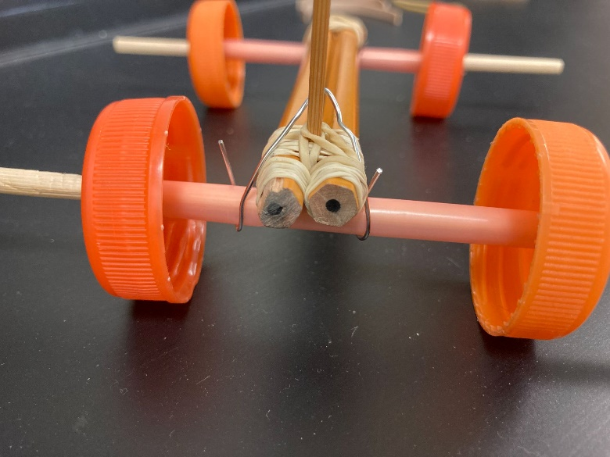
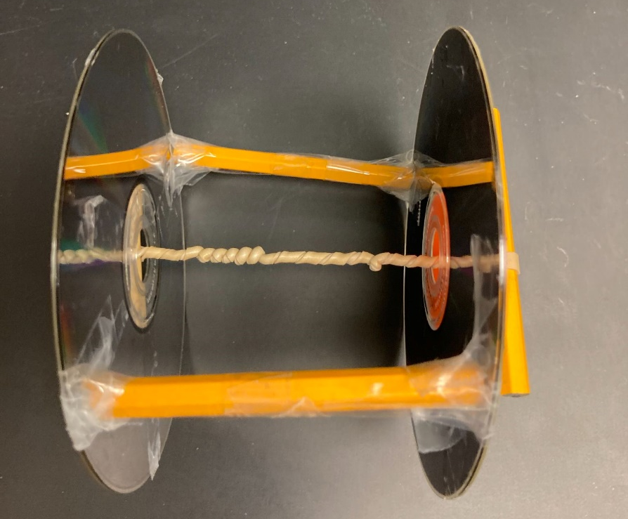
Science Challenge: Real-word applications
Plan
Evaluate
Implement
2022-2023: School Challenges
2023-2024: Rubber band Car Challenge
School Challenges
How could exit traffic be reduced?
How could bathroom cleanliness improve?
How could hallway rough play be reduced?
How could lunch food improve?
How would school workload be more fair?
How would school have better temperature control?
How could schools improve technology performance?
Improvement Workshops
How to improve my time management?
Sleeping science
Best studying practices
The science of motivation

Slide 9
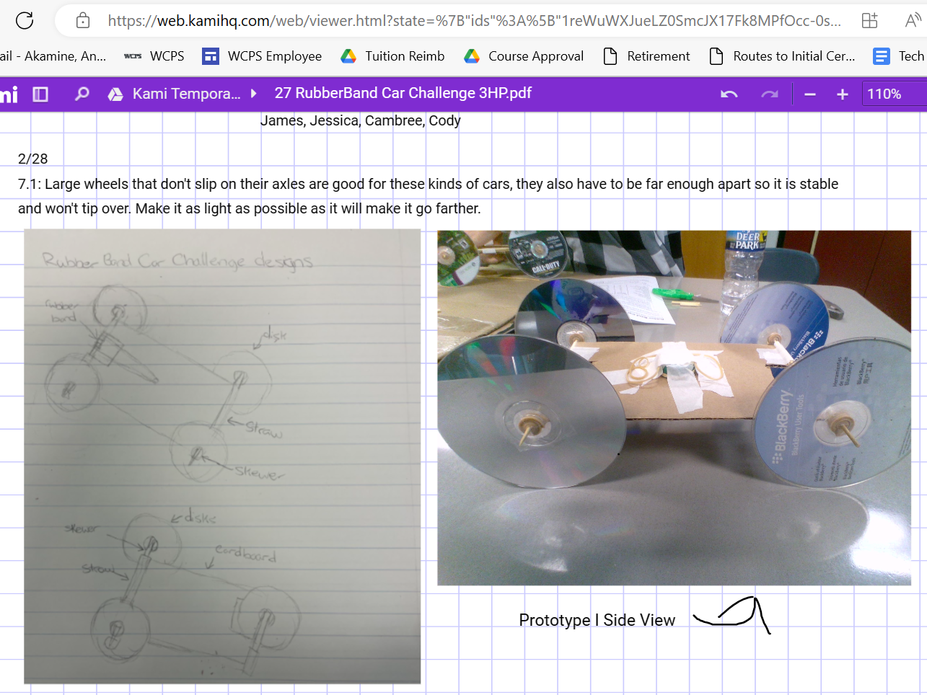
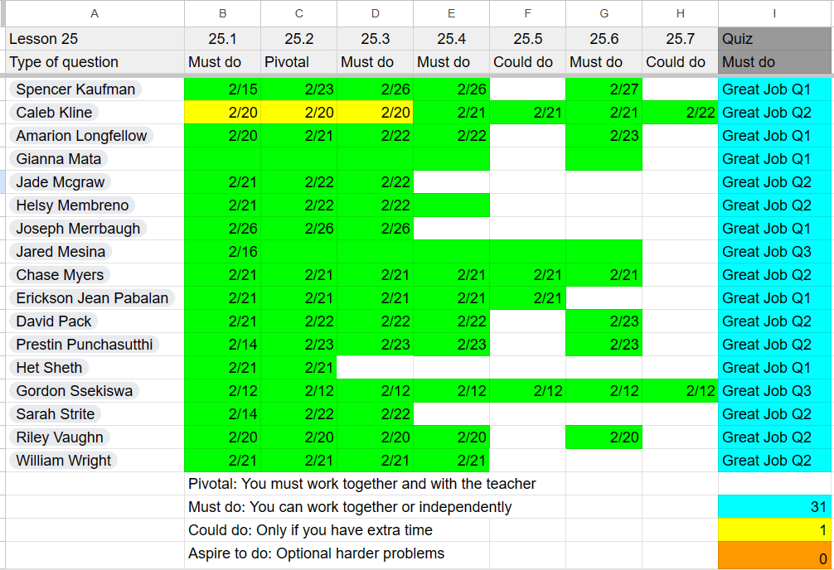
Making it a modern classroom: Feedback and Grades
Plan
Evaluate
Implement
KAMI: Public evidence notebooks
Sheets: Public self-paced activity tracker
Student Names
Student
Names

Slide 10
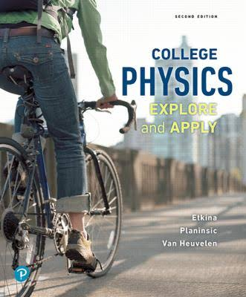
3 minutes of Questions & Answers
Plan
Evaluate
Implement
Acknowledgements
Takeaways
210 students
Use and adapt the curriculum for the needs and pace of the students
Model students to be learners
Apply the science to their daily lives
Give them feedback and continuously correct them
Teach them English, Math and Physics
CSAAPT

Slide 11
References
Plan
Evaluate
Implement
Akamine (2024). Distribution of Students by Math Level, Physics Grade during the academic year 2023-2024. https://www.desmos.com/calculator/a1z1ysuk2i
Otero, V., Meltzer, D. (2017). The past and future of physics education reform. Physics Today. https://pubs.aip.org/physicstoday/article/70/5/50/835576/The-past-and-future-of-physics-education-reformThe
Stewart, J., DeVore, S., Stewart, G. (2016). Behavioral self-regulation in a physics class. Physical review physics education research. https://journals.aps.org/prper/pdf/10.1103/PhysRevPhysEducRes.12.010125
Swartz, C. (1999). Survey of High-School Physics Text. The Physics Teacher. https://www.aapt.org/resources/hstexts.cfm
Takaoglu, Z. (2017). Comparing Physics Textbooks in Terms of Assessment and Evaluation Tools. International Journal of Assessment Tools in Education. https://files.eric.ed.gov/fulltext/EJ1250172.pdf
Tesfaye, C. & White, S. (2010). High School Physics Textbooks. Focus on. https://www.aip.org/sites/default/files/statistics/highschool/hs-textbooks-09.pdf
Tesfaye, C. & White, S. (2014). High School Physics Textbooks. Focus on. https://aip.brightspotcdn.com/03/cb/6bfdf8fc2111b1fa57624b0c9861/hs-textbooks-13-2.pdf
College Board (2024). AP Physics 1 Course and Exam Description 2024-2025. https://apcentral.collegeboard.org/media/pdf/ap-physics-1-course-and-exam-description-effective-fall-2024.pdf
Next Generation Science Standards (2013) Appendix F. Appendix F Science and Engineering Practices in the NGSS - FINAL 060513.pdf (nextgenscience.org)

