Slide 1
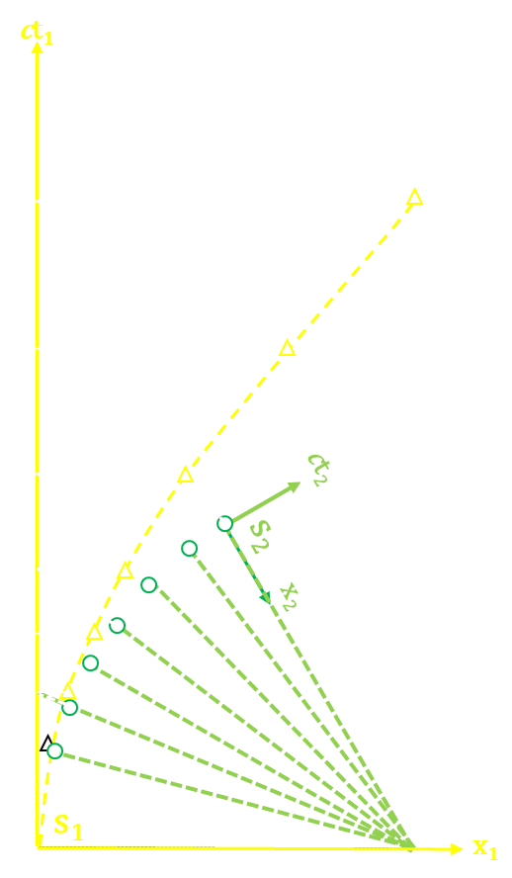
The Lorentz Transform Axis of Symmetry
CS-AAPT Spring 2024
Lewis F. McIntyre
www.Lewis-McIntyre.com/light-beam
mcintyrel@verizon.net
β
Notes:
My name is Lewis McIntyre. I am going to talk to you about the axis of symmetry of the Lorentz Transform. What axis of symmetry, you say? Well … let’s get into it.

Slide 2
The Velocity Triangle and the Trigonometric Lorentz Transform
β
www.Lewis-McIntyre.com/light-beam
mcintyrel@verizon.net
Notes:
My previous talks here have discussed the trigonometric, graphical solution for the Lorentz Transform that I call the velocity triangle

Slide 3
HENDRICK LORENTZ DEVELOPED THE LORENTZ TRANSFORM IN 1899
DERIVATION
Modifies the Galilean Transform $x_{0}+vt_{0}$ with unknown weights α, β and γ:
$$x_{1}=α\left(x_{0}+vt_{0}\right) \\ t_{1}=βt_{0}+γx_{0}$$
$$y_{1}=y_{0} \\ z_{1}=t_{0}$$
With Constraint that Both Must Measure the Same Speed of Light.
$$c^{2}t_{0}^{2}=x_{0}^{2}+y_{0}^{2}+z_{0}^{2} \\ c^{2}t_{1}^{2}=x_{1}^{2}+y_{1}^{2}+z_{1}^{2}$$
Solving for Unknowns α, β and γ Yields the Lorentz Transform
$$x_{1}=\frac{x_{0}+{ct}_{0}∙ (v/c)}{\sqrt{1−{(v/c)}^{2}}} \\ {ct}_{1}=\frac{{ct}_{0}+x_{0}∙ (v/c)}{\sqrt{1−{(v/c)}^{2}}}$$
Notes:
The Lorentz Transform is the basis for Special Relativity. It was derived in 1892 from the familiar Galilean Transform which simply relates measurements between two reference frames in relative motion, by applying unknown weights α, β and γ so that both reference frames will measure the same speed of light. Solving for these unknown weights yields, after some messy algebra, the Lorentz Transform. The Lorentz Transform is simple enough, but to date, no one has come up with a good graphical solution for it, or even a good explanation. It is generally explained that space is contracted and time is dilated by relative velocity, through some undefined process. However, both reference frames view the other’s space and time being contracted or dilated.

Slide 4
VELOCITY TRIANGLE OAB:
S₁ in blue
S₀ in red
β=arcsin (v/c)
TRIGONOMETRIC LORENTZ TRANSFORM
$$x_{1}=\frac{x_{0}+{ct}_{0}∙ (v/c)}{\sqrt{1−{(v/c)}^{2}}}=\frac{x_{0}+{ct}_{0}∙sin⁡(β)}{cos⁡(β)} \\ {ct}_{1}=\frac{{ct}_{0}+x_{0}∙ (v/c)}{\sqrt{1−{(v/c)}^{2}}}=\frac{{ct}_{0}+x_{2}∙sin⁡(β)}{cos⁡(β)}$$
TRIGONOMETRIC DOPPLER SHIFT ${c∆t}_{1}={c∆t}_{0}\frac{1+ (v/c)}{\sqrt{1−{(v/c)}^{2}}}={c∆t}_{0}\frac{1+sin⁡(β)}{cos⁡(β)}$
ct₁
S₁ Timeline
ct₀
B
S₀ timeline
C
ct₁, x₁
A
ct₀, x₀
β
S₁
O
x₁
S₀
x₀
Notes:
I have derived the velocity triangle which very clearly conceptualizes the Lorentz Transform, and shows that it is the observer’s measurement of an event in relative motion that is affected by relativistic Doppler shift, and not the event's time and space. This simple paradigm shift makes the Special Theory suddenly much easier to understand.
The velocity triangle OAB, shown on the right, is based on the fact that all matter moves with a proper velocity equal to the speed of light, defining the direction of that travel as time. Relative velocity disappears as an independent variable, becoming a projection of one body’s proper velocity ct onto time-varying components on the temporal axis OB and spatial axis BC of another body moving in a different direction, through the Lorentz Transform. The Brehme velocity angle beta defines that difference in direction between reference frames S₀ and S₁, the sine of which equals v/c. This allows the Lorentz transformation and Doppler shift to be written trigonometrically as shown. The Lorentz transform simply equates the measurement of event A in S₀ to a measurement C in S₁.

Slide 5
Limitations of the Velocity Triangle
β
www.Lewis-McIntyre.com/light-beam
mcintyrel@verizon.net
Notes:
There is only one problem: the velocity triangle works only for proper events in one reference frame, events which have zero x components, which transform to trajectories x=vt in the other. Why is this?

Slide 6
THE VELOCITY TRIANGLE REQUIRES ONE POINT WITH COMMON TIME AND DISTANCE IN BOTH REFERENCE FRAMES
O SATISFIES THIS WITH ZERO OFFSET
ct₀=ct₁=0
x₀=x₁=0
O’ DOES NOT MEET THIS CRITERIA DUE TO x OFFSET
ct₁
S₁ Timeline
ct₀
S₀ timeline
A
ct₀, x₀
β
S₁
O
x₁
S₀
O’
x₀
Notes:
The reason is that the velocity triangle requires one point with common time in both reference frames. O satisfies this because at t=0, the two reference frames are collocated with x=0. With an x offset, this is no longer true, as shown at O’

Slide 7
The Axis of Symmetry of the Lorentz Transform
β
www.Lewis-McIntyre.com/light-beam
mcintyrel@verizon.net
Notes:
So what is the solution? The answer lies in the axis of symmetry for the Lorentz Transform, something that I have discovered.

Slide 8
LOCATE POINTS WITH EQUAL TIME IN BOTH REFERENCE FRAMES
$${ct}_{1}={ct}_{0}=\frac{{ct}_{0}+x_{0}∙ (v/c)}{\sqrt{1−{(v/c)}^{2}}} \\ x_{0}=−{ct}_{0}\frac{1−\sqrt{1−{\left(v/c\right)}^{2}}}{v/c}$$
ct₁
S₁ Timeline
ct₀
S₀ timeline
β
S₁
x₁
S₀
O’
x₀
Notes:
First, we want to identify points in S₀ that transform to identical times in S₁. We take the Lorentz transform for ct₁ and set the result equal to ct₀ , then solve for x₀. I did this algebraically just to demonstrate the power of the trigonometric solution, because the result is an algebraic jumble that does not tell us much, except that such points exist.

Slide 9
LOCATE POINTS WITH EQUAL TIME IN BOTH REFERENCE FRAMES
$${ct}_{1}={ct}_{0}=\frac{{ct}_{0}+x_{0}∙ (v/c)}{\sqrt{1−{(v/c)}^{2}}} \\ x_{0}=−{ct}_{0}\frac{1−\sqrt{1−{\left(v/c\right)}^{2}}}{v/c} \\ x_{0}=−{ct}_{0}\frac{1−\cos\left(β\right)}{\sin\left(β\right)}$$
ct₁
S₁ Timeline
ct₀
S₀ timeline
β
S₁
x₁
S₀
O’
x₀
Notes:
It is a less messy when expressed trigonometrically …

Slide 10
LOCATE POINTS WITH EQUAL TIME IN BOTH REFERENCE FRAMES
$${ct}_{1}={ct}_{0}=\frac{{ct}_{0}+x_{0}∙ (v/c)}{\sqrt{1−{(v/c)}^{2}}} \\ x_{0}=−{ct}_{0}\frac{1−\sqrt{1−{\left(v/c\right)}^{2}}}{v/c} \\ x_{0}=−{ct}_{0}\frac{1−\cos\left(β\right)}{\sin\left(β\right)}={−ct}_{0}∙tan\left(β/2\right)$$
ct₁
S₁ Timeline
ct₀
S₀ timeline
β
S₁
x₁
S₀
O’
x₀
Notes:
… and we recognize the trigonometric beta function as the trig identity for the tangent of one half the velocity angle beta.

Slide 11
LOCATE POINTS WITH EQUAL TIME IN BOTH REFERENCE FRAMES
$${ct}_{1}={ct}_{0}=\frac{{ct}_{0}+x_{0}∙ (v/c)}{\sqrt{1−{(v/c)}^{2}}} \\ x_{0}=−{ct}_{0}\frac{1−\sqrt{1−{\left(v/c\right)}^{2}}}{v/c} \\ x_{0}=−{ct}_{0}\frac{1−\cos\left(β\right)}{\sin\left(β\right)}={−ct}_{0}∙tan\left(β/2\right) \\ x_{1}=\frac{x_{0}+{ct}_{0}∙sin⁡(β)}{cos⁡(β)}={ct}_{0}∙tan\left(β/2\right)=−x_{0}$$
ct₁
S₁ Timeline
ct₀
S₀ timeline
β
S₁
x₁
S₀
O’
x₀
Notes:
Next, we do the Lorentz transform for x₁, using the value we just determined for x₀ and determine that x₁ is equal and opposite to x₀.

Slide 12
ct₁
THE BISECTOR OF THE VELOCITY ANGLE IS THE AXIS OF SYMMETRY FOR THE LORENTZ TRANSFORM
Locate Equal Times In S₀ and S₁
The x coordinate is ct·tan(β/2), equal and opposite.
S₁ Timeline
ct₀
S₀ timeline
B
ct₁=ct₀
x₁=x₀
A
ct₀, x₀
β
S₁
x₁
S₀
O’
x₀
Notes:
We can then see that if we locate identical times on both time axes, the resulting x values are equal to the time multiplied by the tangent of beta over 2, with opposite signs.

Slide 13
Using the Axis of Symmetry to Solve the Generalized Lorentz Transform
β
www.Lewis-McIntyre.com/light-beam
mcintyrel@verizon.net
Notes:
Now let me show you how to use the axis of symmetry to solve the generalized Lorentz Transform with arbitrary values of x

Slide 14
EXTEND S₀ TIMELINE THROUGH A PARALLEL TO ct₀ TO INTERSECT AXIS OF SYMMMETRY AT O
ct₁
S₁ Timeline
ct₀
S₀ timeline
A
ct₀, x₀
β
S₁
S₀
x₁
x₀
O
Notes:
We now draw a timeline through the S₀ measurement A, parallel to the ct₀ timeline to intersect the axis of symmetry at a new O

Slide 15
EXTEND S₀ TIMELINE THROUGH A PARALLEL TO ct₀ TO INTERSECT AXIS OF SYMMMETRY AT O
ADD x₁ OFFSET TO S₁ EQUAL TO –x₀
ct₁
S₁ Timeline
ct₀
S₀ timeline
A
ct₀, x₀
β
S₁
S₀
x₁
x₀
O
Notes:
Next, we add an offset x₁ equal to minus x₀.

Slide 16
EXTEND S₀ TIMELINE THROUGH A PARALLEL TO ct₀ TO INTERSECT AXIS OF SYMMMETRY AT O
ADD x₁ OFFSET TO S₁ EQUAL TO –x₀
EXTEND OFFSET TIMELINE TO INTERSECT AXIS OF SYMMETRY ALSO AT O
ct₁
S₁ Timeline
ct₀
S₀ timeline
A
ct₀, x₀
β
S₁
S₀
x₁
x₀
O
Notes:
We extend the offset timeline in S₁ through x₁ to intercept the axis of symmetry, also at O

Slide 17
EXTEND S₀ TIMELINE THROUGH A PARALLEL TO ct₀ TO INTERSECT AXIS OF SYMMMETRY AT O
ADD x₁ OFFSET TO S₁ EQUAL TO –x₀
EXTEND OFFSET TIMELINE TO INTERSECT AXIS OF SYMMETRY ALSO AT O
OAB NOW FORMS VELOCITY TRIANGLE WITH COMMON POINT O
ct₀=ct₁=-x₀/tan(β/2)
x₁=-x₀
ct₁
S₁ Timeline
ct₀
C
B
S₀ timeline
A
ct₀, x₀
β
S₁
S₀
x₁
x₀
O
Notes:
We now construct the velocity triangle OAB, by extending the S₀ x axis from A to intercept the offset timeline of S₁ at B, then rotating BA normal to the S₁ timeline to locate C.

Slide 18
EXTEND S₀ TIMELINE THROUGH A PARALLEL TO ct₀ TO INTERSECT AXIS OF SYMMMETRY AT O
ADD x₁ OFFSET TO S₁ EQUAL TO –x₀
EXTEND OFFSET TIMELINE TO INTERSECT AXIS OF SYMMETRY ALSO AT O
OAB NOW FORMS VELOCITY TRIANGLE WITH COMMON POINT O
ct₀=ct₁=-x₀/tan(β/2)
x₁=-x₀
SUBTRACT ct₁ AND x₁ OFFSETS TO OBTAIN LORENTZ TRANSFORM
OB=[ct₀+x_{o}·sin(β)]/cos(β)+x₀/tan(β/2)
BC=BA =[x₀+ct_{o}·sin(β)]/cos(β)+x₀
ct₁
S₁ Timeline
ct₀
C
S₀ timeline
B
C
A
ct₀, x₀
β
S₁
S₀
x₁
x₀
O
Notes:
Finally, we subtract the ct₀ and x₁ offsets from OB and BC to obtain the Lorentz transform of A in S₁ at C. The axis of symmetry allows the construction of velocity triangle from any reference frame by setting a x offset in the target reference frame S₁, and establishing a timeline through that point, to intersect with the axis of symmetry at O, to meet the timeline through A in S₀,. This sets up the velocity triangle OAB for arbitrary x, just as was done a proper S₀ with no x coordinate: Project OA onto the offset timeline OB in S₁ to obtain ct₁, and rotate AB to the S₁ x-axis to locate x₁ at C, the Lorentz transform of A.

Slide 19
A Shortcut Solution
β
www.Lewis-McIntyre.com/light-beam
mcintyrel@verizon.net
Notes:
Now, I am going to show you a shortcut solution.

Slide 20
ct₁
A LOT OF GRAPHIC OVERHEAD!
S₁ Timeline
ct₀
C
S₀ timeline
B
C
A
ct₀, x₀
β
S₁
S₀
x₁
x₀
O
Notes:
What I just showed you is certainly a solution but involves a lot of graphic overhead. Let’s look at bisecting angle ABC, also equal to beta, instead of AOB.

Slide 21
LOCATE ct₁=ct₀ ON THE S₁ TIMELINE
ct₁
S₁ Timeline
ct₀
S₀ timeline
ct₁=ct₀
A
ct₀, x₀
β
S₁
x₁
S₀
x₀
O
Notes:
Locate ct₁=ct₀ on the S₁ timeline

Slide 22
LOCATE ct₁=ct₀ ON THE S₁ TIMELINE
ERECT A TEMPORARY x₁ AXIS AT ct₁
ct₁
S₁ Timeline
ct₀
S₀ timeline
ct₁=ct₀
A
ct₀, x₀
β
S₁
x₁
S₀
x₀
O
Notes:
Erect a temporary x₁ axis at ct₁.

Slide 23
LOCATE ct₁=ct₀ ON THE S₁ TIMELINE
ERECT A TEMPORARY x₁ AXIS AT ct₁
FROM A, PARALLEL TO ct₀ TO INTERCEPT x₁ AXIS
ct₁
S₁ Timeline
ct₀
S₀ timeline
ct₁=ct₀
A
ct₀, x₀
β
S₁
x₁
S₀
x₀
O
Notes:
Proceed from A parallel to ct₀ to intercept the x₁ axis.

Slide 24
LOCATE ct₁=ct₀ ON THE S₁ TIMELINE
ERECT A TEMPORARY x₁ AXIS AT ct₁
FROM A, PARALLEL TO ct₀ TO INTERCEPT x₁ AXIS
FROM x₁ AXIS AN EQUAL DISTANCE TO LOCATE C, THE LORENTZ TRANSFORM OF A.
ct₁
S₁ Timeline
ct₀
C
S₀ timeline
ct₁=ct₀
A
ct₀, x₀
β
S₁
x₁
S₀
x₀
O
Notes:
Then an equal distance parallel to the S₁ time axis to locate C, the Lorentz transform of A. This certainly is a simpler and faster method.

Slide 25
Simultaneous Points in S₀
β
www.Lewis-McIntyre.com/light-beam
mcintyrel@verizon.net
Notes:
This procedure easily solves for multiple simultaneous points in S₀.

Slide 26
ct₁
MULTIPLE MEASUREMENTS A₁-A₃ SIMULTANEOUS IN S₀ …
S₁ Timeline
ct₀
S₀ timeline
ct₁=ct₀
A₁
ct₀, x₀
A₂
β
A₃
S₁
x₁
S₀
x₀
O
Notes:
Points with the same time coordinate in S₀ are simultaneous in that reference frame…

Slide 27
ct₁
THE POINT ON THE AXIS OF SYMMETRY HAS THE SAME TIME IN S₀ AND S₁
S₁ Timeline
ct₀
C₃
C₂
C₁
S₀ timeline
ct₁=ct₀
A₁
ct₀, x₀
A₂
β
A₃
S₁
x₁
S₀
x₀
O
Notes:
But not simultaneous in S_{1.} Points to the right of the axis of symmetry in are observed later in S_{1.}

Slide 28
ct₁
THE POINT ON THE AXIS OF SYMMETRY HAS THE SAME TIME IN S₀ AND S₁
TRANSFORMATION POINTS C₀-C₄ LIE ON SLOPE IN S₁
dct₁/dx₁= (dct₁/dct₀)/(dx₁/dct₀)=sin(β)
S₁ Timeline
ct₀
C₃
A₄
C₂
C₁
S₀ timeline
ct₁=ct₀
A₀/C₀
A₁
ct₀, x₀
A₂
C₄
β
A₃
S₁
x₁
S₀
x₀
O
Notes:
The point on the axis of symmetry will be observed at the same time in S₀ and S₁, and points to the left of the axis of symmetry will be observed earlier in S₁. The transformed points lie on a slope in S₁ equal to the sine of beta

Slide 29
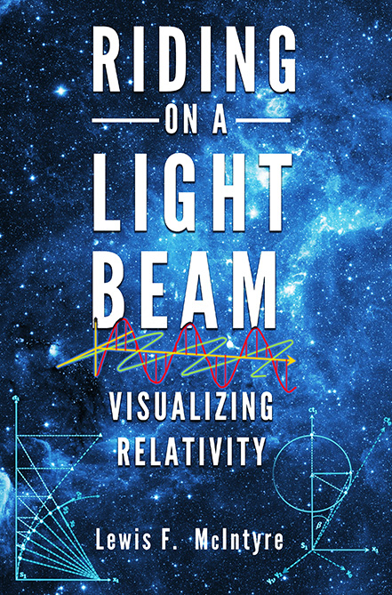
SUMMARY
AXIS OF SYMMETRY
Previously Unknown Property of the Lorentz Transform
Allows the solution of all problems with simple graphics
www.lewis-mcintyre.com
Notes:
So, I hope you enjoyed this presentation, and perhaps learned some things you didn’t know about the Lorentz Transform and the Velocity Triangle. If you want to learn more , read my book. You can purchase it on Amazon, via my website shown, or even a signed copy from me, as I have a few copies

