Slide 1


Social Dynamics and Positioning around a Black Woman’s
Equipment Handling in a Physics Lab
Mark O. Akubo,
University of Delaware
Emily Stump, Natasha G. Holmes
Cornell Physics Education Research Lab (CPERL)
CSAAPT, DOVER
March 16, 2024

Slide 2
Motivation for this Research
On average, women handle equipment less than men in physics labs
(Danielsson, 2012; Holmes, Roll, & Bonn, 2019)
But there is scant research on Black women’s equipment handling
Division of labor in an explicit way — is highly supportive of equitable participation. (Doucette, Clark, & Singh, 2020)
Experiences of Black women in physics highlight
            the exclusion of women of color in physics (aip.org, Hennessey et al. 2019; Rosa & Mensah, 2016; Santana & Singh, 2022)

Slide 3
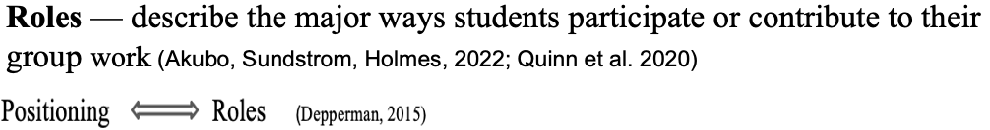
Framework: Positioning, & Equity of Individuality
Positioning = the ordering of social actions and participants’ preferences
and obligation to act and speak in certain ways
Dynamics = Enactment of interactions around equipment handling roles
(Davies & Harré, 1990; Hirvonen, 2016; Harré, 2012b ; Harré & Van Langenhove, 1991)
Implicit: Participants do not verbalize their intention to handle equipment in a
certain role but simply take on the role
Explicit: Participants state their intention to handle equipment in
a certain role, ask someone else to take on a certain role
                three forms: (Self-advocacy, Other-assigned, group-talked)
Equity of Individuality = individual students’ excellence and access
(Rodriguez, Brewe, Sawtelle, & Kramer(2012).

Slide 4
Dynamics around Zainab’s Equipment Handling

Slide 5
Data
Six 2-hour lab class sessions in the F2019 semester
(Transcripts of videos, memos, pictures, graphical illustrations)
3 Groups:
A— Pendulum Lab
B — Objects in flight
C — Hooke’s Law Lab

Slide 6
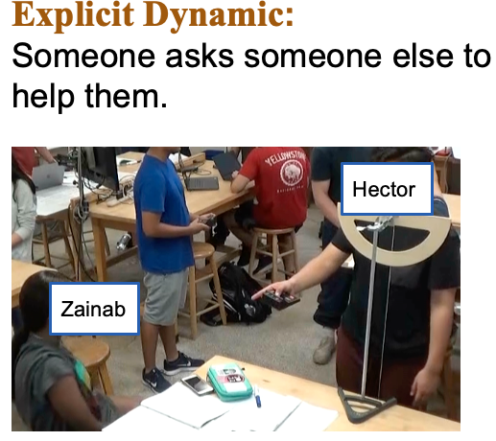
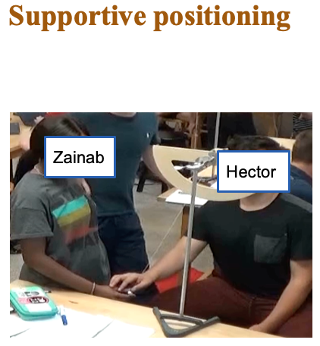
Finding: Implicit and explicit dynamics were enacted in a range of ways, with different positionings for Zainab, and implications for her equitable access to equipment handling
Group A
        Hector
        Hector

Slide 7
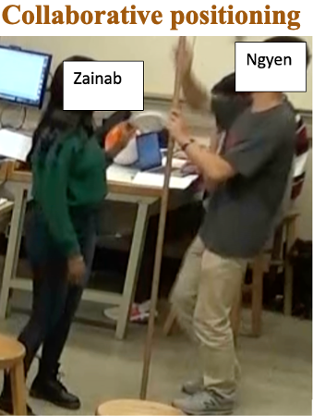
Finding: Implicit and explicit dynamics were enacted in a range of ways, with different positionings for Zainab, and implications for her equitable access to equipment handling
Group B
Implicit dynamic
Two people “just fall into the same positioning” around different roles

Slide 8
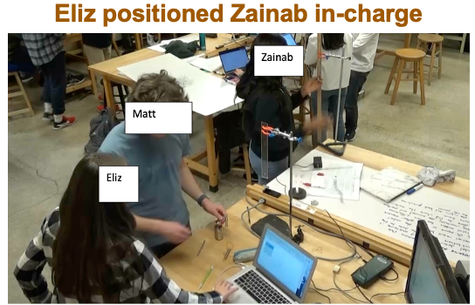
Finding: Implicit and explicit dynamics were enacted in a range of ways, with different positionings for Zainab, and implications for her equitable access to equipment handling
Group C
Explicit dynamic: Someone tells someone else what to do
Eliz: Okay, so, one person will check if the diameter of the spring changes the point at which it breaks down. And another person checks if the magnitude of the spring constant changes where it breaks down. Okay, and I can do excel and if you guys check, I can just record the data.

Slide 9
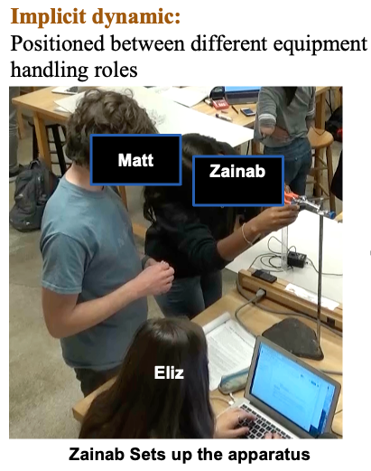
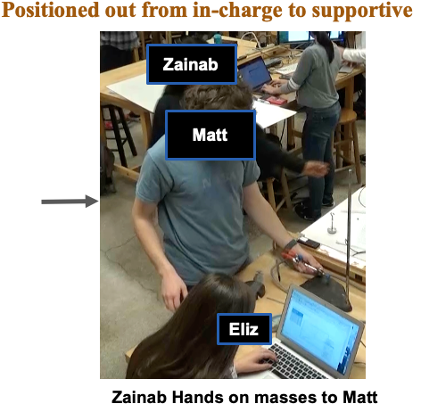
Finding: Implicit and explicit dynamics were enacted in a range of ways, with different positionings for Zainab, and implications for her equitable access to equipment handling
        Zainab
Group C
        Zainab
        Matt
        Matt
        Hector
        Jack
        Zainab
        Eliz
        Eliz

Slide 10
Summary of Zainab’s Positionings During Diverse Dynamics

Slide 11
Discussion
Previous evidence has argued that implicit dynamics lead to inequities in group work. We see that it is not always the case.
Even though explicit assignment of roles by a peer leads to Zainab’s taking charge of her own experiment and equipment handling, this effectively makes her overworked.

Slide 12
Conclusion
Implicit and explicit dynamics can happen in different ways, with different positionings, and implications for equity.

Slide 13
Implications
For Research: Need for more research to understand differences in the minoritized students’ experiences from group to group
For Practice:
Toward more instructor facilitation of equitable handling of equipment in lab, need for training on what kinds of explicit assignment are equitable.

Slide 14
Future Work
Intersectionality lens to understand nuances in positioning and dynamics around equipment handling by the minoritized participant
The role of explicit negotiation in (in)equity around equipment handling

Slide 15

GRFP Grant No. DGE-2139899 & NSF Grant No. DUE-2000739
Contact: marka@udel.edu
This Photo by Unknown Author is licensed under CC BY-SA

Slide 16
References
Crenshaw, K. (1989). Demarginalizing the intersection of race and sex: A black feminist critique of antidiscrimination doctrine, feminist theory and antiracist politics. u. Chi. Legal f., 139.
Doucette, D. Clark, R. & Singh, C. Hermione and the secretary: how gendered task division in introductory physics labs can disrupt equitable learning, European Journal of Physics 41,035702 (2020).
Danielsson, A. T. (2012). Exploring woman university physics students ‘doing gender’ and ‘doing physics’. Gender and Education, 24(1), 25-39.
Freeman, S., Haak, D., & Wenderoth, M. P. (2011). Increased course structure improves performance in introductory biology. CBE— Life Sciences Education, 10(2), 175-186.
Harre, R. & Van Langenhove, L. (1991). Varieties of positioning, Journal for the theory of social behavior 10.1111/j.1468- 5914.1991.tb00203.x.
Holmes, N. G., Roll, I., & Bonn, D. A. (2019). Participating in the physics lab: does gender matter? arXiv preprint arXiv:1905.03331.
MacIsaac, D. (Ed.). (2019). US government releases Charting a Course for Success: America’s Strategy for STEM Education, report guiding federal agencies that offer STEM funding opportunities. TPT, 57(2), 126-126.
Rosa, K., & Mensah, F. M. (2016). Educational pathways of Black women physicists: Stories of experiencing and overcoming obstacles in life. Physical Review Physics Education Research, 12(2), 020113.
National Science Teachers Association. (2007). NSTA position statement: The integral role of laboratory investigations in science instruction. NSTA Handbook: 2010, 11, 201-204.
Partnership for 21st Century Skills (P21). Framework for 21st Century Learning. December 2009. Science Maps: http://science.nsta.org/ps/Final21stCSkillsMapScience.pdf
Rodriguez, I., Brewe, E., Sawtelle, V., & Kramer, L. H. (2012). Impact of equity models and statistical measures on interpretations of educational reform. Physical Review Special Topics-Physics Education Research, 8(2), 020103.
Santana, L., & Singh, C. (2022, July 13-14). Investigating experiences of a Black woman in physics and astronomy. Paper presented at Physics Education Research Conference 2022, Grand Rapids, MI. Retrieved March 29, 2023,
Walsh, C., Lewandowski, H. J., & Holmes, N. G. (2022). Skills-focused lab instruction improves critical thinking skills and experimentation views for all students. Physical Review Physics Education Research, 18(1), 010128.

Slide 17
Methodology
Research Design:
Qualitative, Single Case Study
Study Context:
undergraduate non-traditional physics lab
Participants:
Seven participants split in three groups: (Zainab) the Black Woman member of all groups

Slide 18
Data/Analysis
Purposefully selected the lab groups/sessions involving Zainab.
Why?
Her indication of interest to handle equipment
So, we wanted to characterize her equipment handling in the lab

Slide 19
Analysis
Developed positioning coding scheme
In-charge (I): Participant independently handles equipment or leads equipment
Collaborative (C): Two or more participants work together handling equipment during their lab activity
Supportive (S): Participant takes on an equipment handling role which is
(a) auxiliary to another role,
(b) enacted with evidence of receiving constraining direction

Slide 20
Analysis
Developed two coding schemes: (a) positioning (b) dynamics
Selected transcripts of equipment handling episodes,
Research group deliberated on selection for equipment-handling-definition fit
First and second authors independently coded video/transcripts for the
dynamics, compared coding in research group meetings,
reaching approximately 90% agreement, discussed disagreement,
where still unreconciled, 3rd researcher’s decision was accepted
Similar iteration for Zainab’s positioning around equipment handling
agreed almost in all cases
Plotted graphs/charts to visualize the dynamics & positioning, computed
the duration of each positioning

Slide 21


Analysis
Developed dynamics coding scheme
= Participants do not verbalize their intention to handle equipment in a
certain role but simply take on the role
= Participants state their intention to handle equipment in
a certain role, ask someone else to take on a certain role
= Participants democratically discuss the available role options, and
each chooses what equipment handling role they wanted to take on
Implicit
Explicit
Negotiation

Slide 22
Our Definition of Equipment Handling
When participants collect/put away equipment for their investigation,
use the equipment
to conduct investigation, and so generate data,
during a discussion to illustrate a point while sharing ideas,
take/read measurements,
In general, the activity will be fundamentally changed if they were not handling the equipment.

Slide 23
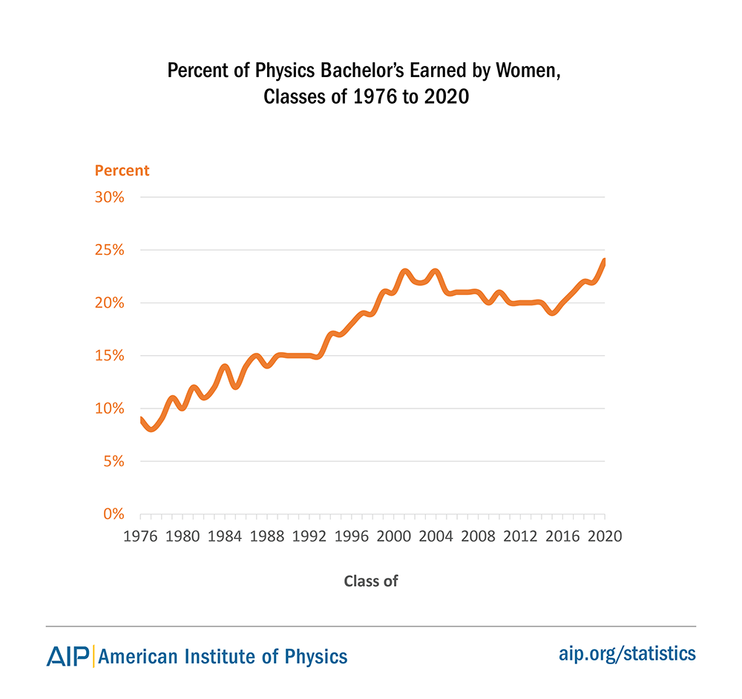
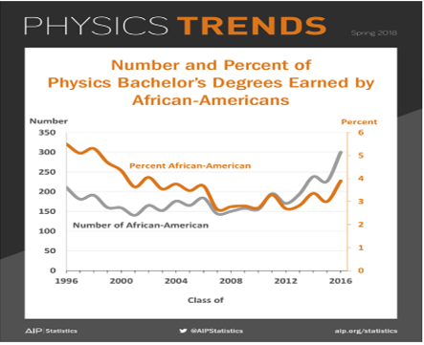
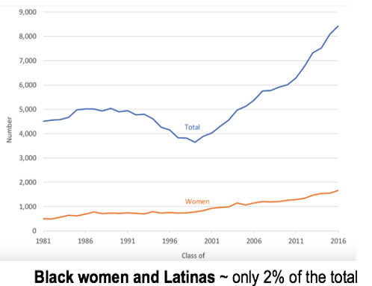
Historical Exclusion
aip.org

Slide 24
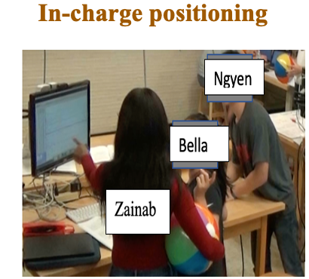
Group B
Explicit (Negotiation) Dynamic
1. Ngyen: So, one person can take down notes.
2. Bella: …I think I can take down the notes.
3. Ngyen: Okay
4. Ngyen: What do you want?...
5. Zainab: I could do the experiment.
        Zainab
        Hector
        Hector

Slide 25
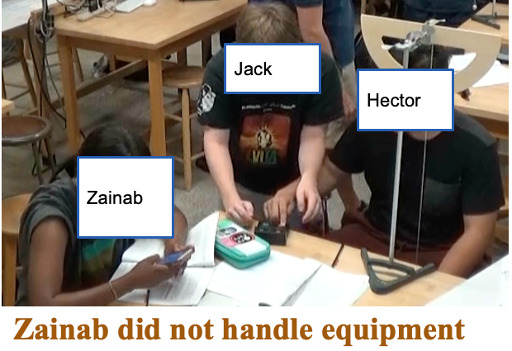
Implicit Dynamics: Two people just “fall into the role”
        Hector
        Jack
        Zainab

Slide 26
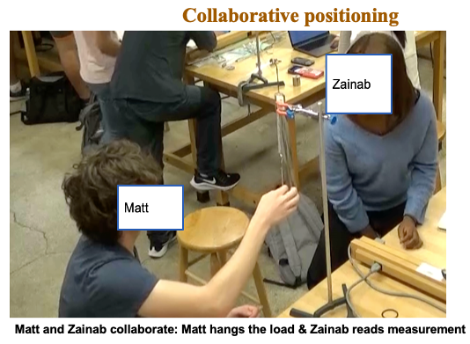
Implicit and explicit dynamics were enacted in a range of ways, with different positionings. Replace with Ngyen and Zainab
Group C
Implicit dynamic
Two people “just fall into the same positioning” around different roles

