Slide 1
Physics of an accelerating unicycle
Chesapeake Section of AAPT
Delaware State University, Dover
Carl Mungan, Physics Department, U.S. Naval Academy, Annapolis MD
Spring 2024 Meeting
Saturday16 March 2024

Slide 2
A ball rolls along a ramp without slipping.
(Neglect air drag and rolling friction throughout this talk.)
Why doesn’t the ball slide instead of rolling?
Answer: Because of static friction.
Let’s see how that works by drawing a FBD.

Slide 3
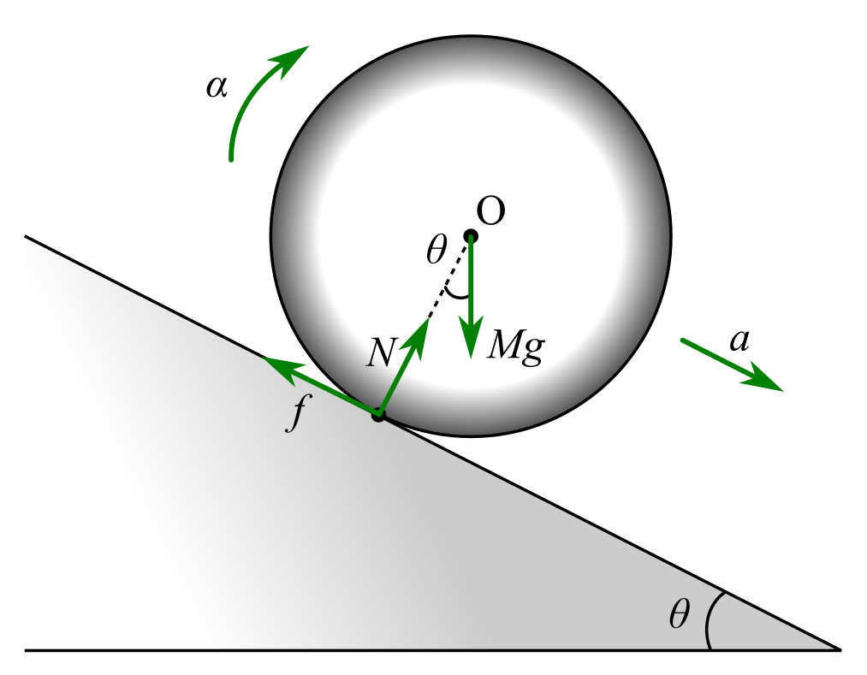
(regardless of whether the ball is
moving up or down the ramp)

Slide 4
Does f = μN
where μ is the coefficient of static friction?
Hopefully not,
because otherwise the ball will be about to slip.
Specifically suppose θ is small enough and μ large enough
that tanθ < μ to avoid that.
In that case, how do we find an expression for f ?
Answer: We need it to get α so use N2L.

Slide 5
translations of O:
rotations about O:
add the two equations:
(rolling object
of radius R)

Slide 6
Now let θ = 0 so we’re on a horizontal surface.
Then f = 0 ! Does that mean it cannot roll without slipping?
Answer: No, but a = 0 and α = 0 so it must be rolling
at constant translational speed υ and angular speed ω
with υ = Rω.

Slide 7
But what if we want to speed up or slow down the rolling?
Good question! As an example of a single-wheeled object
that can increase in speed, consider a unicycle.
There must now be a forward static frictional force
to produce the forward translational acceleration.
But the frictional torque then tries to angularly decelerate
the wheel. Thus the driving torque τ applied by the rider
must be opposite in direction and larger in magnitude than it.

Slide 8
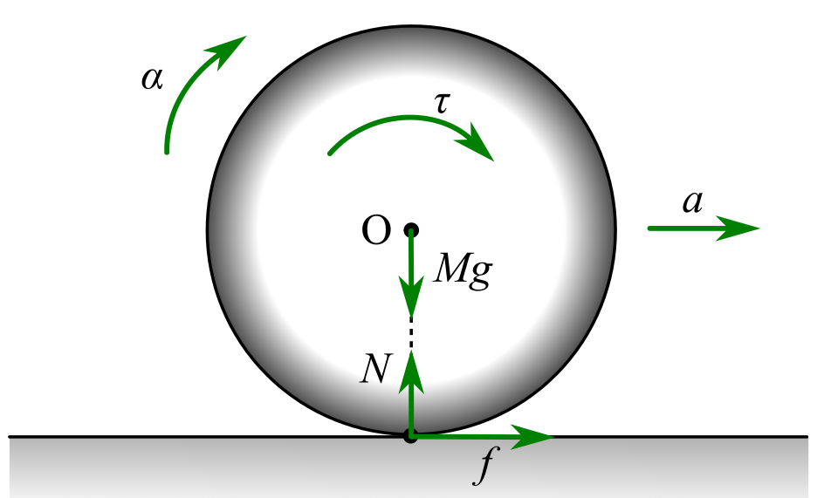
partial FBD:
We’re missing the rider!
Model him as a point mass m
at radial distance r.

Slide 9
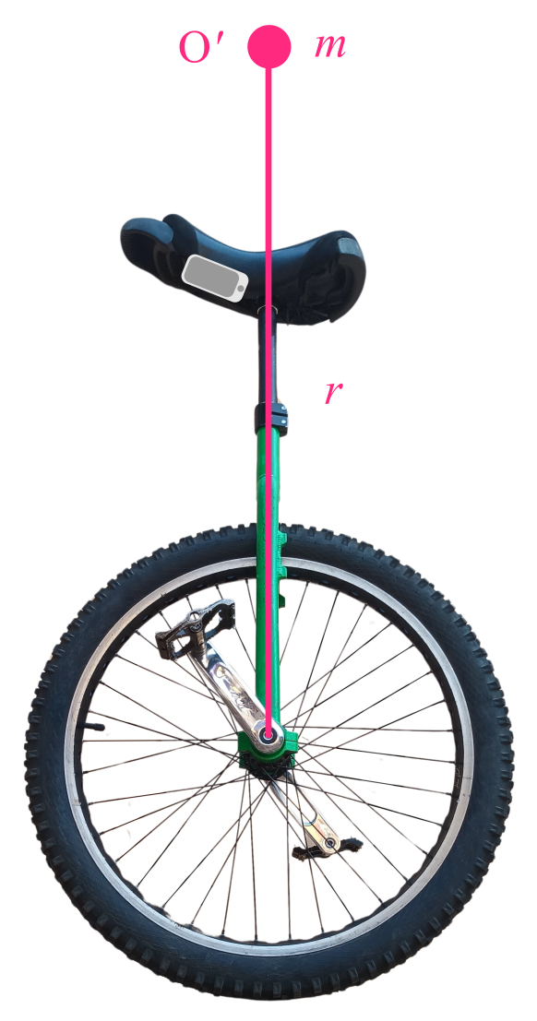
Includes the seat, support rod,
and rider.
Smartphone running Phyphox
to measure acceleration.

Slide 10
FBD:
for rider alone
for whole system
for wheel alone
Equal & opposite F
and τ as on the wheel
by N3L.
Rider is accelerated forward by F_{x} and must tilt to counter τ.
Rider must
tilt forward by ϕ
to accelerate forward
as panel (c) shows.
Rider applies
driving torque τ
and reaction force F
to the wheel.

Slide 11
Apply N2L for translations and rotations
both to the wheel alone and to the rider alone.
Use small-angle approximation for ϕ.
(Details in upcoming paper in Physics Education.)
acceleration of unicycle:
tilt angle to balance
torques on rider:
frictional coefficient
to avoid slipping:
(all three are
proportional to
the applied torque)

Slide 12
Compare theory to experiment
Variable | Value
M | 6.0 kg
m | 65 kg
γ | 0.90
R | 0.38 m
r | 1.1 m
g | 9.8 N/kg

Slide 13
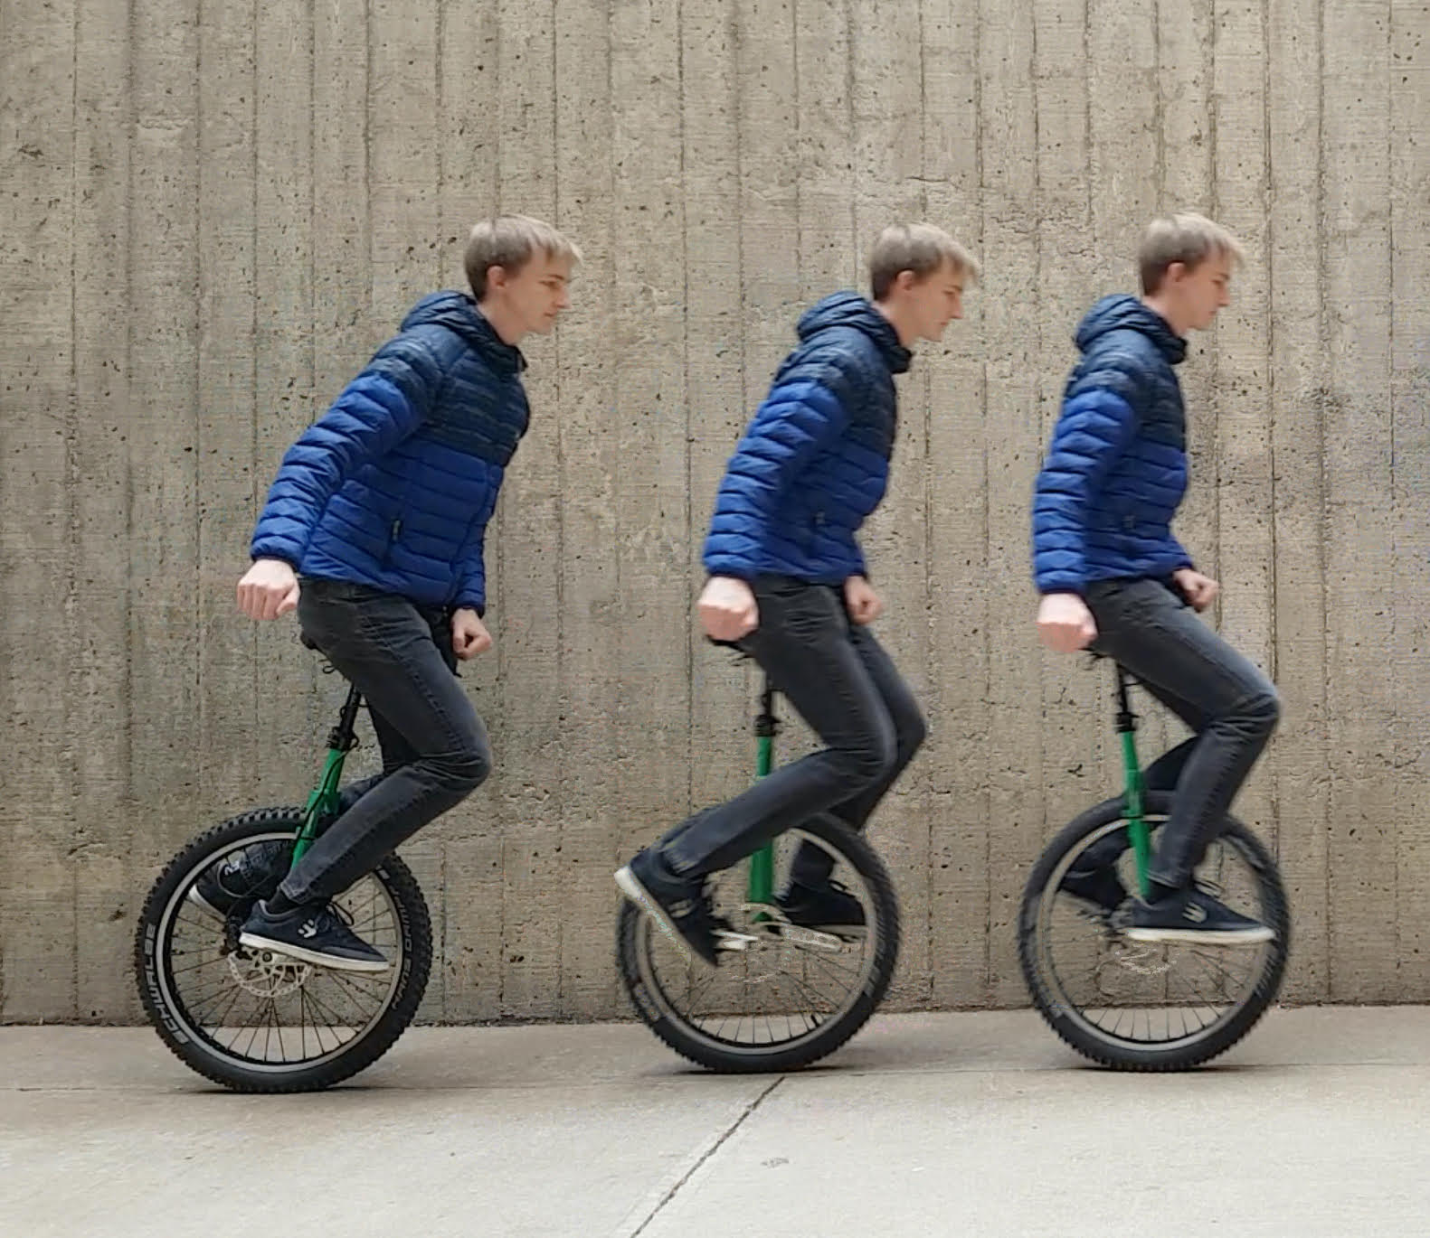
Accelerating by tilting 15° and then returning to constant velocity:
(Ph.D. student
Heiko Kabutz at
Univ. of CO Boulder)

Slide 14
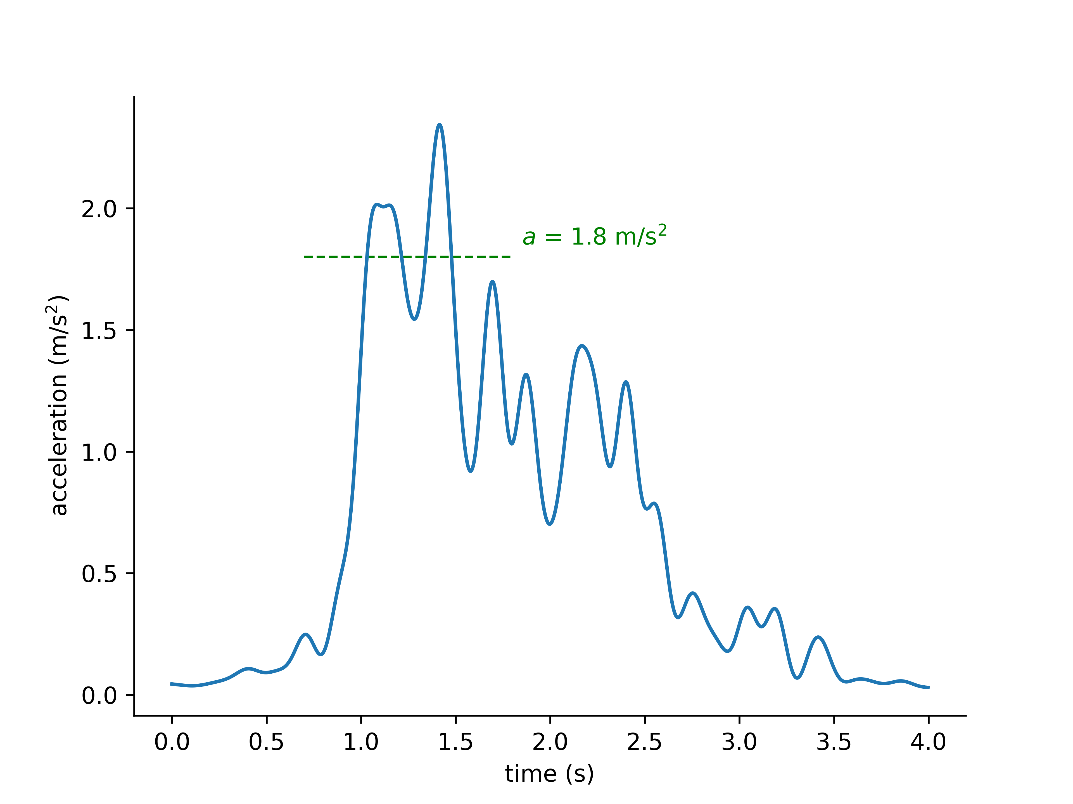
Measured acceleration in blue versus theoretical peak acceleration in green:

Slide 15
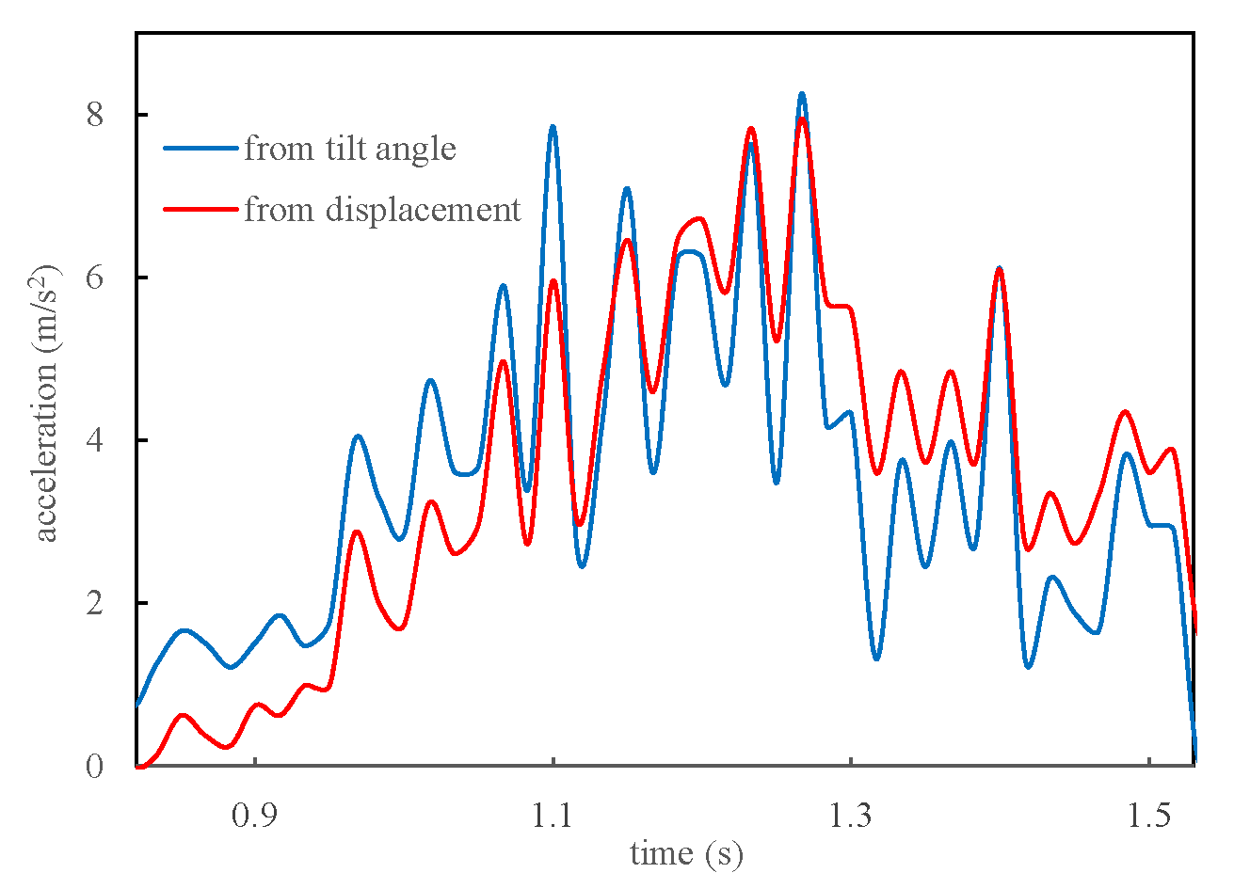
More detailed comparison from video analysis of tilt and displacement:
(used Tracker
to measure
coordinates of
axle and of seat)

Slide 16
Comments or questions?
email: mungan@usna.edu
webpage: usna.edu/Users/physics/mungan

