Slide 1
Enhancing STEM Graduate Student Teaching: Cultivating Teaching Skills and Identity Among Graduate Students
Nishchal Thapa Magar, Jessica L. Rosenberg, Jill K. Nelson, Marco Brizzolara

Slide 2
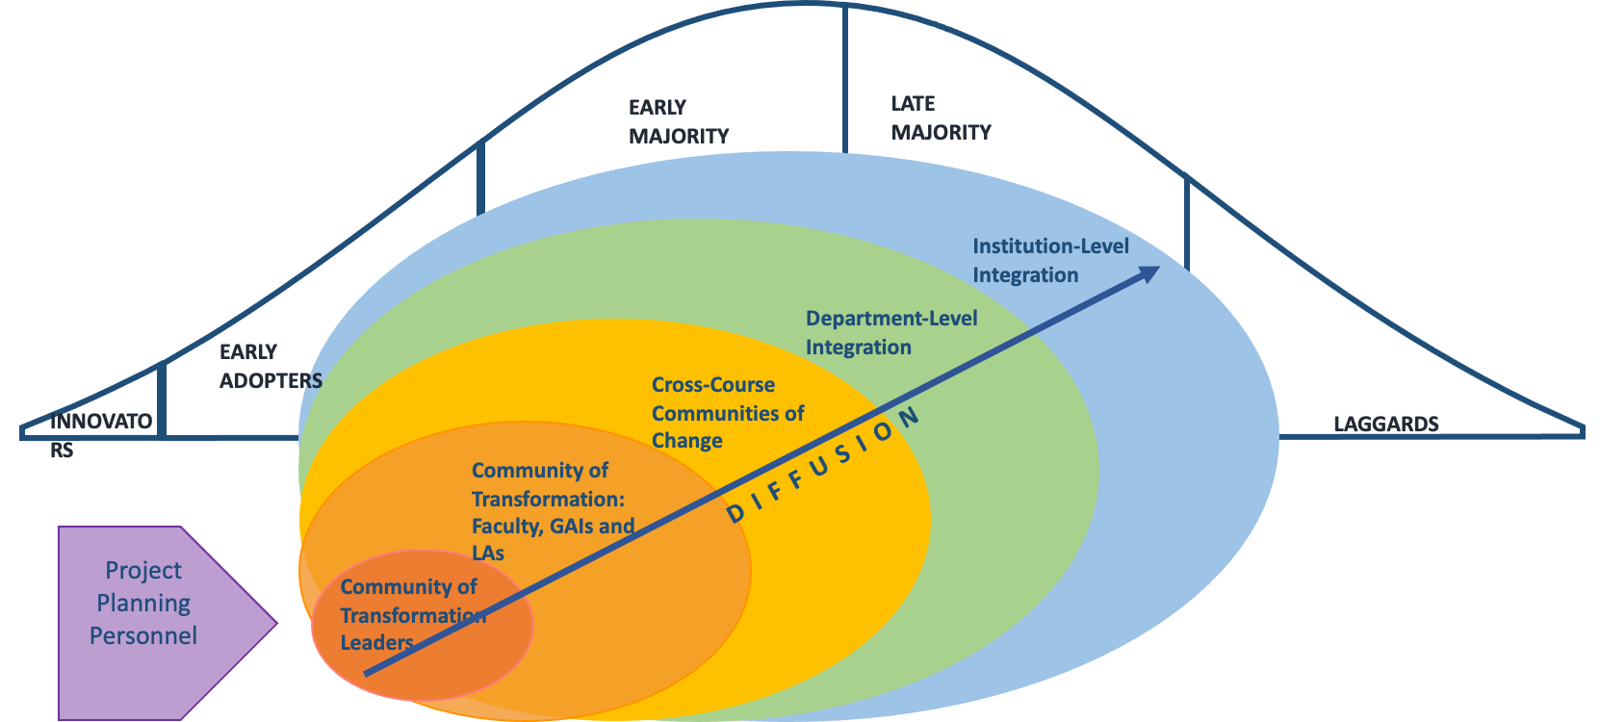
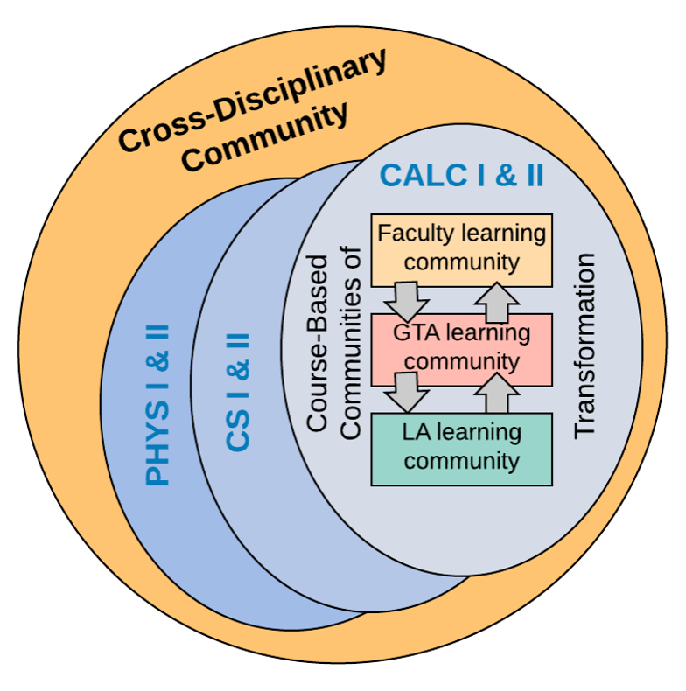
The Gateway2STEM Goal: Make large undergraduate courses more active
Implementation:
Active learning across Math, Physics, and CS
The Idea

Slide 3
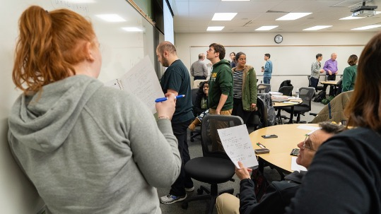
Why GTAs are Important Focus to Project
Play important role in large enrollment introductory courses
Engage with and instruct many undergraduates
Can help change teaching pedagogies and impact many students
Are future faculty

Slide 4
GTA Professional Development Overview
2 Day workshop for new GTAs before Fall semester
Physics seminar series with first year GTAs
Meetings of Math GTAs in calculus run by a lead GTA
CS peer mentorship model – new GTAs work with returning GTA in the classroom

Slide 5
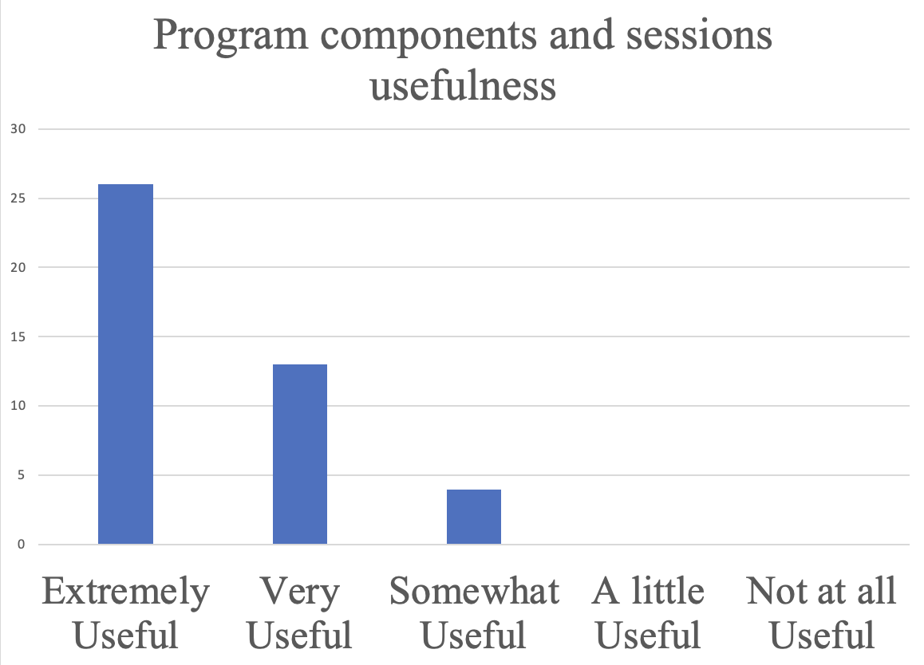
Major Workshop Topics
What is Active Learning and how can you implement it?
Building classroom community
Planning for day one
Campus resources
Returning GTA discussion
Fall 2023​

Slide 6
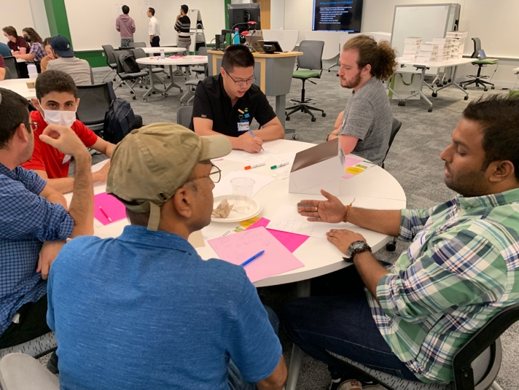
Findings:
Preliminary analysis examined :
Use of active learning in the classroom
GTA's perception of their role
Experiences of international GTAs

Slide 7
Use Active Learning in the Classroom
All interviewees used active learning in their classrooms
Group work at tables and on whiteboards
Practice problem solving and programming on their own
Engaging them by asking questions
Students benefitted from extra practice, interacted more with GTAs
“I decided that a lot of hard work using the old-school method, checking 50-60 students at the top of the grading, is super hard. So, I implemented group work.”

Slide 8
GTAs Perception of their role in the Classroom
Have significant autonomy in their classes and have mix of responsibilities
Grader
Instructor
Curriculum designer
Struggle to find the balance between authority and connection with students in classroom
“I initially wanted to be friends with all the students, but within a few weeks, I realized that being too friendly could lead to unwanted questions and disruptions in the class.”

Slide 9
Differences in experiences of International GTAs
Different educational structures in home country
Different relationship between students and teacher
Teaching in a second language poses a language barrier that may result in miscommunication
“From a cultural perspective this might be the most challenging aspect for me. In my home country, students are afraid of their teachers. So, I think it’s somewhat different here. They are not afraid and keep asking questions.”

Slide 10
Conclusions and Next Steps
GTAs learned new teaching strategies from professional development
GTAs incorporated active learning techniques into their teaching practice
Continue follow-up interviews with GTAs
Understand international GTAs challenges
Bridge the classroom culture gap for effective GTA PD

Slide 11
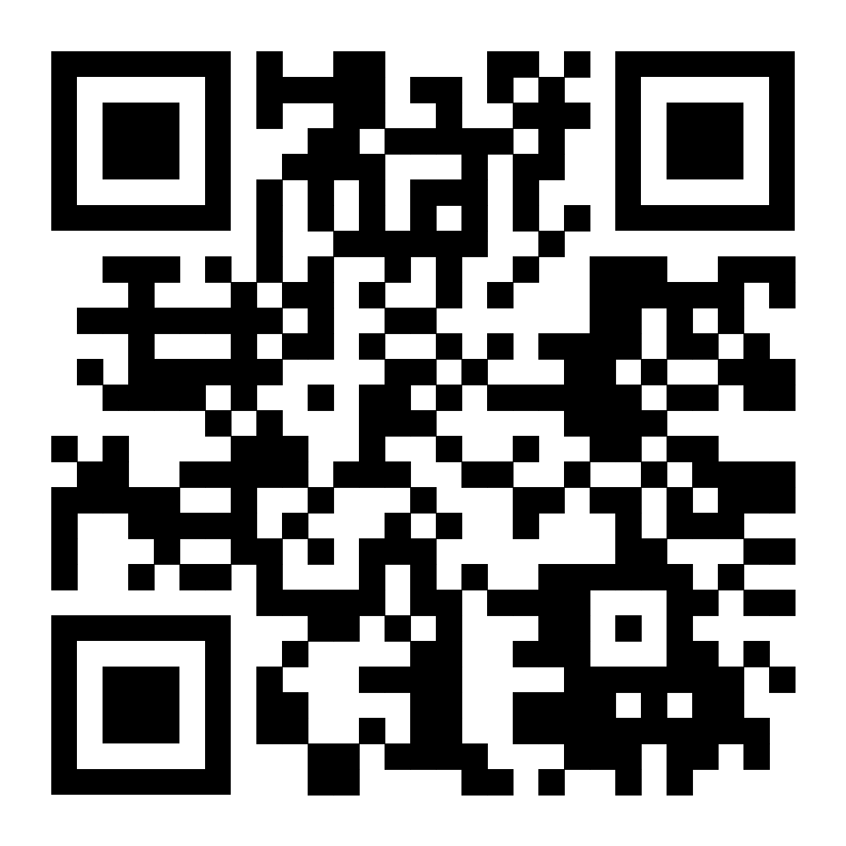
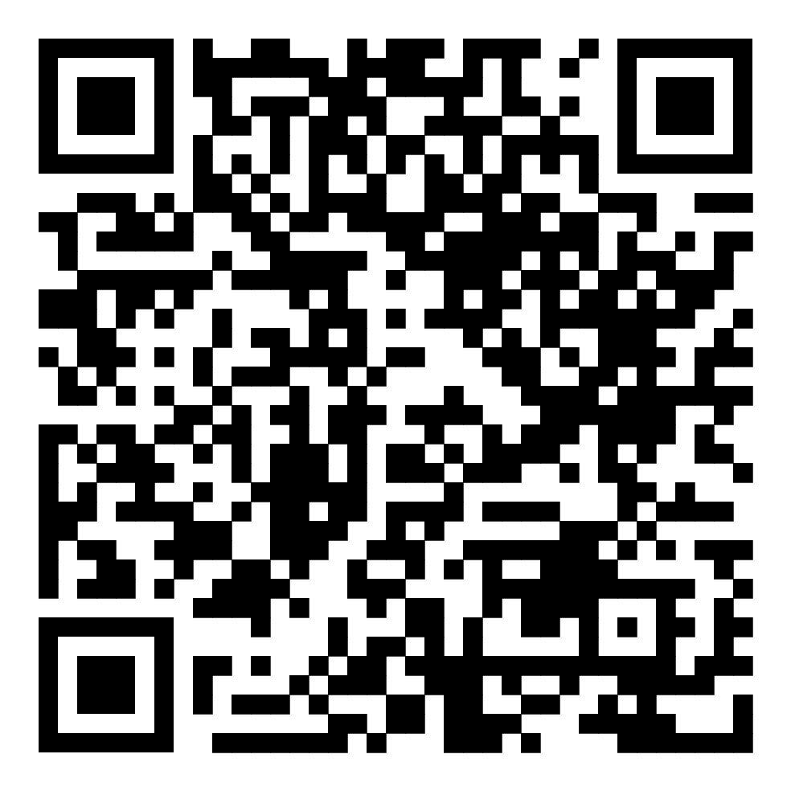
Thank you!
Gateway2STEM website:
https://gstem.research.gmu.edu
Video about the Gateway2STEM project:
https://www.youtube.com/watch?v=n4gBld5GFhk

