Slide 1
Let it Go!
Henry Hilgendorf
Tatsu Takeuchi
Virginia Tech March 16, 2024 @ Chesapeake Section of the AAPT spring 2024 Meeting @ Delaware state University

Slide 2
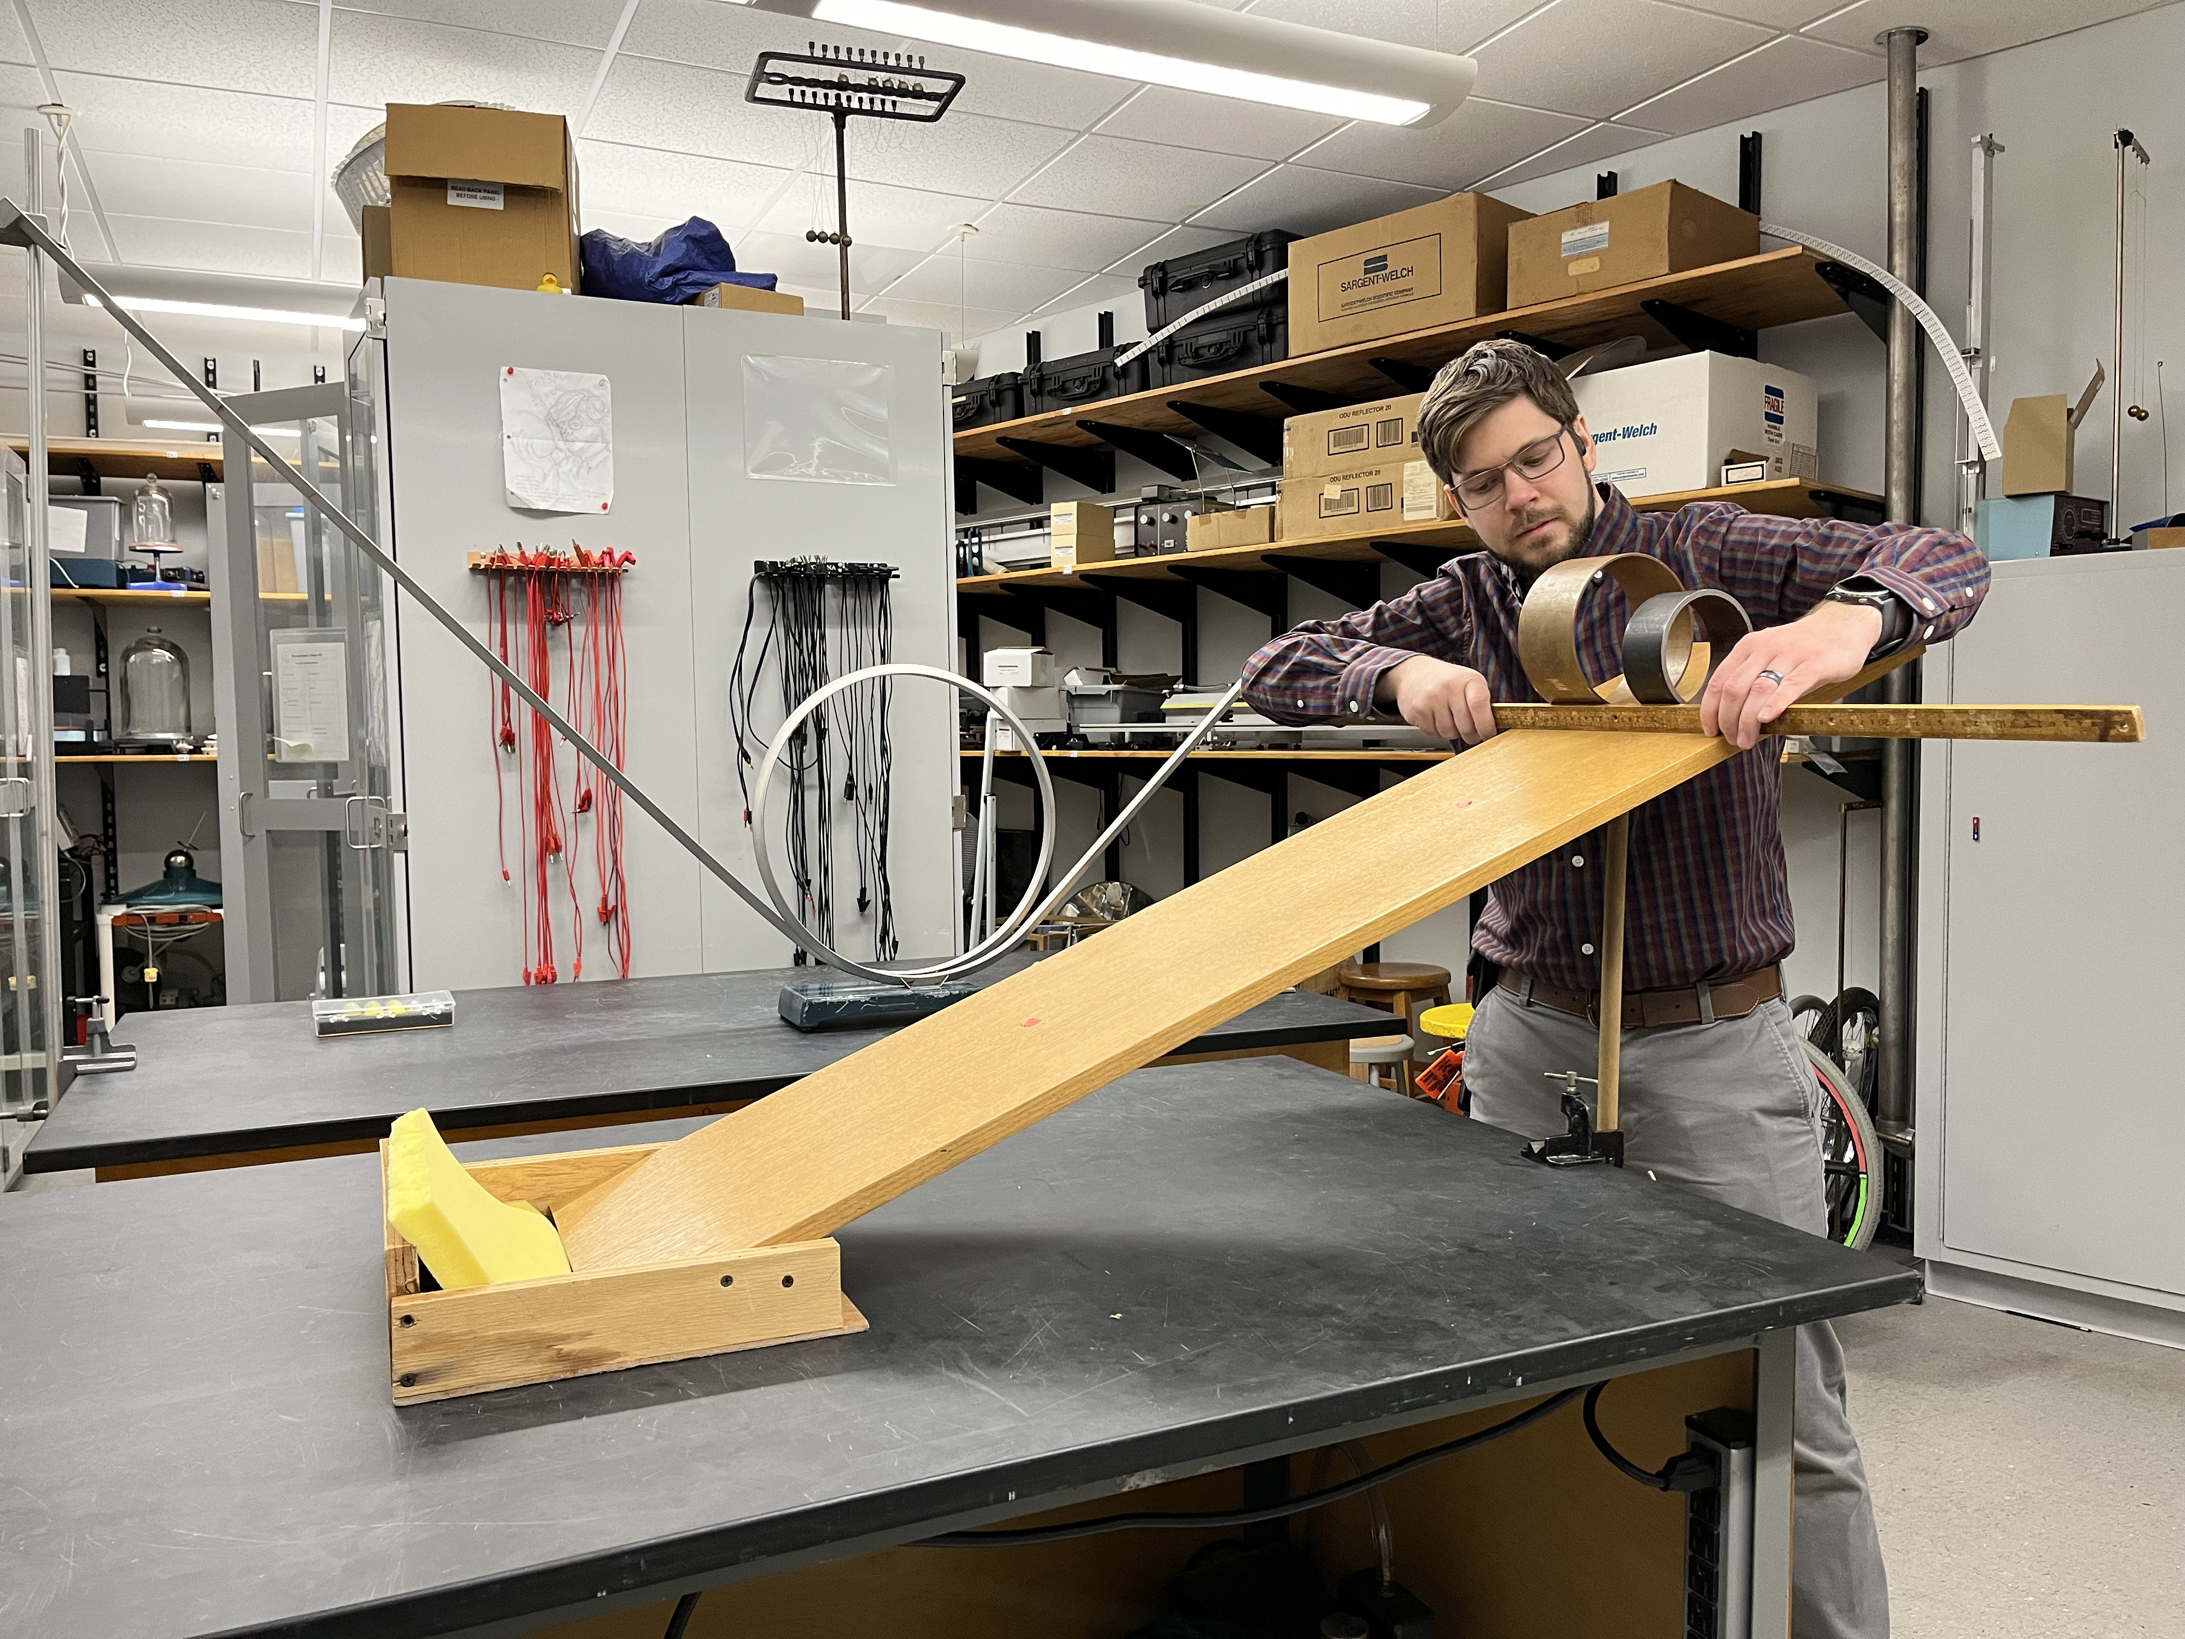
Rolling down the ramp demo:

Slide 3
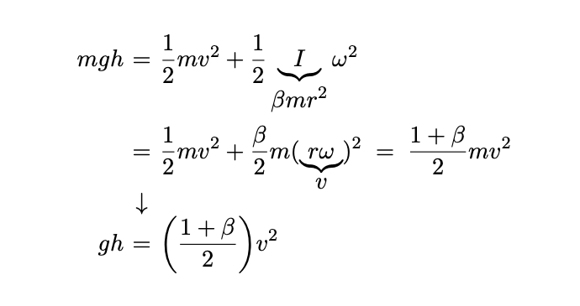
USED TO DEMONSTRATE ENERGY CONSERVATION:
The velocity at the bottom does not depend on the mass or radius.

Slide 4
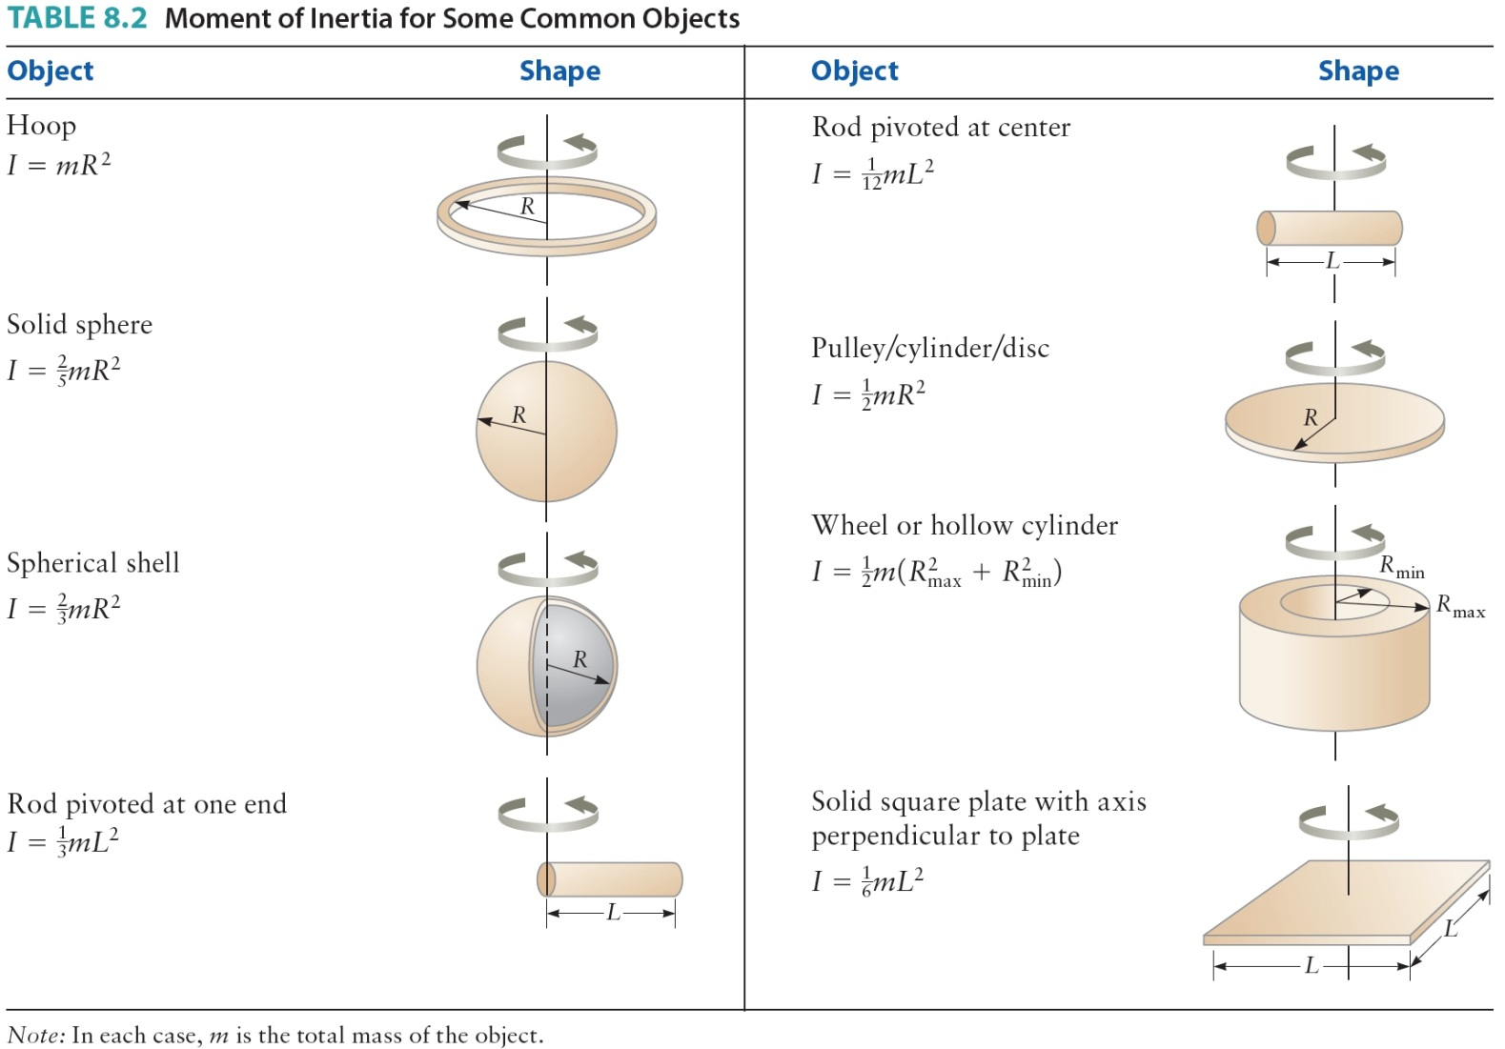
Moment of inertia:

Slide 5
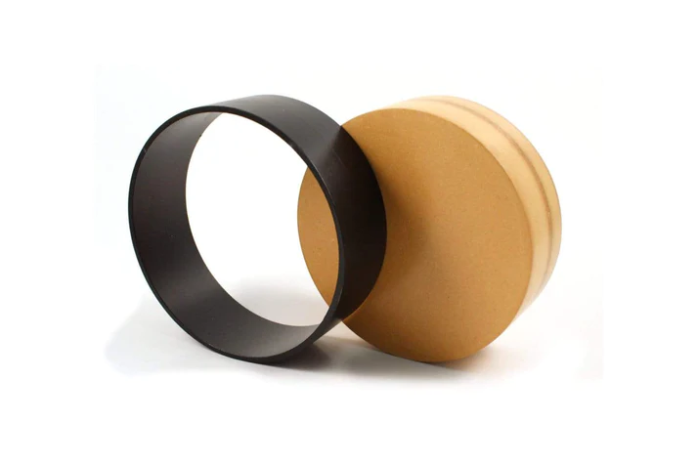
cost:
The ramp can be constructed out of relatively inexpensive material. (1 in x 12 in x 4 ft unfinished pine board is about $20 at Lowes/Home Depot)
Rolling objects can be expensive. Example: Ring and Disk set from Arbor Scientific (equal mass and equal radii) - $44
Can we use canned foods we have lying around in the pantry instead? (No need for equal mass or equal radii after all.)

Slide 6
Andy Warhol race:
Which can will win the race?

Slide 7
inorganic (condensed) vs. Organic (non-condensed):
Which can will win the race?

Slide 8
Frozen (Left) and thawed (right) cans of Orange juice
Which can will win the race?

Slide 9
Other possible races between household items:
Ping-Pong ball vs. Golf Ball (hollow vs. solid sphere)
Baseball vs. Golf ball (different mass and size but same shape)
Baseball vs. Soup Can (sphere vs. cylinder)
Baseball vs. Toy Car (rolling vs. non-rolling)
etc.

