Slide 1
Mechanical Oscillations With and Without Damping
- An Analog Computer Physics-Themed Simulation
Ryan Bischof
Advisor: Michael Cimorosi
Division of Physics, Engineering, Mathematics, and Computer Science (PEMaCS)
Delaware State University

Slide 2
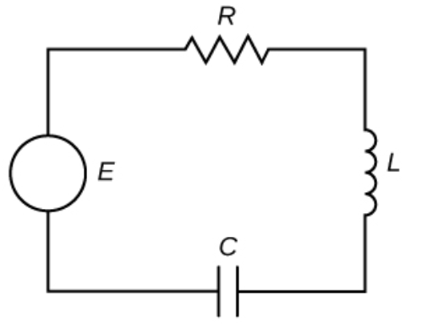
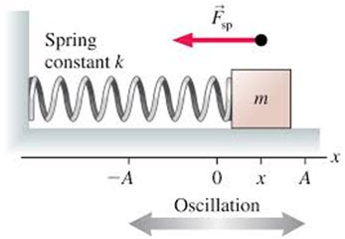
Simple Harmonic Motion
RLC Circuit
m - mass
b – damping coefficient
k – spring constant
f(t) –external force
L - inductance
R – resistance
C – capacitance
E(t) – voltage source
Both spring-mass systems and RLC circuits can be modeled by second-order constant-coefficient differential equations.
Notes:
https://math.libretexts.org/Bookshelves/Calculus/Calculus_(OpenStax)/17%3A_Second-Order_Differential_Equations/17.03%3A_Applications_of_Second-Order_Differential_Equations

Slide 3
We constructed a breadboard analog computer
with currents following a second-order linear differential equation
to model the position of a sliding block attached to a massless spring
in two cases (1) with damping and (2) without damping.
Solutions displayed on an oscilloscope
An instructional approach for students to visualize classical physics through hands-on analog circuit design

Slide 4
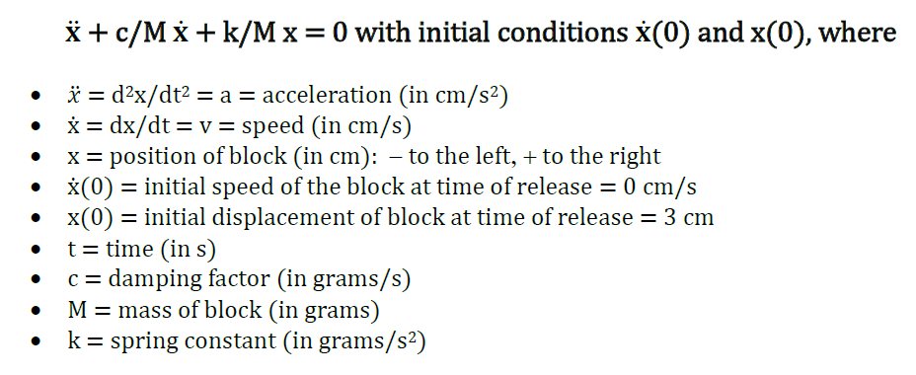
We began with the dynamics of the spring-mass system.

Slide 5
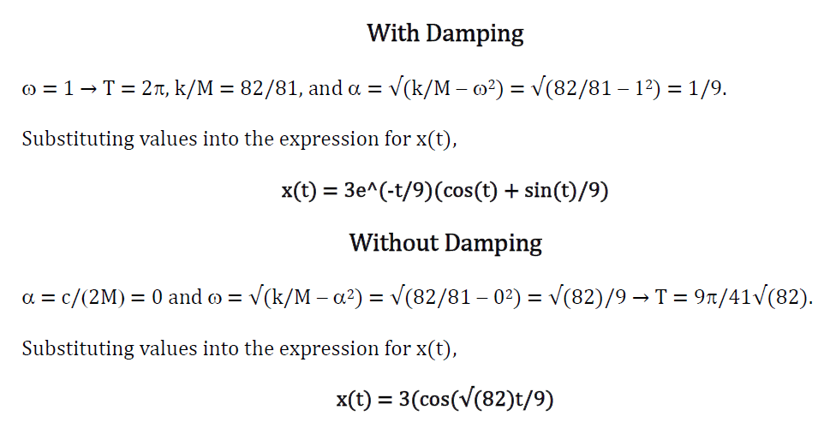
We then delved in the math and arrived at

Slide 6
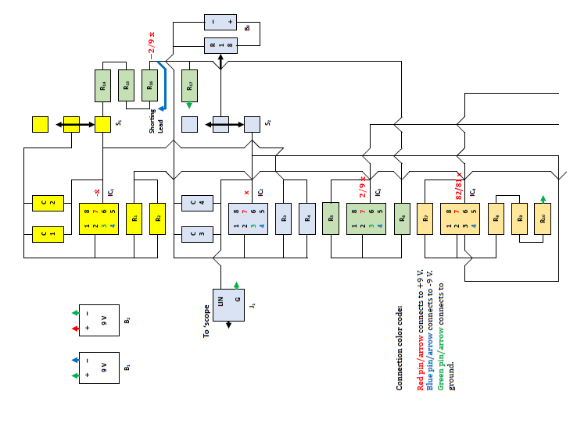
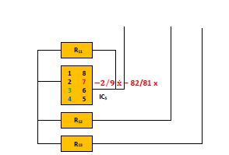
We drew the diagram of analog computer breadboard connection and mathematics flow.

Slide 7
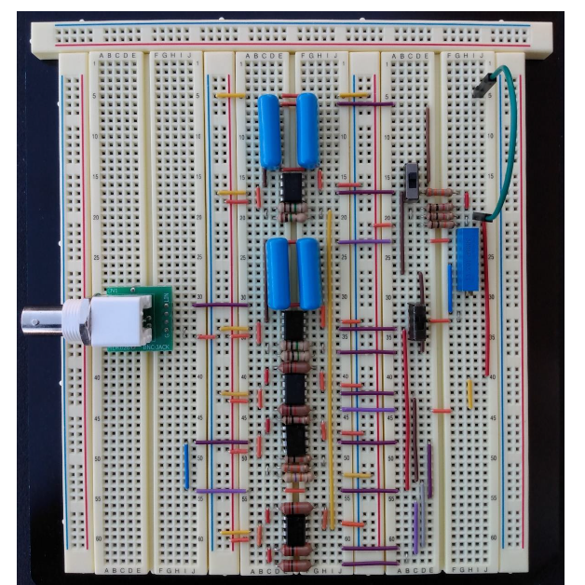
Finally, we built the breadboard circuit according to the diagram.

Slide 8
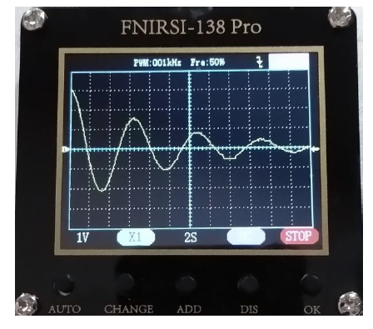
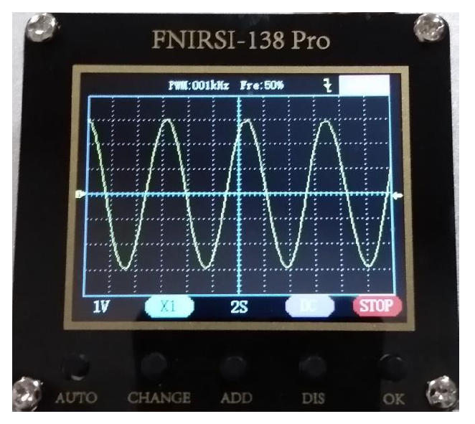
When we connect the batteries to the circuit and have the initial conditions set right, we see these displayed on the oscilloscope.
They behave exactly the same as the oscillation of a spring-mass system with or without damping.

Slide 9
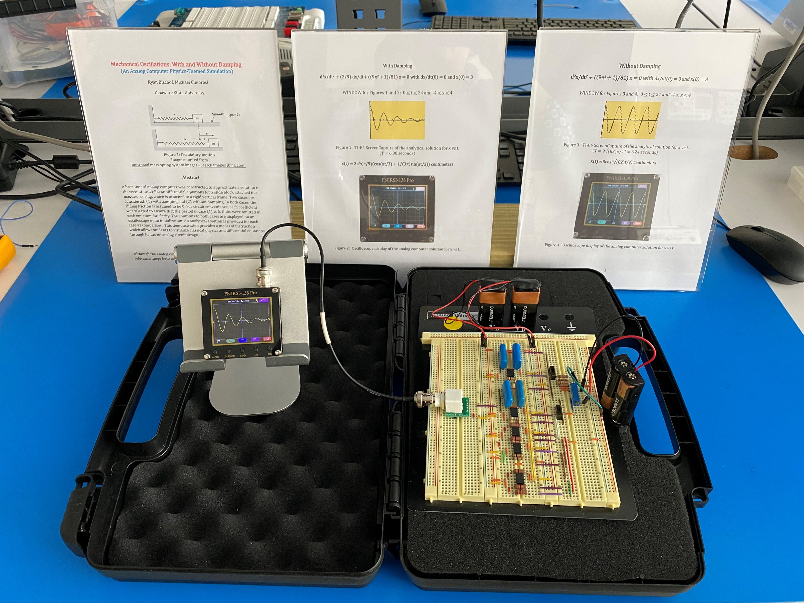
The complete demonstration set

Slide 10
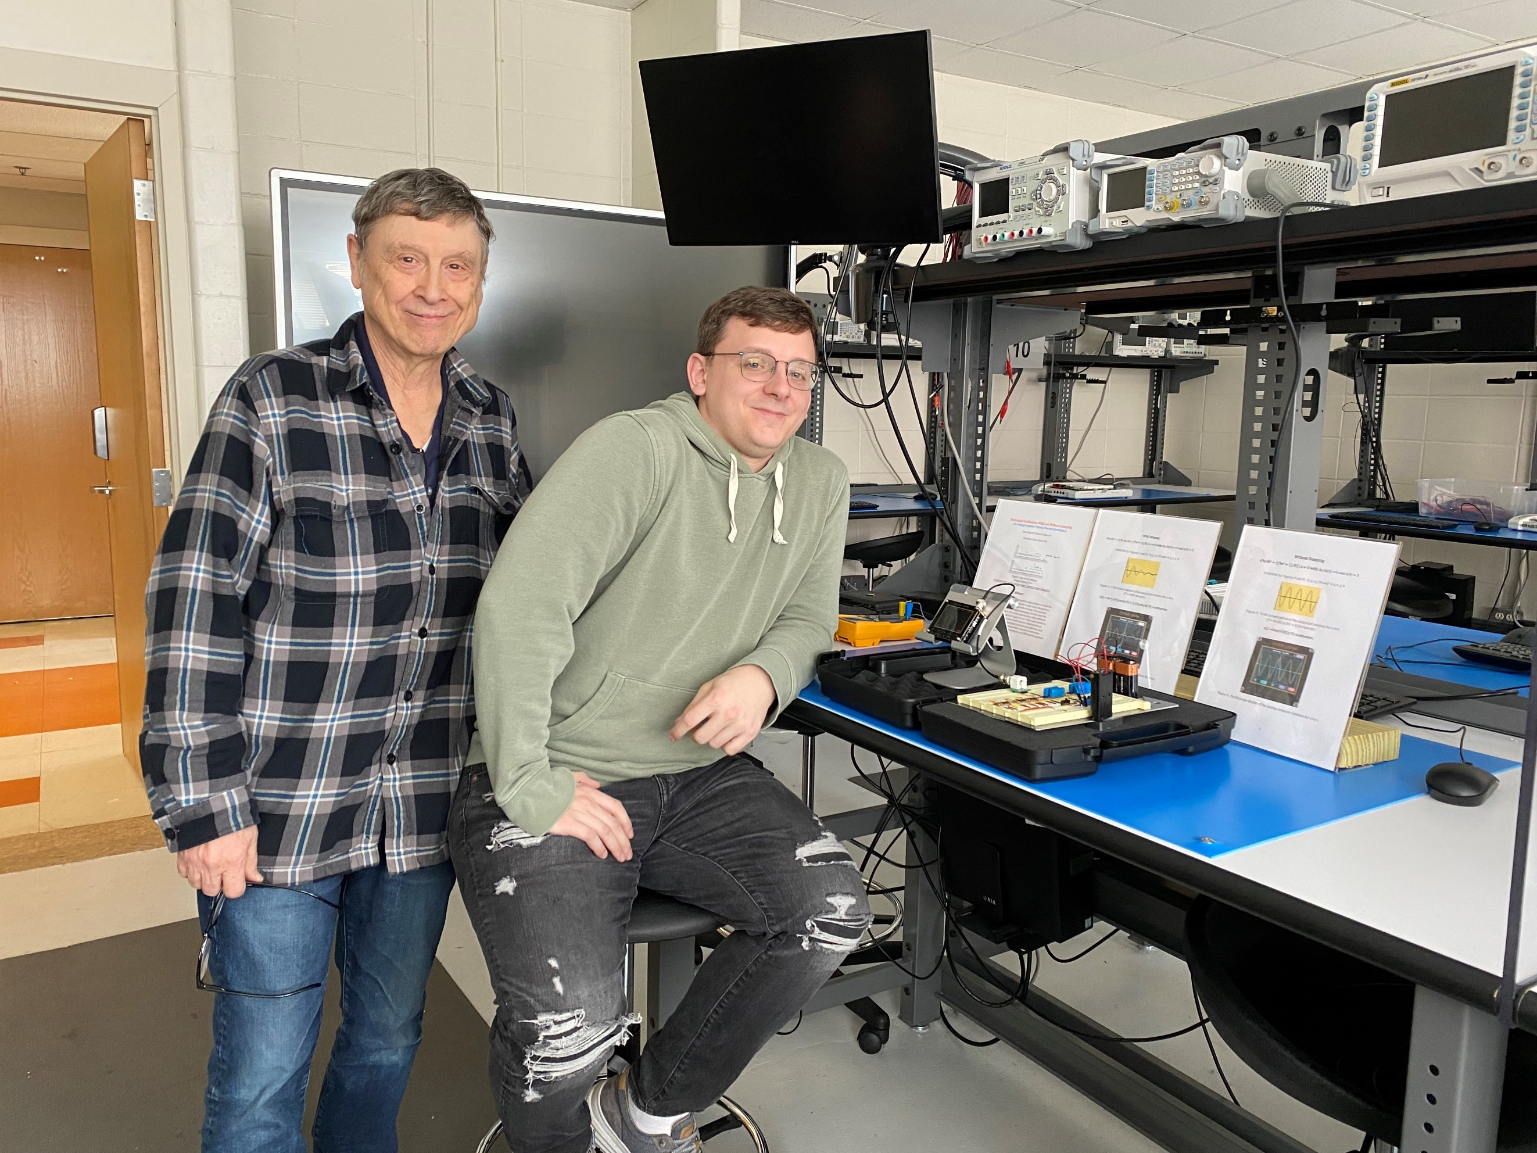
Me with my advisor Mr. C

Slide 11
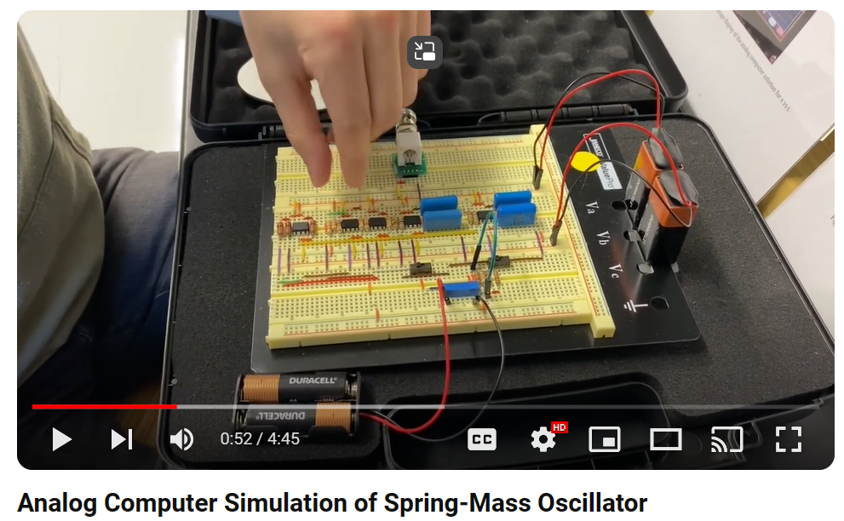
Enjoy the demonstration!
https://www.youtube.com/watch?v=syRmXpcJmA8
Notes:
https://www.youtube.com/watch?v=syRmXpcJmA8

