Slide 1
Using Hand-held Visual Accelerometers and the CER Framework in Student-Centered Classrooms to Talk Through FCI Misconceptions.
Judson Wagner, Ed.D.
Spring 2024 Meeting Chesapeake Section of the American Association of Physics Teachers (CSAAPT)
Saturday, March 16, 2024
Delaware State University
EDUCATE FOR SERVICE. ENGINEER FOR SOCIETY.

Slide 2
STUDENT-CENTERED
CER FRAMEWORK
FCI MISCONCEPTIONS
NORMALOMETER
ACTIVITY
Student-Centered Learning Environments
“Students drive their own and their
peers’ learning, holding themselves
accountable for reaching their learning
targets, while the teacher shifts to the
role of facilitator and verifies learning.”
Toth, M. D., & Sousa, D. A. (2019). The Power of Student Teams: Achieving Social, Emotional, and Cognitive Learning in Every Classroom Through Academic Teaming. West Palm Beach, FL.: Learning Sciences International.
EDUCATE FOR SERVICE. ENGINEER FOR SOCIETY.

Slide 3
STUDENT-CENTERED
CER FRAMEWORK
FCI MISCONCEPTIONS
NORMALOMETER
ACTIVITY
Research has shown that Student-Centered Learning is associated with:
an increase in students’ perceived competence.¹
improvement in students’ organization around a clear purpose.¹
students establishing secure connections with others.²
student engagement in meaningful and relevant work.²
increased student self-regulation.³
students’ increased capacity to learn.⁴
¹ Newmann, F. M., Wehlage, G. G., & Lamborn, S. D. (1992). The significance and sources of student achievement. In F. M. Newmann (Ed.), Student engagement and achievement in American secondary schools. New York, NY: Teachers College Press.
² Stipek, D. (1996). Motivation and instruction. In D. Berliner & R. Calfee (Eds.), Handbook of educational psychology. New York, NY: Macmillan.
³ Boekaerts, M., & Corno, L. (2005, April). Self-regulation in the classroom: A perspective on assessment and intervention. Applied Psychology, 54(2), 199-231.
⁴ Claxton, G. (2007). Expanding young people’s capacity to learn. British Journal of Educational Studies, 2(55), 115-134.
EDUCATE FOR SERVICE. ENGINEER FOR SOCIETY.

Slide 4
STUDENT-CENTERED
CER FRAMEWORK
FCI MISCONCEPTIONS
NORMALOMETER
ACTIVITY
SCIENCE & ENGINEERING PRACTICES
CLAIM – EVIDENCE – REASONING
FRAMEWORK¹
7. Engaging in argument from evidence
Student explanations can be deconstructed into:
a claim that gives a stance in an argument,
Increase
in
difficulty for students.²
evidence that is based on relevant observations to support the claim, and
reasoning that uses logic and scientific theories to link the cited evidence to the claim.
¹ McNeill, K., & Krajcik, J. (2011). Supporting grade 5-8 students in constructing explanations in science: The claim, evidence and reasoning framework for talk and writing. Boston, MA: Pearson Education.
² Gotwals, A. W., & Songer, N. B. (2013). Validity evidence for learning progression-based assessment items that fuse core disciplinary ideas and science practices. Journal of Research in Science Teaching. https://doi.org/10.1002/tea.21083
EDUCATE FOR SERVICE. ENGINEER FOR SOCIETY.

Slide 5
STUDENT-CENTERED
CER FRAMEWORK
FCI MISCONCEPTIONS
NORMALOMETER
ACTIVITY
FORCE CONCEPT INVENTORY¹ (1992)
Source of Confusion
Most People Think That…
Motion
if an object is moving, there must be a force making it move.
Direction
the direction of motion is the same as the direction of the forces.
Size
bigger objects (volume, mass, density) apply greater forces.
Order
when multiple forces act on an object, they happen one at a time.
Visibility
the source of a force has to be something that can be seen.
Origin
only moving objects can be the source of a force.
Possession
objects can get a force and keep it for a while.
¹ Hestenes, D., Wells, M., and Swackhamer, G. (1992). Force Concept Inventory, The Physics Teacher 30, 141-151
EDUCATE FOR SERVICE. ENGINEER FOR SOCIETY.

Slide 6
STUDENT-CENTERED
CER FRAMEWORK
FCI MISCONCEPTIONS
NORMALOMETER
ACTIVITY
MISCONCEPTION AS A
CLAIM
MOST PEOPLE THINK THAT
MOST PEOPLE THINK THAT
the source of a force must be something you can see.
the source of a force must be something you can see.
VISIBILITY
I DON’T AGREE
VISIBILITY
I AGREE
Flip Card Design:
De-emphasize right or wrong
Make claim agree / disagree
Add graphics
Color code for cross-room monitoring.
EDUCATE FOR SERVICE. ENGINEER FOR SOCIETY.

Slide 7
STUDENT-CENTERED
CER FRAMEWORK
FCI MISCONCEPTIONS
NORMALOMETER
ACTIVITY
a
a?
a
F_{S}
F_{S}
F_{S}
F_{S}
How do accelerometers work?
EDUCATE FOR SERVICE. ENGINEER FOR SOCIETY.

Slide 8
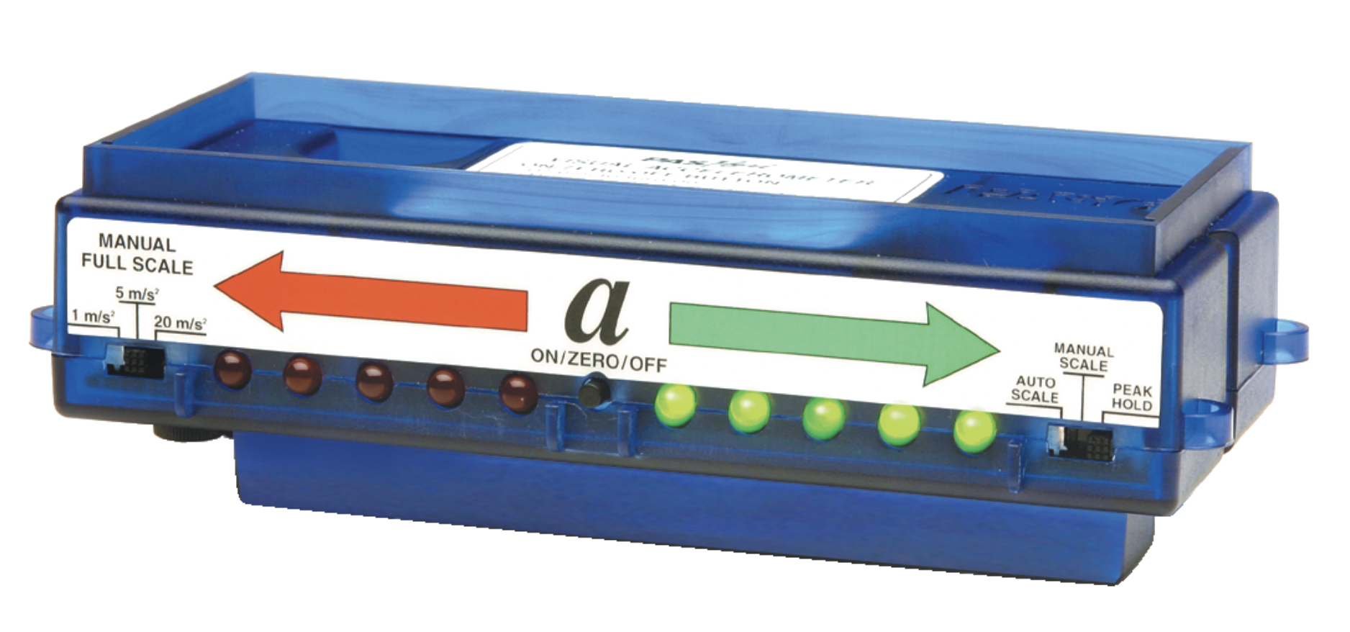
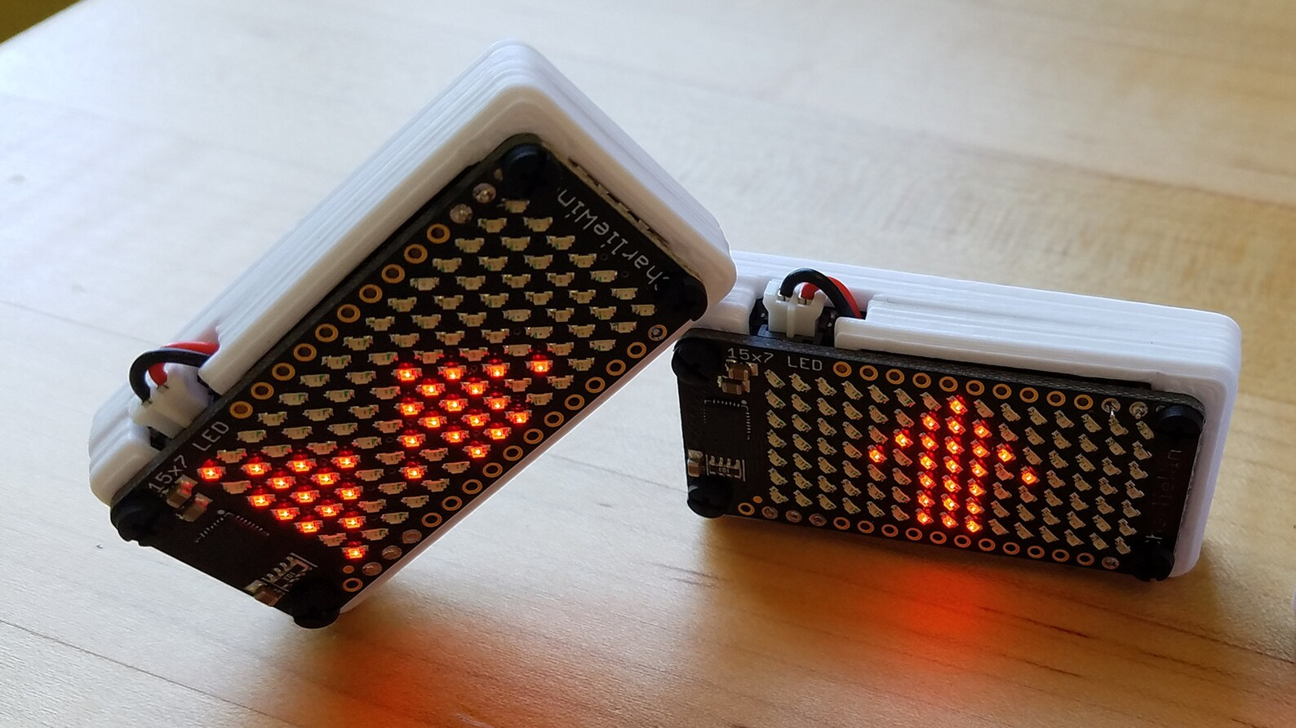
STUDENT-CENTERED
CER FRAMEWORK
FCI MISCONCEPTIONS
NORMALOMETER
ACTIVITY
$199
<$75
DIY Project: WagnerLabs.net/NormalProject/
EDUCATE FOR SERVICE. ENGINEER FOR SOCIETY.

Slide 9
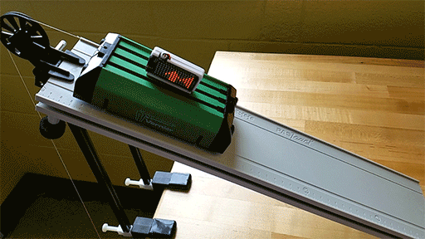
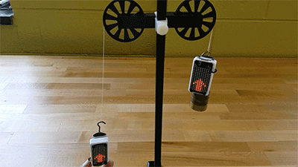
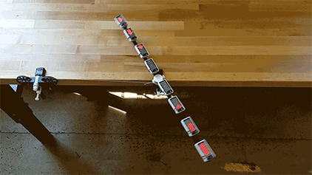
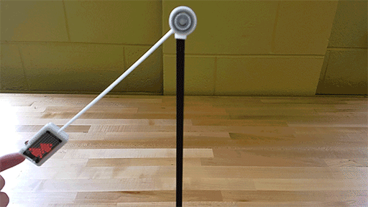
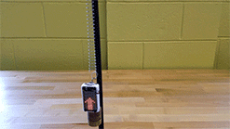
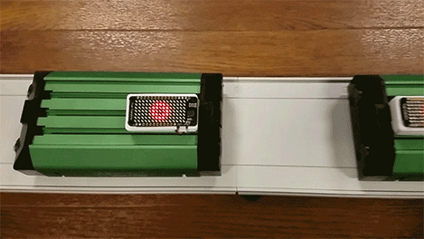
STUDENT-CENTERED
CER FRAMEWORK
FCI MISCONCEPTIONS
NORMALOMETER
ACTIVITY
In most situations, it does a good job of representing the direction and relative magnitude of the Normal force
Blog: WagnerPhysics.net
EDUCATE FOR SERVICE. ENGINEER FOR SOCIETY.

Slide 10
STUDENT-CENTERED
CER FRAMEWORK
FCI MISCONCEPTIONS
NORMALOMETER
ACTIVITY
With Thought Partner(s):
1. Use FCI Flip Cards to make a CLAIM.
2. Use NORMALOMETER to find EVIDENCE.
3. Engage in argument to clearly articulate REASONING.
EDUCATE FOR SERVICE. ENGINEER FOR SOCIETY.

