Slide 1
Throw Things Down the Stairs and Call It Science
A Design-Build Concussion Project

Slide 2
Healthy Brain
Brain with Severe Chronic Traumatic Encephalopathy
Ann McKee – Boston University

Slide 3
Impulse
$$\vec{J}=\int{\vec{F} dt}=∆\vec{p}=m\vec{v}−m\vec{v_{0}}$$

Slide 4
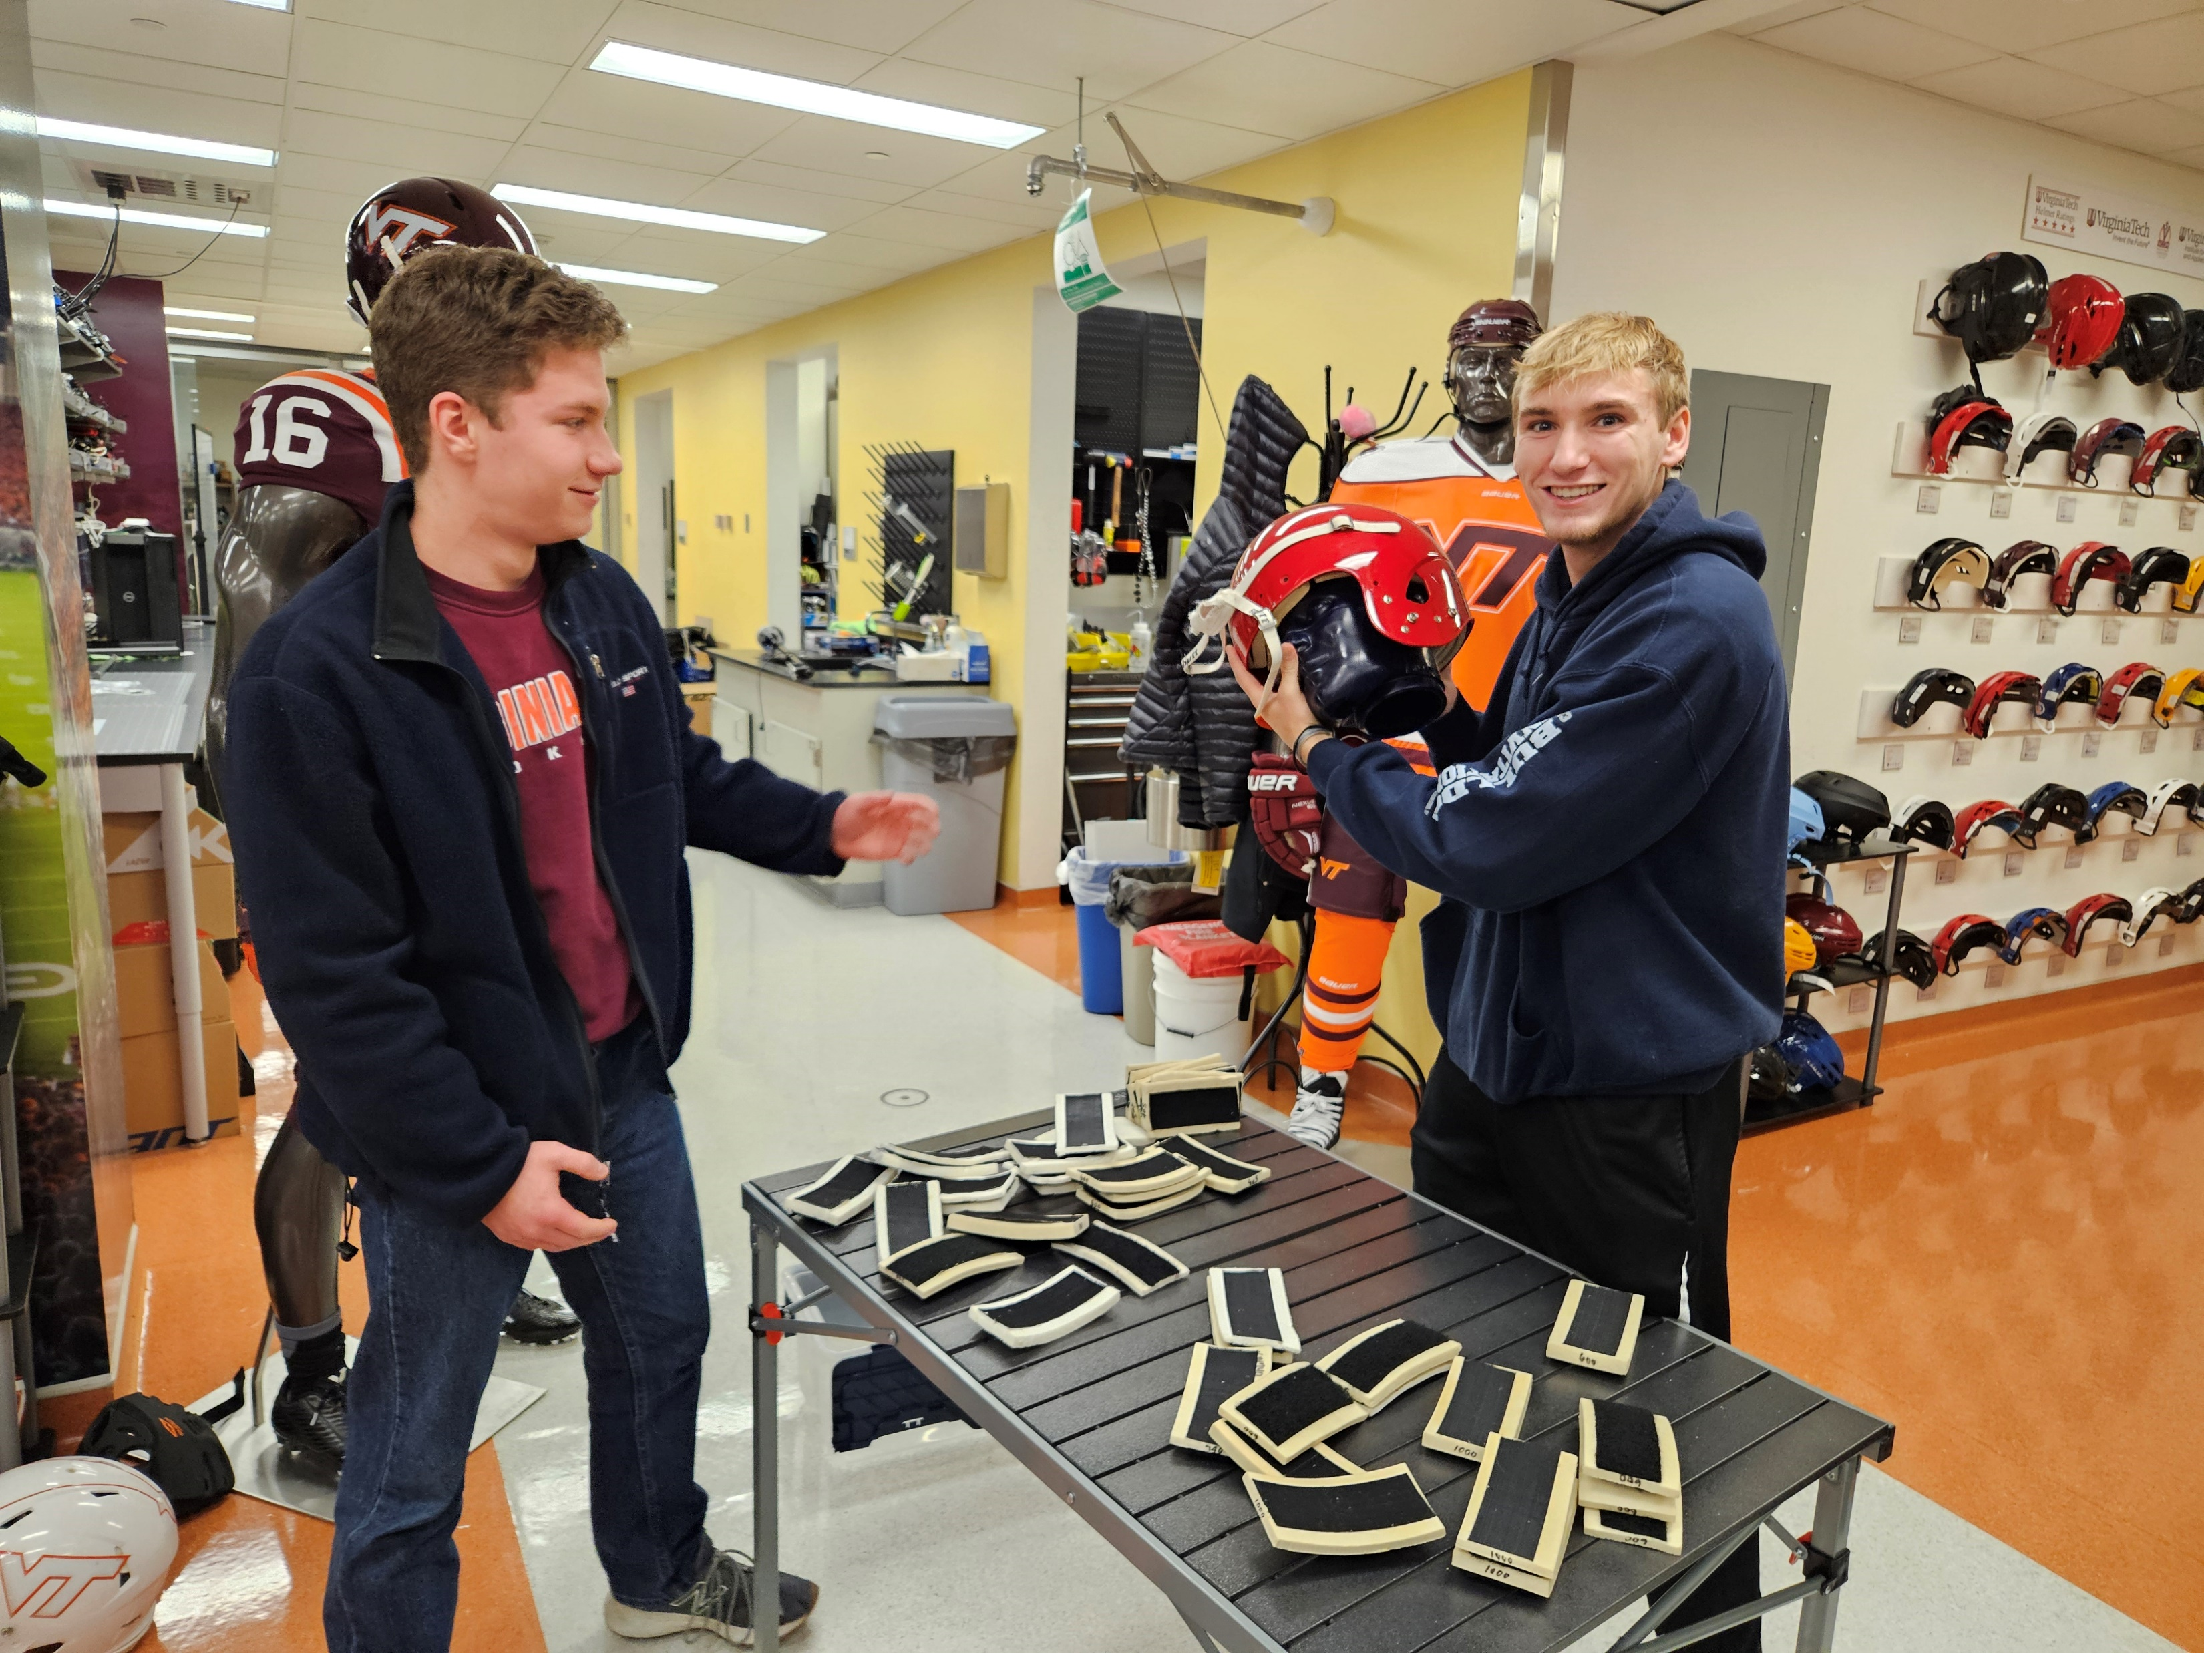
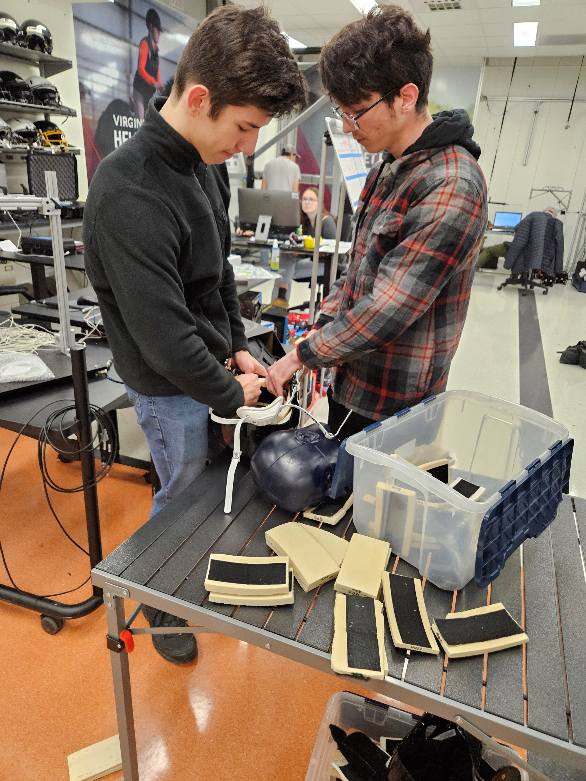
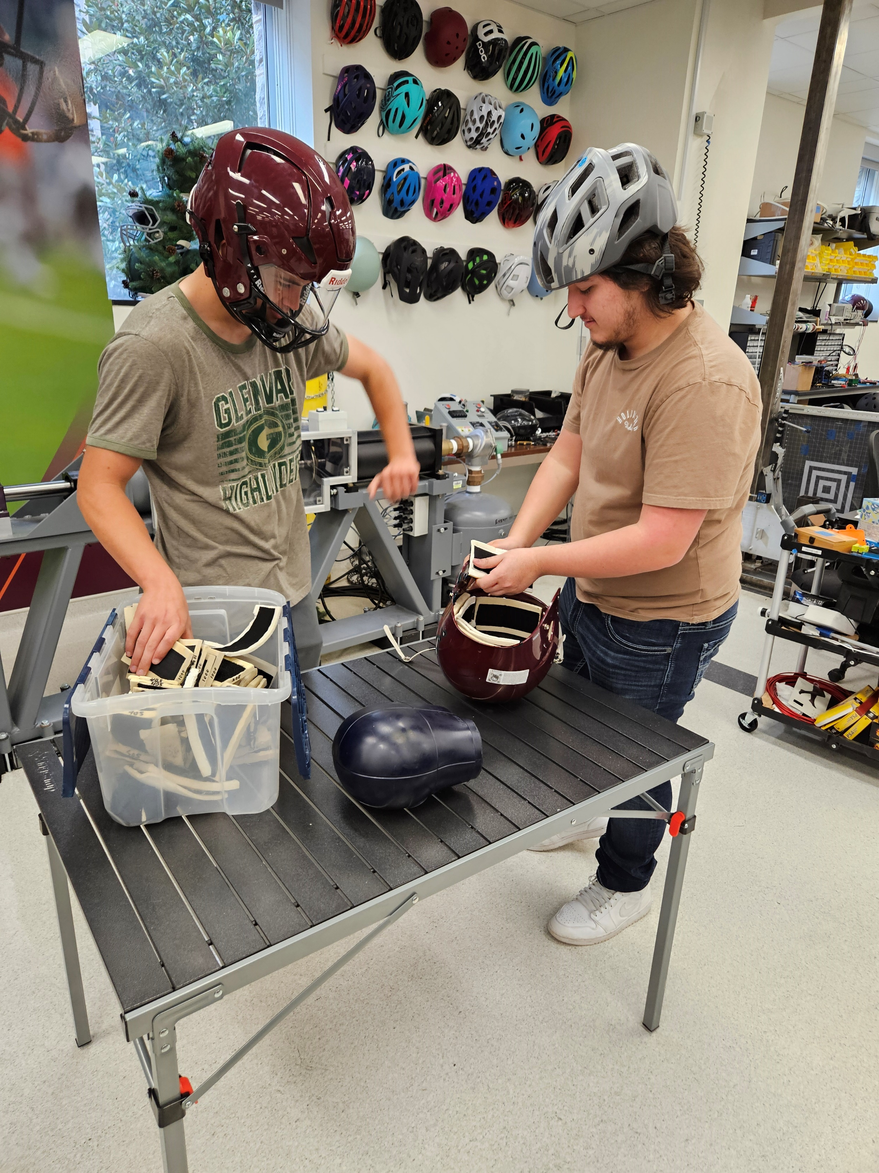
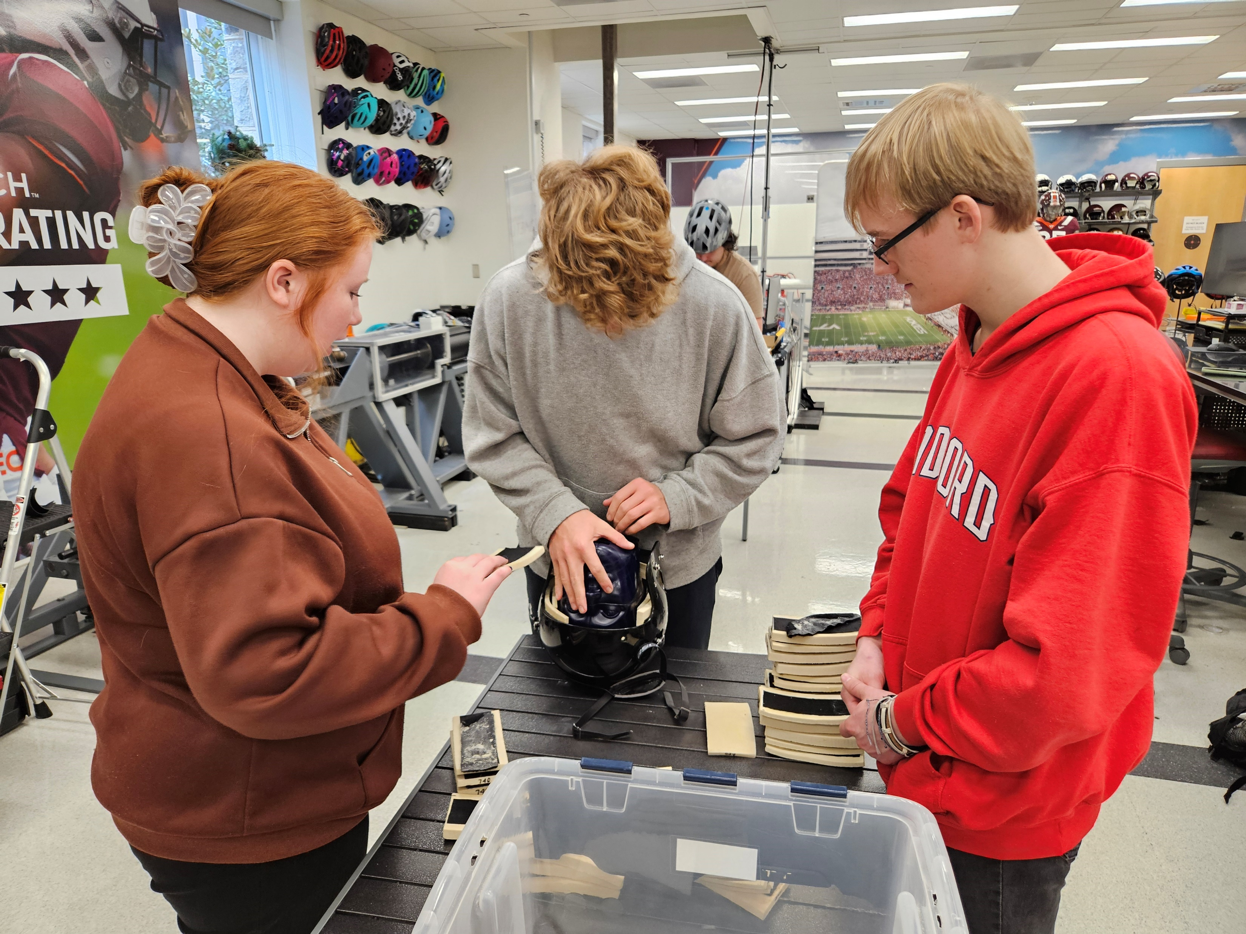
Virginia Tech Helmet Lab Field Trip
All students and their legal guardians signed media releases.

Slide 6
2020-2021 Project Year

Slide 7
Vernier GoDirect Acceleration Sensors

Slide 9
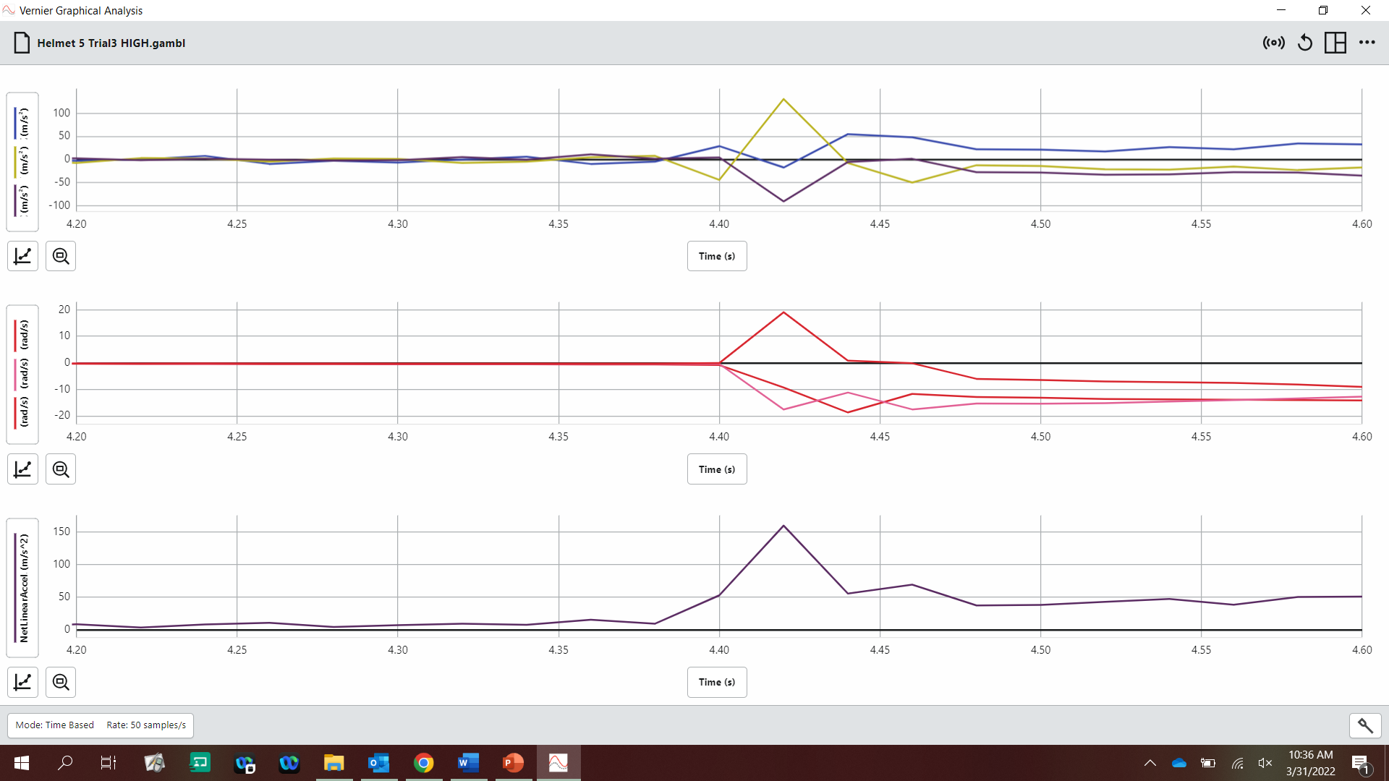

Slide 10
