Slide 1
Lessons from Dyslexia
Strategies for teaching compromised students

Slide 2
Why this talk?
I currently teach at a school that focuses on the teaching of students with dyslexia and related language-based learning differences.
Our students are quite compromised in issues related to reading, calculation, writing, memory, anxiety, attention, and more. Many are doubly or triply exceptional, meaning that they have multiple issues to deal with.
We focus on strategies for helping them succeed in and beyond school - college (for the majority of our students who attend), trade school, or work.

Slide 3
Why this talk?
Our School Philosophy:
Jemicy School educates talented and bright students with dyslexia or other related language-based learning differences by addressing both their intellectual strengths and their learning needs. The school utilizes creative, multisensory, and research-based programs and techniques to develop reading, writing, spelling, math, and organization skills; promote a love of learning; and prepare students for the intellectual and social challenges of college and life.

Slide 4
We often reference this Aldous Huxley quote:
“It is no good knowing about the taste of strawberries out of a book.”
Translation: education should be experiential.

Slide 5
Remember also this George Evans quote:
“Every student can learn, just not on the same day, or the same way.”

Slide 6
What we see - and what many of you will also see
Dyslexia
Dysgraphia
Dyscalculia
ADD
Executive function issues
Anxiety
Extreme math phobia

Slide 7
Day to day issues
Lab errors you never imagined possible
No number sense - for example, calculating how much it costs in gas to drive to Ocean City and arriving at an answer in thousands of dollars (or pennies), and having no sense that it is ridiculous
Repeated units in data tables when units are at the top
Scientific notation baffling students
Difficulty with measurement and units
Difficulty understanding fractions, time (3 minutes and 30 seconds written as 3.30)

Slide 8
Day to day issues
Taking notes by copying and pasting yours
Taking huge amounts of time between experiment trials
Not remembering what ‘c’ or ‘g’ means no matter how many times you say it
Hearing “I’m so confused” over and over again
Huge variety of processing speeds - some kids in their own time zone
ADD x 3 kids = ADD¹⁰
Trouble getting started with labs

Slide 9
Day to day issues
Getting a 1 sentence answer when you ask for a paragraph; or simply seeing “IDK”
Taking half of the data (only diameter and not circumference, for example)
Difficulty understanding graphs, circuit diagrams, etc.
Occasional speech issues - students with impediments, mumbling, etc.
Not knowing words you think they should know: “What is a lens?”

Slide 10
Day to day issues
Refusal to read directions - or inability to read and process them
Short-term memory issues - even on tests, quizzes. Not making connections between problems
Missing key descriptive words in sentence - “currently,” “greatest”.
Impulsive answering on multiple-choice questions
Big confusion with base-12 and base-60 systems: 5’ 2” is NOT 5.2’. 3.45 hours is NOT 3 hours 45 minutes

Slide 11
Day to day issues
Minimal attention to detail and writing; putting words down that seem like gibberish to you, but they mean something in the kid’s head
No matter how many times you will demonstrate the right way to take data (and what to write down), students will make mistakes and write down things that make no sense. You will often not be able to deconstruct where they went wrong.

Slide 12
What I see every day.
You will be shocked at how many times you repeat yourself.
You will hear a lot of student “helplessness.” For example, “What does 2f mean?”
Students often want you to grade their work/lab AS they do it - asking you to help them with and/or grade every question on a lab as they answer it
Students not knowing how or what to study

Slide 13
What I see every day.
Listening to music while they work/study
Students who do not using study hall time
Students often have trouble with trying to do “obvious” calculations: subtracting 2 location distances to get the net distance between 2 things (think lens lab)
Inability to get started - wasting of entire period, taking no data (getting distracted or never starting)

Slide 14
What I see every day.
Students forgetting how to do a lab in the middle of a lab.
Students not know how to take notes - very common
And much, much more…

Slide 15
It sounds bleak. What can you do?
There is not one approach that will work for all students.
Patience is essential. I seem to lose my temper once every few months. It happens.
You are first teaching children, not physics - the material is obvious to you because you learned it several times and have already done the problems and derivations. The steps in the derivation, and indeed, the rationale for doing a derivation in the first place is obvious to you. Actually, physics itself is way more important to you than to them.
Avoid sarcasm - many kids don’t get it, and you just seem like a jerk

Slide 16
Beginning of year teachables
My first unit covers basic executive function skills, then a variety of other things students should (in my view) know early in the course;
Note-taking
Detecting BS (memes vs. truth, etc.) and how to test claims; see Sagan’s “Tools for Skeptical Thinking,” etc.
Why we study physics (or any science, for that matter)

Slide 17
Beginning of year teachables
My second unit covers some important quantitative skills:
Graph interpretation - I show a variety of graphs that are misleading and discuss why it is so
How to graph - Google sheets is nice and free, but not as intuitive as Graphical Analysis (Logger Pro).
Units - why and how we use them
Equations - what are they, why we care, how to use them, triangle forms of equations
Unit conversions (for my accelerated classes)

Slide 18
Note-taking strategies for digital note-takers
Marrying typed notes with written equations:
Use the “insert drawing” tool in Google Docs to add equations to typed notes
Have students take pictures of their written-out equations or mathematical notes; add to typed notes

Slide 19
You must demonstrate (and help with) note-taking
Provide digital templates
Use my suggested rules (see end notes)

Slide 20
Measurement
Metric vs. English. Use metric. If you have meter tapes or meter sticks, cross out the non-metric side. Very clearly cross it out, as students will still try to use imperial units when you put a very bold line through the entire side of the tape. Yes, that was a lesson learned. Students will also mix units, if there are different units on each side tape - make it clear which side is to be used. It is NOT obvious to students.

Slide 21
Quick suggestions
Place equations in boxes in your notes and on the board.
Have highlighters handy.
Use variables that make sense, wherever possible: d for distance/displacement.
Formal labs - use checklists with boxes to check
In your notes, boldface things that should be written down.
Discourage the use of phones as calculators - they cannot see their mistakes.
Attach a metric height scale on your wall.
Use Screenpal (formerly Screencast-o-matic) or some other tool to prepare videos that walk students through labs, calculations, derivations, etc.

Slide 22
Quick suggestions
Check student notes once per quarter and make helpful comments on them.
Start your labs early in the year by giving data tables (with legend and units listed). Students will soon learn to create their own tables and graphs.
Use triangle/circle equations when possible, though they are not intuitive to all students.
Students will frequently have technology issues. If possible, keep chargers handy.
Avoid sarcasm.
Have scale models in your room: Earth and Moon, for example

Slide 23
Quick suggestions
Expect to help some students get started on a lab. You may have assigned it to read, but that does not mean that they actually read or understood it.
Create a class YouTube page and/or post explanation videos for complex labs and tricky problems to solve.
Be patient. Sometimes you are preparing the next generation of scientists. More often than that, you are helping students understand some science for their own personal enrichment. Always, you are trying to be a kind role model for children who are struggling with learning way more than you ever did.

Slide 25
Notes on note-taking

Slide 26
Notes on note-taking
Use a bound notebook, ideally with quad-paper (or whatever works for you - I prefer totally blank pages). Spiral-bound notebooks fall apart. Bound notebooks keep you "honest."
Use a new page for each new class and/or topic.
Write on only one side of the page - it makes it easier to read, particularly if you use pen (which can bleed through to the other side).
Give each new page a heading and date.
Use color to highlight central concepts and/or put boxes around important ideas or equations. Highlighters can be your friend!

Slide 27
Notes on note-taking
Draw pictures that represent the problem - label relevant things in the diagram.
Unless truly necessary for your learning, do not use a laptop to take notes. You spend too much time getting down trivial details and will inevitably miss something critical. It is also way too tedious to include equations, pictures, graphs, calculations and anything that really demands visual representation.
Keep a running page of the important equations or ideas - maybe on the inside cover of the notebook.
Label formulas with what each variable represents, as well as the units.

Slide 28
Notes on note-taking
If things are moving too quickly for you, leave space for omitted notes – with a heading of what that topic is. And then touch base with me or a classmate to fill in the gaps.
Leave space in your notes – don’t cram them all together. Again, writing on one side of the page is helpful.
If you have questions, but don’t want to ask them in class (or see that we have moved beyond that topic already and you don’t want to revisit it at the moment) – write down the questions in the margin of your notes, and circle it. And then seek out the answer after class, or by email. But get your question answered!

Slide 29
Notes on note-taking
If taking notes on a laptop is really important for your learning, use the Google drawing tool (best with a touchscreen) and take images of the board and incorporate them into your notes. You can even add pictures in real-time. More about this later.
By and large, if it is on the board it should probably be written down. For me personally - if I think it is important for the students, I will write it on the board.
Never be shy about asking for extra help – even to have me look at your notes. Sometimes I can tell where you went wrong in your thinking by seeing errors in your notes.
I AM ON YOUR SIDE.

Slide 30
Notes on note-taking - another take on it
From one physics student who prefers to use binders:
Be consistent across your classes. Use a different binder for each subject.
Section 1: Homework. Your version, then the solutions (if available).
Section 2: Teacher’s Notes, if given out, split into appropriate content sections. Your version of the notes (re-written?) after the teacher’s notes.
Section 3: Laboratory experiments
Use engineering paper for technical classes. Write on only one side of each page, date and title each page.
Rewrite notes to help ideas make more sense. The notes are for you, so you should understand them.

Slide 31
Helping your students with executive function

Slide 32
Digital Organization - in your Google Drive
Folders for each class
Sub-folders in each class folder, as needed:
Homework
Notes
Labs
Quizzes and tests
Review

Slide 33
Digital Organization - for those who type notes
Choose a notebook style - see samples in class
Do you want it to be google doc style or slides style? See the templates and pages available.

Slide 34
Digital Organization - so many options and ideas…
https://www.onlineschoolscenter.com/notetaking-techniques-tips/
https://success.oregonstate.edu/sites/success.oregonstate.edu/files/note_taking_-_7_kinds_20.pdf
https://sciencenotes.org/how-to-take-science-notes/
https://collegeinfogeek.com/how-to-take-notes-in-college/
https://www.cc-seas.columbia.edu/node/31875

Slide 35
If you use Google Docs
Here are some ideas found online. The complete notebook examples are shared with you.
You can use some of the templates shared, or you can create your own. You can also easily adapt some of the strategies you may already know - concept maps, Cornell notes, Kami, OneNote, Apple Notes, etc. - to Physics class.

Slide 36
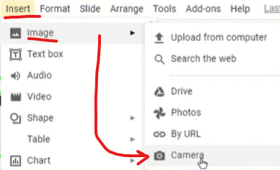
If you use Google Docs
For you Google Docs 'n Slides folks, please know that you can insert images in real time (if your device has a camera). This could be a huge time saver. Chromebooks can do this.

Slide 37
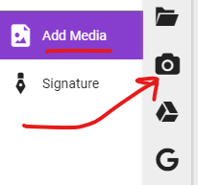
Or in Kami:

Slide 38
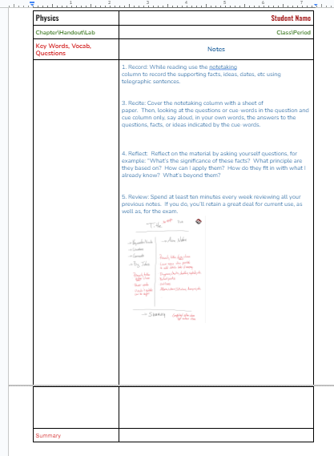

Slide 39
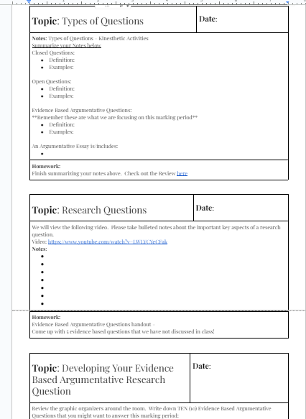

Slide 40
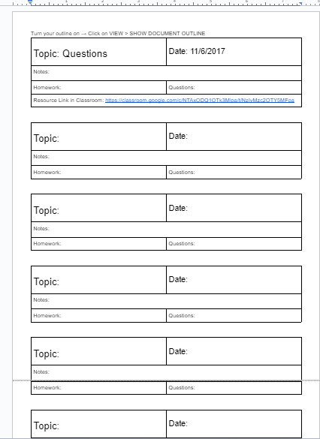

Slide 41
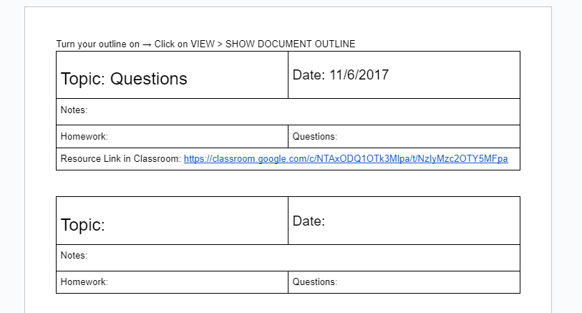

Slide 42
If you use Google Slides…
Here are some ideas found online. The complete notebook examples are shared with you.

Slide 43
MY NOTEBOOK
Here goes your name.

Slide 44
Table of Contents
SECTION | CONTENTS
01
Section 01 is about this and that.
02
Section 02 is about this.
03
Section 03 is about that.
04
Section 04 is about this and that.
05
Section 05 is about this.
06
Section 06 is about this and that.
07
Section 07 is about that.
08
Section 08 is about this.
09
Section 09 is about this and that.
10
Section 10 is about that.

Slide 48
This is your presentation title

Slide 49
Instructions for use
EDIT IN GOOGLE SLIDES
Click on the button under the presentation preview that says "Use as Google Slides Theme".
You will get a copy of this document on your Google Drive and will be able to edit, add or delete slides.
You have to be signed in to your Google account.
EDIT IN POWERPOINT®
Click on the button under the presentation preview that says "Download as PowerPoint template". You will get a .pptx file that you can edit in PowerPoint.
Remember to download and install the fonts used in this presentation (you’ll find the links to the font files needed in the Presentation design slide)
More info on how to use this template at www.slidescarnival.com/help-use-presentation-template
This template is free to use under Creative Commons Attribution license. You can keep the Credits slide or mention SlidesCarnival and other resources used in a slide footer.

Slide 50
4000
3000
2000
1000
0
You can insert graphs from Excel or Google Sheets

Slide 51
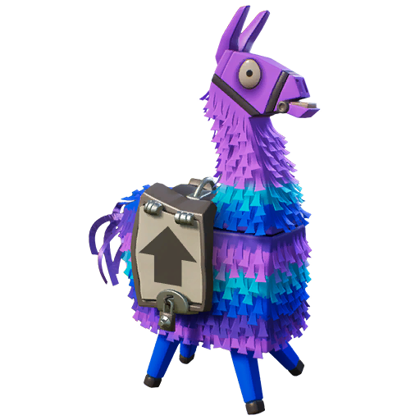
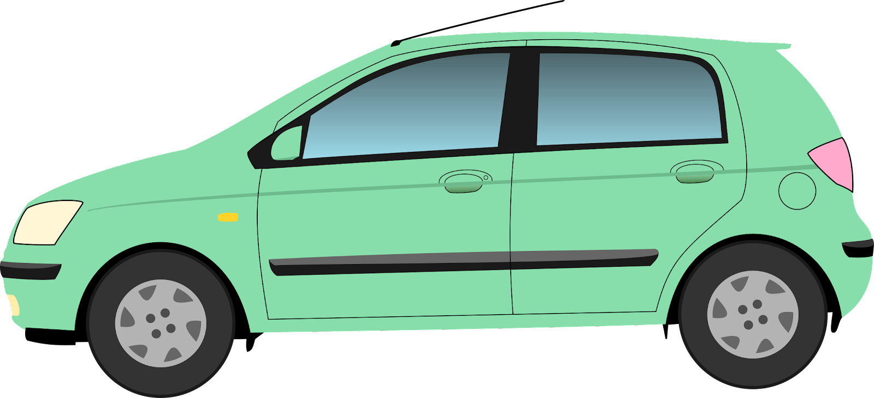
Unit ___ Digital
Interactive Notebook
Make your notebook your own!
Choose from the following stickers or add some of your own. Also include your name on your notebook, make sure to change the font and color
Jessica Smith
ELA
Delete the stickers you don’t want

Slide 52
1
Table of Contents
Table of Contents
2
Date | Assignment | Slide Number | Grade
3/12 | Title of Assignment | Slide3, page 3
 | Title of assignment | Slide 4 Page 6
Date | Assignment | Slide Number | Grade

Slide 53
3
4

Slide 54
MY NOTEBOOK TITLE
Name
Class
Period

Slide 55
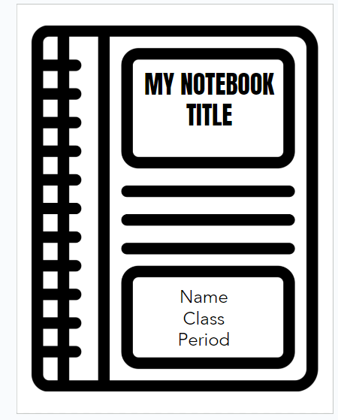

Slide 56
Moveable vocabulary
Vocab word
Vocab word
Category 1 for sorting
Category 2 for sorting
Vocab word
Vocab word
Vocab word
Vocab word
Vocab word
Vocab word
Vocab word
Vocab word
Category 3 for sorting
Category 4 for sorting
Vocab word
Vocab word
Vocab word
Vocab word
Vocab word
Vocab word

Slide 57
Other techniques for digital notetaking
Apple notes
Microsoft OneNote
Evernote
Google Keep
Simplenote
Kami
Mindomo
Canva
Sketchnote

