Slide 1
Sticking point: The
Role of QM in Gecko
Wall Climbing
Kausik S Das

Slide 2
How does a gecko stick to a wall or a ceiling?
Using hooks
Sticky glue
Suction

Slide 3
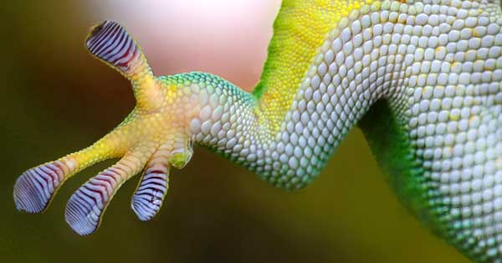
Gecko toes

Slide 4
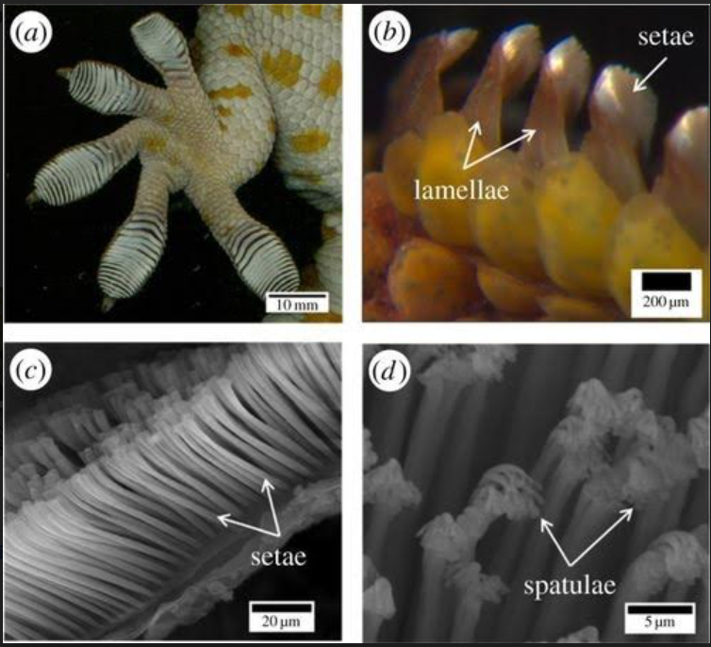
Geckos have hairy toes

Slide 6
Geckos stick to the wall/ceiling using Van Der Waals force

Slide 7
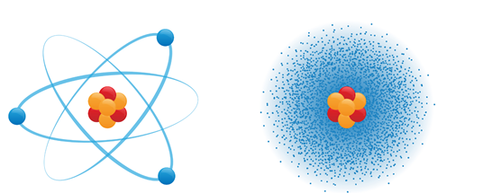
Geckos stick to the wall/ceiling using Van Der Waals force
Bohr Model
QM Model

Slide 8
Bohr Model
QM Model

Slide 9
Geckos stick to the wall/ceiling using Van Der Waals force
Bohr Model
QM Model

Slide 10
Geckos stick to the wall/ceiling using Van Der Waals force
Bohr Model
QM Model

Slide 11
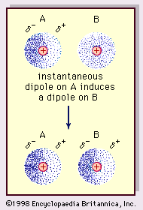
Geckos stick to the wall/ceiling using Van Der Waals force

Slide 12
For making the gecko “tape”
• Silicone RTV Mold-Making System
o Side A 1 lb,
o Side B Fast Catalyst (Blue) 0.1 lb,
• Polycarbonate Millipore Track etched Isopore membrane filter

Slide 13
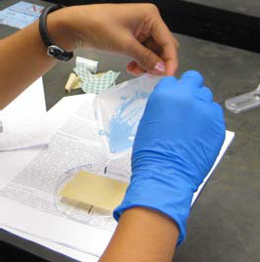

Slide 14
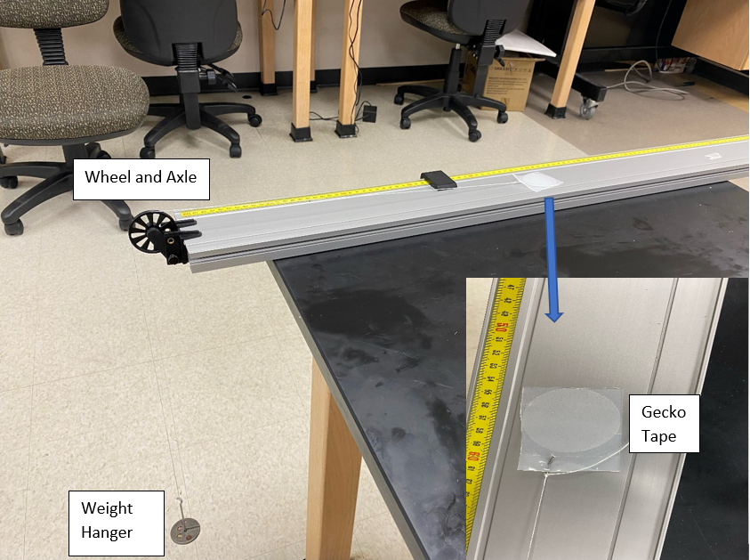

Slide 15
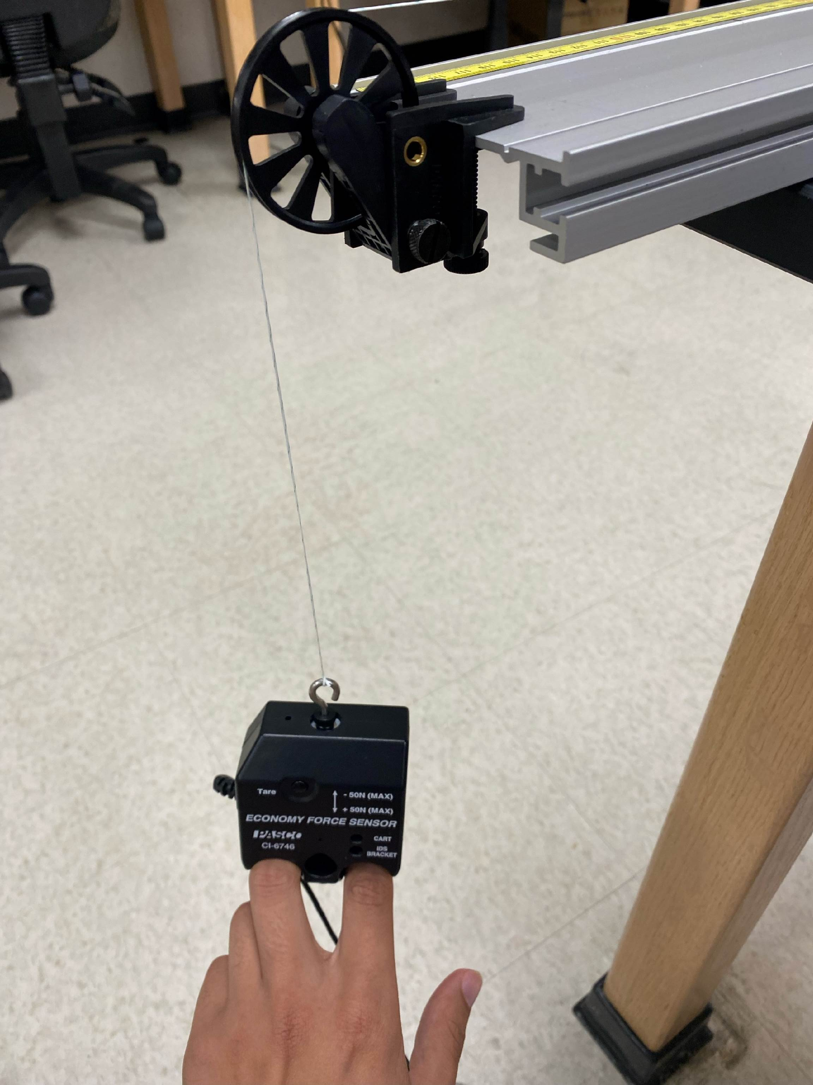

Slide 16
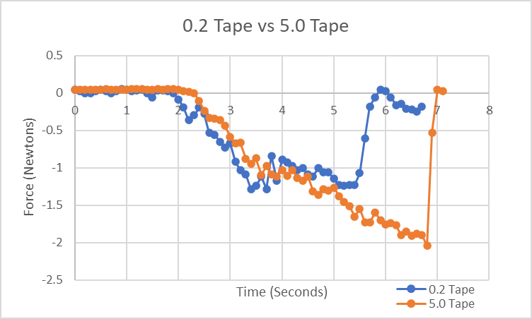

Slide 17
Acknowledgement
Isaac Omodia
Clinton Wiggins
Ralphael Agodo
-270.45ºC ( ~ 2.7 K)
15ºC ( ~ 288 K)

