Slide 1
James Freericks, Department of Physics
Georgetown University
Work funded by the AFOSR and Georgetown

Slide 2
Complex numbers are often introduced in mechanics as a tool for solving driven-damped harmonic oscillators

Slide 3
Usually this is presented as a set of rules with an uneasy “take the real part of the solution” at the end

Slide 4
In this talk, I will show you a more natural way to organize working with complex numbers and driven-damped harmonic oscillators

Slide 5
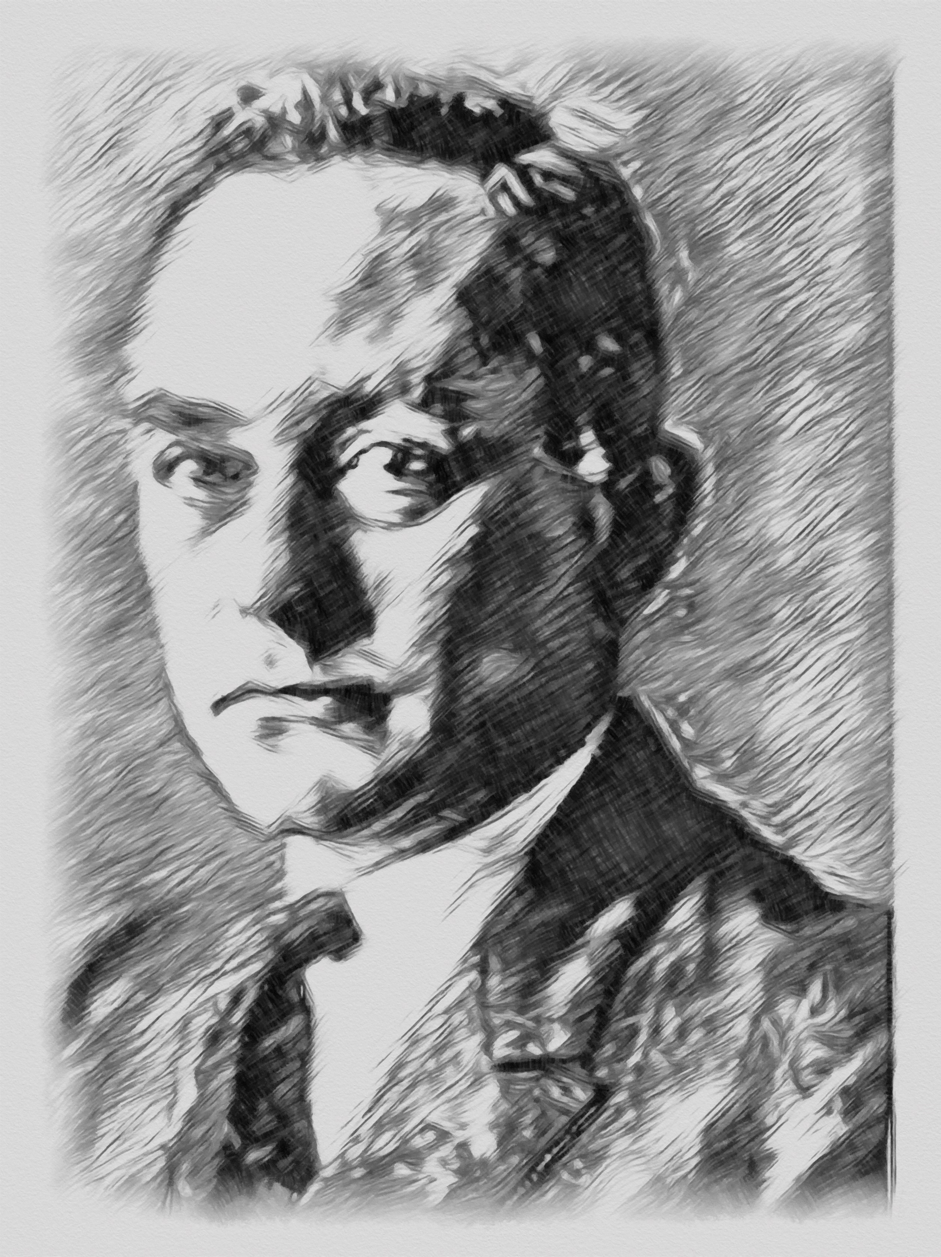
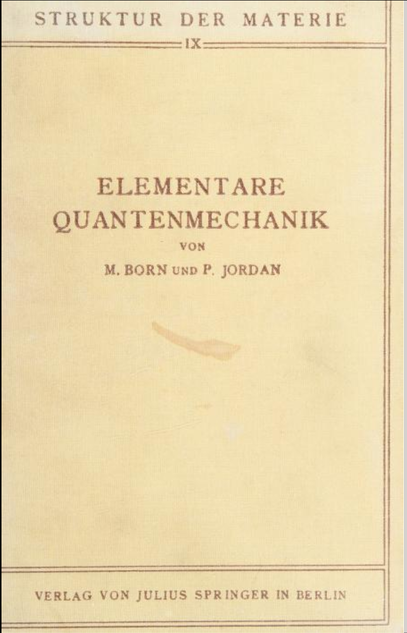
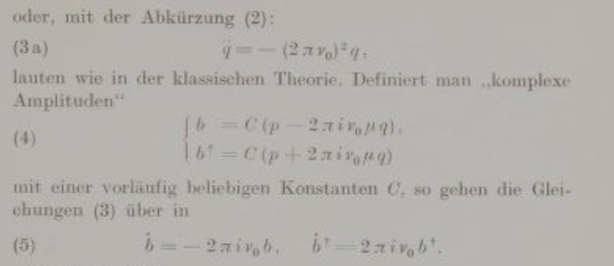
The idea for this comes from Born and Jordan’s Elementare Quantenmechanik (1930)

Slide 6
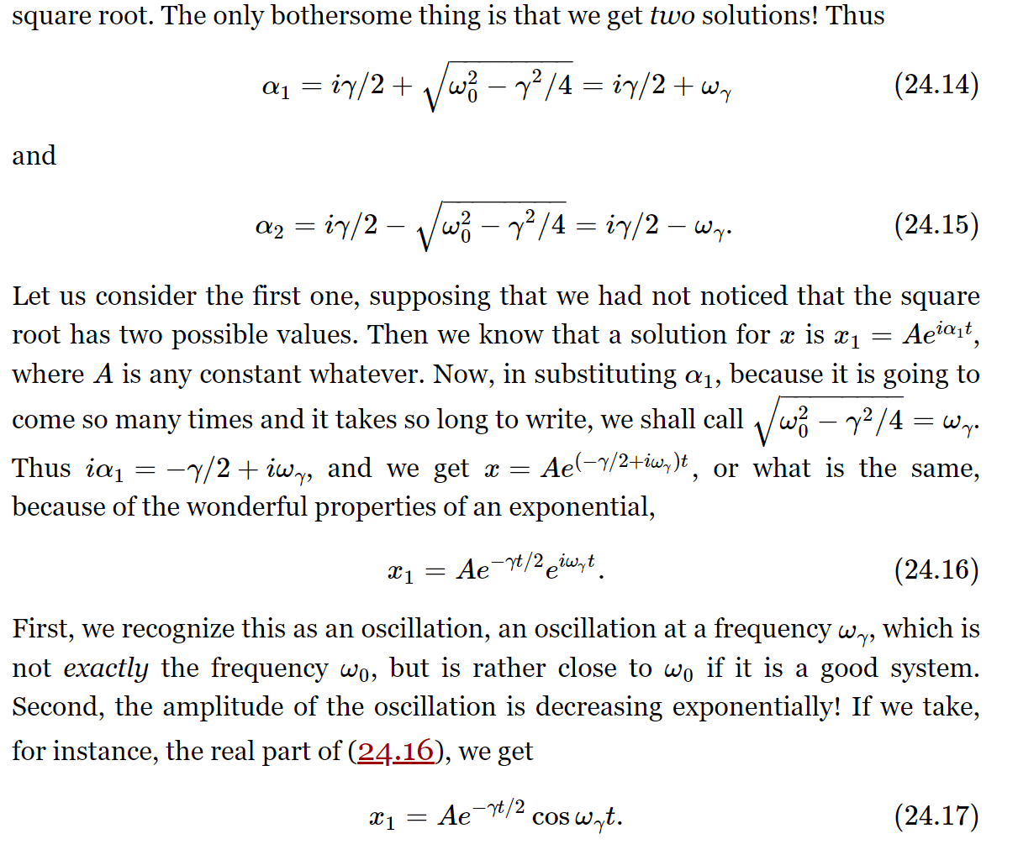
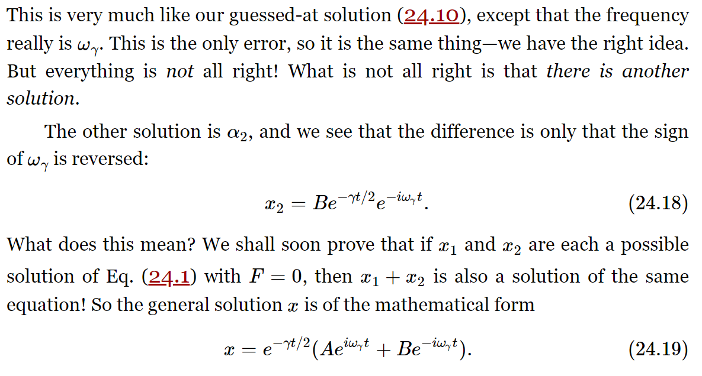
Conventional approach (from Feynman)

Slide 7
Simple Harmonic Oscillator
Hamilton equation of motion: $\dot{x}=\frac{p}{m}$ and $\dot{p}=F=−mω^{2}x$
Decouple the differential equation: Let $A=αx+p$ and find α such that $\dot{A}=cA$
Decouple the differential equation: $\dot{A}=α\dot{x}+\dot{p}=α\frac{p}{m}−mω^{2}x$ implies $c=\frac{α}{m} and cα=−mω^{2}$
Solve for α and c: $−mω^{2}=\frac{α^{2}}{m}$ or $α^{2}=−m^{2}ω^{2}$ or $α=±imω$ and $c=±iω$
So we have $A=p−imωx$ and $\dot{A}=−iωA$ or $A=A_{0}e^{−iωt}$ with $A_{0}=p_{0}−imωx_{0}$
The other solution is $A^{∗}=p+imωx$ and $\dot{A^{∗}}=iωA$ or $A^{∗}=A_{0}^{∗}e^{iωt}$ with $A_{0}^{∗}=p_{0}+imωx_{0}$
Solve for x: $x=\frac{−A+A^{∗}}{2imω}=x_{0}\cos{ωt+\frac{p_{0}}{mω}\sin{ωt}}$

Slide 8
Complex numbers are introduced naturally in the process of finding a first-order differential equation.

Slide 9
Energy
We found $A=A_{0}e^{−iωt}$ with $A_{0}=p_{0}−imωx_{0}$ and $A^{∗}=A_{0}^{∗}e^{iωt}$ with $A_{0}^{∗}=p_{0}+imωx_{0}$
So, we have ${\frac{p^{2}\left(t\right)}{2m}+\frac{1}{2}mω^{2}x^{2}\left(t\right)=\frac{1}{2m}A}^{∗}\left(t\right)A\left(t\right)={\frac{1}{2m}\left|A_{0}\right|}^{2}=\frac{p_{0}^{2}}{2m}+\frac{1}{2}mω^{2}x_{0}^{2}=constant$
So, energy is conserved, automatically in this approach

Slide 10
Relation to quantum mechanics
We found $A=p−imωx$ and $A^{∗}=p+imω$
If we make them operators, with $[\hat{x}, \hat{p}]=iℏ$, then $\frac{1}{2m}{\hat{A}}^{†}\hat{A}+\frac{1}{2}ℏω=\hat{H}$
Hence, this approach makes an easy transition to raising and lowering operators in quantum mechanics.

Slide 11
Damped Harmonic Oscillator
Hamilton equation of motion: $\dot{x}=\frac{p}{m}$ and $\dot{p}=F=−mγ\dot{x}−mω^{2}x$
Decouple the differential equation: Let $A=αx+p$ and find α such that $\dot{A}=cA$
Decouple the differential equation: $\dot{A}=α\dot{x}+\dot{p}=α\frac{p}{m}−γp−mω^{2}x$ implies $c=\frac{α}{m}−γ and cα=−mω^{2}$
Solve for α and c: $−mω^{2}=\frac{α^{2}}{m}−γα$ or $α^{2}−γα+m^{2}ω^{2}=0$ or $α=\frac{γ}{2}±\frac{1}{2}\sqrt{γ^{2}−4m^{2}ω^{2}}$ and $c=−\frac{mω^{2}}{α}$
So we have $A=p−imω\sqrt{1−\frac{γ^{2}}{4m^{2}ω^{2}}}x$ and $\dot{A}=\left(−\frac{γ}{2m}−iω\sqrt{1−\frac{γ^{2}}{4m^{2}ω^{2}}} \right)A$
This gives the standard damped solution. You can look at energy as well, but the analysis is more complicated.

Slide 12
Driven Damped Harmonic Oscillator
Hamilton equation of motion: $\dot{x}=\frac{p}{m}$ and $\dot{p}=F=−mγ\dot{x}−mω^{2}x+F(t)$
Now we can derive an inhomogeneous first-order differential equation. It is easy to show students how to solve this via an integrating factor. But there is not enough time to go into the details in full.

Slide 13
For me, this is a much more natural way to introduce complex numbers and the added connection to quantum mechanics is another bonus

Slide 14
References
Born and Jordan, Elementare Quantenmechanik (Berlin, Springer, 1930)
N. Gauthier, Novel approach for solving the equation of motion of a simple harmonic oscillator, Int. J. Math. Educ. Sci. Tech., 35, 446 (2004).
B. R. Smith, Jr. First-order partial differential equations in classical dynamics, Am. J. Phys. 77, 1153 (2009).
Christopher C. Tisdell, An accessible, justifiable and transferable pedagogical approach for the differential equations of simple harmonic motion, Int. J. Math. Educ. Sci. Tech., 50, 950 (2019).
M. B. Alves, Algebraic solution for the classical harmonic oscillator, Rev. Bras. Ens. Física, 45, e20230152 (2023)

Slide 15
These ideas can be extended to Kepler orbits and be linked to the quantum solutions of hydrogen. But that is for the Fall meeting.

Slide 16
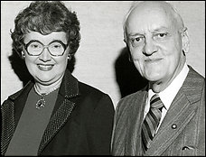
Thanks to
Leanne Doughty Jason Tran

