Slide 1
Integrating Quantum Science into K-12 Classrooms via Engaging Activities
Maajida L.C. Murdock
Morgan State University
October 21, 2023

Slide 2
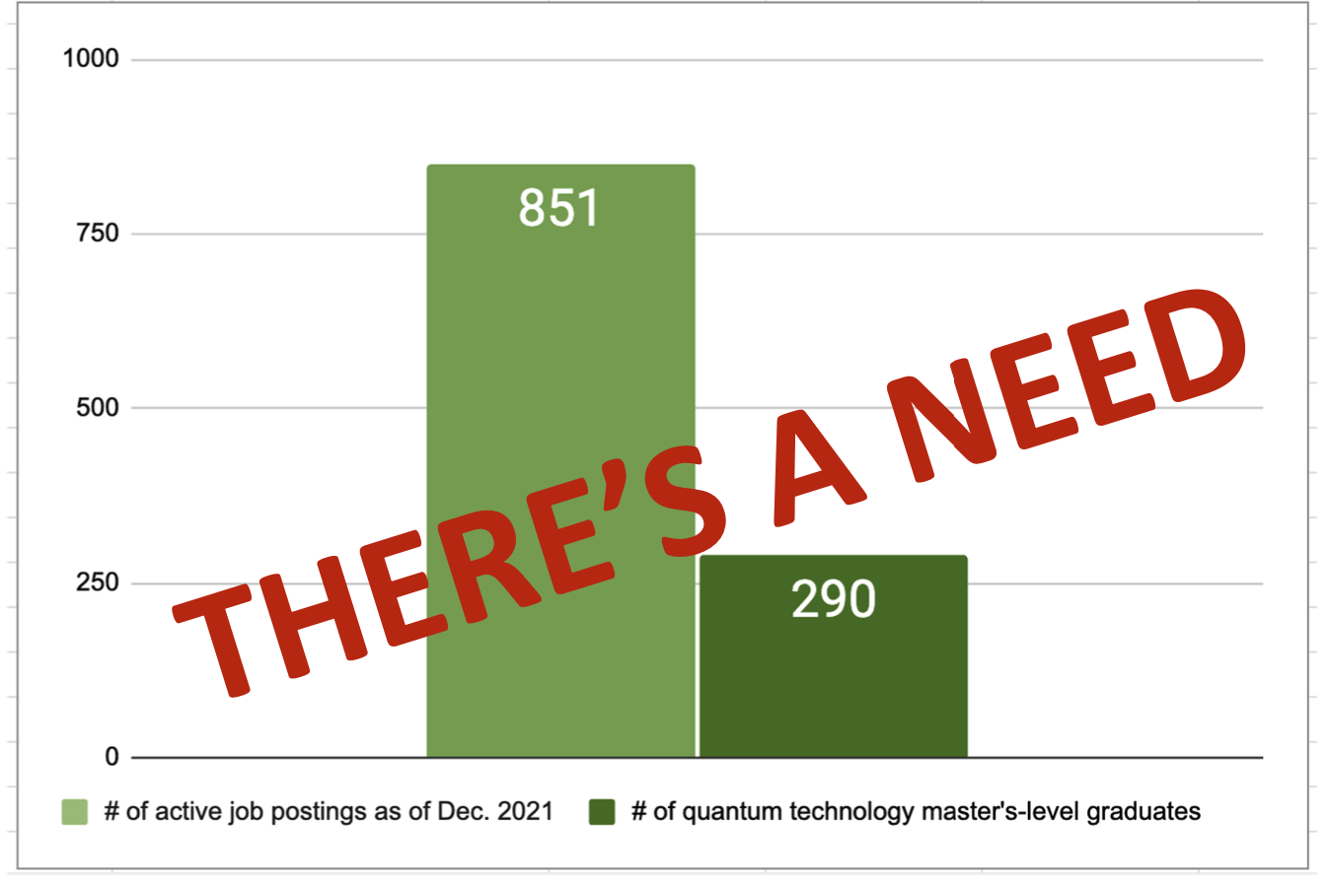
WHY talk about quantum in high, middle, elementary?
https://www.mckinsey.com/

Slide 3
Past Engagement – Outreach
ONE-WAY INTERACTION
Passive learning
A knowledgeable scientist provides information to the recipient audience who may otherwise not know, be aware of, or have access to this information.
deficit model
lacking in some way
defective
deficient
not as good as . . .
,

Slide 5
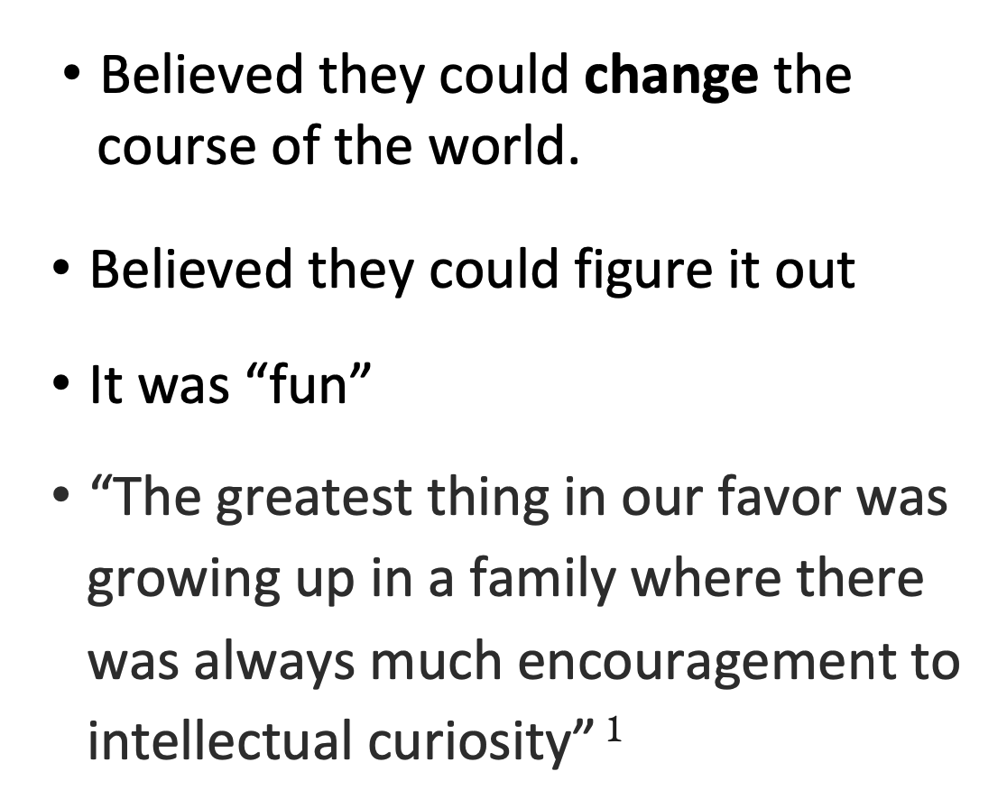

Slide 6
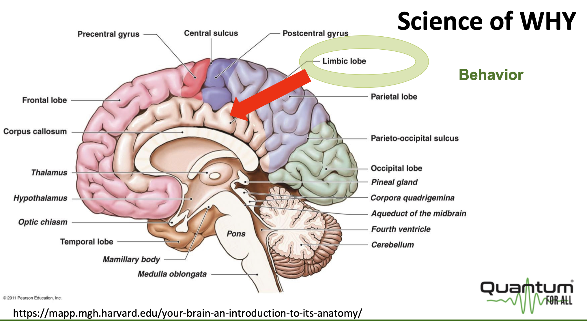

Slide 9
Law of Diffusion Innovation
Process that occurs as people adopt a new idea, product, practice, or philosophy
Describes how new ideas, behaviors, technologies, or goods spread through a population.

Slide 10
Barriers to Crossing the Chasm
Perceived complexity and/or socio-economic incompatibility
• Usage When the system being proposed is incompatible to existing usage, it is difficult to accept
• Value Perceived value is low; does new = better; benefit vs price
• Risk Fearful so one continues to use existing alternatives; Fear to take risks: physical, social, financial, psychological, time; need encouragement
• Psychological factors Two common threats: tradition (what is right) and image (self image, attitude)

Slide 11
Challenges of Quantum Change In K-12
Recognize the problem
Inadequate background in content and context
Limited appropriate resources
Lack of context = limited curriculum connections
Lack of connection to standards

Slide 12
5 Step Process for Educators
Awareness/Knowledge: Recognition of the unknown.
Interest/Persuasion: Interest leads to understanding and ultimately persuasion or purpose.
Evaluation/Decision: Is the destination worth the trip?
Trial/Implementation: Can this be done?
Adoption/Implementation: Let's do this!

Slide 25
Quantum for All at Morgan State University 2022 Teacher/Student Camp

Slide 26
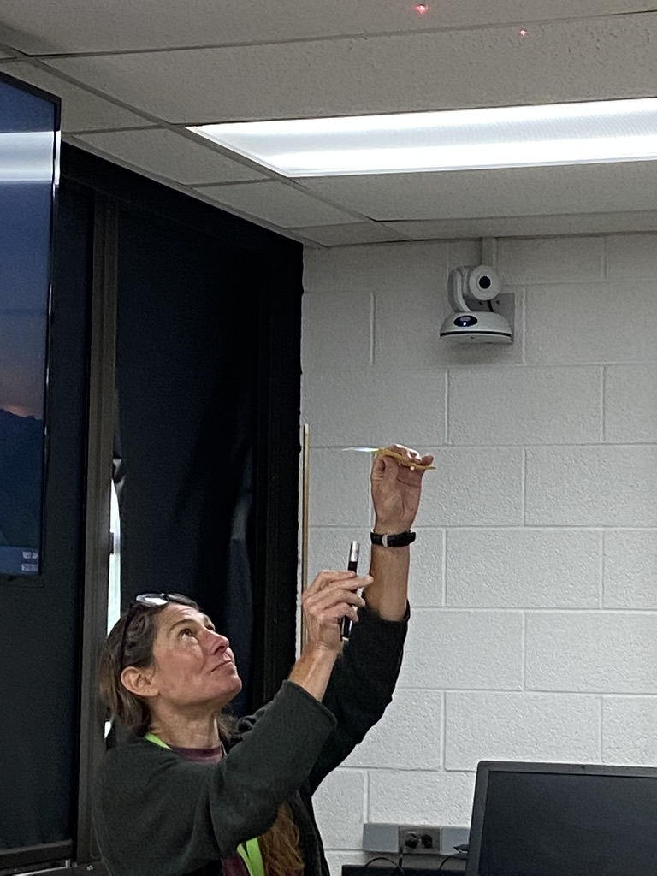
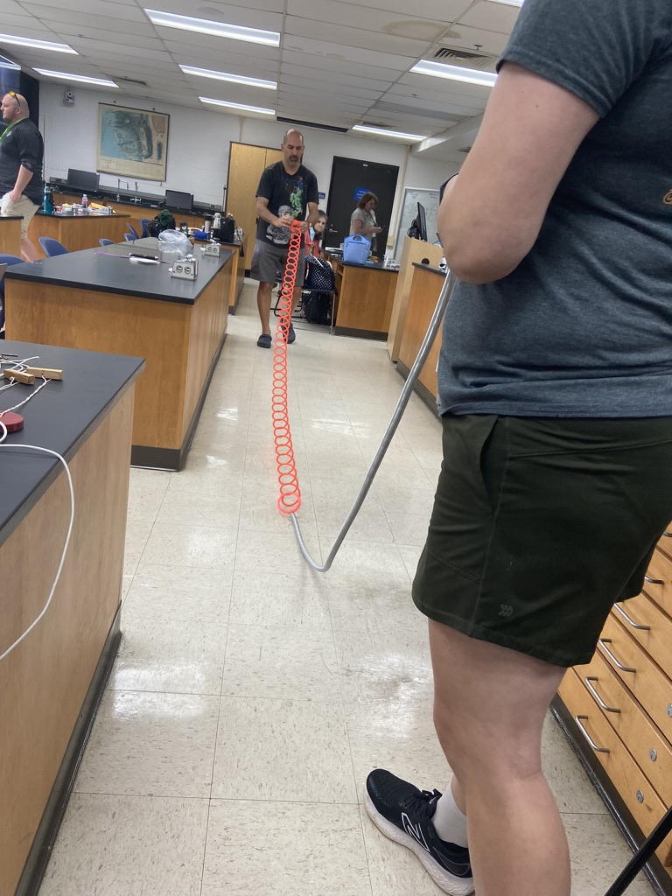
Quantum for All at Morgan State University 2022 Teacher/Student Camp

Slide 27
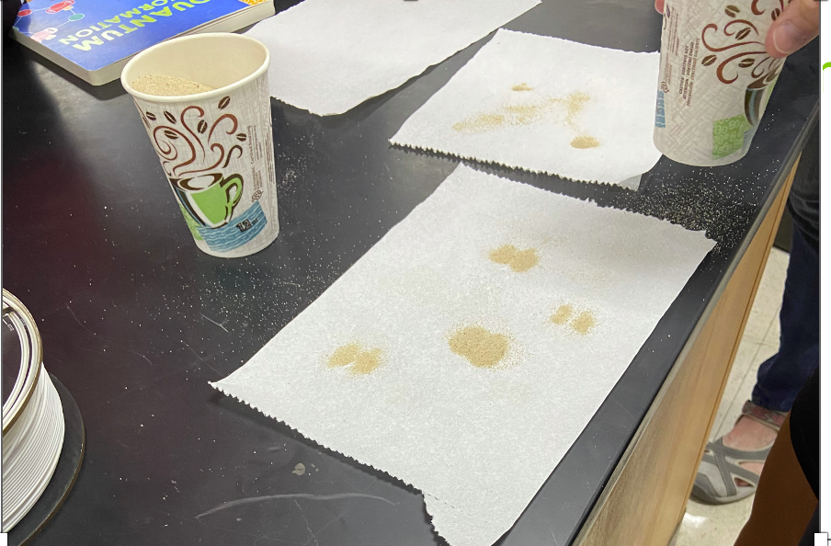
Quantum Science Focus Activities For Teachers And Students In K-12
Simple Materials

Slide 28
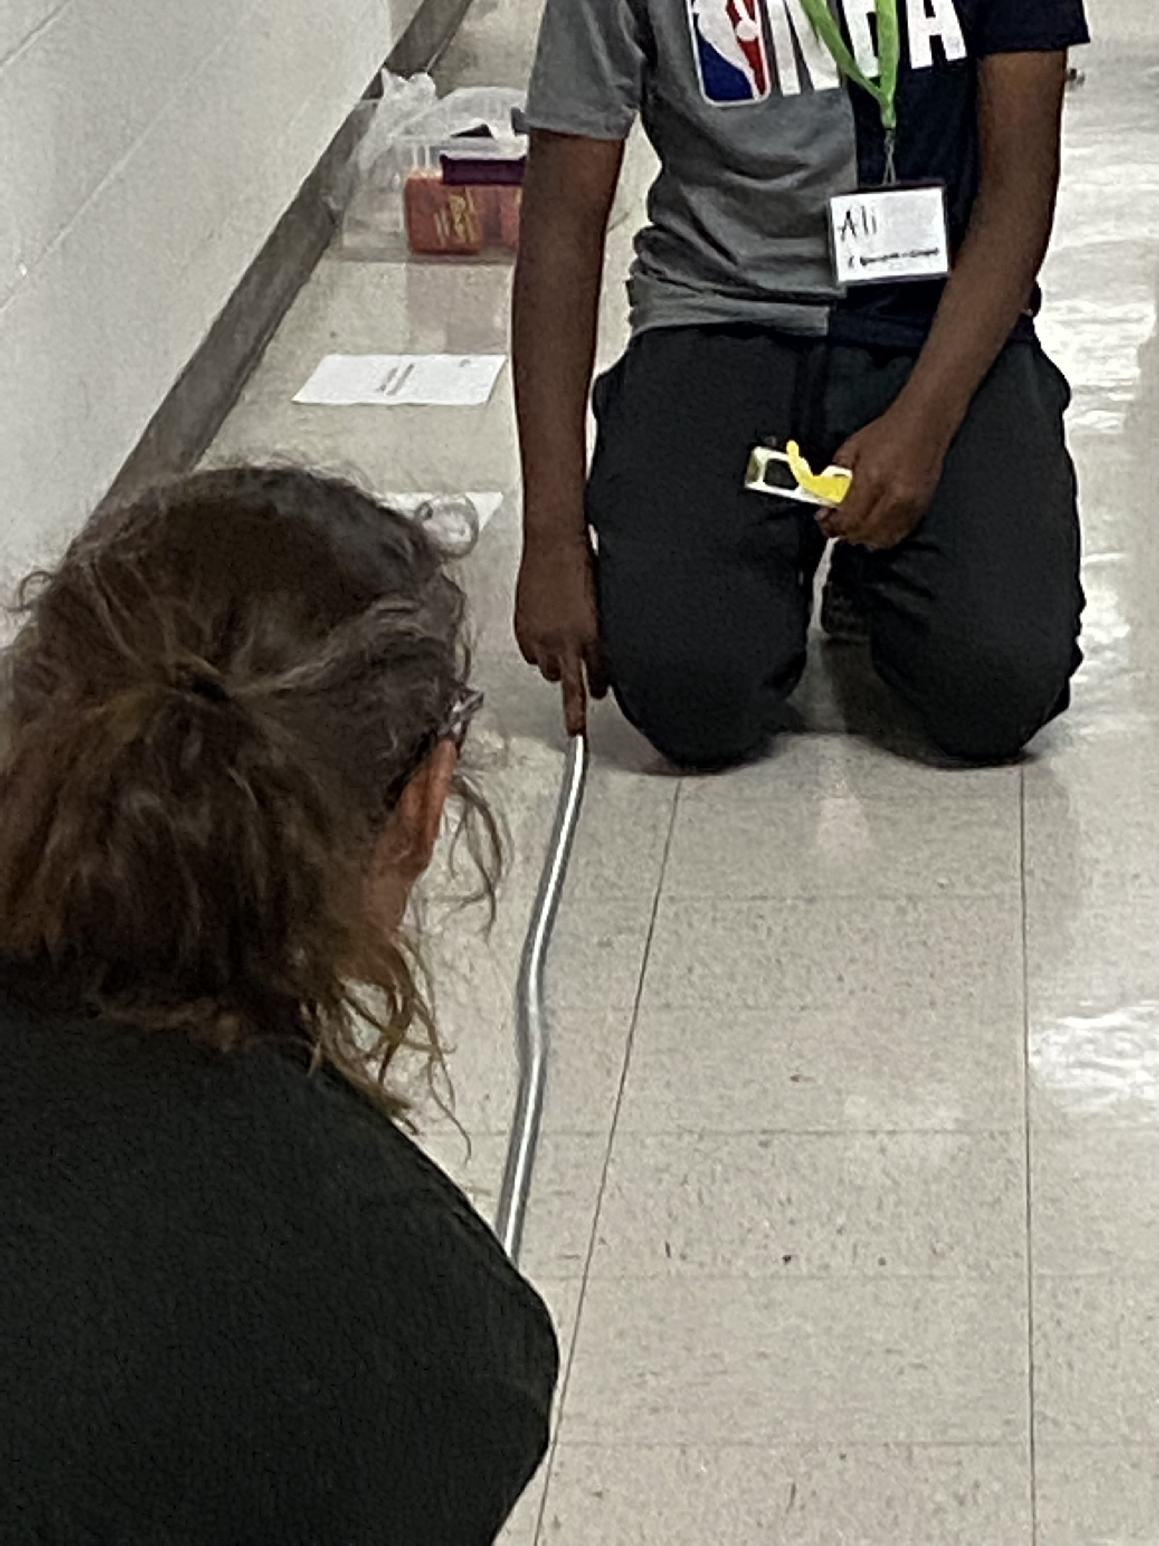
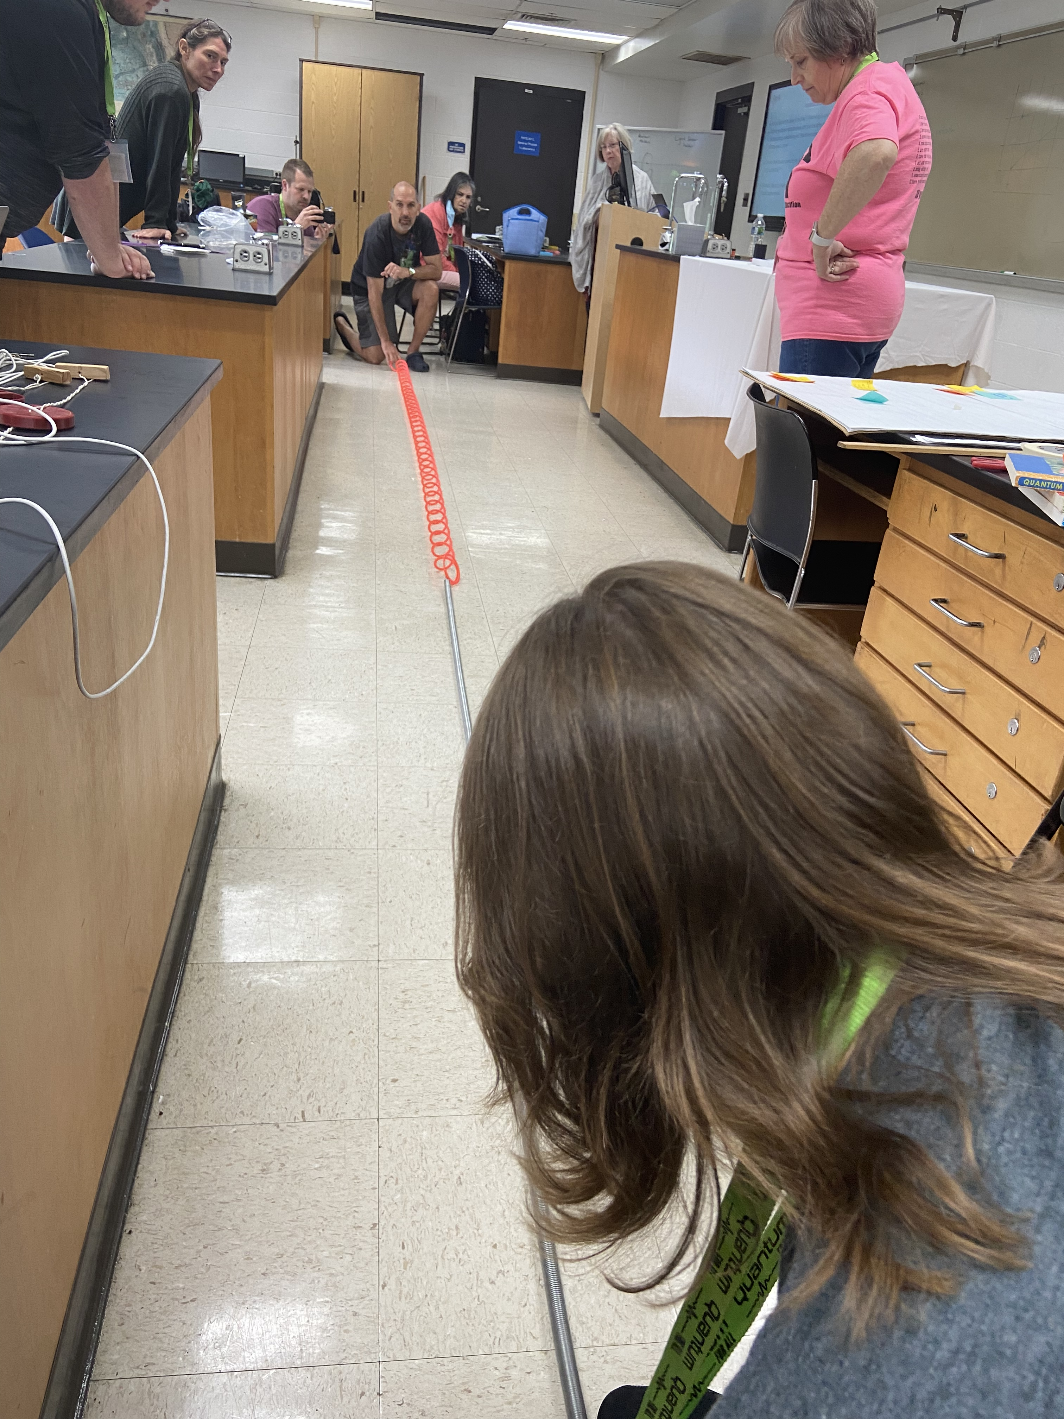
Quantum Science Focus Activities For Teachers And Students In K-12

Slide 29
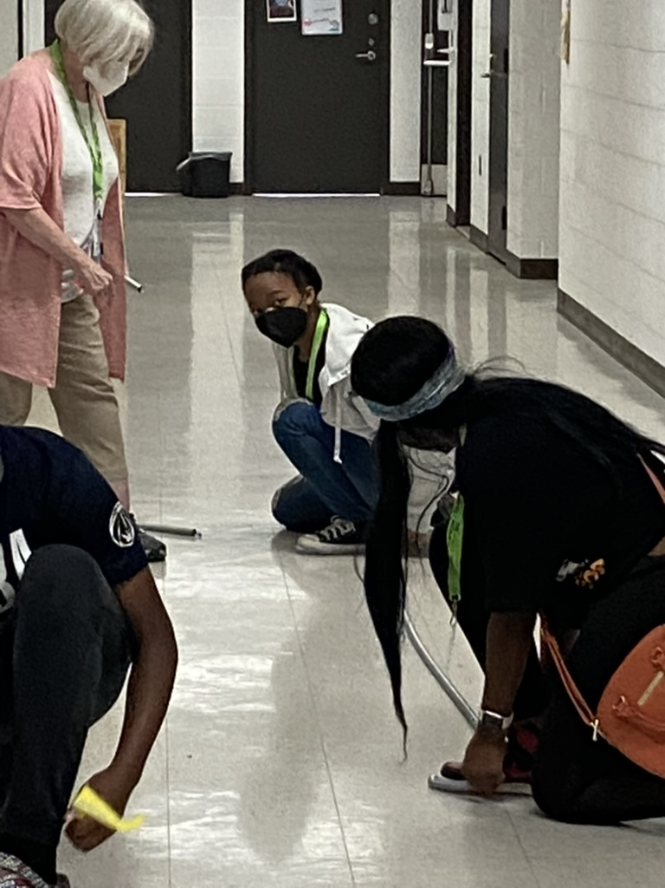
Quantum for All at Morgan State University 2022 Teacher/Student Camp

Slide 31
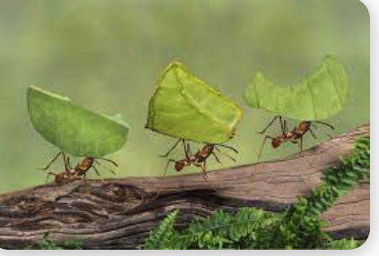
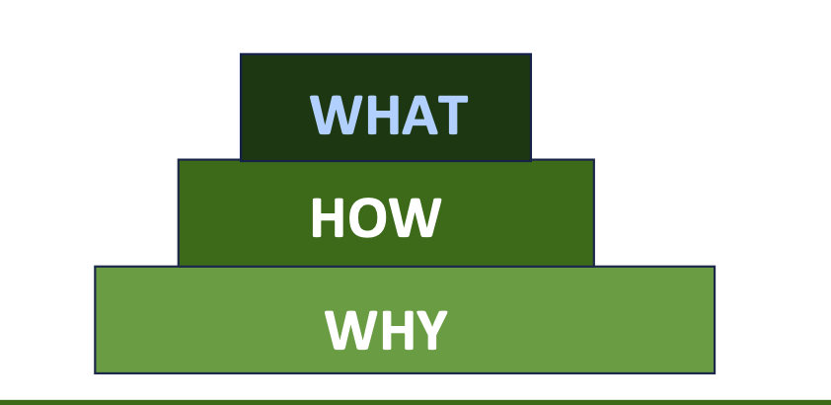
Let’s Create a TEAM
WHY is obvious
HOW is challenging, but we can do this (TEAM)
1. Support Teachers 2. Create Partnerships 3. Encourage each others (TEAM)
WHAT WE do proves what WE believe

Slide 32
Acknowledgement: Morgan State University Physics and Engineering Physics Physics Quest Quantum for All Perimeter Institute MicroNano Educational Outreach National Q-12 Education Partnership

Slide 33
Thank you For Your Attention Any Questions ?

