Slide 1
Transforming STEM Graduate Student Teaching: The Gateway2STEM Workshop
Nishchal Thapa Magar, Jessica L. Rosenberg, Jill K. Nelson, Derrick Wong, Marco Brizzolara

Slide 2
Outline of Presentation
Brief overview of Gateway2STEM Project.
Preparation for STEM GTAs.​
Preliminary results.

Slide 3
What is Gateway2STEM?
Gateway2STEM is an NSF-funded project.
The goal is to establish active and collaborative learning as the primary instructional approach in large undergraduate courses.
We support faculty, GTAs, and learning assistants in actively engaging students.

Slide 4
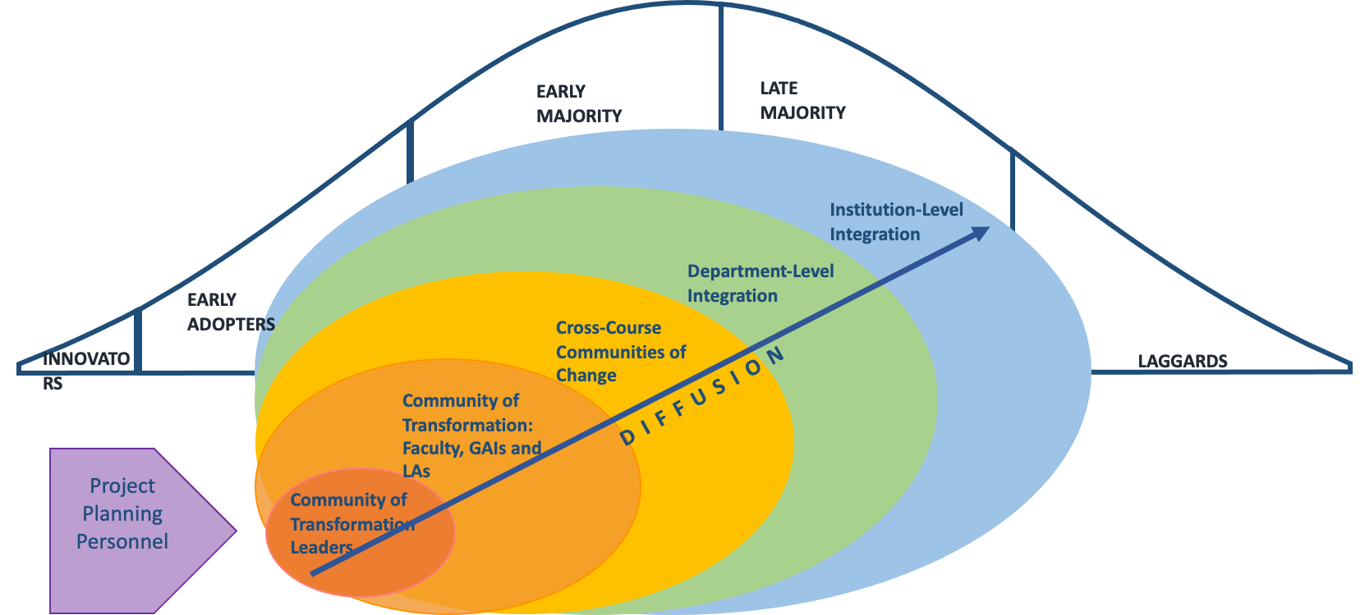
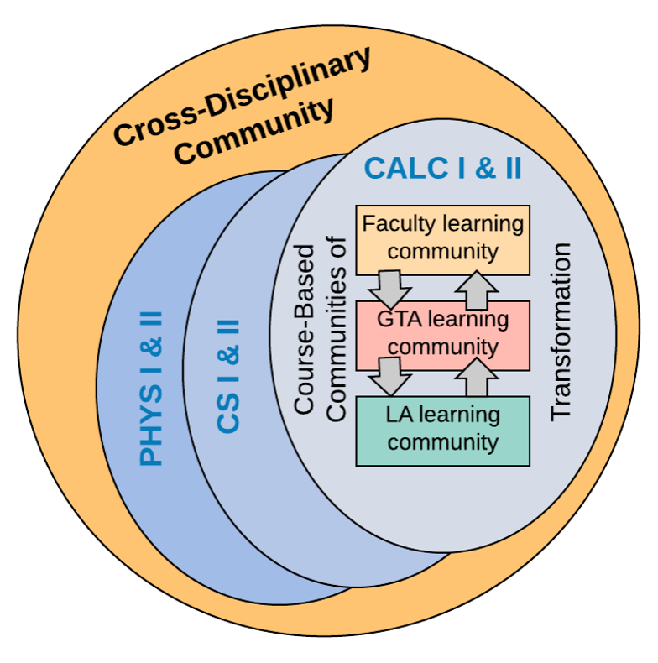
The Gateway2STEM Model for Change
The Implementation
The Idea

Slide 5
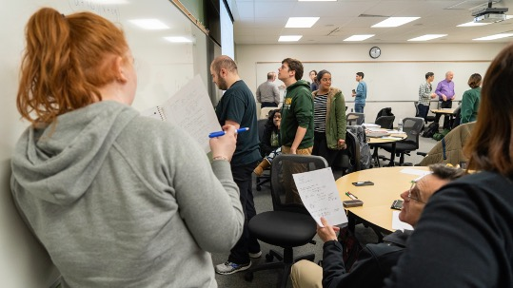
Active Learning across three department:
PHYS 160/260 calculus-based introductory physics sequence
CS 112, 211,262,310 courses with labs or recitations.
Math 113/114 calculus sequence into active learning
GTA preparation focus – creation of a new weekly GTA seminar.

Slide 6
Why focus on GTAs?
Future faculty are today’s graduate students.
GTAs engage with and instruct many undergraduates.
GTAs play an important role in large enrollment introductory courses.
GTAs can help change teaching pedagogies in ways that impact many students.

Slide 7
GTA Training Demographic
A combined total of 104 GTAs have taken part in both the Fall 2022 and Fall 2023 sessions.
6
10
44
10

Slide 8
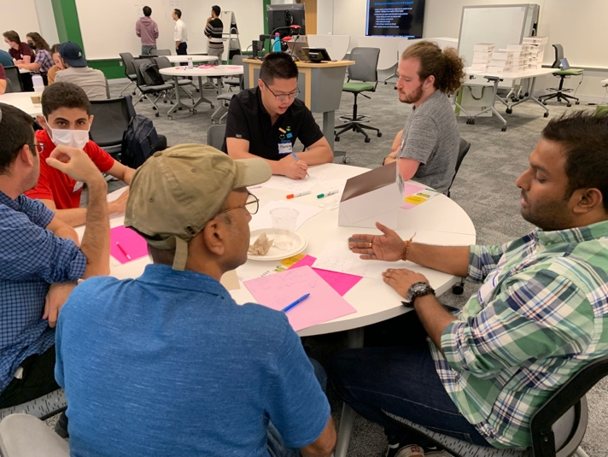
GTA Reactions
“I am prepared to implement active learning and first day.”
“Active learning and communication is really important to keep students engaged.”
Fall 2022
“It was very informative and fun, takeaway is that GTA work is tough but fun and we are not alone.”

Slide 9
GTA Reactions
“For me, classroom teaching is a lab, so it blends itself quite well to active learning because the students are actively engaging in physics.”
Fall 2023
“In a flipped classroom, sometimes your students become the producers, and sometimes your producers do more than just consume.”

Slide 10
Major topics discussed during the Workshop
What is Active Learning and how can you implement it?
Building classroom community.
Planning for day one.
Campus resources.
Returning GTA discussion.
Fall 2023

Slide 11
Initial Summary / Findings :
Starting teaching preparation is not enough for incoming graduate students.
2-day workshop helps GTAs transition into their graduate student role.
Helps for transition into graduate education as well as graduate teaching.
International students/GTAs face additional challenges for which support will be important.

Slide 12
“From a cultural perspective, this might be the most challenging aspect for me.”
“In my home country, students are afraid of their teachers. So, I think it's somewhat different here. They are not afraid and keep asking questions.”
“The language barrier may be a challenge. Hopefully, it will be fine, but sometimes things may be lost.”
International GTAs
“I have never taught before, and it's my first time abroad rather than in my home country. Everything is overwhelming.”

Slide 13
What’s next?
Explore how increased classroom experience changes GTAs.
How teaching practice evolves ?
How sense of role as an instructor evolves?
Explore influences on changes in GTA teaching practice and understanding of their role as instructor..
Will examine both time in classroom and additional interventions.
Explore whether there are differences in these experiences for international GTAs.

Slide 14
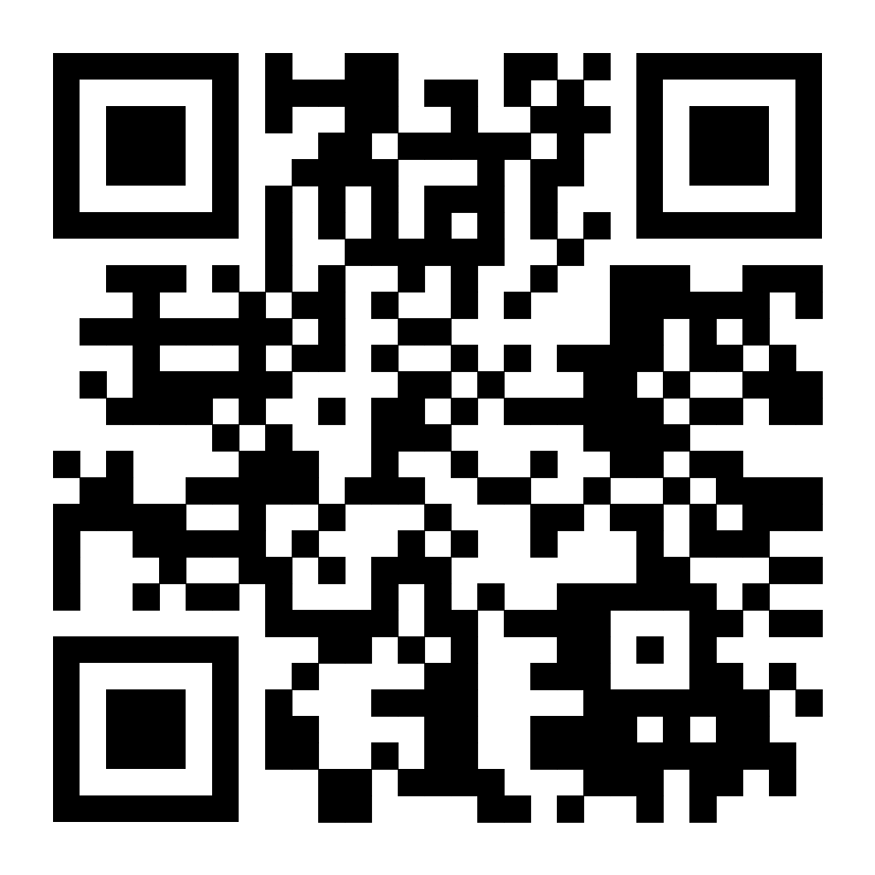
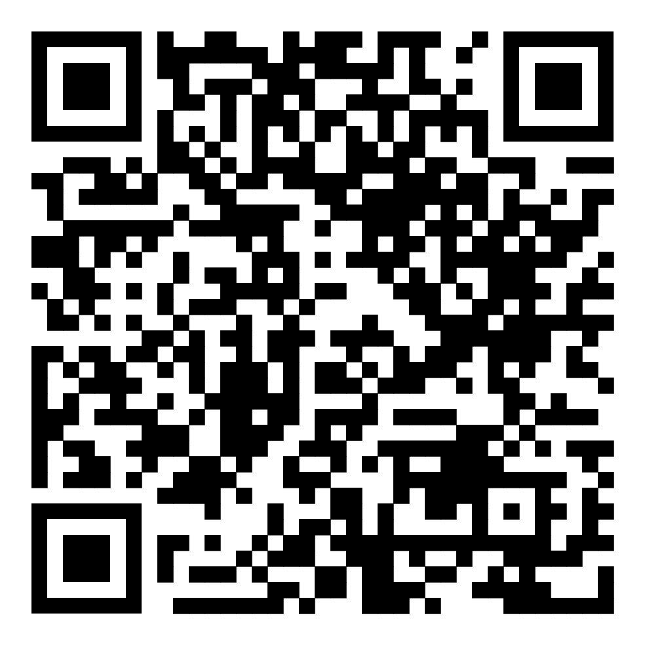
Thank you!
Gateway2STEM website:
https://gstem.research.gmu.edu
Video about the Gateway2STEM project:
https://www.youtube.com/watch?v=n4gBld5GFhk

