Slide 1
Physics for Pre-health – Fostering Student Motivation
Jency Sundararajan
University of Virginia

Slide 2
Why Motivate?
Desire to learn and achieve
Valuable educational goal
Commitment to life-long learning

Slide 3
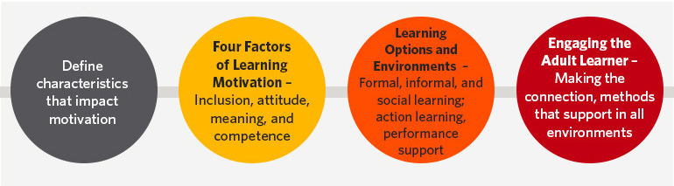
How to Motivate?
Clear goals and expectations
Constructive criticism and feedback
Know your students
Give them control
Be enthusiastic
Interactive/
collaborative activities
Sense of belonging

Slide 4
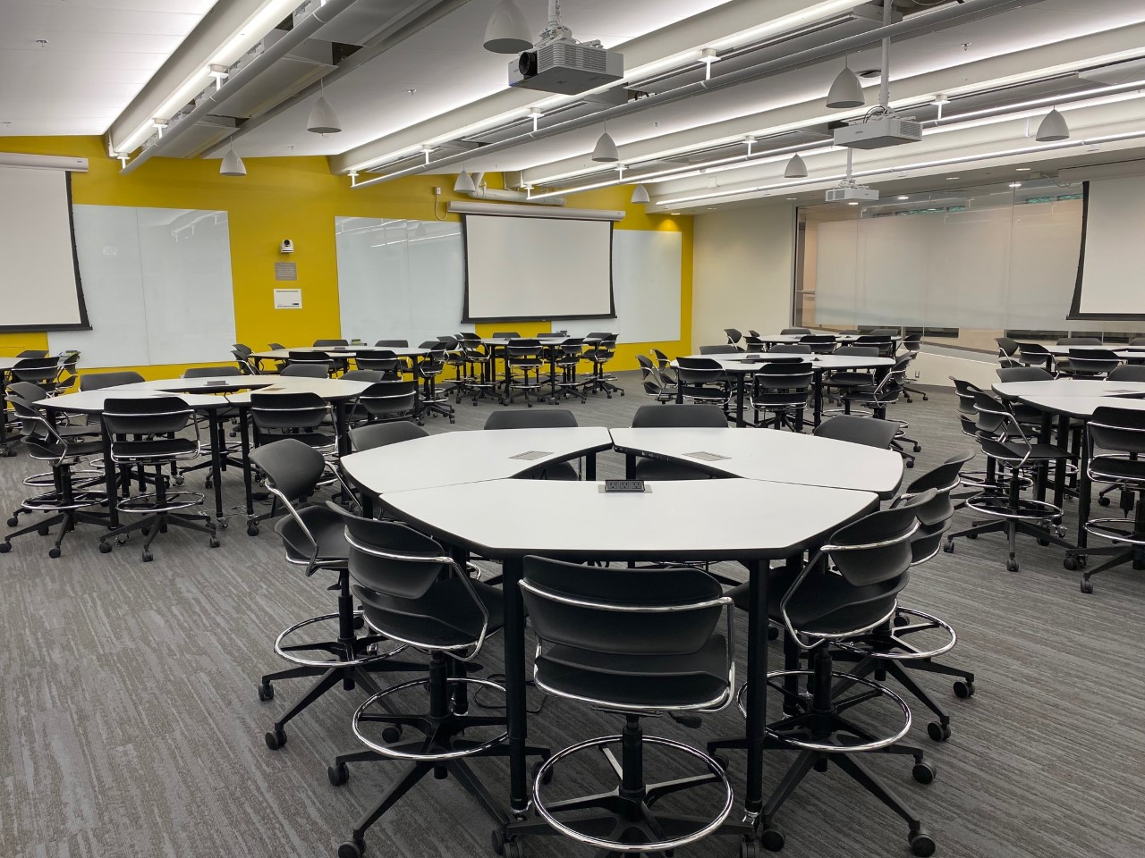
My courses – Fall 2023
- Active learning format
- 3 sections of 99 students each
- 11 tables of 9 students each
- Work in groups of three
4 Teaching Assistants (1 GTA and 3 UTAs)

Slide 5
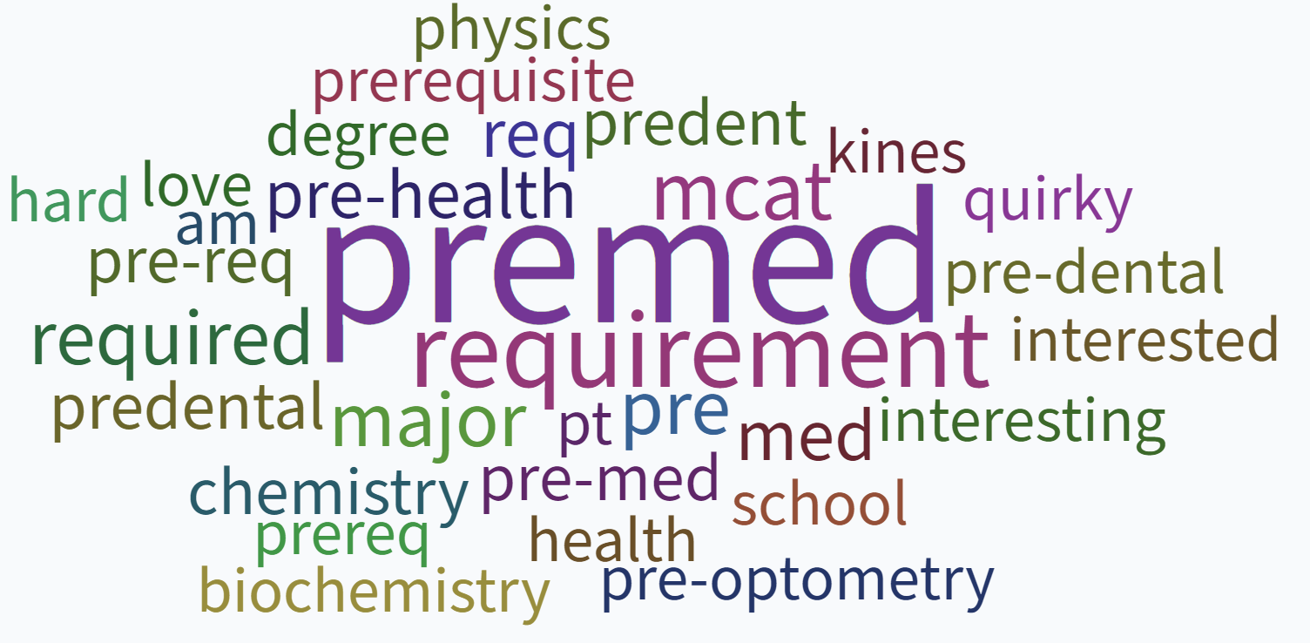
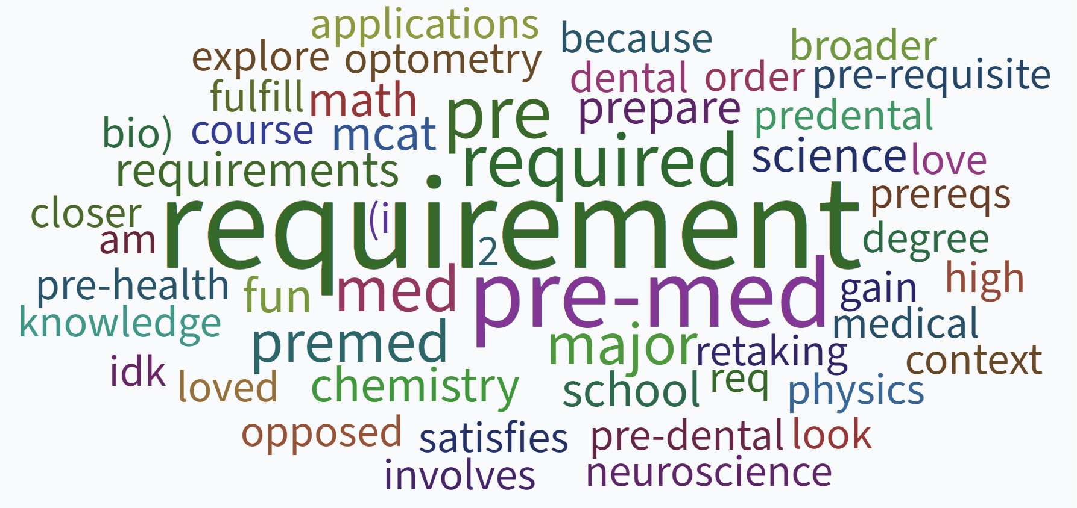
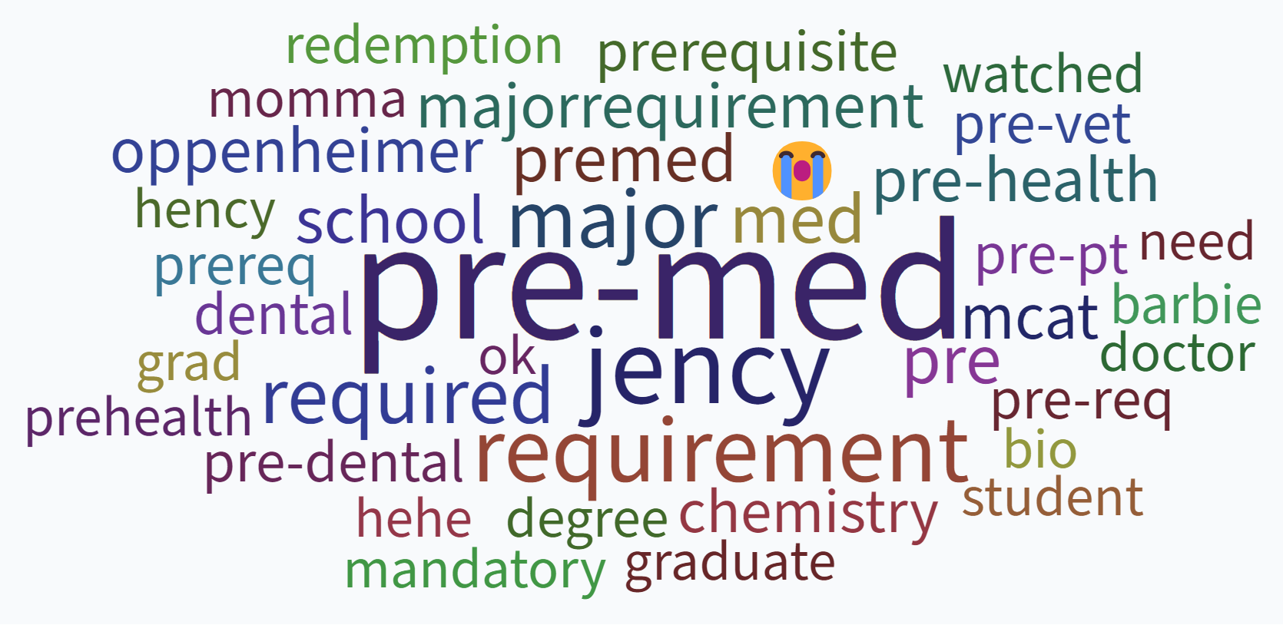
Section 1
Section 2
Section 3
What is your motivation to take this class?
(1st day of class)

Slide 6
Class Format
Pre-lecture:
Reading Assignments
Chapter Power Point
Textbook Demo videos
Instructor Pre-lecture video

Slide 7
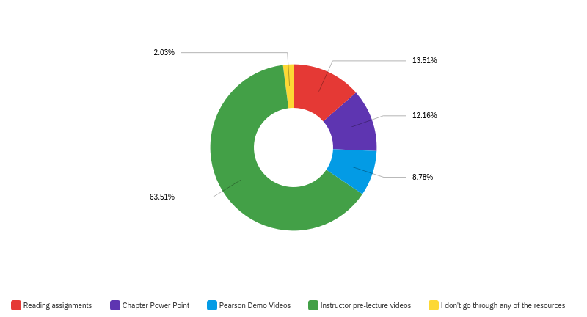
You are required to read each week's course content before coming to lecture. Which of the following resources do you go through?
Mid-semester survey: ~150 students

Slide 8
Class Format
In-class activities:
Poll everywhere quizzes
Demos – student participation
Questions and discussion
Mini-lecture/Problem solving
Group work

Slide 9
Which activity/resource do you think is most beneficial in learning/understanding the material?

Slide 10
Class Format
Post lecture:
Weekly report
Weekly homework (8 multi-section problems)
Weekly Quiz (multiple choice)

Slide 11
Comments on Assignments
I like all the assignments except the End Of Lecture quizzes because the 50-minute class time does not provide enough time to answer the questions needed for the EOLs.
While the workload in this course is intensive, it keeps students studying and ensures proper understanding of each concept.
I think all the assignments are beneficial to my understanding of the content.
Sometimes it's just a lot of work to do and can be time consuming even though it is helpful. The equations part of the weekly summary report is the one I find the least beneficial when comparing the time it takes.

Slide 12
One factor that helps you stay motivated in this course.
Desire to survive
Course Structure/materials
Working in Groups
Pre-med
Pre-lecture videos
Class Environment
Spreadsheet
MCAT
Help from TAs/Instructor
Good Grade
Homework assignments

Slide 13
Comments – What keeps you motivated?
I really like the group work structure of the class because we get to learn from each other and put our brains to work understanding and solving the problems.
Working in groups helps me stay motivated and when I get confused it is always nice to be able to ask one of my group members for help.
Definitely the homework assignments keep me constantly learning.
While the workload is a lot, it definitely is helpful to spend some part of every day working on physics because when it is time to take the exam I have consistently worked with the material which makes me feel more motivated and confident.
I like that the course structure keeps things moving and I really like the support I get from working with my peers and from the TAs as well. The class environment is positive which makes me feel better about things
Structured learning objectives
and material that is due routinely through week
My group, actually! We all really want to do well in this class and it gives me the encouragement to also work just as hard.
Enthusiasm of the professor and help from TAs
I love the worksheets and structure of the course. It helps me structure my learning in a way that allows me to easily review concepts and put them into practice.

Slide 14
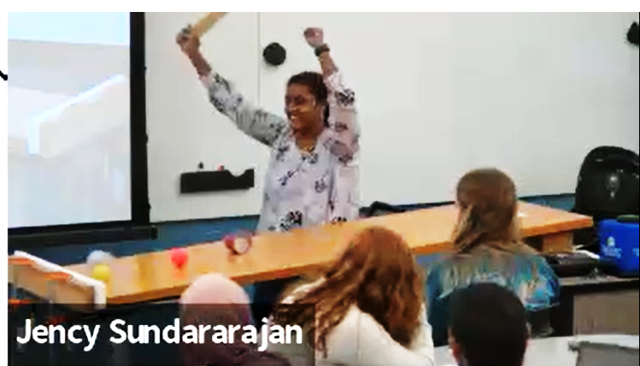
Summary – Fostering student motivation
Creating a classroom environment, a safe space for the students to participate without hesitation and judgement, as they share knowledge in a democratic setting where each one of them senses a responsibility to contribute to learning.
Student collaboration is the key factor in my classroom, as they become active participants and engage in extensive discussions, leading to a better understanding of the subject matter and a dynamic learning experience.
Course structure and materials that emphasizes on the importance of learning a concept by providing examples of direct applications in their respective field.
Energy and passion of the Instructor/TAs motivates the students to get excited to learn and helps them to stay curious.
As a teacher, it is important for me to teach in a way that respects and cares for the souls of my students.

