Slide 1
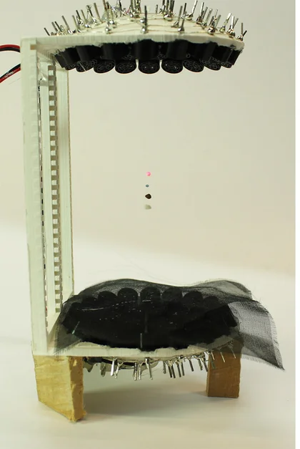
Acoustic Levitator
Patrick Stanley
Graduate Student
Dept. of Physics and Astronomy
University of Delaware
Marzo et al. 2017

Slide 2
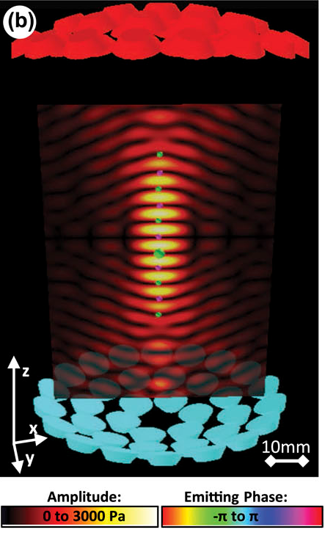
Marzo et al. 2017

Slide 3
Other things that can be levitated:
Other types of small beads
Drops of liquids
Ants
Any other small light objects
Marzo et al. 2017

Slide 4
Other things that can be levitated:
Other types of small beads
Drops of liquids
Ants
Any other small light objects
Building and buying instructions: https://www.instructables.com/Acoustic-Levitator/
References
A. Marzo, A. Barnes, and B. Drinkwater, “Tinylev: A multi-emitter single-axis acoustic levitator,” Review of Scientific Instruments, vol. 88, p. 085105, 08 2017.
Marzo et al. 2017

