Slide 1
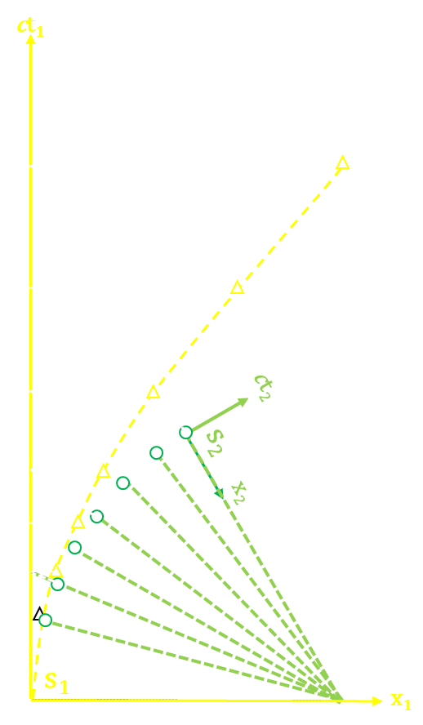
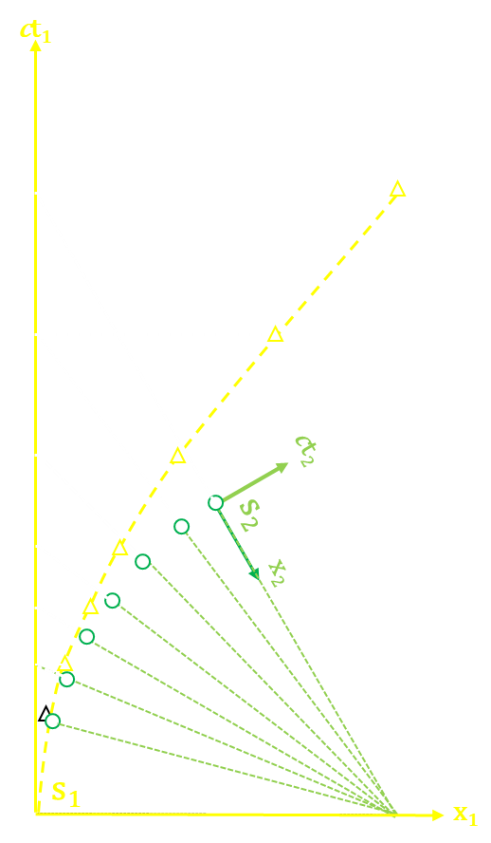
Riding on a Light Beam
Observing the Velocity Triangle
Lewis F. McIntyre
CS AAPT Fall Session
October 21, 2023
mcintyrel@verizon.net
Notes:
Good Morning! My name is Lewis McIntyre, a retired Naval Aviator, and now a retired engineer. This is a continuation of several presentations I have made on a graphical solution to special relativity that I call the velocity triangle.

Slide 2
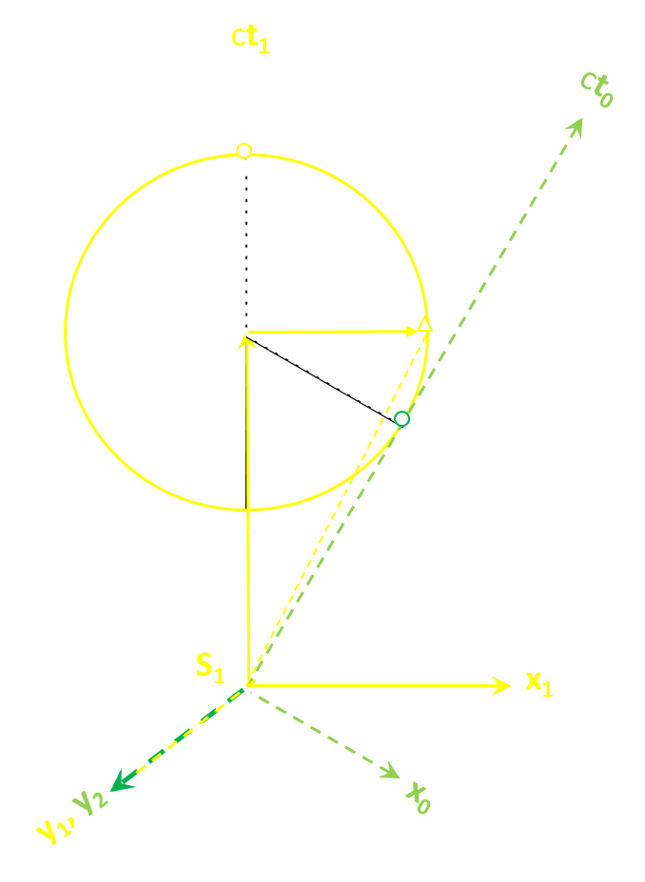
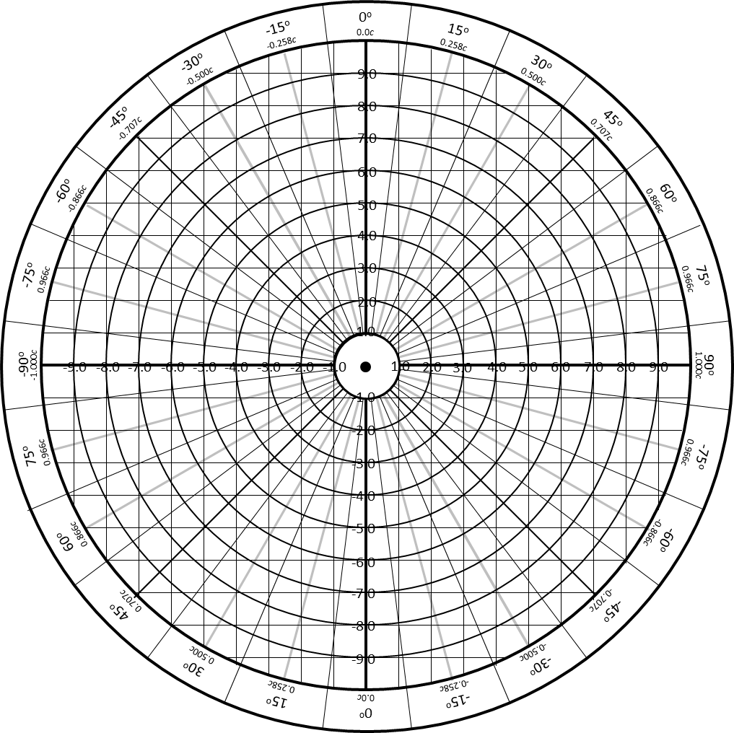
INTRODUCTION
VELOCITY TRIANGLE
Powerful Tool For Analysis
Does It Have Any Basis in Reality?
Notes:
The velocity triangle can be solved on a simple polar plot as shown, that allows all special relativity problems, including mass, momentum, energy and kinematics, to be solved with straight edge and divider, no computation necessary. Copies of the polar plot are available for you to take.
The velocity triangle is a powerful analytical tool, but does it have any basis in reality?

Slide 3
OBSERVING THE VELOCITY TRIANGLE
SALLY LEAVES EARTH AT NOON
Tangent to Earth’s Orbit
Defined as x Direction
STEVE LEAVES EARTH AT SAME TIME
Normal to Earth’s Orbit
Defined as y Direction
SAM REMAINS ON EARTH IN MISSION CONTROL
WHERE WILL STEVE LOCATE SALLY AND SAM AT 1PM?
Steve in y Direction
Sam on Earth
In Mission Control
Sally in x Direction
Notes:
TO observe the velocity triangle, we are going to set up a problem of two orthogonal velocities. At noon, Sally leaves the Earth at half the speed of light tangential to Earth’s orbit, leaving Sam behind on earth in mission control. At the same time, Steve leaves the Earth perpendicular to Earth’s orbit. At 1PM, we are going to examine where and when Steve will locate Sally and Sam, at his various departure velocities from the very low up to near the speed of light.

Slide 4
THE VELOCITY TRIANGLE Reference Frames S₁, S₂, and S₃
THE VELOCITY TRIANGLE FOR S₁ AND S₂
ORTHOGONAL OBSERVER S₃
SPHERICAL TRIGONOMETRIC SOLUTIONS FOR ORTHOGONAL VELOCITY ANGLES
Low Speed Approximations, v₃₁<<c
High Speed Approximations, v₃₁→c
S₃’s MEASUREMENTS ON x-y PLANE
Vector Sum, v₃₁<<c
Velocity Triangle as v₃₁→c
Notes:
We are going to define Sam’s reference frame on Earth as S₁, Sally’s as S₂, and Steve’s as S₃. β₁₂, the relative velocity angle between Sam and Sally, is 30 degrees, given Sally’s departure speed of 0.5c. We are going to vary β₃₁, the velocity angle between Steve and Sam, from a very small angle for v₃₁<<c, and tending to 90º as v₃₁ approaches c. We are going to use spherical trigonometry to define the velocity β₃₂, the velocity angle between Steve and Sally, in terms of β₁₂ and β₃₁. We will see that the velocity triangle will make short work of what would otherwise be an eye-watering problem using algebraic forms of the Lorentz Transform.

Slide 5
THE VELOCITY TRIANGLE Sam and Sally
VELOCITY TRIANGLE OAB:
S₁ in blue
S₂ in red
β₁₂=arcsin (v/c)
TRIGONOMETRIC LORENTZ TRANSFORM
$$x_{1}=\frac{x_{2}+{ct}_{2}∙sin⁡(β_{12})}{cos⁡(β_{12})} \\ {ct}_{1}=\frac{{ct}_{2}+x_{2}∙sin⁡(β_{12})}{cos⁡(β_{12})}$$
C IS S₁’s MEASUREMENT OF EVENT C (x₂=0)
C is Lorentz Transform of B
OA=ct₁=ct₂/cos(β₁₂)
AC=x₁=ct₂· sin(β₁₂)/cos(β₁₂)
v₁₂/c=x₁/ct₁= sin(β₁₂)
ct₁
S₁ Timeline
ct₂
S₂ timeline
A
C
ct₁, x₁
B
ct₂, x₂
β₁₂
S₁
O
x₁
S₂
x₂
IS IT REAL?
OR JUST ANOTHER MATHEMATICAL CONSTRUCT?
Notes:
We erect Sam’s reference frame S₁ in blue, with his time axis ct₁ vertical through OA and his x₁ axis normal to it. We erect Sally’s time axis ct₂ in red through OB and her x₂ axis normal to it, inclined by β₁₂ with respect to Sam’s, forming S₂ .
Their y axes are normal to the direction of velocity and remain parallel to each other out of the page.
This permits the solution of the Lorentz Transform trigonometrically in terms of β , as shown. For an event B in Sally’s reference frame at time ct₂ with x₂=0, the Lorentz transform is C, with OA= ct₁, AC=x_{1.} C is Sam’s measurement of Sally’s event B. We did not use the polar plot as the template, with O at the center, as the background would have obscured the details.

Slide 6
THE ORTHOGONAL OBSERVER
ROTATE A BIT TO EXPOSE y AXIS
SPHERE IS LOCUS OF IDENTICAL PROPER TIME cτ FROM ORIGIN O
ct₁
y₁
ct₂
A
x₁
y₂
β₁₂
B
cτ
x₂
cτ
E
O
D
Notes:
We need to rotate this velocity triangle a bit so we can see the y–axis, which is the direction of Steve’s relative motion with respect to Sam and Sally. Two events A and B having same proper time cτ, or distance from O, will lie on the perimeter of a circle about O. Adding the y-axis makes this a sphere of radius cτ

Slide 7
THE ORTHOGONAL OBSERVER Velocity Angles
ADD THIRD REFERENCE FRAME S₃ IN GREEN
Velocity Angle β₃₁ with respect to S₁ (Independent Variable)
Velocity Angle β₃₂ with respect to S₂ (function of β₃₁)
ct₁
y₁
ct₂
ct₃
y₃
A
x₁
y₂
β₃₁
β₁₂
B
C
β₃₂
x₃
x₂
S₃
E
O
D
Notes:
Next, we add Steve in green, whose velocity triangle with respect to Sam will lie in the y-ct plane. Steve’s time axis ct₃ is through OC, and his y₃ axis is normal to it, tangent to the arc AC at C, and his x₃ axis is normal to both. We can see that Steve’s velocity angle β₃₂ with respect to Sally is the arc CB.

Slide 8
THE ORTHOGONAL OBSERVER Velocity Angles
β₁₂, β₃₁ AND β₃₂ FORM SPHERICAL TRIANGLE ABC ON SURFACE OF SPHERE
Great Circle Ranges: Which Reduces to
sin²(β₃₂)= sin²(β₁₂)+sin²(β₃₁)- sin²(β₁₂)·sin²(β₃₁)
using cos²(β)=1-sin²(β)
ct₁
y₁
ct₂
ct₃
y₃
A
x₁
y₂
β₃₁
β₁₂
B
0
C
β₃₂
x₃
x₂
cos(β₃₂)= cos(β₁₂)·cos(β₃₁)-cos(L)·sin(β₁₂)· cos(β₃₁)
S₃
E
O
D
L=-90º
Notes:
The three velocity angles form a spherical triangle ABC on the surface of the sphere, identical to the one used by navigators to determine great circle ranges on the globe. For this problem, angle L is DOE at the center of the globe, which is 90º. This reduces the great circle range equation to a product of cosines, which further reduces to the sine function, using trigonometric identities.

Slide 9
THE ORTHOGONAL OBSERVER Mapping S₁ and S₂ onto x₃ -y₃ Plane
S₃ OBSERVES
S₁ Receding Only in y₃ Direction:
s₃₁= y₃₁=ct₃·sin (β₃₁)
S₂ Receding in x₃ and y₃ Directions
s₃₂= ct₃·sin (β₃₂) x₃₂=s₃₂ ·sin (α) y₃₂=s₃₂ ·cos (α)
Where α is the Great Circle Bearing from S₃ to S₂
y₃
ct₂
y₃
y₃
y₁
ct₃
A
x₁
y₂
α
β₁₂
B
β₃₁
β₃₂
C
x₃
x₃
x₂
S₃
E
O
D
cos(α)= [cos(β₁₂)-cos(β₃₁)· cos(β₃₂)]/[sin(β₃₁)·sin(β₃₂)]
Notes:
Steve is keeping track of Sally’s and Sam’s positions of time on a navigational x-y chart, tangent to C at some arbitrary time ct₃. Steve will see Sam receding at v₃₁=sin(β₃₁). He will see Sally receding at a total distance s₃₂=ct₃*sin(β₃₂) tangent to the great circle segment CB. The angle between CA and CB at C is the great circle bearing α of B from C.

Slide 10
THE ORTHOGONAL OBSERVER v₃₁<<c
ct₃
y₃
ct₂
VELOCITY ANGLE β₃₂:
sin²(β₃₂)= sin²(β₁₂)+sin²(β₃₁)- sin²(β₁₂)·sin²(β₃₁)
≈ sin²(β₁₂)+sin²(β₃₁)
BEARING ANGLE α:
β₃₂→ β₁₂
cos(β₃₁) → 1
y₃
y₁
A
y₂
α
x₁
B
0
β₃₁
x₃
C
x₃
x₂
S₃
E
O
D
1
cos(α)= [cos(β₁₂)-cos(β₃₁)· cos(β₃₂)]/[sin(β₃₁)·sin(β₃₂)] ≈ 0
so α → 90º
cos(β₁₂)
Notes:
If Steve’s speed is very much less than c, then β₃₁ is very small, and the product of sines on the right tends toward zero. In this case, Steve will see Sally’s velocity with respect to him to be approximately the vector sum of his velocity with respect to Sam, and Sally’s velocity with respect to Sam. For this small velocity, Sally’s velocity with respect to him is almost the same as her velocity with respect to Sam, and as his velocity goes to zero, so does the denominator of the bearing angle equation, for a bearing angle of 90 degrees

Slide 11
THE ORTHOGONAL OBSERVER v₃₁→c
VELOCITY ANGLE β₃₂:
sin(β₃₁) → 1
sin²(β₃₂)= sin²(β₁₂)+sin²(β₃₁)- sin²(β₁₂)·sin²(β₃₁)
→ sin²(β₃₁)
BEARING ANGLE α:
cos(β₃₁) → 0
sin(β₃₁) →sin(β₃₂) → 1
SO
y₁
ct₂
y₃
A
x₁
y₂
β₃₁
B
y₃
C
x₃
x₂
α
ct₃
x₃
E
O
D
0
cos(α)= [cos(β₁₂)-cos(β₃₁)· cos(β₃₂)]/[sin(β₃₁)·sin(β₃₂)]
→ cos(β₁₂)
α → β₁₂
1
1
Notes:
On the other hand, as Steve’s velocity with respect to Sam tends toward c, then Sally’s velocity with respect to him is just a bit more than Sam’s. Events of identical proper time in S₁ and S₂ are tending toward simultaneity in S_{3,} equidistant in x and y from C. The bearing angle α is tending toward to β₁₂, the velocity angle between Sam and Sally.

Slide 12
S₃ x₃ – y₃ MEASUREMENTS v₃₁<<c
SALLY WRT SAM v₁₂=0.5c
β₁₂=30º
TIME=1.0
STEVE WRT SAM
v₃₁=0.17c
β₃₁=10º
STEVE WRT SALLY
v₃₂=0.549c
β₃₂=31.47º
y₃₁=0.17
x₃₁=0.0
x₁= x₃=0.5
α=73.6º
y₃₂=0.15
x₃₁=1.0
s₃₂=0.549c
Notes:
This is what Steve will see on his x-y plane with a 10º velocity angle β₃₁ with respect to Sam. This corresponds to v₃₁ equal to 17% of the speed of light. Using the great circle bearing and range equations, at 1 PM, Steve will locate Sam at 0.17 light hours, with a fixed point x₁ =0.5 on Steve’s ruler also equal to x₃=0.5 on Steve’s ruler, since that displacement is orthogonal to his velocity. He will locate Sally at 0.549 light hours, bearing 73.6 degrees. Steve’s measurement of Sally is approximately the same as Sam’s

Slide 13
S₃ x-y MEASUREMENTS v₃₁→c
y₃₁=0.996
x₃₁=0.0
x₁= x₃=0.5
SALLY WRT SAM v₁₂=0.5c
β₁₂=30º
TIME=1.0
STEVE WRT SAM
v₃₁=0.996c
β₃₁=85.67º
STEVE WRT SALLY
v₃₂=0.997c
β₃₂=85.67º
α=30.09º
y₃₂=1.725
x₃₁=1.0
s₃₂=0.997c
Notes:
On the other hand, if Steve were receding from Sam at 0.996c (β₃₁=85.67º), at 1PM Steve would locate Sam at 0.996 light hours, and Sally at 0.997 light hours total distance, nearly equidistant from his origin, with Sally bearing 30.09º. Sam’s fixed ruler point x₁ still equals x₃=0.5 light hours.

Slide 14
S₃ x-y MEASUREMENTS v₃₁→c
y₃₁=0.996
x₃₁=0.0
A’
C
x₁= x₃=0.5
SALLY WRT SAM v₁₂=0.5c
β₁₂=30º
TIME=1.0
STEVE WRT SAM
v₃₁=0.996c
β₃₁=85.67º
STEVE WRT SALLY
v₃₂=0.997c
β₃₂=85.67º
B’
α=30.09º
s₃₁=0.865
y₃₁=0.996
x₃₁=0.0
Notes:
In the beginning, we noted that Sam would measure an event B in Sally’s with coordinates ct₂, x₂=0.866, 0, as occurring at ct₁, x₁=1.0, 0.5. Steve will locate Sally’s event B, at B’. 0.865 light hours. Thus, not only the basic velocity triangle, but the Lorentz transform itself, B’ to C’ will be mapped onto Steve’s x-y chart with increasing accuracy as his speed increases.

Slide 15
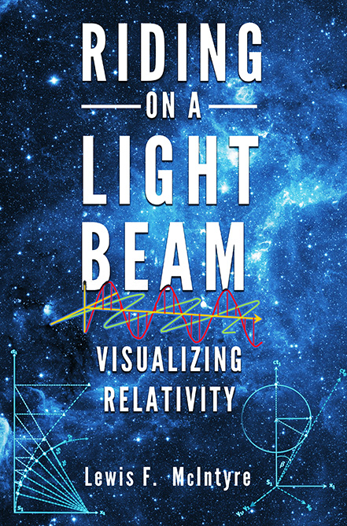
SUMMARY
VELOCITY TRIANGLE
It is Observable
Reflects Underlying Physical Reality of Relativity
Notes:
So, in conclusion, the velocity triangle is not just a useful construct and a mathematical abstraction, it is observable, and therefore reflects the underlying mechanism of the Lorentz Transform and the Special Theory. If you enjoyed this, please pick up your copy of the polar plot used for solving these problems, and also take a look at my new book, which discusses this and all other aspects of the Special Theory using the velocity triangle.

