Slide 1
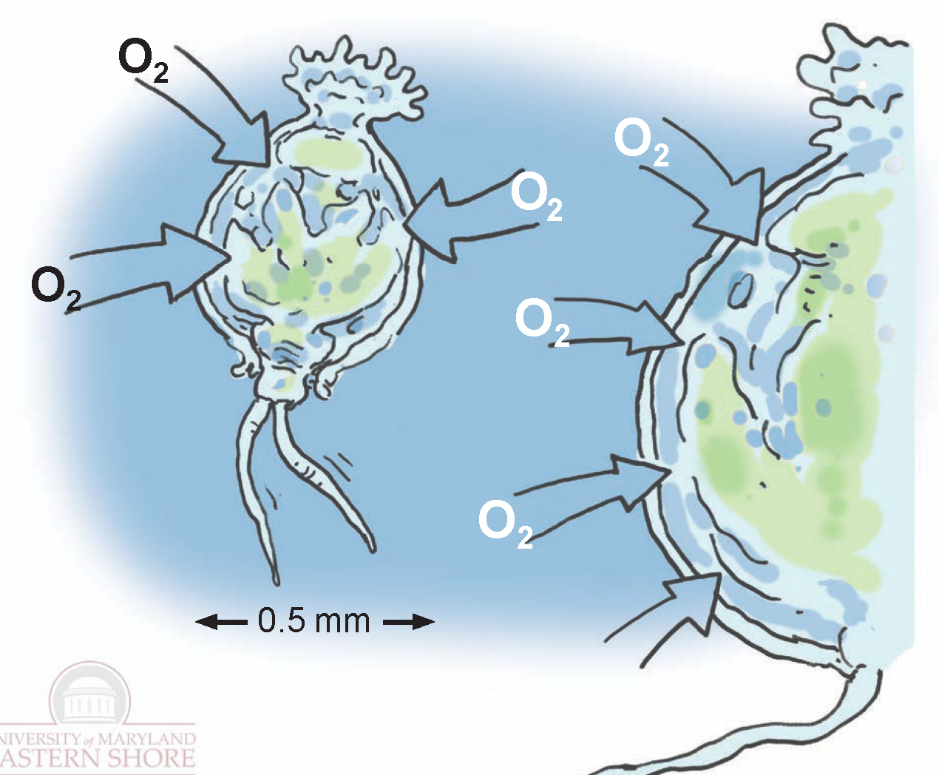
Scaling and Dimensions in Physics: Bridging Growth, Form, and Evolutionary Biology
Dr. Kausik S Das
University of Maryland Eastern Shore

Slide 2
Cell phones as formative assessment tools
www.menti.com
Enter the code 4235 8403

Slide 3
Surface area to volume ratio:
Volume: V ~ l³
Surface Area: A ~ l²
A/V ~ 1/l

Slide 4
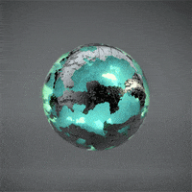
Mentimeter
Surface area to volume ratio:
Volume: V ~ l³
Surface Area: A ~ l²
A/V ~ 1/l

Slide 5
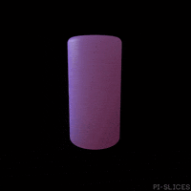
Mentimeter
Surface area to volume ratio:
Volume: V ~ l³
Surface Area: A ~ l²
A/V ~ 1/l

Slide 6
Volume: V ~ L³
Surface Area: A ~ L²

Slide 7
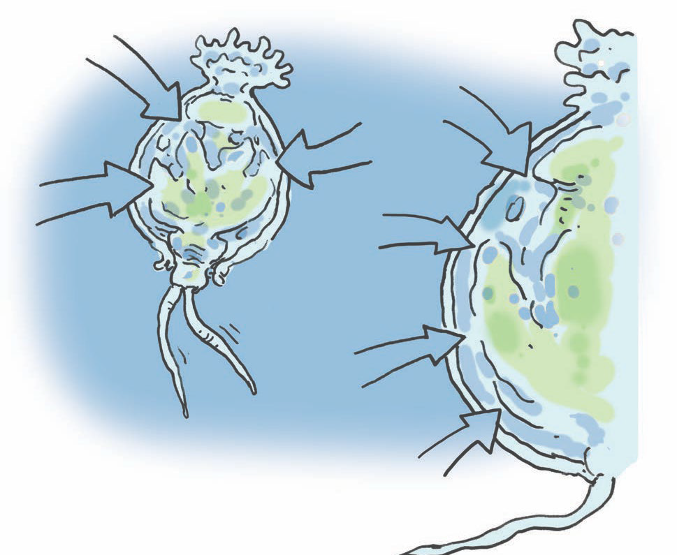
Rotifers breathe oxygen through their skin!
O
2
O₂
O₂
O
2
O
O₂
0.5 mm

Slide 8
Mentimeter
Rotifers breathe oxygen through their skin!

Slide 9
Mentimeter
Rotifers breathe oxygen through their skin!

Slide 10
Earthworms have a straight intestine with smooth wall!
worm
intestine

Slide 11
human
intestine
worm
intestine
worm
intestine

Slide 12
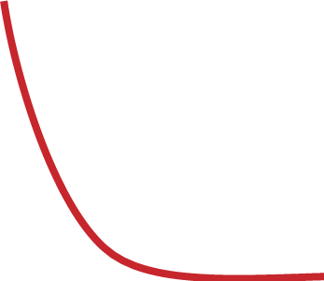
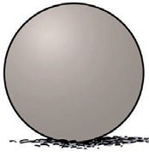
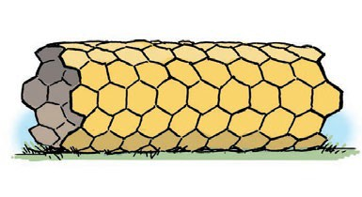
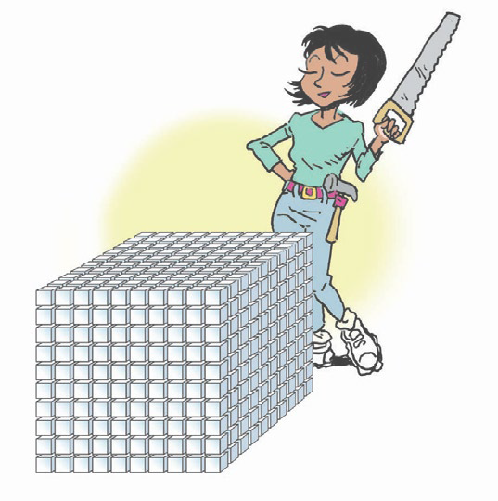
A/V
𝒍
human
intestine
worm
intestine
worm
intestine

Slide 13
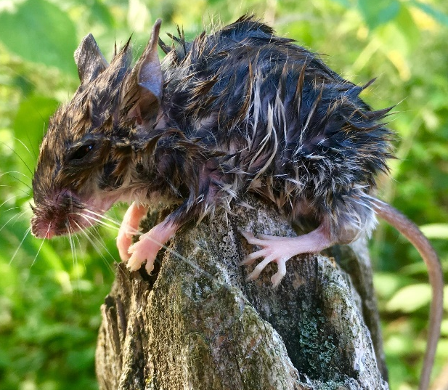
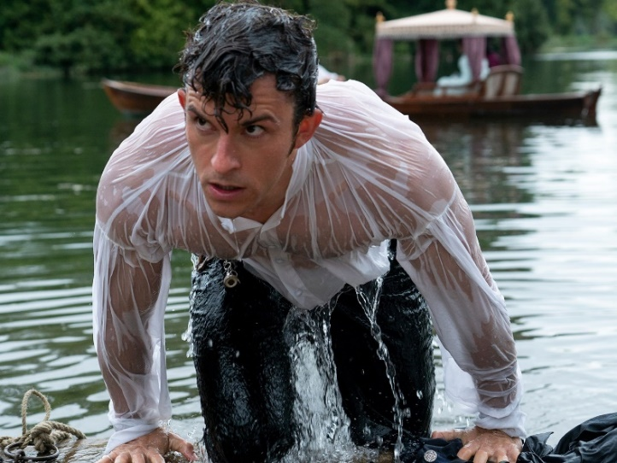
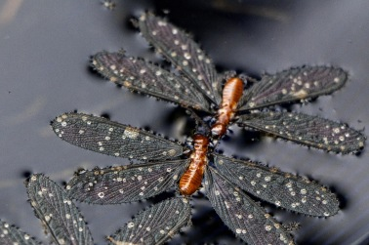
A/V
𝒍

Slide 16
Mentimeter

Slide 17
Mentimeter

Slide 18
Questions?

