Slide 1
Making Nuclear Magnetic Resonance
Resonate With Students
DEDRA DEMAREE | BLUE RIDGE SCHOOL
MERIDETH FREY | SARAH LAWRENCE COLLEGE
COLIN ABERNETHY | SARAH LAWRENCE COLLEGE
DAVID GOSSER | CITY COLLEGE OF NEW YORK
This material is based upon work supported by the National Science Foundation under Grant DUE-2120545
Notes:
30 s.

Slide 2
WHY NMR?
IMPORTANT RESEARCH TOOL
CROSS-DISCIPLINARY
NMR
BRIDGE TO 21st CENTURY CAREERS
ACCESSIBLE
Notes:
2 min.
First of all, you might be wondering why we are focusing on NMR.
Nuclear magnetic resonance is an important research tool - whether it is being used in physics labs to control quantum spins or to search for new medicines in the pharmaceutical industry.
This leads to another great aspect of NMR, that it is valuable tool across multiple scientific disciplines - particularly chemistry, physics, and life sciences - and thus it can be integrated in a wide variety of undergraduate science courses.
As a physicist, I see NMR as a wonderful bridge to introduce our students to the quantum realm, which will be important for preparing them for the 21st century STEM workforce
Lastly, NMR is becoming more and more accessible. There are benchtop systems that more affordable and capable of providing research-quality results.

Slide 3
PROJECT GOALS
Developed curricular materials are interdisciplinary and make use of current pedagogical best practices for an engaged and inclusive science learning environment.
Curricular materials provide students with class-based undergraduate laboratory experiences that introduce research skills and emulate experimental research in a lab (with or without direct access to an NMR system).
Curricular materials are designed to be easily adapted and adopted for use in a wide array of educational environments.
Notes:
1 min.

Slide 4
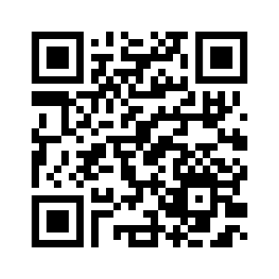
WHAT WE HAVE DEVELOPED
MODULES CONTAIN:
Expected learning outcomes
Real-world examples
Featured scientists
Hands-on activities, simulations, videos of experiments for those without access to equipment
Research-based pedagogy
Notes:
2 min.
Currently 10 physics modules that cover various NMR topics and are designed to take about 1 and ½ hours each to complete. We chose a modular design so that faculty can pick which modules best match their course objectives.
Each module has a webpage that can be viewed online, a PDF text version, and an associated student worksheet.
We also have instructional materials for each module which include suggestions on how to implement the module and all the supplemental materials and assessments we have used in our own implementations.
Modules contain…expected learning outcomes, real-world examples to highlight different applications of magnetic resonance, featured scientists from a wide range of careers that make use of MR techniques, hands-on activities, simulations, videos of experiments for those without access to the equipment, and everything is designed to use research-based teaching practices.

Slide 5
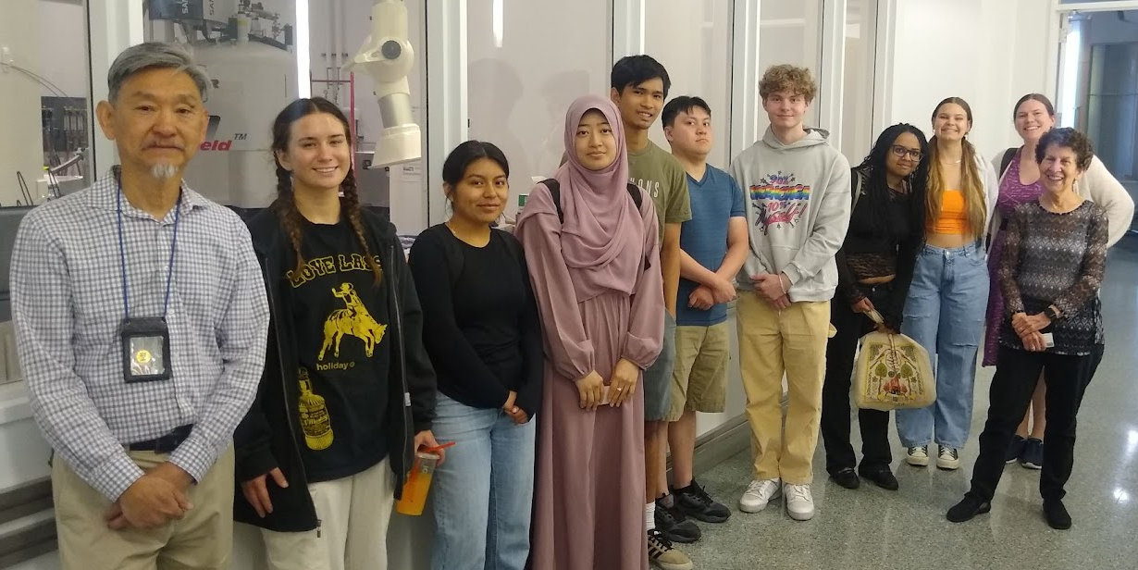
UNDERGRADUATE RESEARCHERS
Sarah Lawrence College
Lillian Bower Nicholas Fajardo Leah Goodall Jane Joncha Skyler Kawecki-Muonio Christina Kefela Afia Khan Ashley Spector-Townsend Christian Tarrasch Chris Torres
City College of New York
Mahisha Akhand Bibi Zameena Alli Sophia Jiang Sammely Perez Racquel Scott Taylor Tram
The 2023 summer crew visiting the NMR facility at CCNY.
Notes:
1 min.
We also have a wonderful team of undergraduate researchers who have been contributing to this project. On the right are the names of all the undergraduate students who have contributed to this work thus far, and this is a picture of our current cohort of researchers when we recently visited the NMR facility at CCNY. These undergraduate researches have been critical by testing out the activities, creating figures and videos for the materials, and providing valuable feedback.

Slide 6
Where we are now
Implementations: Implemented all the modules at Sarah Lawrence College, and 4 modules at City College of New York.
Revising the materials and creating instructional materials.
Disseminating our work online as well as leading professional development workshops for faculty to learn how to best adapt the material for their particular needs.
OVERALL
based off instructor and student feedback
Most of the desired learning objectives are being met
Students enjoyed using the modules
Instructors noticed that students were engaged and had increased confidence in answering questions and explaining their reasoning
Instructors had a very positive experience using the modules and felt that they helped students develop skills in the techniques or procedures of science
Notes:
2 min.
We have tested and implemented the modules in a yearlong class at Sarah Lawrence, and a few different modules in more standard chemistry courses at both Sarah Lawrence and City College.
In order to evaluate the materials, we did surveys, focus group interviews, video-recordings of classes, kept copies of student work -> and you can hear about the results of some of the analysis of this data in Dedra’s talk coming up next!
Overall, as an instructor, it was clear that the students enjoyed using the modules and most of the learning objectives were being met. Faculty also had a positive experience using the modules and felt that the modules helped students develop important scientific skills.

Slide 7
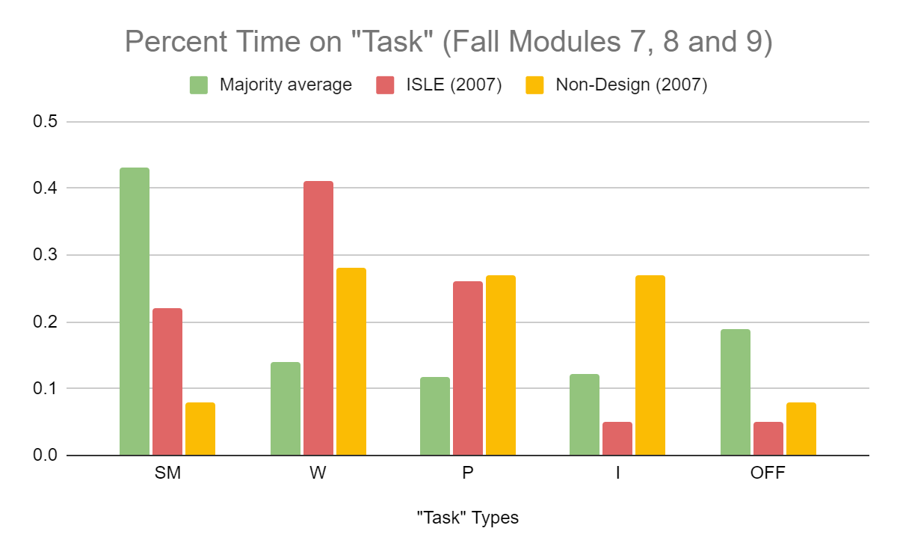
LESSONS LEARNED FROM EVALUATION
Content assessments have strong scores for all students
No notable identity shifts - their identities as scientists started and remained strong
Unsurprisingly, no notable ECLASS shift
* these are VERY small N results
Students spend a LOT of time sense making (not a lot writing)
Notes:
2 min.
Chemistry faculty member Colin Abernethy and I implemented all the modules in a year-long ‘non-standard’ course called “Resonance Research and Spectroscopy Seminar”, but then Colin also implemented a few of the modules into his Organic Chemistry courses and Dave added a few of the modules to his Analytical Chemistry course.
In order to evaluate the materials, we did surveys, focus group interviews, video-recordings of classes, kept copies of student work -> and you can hear about the results of some of the analysis of this data in Dedra’s talk coming up next!
-> Then go over ‘overall’ points and mention where there is room for development to close the loop so that students recognize that the skills they learned are actually relevant to doing scientific work

Slide 8
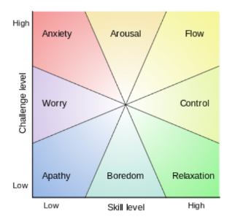
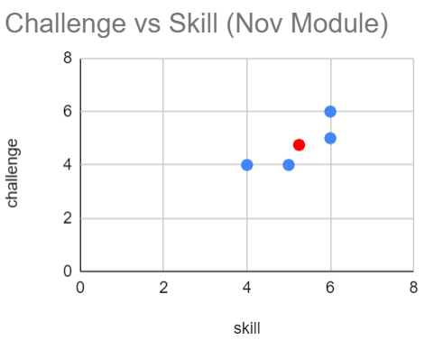
LESSONS LEARNED FROM EVALUATION
FLOW*: mental state in which a person performing some activity is fully immersed in a feeling of energized focus, full involvement, and enjoyment in the process of the activity
*Named by Csíkszentmihályi in 1970
Notes:
2 min.
Chemistry faculty member Colin Abernethy and I implemented all the modules in a year-long ‘non-standard’ course called “Resonance Research and Spectroscopy Seminar”, but then Colin also implemented a few of the modules into his Organic Chemistry courses and Dave added a few of the modules to his Analytical Chemistry course.
In order to evaluate the materials, we did surveys, focus group interviews, video-recordings of classes, kept copies of student work -> and you can hear about the results of some of the analysis of this data in Dedra’s talk coming up next!
-> Then go over ‘overall’ points and mention where there is room for development to close the loop so that students recognize that the skills they learned are actually relevant to doing scientific work

Slide 9
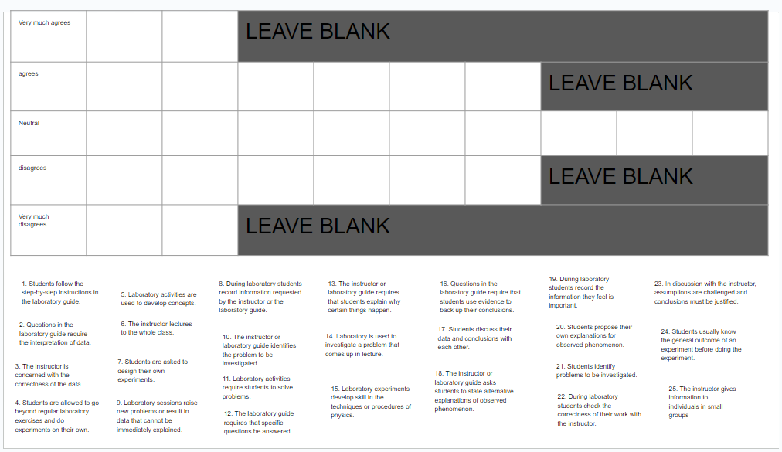
LESSONS LEARNED FROM EVALUATION
25 Ranked Statements:
Teachers > Students: Laboratory experiments develop skill in the techniques or procedures of physics.
BOTH: Students discuss their data and conclusions with each other.
Students > Teachers: Students follow the step-by-step instructions in the laboratory guide.
Q SORT
Notes:
2 min.
Chemistry faculty member Colin Abernethy and I implemented all the modules in a year-long ‘non-standard’ course called “Resonance Research and Spectroscopy Seminar”, but then Colin also implemented a few of the modules into his Organic Chemistry courses and Dave added a few of the modules to his Analytical Chemistry course.
In order to evaluate the materials, we did surveys, focus group interviews, video-recordings of classes, kept copies of student work -> and you can hear about the results of some of the analysis of this data in Dedra’s talk coming up next!
-> Then go over ‘overall’ points and mention where there is room for development to close the loop so that students recognize that the skills they learned are actually relevant to doing scientific work

Slide 10
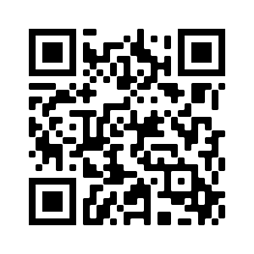
INTERESTED IN USING OUR MATERIALS?
This project is designed to benefit all undergraduate science programs but will have the most impact at primarily undergraduate institutions with limited access to research experiences and historically underserved student populations.
Scan the QR code to be contacted when the materials are available and/or to provide suggestions of potential resources to include!
Notes:
30 s.
If you are at all interested in using these materials, this QR code will take you to a form that you can fill out to provide your contact information, and I will be in touch with you!
Thank you for your time, and I am happy to answer any questions you may have!

