Slide 1
Elementary approaches to rlc circuits
Fall 2023 Meeting
Saturday 21 October 2023
Carl E. Mungan, Physics Department
U.S. Naval Academy, Annapolis MD
University of Maryland College Park
Chesapeake Section of AAPT

Slide 2
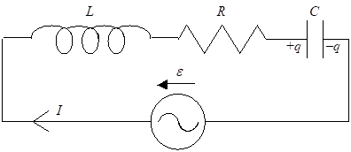
Part 1: THEORY
driver:
(by choice of zero of time)
response:
responds at
driving frequency
response lags
behind driver

Slide 3
capacitor:
but the current is
so that
which integrates to
and thus
Introduce reactance
to get

Slide 4
inductor:
introduce reactance
to get
resistor:
so that

Slide 5
emf:
introduce impedance
so that
Now use the voltage loop rule:
and divide by I₀ to get
The two unknowns Z and φ are to be expressed
in terms of the givens L, R, C, ε₀, and ω.

Slide 6
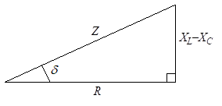
Solve by substituting two orthogonal values of t:
These two results can be
summarized on a triangle diagram:
φ

Slide 7
φ
This triangle implies:
the impedance is
and the phase shift is

Slide 8
So we can graph the amplitude and phase shift of the response:
current amplitude

Slide 9
phase lag of the current
relative to the emf

Slide 10
Part 2: EXPERIMENT
• use large coil for L and R
• use sinusoidal function generator for ε
• use variable capacitor box for C
• use multimeter for measurements

Slide 11
Actual circuit configured to measure rms capacitor voltage:

Slide 12
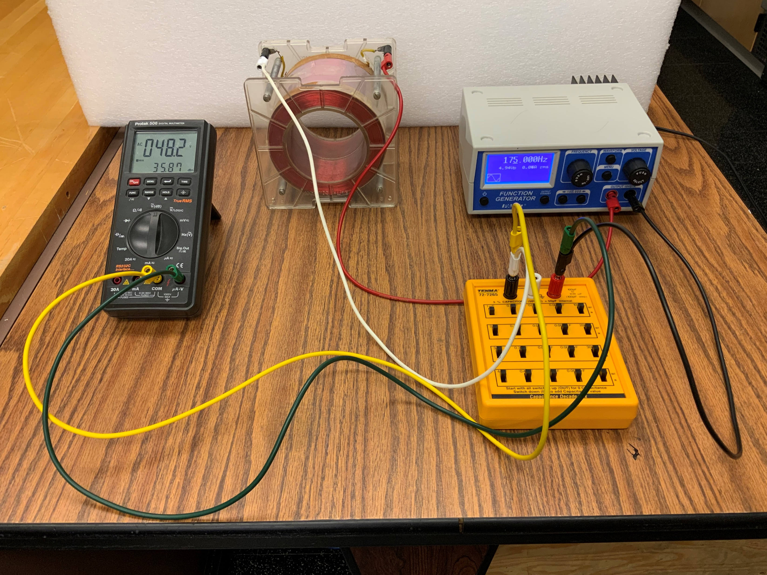

Slide 13
During setup, use the Protek multimeter to measure:
• L = 0.83 H
• C = 0.98 μF
so the resonance frequency is 176 Hz
• R = 63 Ω
• V_{ε} = 3.5 V rms
and turn the frequency knob on the Pasco
function generator in roughly 10 Hz steps.

Slide 14
Blue data points compared to red theory curve with NO free parameters.

Slide 15

Comments are welcome!
email: mungan@usna.edu
webpage: usna.edu/Users/physics/mungan

