Slide 1
Agenda
McGraw Hill Connect
Physics Virtual Labs
ALEKS – Math Prep for College Physics
Sharpen
Support

Slide 2
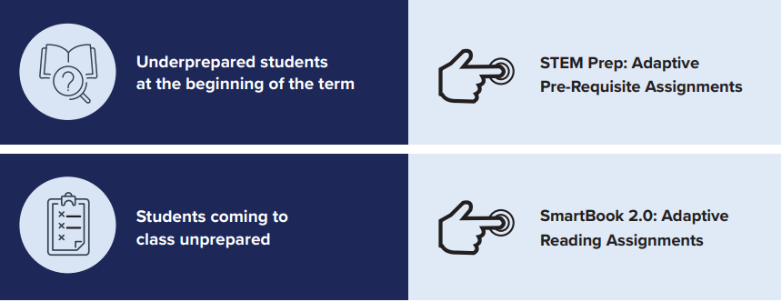
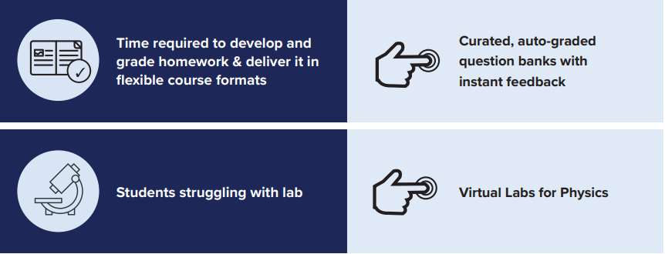
Smartbook 2.0 video

Slide 3
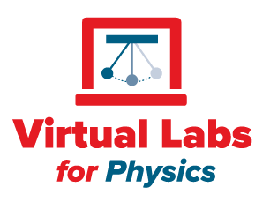
Mechanics
Virtual Labs
Electricity & Magnetism
Free Fall
Trajectory
Inclined Plane
Friction Force
Terminal Velocity
Kinetic and Potential Energy
Collisions in One Dimension
Collisions in Two Dimensions
Rotation, Moment of Inertia
Harmonic Oscillation
Uniform Circular Motion
Finding the Density of an Object
Batteries, Resistors, and Currents
Charging Capacitor
Wheatstone Bridge
Electron Beam in Magnetic Field
Induction
Impedance
Photo-Electric Effect
Optics
Image Construction on Curved Mirrors
Image Construction Through Lenses
Refraction, Snell’s Law, and Chromatic Dispersion
Light Polarization
Double-Slit Interference and Diffraction
Waves
Beats
Doppler
Standing waves
Thermodynamics
Calorimetry

Slide 4
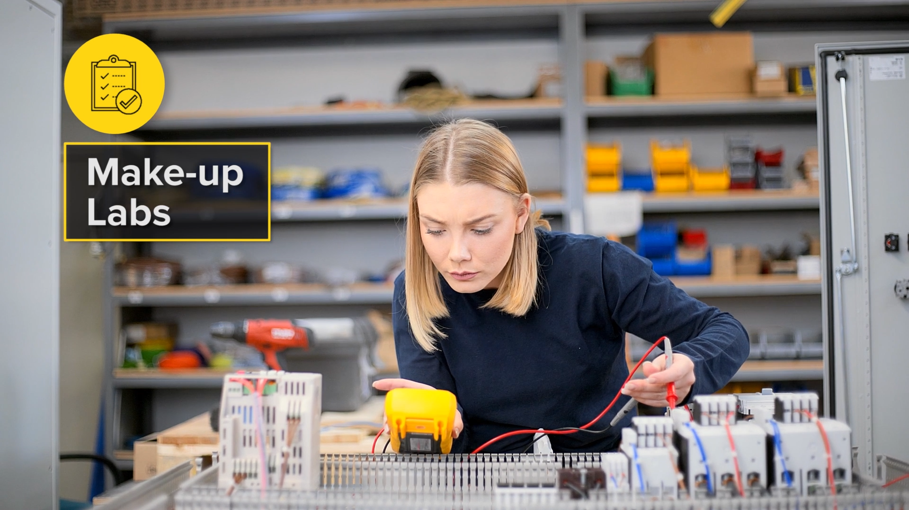
Assignments
Pre-Lab Assessment
Virtual Lab
Post-Lab Assessment
Lab Report
Goal | Ensure students are ready for lab | Provide the learning experience | Assess student knowledge | Assess student comprehension
Grading | Automatic | Automatic | Automatic | Manual
Scoring | Correctness | Completion | Correctness | Rubric-guided

Slide 5
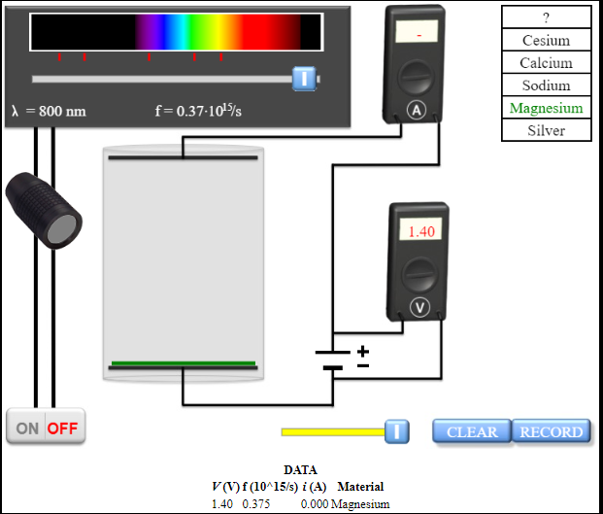
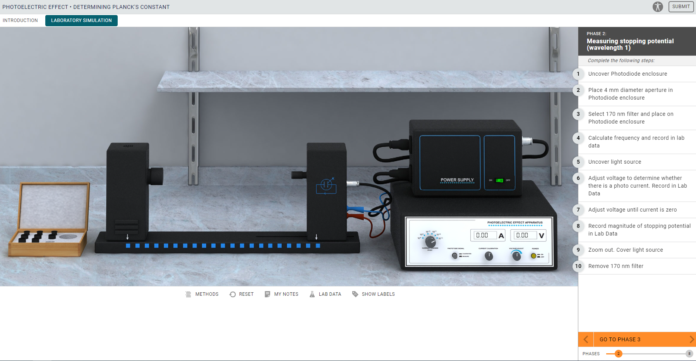
Experience
Version 1
Virtual Labs for Physics
https://video..com/watch/yfStaxs5PbSsyRVnLfN91xmhhe

Slide 6
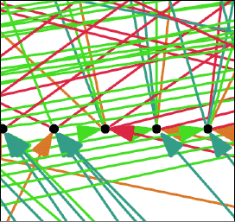
AI
X = (Adaptive Learning + Positive Reinforcement)

Slide 7
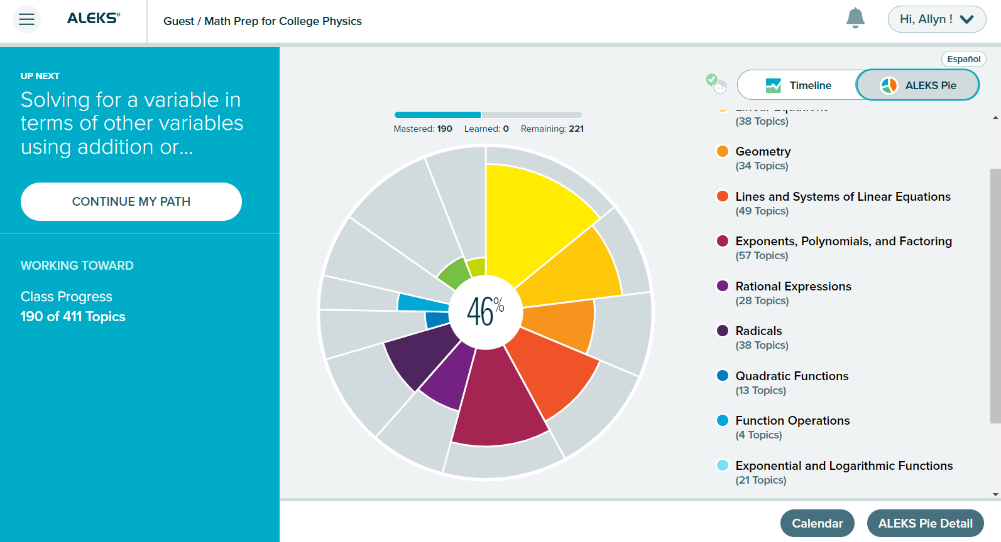

Slide 9
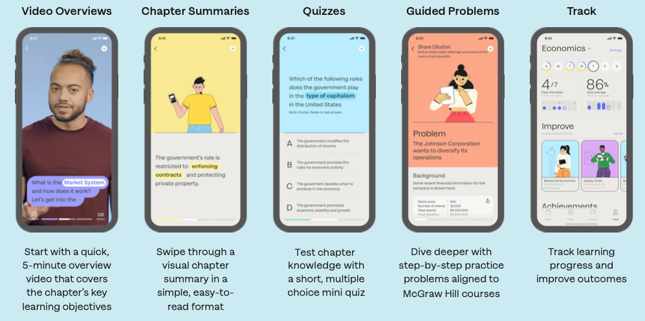
McGraw Hill Sharpen
Complimentary Study App.
53 titles and 11 generic course offerings.
Helps instructors by providing their students with credible, supplemental resources.

Slide 11
Thank you!
Allyn Bryson
Learning Technology Representative
McGraw Hill | Higher Education

