Slide 1
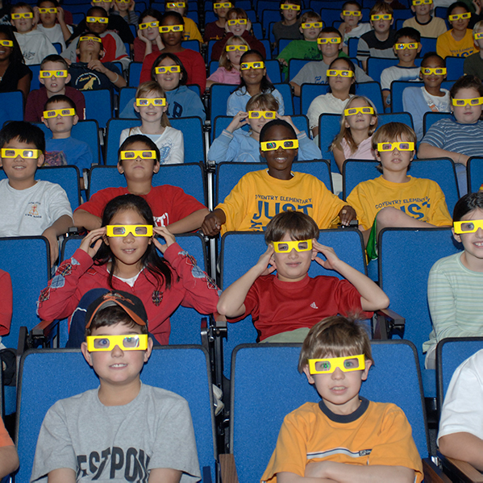
JLab Science Education – Fortifying the STEM Pipeline
Lisa Surles-Law
Science Education Team Lead

Slide 2
Science Education Goals
Develop local and state partnerships to advance STEM education
Improve the quality of K-12 instruction by enhancing teachers’ content knowledge
Immerse graduate, undergraduate, and high school students in a world-class facility research environment to prepare the nation’s next generation of leaders

Slide 3
Science Education Pipeline
As a world-class research facility, Jefferson Lab is a valued partner to the local, regional, and national education community. Jefferson Lab's long-term commitment to science education continues to focus on increasing the number of teachers with a substantial background in math and science, strengthening the motivation and preparation of all students and addressing the serious underrepresentation of minorities and females in science, math, engineering and technology careers.
STEM Educator Professional Development
JLab Science Activities for Teachers (JSAT)
Grades 5, 6, and 8
Region II Annual Teacher Night
Annually serves >940 teachers
K-12 Programming
Becoming Enthusiastic About Math and Science (BEAMS)
High School Summer Honors Program (HSSHP)
Summer Residential Governor’s School (SRGS) in Engineering
JLab Mentorship Program
Annually serves >13,000 students
Undergraduate Programming
Science Undergraduate Laboratory Internship (SULI)
Research Experience for Undergraduates (REU)
Community College Internship (CCI)
Mexican Physical Society (MPS)
Undergraduate Physics Research (UPR) Program
Minority/Female Undergraduate Research Assistantships (M/FURA)
Supports >45 undergraduate students/year
Graduate Research
Office of Science Graduate Student Research (SCGSR) Program
Supports >100 graduate students/year

Slide 4
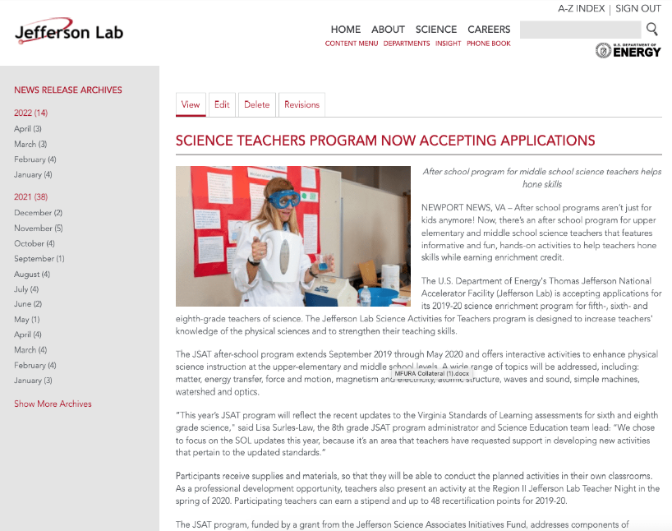
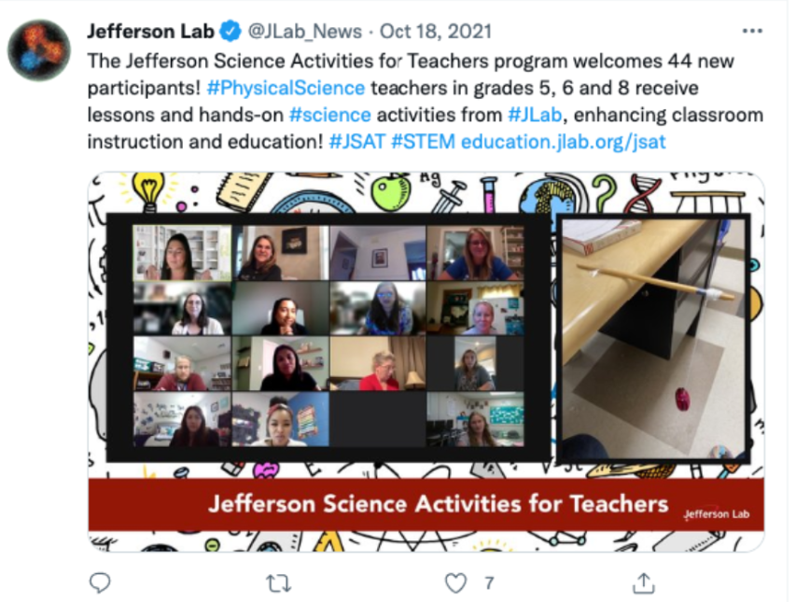
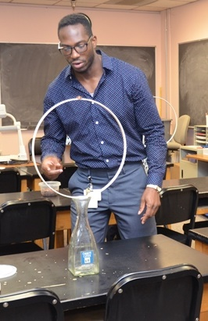
JLab Science Activities for Teachers (JSAT)
JSAT places JLab as the community's leader in providing needed professional development for local teachers through SOL-based content and STEM applications, during the school year.

Slide 5
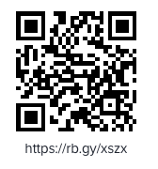
JLab Science Activities for Teachers (JSAT)
Jefferson Lab Science Associates Teacher Development Initiative
5th, 6th & 8th grade cohorts
Meet twice monthly
Receive classroom equipment and supplies to conduct activities
48 teacher education recertification points
Participation stipend
APPLY HERE
https://education.jlab.org/jsat/

Slide 6
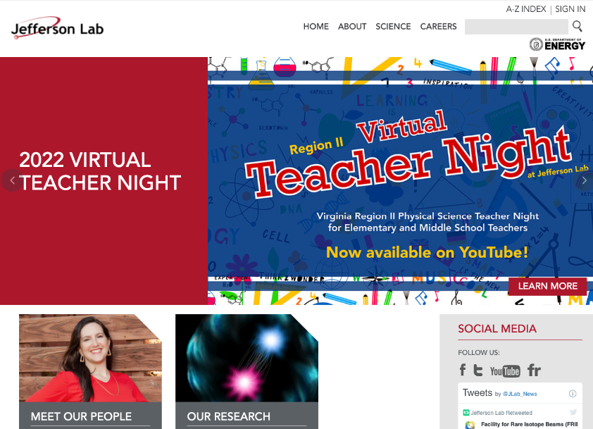
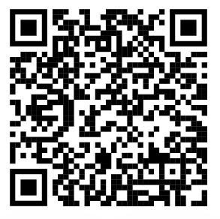
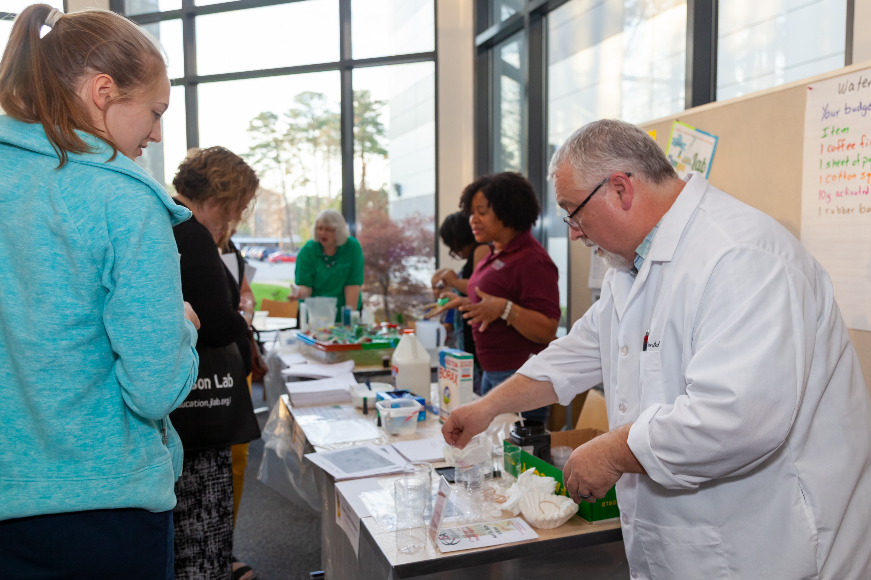
Region II Annual Teacher Night
Teachers from the JSAT (Jefferson Lab Science Activities for Teachers) program share science-themed classroom activities, focused on upper elementary and middle school students.
REGISTER HERE:
~ April 19th, 2023 ~

Slide 7
Mentorships and Internships
JLab staff and users encourage and prepare high school and undergraduate students to pursue advanced degrees in experimental/theoretical physics and accelerator science.
Jefferson Lab supports ~40 undergraduate students/year and ~30 high school students/year.
Programs by the numbers: 23 Science Undergraduate Laboratory Internship (SULI) students for FY22 8 NSF-Funded Research Experience for Undergraduates (REU) students via Old Dominion University for Summer 2022 4 Community College Internship (CCI) students for FY22 12 High School Summer Honors Program (HSSHP) students for Summer 2022 12 Summer Residential Governor’s School (SRGS) in Engineering students for Summer 2022 9 High School Mentorship students for FY22 2 Mexican Physical Society Awardee Interns 3 M/FURA Assistantship Positions

Slide 8
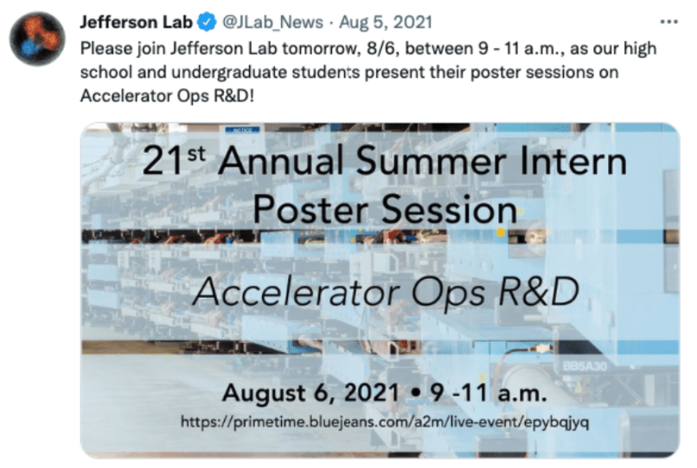
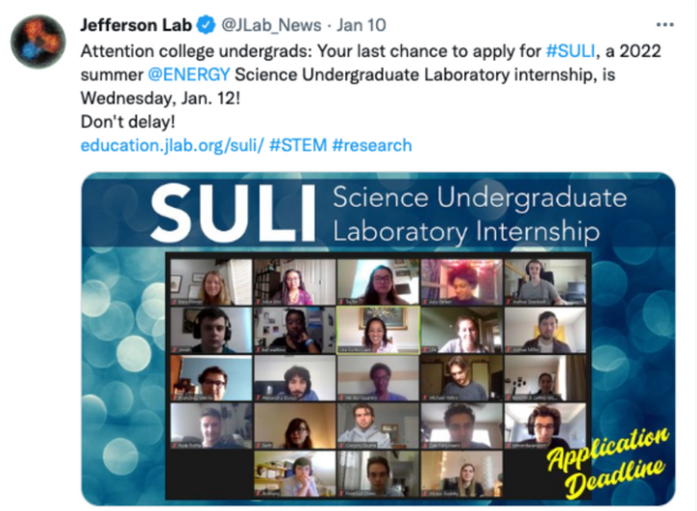
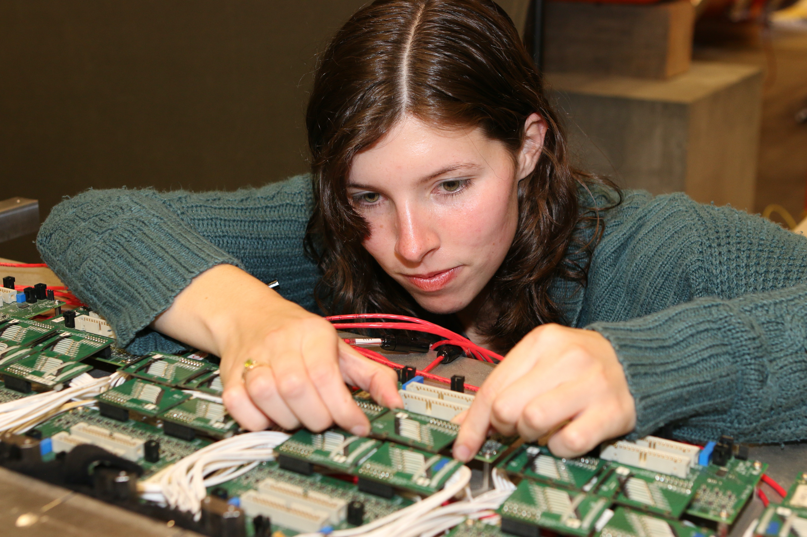
Mentorships and Internships
Programs match students with mentors in scientific or technical areas, creating experiences that cement classroom content into practical applications in math, science, and/or computer science.

Slide 9
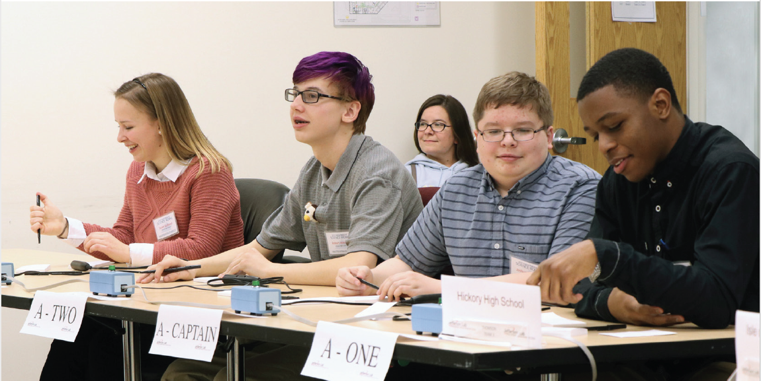
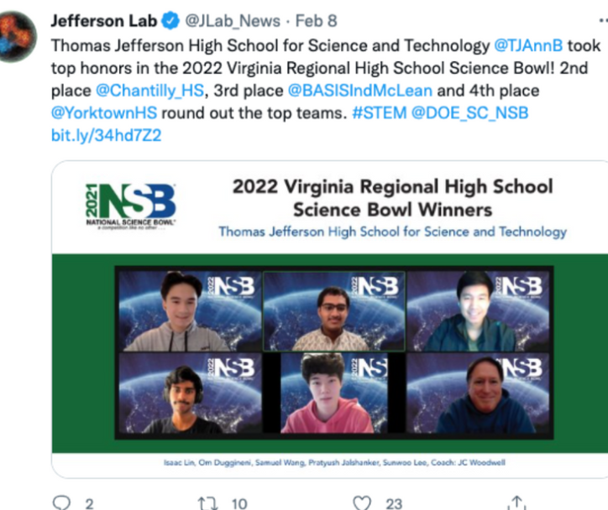
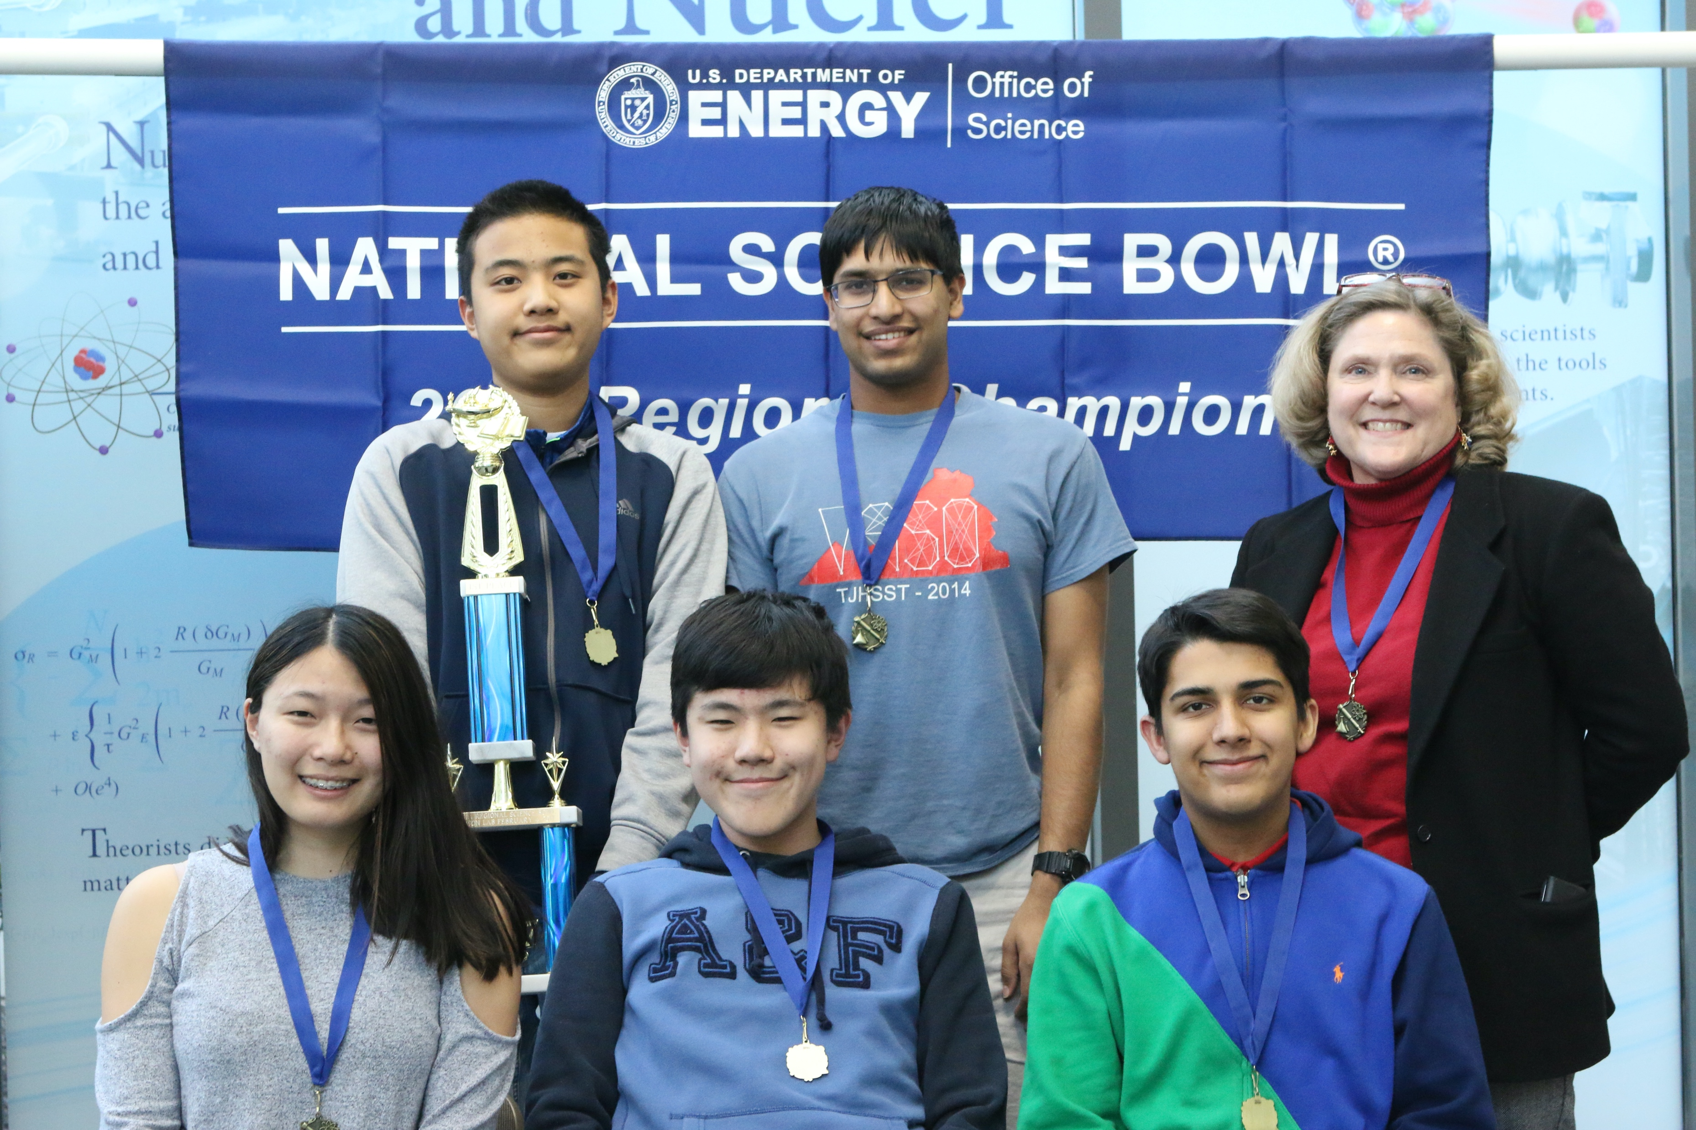
Virginia Regional Science Bowl
Jefferson Lab is a regional host for the U.S. Department of Energy (DOE) National Science Bowl® middle and high school academic competition.
https://science.osti.gov/wdts/nsb
High School – February
Middle School – March
Registration begins Oct 1

Slide 10
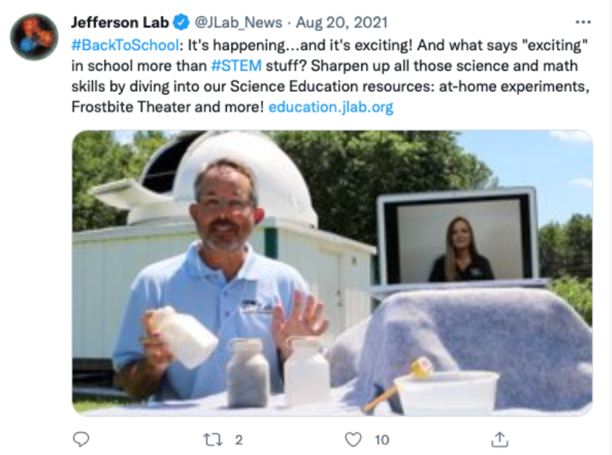
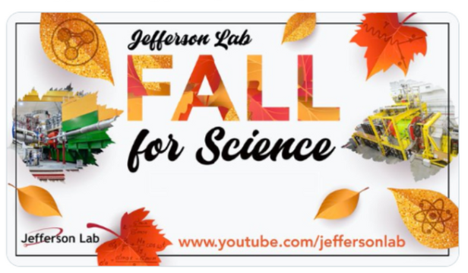
Outreach & Community Engagement
Opportunities, such as the virtual field-trip, Frost Bite Theater at Home and the SOL Practice Tests website, engage the community in the science promoted at Jefferson Lab and the world of STEM that supports it.
Impact by the numbers: BEAMS 1,300 Title I students, 80 teachers Physics Fest 5,000 students, 175 teachers Other school visits and workshops 5,000 students, 800 teachers Jefferson Lab’s YouTube Channel >320,800 subscribers 300,000 monthly average views
https://www.jlab.org/vft2021

Slide 11
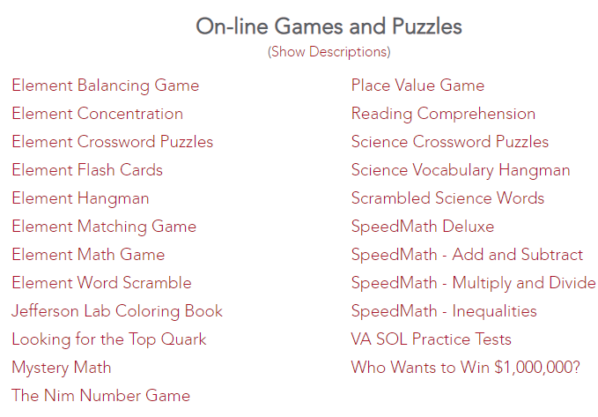
Science Education Website Resources
Educational resources for students and teachers: interactive periodic table of elements, engaging “Science at Home!” video series, Frostbite Theater video series, STEM virtual games, and SOL Review Practice Tests
Science at Home!
UV Detectives
Interactive Periodic Table of Elements
Fun with Static Electricity
https://education.jlab.org

Slide 12
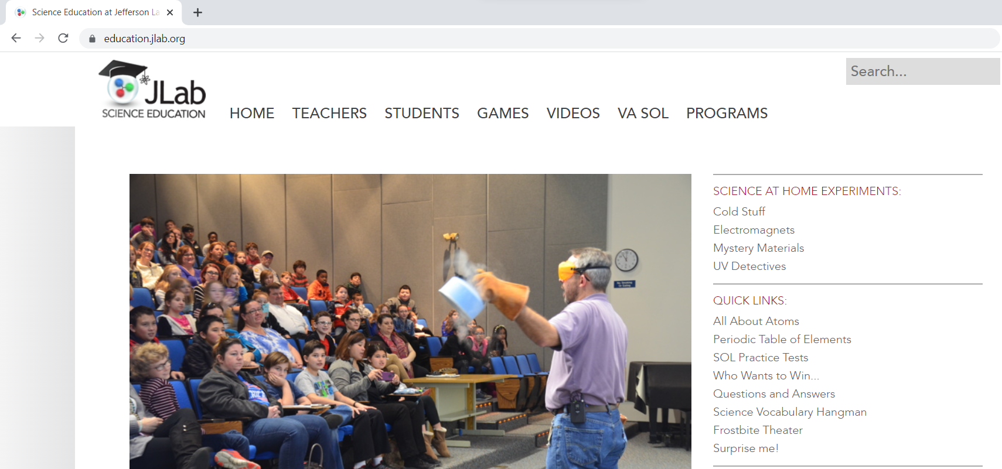
Science Education Website

Slide 13
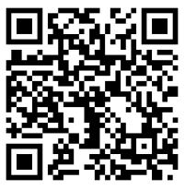
Thank you for joining us today!
QUESTIONS?
Lisa Surles-Law
Science Education Team Lead
education @jlab.org
SCAN TO RECEIVE SWAG

