Slide 1
Pivot Interactives
PivotInteractives.com
Active Learning Made Easy
With Pivot Interactives

Slide 2
Eric Rhoades
30 years as a science educator in Virginia
Middle and high school teacher
Physical Science, Biology, and Chemistry
District Science Coordinator
Director of Science VDOE
B.S. Biology, M.Ed. Ed Leadership
Partnership Manager

Slide 3
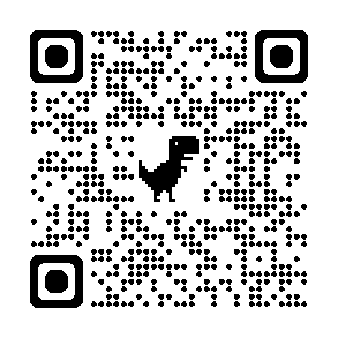
Problem:
Phenomena-based active learning is most effective, but limited by classroom constraints.
60-Day Free Trial
Solution:
Phenomena-based, active learning through interactive video

Slide 5
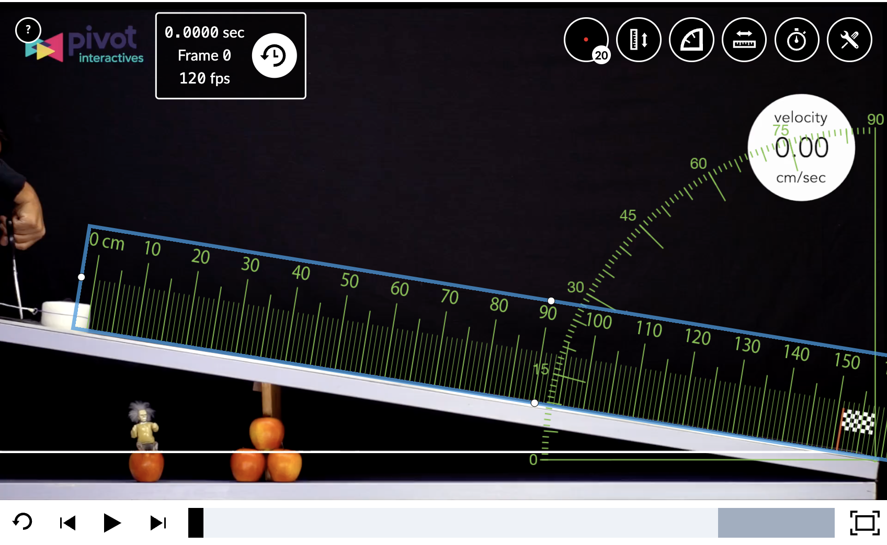
What is Interactive Video?
Preview Activity | Pivot Interactives
Through signature interactive videos in Pivot Interactives, teachers can engage students with typically inaccessible or unrealistic, authentic phenomena to see qualitatively AND measure quantitatively.
Introduction to Constant Acceleration
We'll learn to apply a formula to this situation and use a graph to find the acceleration.

Slide 6
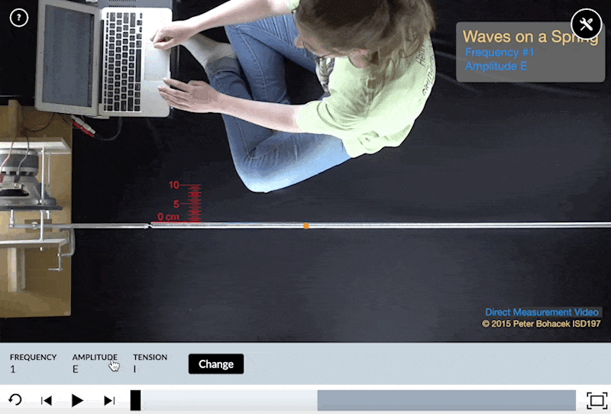
What is Interactive Video?
Preview Activity | Pivot Interactives
Through signature interactive videos in Pivot Interactives, teachers can provide their students with unrestricted exploration of authentic phenomena and seamlessly embed the science practices in their lessons.
Properties of Transverse Mechanical Waves - Students explore relationships between mechanical wave properties. With over 75 trials, students can easily implement experimental design, collaboratively or independently.

Slide 7
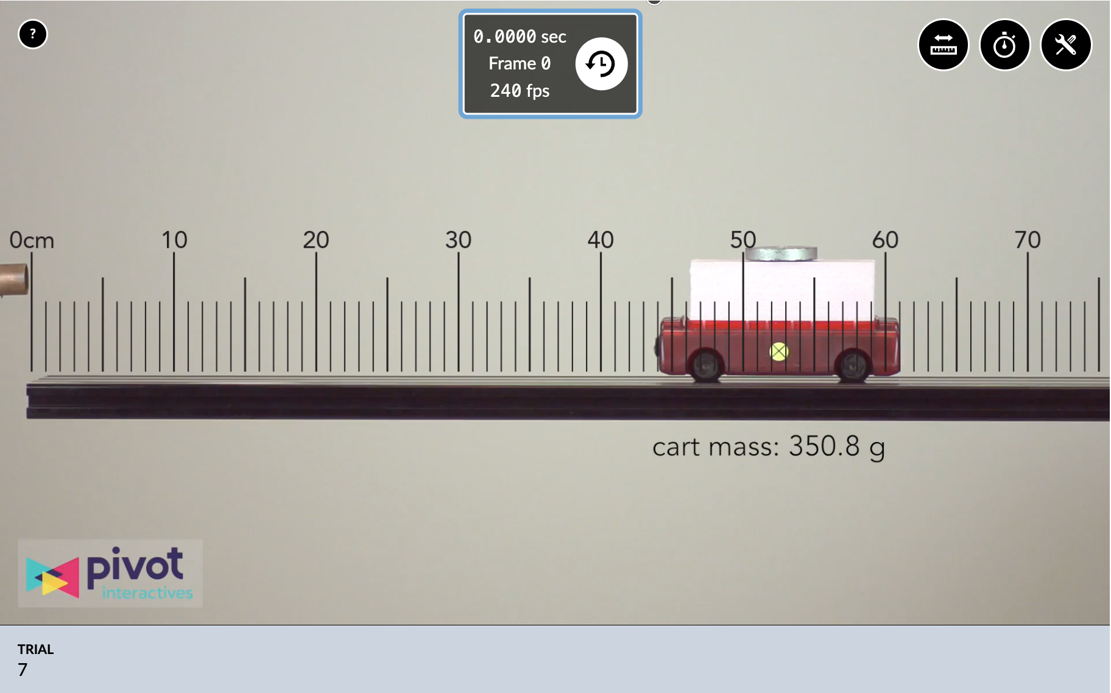
What can the platform do?
Preview Activity | Pivot Interactives
With Pivot Interactives activities, students receive continuous, personalized feedback and are actively engaged with their learning.
The 100% customizable activities are crafted with powerful features, like randomized questions, automatic feedback & autograding, data tables, and robust graphing tools.

Slide 8
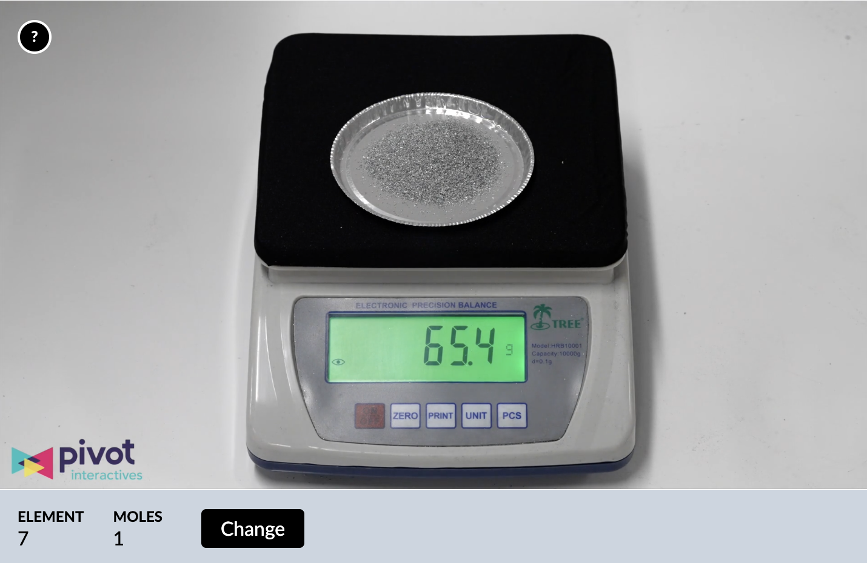
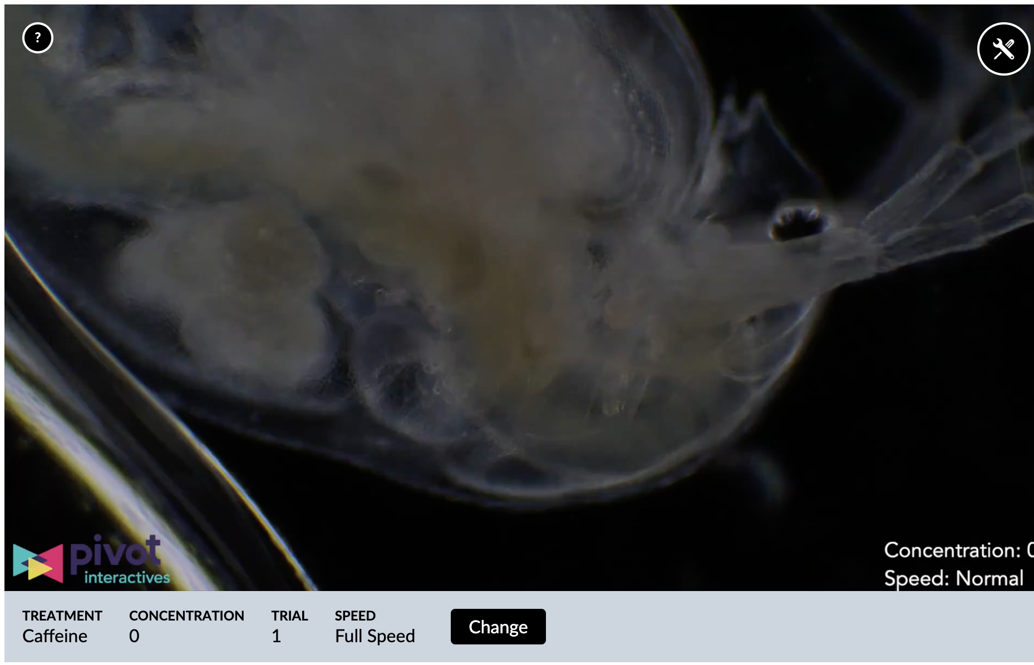
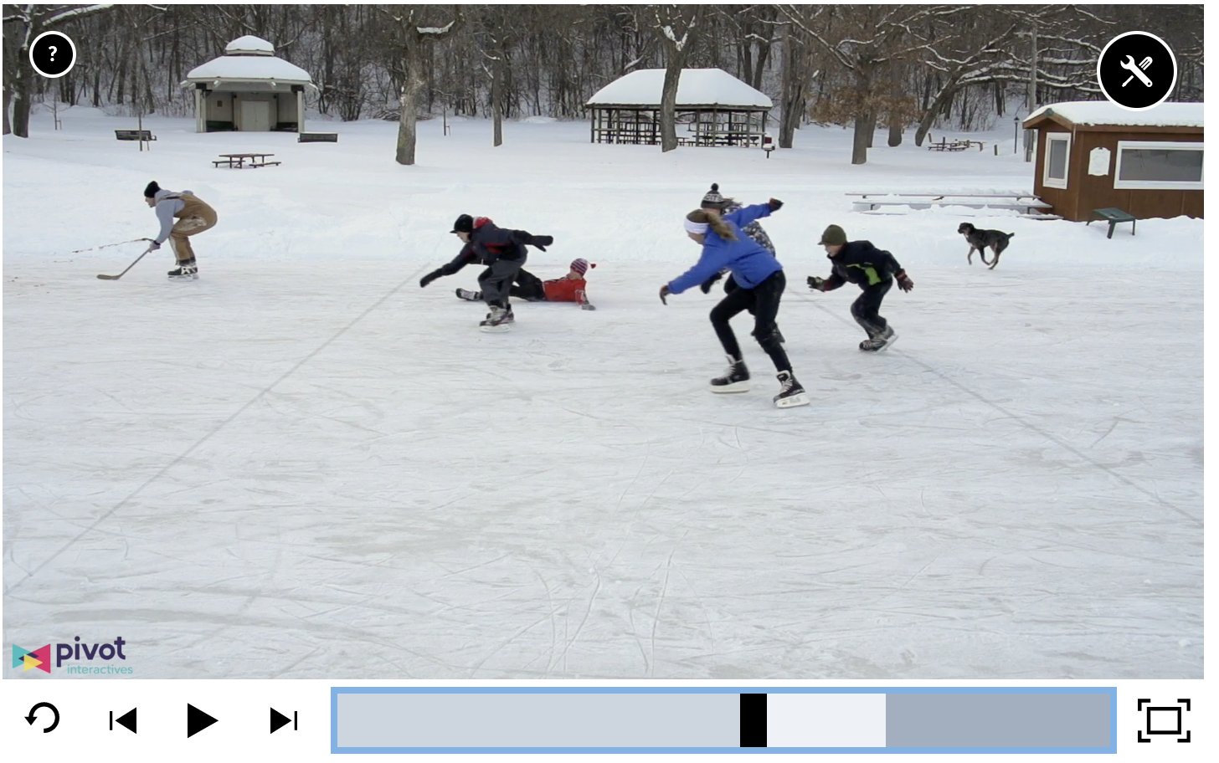
Where does Pivot fit into the classroom?
Introduction:
Building a model
Sensemaking
Guided Inquiry
Application:
Testing a model
Practice
Traditional “lab”
Fluency building
Assessment:
Testing understanding
Less feedback provided
Pivot Interactives is not just labs!
Phenomena, active learning, and the science practices throughout the learning cycle!
The science practices ooze out of our activities!
Intro to the Mole Concept
Daphnia and Chemicals
How fast is that skater?

Slide 9
What does it look like in the classroom?
Collaboration is simple to implement with Co-Lab in Pivot Interactives. Students have open exploration, design experiments, and walk through the science practices, without the typical constraints, like time, money, resources, teacher experience level, using various platforms, etc
Properties of Transverse Mechanical Waves - Students explore relationships between mechanical wave properties. With over 75 trials, students can easily implement experimental design, collaboratively or independently.

Slide 10
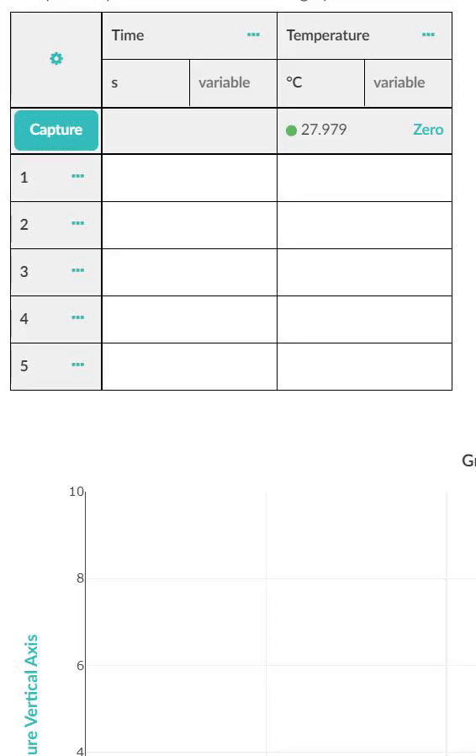
Other phenomena: Sensors
Stream data with Pasco and Vernier Bluetooth sensors right into activities.
Conduct “hands-on” data collection
Place that data right next to the content questions
Easy way to collect real data as a class demo, groups, or individuals
Demo Link - Graph

Slide 11
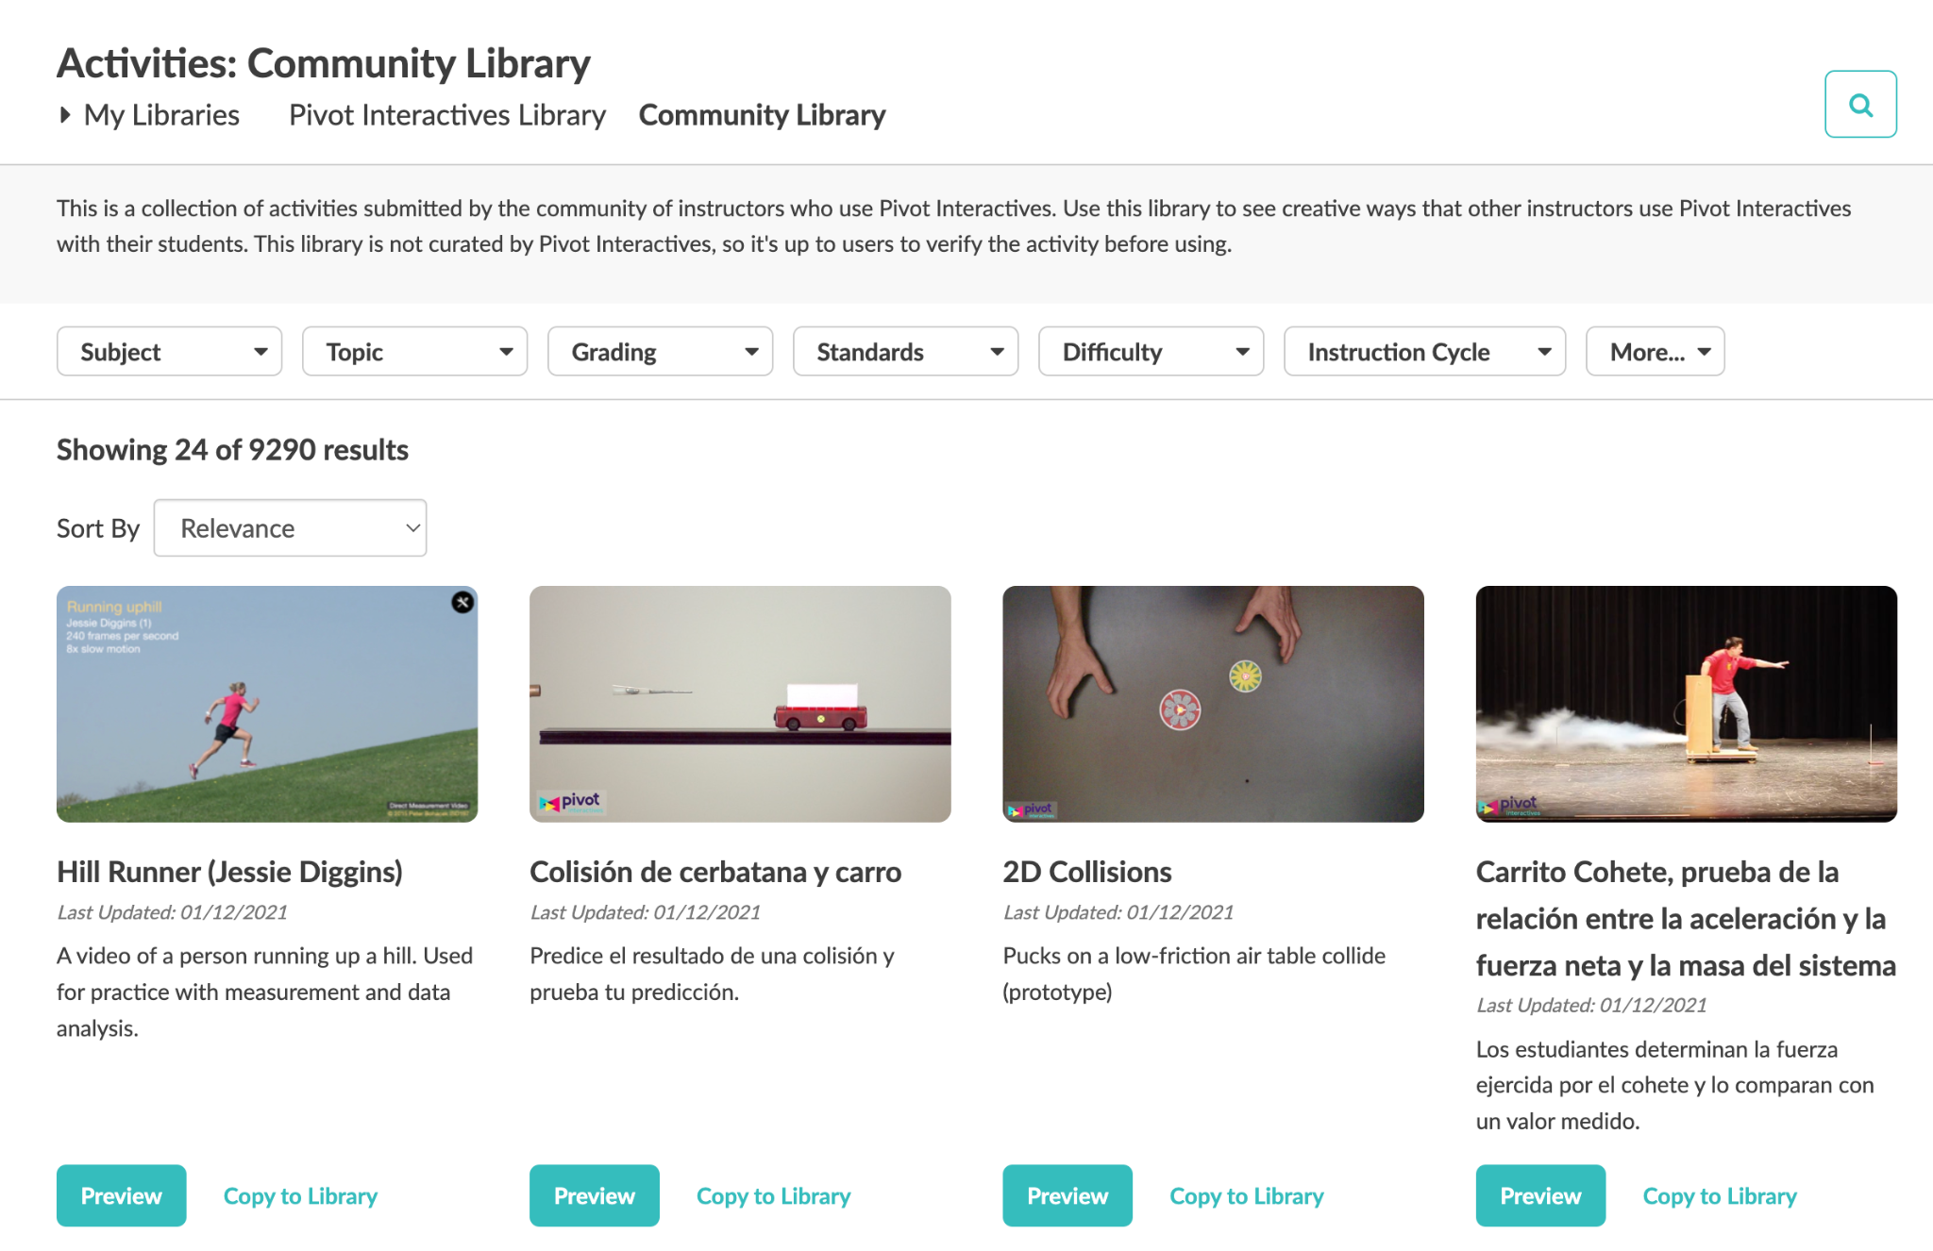
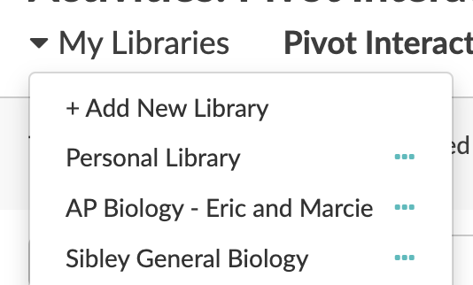
Instructors can create and collaborate!
Everything on the platform is editable!
Change question properties:
Attempts, feedback, autograding, etc.
Use hints to include additional scaffolding
Pre-populate data tables and graphs to guide data collection
Embed additional content
Instructional videos, GoogleDocs, etc.
Check out the Community Library to see what other teachers across the Pivot Interactives Network.
Use shared libraries to work with teachers at the same school or subject area.

Slide 12
Schoology and Canvas Integration with LTI
LTI 1.3 integration
Students interact with Pivot through their Schoology accounts.
Teachers will still write, edit, and grade activities within Pivot Interactives
After grading, grades will pass to Schoology gradebook

Slide 13
Additional Features
LMS Integration
Rostering and SSO
Standards alignment crosswalks
(AP, IB, NGSS, or other state standards)
Robust reporting dashboard
Co-LabTM groups for student collaboration
Streamlined grading tools
Covers all science subjects
500+, 100% customizable, activities
Syncs with Bluetooth data sensors
Shared teacher libraries
Students video upload
PhET.iO simulations integration
Scaffolded instruction

Slide 14
What are others saying about Pivot Interactives?
“You've made me a better teacher and helped my students to learn at high levels.” - Ryan P.
“Your attention to our needs as science teachers is incredibly valuable and so rare.” - Kate E.
“This is the most lovingly crafted, expertly executed educational software I have ever encountered.” - James K.
“I love that your product gives my students access to high-quality experiments that emphasizes accurate data collection, visualization, and analysis, that I can customize the assessments given to my kids, that autograding provides students with instant feedback and can help them get back on track if they're struggling, and that I have a simple tool where they can easily find all of their assigned labs in the same place. This thing works like a dream.” - Claire S.

Slide 15
Additional Questions?
Contacts:
Eric Rhoades – Pivot Partnerships
60-Day Free Trial

