Slide 1
Active Learning Strategies in Teaching Physics for Pre-health Students in Large Classroom
Jency Sundararajan
University of Virginia

Slide 2
Why Active Learning?
Students must be physically, mentally, verbally involved in class activities to learn efficiently.
They DISCUSS the concepts, RELATE them to what they know/observe, ask QUESTIONS to gain a deep understanding, APPLY to real-life examples while SOLVING problems proficiently.

Slide 3
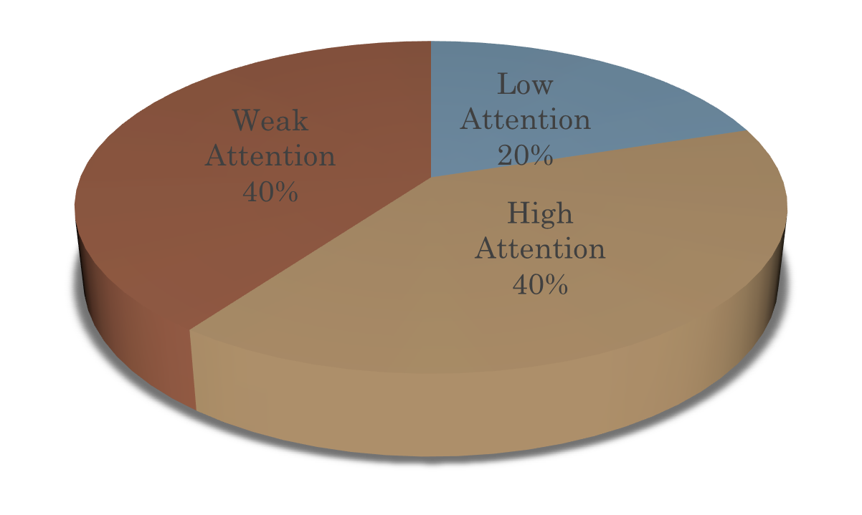
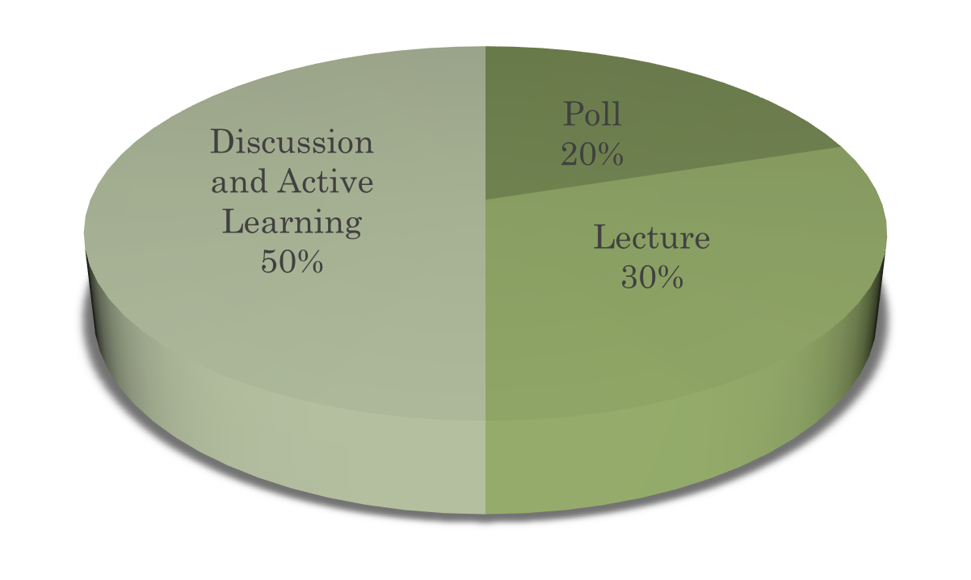
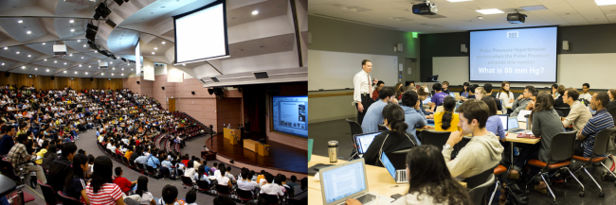
Traditional Lecture Vs Active Learning
Fails to engage students
Passive listening of the lecture.
Instructor-centered
Less room for questions, discussions
Lack self-directed learning skills
Facilitates meaningful interactions with peers and instructor.
Engages students in learning via activities and/or discussions.
Students work in groups on concepts and solving problems.

Slide 4
My AL Classroom (99 students -50 minutes)
Announcements and DIRT quiz:
5 minutes
Overview of the concept and problem (by instructor)
15 minutes
Worksheet on concepts/problems (group work with assistance from TA/instructor)
25 minutes
Summary and EOL quiz
5 minutes

Slide 5
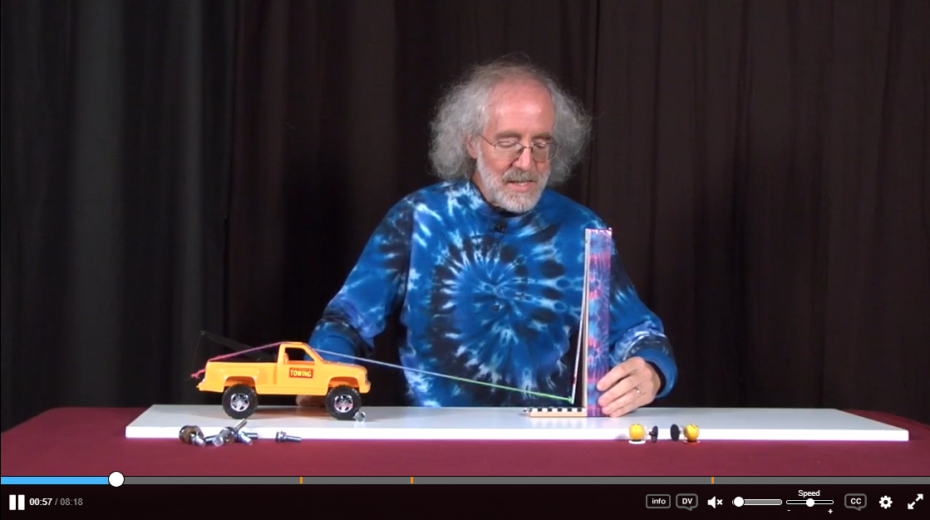
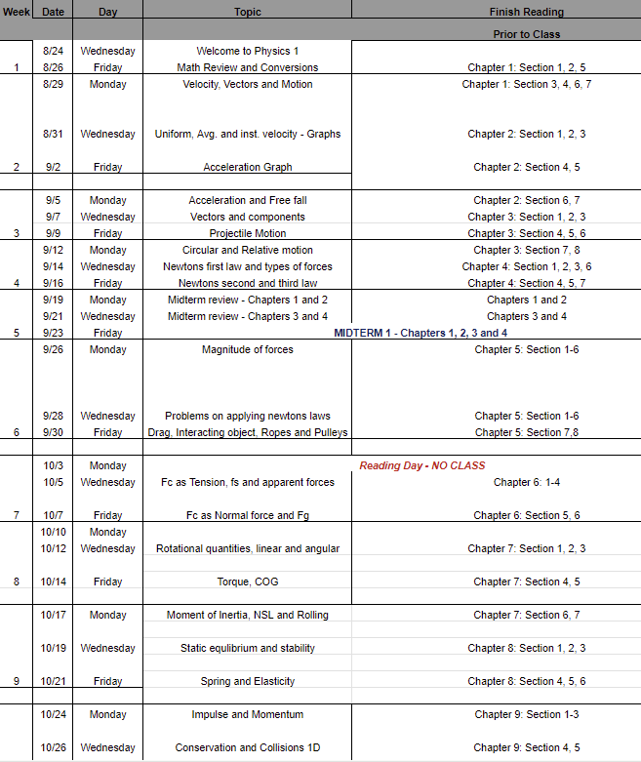
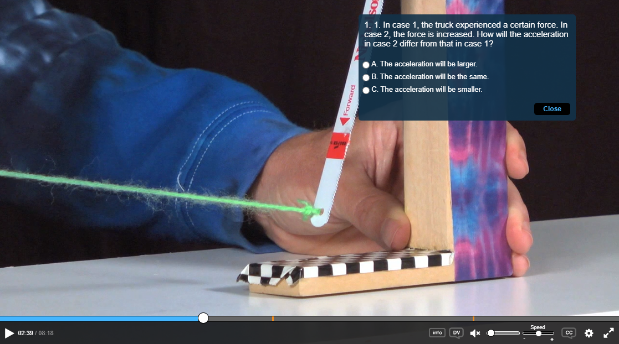
Pre-class Preparation (posted a week ahead)
Pre-lecture demo videos
Pre-lecture recording
Pre-lecture reading
Recording Handout

Slide 6
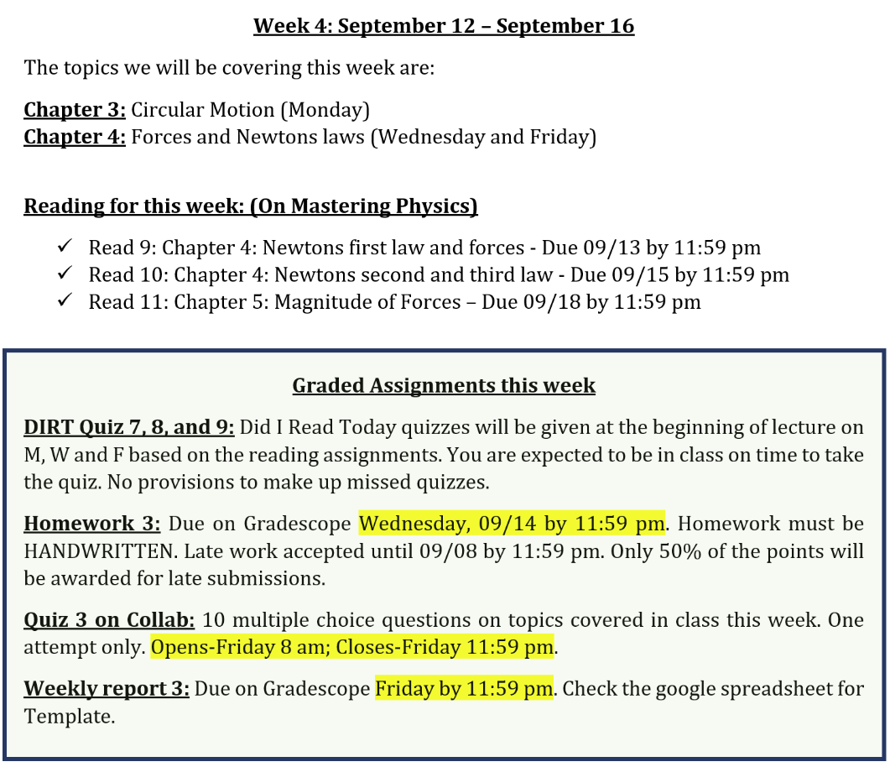
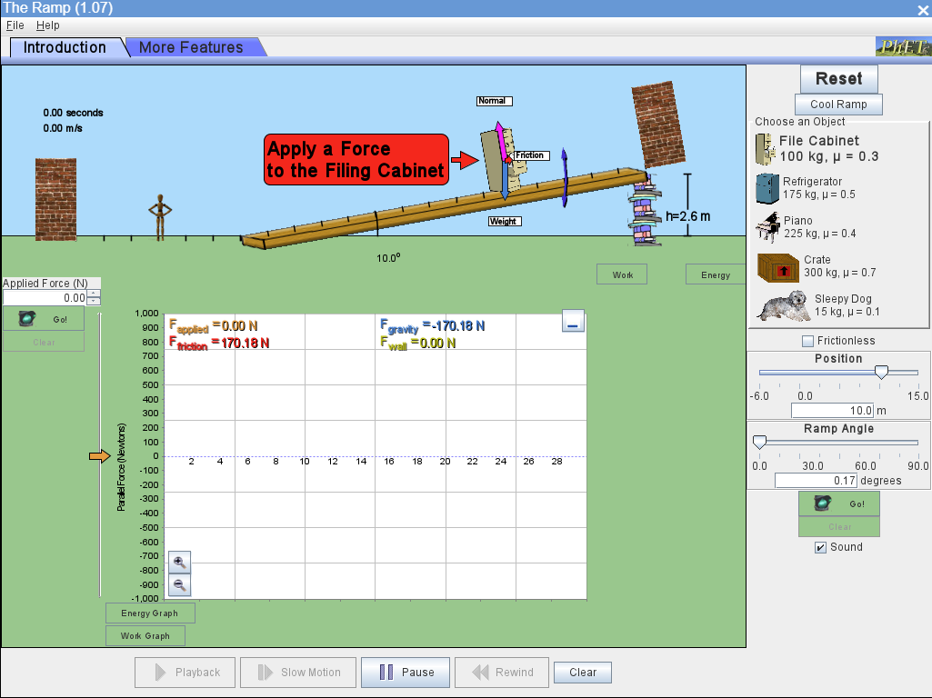
Pre-class Preparation (posted a week ahead)
PHET Simulations

Slide 7
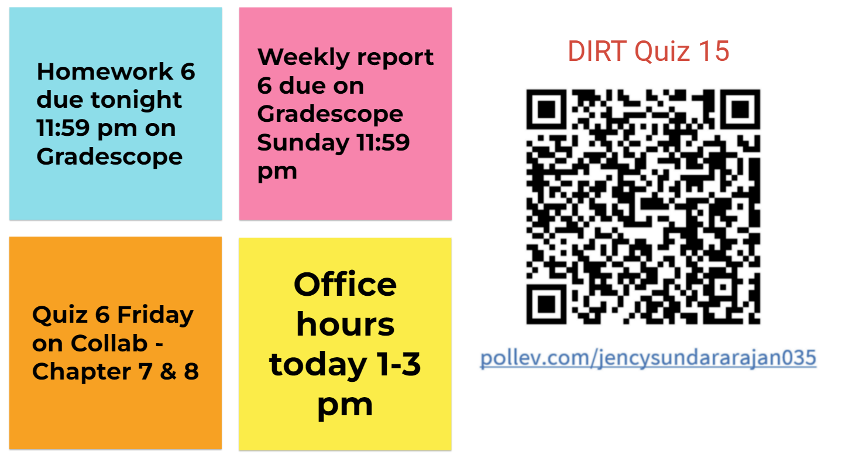
Activities in-class (50 minutes)
~5 minutes

Slide 8
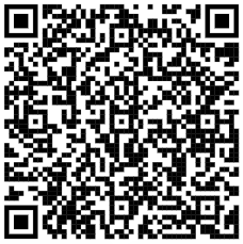
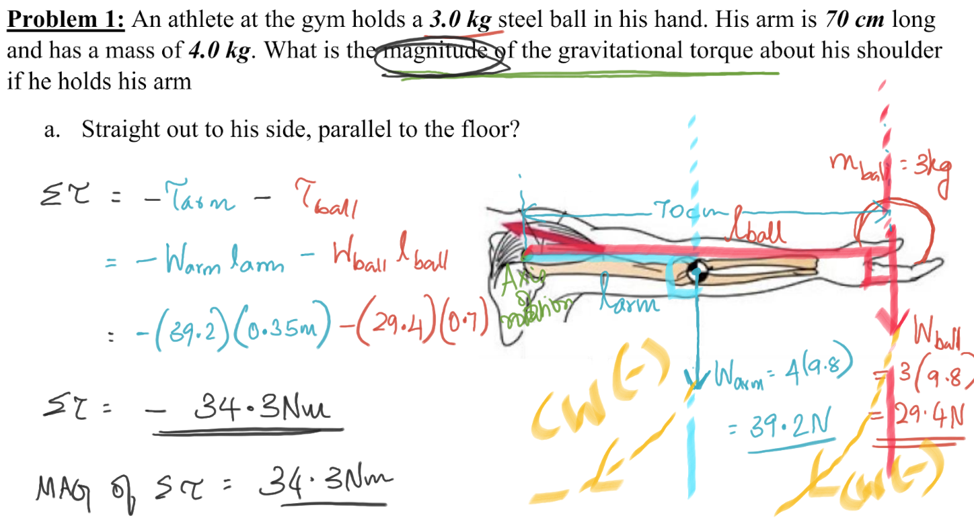
Activities in-class (50 minutes)
Sample Worksheet
Lecture (and demo) ~15 minutes
Group work ~25 minutes

Slide 9
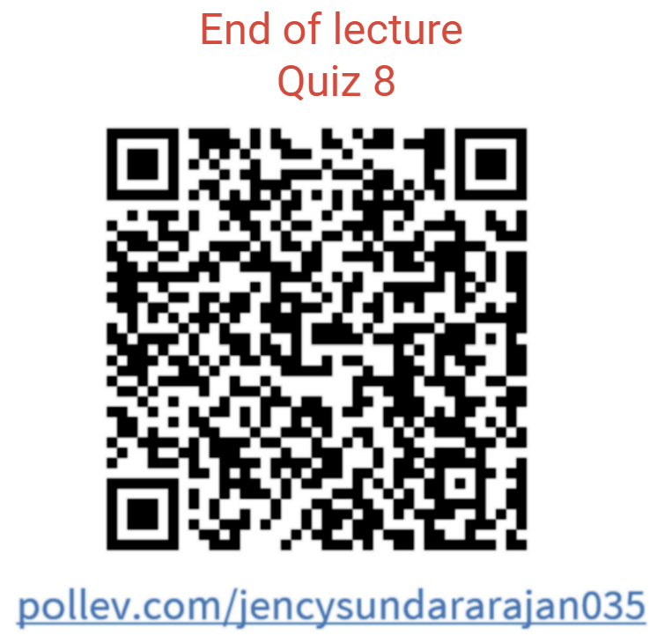
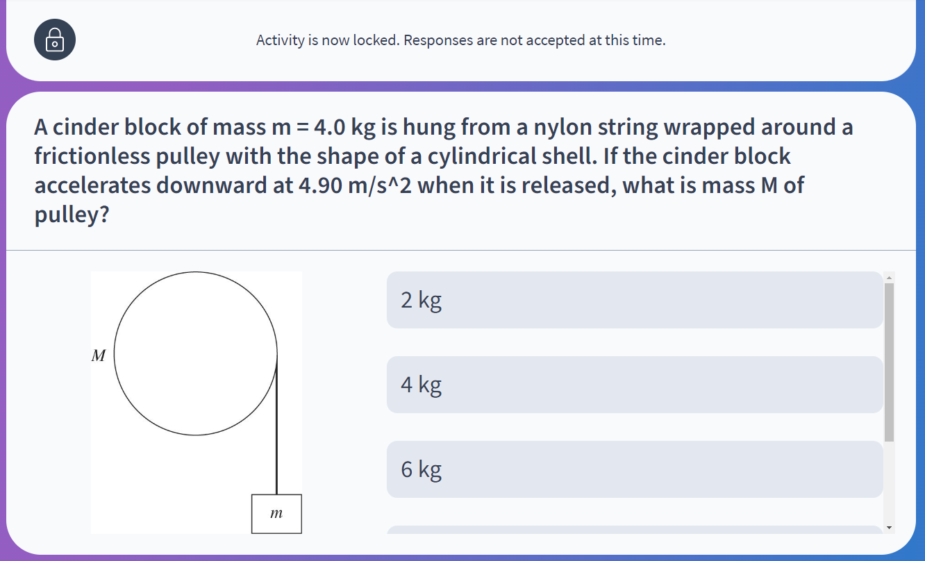
Activities in-class (50 minutes)
~5 minutes

Slide 10
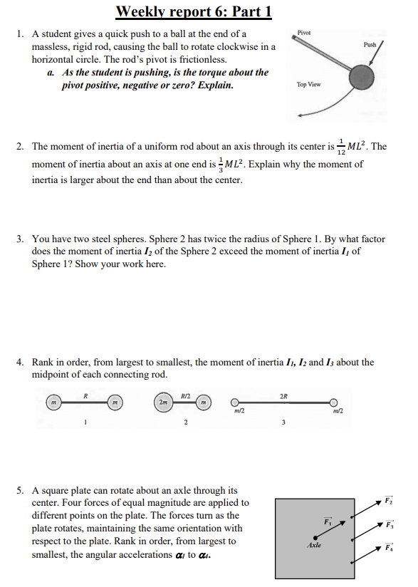
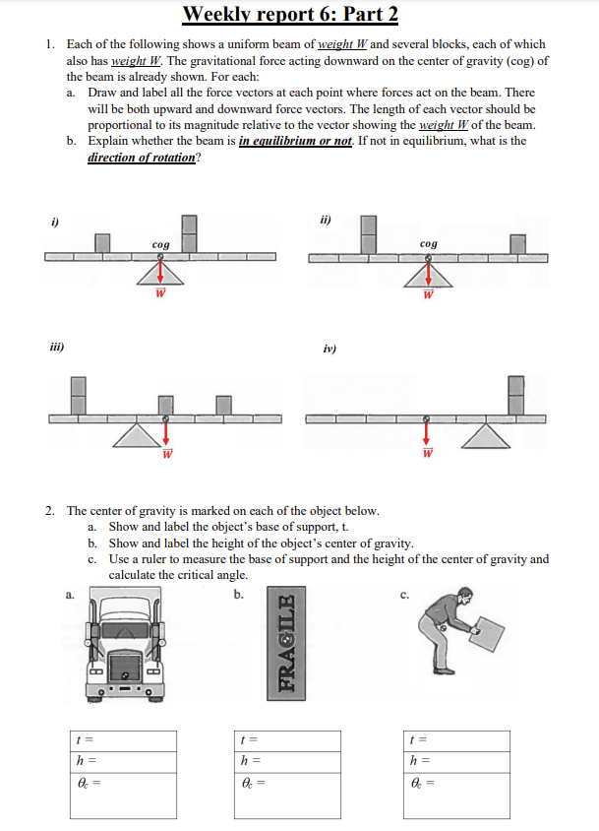
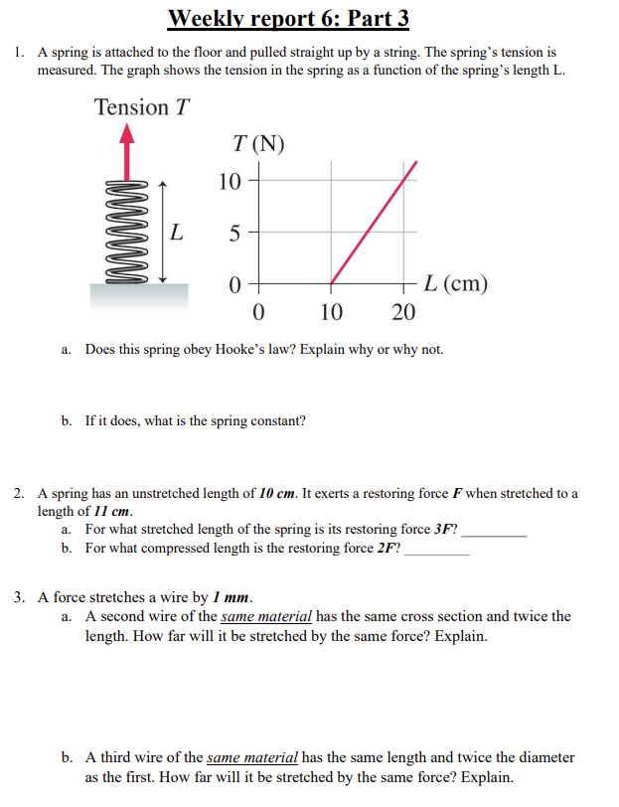
Post-class assignments

Slide 11
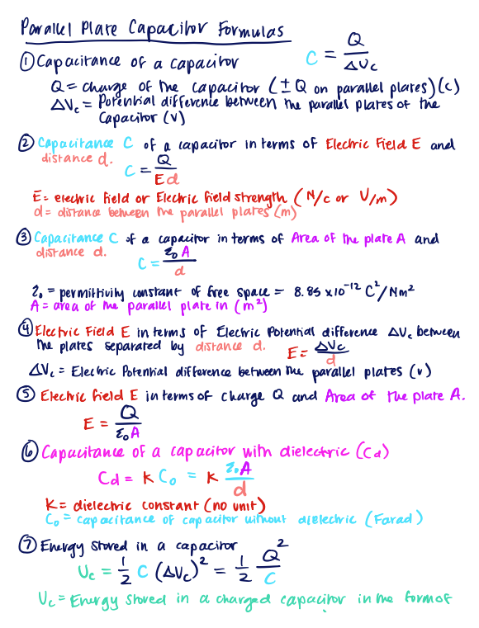
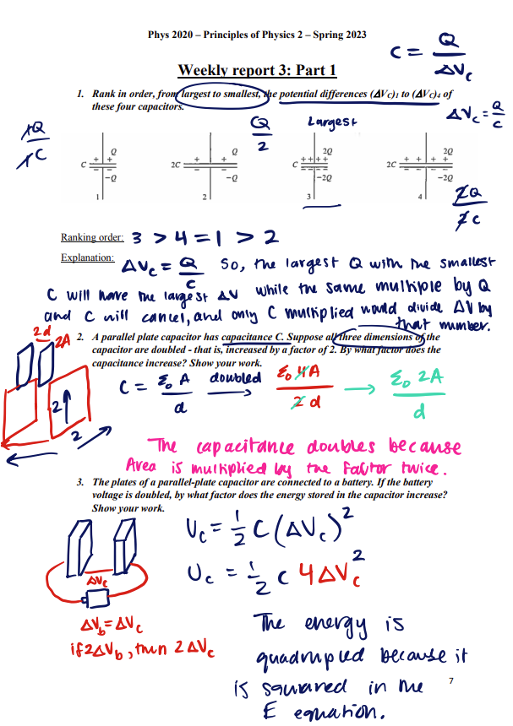
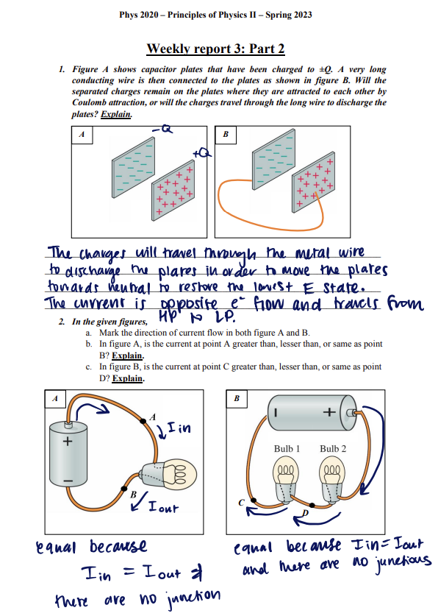
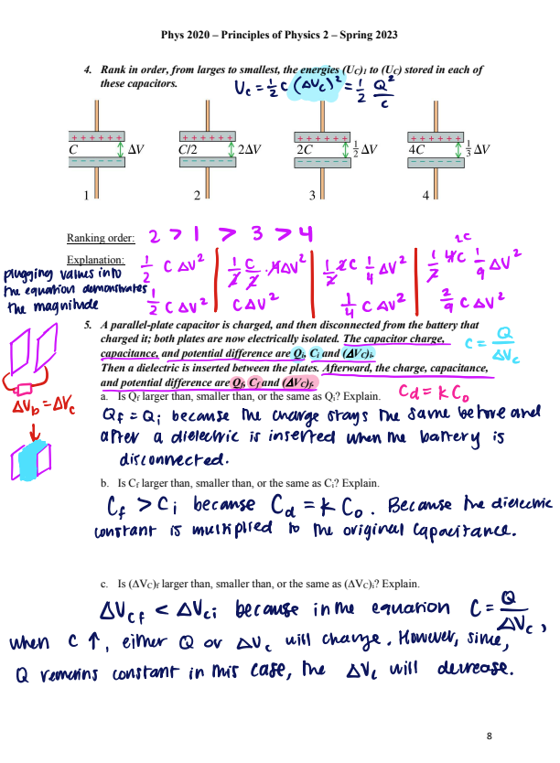
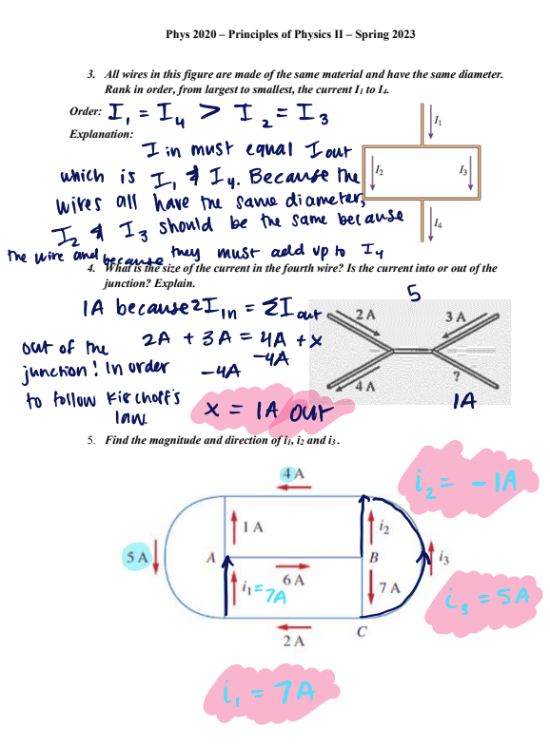
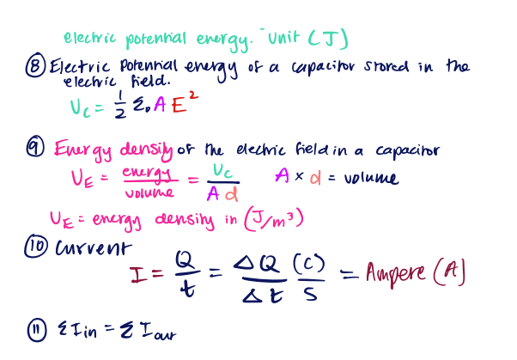
Sample Weekly report

Slide 12
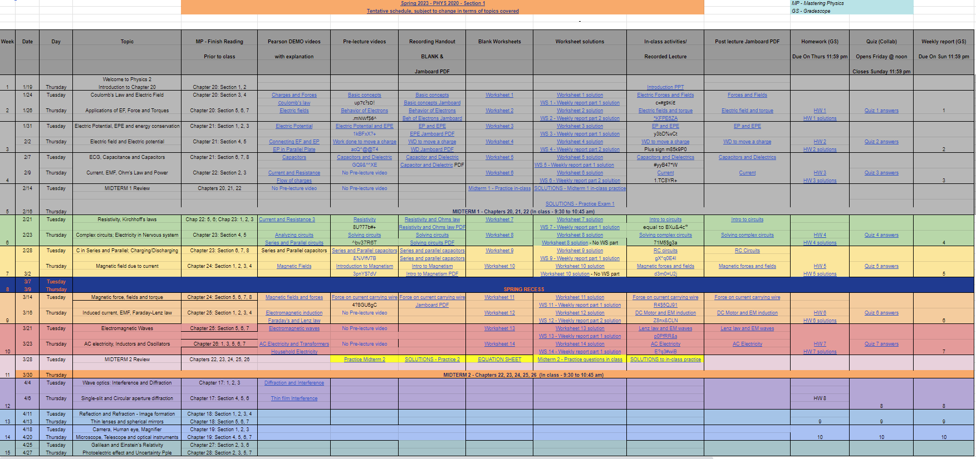
Google spreadsheet

Slide 13
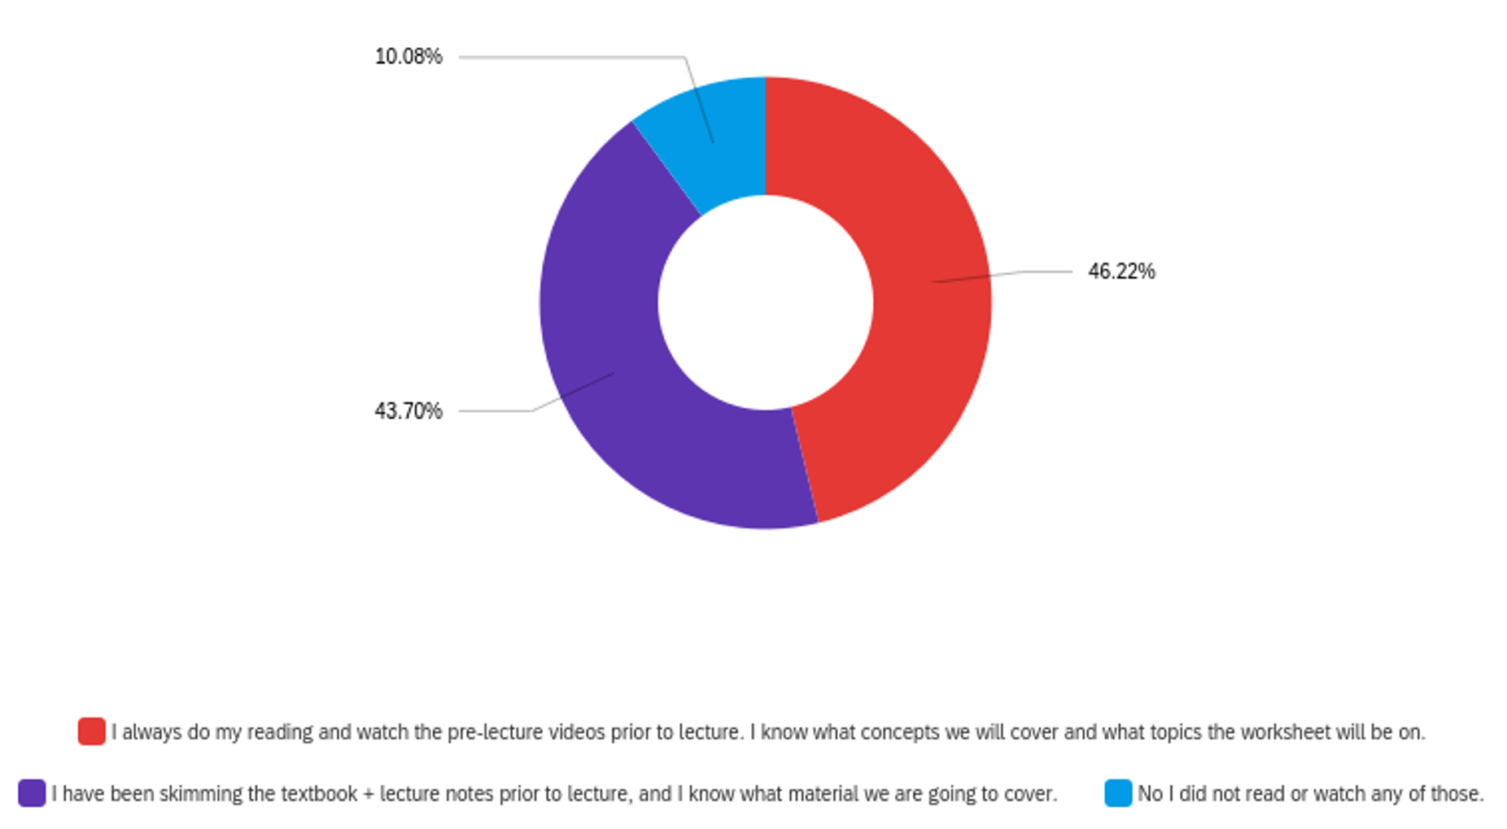
Survey: ~200 students
You are required to read each week's course content before coming to lecture, and complete the reading

Slide 14
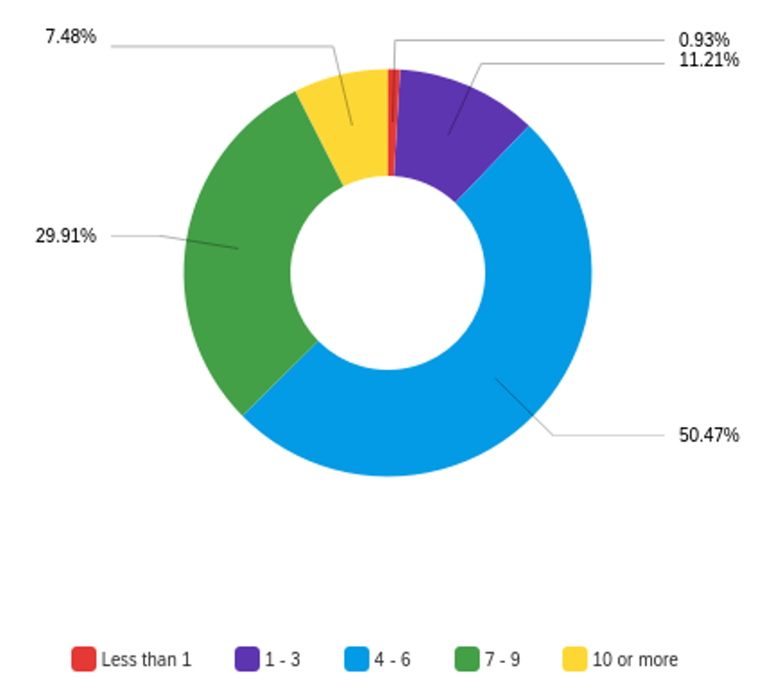
Survey: ~200 students
The average number of hours per week I spent outside of class preparing for this course, including reading and doing all HW, is approximately:

Slide 15
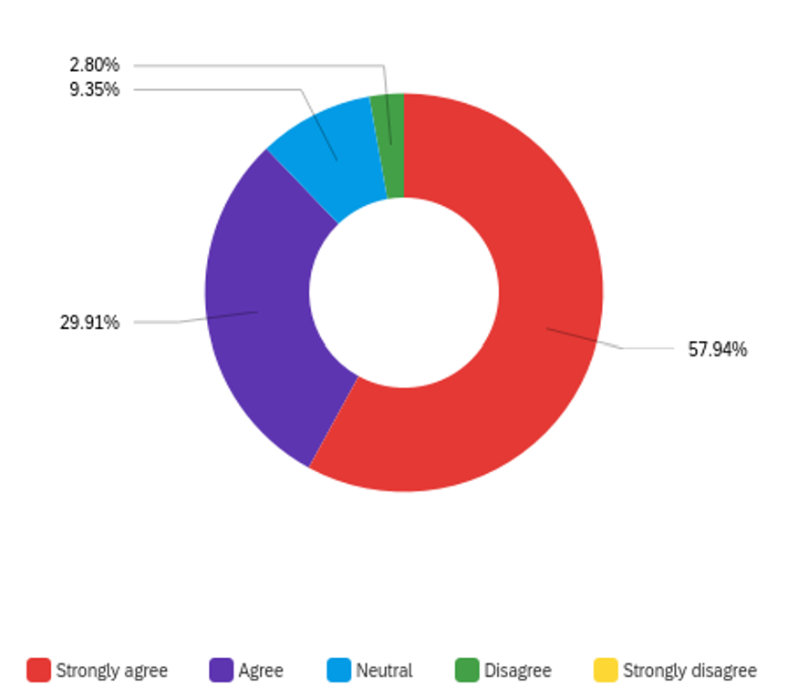
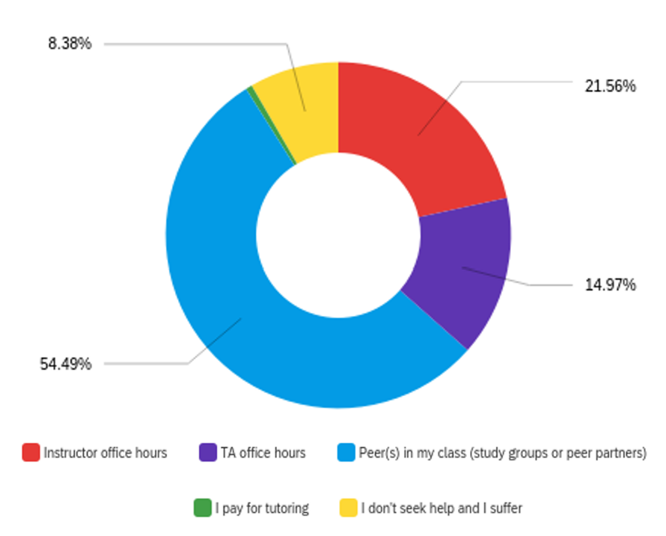
Survey: ~200 students
When discussing concepts and/or solving problems with my group/partner, I feel confident asking questions and/or sharing ideas
When I encounter difficulties with solving a problem or understanding a concept, I seek help from

Slide 16
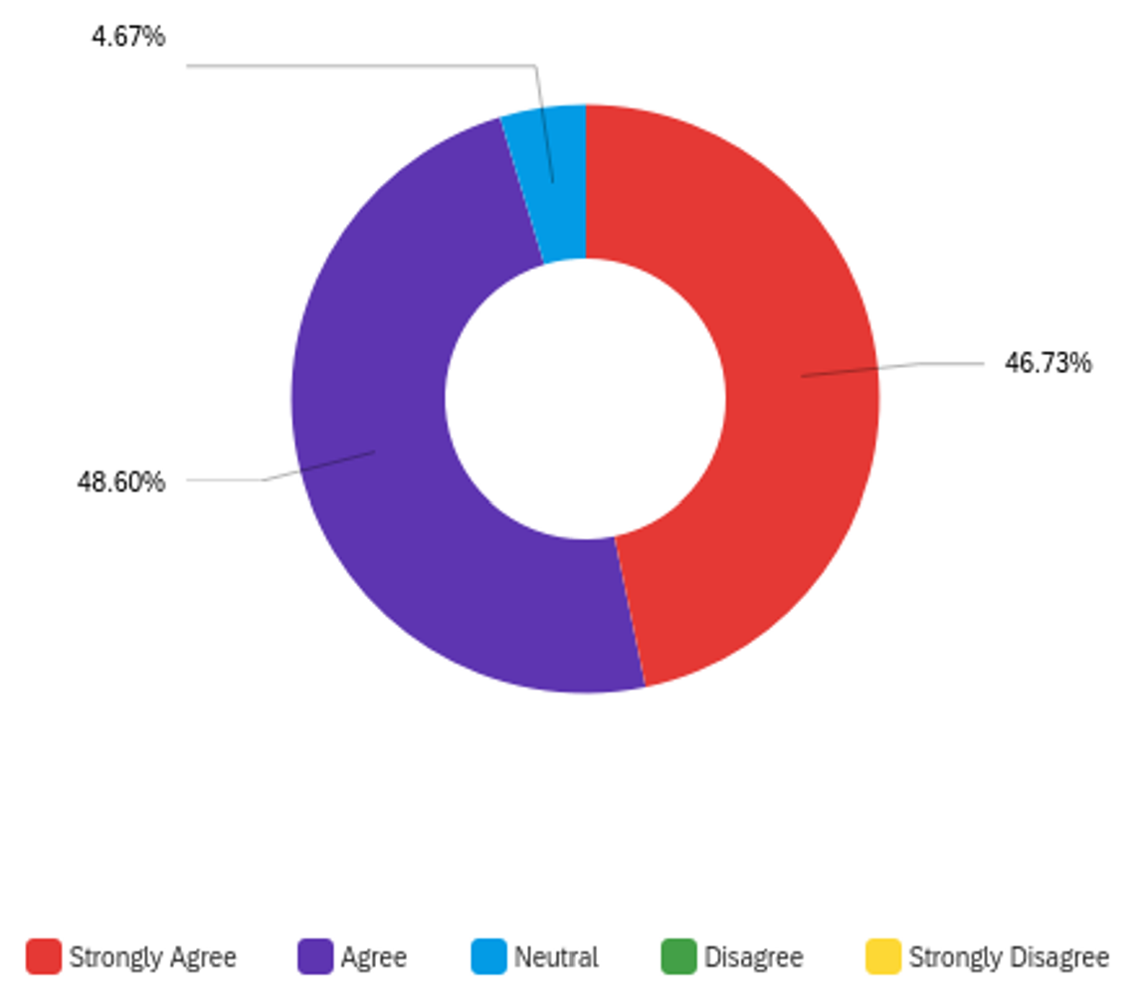
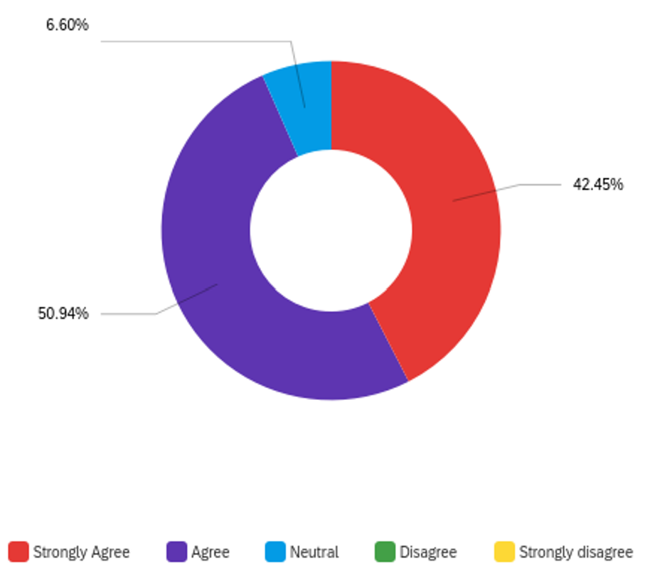
Survey: ~200 students
So far, I feel I am learning a great deal in this course.
So far, I feel I have gained a deeper understanding of the subject (physics).

Slide 17
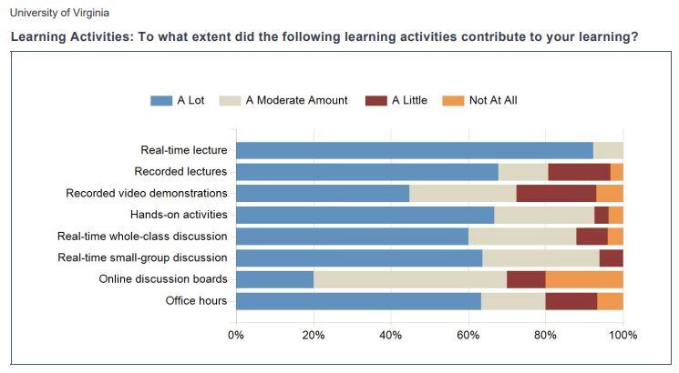

Slide 18
Student comments
Learning activities in this course were beneficial for reviewing the materials, and hands–on activities were especially helpful to me when it comes to solve problems on my own for working on homework.
The structure of this course this semester was outlined such that there was a method of learning present that suited almost any student to further their knowledge. From the worksheets, to the weekly reports or simply the lectures and readings, the varying approaches to all of the topics made them readily accessible through a variety of means.
I liked having time in class to work on practice problems with my classmates. It was also nice to start class with a recap of the chapter and have time for the professor to work through practice problems with all of us.
Smaller group problem solving time during class was extremely helpful in ensuring that I was able to learn the course material well.

Slide 19
Student comments
I benefited from learning concepts and equations during the first part of lecture, and then having the opportunity to apply it to different practice problems in the second half of class, with TAs and classmates available to answer any questions I have.
The way that the classroom was laid out was beneficial because students sat at round tables which meant that small group discussions were encouraged. These discussions definitely aided in my understanding of class work. The real time lectures were also efficient and often left us with some time to work on in class problems and to ask questions.
I learned from lectures, doing worksheets in class, homework, DIRT quizzes, and the weekly summary reports. Honestly, I felt like all of the work we did in this class was super helpful for learning physics.
The real time whole class discussion and lectures were a great and effective way of teaching the students the course material on a concise way.

Slide 20
Summary
During the Fall semester at UVA, I tried different tools to facilitate student engagement in class. I am constantly looking for opportunities to enhance my teaching skills and present the material to my students in a way that creates a passion for the subject and appreciate the opportunity to learn physics.
Students were engaged in class physically, mentally and verbally. They were/are discussing the concepts with their peers at the table, asking questions if there is a difficulty in understanding, solving problems together in class
All course materials were accessible to the students. (Pre-lecture/post-lecture videos, blank worksheets and homework, solved worksheet and homework, lecture handouts pre and post, exam reviews, equations).
Hands-on demonstrations: I would like to incorporate more hands-on and interactive demos during lecture which would be helpful in visual learning and application of the concepts.
New techniques: I would like to implement new tools and active learning strategies that other instructors use in their classrooms.

Slide 21
Questions?

