Slide 1
A "Transformative" Assignment on Rotation: A Seemingly Simple Question Becomes an Epic Four-Part Exploration
Dr. Mark Huntress
Professor of Chemistry and Physics
Patrick & Henry Community College

Slide 2
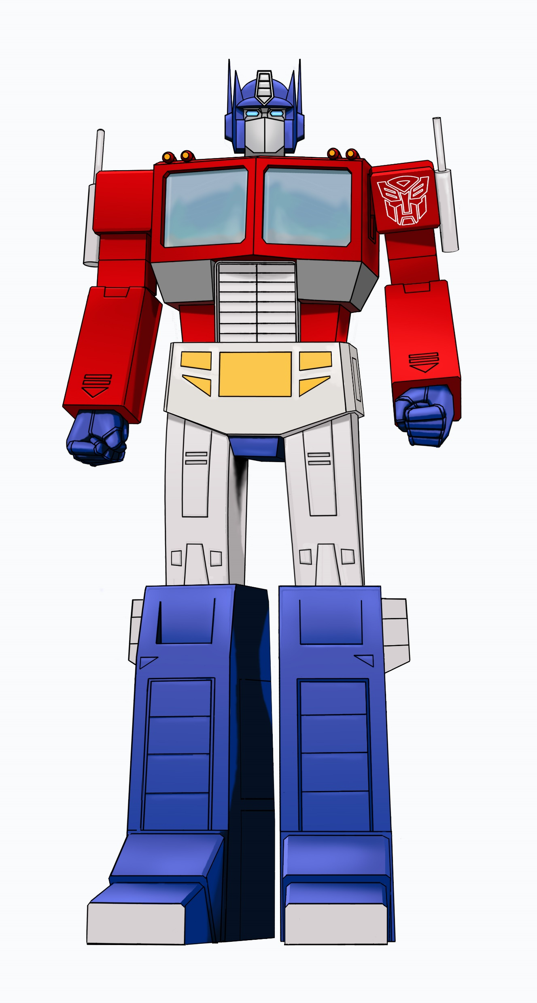
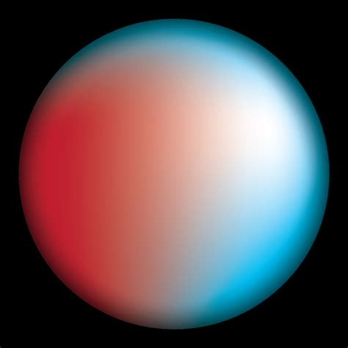
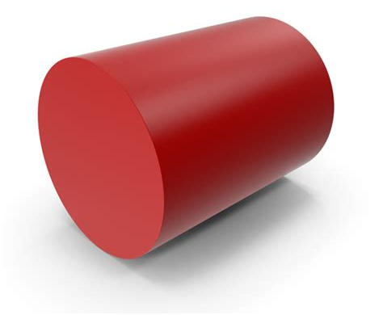
or
?

Slide 3
Optimus Prime, the Transformer hero, is rotating with negligible friction and negligible externally applied forces. He wants to rotate as fast as possible, so he transforms into a shape that is less spread out (like when you pull your arms in to rotate faster on a spinning chair). To end up rotating the fastest, AND to be able to angularly accelerate the fastest with a specific amount of torque, should he transform into a uniform disk / cylinder, a ring / hoop, or a uniform solid sphere?

Slide 4
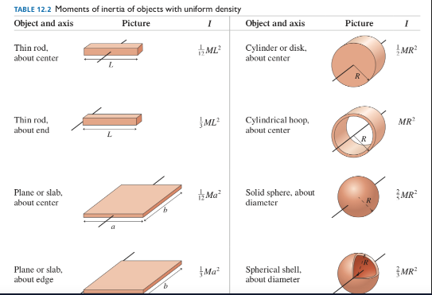
(first result for “moment of inertia table” search):

Slide 5
Must understand that angular momentum is conserved and a lower I means higher angular velocity.
Results of Part One (Students’ First Attempt):
-Most pick sphere b/c of smaller fraction in eqn for I in table.
-Significant contingent say disk because “higher I means higher angular momentum”

Slide 6
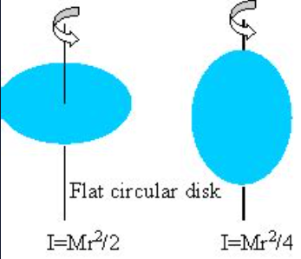
Part 2: Look at this and reconsider.
A disk can rotate around multiple axes!

Slide 7
Results:
On Part 2, vast majority of students change their answer to disk, since ¼ is lower than 2/5.

Slide 8
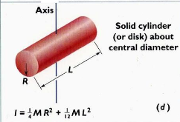
Part 3: Again, reconsider your answer. Realize that a disk is actually just a very short cylinder. For disk / cylinder of non-negligible length:
Qs: In order for the equation I=1/4 MR² to apply, what is the assumed length of the disk / cylinder? a. pretty much zero b. equal to R c. 12 times R
If the length of a disk / cylinder approaches zero, its R must approach infinity.
How would a higher R value affect the moment of inertia of a disk, the mass being the same?
If Optimus Prime were to have a much higher R value as a disk rather than a sphere (lets say at least 2 times higher), could he possibly have a lower moment of inertia as a thin disk shape than as a sphere?

Slide 9
Results:
On Part 3, a small minority of students are STILL convinced that he could have a smaller I as a thin disk!

Slide 10
Part 4: … but he would not have a negligibly small length as a cylinder! Maybe R=L?
If R=L for our cylinder, we could substitute L for R in the above equation and get: I = 1/4 MR² + 1/12 MR² = 1/3MR²
1/3 < 2/5 so we are back to disk again as our answer?
… but R for this cylinder would not = R for sphere.
Compare I for sphere to I for disk with equal R and L. The math:
Assume an arbitrary volume of 100 arbitrary units for Optimus Prime. Find the radius he would have as a sphere by solving V=4/3 πR³ for R: R =(100*(3/4)/π)^{(1/3)} = 2.879
Next, find the L and R values that Optimus as a cylinder must have if L=R: V=LπR² becomes V=πR³, and L= R = (100/π)^{(1/3)} = 3.169
Now, moments of inertia can be compared. For the sphere, we find I=2/5 M*2.879² = 3.316M. For the cylinder, we find I = 1/4 M*3.169² + 1/12 M*3.169² = 1/3 M*3.169² = 3.348M.
The disk/cylinder has 1% higher moment of inertia and we can’t conclude it is the best answer!

Slide 11
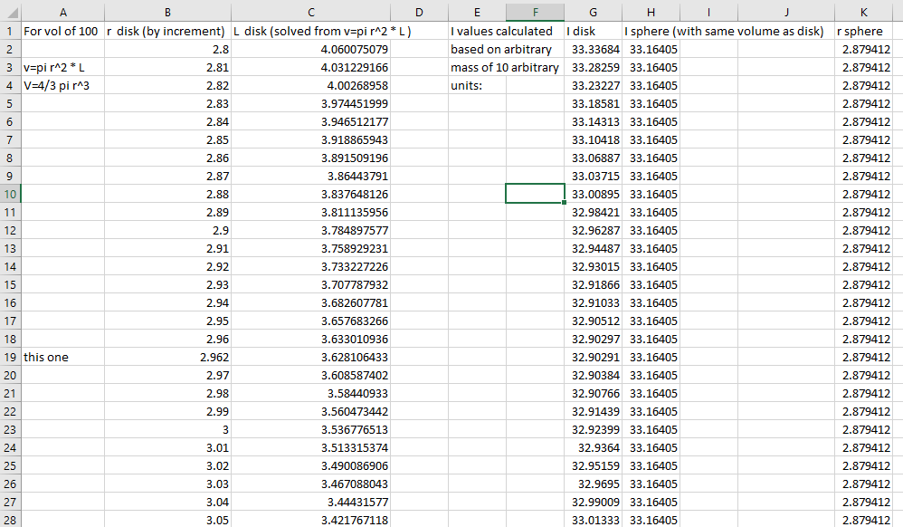
Part 5: Function Optimization For Algebra-Based Class:

Slide 12
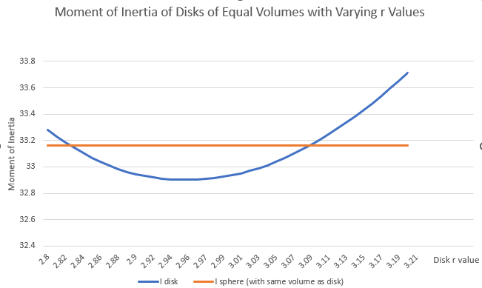
(Disk r = Disk L)

Slide 13
Part 5: Function Optimization For Calculus-Based Class:
Find the optimum dimensions of a cylinder by finding the minimum of the function I=1/4 MR² + 1/12 ML². First, define L in terms of R using V=LπR²: L=V/πR².
I=1/4 MR² + 1/12 M (V/πR²)².
Next, set the derivative of the function, dI/dr, equal to 0, to find the optimal R at the minimum I value, where the tangent line to the curve is horizontal:
dI/dr = 1/2 MR + -4/12 M (V²/π²)R ⁻⁵ = 0 then cancel M:
1/2 R = 1/3 (V²/π²)R⁻⁵ ; R⁻⁶ = 3/2 (V²/π²); R = (3/2 (V²/π²))^{-1/6}.
Keeping the value of 100 for the volume gives:
R=2.962 Length in this case is L=V/πr² = 100/(π*2.962²) = 3.628.
The moment of inertia of this cylinder comes out to:
I=1/4 MR² + 1/12 ML² = 3.290M
Compare to I of sphere (3.316M)

Slide 14
The Final Answer:
Disk wins by < 1% !!!
!!

Slide 15
Results:
Students mostly get walked through parts 4 and 5.

Slide 16
Student Feedback:
Mostly: “Breaking the question down made it easier to understand”
Negative feedback: “Too many parts of the assignment due one after the other on the same weekend I have a (sports game thing).”

