Slide 1
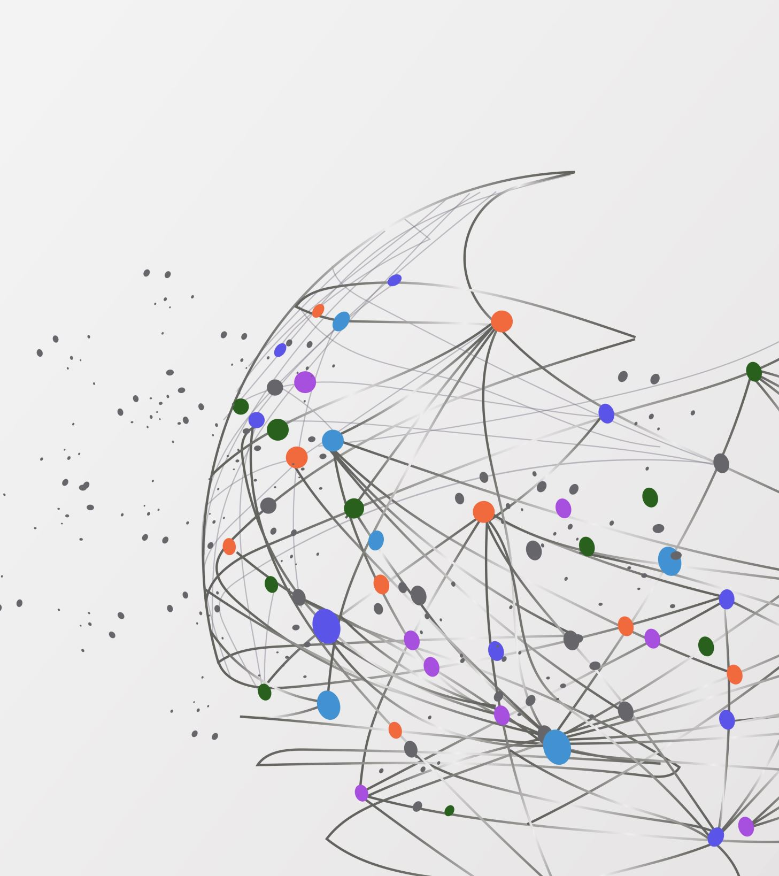
Scaffolding the Transition to Higher-level Physics at the University of Virginia
Elizabeth Larson
CSAAPT Semi-Virtual Meeting
1 April 2023

Slide 2
Overview
Evolution of the intro physics curriculum at UVa
PHYS 2720: Problem Solving and Special Topics in Classical Physics
Motivation behind the course
Current implementation
Early results and lessons learned
Future goals and outlook

Slide 3
Evolution of Intro Physics Curriculum
2015-2021
Physics starts in fall of 1st year
2 semesters of intro lecture, 5 credits each
Calc I pre-requisite for fall of 1st year
2022-Present
Physics starts in spring of 1st year
2 semesters of intro lecture + labs, 3 + 1 credits each
Calc I pre-requisite for spring of 1st year
Math now more accessible
Avoids conflict with UVa’s 1st year gen ed curriculum
Aligns more closely with engineering track

Slide 4
Evolution of Intro Physics Curriculum
Lecture credit hours reduced by 40%
Later start → more urgency to prepare students for research
Higher-level curriculum largely unchanged
Solution: new course to “fill in the gaps” and help students transition to higher-level physics courses
PHYS 2720: Problem Solving and Special Topics in Classical Physics

Slide 5
PHYS 2720: Problem Solving and Special Topics in Classical Physics
2-credit course
Taken in spring of 2nd year
Spring of 1st year for students with AP credit
After 2-semester intro sequence
Meets 2x weekly for 75 minutes
Active learning and group problem-solving
Extensive reliance on calc I-III, basic ODEs
Time- and position-dependent forces
Extended objects
Oscillations
Optics
Thermo-dynamics

Slide 6
PHYS 2720: Problem Solving and Special Topics in Classical Physics
Weekly Assignments:
Pre-class reading
Pre-workshop exercises (45% of grade)
Group written homework (50% of grade)
Self- and peer-evaluations (5% of grade)
Points of Emphasis:
Group work – signed contracts of expectations for team members
Applying math to physics – more reliance on calculus than in intro sequence
Graphing – establish good habits of labeling axes, scaling appropriately, etc.
Long, multi-step problems – more closely aligned with 3000+ level courses
Connecting physics topics – e.g., resonance in mechanical oscillators and LRC circuits

Slide 7
Early Results
Pre-class diagnostic provided insights into students’ strengths and weaknesses
Students’ fluency with graphing was poor initially, but rapidly improving
Group dynamics are very good
Students need more repetition/practice than we realize on key topics/techniques
1-8: Mech.
9-13: E&M
14: Thermo
15: Optics

Slide 8
Future Goals and Outlook
Preserve focus on skill development rather than assessment
Introduce students to numerical methods
Expand course offering to summer session
Will make scheduling easier for transfer students
Could also be taken by Physics Bridge students in graduate program
Lingering Issue: “too much work” for 2 credits?

