Slide 1
Using ALEKS in introductory physics courses at the college level

Slide 2
Elements of INTRO PHYS LABs
Scientific methods and equipment
Skills
Actual labs
Math “only” sections
Math readiness
Systematic problem solving
Scientific writing

Slide 3
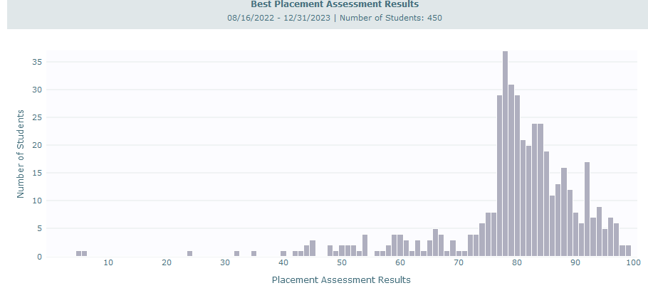
Math READINESS
21% still below the threshold
56% below the readiness threshold

Slide 4
Successful Testing?

Slide 5
TO DO LIST
Correlate with the lecture
Correlate with previous math courses
Correlate “gains” with lab/lecture scores
Do a qualitative confidence growth mindset study with my special math only sections

Slide 6
All of the materials for these courses can be found at the following URL:
https://drive.google.com/drive/folders/1SmaE9UoDzECzDjjcTitINZMcj4J4wMaj?usp=sharing
Contact info: mab3ed@virginia.edu
Maxim Bychkov

