Slide 1
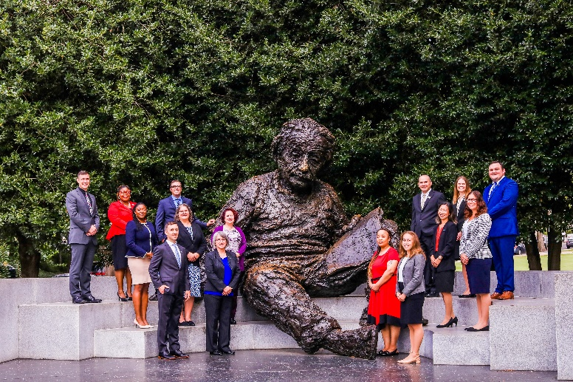
What is the purpose of the program?
A unique opportunity for accomplished K-12 STEM educators to
serve and make an impact in the national education arena
and to bring their insights, knowledge, and classroom experience to Federal STEM education program and education policy efforts
Join in on our monthly twitter chat!
@AEF_Program
#einsteinfellows22

Slide 2
Spend 11 months in Washington DC serving in a Federal placement
Stipend of $90,200
Up to $550 per month individual health insurance premiums
$5000 travel allowance $1000 education allowance
Up to $3500 relocation expenses
Support levels for the 2023-2024 Fellowship Year.
Visit the DOE Web site:
https://science.osti.gov/wdts/einstein
Applications are open August 14, 2023 and close mid November.
Join in on our monthly twitter chat!
@AEF_Program
#einsteinfellows22

Slide 3
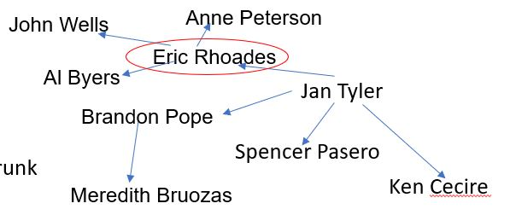
Laura Akesson- Dept of Energy
PROGRAMS & COMMUNICATION
Networking

Slide 4
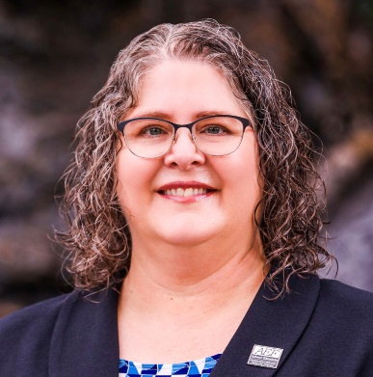
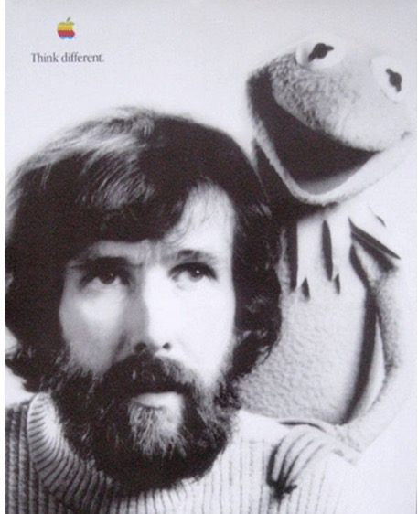
Growth
Michelle Strand- Capitol Hill
Placement: Office of Congressman DeSaulnier (CA-10)

Slide 5
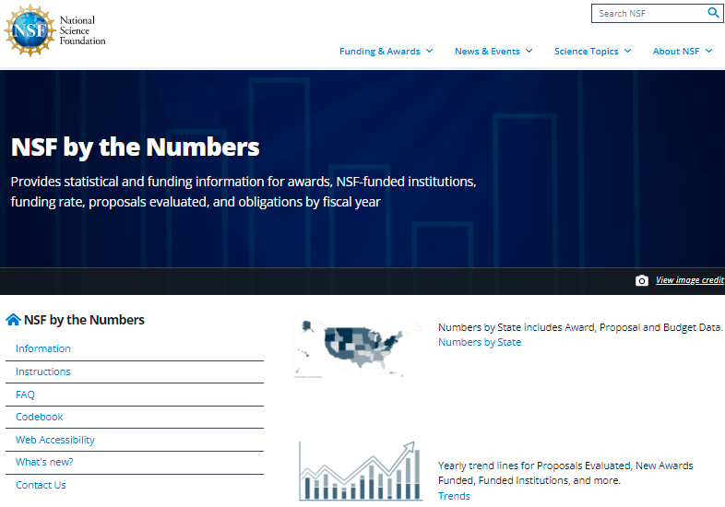
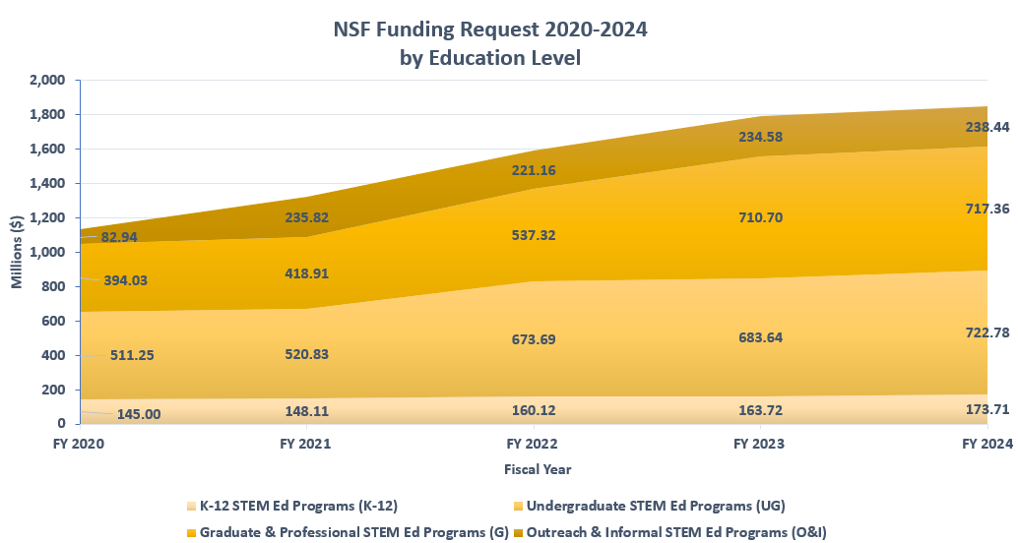
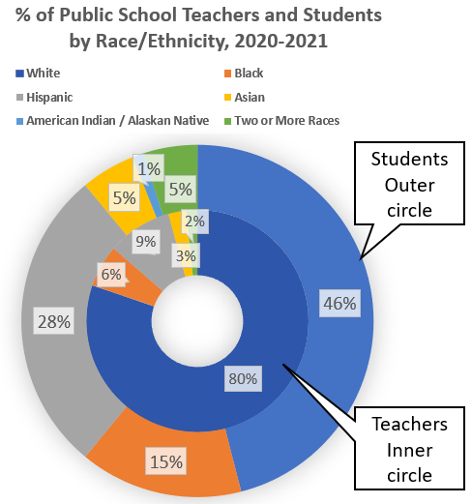
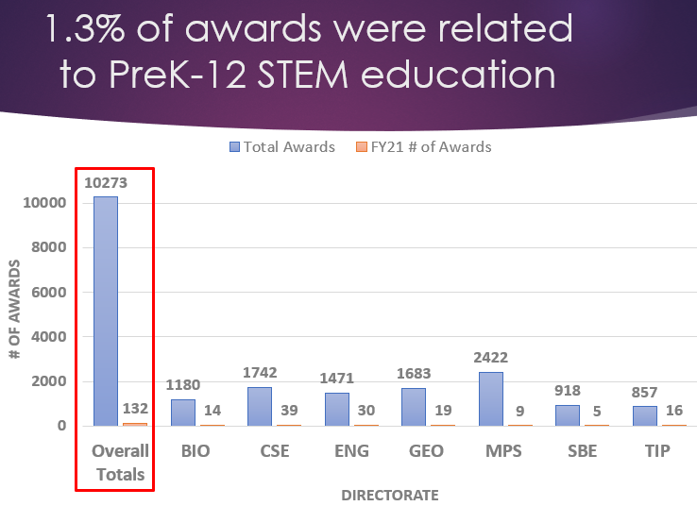
Vida Treviño National Science Foundation, National Science Board Office Biggest Skills Developed & Proudest Moments
Developing MAD skills using data sets
Presenting to NSB
Advocating for teachers
Who knew I could perform?

Slide 6
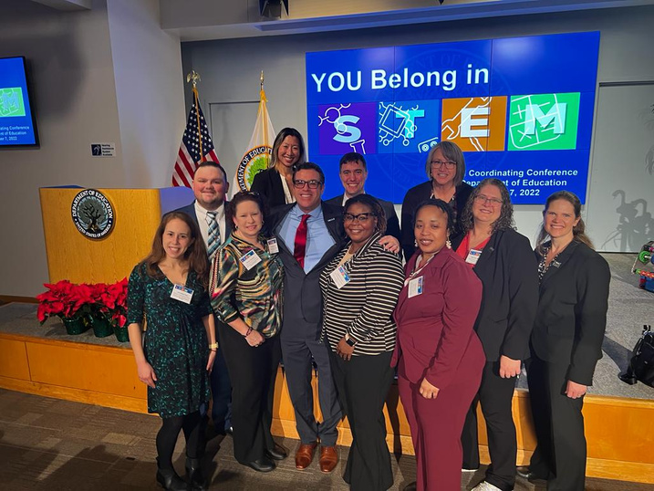
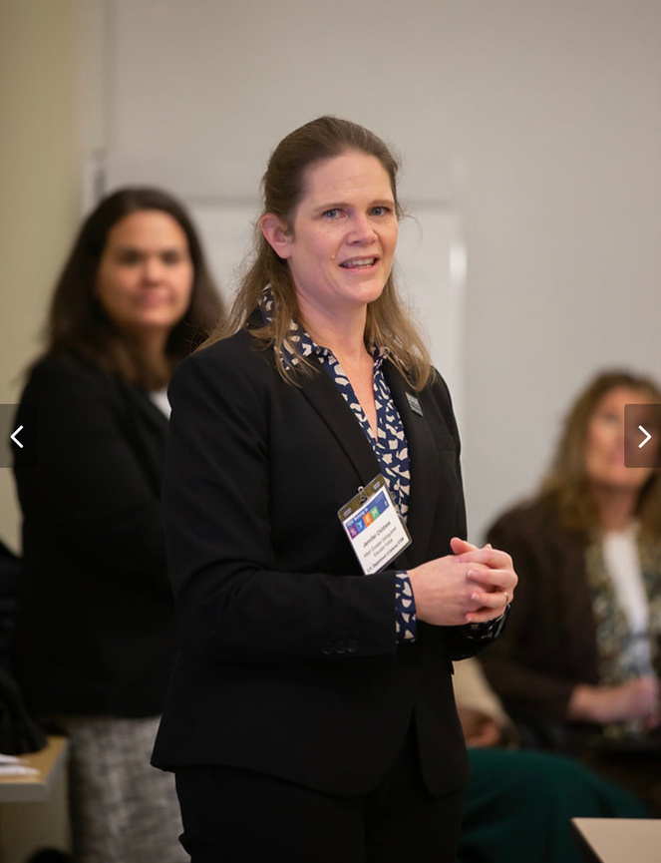
Jennifer Childress- DoD STEM Office
Conferences & Webinars
Department of Ed
You Belong in STEM
NCWIT C4C Webinar
IWG - Convergence Webinar
STEM Tech Exchange
NSTA Conference
ISTE Conference
You Belong in STEM
Notes:
I get to be a spokesperson for DoD STEM - share the amazing opportunities and knowledge that I'm gaining
In the process, also learn and gain leadership skills

Slide 7
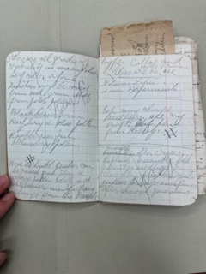
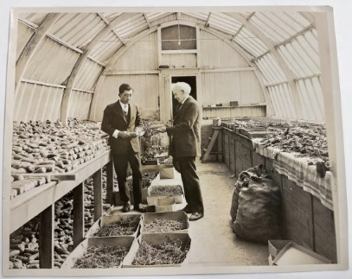
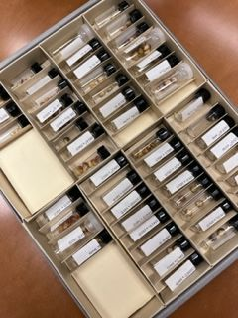
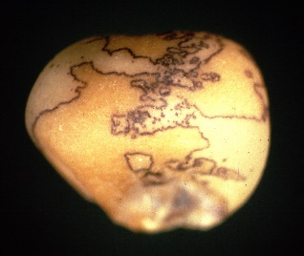
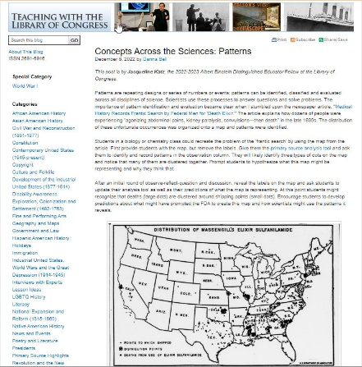
So what did this corn-shaped rabbit hole teach me…
Jackie Katz- Library of Congress
Science is a human-endeavor that can be recounted through story.
Science is connected to all other disciplines.
How we know what we know about science is equally as important as what we know.
Students need to become aware of the previous 3 points!
Notes:
These realizations have shaped much of my work at the LOC so far this year, as well as my thinking for a return to the classroom

Slide 8
Carla Neely Placement: U.S. Senate
I am placed in the Office of Senator Jacky Rosen.
I introduced the Women of Color in Tech Day Resolution on March 24, 2023.
I am working on programs for the Senate’s Women in STEM Caucus.
I’m working on legislation that increases the STEM pipeline for PreK-8 girls of color.

Slide 9
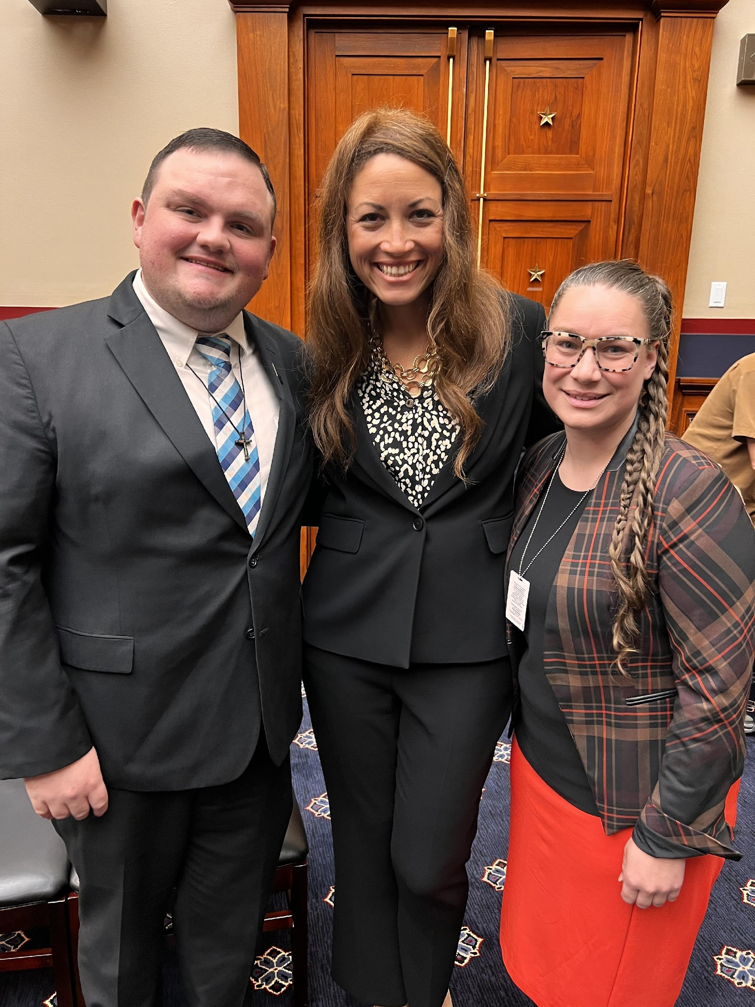
Tyler Dufrene- Capitol Hill
The Hill Life
Office Responsibilities:
Research
Draft Blurbs for Weekly Newsletter
Write Speeches & Talking Points
Compose Reports, Memos, and Official Letters
Vet Witnesses to Testify in Hearings
Attend Stakeholder Meetings
Summarize Bills
New Portfolio:
Child care (CCDBG)
Child Nutrition
CCAMPIS
Head Start
Older Americans Act
Notes:
Song by Kate Bush “Running up that hill”
Currently do K-12, higher ed, workforce development, and anything that needs assistance
Each week, team meetings.

Slide 10
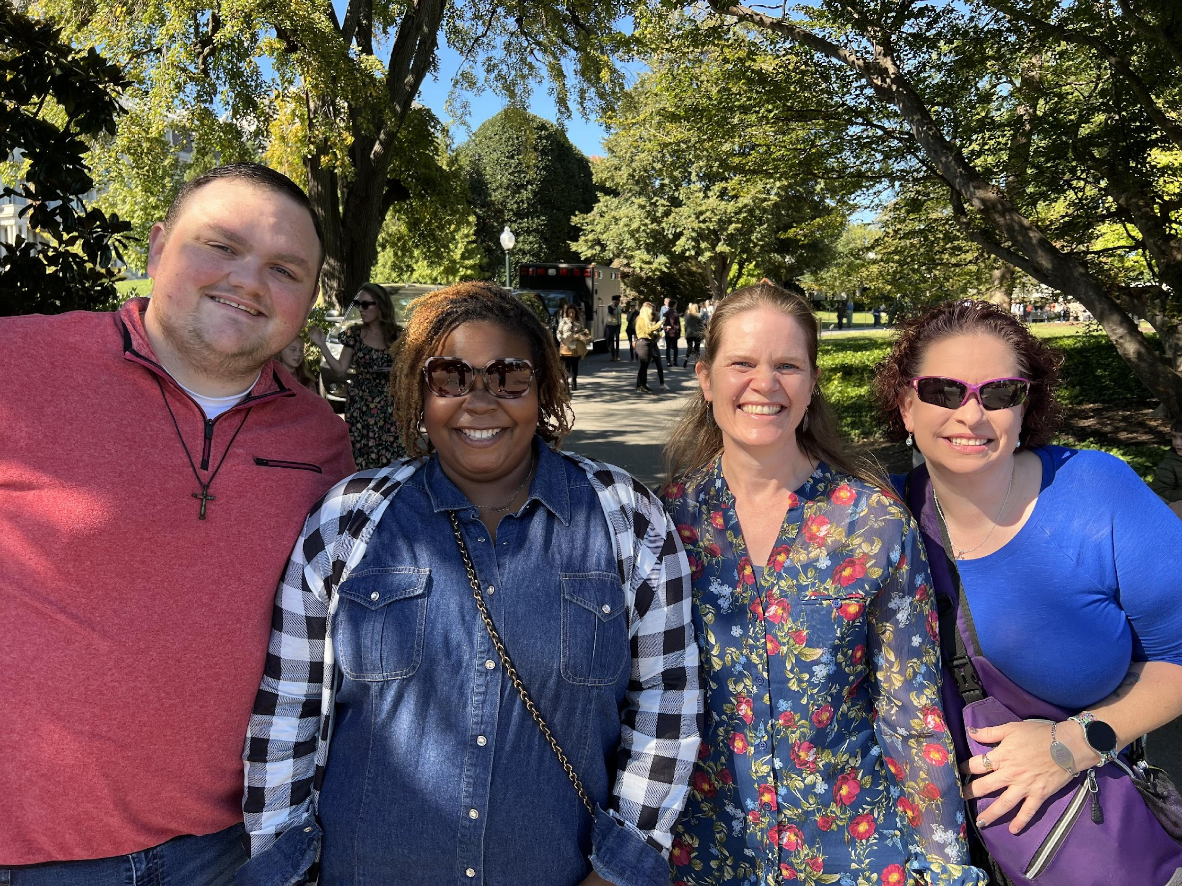
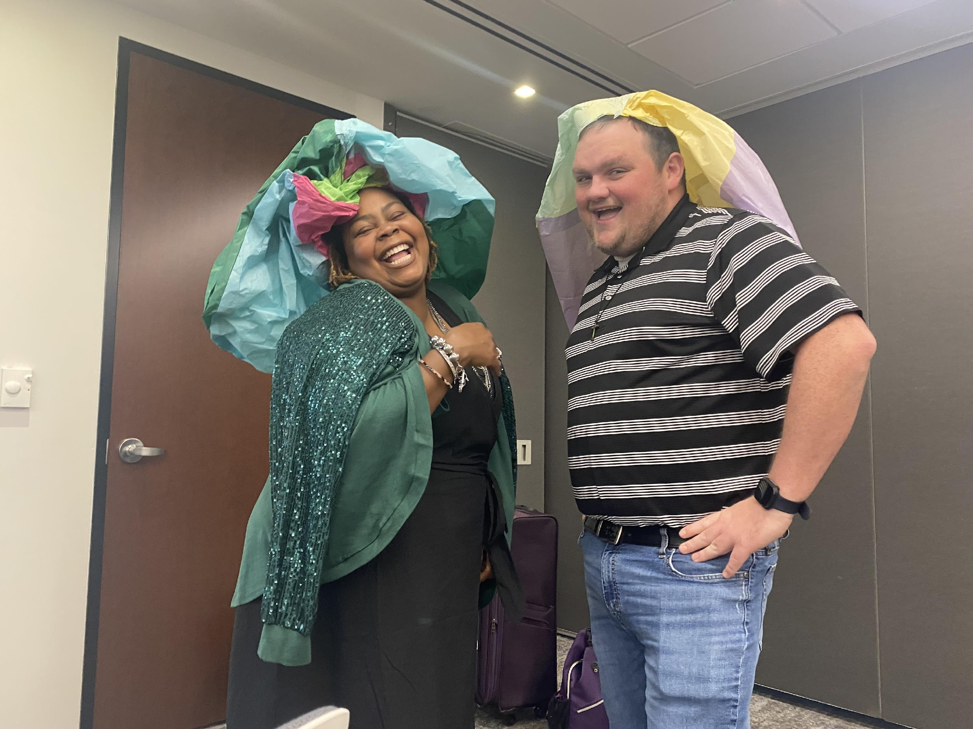
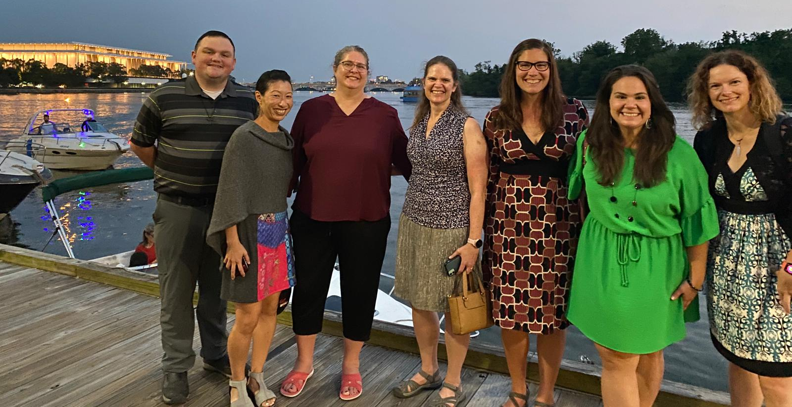
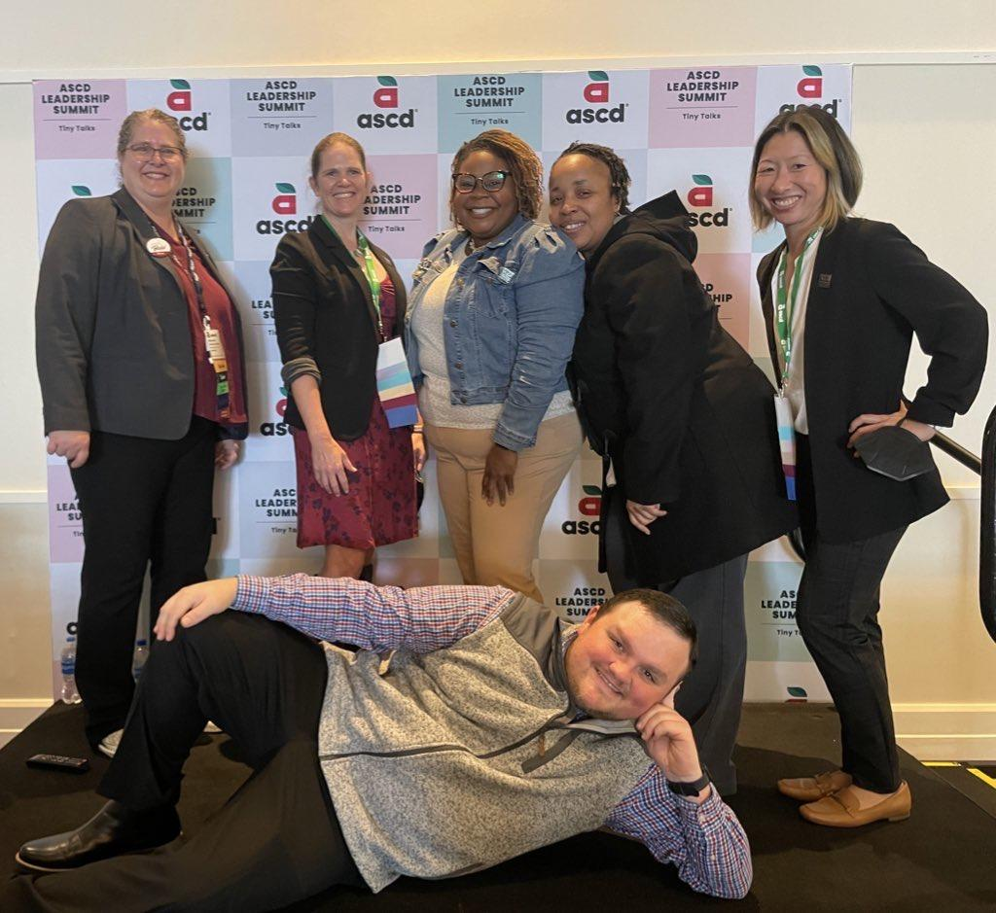
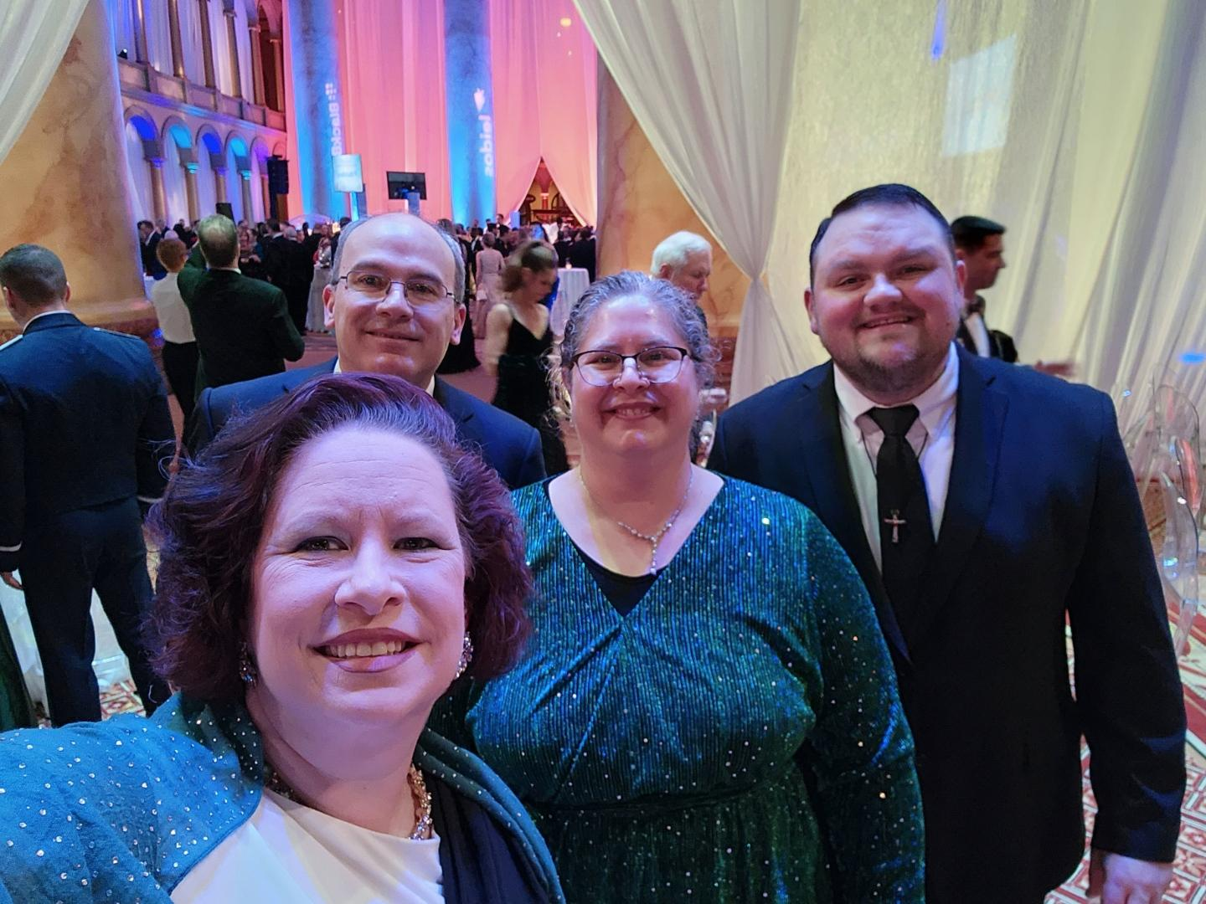
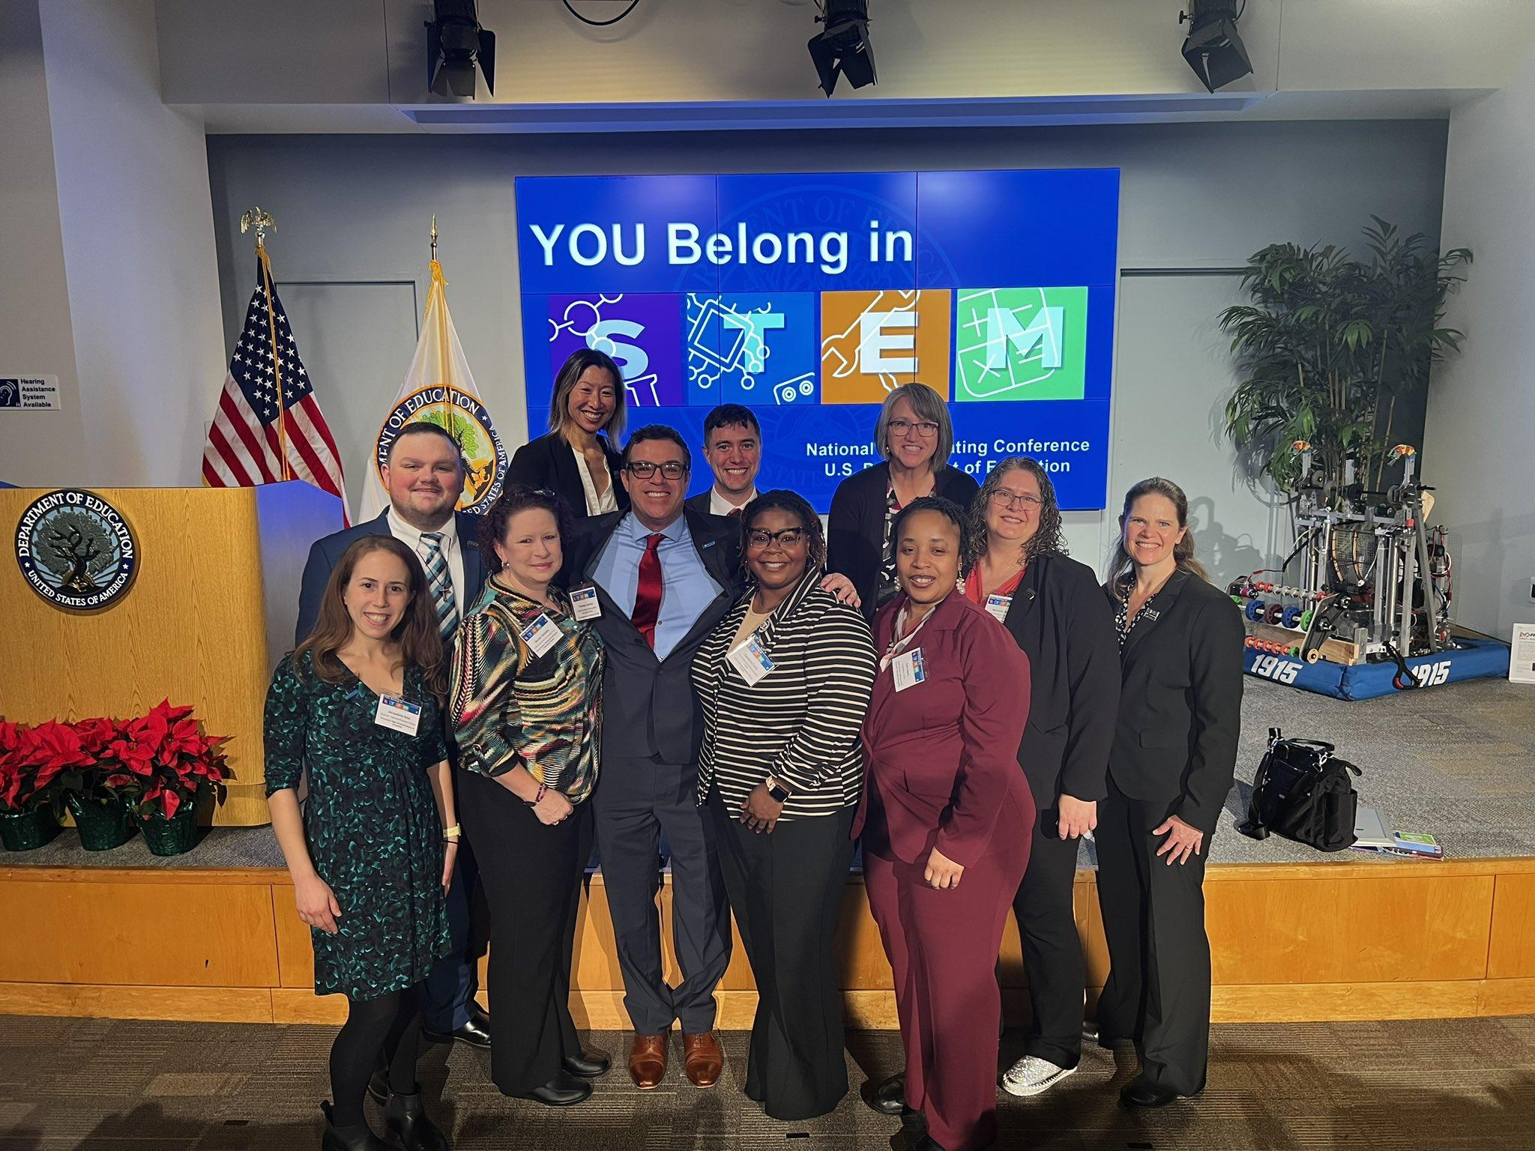
New Family
Laura Akesson. Laura.akesson@gmail.com
Michelle Strand. shelhusk@gmail.com

