Slide 1
Mike Florek
mflorek@rcps.us
This is the first slide.

Slide 2
Many science words are not simple.
Hard to say
Hard to write
Hard to remember

Slide 3
Things and ideas have a lot of parts.
Many parts of things have science names.
Some people don’t know the names of the parts.

Slide 4
This can be bad.

Slide 5
The Answer?

Slide 6
Teaching Students How to Explain Big Ideas with Simpler Words
Mike Florek – (Names that are not simple are okay)

Slide 7
Step 1
Read a book.

Slide 8
Thing Explainer
This is the book we read.
It explains big ideas in small words.
It is funny.

Slide 9
Step 2
Choose a thing.

Slide 10
Laws for Choosing Things
1) Choose a thing that is not simple.
2) Choose a thing that can be talked about at school.
3) Choose a thing you can draw.

Slide 11
Step 3
Study the thing.

Slide 12
Laws for Studying Things
Read school papers.
1
Read business papers.
2
Use the thing yourself (unless you should not).
3
Tell us what you read.
4

Slide 13
Step 4
Draw the thing.

Slide 14
Laws for Drawing Things
1) You draw the picture.
2) Make it look good.

Slide 15
Step 5
Explain the thing.

Slide 16
Laws for Explaining Things
Choose interesting parts.
1
Use simple words.
2
Pretend you are talking to a child.
3
Pretend the child knows some things already.
4

Slide 17
Blender
This is a good Thing Explainer.

Slide 18
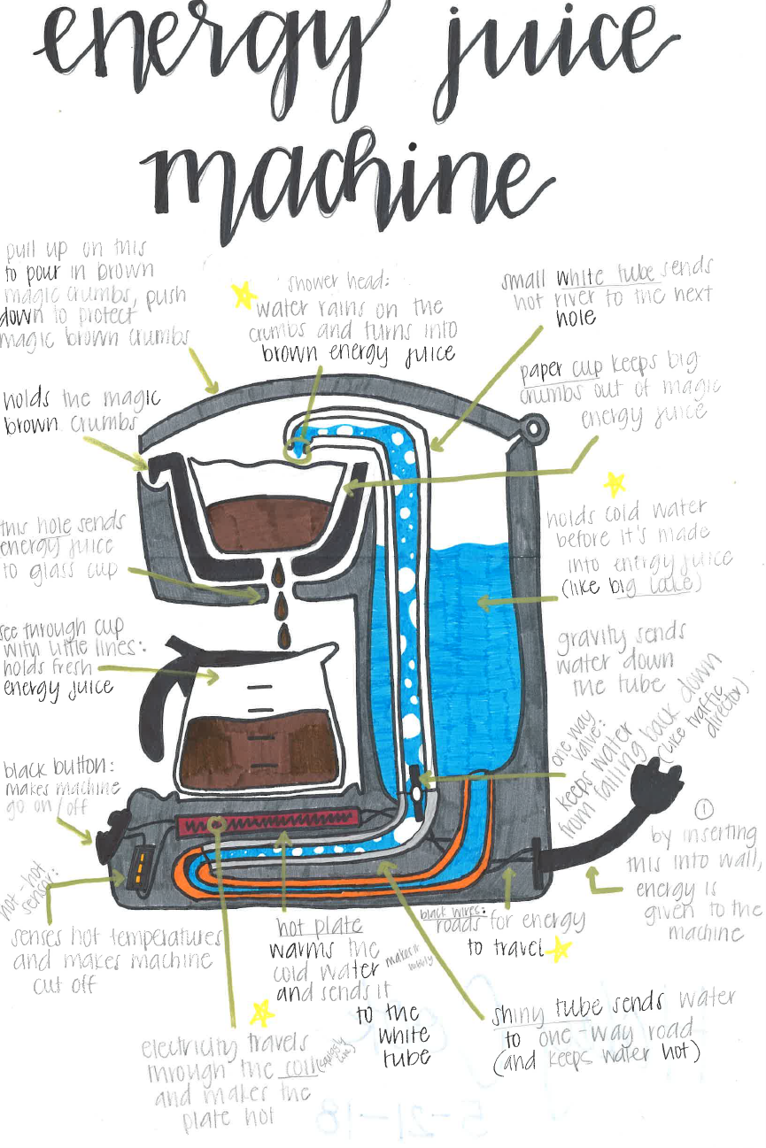
Coffee Maker
This is a good Thing Explainer.

Slide 19
The 2008 Financial Crisis
Sometimes it is okay to say yes to a strange idea.

Slide 20
Drinking Bird
I like this Thing Explainer best.
It is hard to read.

Slide 21
Questions?
mflorek@rcps.us

