Slide 1
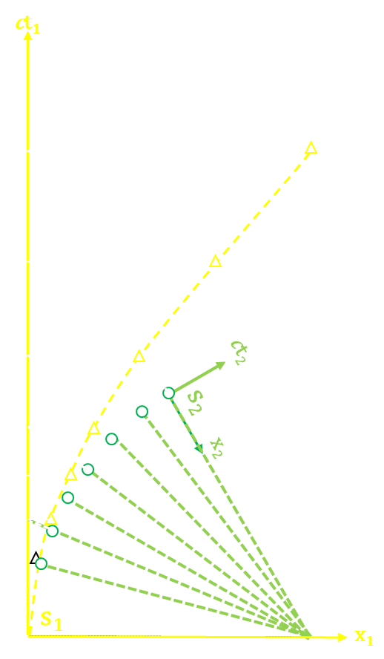
Riding on a Light Beam
Acceleration and Mass Rise
Lewis F. McIntyre
CS-AAPT Spring Meeting
April 1, 2023
mcintyrel@verizon.net
Notes:
Good Morning! My name is Lewis McIntyre, a retired Naval Aviator, and now a retired engineer. This is a continuation of a presentation I made last year to this group on a graphical solution to special relativity that I call the velocity triangle
This presentation deals with the analysis of a body undergoing constant acceleration from velocity equal to zero, up to c, as measured by an unaccelerated observer initially at rest with that body. Acceleration is normally out-of-scope for the Special Theory, but I have included proofs to demonstrate that this model appears to be correct.

Slide 2
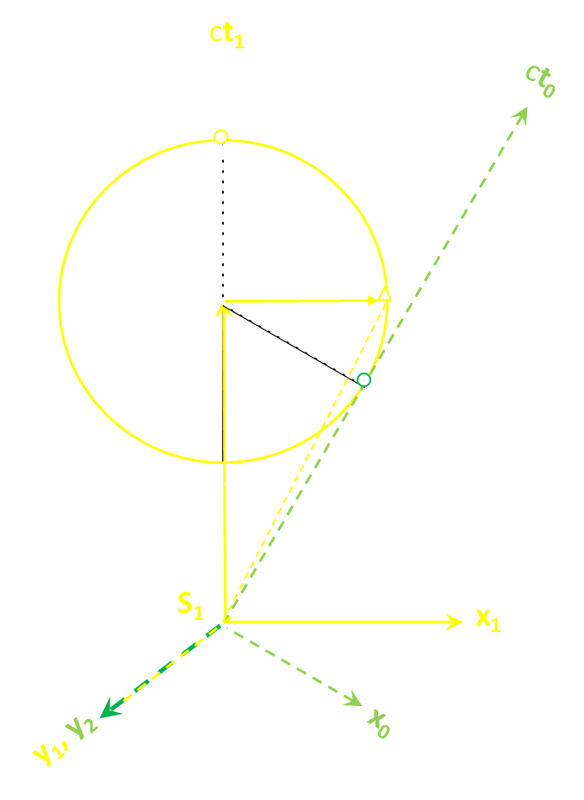
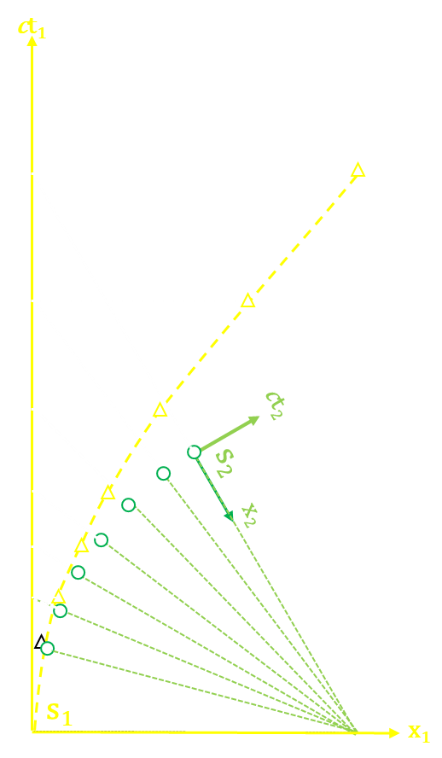
OUTLINE
REVIEW OF VELOCITY TRIANGLE
TIMELINE OF AN ACCELERATING BODY S₀
UNACCELERATED S₁’s MEASUREMENT OF ACCELERATED S₀’s WORLDLINE
SMALL ANGLE APPROXIMATION GIVES CLASSICAL LAWS FOR ACCELERATION
S₁’s MEASUREMENT OF S₀ CAUSES OBSERVED RELATIVISTIC MASS RISE
Notes:
I am going to follow this outline

Slide 3
REVIEW OF VELOCITY TRIANGLE
ct₁
ct₀
β=arcsin (v/c)
A= Time of Transmission ct₀
$${ct}_{1}=\frac{{ct}_{0}+x_{0}·sin\left(β\right)}{\cos\left(β\right)} \\ x_{1}=\frac{x_{0}+{ct}_{0}·sin\left(β\right)}{\cos\left(β\right)}$$
A=ct₀
β
O
S₀
x₁
S₁
y₁, y₂
x₀
Notes:
Let’s review the velocity triangle. It is based on four key assumptions:
Light travels in all four dimensions of space at c.
Matter also travels at c, but in a single direction, defining that direction as its time axis, with its spatial axes normal to time.
Relative velocity disappears as an independent variable, becoming a difference of direction by the Brehme angle beta
A body’s proper velocity of c projects as a time-varying component onto the spatial and temporal axes of another by the Lorentz transform, shown trigonometrically.
Here we have an event at A on reference frame S₀, which emits light as some time ct₀ to be observed by another reference frame S₁.

Slide 4
REVIEW OF VELOCITY TRIANGLE
ct₁
ct₀
β=arcsin(v/c)
A= Time of Transmission ct₀
Doppler Shift A along ABC, to C=Time of Receipt
C ct_{1r}
B
$${ct}_{1r}={ct}_{0}\frac{1+\sin\left(β\right)}{\cos\left(β\right)}$$
A=ct₀
β
O
S₀
x₁
S₁
y₁, y₂
x₀
Notes:
The light emitted at A, the time of transmission in S₀, is Doppler-shifted along the path ABC to C, the time of receipt in S₁, the relativistic Doppler shift for time, as shown.

Slide 5
REVIEW OF VELOCITY TRIANGLE
ct₁
ct₀
β=arcsin(v/c)
A= Time of Transmission ct₀
Doppler Shift A along ABC, to C=Time of Observation
D=Measurement
Simultaneous with Event A
OB=ct₁= ct₀/cos(β)
BD=x₁=ct₀·sin(β)/cos(β)
v= x₁/ct₁=c·sin(β)
C ct_{1r}
B
D
x₁=vt₁
A=ct₀
β
O
S₀
x₁
S₁
y₁, y₂
x₀
Notes:
Based on the time of receipt, the observer in S₁ locates the event at D, the light from which will reach C simultaneously with light from A. D is on the worldline of successive measurements in S₁ of events in S₀, x=vt.

Slide 6
REVIEW OF VELOCITY TRIANGLE
ct₁
ct₀
β=arcsin(v/c)
A= Time of Transmission ct₀
Doppler Shift A along ABC, to C=Time of Observation
D is Lorentz Transform of A
C ct_{1r}
B
D
x₁=vt₁
A=ct₀
$${ct}_{1}=\frac{{ct}_{0}+x_{0}·sin\left(β\right)}{\cos\left(β\right)} \\ x_{1}=\frac{x_{0}+{ct}_{0}·sin\left(β\right)}{\cos\left(β\right)}$$
β
O
S₀
x₁
S₁
y₁, y₂
x₀
Notes:
D is the Lorentz Transform into S₁ of A, expressed trigonometrically in terms of β.

Slide 7
TIMELINE OF ACCELERATING BODY
CONSTANT CENTRIPETAL FORCE F APPLIED NORMAL TO S_{o} TIMELINE in +x₀ DIRECTION
S₀ OBSERVES CONSTANT ACCELERATION
CONSTANT VELOCITY ANGLE CHANGE WITH RESPECT TO ITSELF β= ω·t₀ dβ =arcsin(a·dt₀/c) ≈ a⸱dt₀/c dβ/dt₀= ω=a/c
S₀ FEELS RESULTING INERTIAL CENTRIFUGAL FORCE IN -x₀ DIRECTION
FOR SMALL dt₀, dv « c: CLASSICAL MECHANICS APPLIES: ω=a/c=c/ρ ρ =c²/a (At 1g, ρ = 0.97 lightyears)
$F=mρω^{2}=m\frac{c^{2}}{a}{\left(\frac{a}{c}\right)}^{2}$=ma
F
ct₀
F
cdt₀
ct₀
x₀
x₀
S₀(t₀)
S₀(t₀+dt₀)
ct₁
dβ
β=ωt₀
s₁
O
x₁
ρ
Notes:
On to accelerated motion. For every click of its proper clock dt, the accelerating body will increase its velocity by dv. With respect to its timeline’s previous direction, its timeline will increase by the amount dβ=dv with each dt. And, if acceleration dv/dt is constant, dβ/dt=ω must also be constant. Thus, beginning at O, its timeline must follow a circular path of radius ρ in 4-dimensional space.
For acceleration to be constant, a centripetal force F must be applied normal to the timeline in the direction of the x₁ axis, and the body will feel a resisting centrifugal force in the negative x₁ direction. For small dt, dv is very much less than cUsing c as the tangential velocity of that rotary motion, we determine that ρ=c²/a, almost a light year for 1g acceleration. . Although this is linear acceleration of the body in its x direction, it is rotary acceleration in 4-dimensional space.

Slide 8
S₁’s MEASUREMENT OF ACCELERATING BODY S₀
TIME OF TRANSMISSION TO TIME OF RECEIPT: ABC
MEASUREMENT AT D x₁=ρ/cos(ωt₀)- ρ ct₁= ρ·sin(ωt₀)/cos(ωt₀)
WORLDLINE IS HYPERBOLIC: TRIANGLE OBE ${\left(x_{1}+ρ\right)}^{2}−c^{2}t_{1}^{2}=ρ^{2}=c^{4}/a_{0}^{2}$
cf Gravitation, p. 166
(Misner, Thorne and Wheeler) x²-t²=1/a² (c=1 and omitted, initial offset) Done with tensors vs. trigonometry
ct₁
ρ/cos(ωt₀)- ρ
C
B
D
s₀
A= ct_{0t}
ρ⸱tan(ωt₀)
x₀
β=ωt₀
s₁
E
O
x₁
ρ
Notes:
Now let’s see what the unaccelerated observer S₁ sees, as he makes a measurement of S₀’s accelerated timeline. The observer observes and measures an event A on the accelerated timeline in the same manner as with the unaccelerated velocity triangle, Light from A is doppler shifted along the path ABC to time of receipt at C, developed into a measurement at C, from which the observer develops the measurement D, shown trigonometrically in terms of ct_{0.} To determine x₁ in terms of ct₁, we solve the triangle OBE to determine that S₀ is following a hyperbolic worldline of successive measurements in S₁.
I validate this analysis by one done by Misner, Thorne and Wheeler on page 166 of Gravitation. After two pages of tensor calculus, they came up the equation shown. This differs from mine in that they omitted c, as they assigned it unity value, and used a different offset: at ct₁=0, x₁=0 in mine, point O on the chart, while in theirs it is at E.

Slide 9
S₁’s MEASUREMENT OF ACCELERATING BODY S₀
ct₁
s₀
s₁
ωt₀ =15º
O
x₁
Notes:
Let’s step through the measurement of S₀ in S₁. At the beginning of acceleration velocity is small with respect to c, and the measurement and the event are nearly identical.

Slide 10
SMALL ANGLE APPROX CLASSICAL SOLUTION
SMALL ANGLE APPROXIMATIONS
a₁ =a₀·cos(ωt₀) $≅$a₀
ct₁ = ρ·tan (ωt₀) $≅$ct₀ v =c·sin($\text{ω}\text{t}\text{0}$) $≅$a₀t₀
TRIG IDENTITY: $\sin^{2}{(}α)=\left(1−cos⁡(2α)\right)/2$
$$x_{1}=ρ\frac{1−\cos\left(ωt_{0}\right)}{\cos\left(ωt_{0}\right)}=ρ\frac{2⸱\sin^{2}\left({ωt_{0}}/2\right)}{\cos\left(ωt_{0}\right)}≅\frac{a_{0}{t_{0}}^{2}}{2}$$
FOR SMALL VALUES OF ωt₀, v « c
a₁ $≅$a₀
ct₁ $≅$ct₀ v $≅$a₀t₀
x₁ $≅$a₀t₀²/2
Notes:
For such low speeds, we can use the small angle approximation that cos(ωt₀) is approximately 1, and that sin(ωt₀) and tan(ωt₀) is approximately ωt₀. In this case, the observed and measured acceleration and time are nearly identical, and velocity equals acceleration times time. Using the trig identity shown, we determine that x=1/2at^{2.} These are the classical equations for constant acceleration.

Slide 11
S₁’s MEASUREMENT ACCELERATING BODY S₀
ct₁
s₀
ωt₀ =30º
^{v=0.5c}
s₁
O
x₁
Notes:
As acceleration continues, the velocities becomes significant with respect to that of light

Slide 12
S₁’s MEASUREMENT OF ACCELERATING BODY S₀
ct₁
s₀
ωt₀ =45º
^{v=0.707c}
s₁
O
x₁
Notes:
And the measurement and the event become increasingly separated

Slide 13
S₁’s MEASUREMENT OF RELATIVISTIC MASS
S₁’s MEASUREMENT OF S₀’s VELOCITY AND ACCELERATION
$v/c=\frac{dx_{1}}{dt_{1}}=\frac{dx_{1}}{dt_{0}}⸱\frac{dt_{0}}{dt_{1}}=\frac{ωρ⸱sec⁡(ωt_{0})⸱tan⁡(ωt_{0})}{ωρ⸱\sec^{2}⁡(ωt_{0})}=sin⁡(ωt_{0}$) $a_{1}=\frac{d}{dt}⸱c⸱sin\left(ωt_{0}\right)=a_{0}⸱cos\left(ωt_{0}\right)$
As ω·t₀ → 90º, Velocity→ c, Acceleration → 0
MEASURE MASS:
Divide Constant Force F₀=m₀·a₀ by Observed Acceleration
$m_{1}=\frac{F_{0}}{a_{1}}=\frac{m_{0⸱}a_{0}}{a_{0}⸱cos(ωt_{0})}=\frac{m_{0⸱}}{\sqrt{1−{v^{2}}/{c^{2}}}}$
Notes:
We can take the differential of dx₁/dt₁ as shown. S₁ will determine S₀’s trajectory asymptotically tending to c, and acceleration tending toward zero, as ωt₀ tends to 90º.
It is this diminishing acceleration that causes the apparent mass rise, because we cannot stop a moving body and weigh it. We determine the force acting on it and measure the resulting acceleration and thus the observed relativistic mass, m_{o} divided by cos (ωt₀), which is the relativistic radical

Slide 14
SUMMARY
CONSTANT LINEAR ACCELERATION IS A CIRCULAR TRAJECTORY IN 4-DIMENSIONAL SPACE
UNACCELERATED OBSERVER WILL SEE A HYPERBOLIC WORLDLINE ASYMPTOTIC TO c AS ωt₀ → 90º
PROOF
Small Angle Approximation For v«c Gives Classical Equation for Accelerated Motion
Diminishing Acceleration as ωt₀ → 90º Results in Measured Mass Rise
Validated By Gravitation (Misner, Thorne and Wheeler)
Notes:
So we see that this simple model, that uniform linear acceleration follows a circular trajectory of radius ρ in four-dimensional space, yields a measured hyperbolic trajectory by an unaccelerated observer, validated by Misner, Thorne and Wheeler. This hyperbolic trajectory for low velocities gives the classical solution s=1/2at², while at higher velocities yields the measured relativistic mass rise.

Slide 15
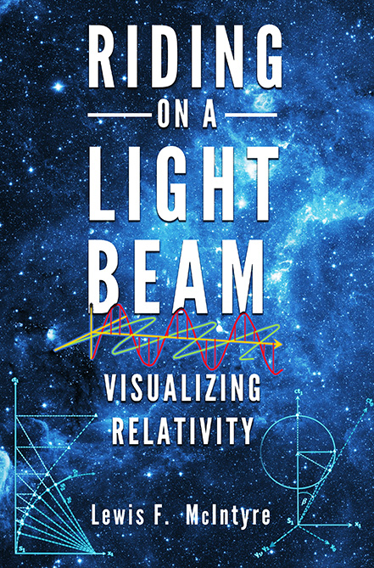
Q.E.D.
QUOD ERAT
DEMONSTRANDUM!
(Which was to be shown!)
Notes:
Any questions?

