Slide 1



Designing a First-Year Undergraduate Lab Course to Teach Authentic Experimentation Skills
Travis Merritt
Department of physics
Virginia tech
(tmerritt@vt.edu)

Slide 2
What is a Traditional Lab?
Traditional teaching laboratories are highly structured and serve to reinforce or verify lecture content.
  Highly-structured: Students are given a step-by-step protocol to follow.
  “…[students] follow a prescribed procedure to replicate a prescribed outcome." [1]

Slide 3
Concerning Evidence about Traditional Labs
Recent Research: Traditional labs have minimal impact on student learning of the lecture content but negative impacts on student attitudes and views of experimental science [2-4].

Slide 4
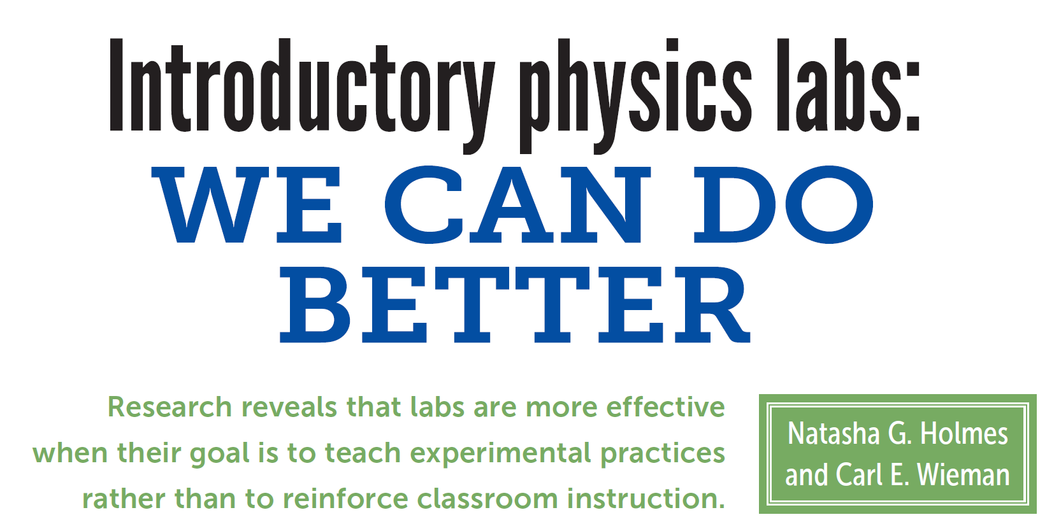
Concerning Evidence about Traditional Labs
Recent Research: Traditional labs have minimal impact on student learning of the lecture content but negative impacts on student attitudes and views of experimental science [2-4].

Slide 5
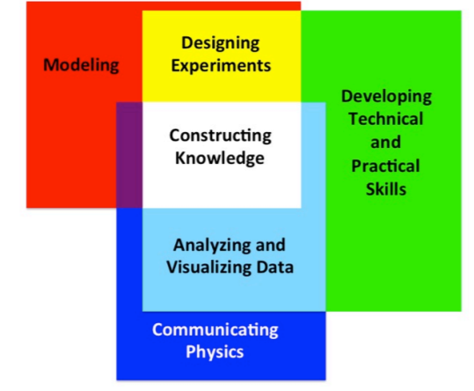
New Standards for Laboratory Education
AAPT Recommended Learning Outcomes [8]
  "Developing particular habits of mind (i.e., "Thinking like a physicist") and constructing knowledge of our physical universe pervades all of the recommended learning outcomes…. since the enterprise of physics is the construction of new knowledge.”
  Constructing Knowledge
    “Through laboratory work, students should gain the awareness that they are able to do science; that is, students should be able to collect, analyze, and interpret real measured data in an ethical manner as responsible scientists and draw meaningful conclusions from personal observations of the physical world. The laboratory curriculum should get students to start thinking like physicists by constructing knowledge that does not rely on an outside authority…”

Slide 6
New Lab Curriculum: Guiding Principles
At Virginia Tech, we are developing a new intro lab curriculum¹ to align with the AAPT’s recommendations by
  removing all verification goals,
  simulating authentic scientific activities,
  letting students engage in scientific decision-making,
  making students and their data the source of investigative authority, and
  providing formative feedback throughout course
¹Adapted from Thinking Critically in Physics Labs by Holmes et al.

Slide 7
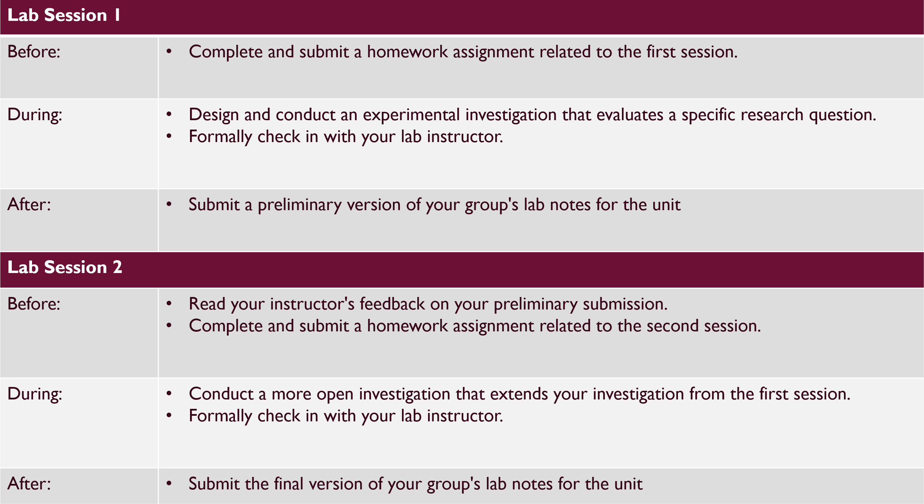
New Lab Curriculum: Course Structure
Overview
  During the semester, students complete a sequence of lab units.

Slide 8
Lab Session 1
Before: | Complete and submit a homework assignment related to the first session.
During: | Design and conduct an experimental investigation that evaluates a specific research question. Formally check in with your lab instructor.
After: | Submit a preliminary version of your group's lab notes for the unit
Lab Session 2
Before: | Read your instructor's feedback on your preliminary submission. Complete and submit a homework assignment related to the second session.
During: | Conduct a more open investigation that extends your investigation from the first session. Formally check in with your lab instructor.
After: | Submit the final version of your group's lab notes for the unit

Slide 9
Lab Session 1
Before: | Complete and submit a homework assignment related to the first session.
During: | Design and conduct an experimental investigation that evaluates a specific research question. Formally check in with your lab instructor.
After: | Submit a preliminary version of your group's lab notes for the unit
Lab Session 2
Before: | Read your instructor's feedback on your preliminary submission. Complete and submit a homework assignment related to the second session.
During: | Conduct a more open investigation that extends your investigation from the first session. Formally check in with your lab instructor.
After: | Submit the final version of your group's lab notes for the unit

Slide 10
Lab Session 1
Before: | Complete and submit a homework assignment related to the first session.
During: | Design and conduct an experimental investigation that evaluates a specific research question. Formally check in with your lab instructor.
After: | Submit a preliminary version of your group's lab notes for the unit
Lab Session 2
Before: | Read your instructor's feedback on your preliminary submission. Complete and submit a homework assignment related to the second session.
During: | Conduct a more open investigation that extends your investigation from the first session. Formally check in with your lab instructor.
After: | Submit the final version of your group's lab notes for the unit

Slide 11
Lab Session 1
Before: | Complete and submit a homework assignment related to the first session.
During: | Design and conduct an experimental investigation that evaluates a specific research question. Formally check in with your lab instructor.
After: | Submit a preliminary version of your group's lab notes for the unit
Lab Session 2
Before: | Read your instructor's feedback on your preliminary submission. Complete and submit a homework assignment related to the second session.
During: | Conduct a more open investigation that extends your investigation from the first session. Formally check in with your lab instructor.
After: | Submit the final version of your group's lab notes for the unit

Slide 12
Lab Session 1
Before: | Complete and submit a homework assignment related to the first session.
During: | Design and conduct an experimental investigation that evaluates a specific research question. Formally check in with your lab instructor.
After: | Submit a preliminary version of your group's lab notes for the unit
Lab Session 2
Before: | Read your instructor's feedback on your preliminary submission. Complete and submit a homework assignment related to the second session.
During: | Conduct a more open investigation that extends your investigation from the first session. Formally check in with your lab instructor.
After: | Submit the final version of your group's lab notes for the unit

Slide 13
Lab Session 1
Before: | Complete and submit a homework assignment related to the first session.
During: | Design and conduct an experimental investigation that evaluates a specific research question. Formally check in with your lab instructor.
After: | Submit a preliminary version of your group's lab notes for the unit
Lab Session 2
Before: | Read your instructor's feedback on your preliminary submission. Complete and submit a homework assignment related to the second session.
During: | Conduct a more open investigation that extends your investigation from the first session. Formally check in with your lab instructor.
After: | Submit the final version of your group's lab notes for the unit

Slide 14
Unit 1: Introduction to Model Testing
High-precision Experiments and Pendulums

Slide 15
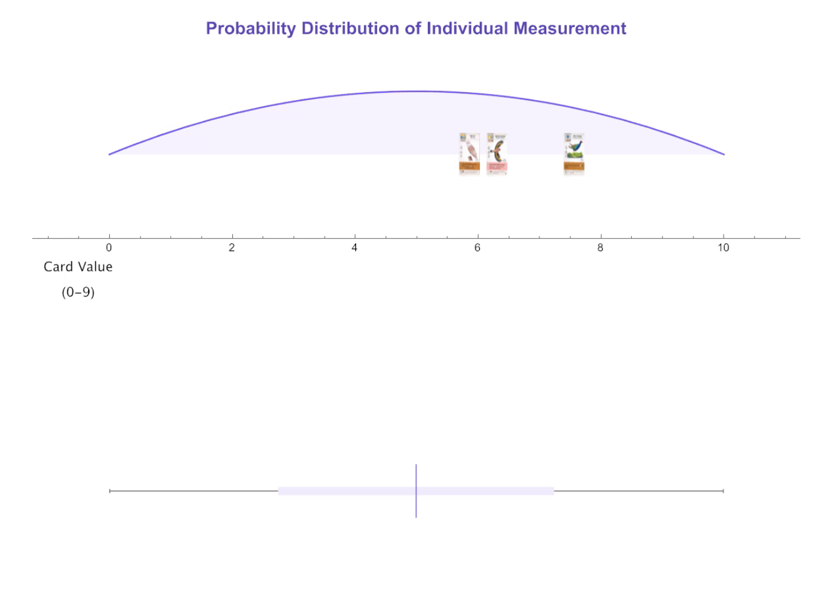
Lab Unit 1: First Homework
Homework 1.1
  Students complete a Mathematica-based guided tutorial about uncertainty
    Develop a conceptual understanding of statistical uncertainty using simulations and invention activities
    Learn how to quantify uncertainty in an individual measurement and mean measurement

Slide 16
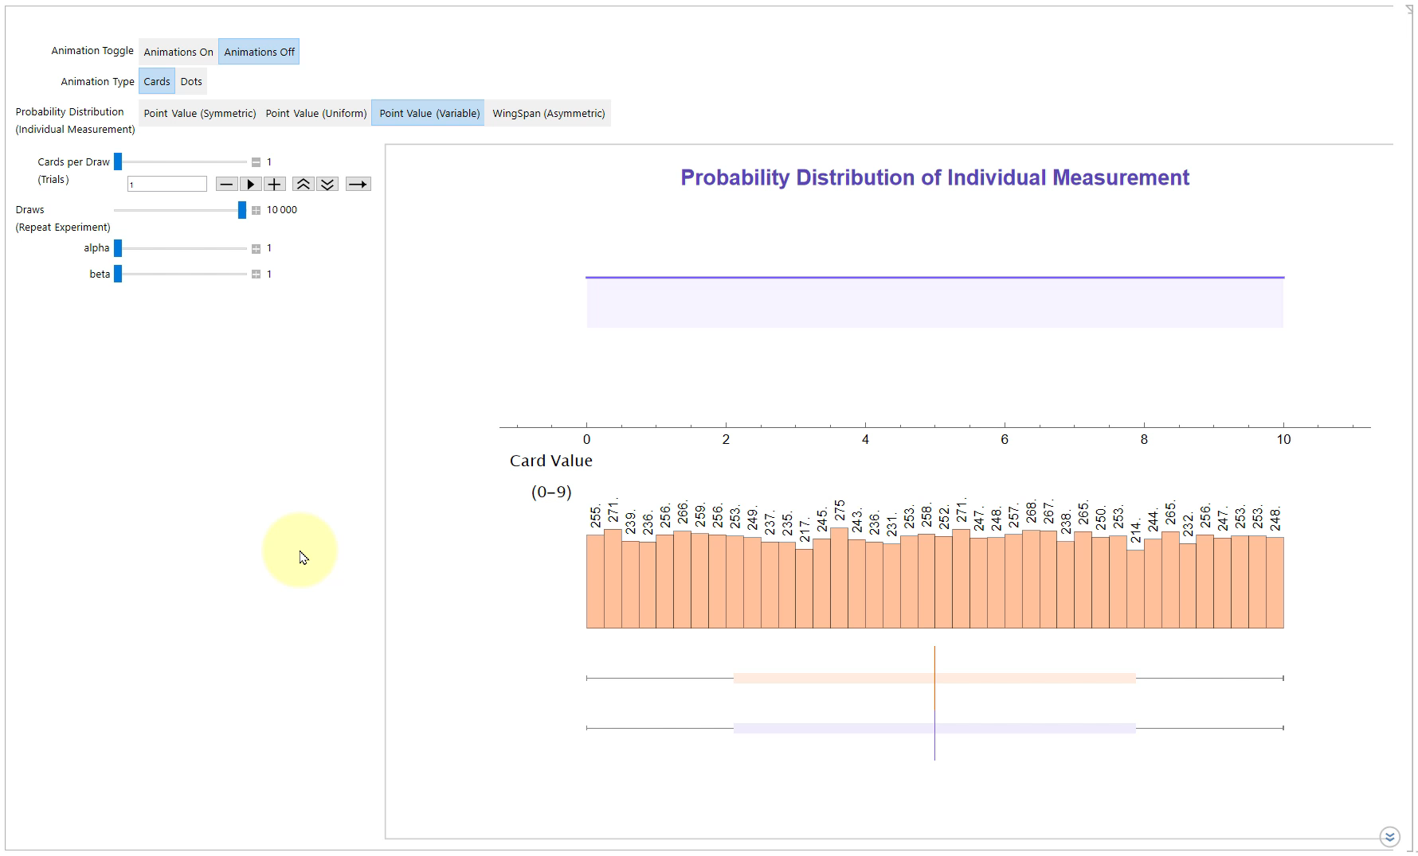
Lab Unit 1: First Homework
Homework 1.1
  Students complete a Mathematica-based guided tutorial about uncertainty
    Develop a conceptual understanding of statistical uncertainty using simulations and invention activities
    Learn how to quantify uncertainty in an individual measurement and mean measurement

Slide 17
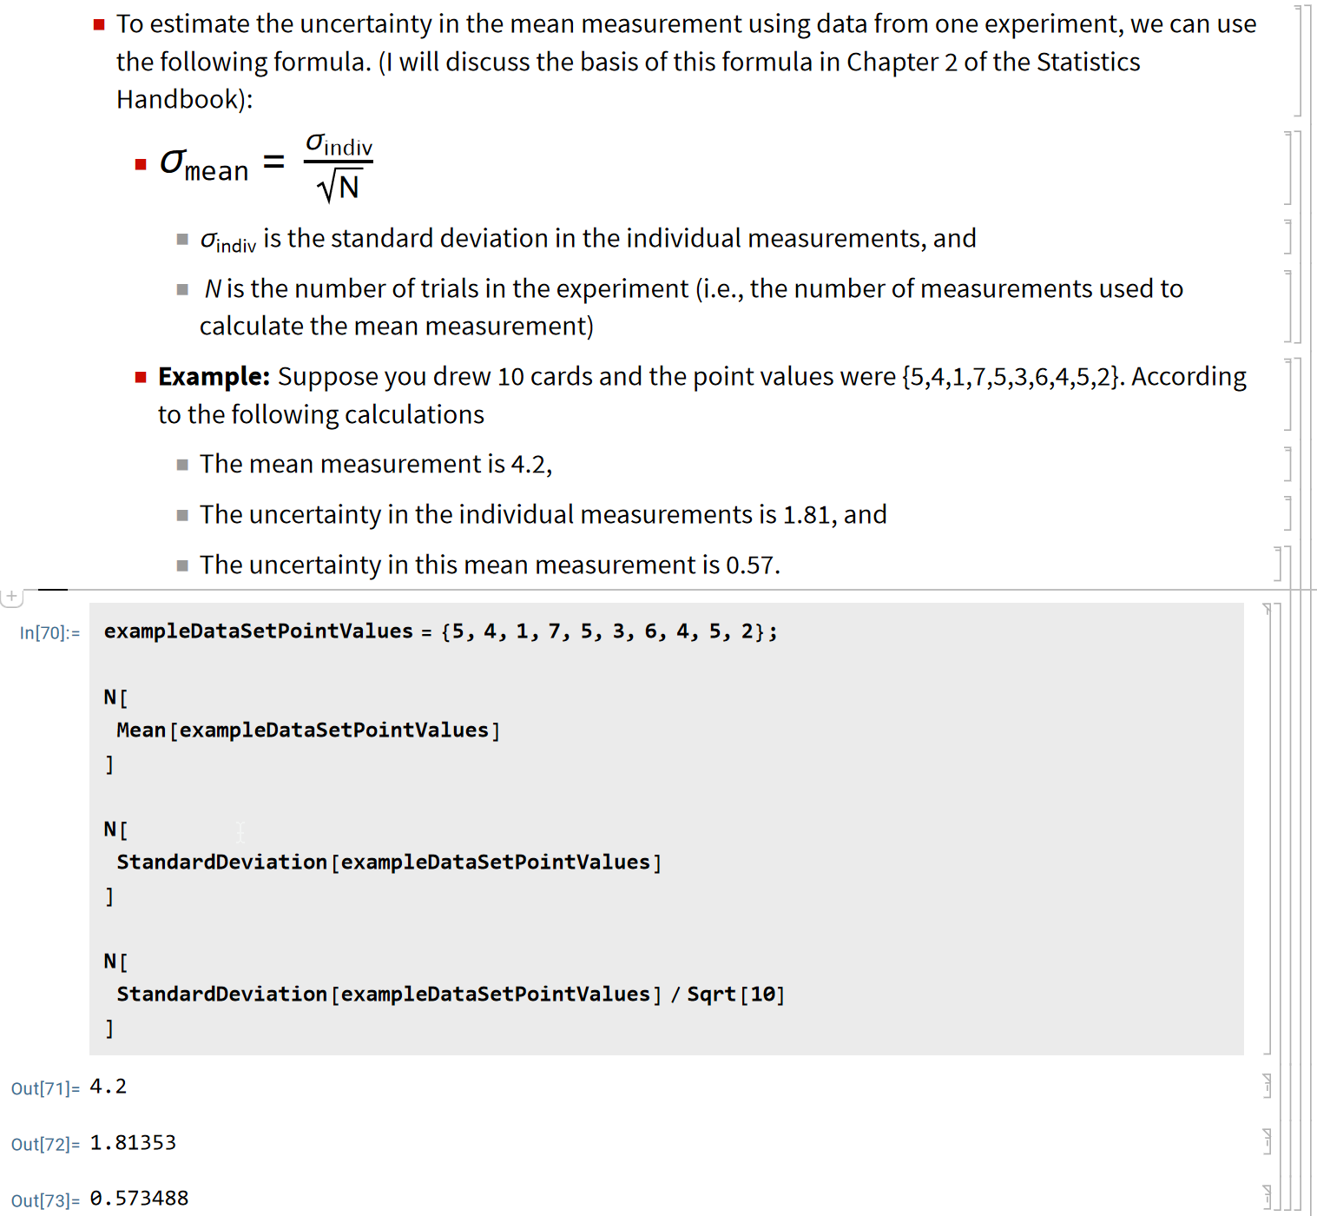
Lab Unit 1: First Homework
Homework 1.1
  Students complete a Mathematica-based guided tutorial about uncertainty
    Develop a conceptual understanding of statistical uncertainty using simulations and invention activities
    Learn how to quantify uncertainty in an individual measurement and mean measurement

Slide 18
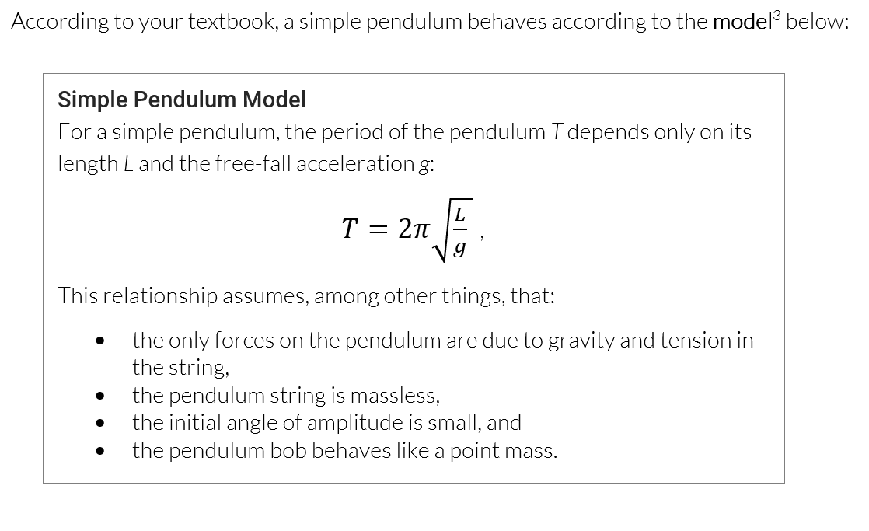
Lab Unit 1: First Lab Session

Slide 19
Lab Unit 1: First Lab Session
Confine preliminary investigation
  Students test the angle dependence of a pendulum’s period by comparing the period at two specific angles.
  Lab instructions specify the number of trials and statistical analysis to perform

Slide 20
Lab Unit 1: First Lab Session
Confine preliminary investigation
  Students test the angle dependence of a pendulum’s period by comparing the period at two particular angles.
  Lab instructions specify the number of trials and statistical analysis to perform
Students design follow-up investigation through reflective decision-making
  Should they improve their measurements?
  Should they perform more trials?

Slide 21
Lab Unit 1: First Lab Session
Confine preliminary investigation
  Students test the angle dependence of a pendulum’s period by comparing the period at two particular angles.
  Lab instructions specify the number of trials and statistical analysis to perform
Students design follow-up investigation through reflective decision-making
  Should they improve their measurements?
  Should they perform more trials?
Use confirmation bias as a learning opportunity
  Due to their previous experience with verification labs, some students will try to confirm the model.

Slide 22
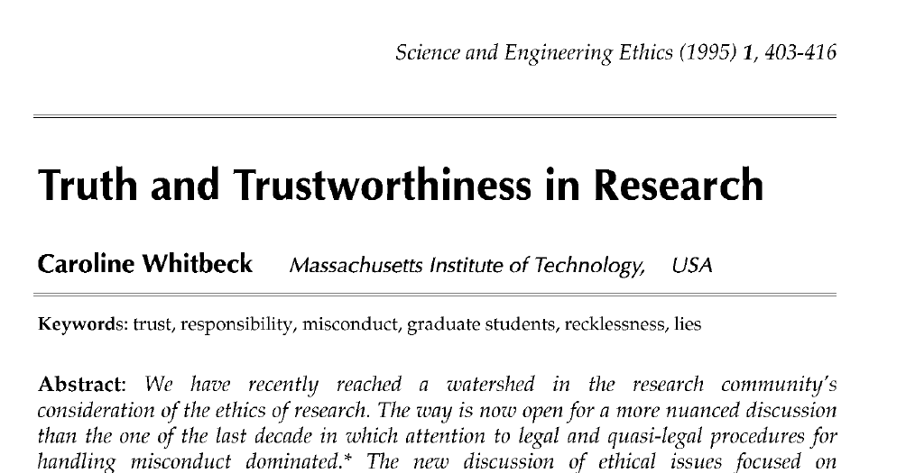
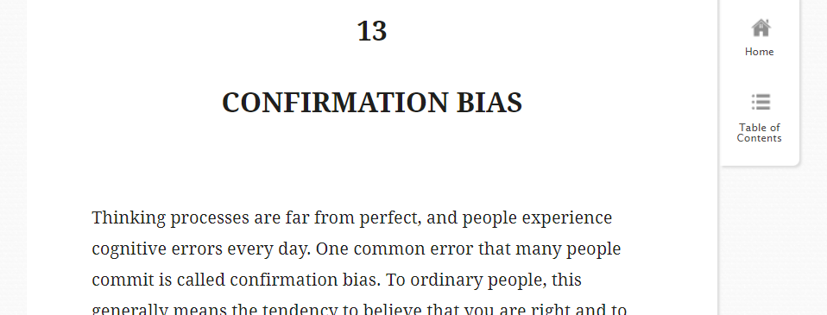
Lab Unit 1: Second Homework
Homework 1.3
  Students complete an ethics tutorial
    Tutorial introduces an ethical framework for responsible research.
    Students explore the ethical implications about confirmation bias and reflect on their experimental decisions.

Slide 23
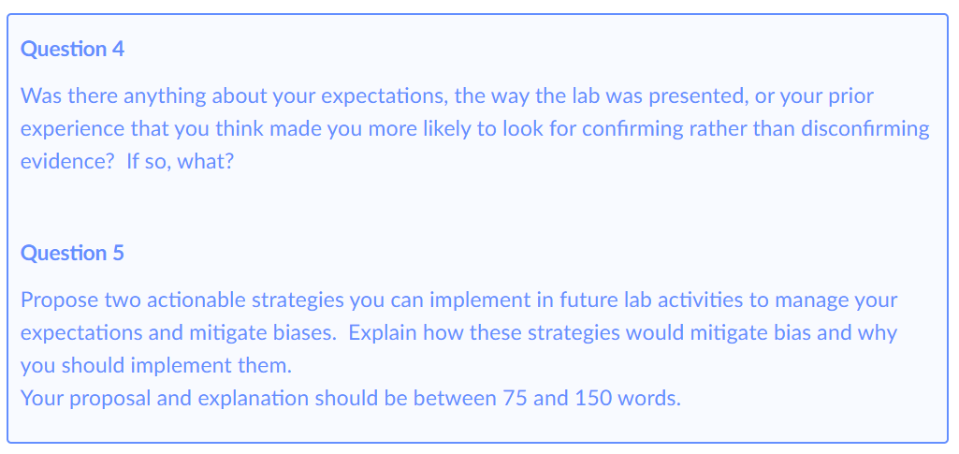
Lab Unit 1: Second Homework
Homework 1.3
  Students complete an ethics tutorial
    Tutorial introduces an ethical framework for responsible research.
    Students explore the ethical implications about confirmation bias and reflect on their experimental decisions.

Slide 24
Lab Unit 1: Second Lab Session
  Students develop actionable strategies to mitigate their biases.
  Investigate the limitations or assumptions of the model with high-precision experiments.
  Example research questions
    “Are the periods of the two angles distinguishable because of air drag?”
    “Will measuring the period with video capture instead of a stopwatch result in higher precision?”

Slide 25
Supplemental Material
Lab Check-ins, Rubrics, and Instructor Support

Slide 26
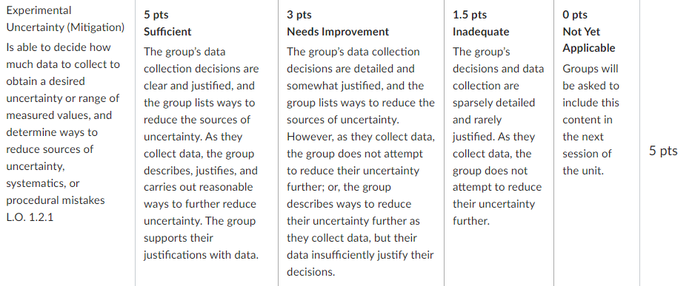
Lab Unit 1: Lab Assessments
Lab Assignment
  During the lab sessions, groups document all their experimental designs, data, analyses, and decisions in a digital lab notebook.
  The lab rubrics specify the criteria on which the groups' lab notebooks will be assessed.
    These criteria assess the groups' empirical skills and quantitative critical thinking abilities

Slide 27
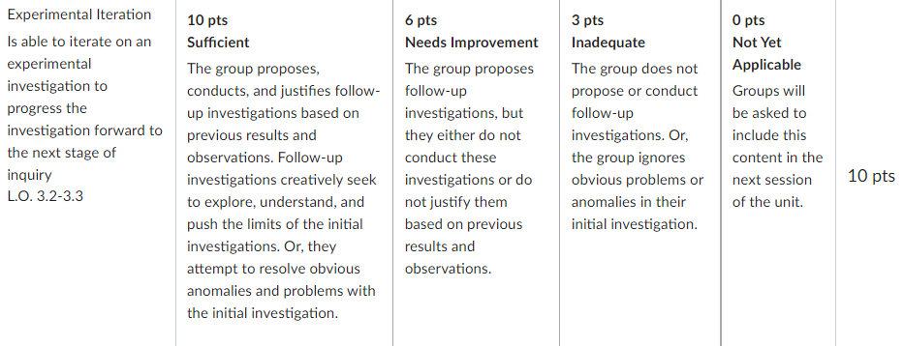
Lab Unit 1: Lab Assessments
Lab Assignment
  During the lab sessions, groups document all their experimental designs, data, analyses, and decisions in a digital lab notebook.
  The lab rubrics specify the criteria on which the groups' lab notebooks will be assessed.
    These criteria assess the groups' empirical skills and quantitative critical thinking abilities

Slide 28
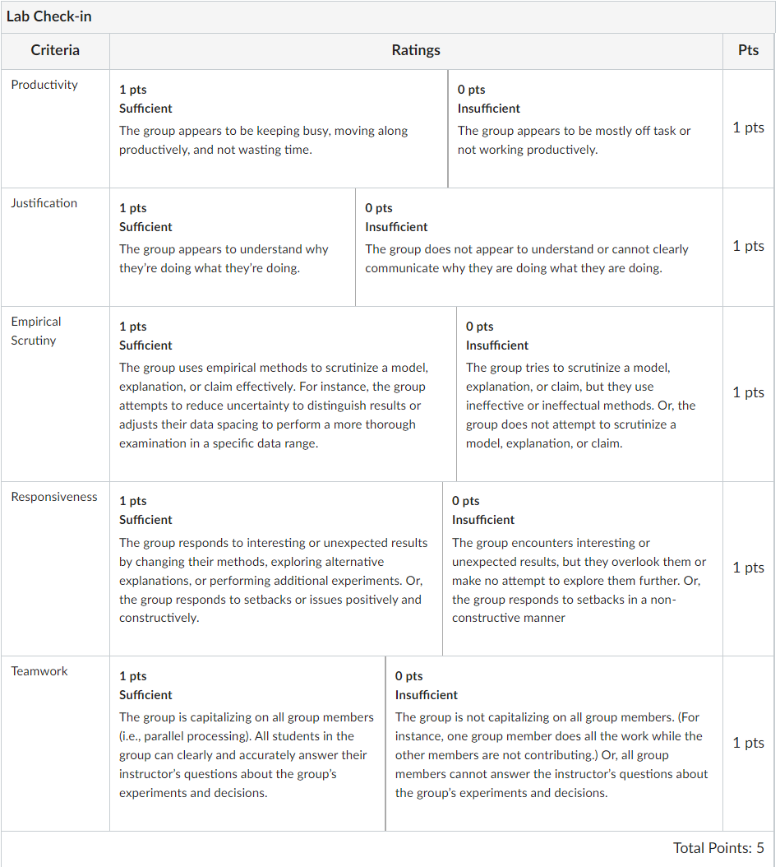
Lab Unit 1: Lab Assessments
Lab Check-ins
  The lab instructors periodically check in with each group during the lab session and provide suggestions and feedback.
  Instructors use a check-in rubric to formally assess each group's productivity, justifications, empirical scrutiny, responsiveness, sand overall teamwork.

Slide 29
Lab Unit 1: Lab Assessments
Lab Check-ins
  The lab instructors periodically check in with each group during the lab session and provide suggestions and feedback.
  Instructors use a check-in rubric to formally assess each group's productivity, justifications, empirical scrutiny, responsiveness, sand overall teamwork.

Slide 30
Lab Unit 1: Lab Assessments
Lab Check-ins
  The lab instructors periodically check in with each group during the lab session and provide suggestions and feedback.
  Instructors use a check-in rubric to formally assess each group's productivity, justifications, empirical scrutiny, responsiveness, sand overall teamwork.

Slide 31
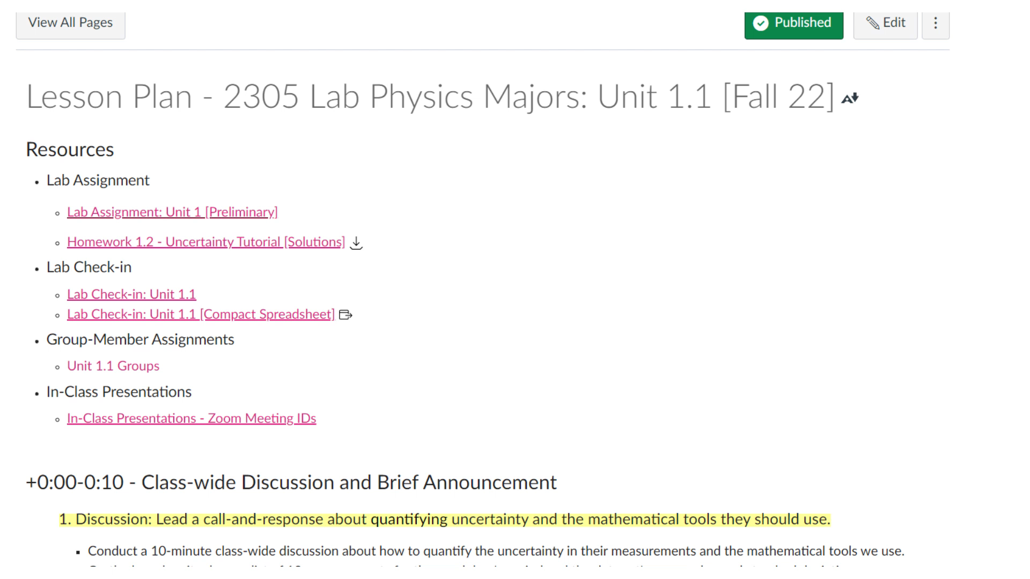
New Lab Curriculum: Instructor support
Lesson Plans
  Each lab sessions, lab instructors are provided a lesson plan

Slide 32
New Lab Curriculum: Instructor support
Lesson Plans
  Each lab sessions, lab instructors are provided a lesson plan which includes
    a timeline for the session,
    topics and activities for class-wide discussions,
    a list of specific questions that instructors should ask during the lab check-ins,
    a list of common student misconceptions and missteps, and question strategies for addressing them.

Slide 33
New Lab Curriculum: Instructor support
Lesson Plans
  Each lab sessions, lab instructors are provided a lesson plan which includes
    a timeline for the session,
    topics and activities for class-wide discussions,
    a list of specific questions that instructors should ask during the lab check-ins,
    a list of common student misconceptions and missteps, and question strategies for addressing them.

Slide 34
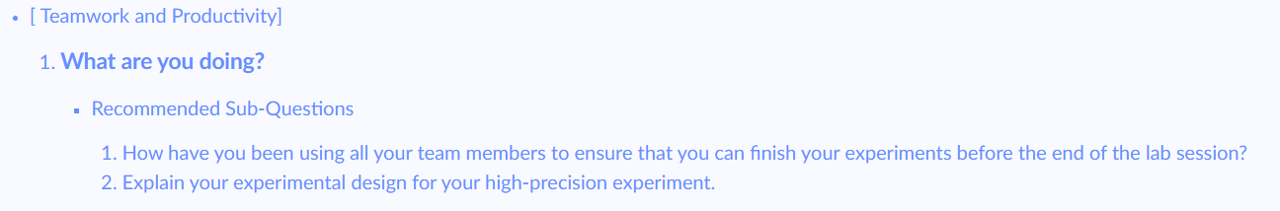
New Lab Curriculum: Instructor support
Lesson Plans
  Each lab sessions, lab instructors are provided a lesson plan which includes
    a timeline for the session,
    topics and activities for class-wide discussions,
    a list of specific questions that instructors should ask during the lab check-ins,
    a list of common student misconceptions and missteps, and question strategies for addressing them.

Slide 35
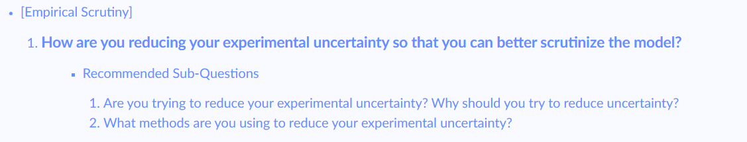
New Lab Curriculum: Instructor support
Lesson Plans
  Each lab sessions, lab instructors are provided a lesson plan which includes
    a timeline for the session,
    topics and activities for class-wide discussions,
    a list of specific questions that instructors should ask during the lab check-ins,
    a list of common student misconceptions and missteps, and question strategies for addressing them.

Slide 36
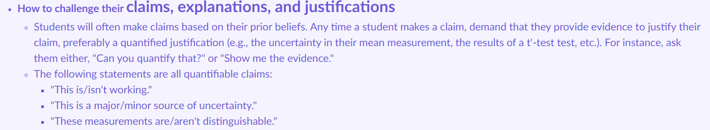
New Lab Curriculum: Instructor support
Lesson Plans
  Each lab sessions, lab instructors are provided a lesson plan which includes
    a timeline for the session,
    topics and activities for class-wide discussions,
    a list of specific questions that instructors should ask during the lab check-ins,
    a list of common student misconceptions and missteps, and question strategies for addressing them.

Slide 37
References

Slide 38
References
[1] Singer, S. R., Hilton, M. L., & Schweingruber, H. A. (2005). America’s lab report: Investigations in high school science (Tech. Rep.). Washington, DC: Committee on High School Science Laboratories: Role and Vision; National Research Council.
[2] Holmes, N., Olsen, J., Thomas, J. L., & Wieman, C. E. (2017). Value added or misattributed? A multi-institution study on the educational benefit of labs for reinforcing physics content. Physical Review Physics Education Research, 13(1), 010129.
[3] Wilcox, B. R., & Lewandowski, H. J. (2016). Open-ended versus guided laboratory activities: Impact on students’ beliefs about experimental physics. Physical Review Physics Education Research, 12(2), 020132.
[4] Wilcox, B. R., & Lewandowski, H. J. (2017). Developing skills versus reinforcing concepts in physics labs: Insight from a survey of students’ beliefs about experimental physics. Physical Review Physics Education Research, 13(1), 010108.
[5] A Framework for K-12 Science Education: Practices, Crosscutting Concepts, and Core Ideas, edited by H. Quinn, H. A. Schweingruber, and T. Keller (National Academies Press, Washington, DC, 2012), ISBN 0309217423.
[6] Technical Report, The College Board, New York, NY (2015), http://media.collegeboard.com/digitalServices/pdf/ap/ap‑physics‑1‑2‑course‑and‑exam‑description.pdf
[7] Joint Task Force on Undergraduate Physics Programs, P. Heron (co-chair), and L. McNeil (co-chair), Technical Report, American Physical Society and American Association of Physics Teachers (2016).
[8] American Association of Physics Teachers, Technical Report, American Association of Physics Teachers (2014), http://www.aapt.org/Resources/upload/LabGuidlinesDocument_ EBendorsed_nov10.pdf.

