Slide 1
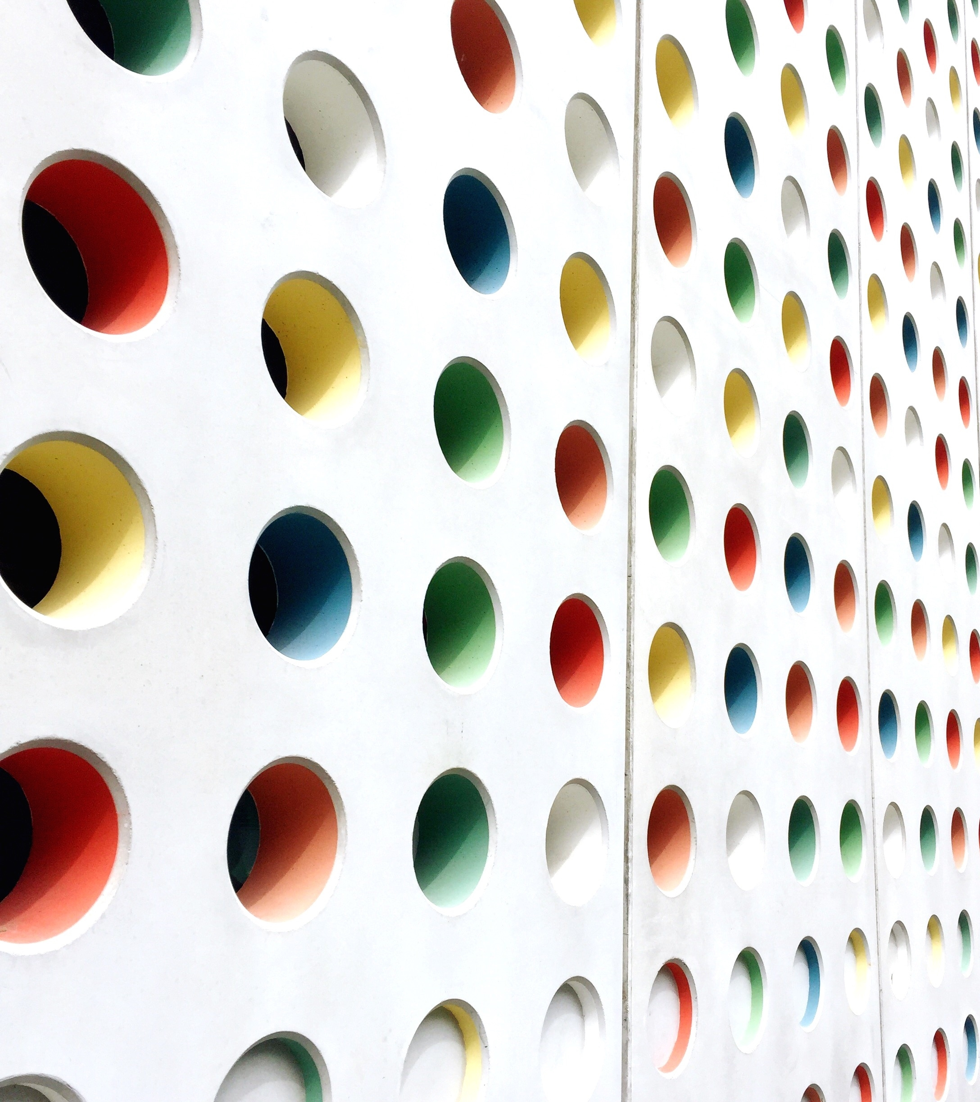
To Think Deeply of Simple Things| Reflections & Possible Results from an Ancient REU
Rebecca Rosenblatt
Oct 22, 2022
Please note that the opinions, findings, conclusions and recommendations expressed here are mine and do not necessarily reflect the views of the National Science Foundation (NSF)
Notes:
Good afternoon everyone! I would like to thank our CSAAPT organizers for the chance to speak at this session. I am glad I can present this work which, at long last, maybe has some results. My topic is To Think Deeply of Simple Things: Reflections & Possible Results from an Ancient REU. Ah before I get started, please note that what I will present here today are my personal opinions and recommendation and do not necessarily reflect the views of the national science foundation.

Slide 2
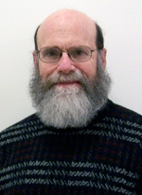
Summer 2005 REU at UIUC
Notes:
During summer of 2005 I worked with my dad who was a professor in mathematics at the University of Illinois (now emeritus) on a research project that was broadly in the area of inverse problems.

Slide 3
An Inverse Problem
is the process of calculating from a set of observations the causal factors that produced them.
Notes:
An inverse problem in science is the process of calculating from a set of observations the causal factors that produced them. For example, calculating an image from MRI data. I actually spent the first few weeks of my REU studying MRIs, which was perfect because I had all the physics I needed to understand how this worked. And MRIs use a lot of different physics and are quite inventive. So I spent a few weeks reading about MRIs and then I wasn’t sure what I was going to do with the rest of my REU. And at the time I definitely felt like I needed an innovative, never studied outcome. So I sat down and I thought about it.

Slide 4
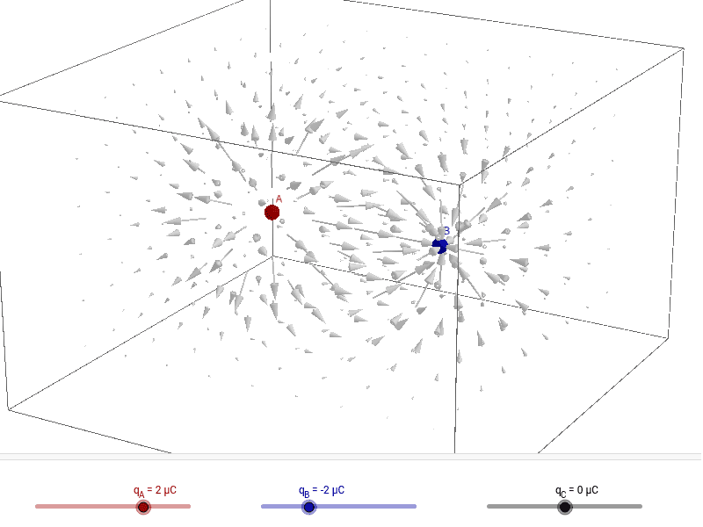
Electric field
Where and how many measurements do I need to uniquely determine the placement of the point charges that created it?
Notes:
The project I came up with was assume that a finite number of point charges create a field. What measurements are needed (where and how many) to uniquely determine the placement of the point charges that created it?

Slide 5
Electric field
What is the zero set of an electric field from a finite set of point charges?
Notes:
This question is mathematically identical to the question: What is the zero set of an electric field from a finite set of point charges? And this is because if I have two sets of charges that give the same field in a space or region of the space then you can subtract the two sets (or change signs on the charges) and you would get zero in that space or region. And you might be thinking wait a minute isn’t there a theorem that says the electric field is unique. And yes, there is. So, for a set of point charges it is true that there is a unique field that is created by those charges. However, it is not clear that the field must be unique in a portion of space. And in fact fields need not be unique in certain kinds of portions of space. And I will give an example.

Slide 6
I can know the field at each point P along a line in z
Notes:
Think of equal size point charges are the corners of a square arranged with two positives and two negatives as shown. I can know the field at every point P along the Z axis. (This is field is zero in our example.) There are infinitely many sets of point charges that will give this result because you can change Qs or increase the size of the square and you still have zero on the z axis. So, you can have an infinite amount of data on the electric field but if its along a line you cannot be sure you have unique 3D description of the charges. So you might say ok, but what if I know an extra point or another line.

Slide 7
Question: Taking an unknown finite electrical field, what method of taking a limited set of measurements will guarantee that if the measurements are all zero, then the field itself is zero everywhere?
Yanushauskas used the fact that the field in this case is the gradient of a harmonic function to show that the zero set consists of a locally finite set of points and analytic curves.
A. I. Yanushauskas, On the zeros of the gradient of a harmonic function, Dokl. Akad. Nauk SSSR 158 (1964) 547-549.
Notes:
Question: Taking an unknown electrical field from a finite set of point charges, what method of taking a limited set of measurements will guarantee that if the measurements are all zero, then the field itself is zero everywhere? Some of the characteristics of the zero set are solved. For example, there is a paper by Yanushaushas who used the fact that the electric field from a finite set of charges is the gradient of a harmonic function to show that the zero set consists of a locally finite set of points and analytic curves (i.e. a two dimensional areas cannot be all zero). However, other conjectures were/are still unproven. For example, if the charges are constrained to a plane, and you measure in the plane, does this reduces the zero set to a finite set of points?

Slide 8
Result in 1D: Measure field in line of points
If points are along a line, the field along that line can only have finite number of zeros.
Proof:
Notes:
So the First step is in 1D field on a line. Define the line to be the x axis. So yj and zj are all zeros. And we are going to measure the field in that line with the charges. So your y and z’s are all zero. thus it’s trivial to see that you are just left with solving for the X component of the electric field and where it can be zero. Taking an interval approach you can show that for all intervals on the line between the charge points, the function that gives the X component of the field is rational and thus may only have a finite number of zeros in these intervals.

Slide 9
Result in 2D: Charges on Line & Field in Plane
Analytic Attack......... Dead End
Y component is not zero unless net charge is zero
X component is not zero unless there is Q*x symmetry
But ultimately this approach was not working
Notes:
Then move into 2D, chargers are still on a line but we will measure the field off the line. During the REU we worked to use analytic approaches to solving this and playing with the math you can show some things. Like Y components can only be zero if the net charge is zero and X components needs Q*x symmetry. But this does not actually answer the question about the number of possible zeros. Roll forward many years, the pandemic hit and my dad was stuck at home, could not go anywhere and he pulled this back up to work on it. At first he tried the analytic approach again but still was finding this unhelpful.

Slide 10
Result in 2D: Charges on Line & Field in Plane
Proposition 3.5. In the Special Case the zero set of F = (X, Y ) contains at most 9M²4^{M} points. (Where M is the number of charges).
Proposition 3.6. (B´ezout’s Theorem) Given any two coprime polynomials f, g ∈ R[x, y] of degrees d1 and d2, respectively, Z(f) ∩ Z(g) contains at most d1d2 points.
https://arxiv.org/abs/2106.04706
https://arxiv.org/abs/2208.12857
Notes:
Then an idea from chatting with others about the project. Through an algebraic method you can manipulate the field expressions and show that the places where the electric field is zero is a subset of the places where a more complicated, larger degree, polynomial is zero. This polynomial is crazy BUT that means that the set of zeros is finite. And using this larger polynomial and Bezout’s theorem we showed that there are at most 9M²4^{M} zero points. There are several other technical points related to this problem in two papers that are up in Arix if you are interested in this topic.

Slide 11
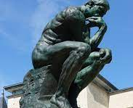
Reflections
What is research?
What makes a good research problem?
What is the value of NSF funding?
Notes:
Personal reflections on the value of this experience for my understanding of theoretical research, and the research enterprise, that still shapes my thinking today.
The importance of sitting and thinking but also the flip side which is the talking and enjoying.
There is a Class of problems that seems to be good for working with students. And I think inverse problems lend themselves nicely to this.
They are easily stated but – perhaps – difficult to prove. And as you think deeply about this it becomes richer. I have been thinking about what makes good problems and would love to talk more about this with anyone that is interested. Specifically I have been thinking about what is Recreational physics and how/why is this different than recreational math.
Finally, my job now is about measuring impact of NSF grants. So we have a lot of discussion of what is the value of an nsf grant or an nsf grant program. I realize that much of what shapes my thinking in this area is in my experiences working on research and benefiting from grants. Some things I know:
Results don’t come immediately, the investment in the researcher takes time to develop,
the questions asked may never be answered but that is not really the goal. Research is a process, its an experience, its an activity, it’s a practice. But, Its absolutely not the result. And this understanding has changed not only my own research career but the work I do at nsf in thinking about what is the value of grants.

Slide 12
Thank you! rrosenbl@nsf.gov
rosenblatt.rebecca@gmail.com

