Slide 1
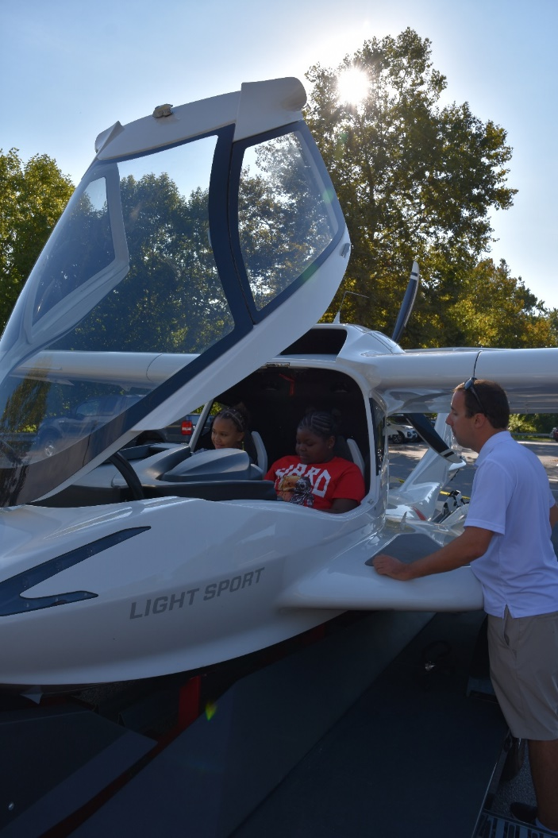
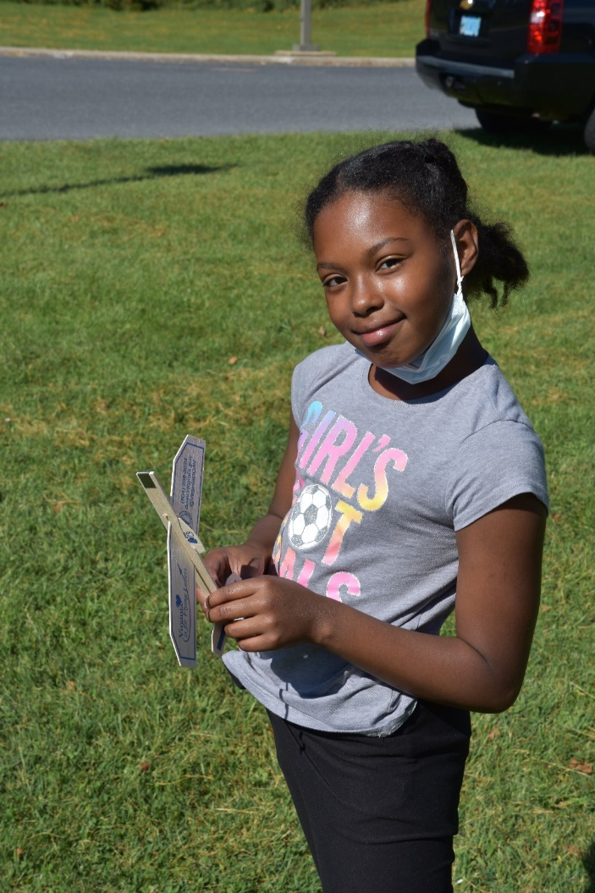
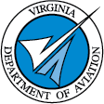
VIRGINIA Department of Aviation
An Educational Resource
Notes:
Introduce yourself
Former educator 4th grade

Slide 2
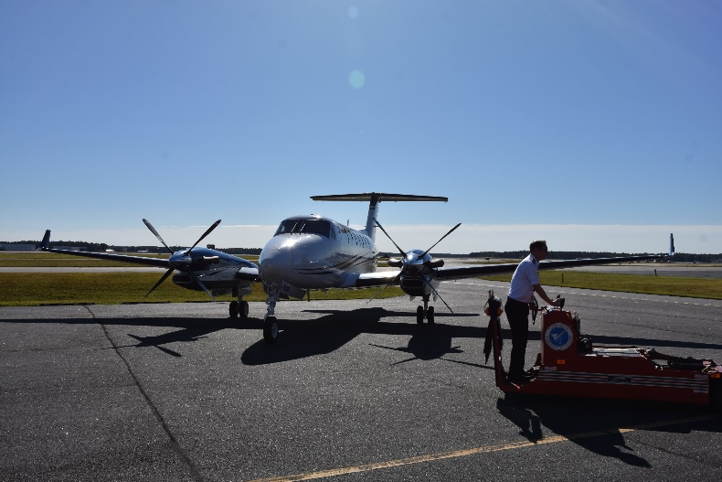
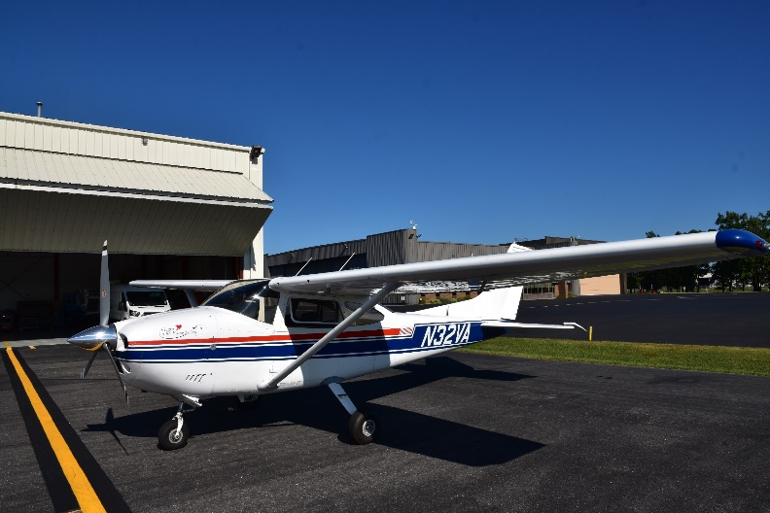
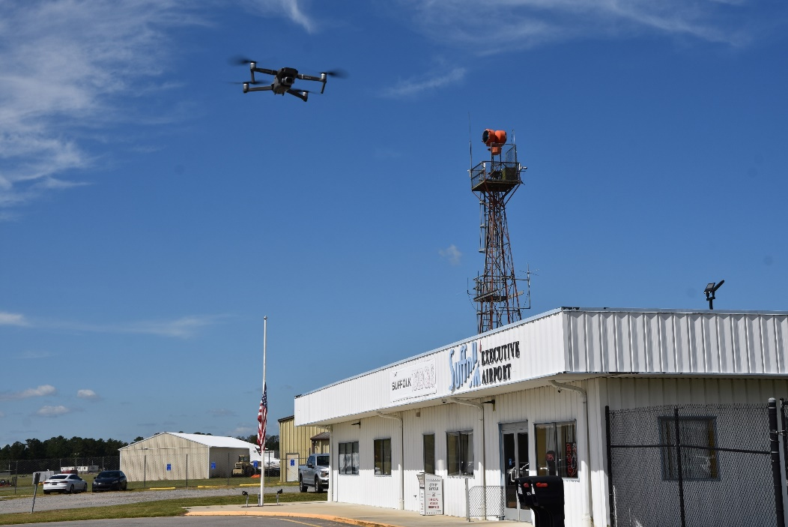
What we Do
Virginia Department of Aviation
We support and advance Virginia’s 65 public use airports
Fly and maintain the Commonwealth’s four aircraft
Educate and inspire Virginians into the world of aviation
Notes:
Airports
Use engineers and planners to help improve airport’s efficiency and functionality
Offer grants to help airports pay for maintenance and improvements
Flight Operations
4 Aircraft: Two Kingairs, Cessna 208, Cessna 182
We fly people from any and all state agencies
Our most famous passenger is the Governor
What we are not
A Flight School
Affiliated with the FAA
No licenses
Aircraft complaints

Slide 3
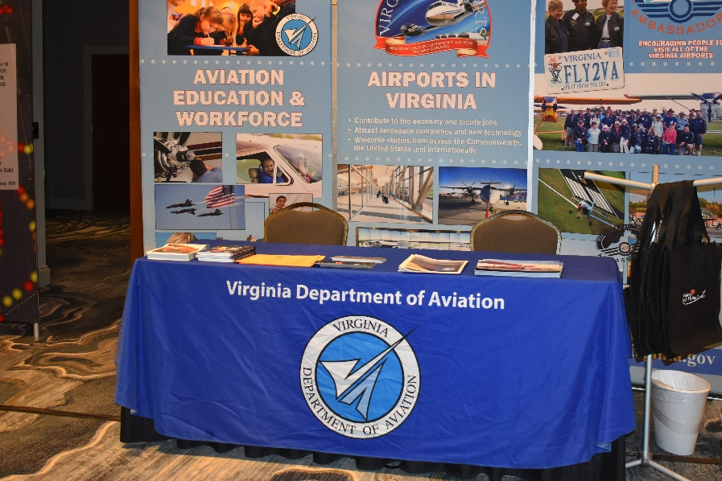
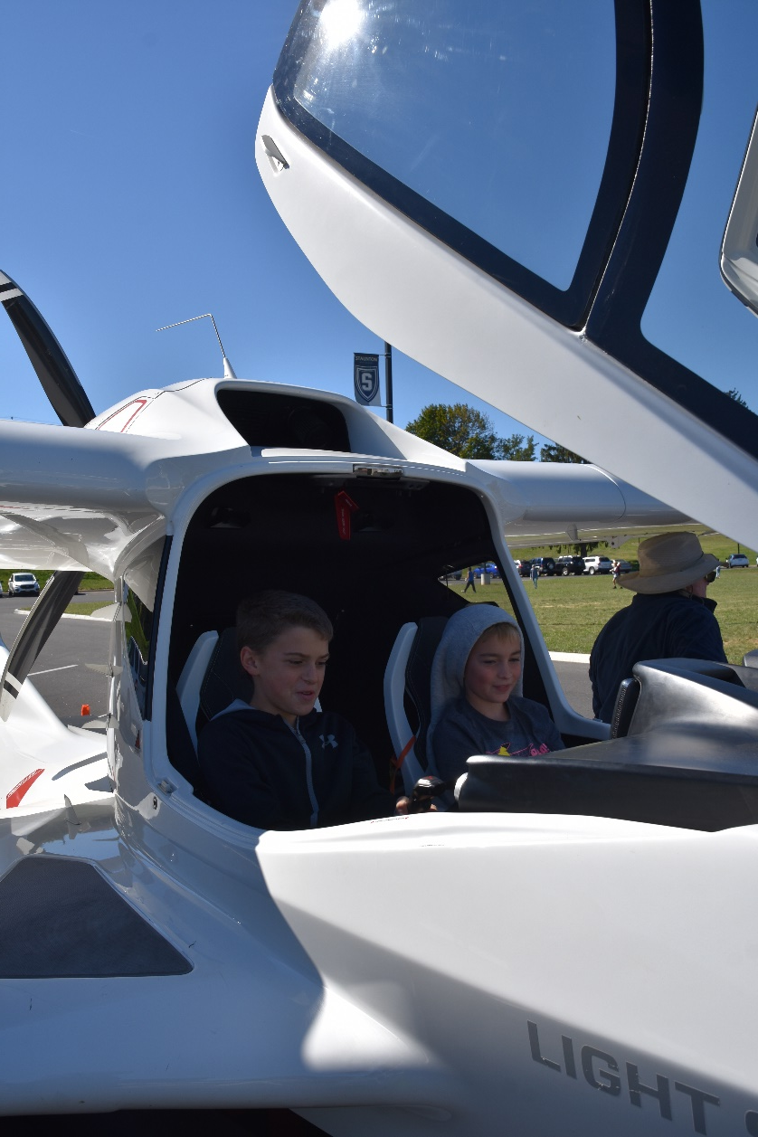
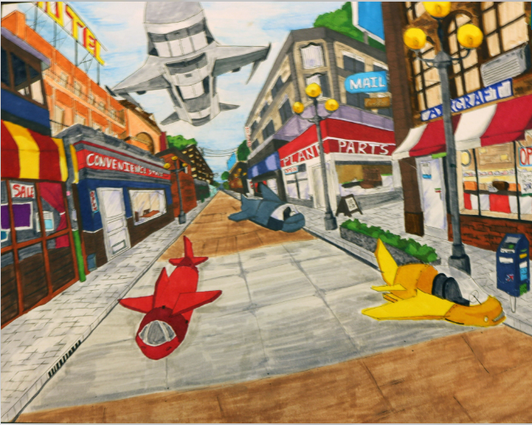
What we Do
Communications and Education Division
Teach residents about jobs in the aviation industry
Manage communication related to aviation awareness
Photo and Art Contests
Aircraft registration
Educate and inspire students about aviation
ICON A5
Aviation grants
College scholarships
Notes:
Communications
Newsletters
Brochures
Social Media
Educate
ICON A5 is the most popular educational program

Slide 4
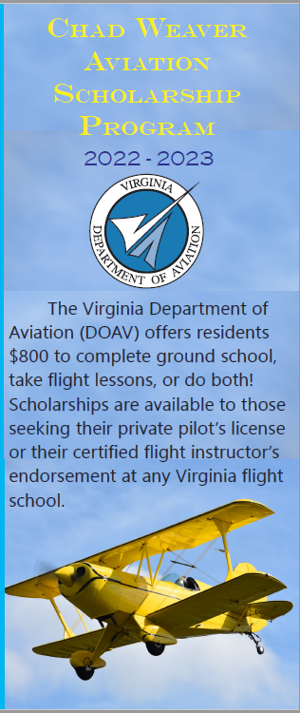
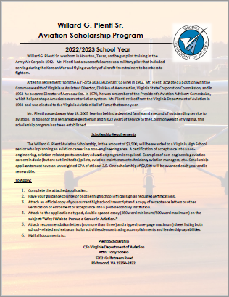
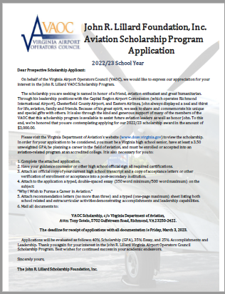
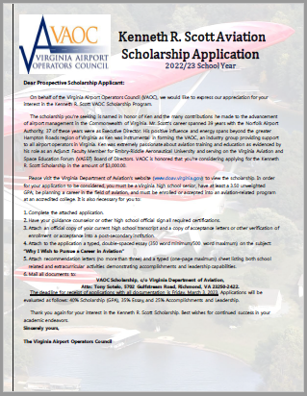
Scholarships
Willard G. Plentl
Non-engineering aviation college scholarship for high school seniors
John R. Lillard Foundation
GPA based aviation scholarship for high school seniors
Kenneth R. Scott
GPA based aviation scholarship for high school seniors
Ground school and flight instruction scholarship open to any Virginia resident

Slide 5
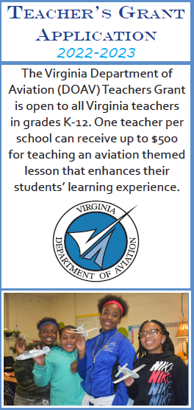
Teacher’s Grant
The Teacher’s Grant reimburses schools or teachers for the expenses of implementing their aviation-inspired lesson.
UP TO $500
Notes:
1. Design an aviation-related lesson
2. Fill out this application and the corresponding questions
3. Become selected for the grant and return the grant agreement
4. Use the funds
5. Submit a final report by date on grant agreement
6. Receive a reimbursement check

Slide 6
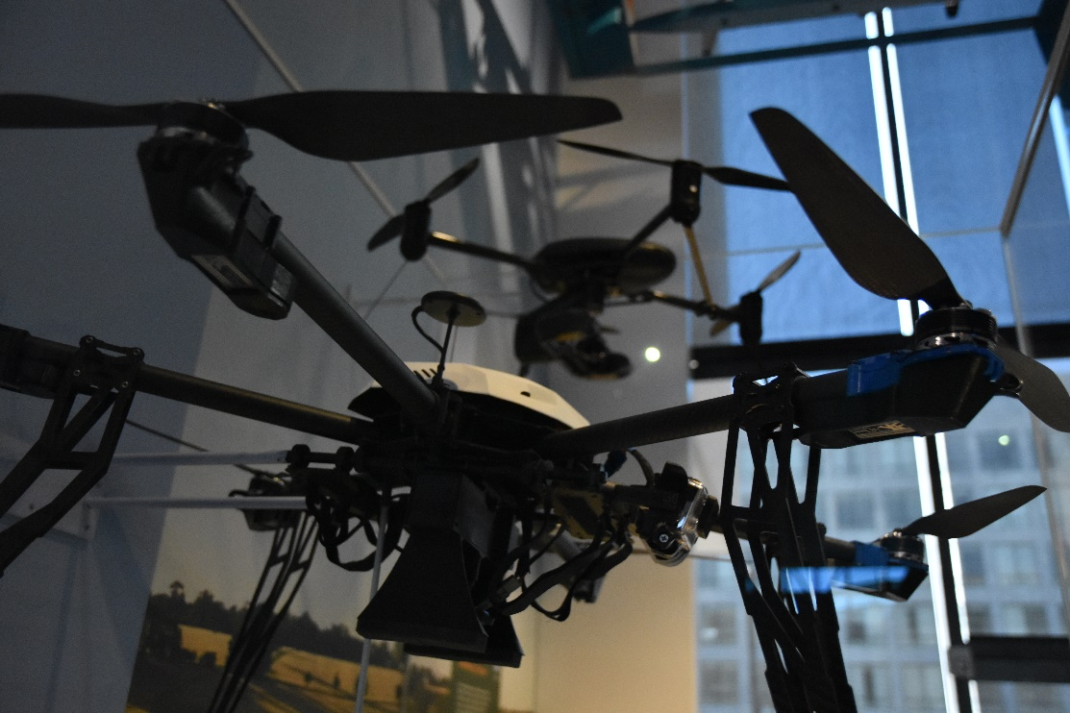
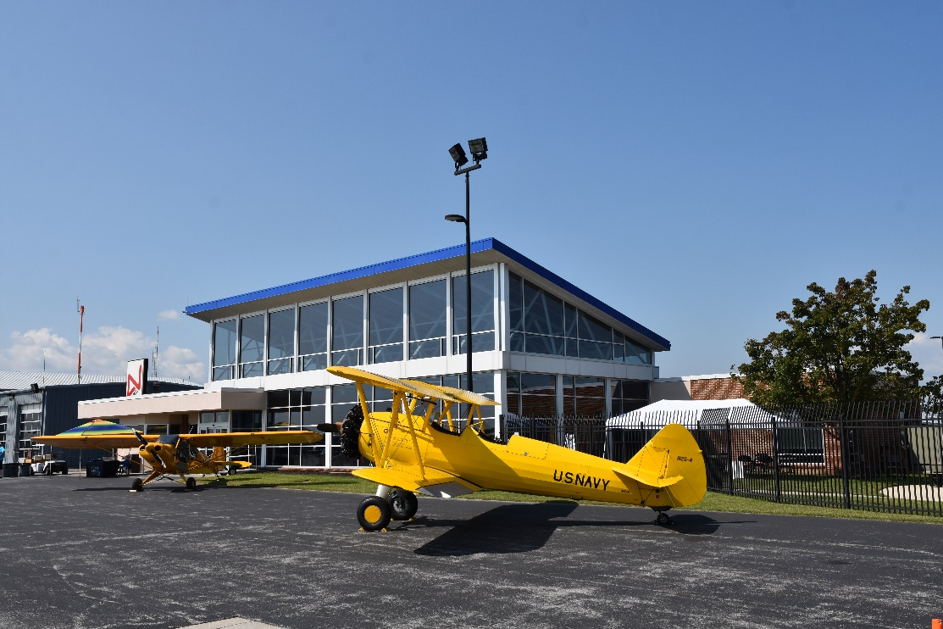
Teacher’s Grant
Past grant uses include but are not limited to:
• Model rockets, airplanes, and gliders
• Developing and building aircraft and drones
• Airport and air museum field trips
•Purchasing art materials
Notes:
1. Design an aviation-related lesson
2. Fill out this application and the corresponding questions
3. Become selected for the grant and return the grant agreement
4. Use the funds
5. Submit a final report by date on grant agreement
6. Receive a reimbursement check

Slide 7
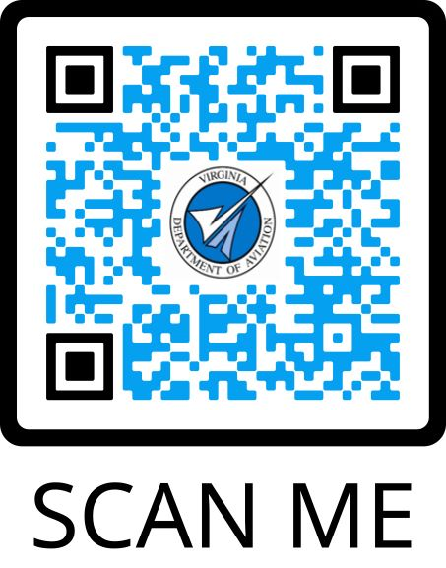
Questions?
Tony Sotelo
Public Relations & Education Specialist
Virginia Department of Aviation
anthony.sotelo@doav.Virginia.gov
(804) 774-4634

